Slide 1
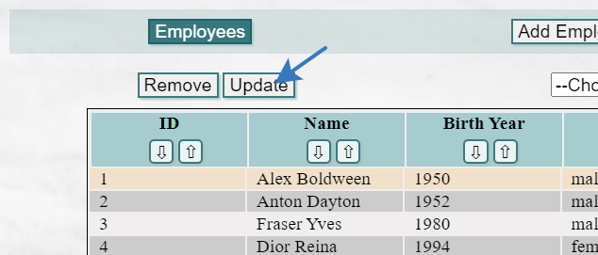
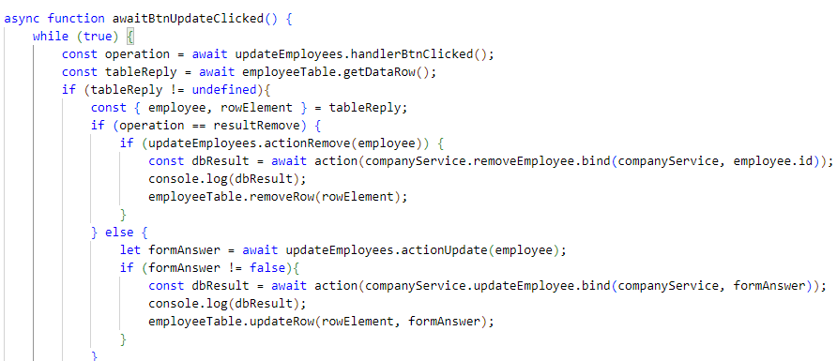
event
Employee Table Update
1
get Promise
Main
1
1.
Data Grid
data
2
get Promise
2.
Query for user
Employee Table Update
data
Main
3
get Promise
1
Data Grid
5
update/
remove
2
calls method
to refresh table
4
3
4
DB
(Company Service)
5
3
5
4
5

