Slide 1
MESSENGER Observations of Extreme Loading and Unloading of Mercury’s Magnetic Tail
James A. Slavin

Slide 2
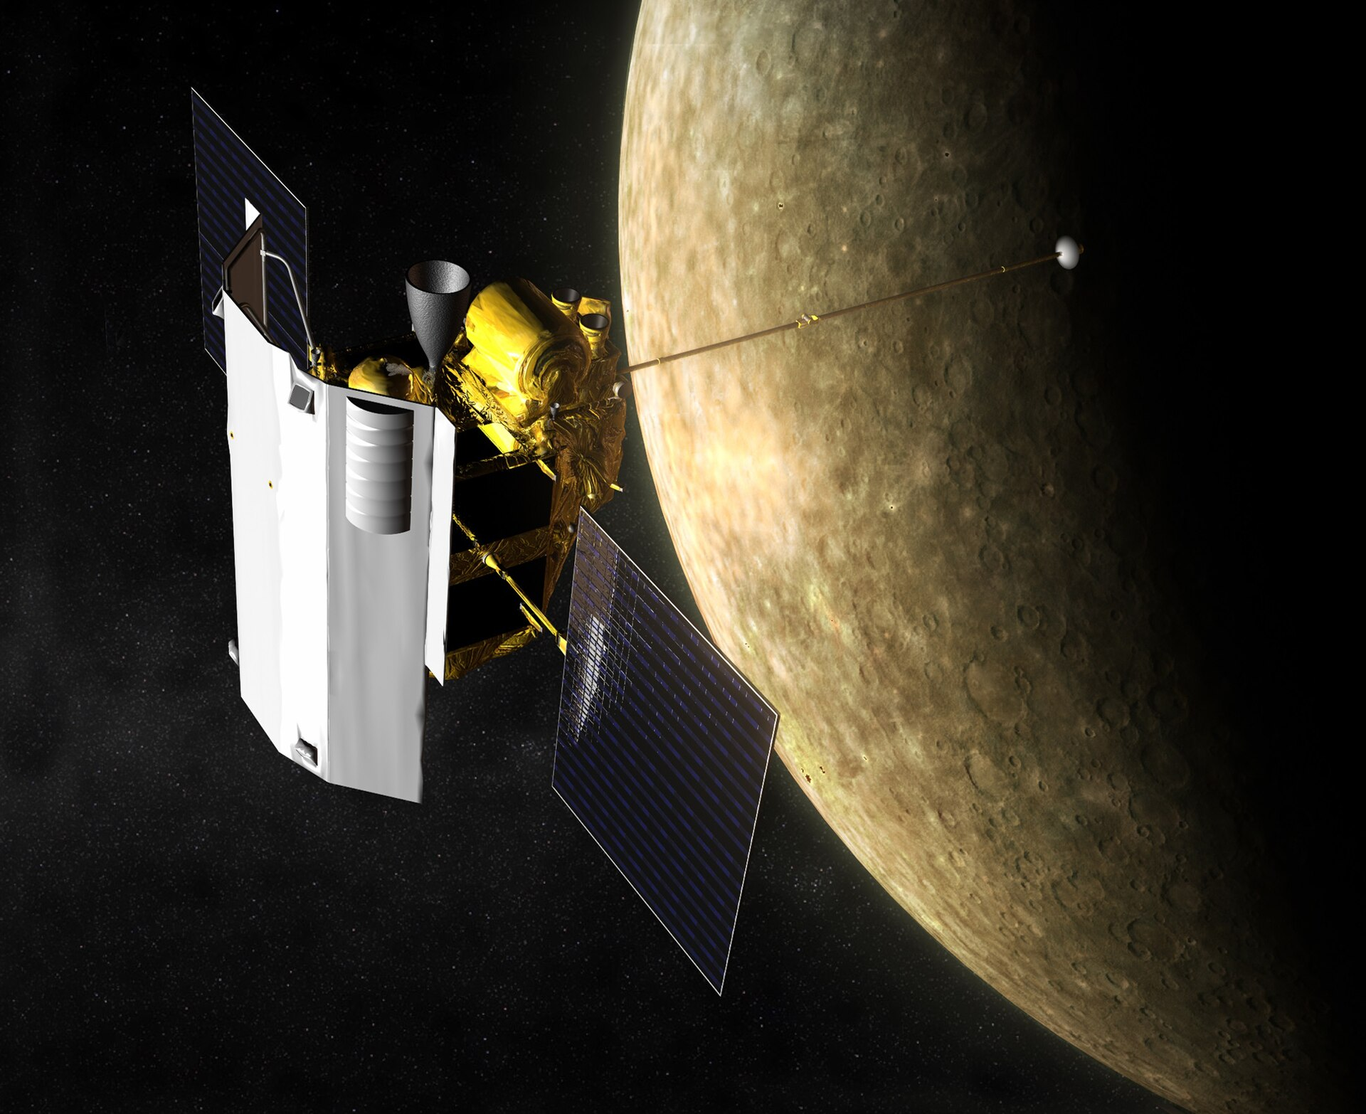
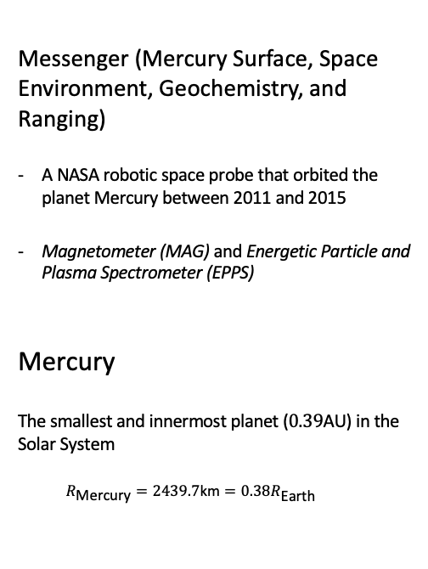
Quick facts
Messenger (Mercury Surface, Space Environment, Geochemistry, and Ranging)
A NASA robotic space probe that orbited the planet Mercury between 2011 and 2015
Magnetometer (MAG) and Energetic Particle and Plasma Spectrometer (EPPS)
Mercury
The smallest and innermost planet ($0.39\text{AU}$) in the Solar System
$$R_{\text{Mercury}}=2439.7\text{km}=0.38R_{\text{Earth}}$$

Slide 3
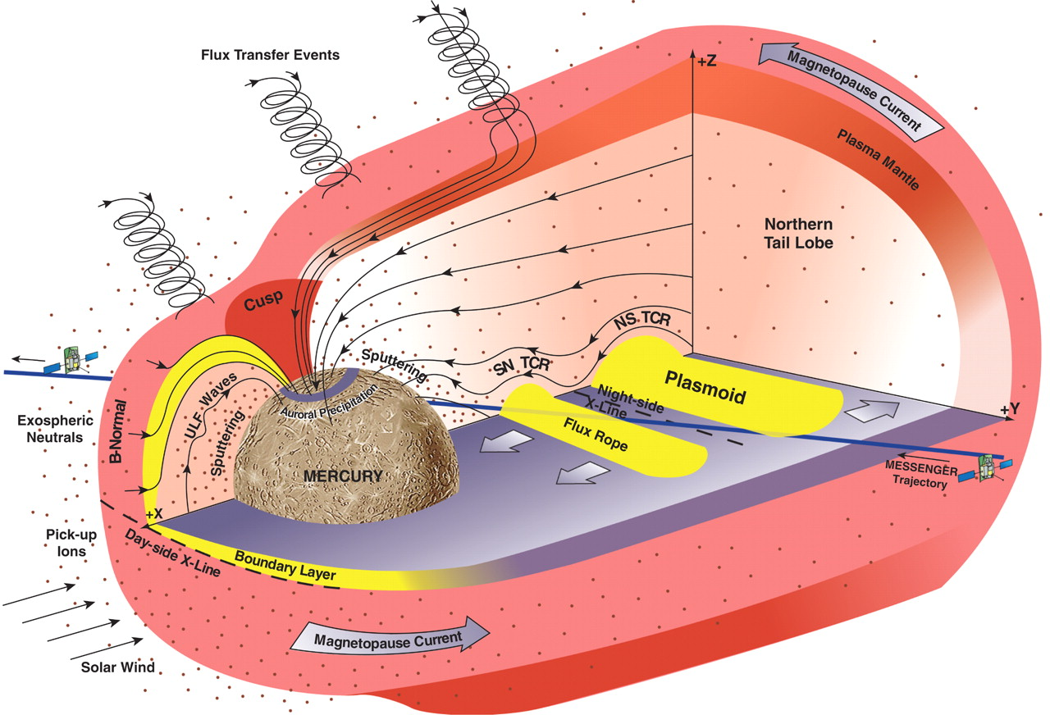
Mercury
Dungey cycle
Circulation of plasma, magnetic flux, and energy from the dayside X-line at the magnetopause
to the nightside X-line in the crosstail current layer and
back to the dayside magnetosphere
Ranges from ~1 month at Jupiter to ~1 week at Saturn and ~1 hour at Earth
Mercury’s magnetosphere under southward IMF conditions

Slide 4
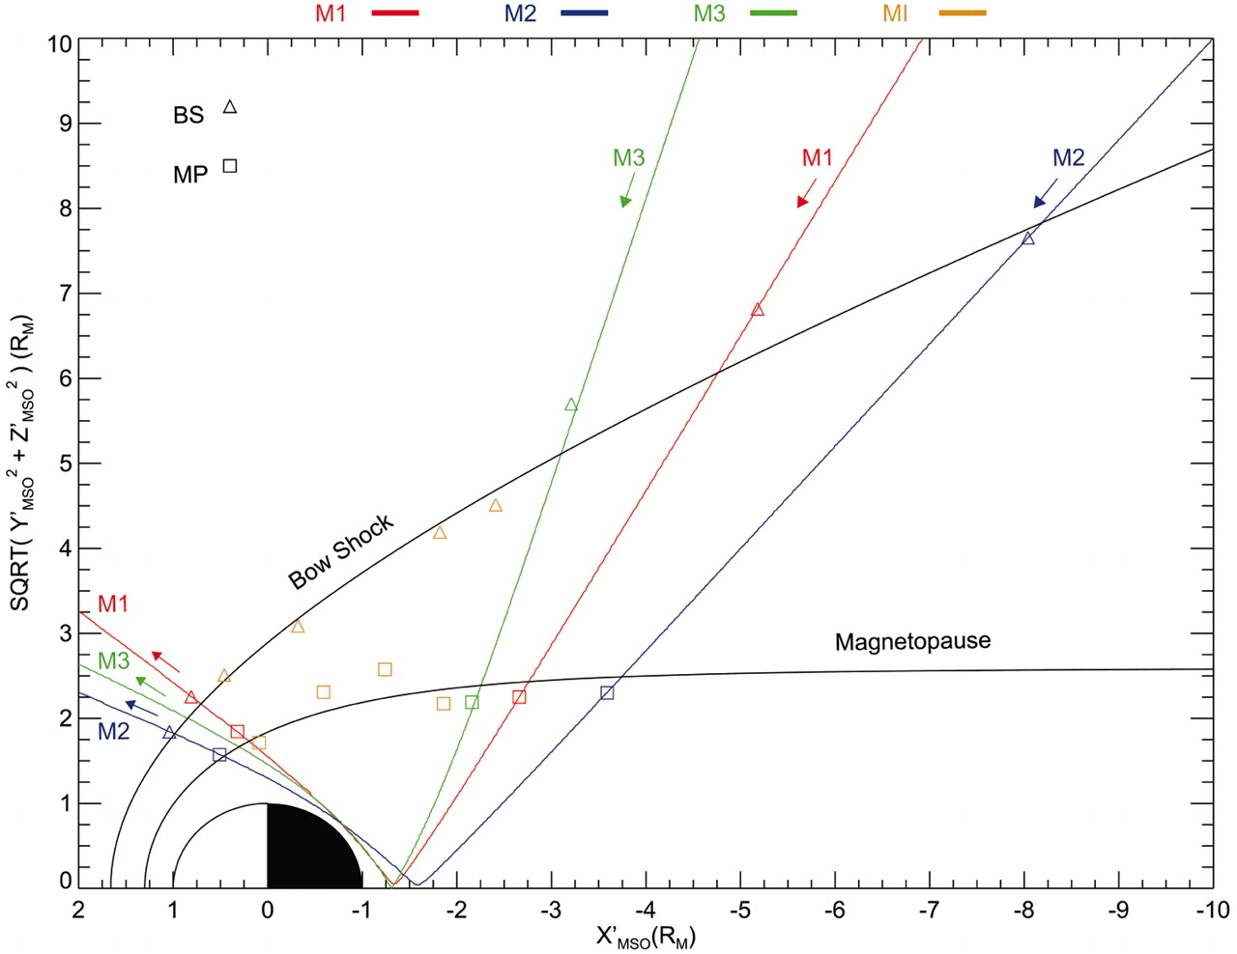


MESSENGER Mercury flyby trajectories
The large magnetic field component normal to the magnetopause measured during the second MESSENGER flyby of Mercury
A cross-magnetosphere electric potential of ~30 kV or a mean dawn-to- dusk electric field of ~2 mV/m.
This electric field implies a Dungey cycle time at Mercury of ~2 min.
The relevant scale is the convection time 𝑇𝑐, defined a the time to cycle the magnetic flux in the tail Φ𝑇 under the action of the electric potential 𝜙𝑐 across the magnetosphere:

Slide 5
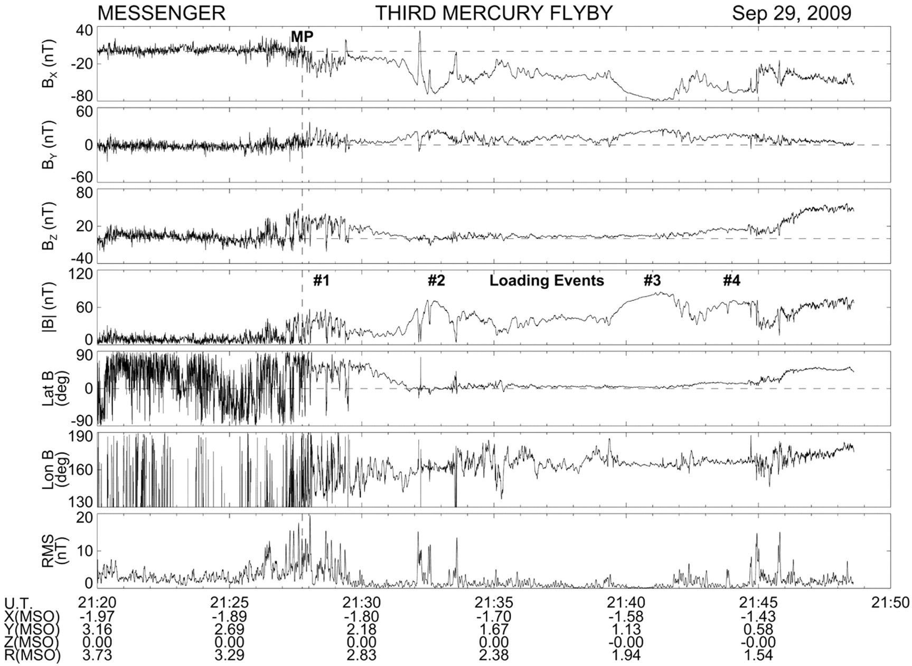
Overview of magnetospheric measurements
1. IMF:
Variable north-south orientation and a magnitude of ~28 nT, ~50% stronger than for the previous encounters.
2. Within the magnetosphere:
a strong negative BX component.

Slide 6
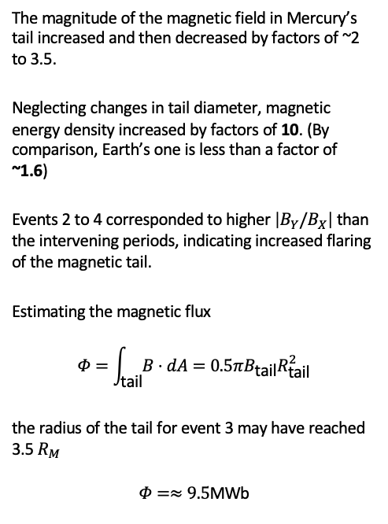
Overview of magnetospheric measurements
The magnitude of the magnetic field in Mercury’s tail increased and then decreased by factors of ~2 to 3.5.
Neglecting changes in tail diameter, magnetic energy density increased by factors of 10. (By comparison, Earth’s one is less than a factor of ~1.6)
Events 2 to 4 corresponded to higher $\left|B_{Y}/B_{X}\right|$ than the intervening periods, indicating increased flaring of the magnetic tail.
Estimating the magnetic flux
$$Φ=\int_{\text{tail}}^{​}{B}⋅dA=0.5πB_{\text{tail}}R_{\text{tail}}^{2}$$
the radius of the tail for event 3 may have reached 3.5 $R_{M}$
$$Φ=≈9.5\text{MWb}$$

Slide 7
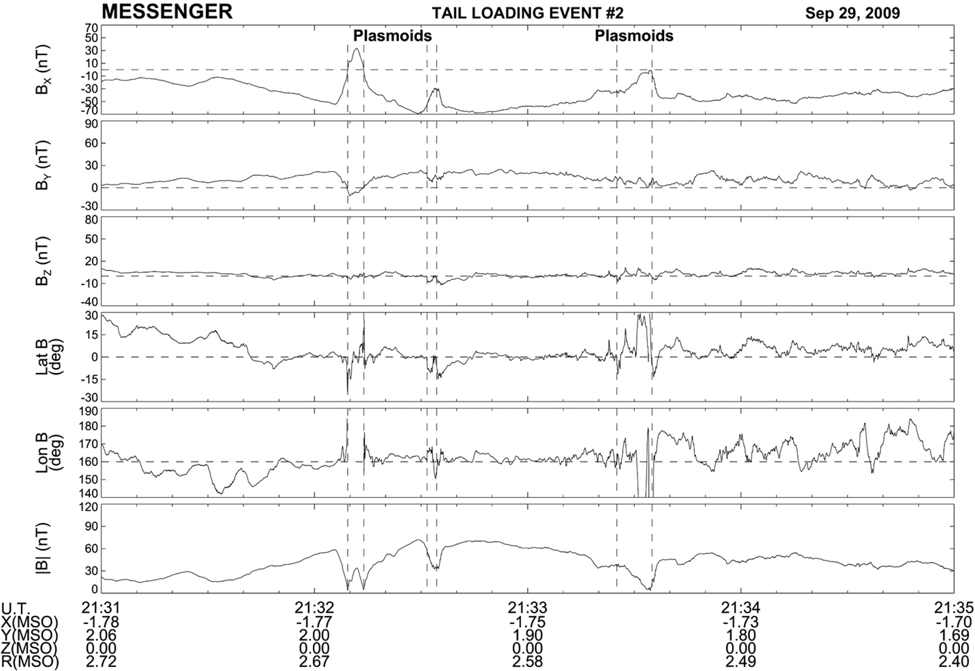
Tail-loading event 2
Six intervals of several seconds each when the total magnetic field weakened
indicating entry into a region with high plasma thermal pressure and low magnetic field pressure.
- These minima in field magnitude coincide with either rapid northward-then-southward or just southward variations in BZ, followed by a slower recovery back to BZ ≈ 0
Fig. 3 Magnetometer observations of tail-loading event 2 during MESSENGER’s third flyby.

Slide 8
Overview of magnetospheric measurements
Near-Mercury neutral line (NMNL):
The NMNL was observed near XMSO = –2.6 RM during MESSENGER’s second flyby (5), but it was closer to the planet, near XMSO ≈ –1.6 RM, for this flyby. The third flyby results therefore suggest that the NMNL develops much closer to the planet when the magnetic tail is heavily loaded with magnetic flux, such as during events 2 and 3.

Slide 9
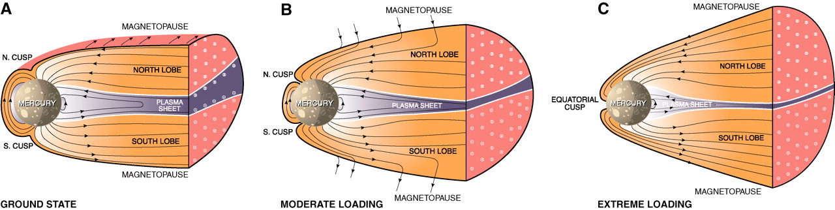
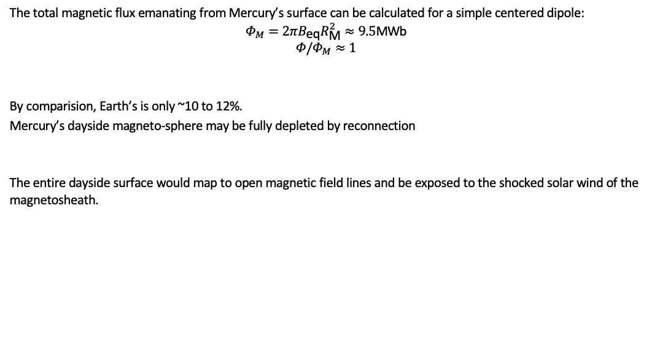
Schematic view
The total magnetic flux emanating from Mercury’s surface can be calculated for a simple centered dipole:
$$Φ_{M}=2πB_{\text{eq}}R_{\text{M}}^{2}≈9.5\text{MWb}$$
$$Φ/Φ_{M}≈1$$
By comparision, Earth’s is only ~10 to 12%.
Mercury’s dayside magneto-sphere may be fully depleted by reconnection
The entire dayside surface would map to open magnetic field lines and be exposed to the shocked solar wind of the magnetosheath.

