Slide 1
Surface charging of Jupiter’s moon europa
Sachin A. Reddy
Tom A. Nordheim
Camilla D. K. Harris

Slide 2
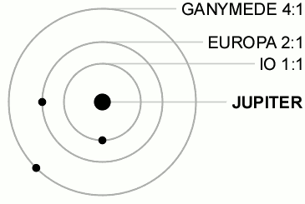
1. Motivation: Europa in Jupiter’s plasma
What are the electric potentials that develop on Europa’s surface?
Why Europa is special? Europa sees two plasma populations at once:
Not shielded by a thick atmosphere => bombardment from the comparatively hot and tenuous Jupiter’s magnetospheric plasma
Ionosphere extends to the surface => exposed to both dense and cold ionospheric plasma
Jupiter’s plasma flows past Europa at 90 km/s versus Europa orbits Jupiter at 14 km/s

Slide 3
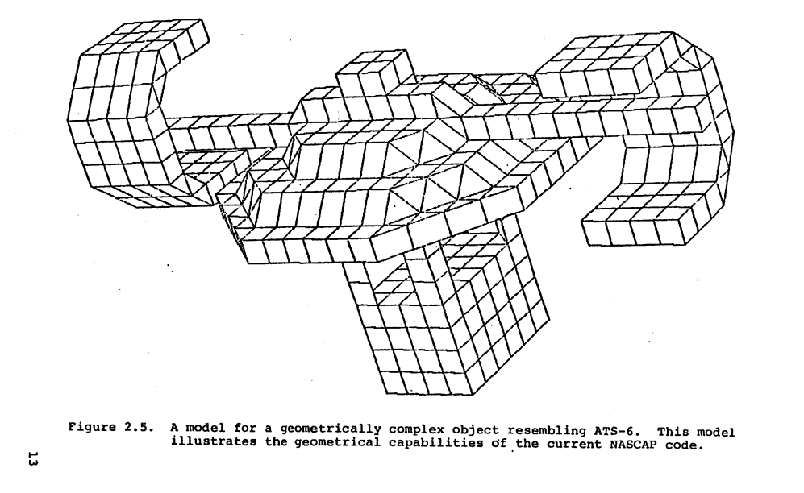
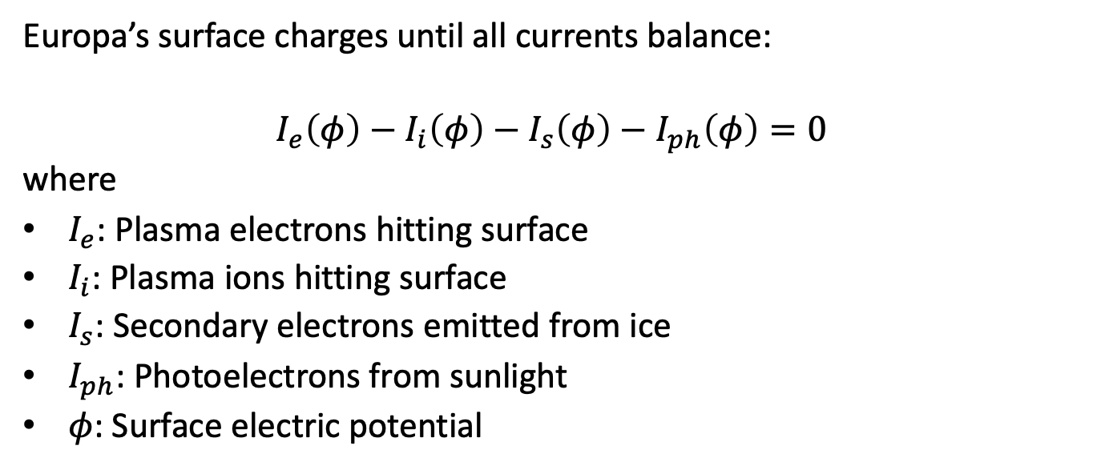
2. The physics model: currents balance
Europa’s surface charges until all currents balance:
$$I_{e}\left(φ\right)−I_{i}\left(φ\right)−I_{s}\left(φ\right)−I_{ph}\left(φ\right)=0$$
where
$I_{e}$: Plasma electrons hitting surface
$I_{i}$: Plasma ions hitting surface
$I_{s}$: Secondary electrons emitted from ice
$I_{ph}$: Photoelectrons from sunlight
$φ$: Surface electric potential
Notes:
The secondary electron current (I_s) is controlled by ((E)). If energetic electrons hit Europa and knock out many secondaries, Europa loses negative charge and becomes more positive. Thus ((E)) is one of the most important material parameters.
Very low-energy electrons: little emission
Intermediate energy: yield rises
High energy: electrons penetrate too deeply → most secondaries are reabsorbed → yield falls
The factor \frac{Q - 1 + e^{-Q}}{Q^2} comes from transport theory: it models how secondaries created at depth escape the material.
It behaves like this:
Low energy (small (Q)): e^{-Q} \approx 1 - Q \quad\Rightarrow \quad Q - 1 + e^{-Q} \approx \tfrac{1}{2}Q^2
So (E): yield rises linearly with energy.
High energy (large (Q)): e^{-Q} \to 0 \quad\Rightarrow\quad \frac{Q-1}{Q^2} \sim \frac{1}{Q}

Slide 4
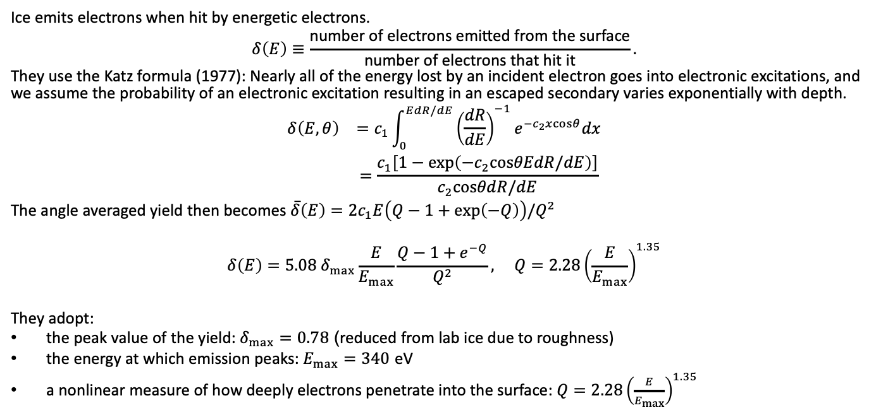
2. The physics model: material parameters and secondary electron emission
Ice emits electrons when hit by energetic electrons.
$$δ\left(E\right)≡\frac{\text{number} \text{of} \text{electrons} \text{emitted} \text{from} \text{the} \text{surface}}{\text{number} \text{of} \text{electrons} \text{that} \text{hit} \text{it}}.$$
They use the Katz formula (1977): Nearly all of the energy lost by an incident electron goes into electronic excitations, and we assume the probability of an electronic excitation resulting in an escaped secondary varies exponentially with depth.
$$\begin{matrix}δ\left(E,θ\right) & =c_{1}\int_{0}^{EdR/dE}{{\left(\frac{dR}{dE}\right)}^{−1}}e^{−c_{2}xcosθ}dx \\ & =\frac{c_{1}\left[1−exp\left(−c_{2}cosθEdR/dE\right)\right]}{c_{2}cosθdR/dE}\end{matrix}$$
The angle averaged yield then becomes $\overset{‾}{δ}\left(E\right)=2c_{1}E\left(Q−1+exp\left(−Q\right)\right)/Q^{2}$
$$δ\left(E\right)=5.08 δ_{max}\frac{E}{E_{max}}\frac{Q−1+e^{−Q}}{Q^{2}}, Q=2.28{\left(\frac{E}{E_{max}}\right)}^{1.35}$$
They adopt:
the peak value of the yield: $δ_{max}=0.78$ (reduced from lab ice due to roughness)
the energy at which emission peaks: $E_{max}=340$ eV
a nonlinear measure of how deeply electrons penetrate into the surface: $Q=2.28{\left(\frac{E}{E_{max}}\right)}^{1.35}$
Notes:
The secondary electron current (I_s) is controlled by ((E)). If energetic electrons hit Europa and knock out many secondaries, Europa loses negative charge and becomes more positive. Thus ((E)) is one of the most important material parameters.
Very low-energy electrons: little emission
Intermediate energy: yield rises
High energy: electrons penetrate too deeply → most secondaries are reabsorbed → yield falls
The factor \frac{Q - 1 + e^{-Q}}{Q^2} comes from transport theory: it models how secondaries created at depth escape the material.
It behaves like this:
Low energy (small (Q)): e^{-Q} \approx 1 - Q \quad\Rightarrow \quad Q - 1 + e^{-Q} \approx \tfrac{1}{2}Q^2
So (E): yield rises linearly with energy.
High energy (large (Q)): e^{-Q} \to 0 \quad\Rightarrow\quad \frac{Q-1}{Q^2} \sim \frac{1}{Q}

Slide 5
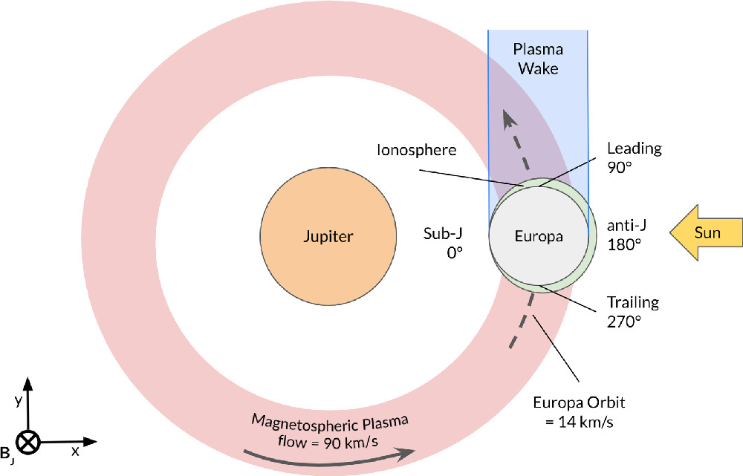
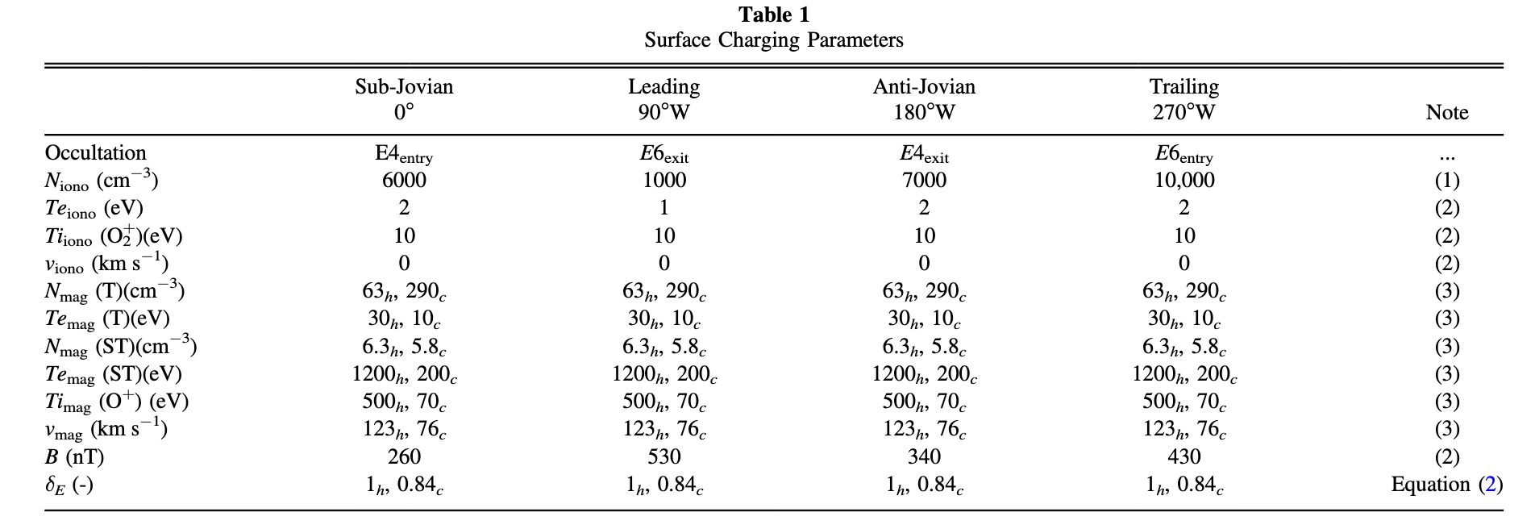
3. Simulation approach
They use SPIS, a 3-D Particle-in-Cell plasma charging code .
Europa’s surface is represented as a 1 m × 3 m cylinder embedded in plasma with:
realistic electron & ion distributions
magnetic field
secondary electron emission
photoemission
Four hemispheres
Sub-Jovian (0°)
Leading (90°W)
Anti-Jovian (180°)
Trailing (270°W)
plus sunlit vs eclipse.
Geometry of Europa’s interaction with Jupiter’s magnetosphere
Notes:
. Europa orbits Jupiter at $14{kms}^{−1}$, while the magnetospheric plasma corotates with Jupiter at $90{kms}^{−1}$, resulting in a wake forming at Europa’s leading (downstream) hemisphere. Europa also possesses an ionosphere that is expected to be nonuniform and denser at the trailing (upstream) hemisphere. We capture this variability by simulating four discrete surface locations: subJovian 0°, leading 90°, anti-Jovian 180°, and trailing 270°, in both sunlight and eclipse.

Slide 6
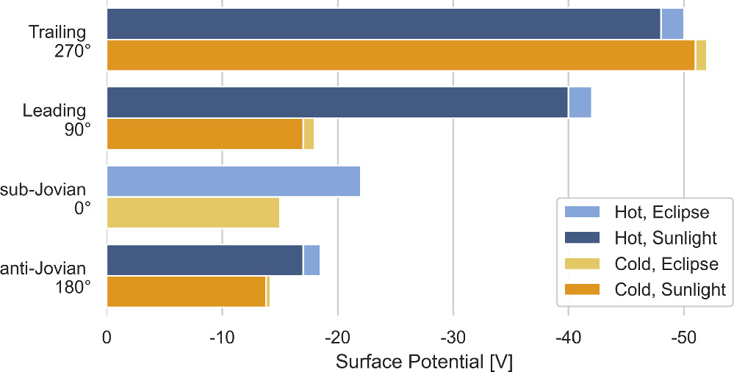
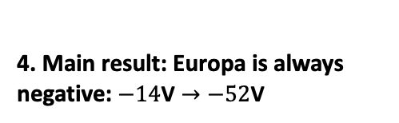
4. Main result: Europa is always negative: $−14\text{V}→−52\text{V}$
Surface potentials as a function of location on Europa’s hemispheres, solar illumination conditions, and magnetospheric plasma properties.
O+ magnetospheric ions access to the surface except leading edge
a hotter population results in a greater negative potential except trailing edge
photoemission reduces the surface potential by up to 2 V (relatively small)
Location | Why
Trailing hemisphere | Faces plasma flow → strongest charging
Leading hemisphere | In plasma wake → fewer ions, more electrons
Notes:
The sub-Jovian hemisphere is slightly more negative than the anti-Jovian side and this is due to the 14% decrease in the ionospheric density
In this hemisphere, plasma is effectively flowing away from the surface and only electrons have access to the surface because of their increased thermal motion compared to the less mobile O+ magnetospheric ions. A temperature increase from 200 eV (cold) to 1200 eV (hot) (per Bagenal et al. 2015), in the suprathermal population leads to significantly higher potentials (−14 versus −42 V) even when the plasma drift is effectively 0 m s−1 or negative. This effect is less pronounced on the other three hemispheres, because the O+ ions have access to the surface, which acts as a positive current
r
n the trailing hemisphere, the colder and denser plasma population (i.e., when Europa is closest to the centrifugal equator), leads to a marginally stronger surface potential. This is attributable to the increased number of electrons that have access to the surface because of the plasma flow.

Slide 7
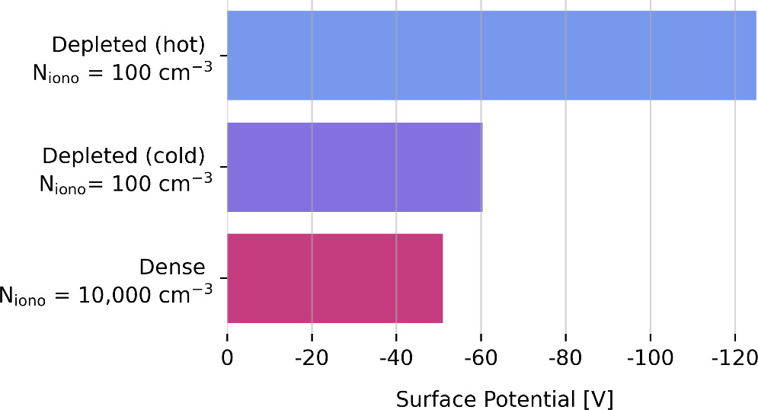
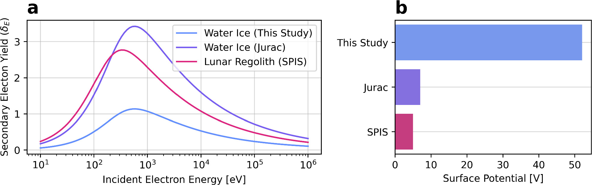

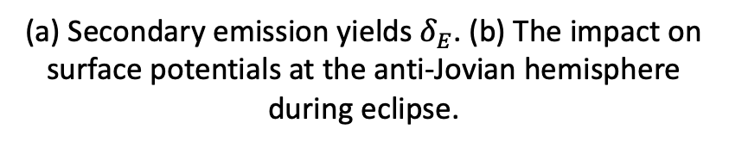

5. The ionosphere “dampens” charging
6. Secondary emission dominates uncertainty
If Europa had less dense ionosphere, potentials would be much larger.
They reduce ionospheric density from 10,000 cm⁻³ to 100 cm⁻³ and find:
$$−51\text{V}→−125\text{V}$$
for hot plasma.
Changing the assumed surface material gives:
$$−52\text{V}→−5\text{V}$$
for the same plasma conditions.
So Europa’s chemistry (water ice vs salts, sulfuric acid, etc.) directly affects its electric environment.
(a) Secondary emission yields $δ_{E}$. (b) The impact on surface potentials at the anti-Jovian hemisphere during eclipse.
The effects of ionospheric density on surface potential on the trailing hemisphere during eclipse.
Notes:
reduced ionosphere leads to a greater surface potential and this is especially the case with the hot parameters. This “ionospheric dampening” effect also acts to suppress surface potentials at the other hemispheres by a similar magnitude

Slide 8
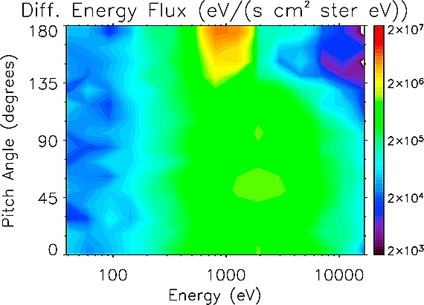
7. Observational consequences and Why this matters?
Negative surfaces accelerate secondary electrons upward along magnetic field lines. These form electron beams detectable by spacecraft (representative of the electrostatic potential difference between the spacecraft and the surface).
This was used at Earth’s Moon and Saturn’s moon Hyperion. Same method could be used by Europa Clipper and JUICE to remotely probe surface composition using plasma instruments.
This makes surface charging a new diagnostic tool for Europa’s geology and chemistry.
Halekas, 2004. Energy pitch angle spectrogram obtained in the plasma sheet on March 11, 1998 at 15:31 UT. Both LP and the location of magnetic connection to the lunar surface lie in shadow.

