Slide 1
Role of Magnetic Reconnection (Tearing Instability) in Magnetohydrodynamic Turbulence

Slide 2
Boldyrev and Loureiro (2020) Loureiro and Boldyrev (2017a) Loureiro and Boldyrev (2017b) Alfred Mallet, Schekochihin, and Chandran (2017) A. Mallet, Schekochihin, and Chandran (2017) Boldyrev and Loureiro (2017) Boldyrev (2006)
This analysis predicts the existence of the subinertial, reconnection interval of MHD turbulence, with the estimated scaling of the Fourier energy spectrum E(k_{⊥})∝k-5/2, where k is the wave number perpendicular to the local mean magnetic field.
Boldyrev and Loureiro (2018) : Calculations in the theory of tearing instability
Key questions: How does magnetic reconnection influence turbulence? What role do tearing instabilities play?
Recent studies suggest that reconnection via tearing plays a crucial role in mediating the turbulent energy cascade.

Slide 3
Theoretical Foundations in MHD Turbulence
Incompressible MHD Equations & Turbulence:
$$\begin{matrix} & ∂_{t}v+\left(v⋅∇\right)v=−∇p+\left(∇×B\right)×B+v∇^{2}v \\ & ∂_{t}B=∇×\left(v×B\right)+η∇^{2}B\end{matrix}$$
Conservation laws in decaying MHD turbulence
$$\begin{matrix} & E=\frac{1}{2}∫\left(v^{2}+B^{2}\right)d^{3}x \\ & H^{C}=∫\left(v⋅B\right)d^{3}x \\ & H^{M}=∫\left(A⋅B\right)d^{3}x\end{matrix}$$
Magnetic helicity is better conserved than the energy => large-scale helical magnetic structures
Cross-helicity may dissipate slower than the energ => dynamically aligned structures
Anisotropic Turbulence Models
Irosnikov & Kraichnan (1963, 1965) $τ_{IK}\left(λ\right)∼Nλ/V_{A}∼λ/δv_{λ}\left(V_{A}/δv_{λ}\right)$ (Kraichnan 1965)
$$E_{IK}\left(k\right)=\left\langle {\left|δv\left(k\right)\right|}^{2}\right\rangle k^{2}∝k^{−3/2}$$
MHD turbulence the energy transfer occurs predominantly in the field-perpendicular direction.
Goldreich & Sridhar (1995, 1997): Introduced anisotropic cascade ideas and scaling predictions for strong Alfvénic turbulence. (Goldreich and Sridhar 1995)
$$E_{GS}\left(k_{⊥}\right)=\left\langle {\left|δv\left(k_{⊥}\right)\right|}^{2}\right\rangle k_{⊥}∝k_{⊥}^{−5/3}$$
Boldyrev (2006): Modifications, incorporating dynamic alignment effects. Eddies are also anisotropic in the plane perpendicular to the local magnetic field. (Boldyrev 2006)

Slide 4
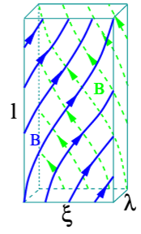
Eddy scales

Slide 5
$$\begin{matrix}ξ & ∼L{\left(λ/L\right)}^{3/4}, \\ ℓ & ∼L{\left(λ/L\right)}^{1/2}, \\ b_{λ} & ∼B_{0}{\left(λ/L\right)}^{1/4}, \\ v_{λ} & ∼V_{0}{\left(λ/L\right)}^{1/4}, \\ τ & ∼ℓ/V_{A,0}∼λ^{1/2}L^{1/2}/V_{A,0}, \\ V_{A,λ} & ∼V_{A,0}{\left(λ/L\right)}^{1/4},\end{matrix}$$
Aspect ratio of an eddy in the perpendicular direction increases as $λ→0$.
$$ξ/λ∼{\left(L/λ\right)}^{1/4}$$
In the perpendicular plane, eddies become ever more elongated current sheets as λ gets smaller.
Turbulent motions generate sheared magnetic structures where magnetic reconnection sets in, which, in turn, modifies turbulent fluctuations at the corresponding scales. A particularly interesting feature of 3D anisotropic eddies is that they can be thought of as current sheets of thickness λ and length ξ in the field-perpendicular plane (with ξ ≫ λ)… The anisotropic, current-sheet-like eddies become the sites of magnetic reconnection before the formal Kolmogorov dissipation scale is reached.
At what scale (i.e., aspect ratio) does reconnection of these current sheets (eddies) become an important effect?
What would be the rate of a linear tearing instability triggered by its magnetic profile?

Slide 6
Tearing instability
Critical scale $λ_{cr}$ at which the growth rate $γ$ of that mode matches the eddy turn over time at that scale.
Two well-known regimes:
FKR (small tearing mode instability parameter, $Δ^{′}$ )
Coppi (large $Δ^{′}$ )
The $N=1$ mode, related to the tearing perturbation wavenumber through $k/2π=N/ξ$, is the most unstable mode until it transitions into the Coppi regime. This happens at the scale that satisfies
$$\left(ξ/λ\right)S_{λ}^{−1/4}∼1$$
yielding the transition scale for the $N=1$ mode
$$λ_{tr,1}/L∼S_{L}^{−4/9}$$
In other words, if $λ>λ_{tr,1}$, the most unstable mode in the current sheet is an FKR mode; if the opposite is true,
FKR regime
For the $N=1$ mode, the growth rate is
$$γ_{1}^{FKR}∼ξ^{2/5}V_{A,λ}^{2/5}λ^{−2}η^{3/5}$$
The equation $γ_{1}^{FKR}τ∼1$ therefore yields
$$λ_{cr,1}/L∼S_{L}^{−6/11}$$
We see that $λ_{cr,1}<λ_{tr,1}$, implying that the modes that will become critical are not FKR modes, but rather Coppi modes.
Coppi regime
The largest growth rate is
$$γ_{max}^{Coppi}∼τ_{A,λ}^{−1}S_{λ}^{−1/2}$$
where $τ_{A,λ}≡λ/V_{A,λ}$, corresponding to a mode number $N_{\text{max }}^{\text{Coppi }}∼ξ/λS_{λ}^{−1/4}$.
The criticality condition now yields
$$λ_{cr}^{Coppi}/L∼S_{L}^{−4/7}$$
As the scale $λ$ decreases, the rate of the corresponding tearing instability increases faster than the eddy turnover rate.

Slide 7
Upper limit of critical current sheets (dissipation)
We first note that we expect such plasmoids of many different sizes to be separated from each other by Sweet-Parker current sheets of a length, $L_{c}$, such that their aspect ratio is marginally stable to plasmoid formation, $∼S_{c}^{1/2}\left[49\right]$, where $S_{c}=L_{c}V_{A,λ_{cr}^{\text{Coppi }}}/η$ is the critical Lundquist number, $S_{c}∼{10}^{4}$.
Current sheets longer than $L_{c}$ are unstable to plasmoid formation; if, on the other hand, they are shorter than $L_{c}$, they will be stretched to that length by differential background flows.
The thickness of these critical current sheets is estimated as:
$$δ_{c}∼L_{c}S_{c}^{−1/2}∼λ_{cr}^{Coppi}S_{λ_{cr}^{Coppi}}^{−1}S_{c}^{1/2}$$
where $S_{λ_{cr}^{Coppi}}=λ_{cr}^{Coppi}V_{A,λ_{cr}^{Coppi}}/η$. We thus obtain
$$δ_{c}/L∼S_{c}^{1/2}S_{L}^{−6/7}$$

Slide 8
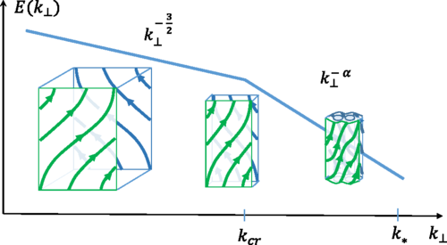
Spectrum of turbulence below the reconnection scale
These critical current sheets are the structures where ohmic and viscous dissipation is happening. It is reasonable to assume that Eq. (18) sets the dissipation scale, that is, the scale below which the reconnection interval is ultimately terminated by the dissipation. Assuming that the energy spectrum in this interval follows a power law, we write it in the form
$$E\left(k_{⊥}\right)∝k_{0}^{−3/2}{\left(k_{⊥}/k_{0}\right)}^{−α}$$
−dEdt=η​k*k⊥2Ek⊥dk⊥∝SL47−32+α+673−α−1
This defines the scaling of the energy spectrum: $α=5/2$.
Sketch of the Fourier energy spectrum (log-log scale)

Slide 9
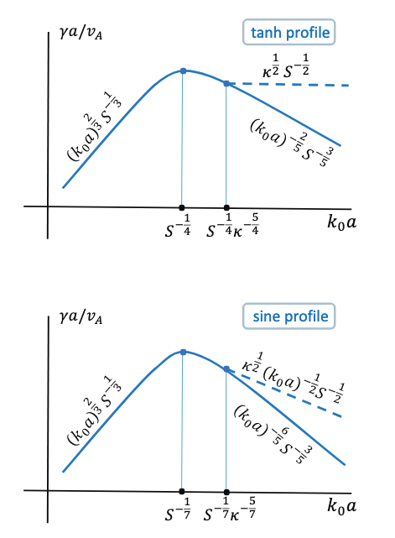
Spectrum of turbulence governed by the tearing instability
Boldyrev and Loureiro (2018)
Replacing the nonlinear turnover time by the tearing time $b_{a}^{2}γ=ε$
$$b_{a}∼ε^{2/5}η^{−1/5}a^{3/5}$$
and to the energy spectrum
$$E_{tanh}\left(k_{⊥}\right)∝k_{⊥}^{−11/5}$$
A similar estimate for the sine-shaped profile leads to somewhat different scaling exponent
$$b_{a}∼ε^{7/18}η^{−1/6}a^{5/9}$$
and
$$E_{sin}\left(k_{⊥}\right)∝k_{⊥}^{−19/9}$$
Sketch of the tearing-mode growth rate as a function of ($k_{0}a$)

Slide 10
Reconnection with multiple timescales
Alfred Mallet, Schekochihin, and Chandran (2017) A. Mallet, Schekochihin, and Chandran (2017)
Tearing instability is the initial nonlinear stage of magnetic reconnection, while the term “reconnection” is often used to describe a broader range of associated fully nonlinear phenomena, such as the X-point collapse and formation of plasmoid chains.
First, there is exponential growth of the linear tearing mode until the width of the island(s) is approximately the width of the inner layer where resistivity is important, w ∼ δin ∼ [γ (kδz)−2λ2η]1/4 , (16) where γ is the linear growth rate of the tearing mode and k ∼ N/ξ is its wavenumber (N is the number of islands).
Secondly, there may be secular “Rutherford’ growth of the islands until w ∼ 1/ ′, where ′ is the instability parameter for the tearing mode.
$$τ_{\text{Ruth }}∼\frac{1}{ηΔ^{′2}}∼N^{2}{\left(\frac{\hat{λ}}{\hat{ξ}}\right)}^{2}S_{λ}\frac{λ}{δz}.$$
Note that $τ_{\text{Ruth }}$ increases with $N$, so if the maximum growth rate is attained for the $N=1$ FKR mode, this mode will also exit the Rutherford stage and saturate first. In the FKR limit, $Δ^{′}δ_{\text{in }}≪1$, and so there is a well-defined Rutherford stage. For the Coppi modes, $Δ^{′}δ_{\text{in }}∼1$, and so there is no Rutherford stage.
Thirdly, the X-point(s) that have arisen collapse into thin sheets, which then undergo fast reconnection, leaving behind a set of magnetic islands.
$$τ_{D}∼\left\{\begin{matrix}max\left[1/γ_{FKR},τ_{Ruth}\right] & \text{ if }\hat{λ}>{\hat{λ}}_{tr}, \\ 1/γ_{max} & \text{ if }\hat{λ}≤{\hat{λ}}_{tr}\end{matrix}\right.$$
Boldyrev, Stanislav. 2006. “Spectrum of Magnetohydrodynamic Turbulence.” Physical Review Letters 96 (11): 115002. https://doi.org/10.1103/PhysRevLett.96.115002.
Boldyrev, Stanislav, and Nuno F. Loureiro. 2017. “Magnetohydrodynamic Turbulence Mediated by Reconnection.” Astrophysical Journal 844 (2): 125. https://doi.org/10.3847/1538-4357/aa7d02.
———. 2018. “Calculations in the Theory of Tearing Instability.” Journal of Physics: Conference Series 1100 (1): 012003. https://doi.org/10.1088/1742-6596/1100/1/012003.
———. 2020. “Tearing Instability in Alfvén and Kinetic-Alfvén Turbulence.” Journal of Geophysical Research: Space Physics 125 (9): e2020JA028185. https://doi.org/10.1029/2020JA028185.
Goldreich, P., and S. Sridhar. 1995. “Toward a Theory of Interstellar Turbulence. II. Strong Alfvenic Turbulence.” Astrophysical Journal 438 (January): 763. https://doi.org/10.1086/175121.
Kraichnan, Robert H. 1965. “Inertial-Range Spectrum of Hydromagnetic Turbulence.” Physics of Fluids 8 (7): 1385–87. https://doi.org/10.1063/1.1761412.
Loureiro, Nuno F., and Stanislav Boldyrev. 2017a. “Role of Magnetic Reconnection in Magnetohydrodynamic Turbulence.” Physical Review Letters 118 (24): 245101. https://doi.org/10.1103/PhysRevLett.118.245101.
———. 2017b. “Collisionless Reconnection in Magnetohydrodynamic and Kinetic Turbulence.” Astrophysical Journal 850 (2): 182. https://doi.org/10.3847/1538-4357/aa9754.
Mallet, Alfred, Alexander A. Schekochihin, and Benjamin D. G. Chandran. 2017. “Disruption of Alfvénic Turbulence by Magnetic Reconnection in a Collisionless Plasma.” Journal of Plasma Physics 83 (6): 905830609. https://doi.org/10.1017/S0022377817000812.
Mallet, A., A. A. Schekochihin, and B. D. G. Chandran. 2017. “Disruption of sheetlike structures in Alfv\’enic turbulence by magnetic reconnection.” Monthly Notices of the Royal Astronomical Society 468 (4): 4862–71. https://doi.org/10.1093/mnras/stx670.

