Slide 1
Detecting magnetic activity and space weather using radio astronomy.

Slide 2
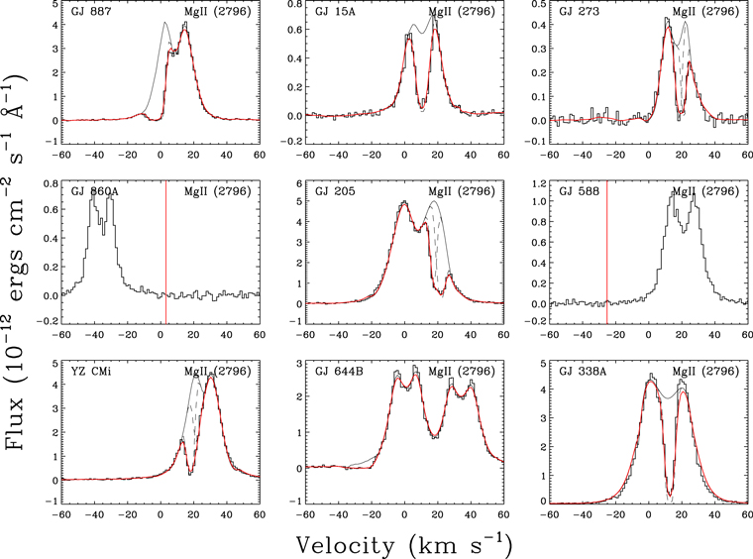
1. Introduction & Motivation
The Big Picture
The Problem: Understanding the space environment around exoplanets is crucial for characterizing their potential habitability. This requires measuring stellar magnetic activity and space weather events (like CMEs).
The Limitation of Other Wavelengths: X-ray and UV observations tell us about the star’s atmosphere, but radio detections offer a unique, sensitive window onto the star’s magnetosphere and the exoplanet’s own magnetic field and its interaction with the star.
The Paper’s Role: This paper is a primer designed to guide new researchers, detailing the physical mechanisms and recent observational advances in the field.
☐ Detection of a CME (too tenuous to detect)
  radio free–free emission from the ionized coronal winds
  X-ray emission generated by charge exchange between the ionized wind and interstellar neutrals
  astrospheric Lyα absorption and absorption from the hydrogen wall
  bursty, low-frequency radio accompanying the CME
☐ Direct measurements of an exoplanet’s magnetic field
  auroral (radio) emission

Slide 3
Key Questions
How can radio bursts (like those from the Sun) characterize stellar space weather and detect stellar CMEs?
What is the role of magnetic Star-Planet Interaction (SPI) in producing observable radio signals?
Can we directly detect the radio emission from an exoplanetary magnetosphere (like Jupiter’s aurora) and use it to measure the planet’s magnetic field?

Slide 4
2. Key Concepts & Mechanisms (The “How?”)
Type | Mechanism | Physics | Significance
Incoherent | Gyrosynchrotron Emission | Generated by mildly-relativistic electrons spiraling in a magnetic field. | Associated with flares and active regions on the star.
Coherent | Electron Cyclotron Maser Instability (ECMI) | Generated by energetic electrons trapped in a magnetic field. All electrons emit in phase, resulting in extremely bright radiation. | This is the mechanism for stellar auroral emission, planetary auroral emission, and Star-Planet Interaction signatures.
A. Radio Emission Mechanisms
The paper differentiates between two main types of radio emission in stellar systems:

Slide 5
B. Solar System Analogues
The paper emphasizes using the Sun and Jupiter as templates:
Solar Bursts:
  Type II Bursts (minutes to hours) are associated with electrons accelerated by CME shocks. Detecting these in exoplanetary systems is the best way to characterize CMEs.
  Type III Bursts (short, seconds) are associated with electron beams from magnetic reconnection events.
Jupiter’s Aurorae: The powerful, highly directional radio emission from Jupiter’s magnetic poles is the direct analogue for potential exoplanet auroral radio emission.

Slide 6
3. Observational Advances & Key Results (The “What?”)
Highlight the areas where low-frequency radio instruments have recently pushed the boundaries.
A. Star-Planet Interactions (SPI)
Concept: When a close-in planet (like a Hot Jupiter) orbits within the star’s magnetosphere, the planetary and stellar magnetic fields can connect and accelerate electrons toward the stellar/planetary poles.
Signature: This magnetic connection is predicted to generate bright, coherent radio bursts that are modulated (or synchronized) with the planet’s orbital period.
Status: The paper reviews recent provisional detections of these SPI-induced radio bursts, highlighting their potential for characterizing exoplanet systems and their magnetic fields.
B. Direct Exoplanet Magnetosphere Detection
Goal: To detect the radio aurorae generated by the exoplanet itself (ECMI emission).
Significance: Detecting a planet’s magnetic field is crucial for determining its ability to shield its atmosphere from harsh stellar wind—a key factor for long-term habitability.
Status: There are early tentative results hinting at the direct detection of exoplanetary magnetospheres.
C. Low-Mass Stars and Brown Dwarfs
Low-Mass Stars: Advances have been driven by low-frequency radio instruments observing auroral emissions from radio-bright low-mass stars.
Brown Dwarfs: These objects often possess very strong magnetospheres and are naturally radio-bright, making them easier targets for detailed study using current instruments, which helps validate the physical models used for exoplanets.

Slide 7
4. Discussion & Future Outlook (The “So What?”)
A. Implications and Unanswered Questions
Space Weather: Time-resolved radio dynamic spectra offer the best way to detect and characterize CMEs from stars other than the Sun, which directly impacts exoplanet atmospheric escape.
Exoplanet Characterization: Radio detections of SPI and planetary aurorae offer the potential to measure the magnetic field strength of exoplanets, a parameter inaccessible by other current methods.
Theory Gaps: There are still outstanding questions in the theory of stellar, SPI, and exoplanet radio emission that require consolidation.
B. Future Facilities
The paper emphasizes that this field is rapidly advancing due to the maturation of new low-frequency radio instruments and wide-field surveys. * Future radio facilities (e.g., SKA, LOFAR upgrades) will be essential for moving beyond tentative results to definitive characterization of exoplanet magnetic fields and the surrounding space environment.
C. Critical Assessment (Journal Club Discussion Points)
Tentative vs. Confirmed: The paper relies heavily on “provisional” and “tentative” detections (especially for direct exoplanet emission and CMEs). Does the community need to agree on a stricter detection criterion?
Model Dependency: How robust are the planetary magnetic field estimates derived from the radio observations, given they rely on models and analogies with Jupiter?
Observational Bias: Is the field currently biased toward highly magnetic, active stars and close-in (Hot Jupiter) systems? How can we expand the target list?

