Slide 1
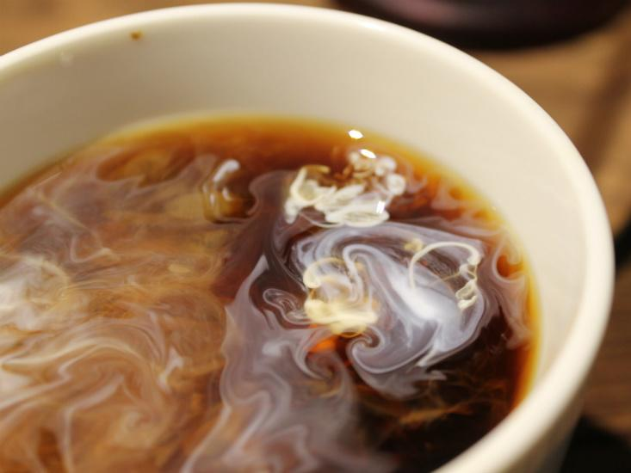

From Coffee

Slide 2
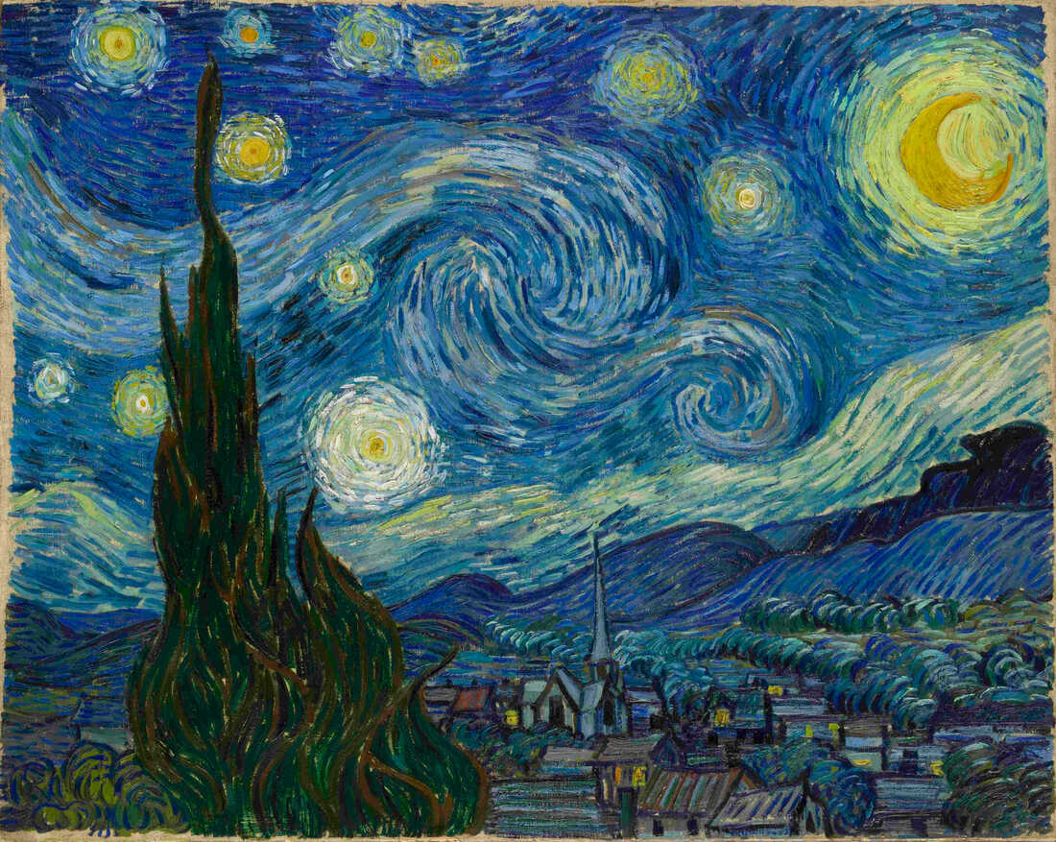
F
To Turbulence
Vincent van Gogh

Slide 3
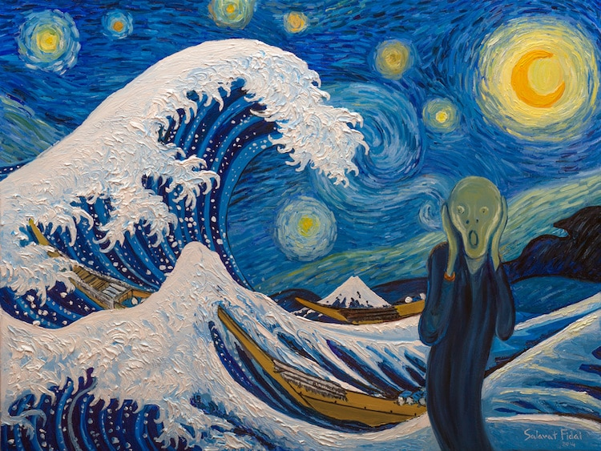
To Turbulent
Mind
Edvard Munch
Photo: Salavat Fidai
Notes:
https://mymodernmet.com/edvard-munch-the-scream-painting/

