Slide 1
Radio signatures of star–planet interactions, exoplanets and space weather
J. R. Callingham
B. J. S. Pope

Slide 2
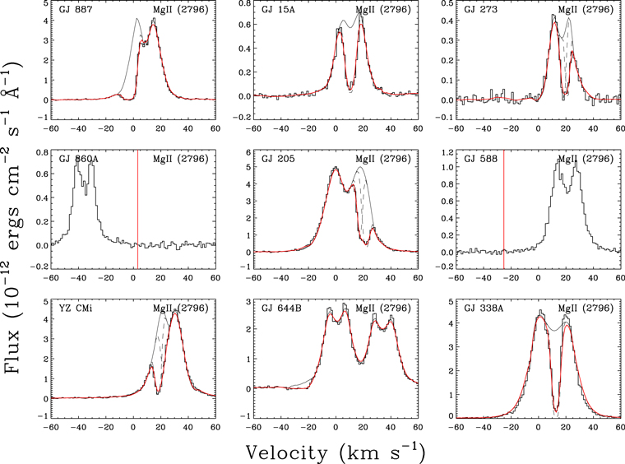
1. Introduction & Motivation
The Problem: Understanding the space environment around exoplanets is crucial for characterizing their potential habitability. This requires measuring stellar magnetic activity and space weather events (like CMEs).
The Limitation of Other Wavelengths: X-ray and UV observations tell us about the star’s atmosphere, but radio detections offer a unique, sensitive window onto the star’s magnetosphere and the exoplanet’s own magnetic field and its interaction with the star.
The Paper’s Role: This paper is a primer designed to guide new researchers, detailing the physical mechanisms and recent observational advances in the field.
☐ Detection of a CME (too tenuous to detect)
  radio free–free emission from the ionized coronal winds
  X-ray emission generated by charge exchange between the ionized wind and interstellar neutrals
  Astrospheric Lyα absorption and absorption from the hydrogen wall
  bursty, low-frequency radio accompanying the CME
☐ Direct measurements of an exoplanet’s magnetic field
  auroral (radio) emission
  Method: astrospheric Lyα absorption and absorption from the hydrogen wall

Slide 3
Key Questions
How to detect stellar CMEs? How can radio bursts (like those from the Sun) characterize stellar space weather and detect stellar CMEs?
What is the role of magnetic Star-Planet Interaction (SPI) in producing observable radio signals?
Can we directly detect the radio emission from an exoplanetary magnetosphere (like Jupiter’s aurora) and use it to measure the planet’s magnetic field?

Slide 4
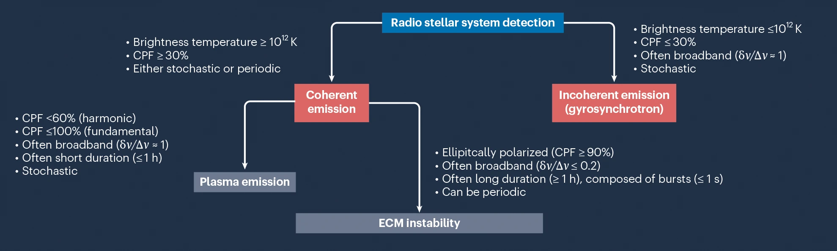
2. Key Concepts & Mechanisms
A. Radio Emission Mechanisms Two main types of radio emission in stellar systems:
The emission characteristics listed to differentiate between the different mechanisms should be treated as approximate guidelines (see refs. 18,43 for a more physical differentiation based on the conditions of the plasma). δν/Δν (where ν is frequency) represents the amount of bandwidth δν the emission occupies relative to the available bandwidth Δν assuming a relatively large fractional bandwidth. Differentiating between plasma emission and emission from the ECM instability can be difficult if the time–frequency structure of the radio emission cannot be resolved. In that case, arguments can be made in favour of one emission mechanism based on the coronal scale height of the radio star, as derived from the stellar X-ray luminosity248,249. Fundamental and harmonic plasma emission have different circular polarization fractions (CPFs) and maximum brightness temperatures, with harmonic plasma emission able to reach the highest brightness temperatures but limited to ≲60% of the circular polarization fraction249. Note that the polarization fractions reported do not take propagation effects into account, which often suppress the fractional amount178.
Type | Mechanism | Physics | Significance
Incoherent | Gyrosynchrotron Emission | Generated by mildly-relativistic electrons spiraling in a magnetic field. | Associated with flares and active regions on the star.
Coherent | Electron Cyclotron Maser Instability (ECMI) | Generated by energetic electrons trapped in a magnetic field. All electrons emit in phase, resulting in extremely bright radiation. | This is the mechanism for stellar auroral emission, planetary auroral emission, and Star-Planet Interaction signatures.

Slide 5
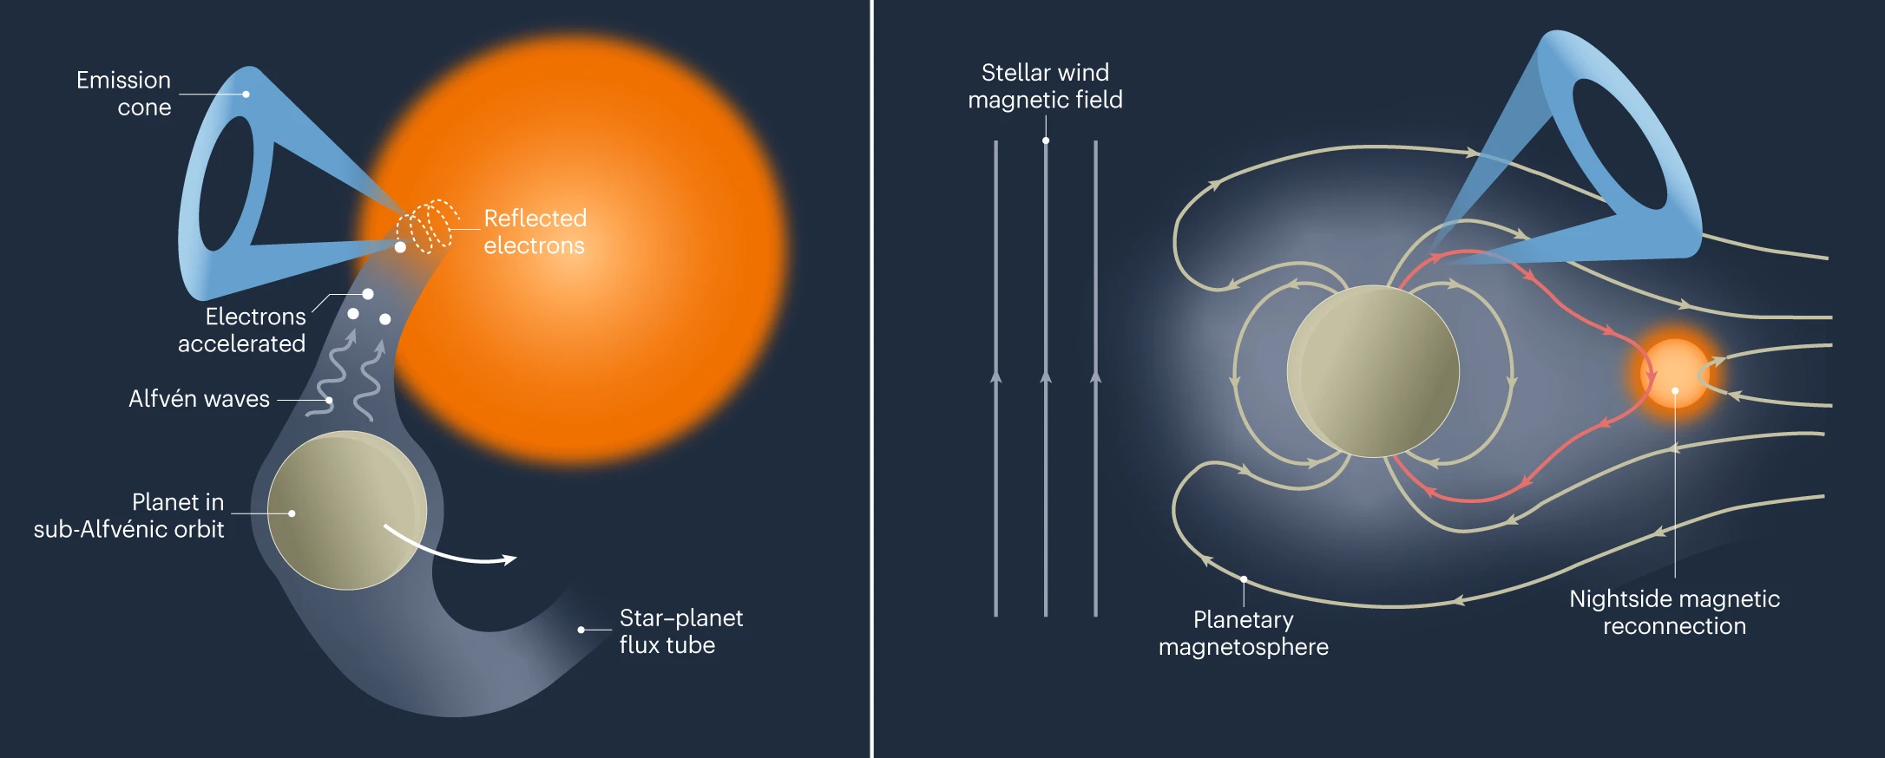
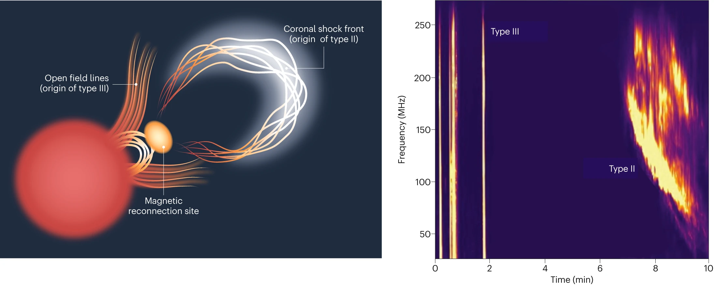
B. Solar System Analogues
Sun and Jupiter as templates
Solar Bursts:
  Type II Bursts (minutes to hours) are associated with electrons accelerated by CME shocks. Detecting these in exoplanetary systems is the best way to characterize CMEs.
  Type III Bursts (short, seconds) are associated with electron beams from magnetic reconnection events.
Jupiter’s Aurorae (ECMI):
The powerful, highly directional radio emission from Jupiter’s magnetic poles is the direct analogue for potential exoplanet auroral radio emission.
Fig. 3: Sketch illustrating the two putative sources of ECM emission in exoplanetary systems. Left: emission induced on a star by a close-in planet. If the planet orbits inside the Alfvén surface of the star, it can perturb the star’s magnetic field, producing Alfvén waves that propagate back towards the star. These waves interact with electrons, accelerating them towards the stellar surface. Electrons with sufficiently large pitch angles undergo a magnetic mirroring effect and are reflected, producing ECM emission that propagates in a hollow cone. Right: auroral emission induced on a planet by the interaction of its magnetosphere with the incident wind of its host star. The magnetic field carried by the stellar wind causes the planet’s magnetosphere to open up on the dayside (left). These field lines are pushed towards the nightside (right), where they subsequently reconnect. The energy released in the magnetic reconnection accelerates electrons back towards the poles along the field line highlighted in red, where they reflect and power ECM emission in a similar manner to that described for the left panel. For clarity, the emission cone is only shown for the northern hemisphere in both cases.
Fig. 1 | Schematic representation of a CME and a dynamic spectrum of the event that shows type II and III bursts. Left: schematic of a CME. Right: radio dynamic spectrum of the event. The type II burst is produced in the coronal shock front, as represented by the region emanating from the red star in the left panel. The magnetic reconnection event that is allowing mass to escape the magnetosphere of the star is shown as the yellow region. Type III bursts are produced on open field lines surrounding the magnetic reconnection event. Some structure and higher-frequency harmonic emission is evident in and around the type II burst in the right panel. The dynamic spectrum is in total intensity.

Slide 6
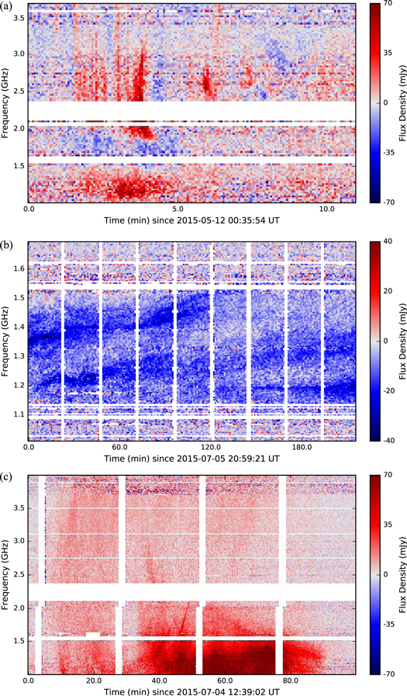
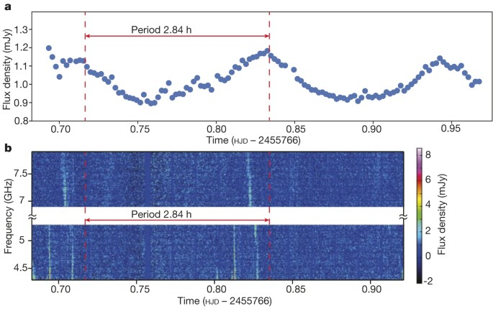
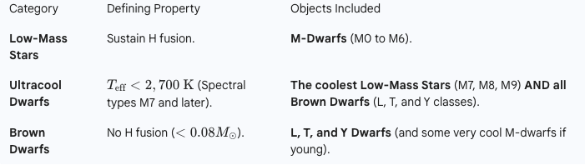
3. Observational Advances & Key
A. Star-Planet Interactions (SPI)
Concept: When a close-in planet orbits within the star’s magnetosphere, the planetary and stellar magnetic fields can connect and accelerate electrons toward the stellar/planetary poles.
Signature: This magnetic connection is predicted to generate bright, coherent radio bursts that are modulated (or synchronized) with the planet’s orbital period.
B. Direct Exoplanet Magnetosphere Radio Detection
Significance: Detecting a planet’s magnetic field
a, Balmer line emission extracted from spectra detected with the Hale telescope. b, Dynamic spectra of the right circularly polarized radio emission detected from LSR J1835 + 3259 with the VLA, with the y axis truncated to remove the large gap between observing bands (see Methods for details). The offset in phase of the radio features relative to the optical peak can be accounted for by the complex beaming of the radio emission. hjd, heliocentric Julian day.
C. Low-Mass Stars and Brown Dwarfs, Ultracool dwarfs (UCDs)
Since UCDs and giant exoplanets share a similar mass, radius, and dynamo mechanism (fully convective), the radio emission from the most massive exoplanets is expected to be governed by the same physics seen in UCDs.

Slide 7
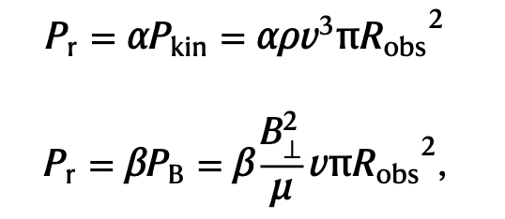
4. Discussion & Future Outlook
A. Implications and Unanswered Questions
Space Weather: Time-resolved radio dynamic spectra offer the best way to detect and characterize CMEs from stars other than the Sun, which directly impacts exoplanet atmospheric escape.
Exoplanet Characterization: Radio detections of SPI and planetary aurorae offer the potential to measure the magnetic field strength of exoplanets, a parameter inaccessible by other current methods.
Theory Gaps: There are still outstanding questions in the theory of magnetohydrodynamics of SPI models.
The maturation of new low-frequency radio instruments and wide-field surveys and future radio facilities (e.g., SKA, LOFAR upgrades) will be essential for moving beyond tentative results to definitive characterization of exoplanet magnetic fields and the surrounding space environment.
B. Critical Assessment
Tentative vs. Confirmed: The paper relies heavily on “provisional” and “tentative” detections (especially for direct exoplanet emission and CMEs).
Model Dependency: How robust are the planetary magnetic field estimates derived from the radio observations, given they rely on models and analogies with Jupiter?

