Slide 1
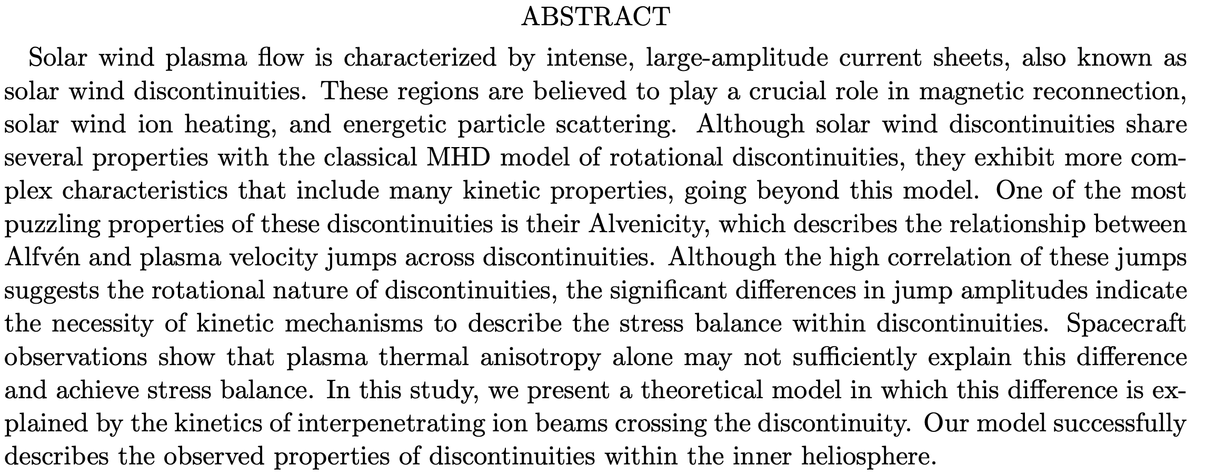
On the Alvenicity of solar wind discontinuities

Slide 2
Introduction

Slide 3
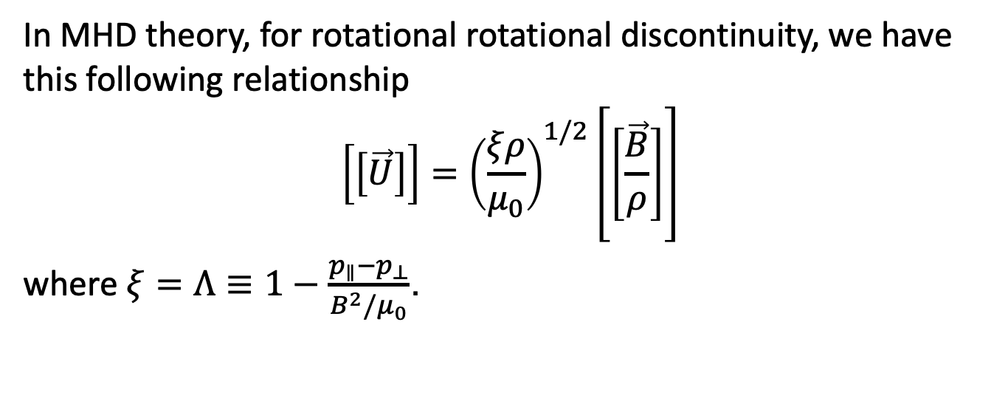
Motivation
In MHD theory, for rotational rotational discontinuity, we have this following relationship
$$\left[\left[\vec{U}\right]\right]={\left(\frac{ξρ}{μ_{0}}\right)}^{1/2}\left[\left[\frac{\vec{B}}{ρ}\right]\right]$$
where $ξ=Λ≡1−\frac{p_{∥}−p_{⊥}}{B^{2}/μ_{0}}$.

Slide 4
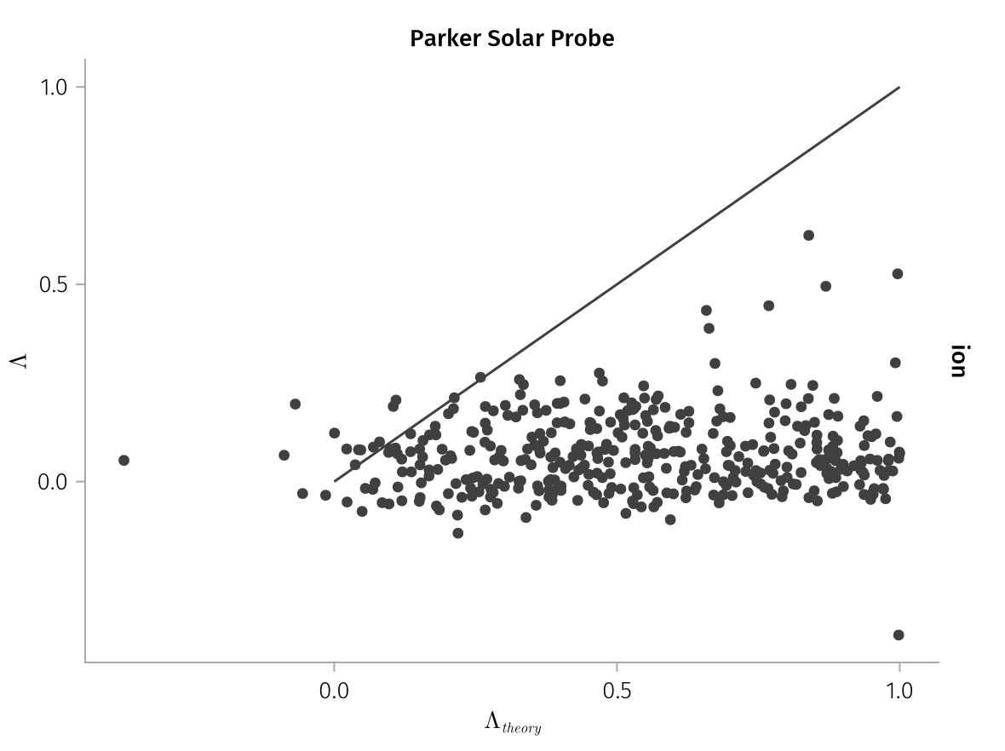

Slide 5
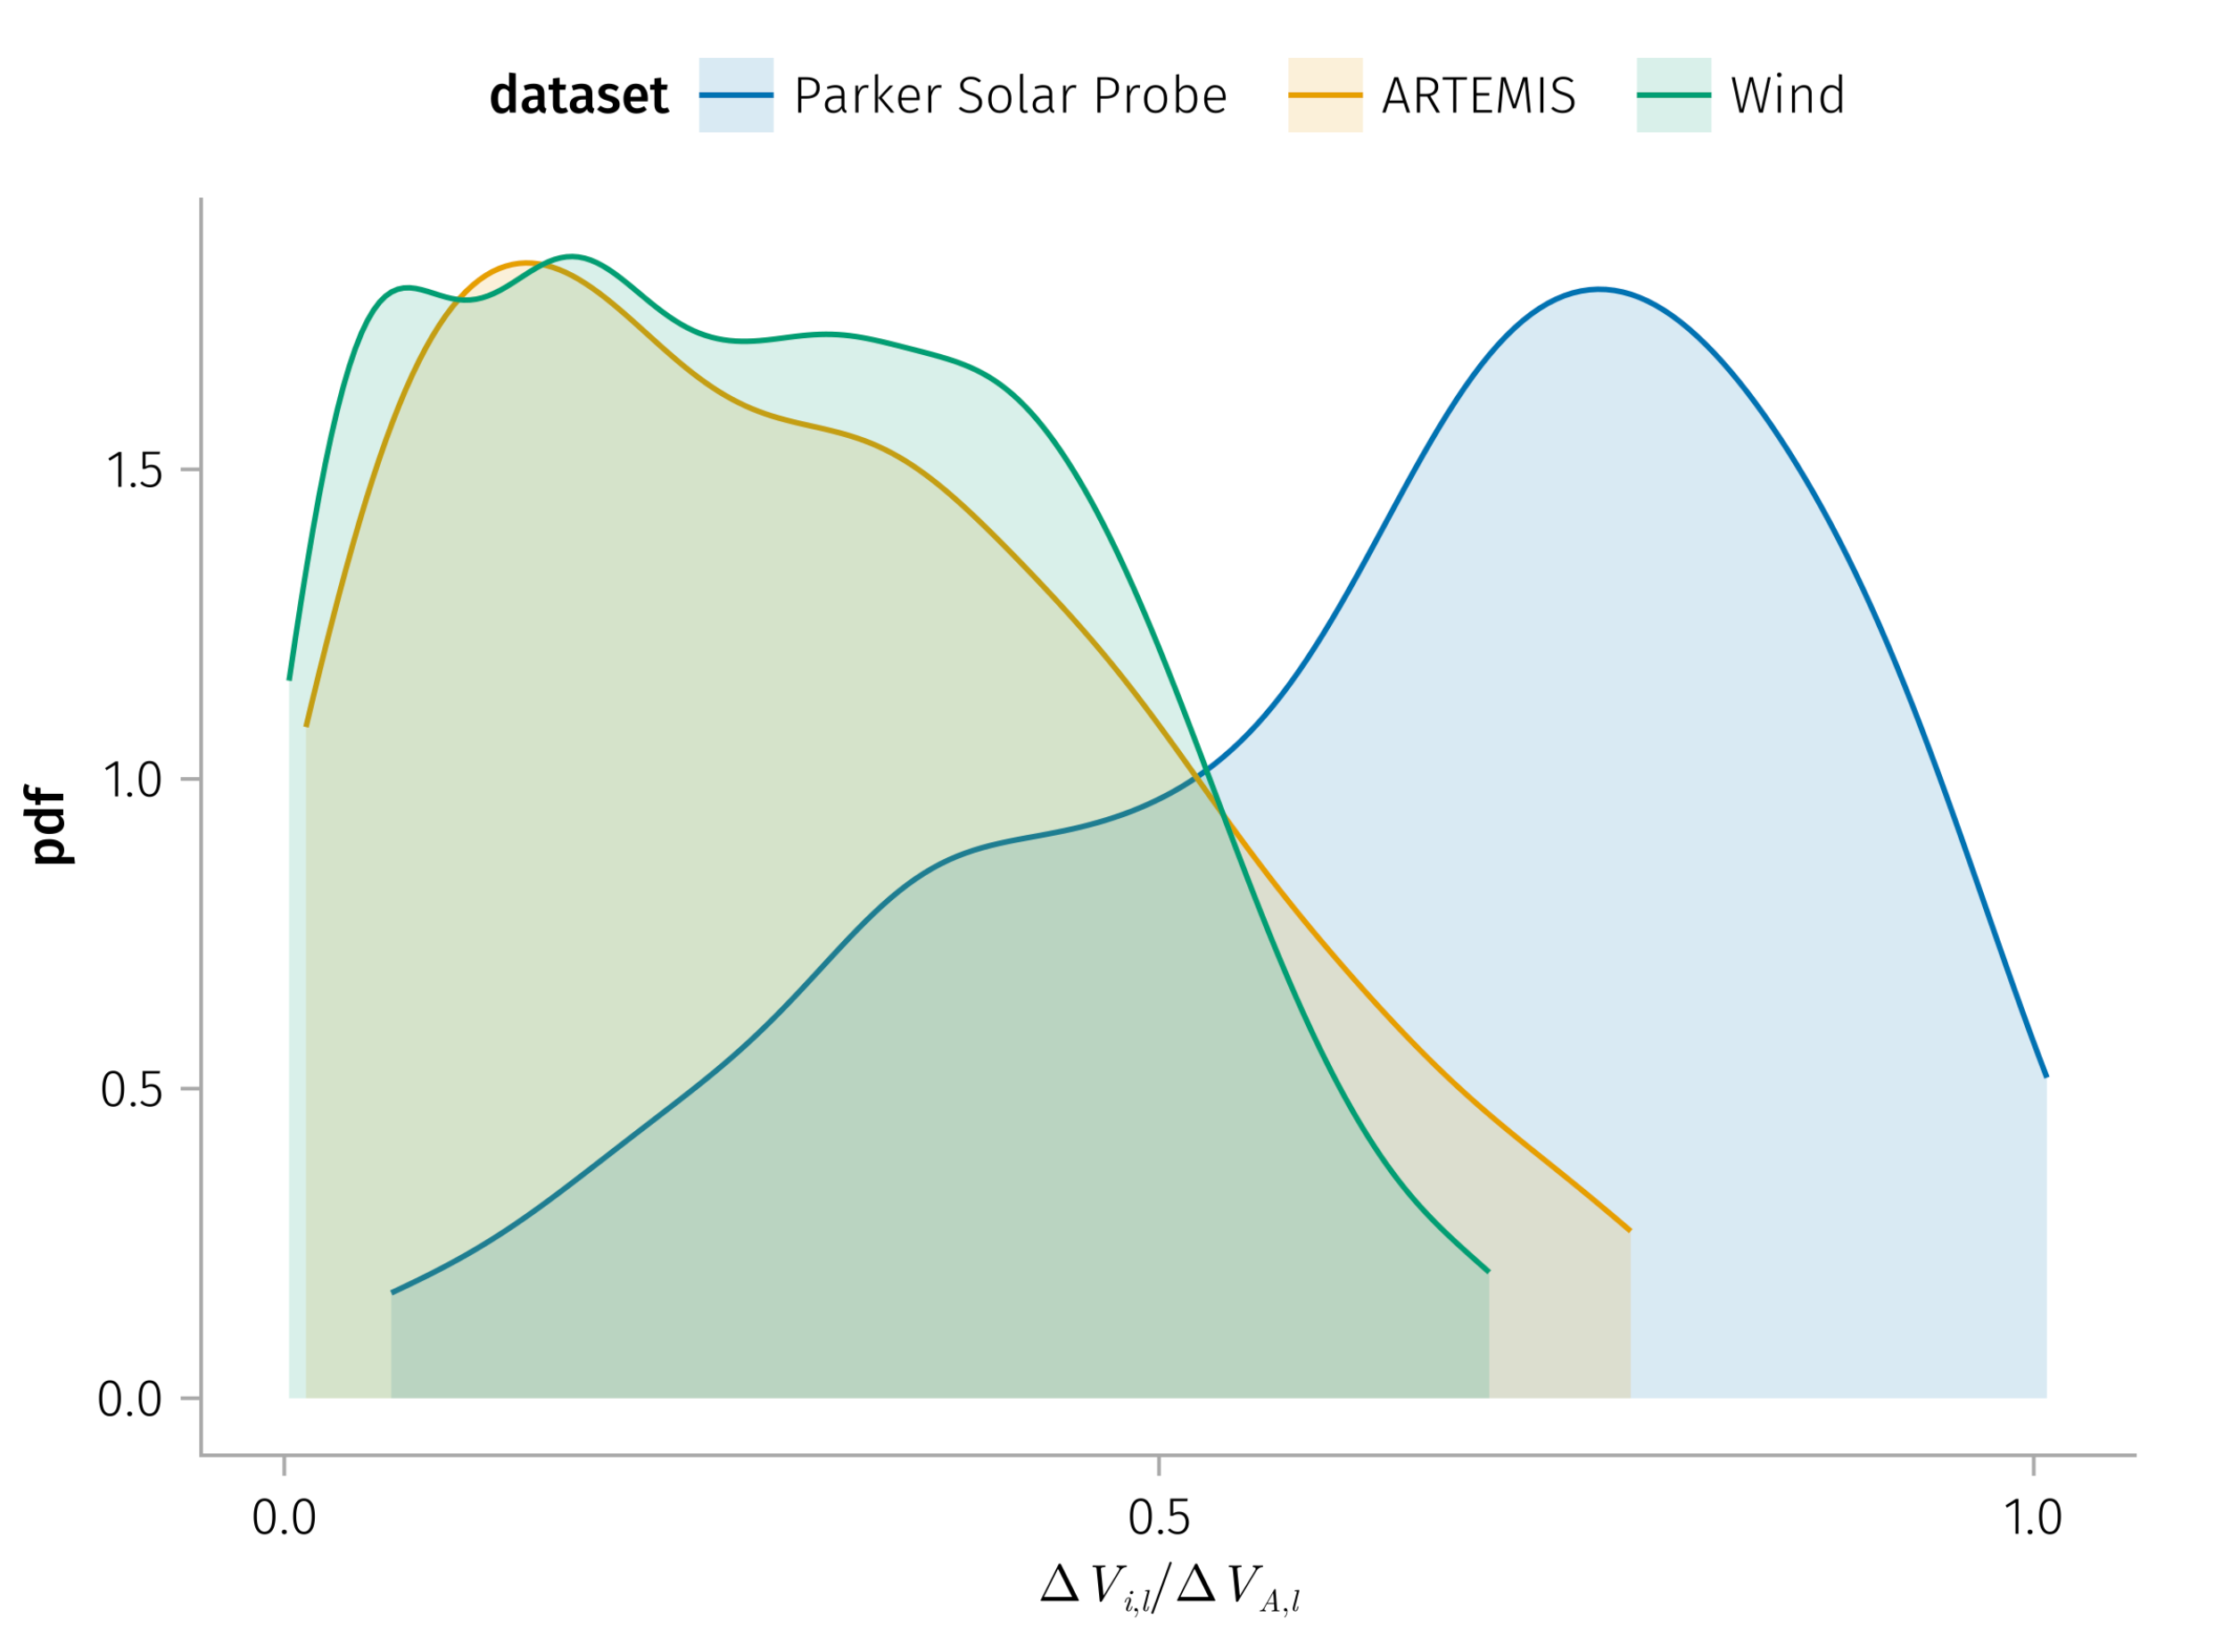

Slide 6
Plasma-Field Equations for a One-Dimensional Multifluid

Slide 7
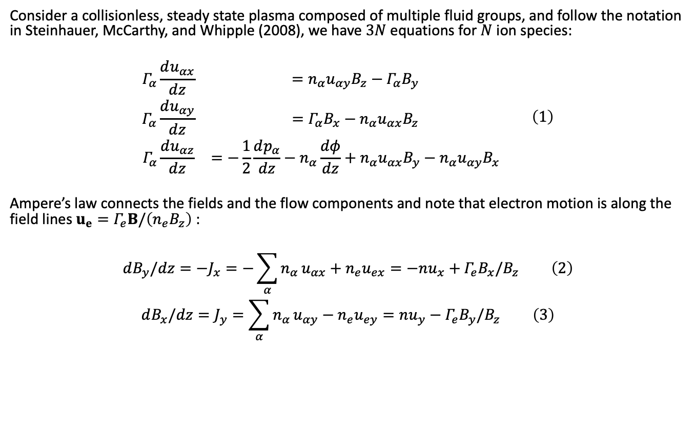
Consider a collisionless, steady state plasma composed of multiple fluid groups, and follow the notation in Steinhauer, McCarthy, and Whipple (2008), we have $3N$ equations for $N$ ion species:
$$\begin{matrix}Γ_{α}\frac{du_{αx}}{dz} & =n_{α}u_{αy}B_{z}−Γ_{α}B_{y} \\ Γ_{α}\frac{du_{αy}}{dz} & =Γ_{α}B_{x}−n_{α}u_{αx}B_{z} \\ Γ_{α}\frac{du_{αz}}{dz} & =−\frac{1}{2}\frac{dp_{α}}{dz}−n_{α}\frac{dφ}{dz}+n_{α}u_{αx}B_{y}−n_{α}u_{αy}B_{x}\end{matrix} \left(1\right)$$
Ampere’s law connects the fields and the flow components and note that electron motion is along the field lines $u_{e}=Γ_{e}B/\left(n_{e}B_{z}\right)$ :
$$dB_{y}/dz=−J_{x}=−\sum_{α}^{​}{n_{α}}u_{αx}+n_{e}u_{ex}=−nu_{x}+Γ_{e}B_{x}/B_{z} \left(2\right)$$
$$dB_{x}/dz=J_{y}=\sum_{α}^{​}{n_{α}}u_{αy}−n_{e}u_{ey}=nu_{y}−Γ_{e}B_{y}/B_{z} \left(3\right)$$

Slide 8
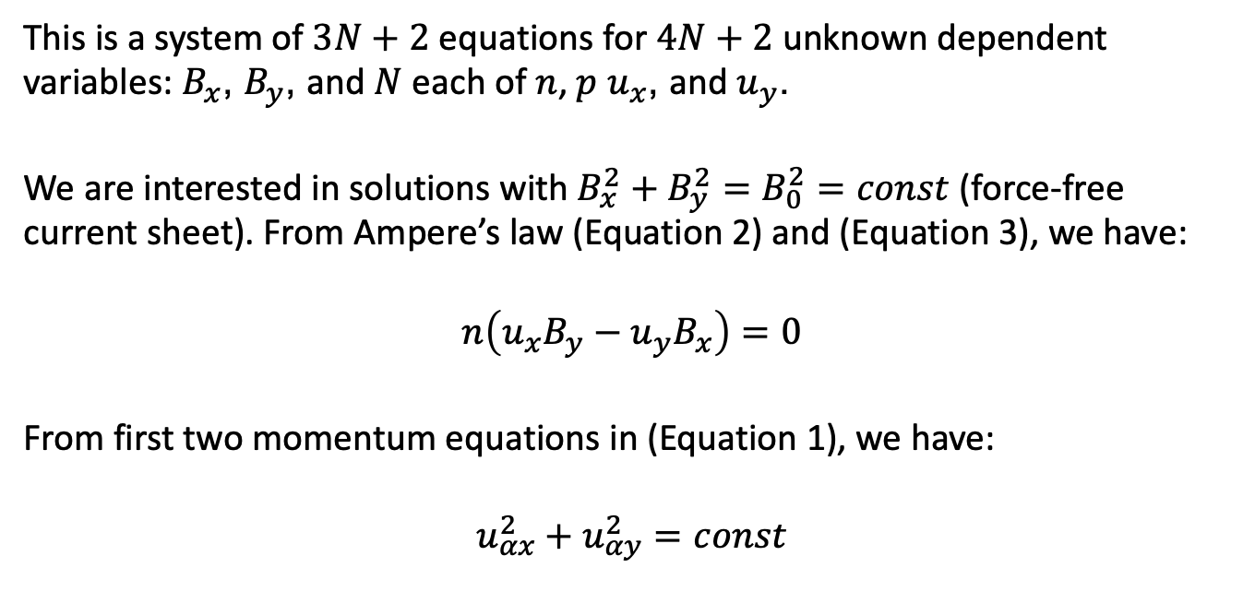
This is a system of $3N+2$ equations for $4N+2$ unknown dependent variables: $B_{x}$, $B_{y}$, and $N$ each of $n$, $p$ $u_{x}$, and $u_{y}$.
We are interested in solutions with $B_{x}^{2}+B_{y}^{2}=B_{0}^{2}=const$ (force-free current sheet). From Ampere’s law (Equation 2) and (Equation 3), we have:
$$n\left(u_{x}B_{y}−u_{y}B_{x}\right)=0$$
From first two momentum equations in (Equation 1), we have:
$$u_{αx}^{2}+u_{αy}^{2}=const$$

Slide 9
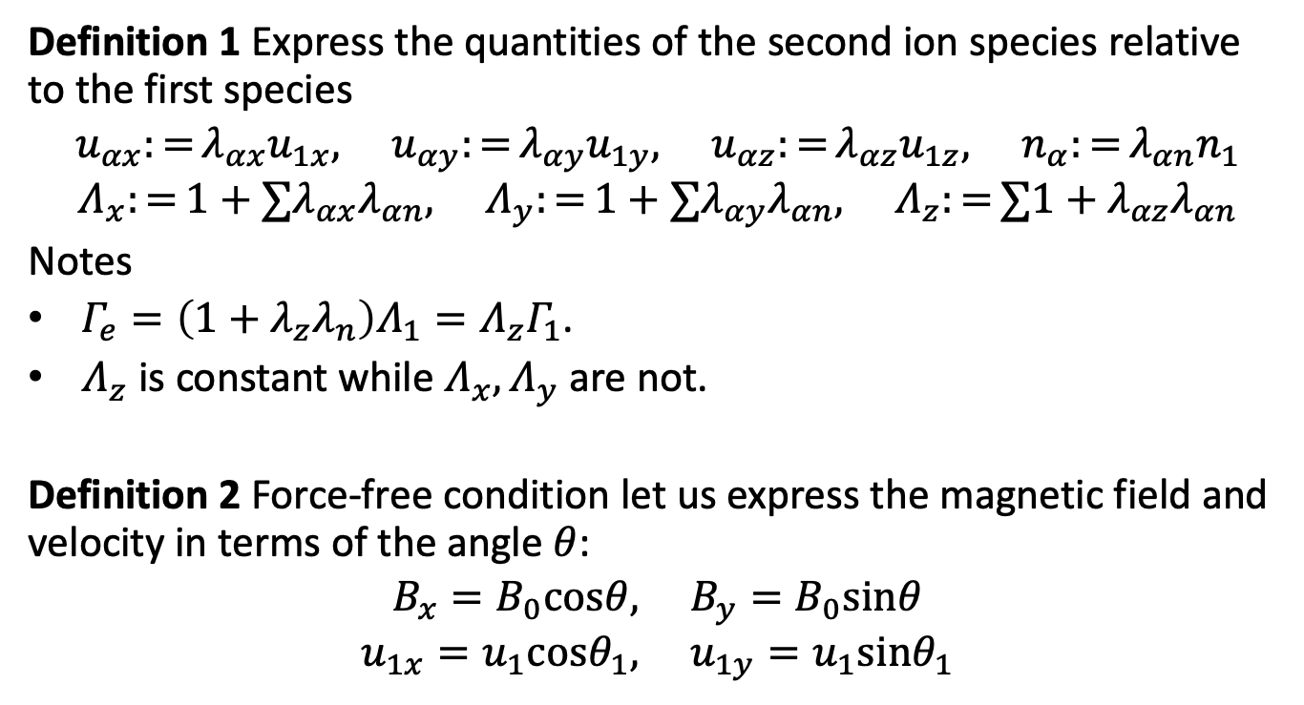
Definition 1 Express the quantities of the second ion species relative to the first species
$$u_{αx}:=λ_{αx}u_{1x}, u_{αy}:=λ_{αy}u_{1y}, u_{αz}:=λ_{αz}u_{1z}, n_{α}:=λ_{αn}n_{1}$$
$$Λ_{x}:=1+∑λ_{αx}λ_{αn}, Λ_{y}:=1+∑λ_{αy}λ_{αn}, Λ_{z}:=∑1+λ_{αz}λ_{αn}$$
Notes
$Γ_{e}=\left(1+λ_{z}λ_{n}\right)Λ_{1}=Λ_{z}Γ_{1}$.
$Λ_{z}$ is constant while $Λ_{x},Λ_{y}$ are not.
Definition 2 Force-free condition let us express the magnetic field and velocity in terms of the angle $θ$:
$$B_{x}=B_{0}cosθ, B_{y}=B_{0}sinθ$$
$$u_{1x}=u_{1}cosθ_{1}, u_{1y}=u_{1}sinθ_{1}$$

Slide 10
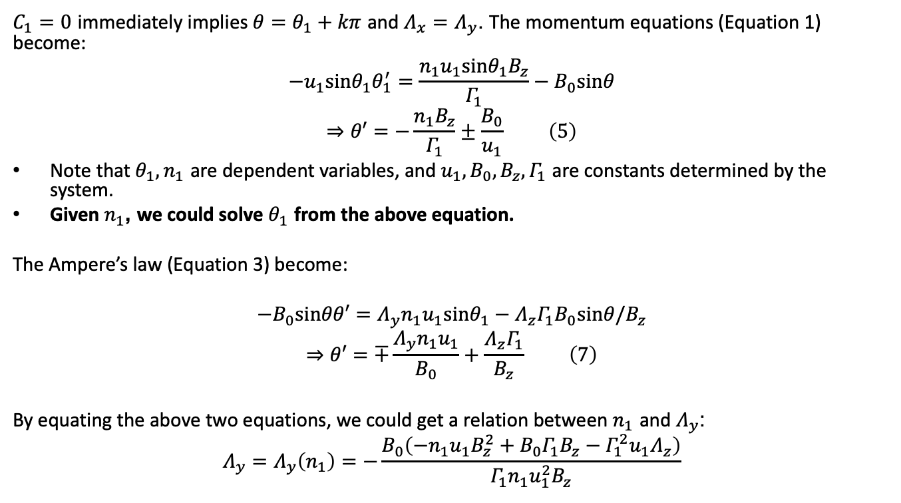
$C_{1}=0$ immediately implies $θ=θ_{1}+kπ$ and $Λ_{x}=Λ_{y}$. The momentum equations (Equation 1) become:
$$−u_{1}sinθ_{1}θ_{1}^{′}=\frac{n_{1}u_{1}sinθ_{1}B_{z}}{Γ_{1}}−B_{0}sinθ$$
$$⇒θ′=−\frac{n_{1}B_{z}}{Γ_{1}}±\frac{B_{0}}{u_{1}} \left(5\right)$$
Note that $θ_{1},n_{1}$ are dependent variables, and $u_{1},B_{0},B_{z},Γ_{1}$ are constants determined by the system.
Given $n_{1}$, we could solve $θ_{1}$ from the above equation.
The Ampere’s law (Equation 3) become:
$$−B_{0}sinθθ′=Λ_{y}n_{1}u_{1}sinθ_{1}−Λ_{z}Γ_{1}B_{0}sinθ/B_{z}$$
$$⇒θ′=∓\frac{Λ_{y}n_{1}u_{1}}{B_{0}}+\frac{Λ_{z}Γ_{1}}{B_{z}} \left(7\right)$$
By equating the above two equations, we could get a relation between $n_{1}$ and $Λ_{y}$:
$$Λ_{y}=Λ_{y}\left(n_{1}\right)=−\frac{B_{0}\left(−n_{1}u_{1}B_{z}^{2}+B_{0}Γ_{1}B_{z}−Γ_{1}^{2}u_{1}Λ_{z}\right)}{Γ_{1}n_{1}u_{1}^{2}B_{z}}$$

Slide 11
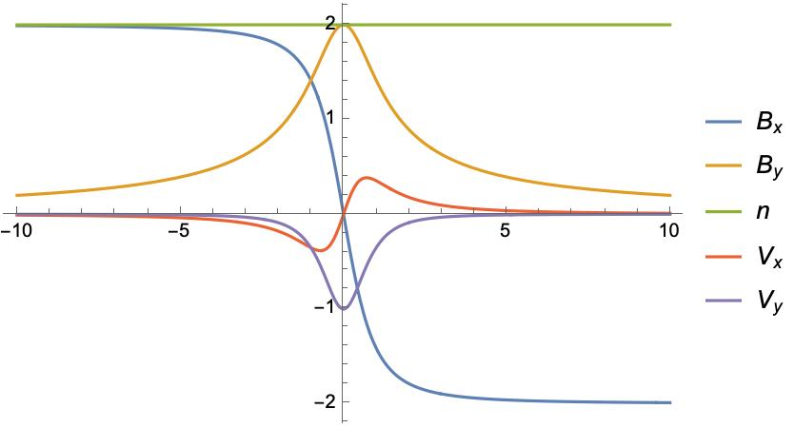
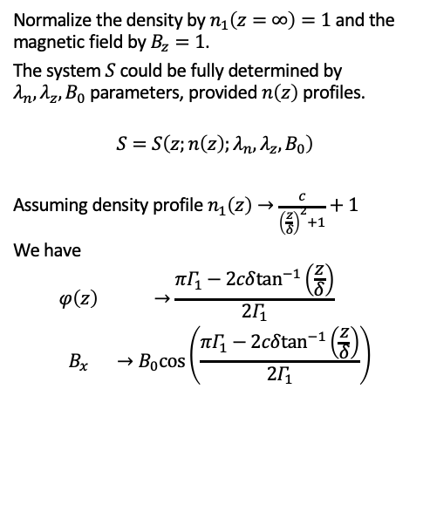
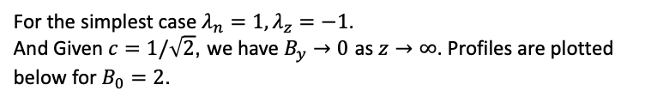
Solutions
Normalize the density by $n_{1}\left(z=∞\right)=1$ and the magnetic field by $B_{z}=1$.
The system $S$ could be fully determined by $λ_{n},λ_{z},B_{0}$ parameters, provided $n\left(z\right)$ profiles.
$$S=S\left(z;n\left(z\right);λ_{n},λ_{z},B_{0}\right)$$
Assuming density profile $n_{1}\left(z\right)→\frac{c}{{\left(\frac{z}{δ}\right)}^{2}+1}+1$
We have
$$\begin{matrix}φ\left(z\right) & →\frac{πΓ_{1}−2cδ\tan^{−1}\left(\frac{z}{δ}\right)}{2Γ_{1}} \\ B_{x} & →B_{0}cos\left(\frac{πΓ_{1}−2cδ\tan^{−1}\left(\frac{z}{δ}\right)}{2Γ_{1}}\right)\end{matrix}$$
For the simplest case $λ_{n}=1,λ_{z}=−1$.
And Given $c=1/\sqrt{2}$, we have $B_{y}→0$ as $z→∞$. Profiles are plotted below for $B_{0}=2$.

Slide 12
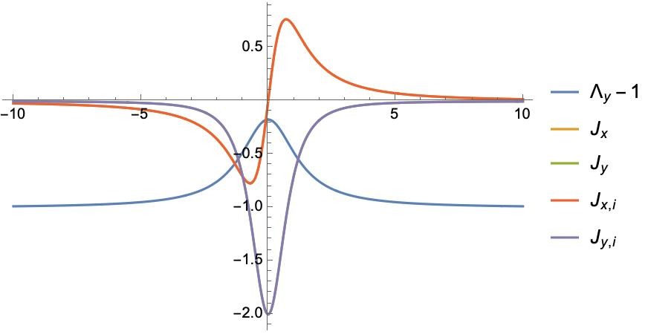

Slide 13
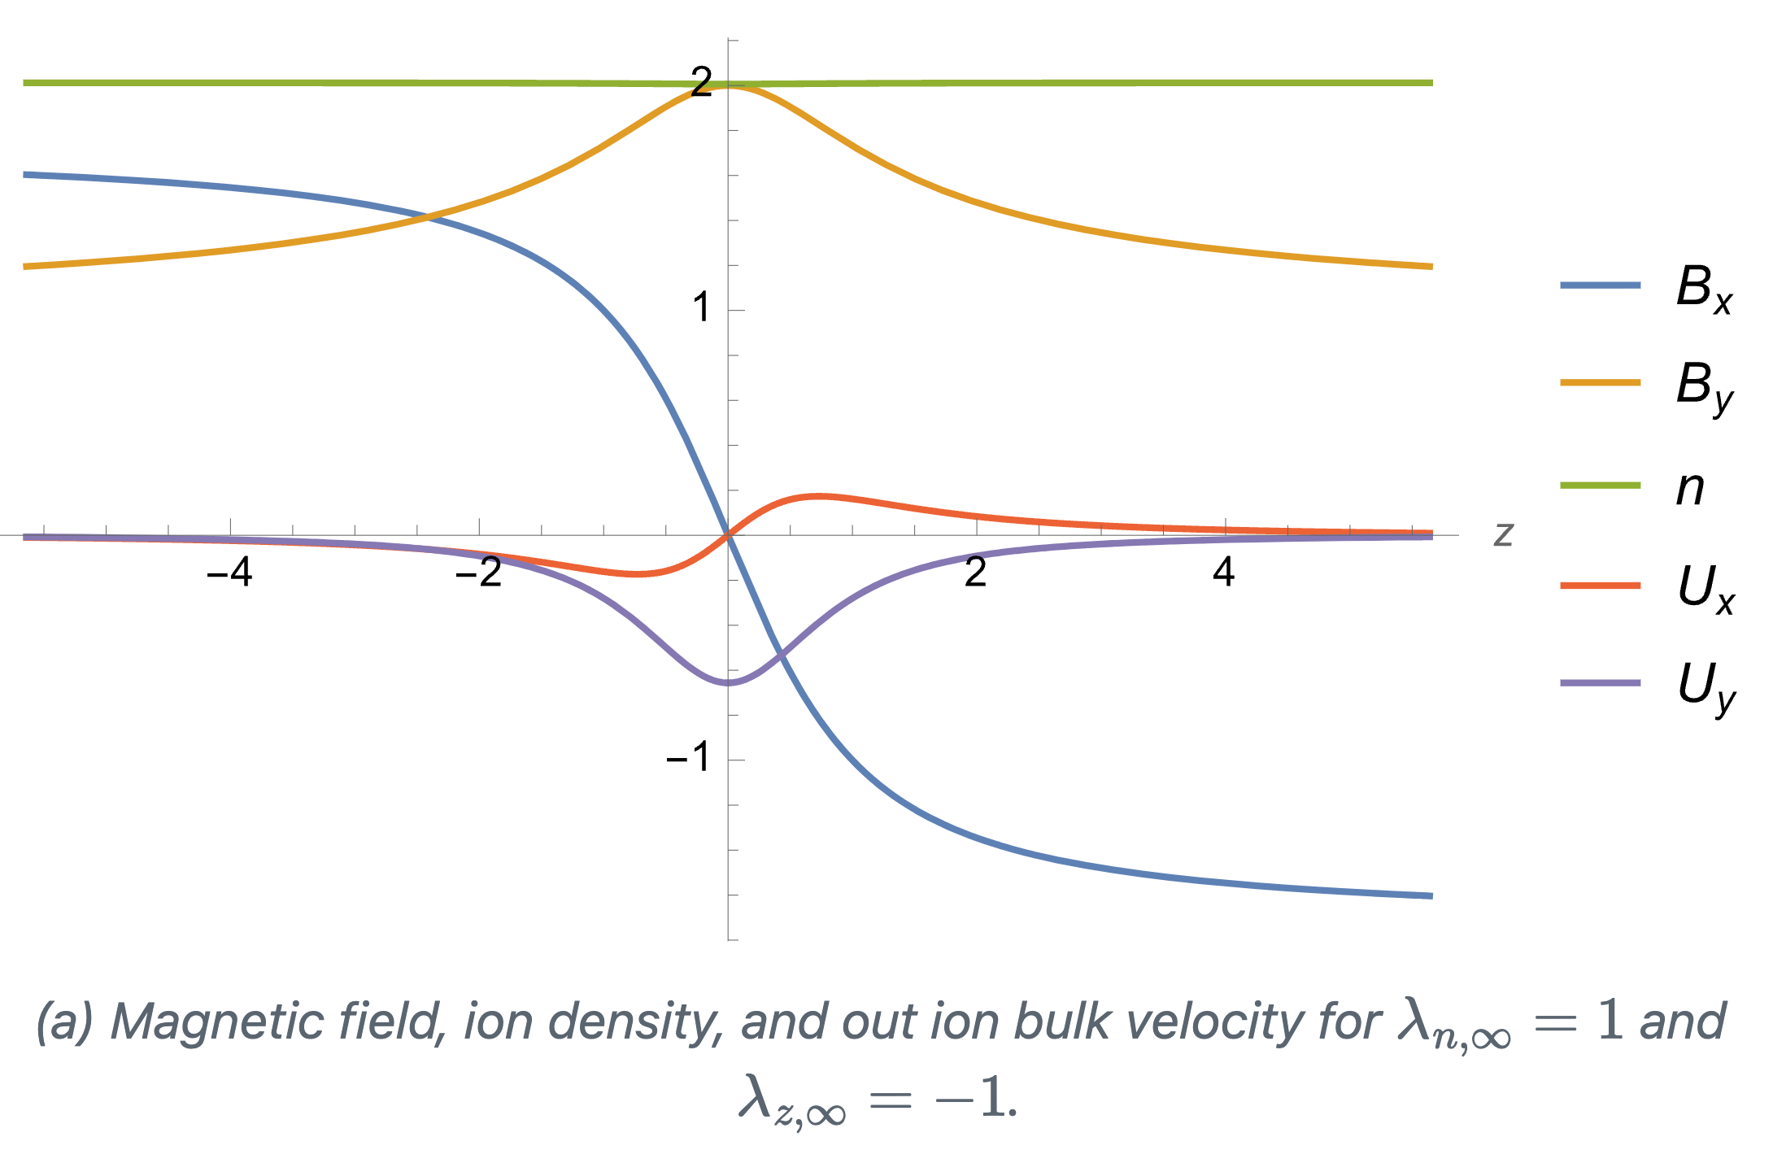

$$u_{αz}:=λ_{αz}u_{1z}$$
$$n_{α}:=λ_{αn}n_{1}$$

Slide 14
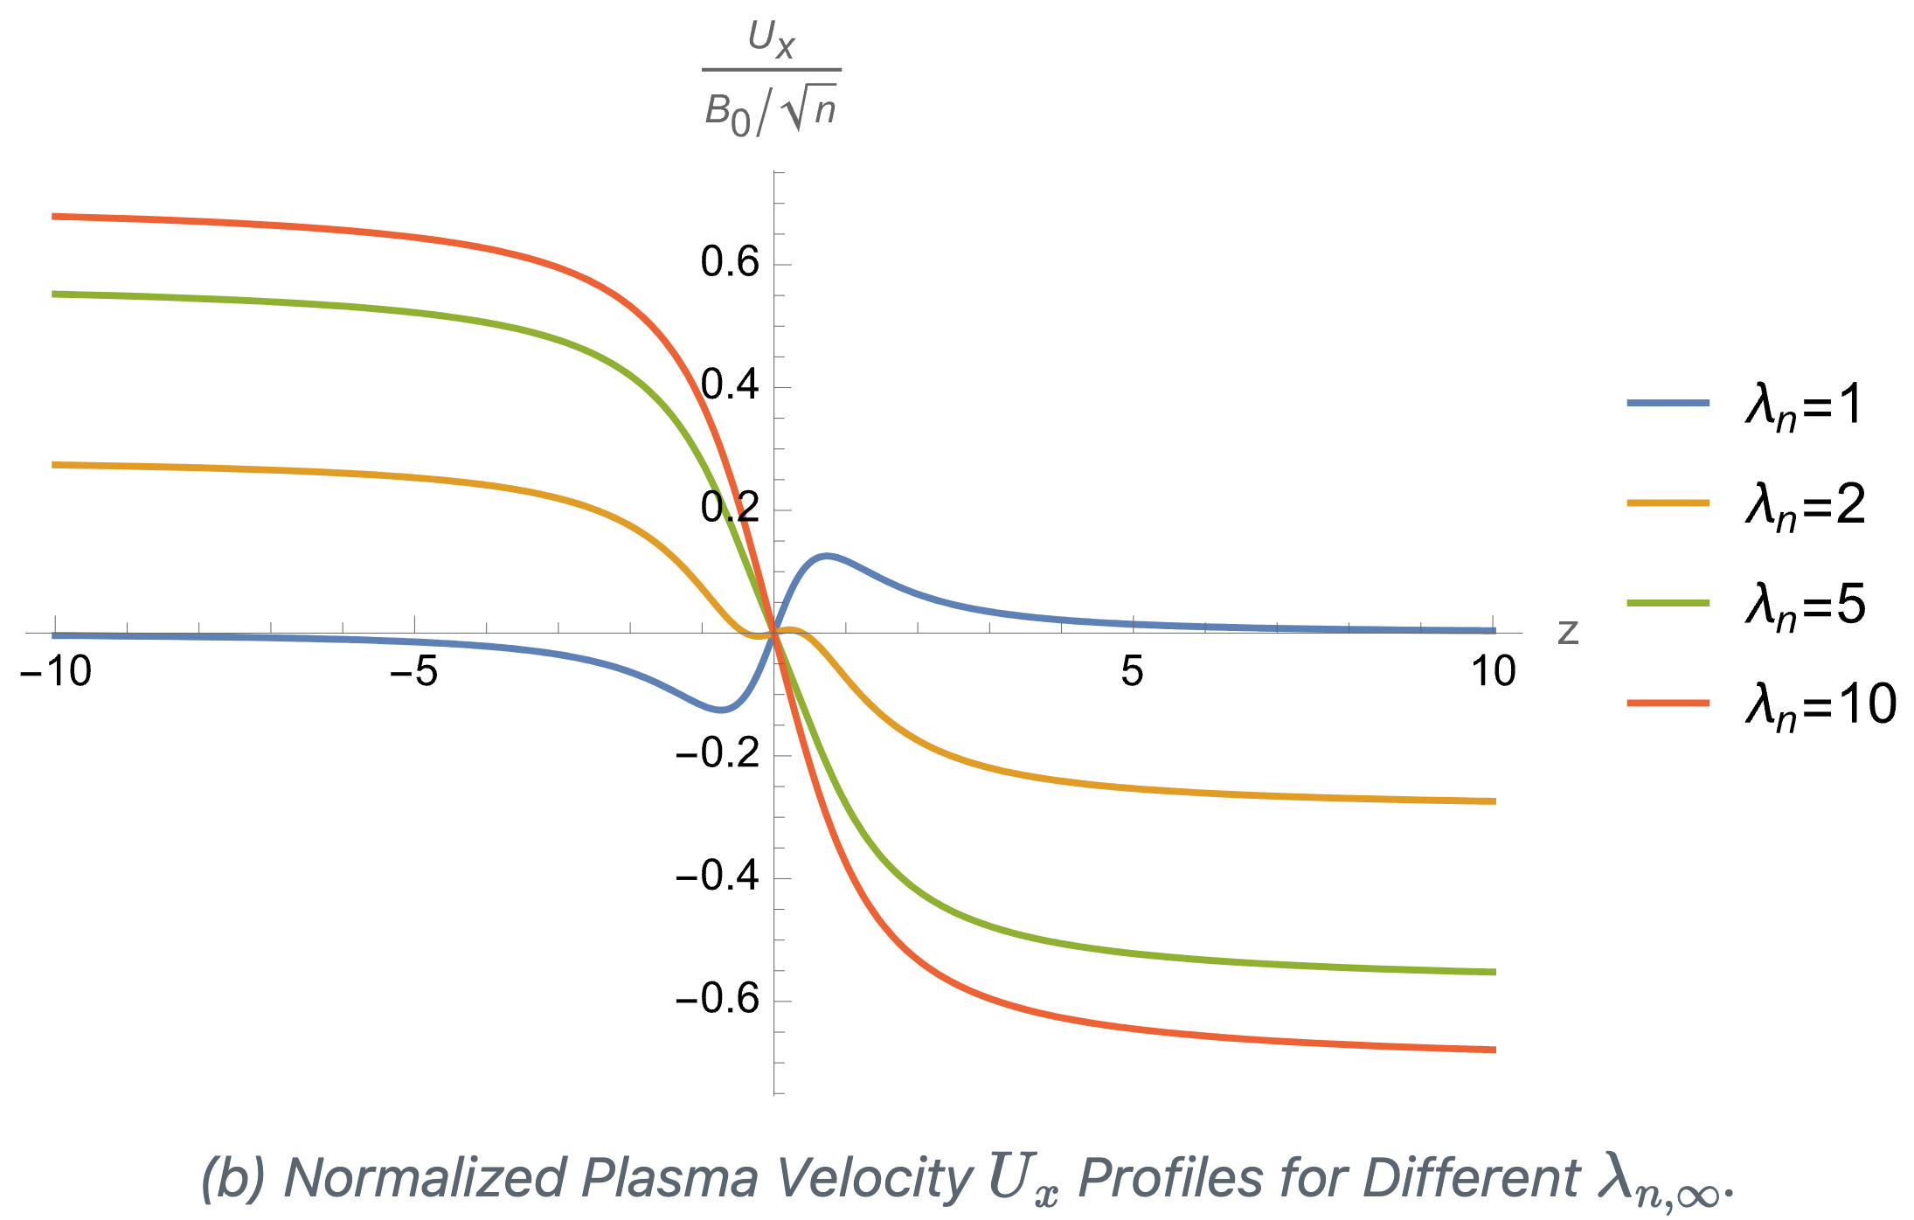
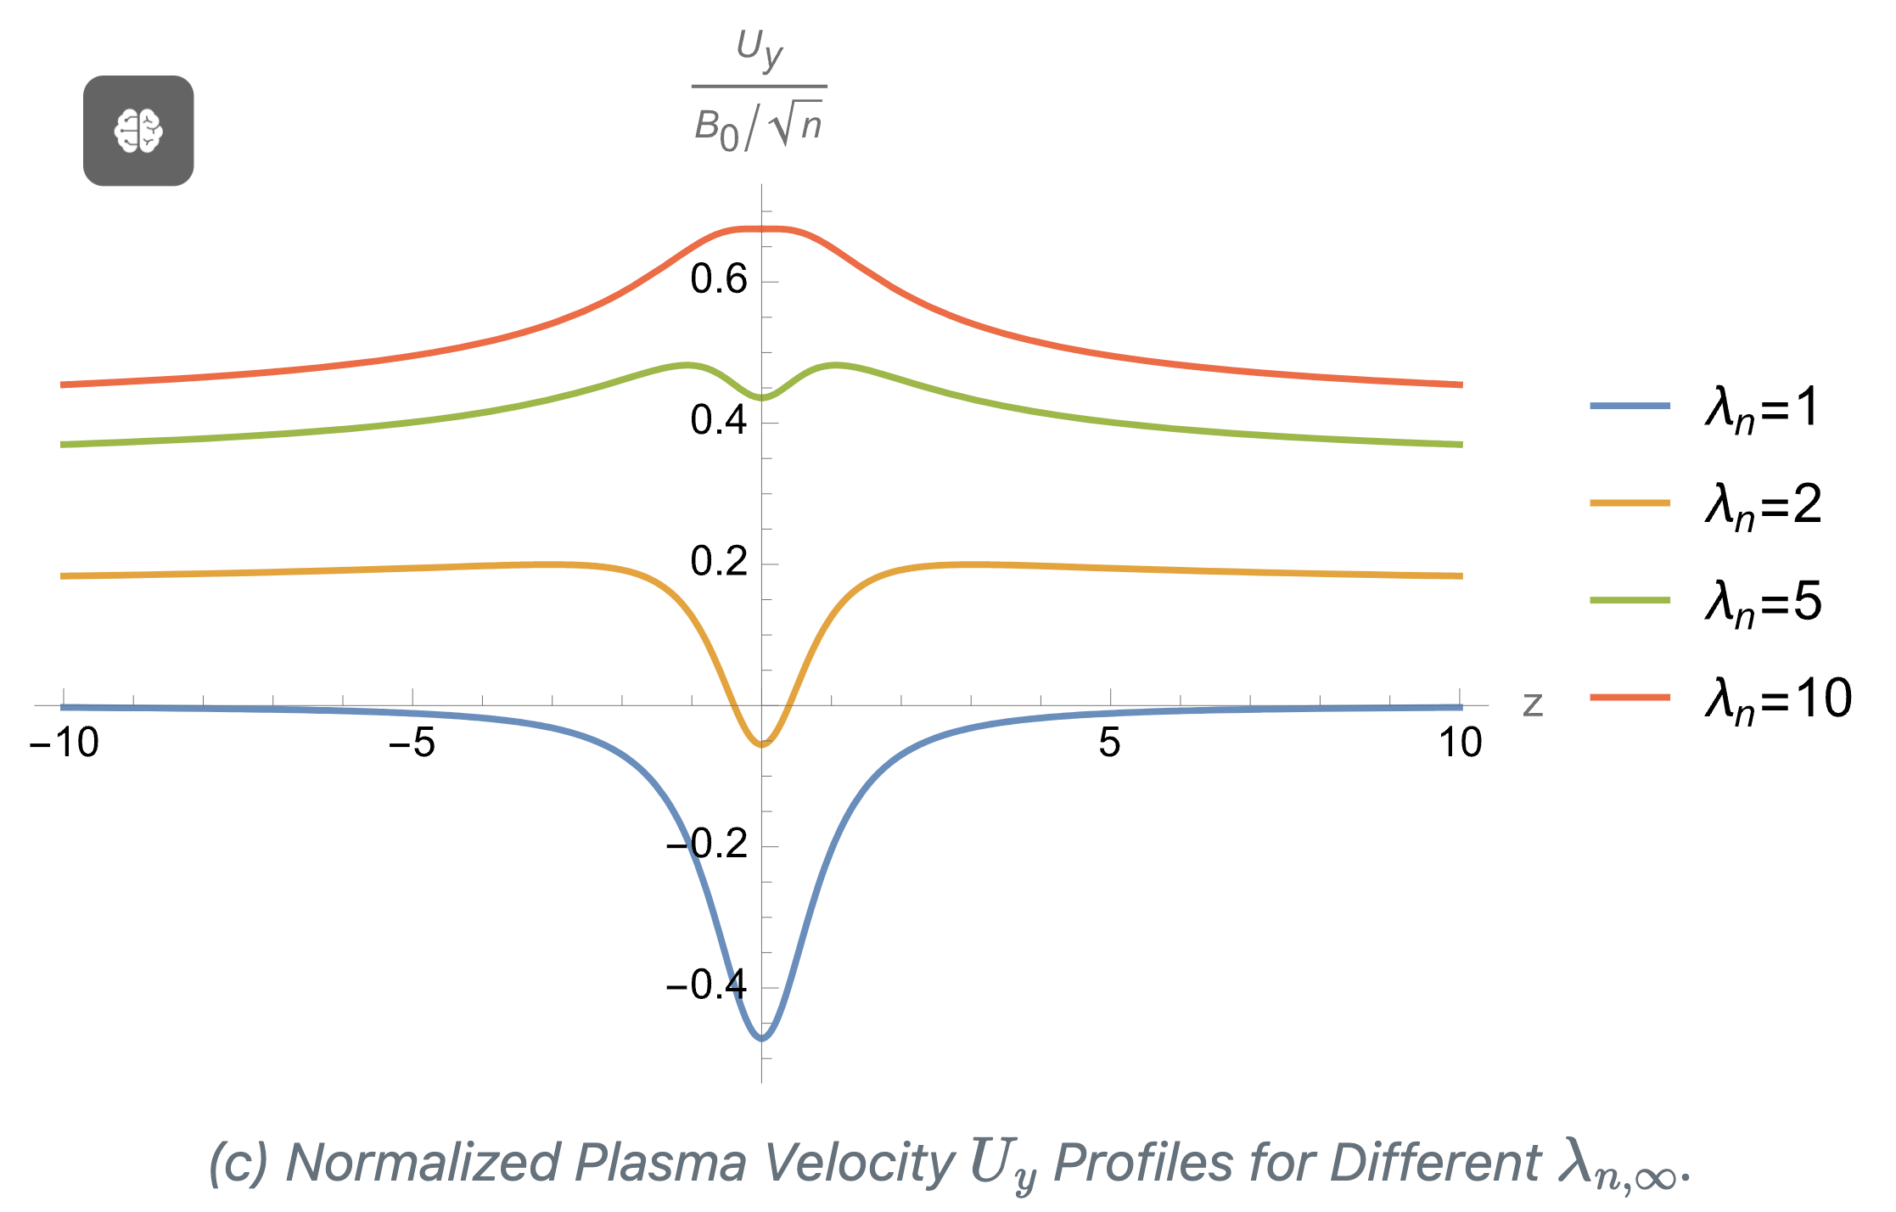

$$n_{α}:=λ_{αn}n_{1}$$

Slide 15
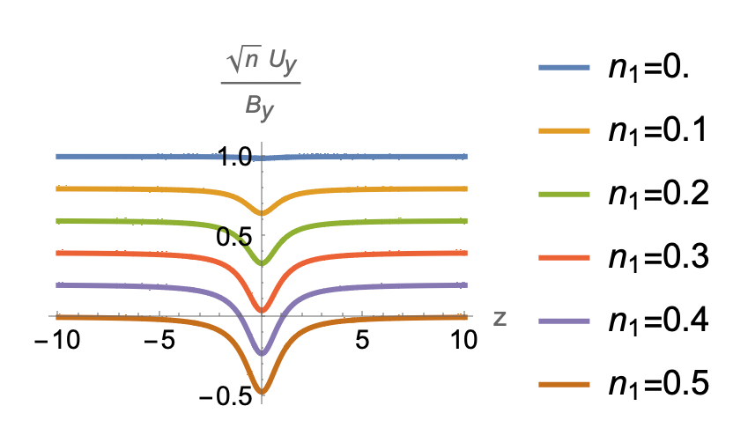
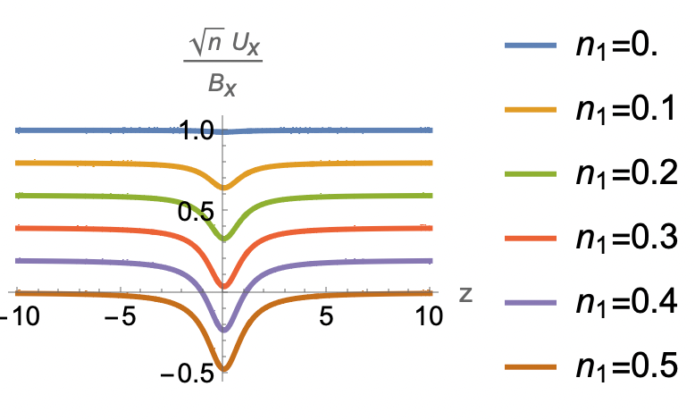

Slide 16
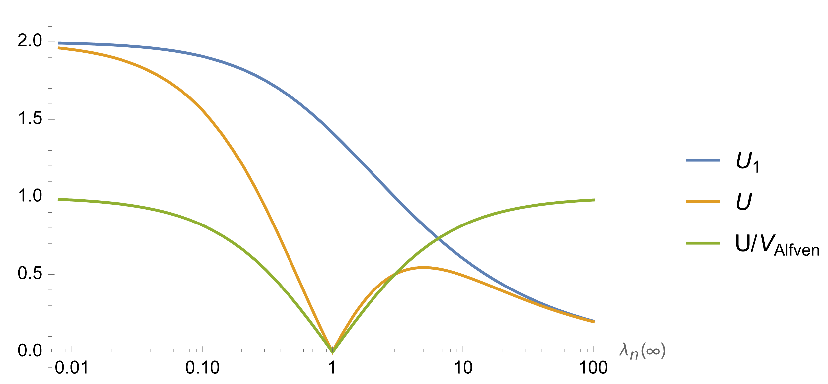

Asymptotic velocity
$$n_{α}:=λ_{αn}n_{1}$$

Slide 18
References

Slide 19
Steinhauer, McCarthy, and Whipple (2008)
Steinhauer, L. C., M. P. McCarthy, and E. C. Whipple. 2008. “Multifluid Model of a One-Dimensional Steady State Magnetotail Current Sheet.” Journal of Geophysical Research: Space Physics 113 (A4). https://doi.org/10.1029/2007JA012578.

