Slide 1
Multifluid model of a one-dimensional steady state force-free current sheet

Slide 2
Introduction

Slide 3
Motivation
In MHD theory, for rotational rotational discontinuity, we have this following relationship
$$\left[\left[\vec{U}\right]\right]={\left(\frac{ξρ}{μ_{0}}\right)}^{1/2}\left[\left[\frac{\vec{B}}{ρ}\right]\right]$$
where $ξ≡1−\frac{p_{∥}−p_{⊥}}{B^{2}/μ_{0}}$.

Slide 4
However, observations of solar wind discontinuities reveals discrepancies between
Alfven velocity and plasma velocity change across discontinuities
Anisotropic MHD theory-predicted and directly measured ion anisotropies
Multifluid theory is proposed to address these discrepancies. The basic idea is that we could have zero bulk velocity with non zero pressure.

Slide 5
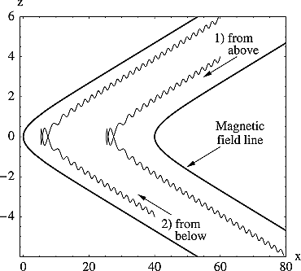
Previous Work
On the extreme of multiple fluid theory, we have the kinetic Harris model for the current sheet.
no normal field, $B_{z}=0$
uniform cross-tail drift velocity, $u_{y}$
vanishing particle density far from the sheet
Steinhauer, McCarthy, and Whipple (2008) built a multifluid model to study the steady state magnetotail current sheet.
Ion trajectories in model magnetic field.

Slide 6
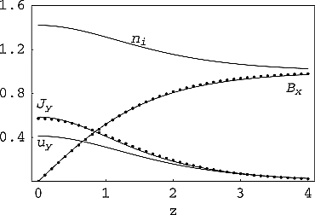
Here, we are interested in the case of a force-free current sheet and start from the simplest case of two ion species.
For the symmetric three-fluid system with $B_{y}=0$,
Magnetic field, current density, ion density and out-of-plane flow for Bz = 0.1, βe = 0.5, βi = 1. Solid lines are fluid model results and dot symbols are from the Harris sheet solution.

Slide 7
Plasma-Field Equations for a One-Dimensional Multifluid

Slide 8
Consider a collisionless, steady state plasma composed of multiple fluid groups, and follow the notation in Steinhauer, McCarthy, and Whipple (2008), we have $3N$ equations for $N$ ion species:
$$\begin{matrix}Γ_{α}\frac{du_{αx}}{dz} & =n_{α}u_{αy}B_{z}−Γ_{α}B_{y} \\ Γ_{α}\frac{du_{αy}}{dz} & =Γ_{α}B_{x}−n_{α}u_{αx}B_{z} \\ Γ_{α}\frac{du_{αz}}{dz} & =−\frac{1}{2}\frac{dp_{α}}{dz}−n_{α}\frac{dϕ}{dz}+n_{α}u_{αx}B_{y}−n_{α}u_{αy}B_{x}\end{matrix} \left(1\right)$$
Ampere’s law connects the fields and the flow components and note that electron motion is along the field lines $u_{e}=Γ_{e}B/\left(n_{e}B_{z}\right)$ :
dBy/dz=−Jx=−α​nαuαx+neuex=−nux+ΓeBx/Bz 2
dBx/dz=Jy=α​nαuαy−neuey=nuy−ΓeBy/Bz 3

Slide 9
This is a system of $3N+2$ equations for $4N+2$ unknown dependent variables: $B_{x}$, $B_{y}$, and $N$ each of $n$, $p$ $u_{x}$, and $u_{y}$.
$B_{z},Γ_{α}$ are constant.
Combine momentum equation (x) (Equation 1) and Ampere’s law (y) (Equation 3) with condition that the constant of integration vanishes at the current sheet center yield
$$B_{x}B_{z}=∑n_{α}u_{α,x}u_{α,z}=∑Γ_{α}u_{α,x}$$
With asymptotic condition that the derivative goes zero, from momentum equation we have
$${B_{z}}^{2}=∑Γ_{α}^{2}/n_{α}\left(∞\right) \left(4\right)$$
In the following, we will consider a system with two ion species.

Slide 10
Force-free current sheet

Slide 11
We are interested in solutions with $B_{x}^{2}+B_{y}^{2}=B_{0}^{2}=const$ (force-free current sheet). This provides another equation for the system, now we have 3*2+2+1=9 equations for 10 unknowns (the system is close to be fully determined). From Ampere’s law (Equation 2) and (Equation 3), we have:
$$n\left(u_{x}B_{y}−u_{y}B_{x}\right)=0$$
And $n_{1}u_{1x}B_{y}=n_{1}u_{1y}B_{x}+C_{1}$ and $n_{2}u_{2x}B_{y}=n_{2}u_{2y}B_{x}−C_{1}$. Assuming $C_{1}=0$, from first two equations in (Equation 1), we have:
$$u_{αx}^{2}+u_{αy}^{2}=const$$

Slide 12
Definition 1 Express the quantities of the second ion species relative to the first species
$$u_{αx}:=λ_{αx}u_{1x}, u_{αy}:=λ_{αy}u_{1y}, u_{αz}:=λ_{αz}u_{1z}, n_{α}:=λ_{αn}n_{1}$$
$$Λ_{x}:=1+∑λ_{αx}λ_{αn}, Λ_{y}:=1+∑λ_{αy}λ_{αn}, Λ_{z}:=∑1+λ_{αz}λ_{αn}$$
Notes
$Γ_{e}=\left(1+λ_{z}λ_{n}\right)Λ_{1}=Λ_{z}Γ_{1}$.
$Λ_{z}$ is constant while $Λ_{x},Λ_{y}$ are not.
Definition 2 Force-free condition let us express the magnetic field and velocity in terms of the angle $θ$:
$$B_{x}=B_{0}cosθ, B_{y}=B_{0}sinθ$$
$$u_{1x}=u_{1}cosθ_{1}, u_{1y}=u_{1}sinθ_{1}$$

Slide 13
$C_{1}=0$ immediately implies $θ=θ_{1}+kπ$ and $Λ_{x}=Λ_{y}$. #TODO: Prove $C_{1}=0$ is like a boundary condition not a equation.
The momentum equations (Equation 1) become:
$$−u_{1}sinθ_{1}θ_{1}′=n_{1}u_{1}sinθ_{1}B_{z}/Γ_{1}−B_{0}sinθ$$$$⇒θ′=−\frac{n_{1}B_{z}}{Γ_{1}}±\frac{B_{0}}{u_{1}} \left(5\right)$$
Note that $θ_{1},n_{1}$ are dependent variables, and $u_{1},B_{0},B_{z},Γ_{1}$ are constants determined by the system.
Given $n_{1}$, we could solve $θ_{1}$ from the above equation.
The derivative of $θ$ goes to zero at infinity, gives us a relation between $u_{1}$ and $B_{0}$:
$$u_{1}=±\frac{B_{0}Γ_{1}}{B_{z}n_{1}\left(∞\right)} \left(6\right)$$
The Ampere’s law (Equation 3) become:
$$−B_{0}sinθθ′=Λ_{y}n_{1}u_{1}sinθ_{1}−Λ_{z}Γ_{1}B_{0}sinθ/B_{z}$$
$$⇒θ′=∓\frac{Λ_{y}n_{1}u_{1}}{B_{0}}+\frac{Λ_{z}Γ_{1}}{B_{z}} \left(7\right)$$
By equating the above two equations, we could get a relation between $n_{1}$ and $Λ_{y}$:
$$Λ_{y}=Λ_{y}\left(n_{1}\right)=−\frac{B_{0}\left(−n_{1}u_{1}B_{z}^{2}+B_{0}Γ_{1}B_{z}−Γ_{1}^{2}u_{1}Λ_{z}\right)}{Γ_{1}n_{1}u_{1}^{2}B_{z}}$$

Slide 14
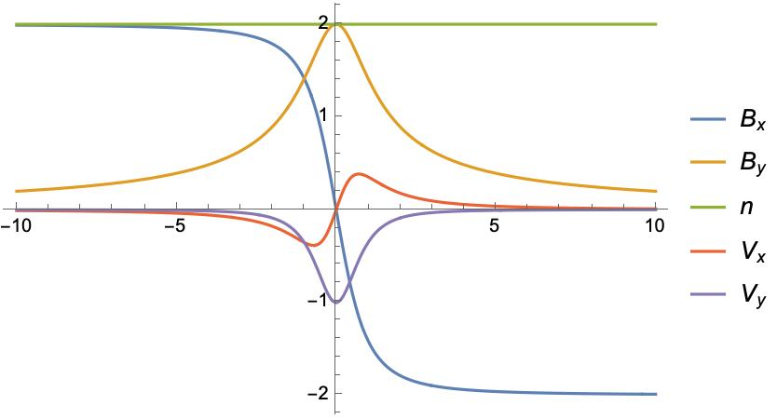
Solutions
Normalize the density by $n_{1}\left(z=∞\right)=1$ and the magnetic field by $B_{z}=1$.
The system $S$ could be fully determined by $λ_{n},λ_{z},B_{0}$ parameters, provided $n\left(z\right)$ profiles.
$$S=S\left(z;n\left(z\right);λ_{n},λ_{z},B_{0}\right)$$
Assuming density profile $n_{1}\left(z\right)→\frac{c}{{\left(\frac{z}{δ}\right)}^{2}+1}+1$
We have
$$\begin{matrix}φ\left(z\right) & →\frac{πΓ_{1}−2cδ\tan^{−1}\left(\frac{z}{δ}\right)}{2Γ_{1}} \\ B_{x} & →B_{0}cos\left(\frac{πΓ_{1}−2cδ\tan^{−1}\left(\frac{z}{δ}\right)}{2Γ_{1}}\right)\end{matrix}$$
For the simplest case $λ_{n}=1,λ_{z}=−1$, from Equation 4, we have $Γ_{1}=−B_{z}/\sqrt{2}$.
We could also normalize the system length by $δ=1$. So now the system could be fully determined by $c,B_{0}$.
Given $c=1/\sqrt{2}$, we have $B_{y}→0$ as $z→∞$. Profiles are plotted below for $B_{0}=2$.

Slide 15
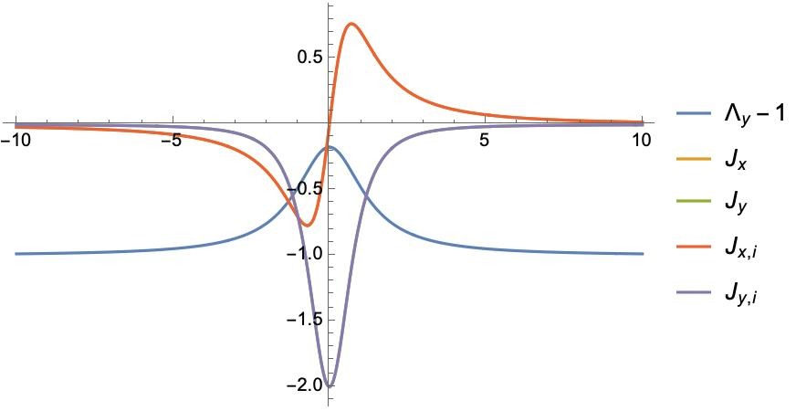

Slide 16
The multi-fluid effect is clearly demonstrated by $Λ_{y}−1$.
Manipulate[ Block[{B0 = B0i, c = ci}, p1 = Plot[ Evaluate[{n[z], Bx[z], By[z], u1x[z], u1y[z]} /. sols //. rulesn], {z, -zmax, zmax}, PlotLegends -> {n, Subscript[B, x], Subscript[B, y], Subscript[u, x], Subscript[u, y]} ]; Export["figures/profiles.jpg", p1]; p1 ], {{ci, 1/Sqrt[2]}, 0, 2}, {{B0i, 2}, 0.5, 2}, {{zmax, 10}, 5, 30} ] Manipulate[ Block[{B0 = B0i, c = ci, Λz = Λz0}, p = Plot[ Evaluate[{Λy - 1, Jxi, Jx, Jyi, Jy} /. sols //. rulesn], {z, -zmax, zmax}, PlotLegends -> {Subscript[Λ, y] - 1, Subscript[J, x, i], Subscript[J, x], Subscript[J, y, i], Subscript[J, y]}, PlotRange -> All]; Export["figures/J_profiles.jpg", p]; p ], {{ci, 1/Sqrt[2]}, 0, 2}, {{B0i, 2}, 0.5, 2}, {Λz0, 0, 1}, {{zmax, 10}, 5, 30} ]

Slide 17
References

Slide 18
Steinhauer, McCarthy, and Whipple (2008)
Steinhauer, L. C., M. P. McCarthy, and E. C. Whipple. 2008. “Multifluid Model of a One-Dimensional Steady State Magnetotail Current Sheet.” Journal of Geophysical Research: Space Physics 113 (A4). https://doi.org/10.1029/2007JA012578.

