Slide 1
Multifluid model of one-dimensional force-free current sheet equilibrium

Slide 3
Introduction

Slide 4
Classification of discontinuities
The ratio $R_{VB}$ is expected to equal unity for rotational discontinuity, but is arbitrary for tangential discontinuities.
$$R_{VB}=\frac{1}{\sqrt{A}}\frac{\left|ΔV\right|}{\left|ΔV_{A}\right|}$$
where $ΔV_{A}=Δ\frac{B}{\sqrt{μ_{0}ρ}}$ and the anisotropy factor A is defined as $A=1−\frac{p_{∥}−p_{⊥}}{B^{2}/μ_{0}}$.

Slide 5
Examples
Three examples of current sheets observed by Parker Solar Probe (PSP), ARTEMIS and Wind spacecraft with sub-Alfvenic flow velocity.

Slide 6
Force-free current sheets
Force-free current sheets are important for modelling low-$β$ plasmas in laboratory, space and astrophysical applications (Marsh 1996)
However, observations of current sheet reveals discrepancies between
Alfven velocity and plasma velocity change across current sheet
Anisotropic MHD theory-predicted and directly measured ion anisotropies

Slide 7
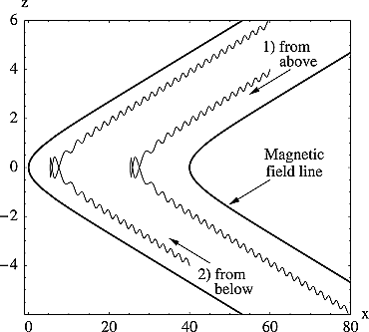
Theory - previous art
Multi-fluid model
A multi-fluid model is developed to estimate the ratio of $R_{VB}$ (Neugebauer et al. 1984). However no analytical solution is provided for the force-free current sheet.
RVB multistream =1Ai​ΔVi2ΔVi,A21/2
Ion trajectories in model magnetic field.

Slide 8
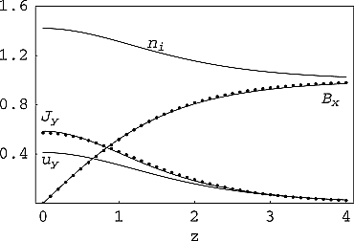
Steinhauer, McCarthy, and Whipple (2008)
Steinhauer, McCarthy, and Whipple (2008) built a multifluid model to study the steady state magnetotail current sheet.
For the symmetric three-fluid system with $B_{y}=0$. However, it is not force-free.
Magnetic field, current density, ion density and out-of-plane flow for Bz = 0.1, βe = 0.5, βi = 1. Solid lines are fluid model results and dot symbols are from the Harris sheet solution.

Slide 9
Vlasov equilibrium
A number of Vlasov-Maxwell distribution function have been found to describe force-free current sheet recently
$$\begin{matrix} & \frac{d^{2}A_{x}}{dz^{2}}=−μ_{0}\frac{∂P_{zz}}{∂A_{x}} \\ & \frac{d^{2}A_{y}}{dz^{2}}=−μ_{0}\frac{∂P_{zz}}{∂A_{y}}\end{matrix}$$
no normal field, $B_{z}=0$
Notes:
As has been shown before, the 1D VM equilibrium equations are equivalent to the motion of a pseudoparticle in a conservative pseudopotential, with the pseudopotential being proportional to one of the diagonal components of the plasma pressure tensor.

Slide 10
Plasma-Field Equations

Slide 11
Multi-fluid collisionless plasma model in a nutshell
The governing equations for the multi-fluid collisionless plasma model can be expressed in conservation law form as follows:
$$\left(\frac{∂}{∂t}+u_{α}·∇\right)n_{α}=−n_{α}∇·u_{α}$$
$$m_{α}n_{α}\left(\frac{∂}{∂t}+u_{α}·∇\right)u_{α}=−∇·P_{α}+q_{α}n_{α}\left(E+\frac{u_{α}×B}{c}\right)$$
$$∇×B=μ_{0}J \left(1\right)$$
$$∇·B=0$$
where $α$ indicates the particle species…

Slide 12
To much, let’s simplify
equilibrium solutions => $\frac{∂}{∂t}=0$
current sheet => magnetic field depends only on a single Cartesian coordinate, $z$
force-free condition => $B_{x}^{2}+B_{y}^{2}=B_{0}^{2}=\text{const}$
Additionally, we assume
background electron is massless => electrons follow the magnetic field lines $u_{e}×B=0$
ion populations are gyrotropic => eliminating any non-diagonal terms in the pressure tensor
To further simplify, we employ a dimensionless system by normalizing the variables with their asymptotic values:
magnetic field by $B_{\text{ref}}=B_{z}$
density by $n_{\text{ref}}=n\left(∞\right)$

Slide 13
After all the simplifications
Conservation of fluid mass integrates to a constant parameter $Γ_{α}=n_{α}u_{αz}$;
Gauss’s law gives another constant parameter $B_{z}=\text{const}$;
The momentum equations for each ion species are then given by:
$$\begin{matrix}Γ_{α}\frac{du_{αx}}{dz} & =n_{α}u_{αy}B_{z}−Γ_{α}B_{y} \\ Γ_{α}\frac{du_{αy}}{dz} & =Γ_{α}B_{x}−n_{α}u_{αx}B_{z} \\ Γ_{α}\frac{du_{αz}}{dz} & =−\frac{1}{2}\frac{dp_{α}}{dz}−n_{α}\frac{dϕ}{dz}+n_{α}u_{αx}B_{y}−n_{α}u_{αy}B_{x}\end{matrix} \left(2\right)$$
Ampere’s law connects the fields and the flow components and note that electron motion is along the field lines $u_{e}=Γ_{e}B/\left(n_{e}B_{z}\right)$ :
dBy/dz=−Jx=−α​nαuαx+neuex=−nux+ΓeBx/Bz 3
dBx/dz=Jy=α​nαuαy−neuey=nuy−ΓeBy/Bz 4

Slide 14
This is a system of $3N+2$ equations for $4N+2$ unknown dependent variables: $B_{x}$, $B_{y}$, and $N$ each of $n$, $p$ $u_{x}$, and $u_{y}$.
$B_{z},Γ_{α}$ are constant.
Combine momentum equation (x) (Equation 2) and Ampere’s law (y) (Equation 4) with condition that the constant of integration vanishes at the current sheet center yield
$$B_{x}B_{z}=∑n_{α}u_{α,x}u_{α,z}=∑Γ_{α}u_{α,x}$$
With asymptotic condition that the derivative goes zero, from momentum equation we have
$${B_{z}}^{2}=∑Γ_{α}^{2}/n_{α}\left(∞\right) \left(5\right)$$
In the following, we will consider a system with two ion species.

Slide 15
Force-free current sheet
We are interested in solutions with $B_{x}^{2}+B_{y}^{2}=B_{0}^{2}=const$ (force-free current sheet). This provides another equation for the system, now we have 3*2+2+1=9 equations for 10 unknowns (the system is close to be fully determined). From Ampere’s law (Equation 3) and (Equation 4), we have:
$$n\left(u_{x}B_{y}−u_{y}B_{x}\right)=0$$
And $n_{1}u_{1x}B_{y}=n_{1}u_{1y}B_{x}+C_{1}$ and $n_{2}u_{2x}B_{y}=n_{2}u_{2y}B_{x}−C_{1}$. Assuming $C_{1}=0$, from first two equations in (Equation 2), we have:
$$u_{αx}^{2}+u_{αy}^{2}=const$$

Slide 16
Definition 1 Force-free condition let us express the magnetic field and velocity in terms of the angle $θ$:
$$B_{x}=B_{0}cosθ, B_{y}=B_{0}sinθ$$
$$u_{1x}=u_{1}cosθ_{1}, u_{1y}=u_{1}sinθ_{1}$$

Slide 17
The first momentum equation (Equation 2) after substituting the above expression becomes:
$$−u_{α}sinθ_{α}θ_{α}′=n_{α}u_{α}sinθ_{α}B_{z}/Γ_{α}−B_{0}sinθ$$
$$⇒θ_{α}′=−\frac{n_{α}B_{z}}{Γ_{α}}+\frac{B_{0}}{u_{α}} \left(6\right)$$
Note that $θ_{α},n_{α}$ are dependent variables, and $u_{α},B_{0},B_{z},Γ_{α}$ are constants determined by the system.
So given the profile of $n_{α}$, we could solve the above equation to get the profile of $θ_{α}$, thus the profile of $u_{α}$.
The derivative of $θ$ goes to zero at infinity, gives us a relation between $u_{α}$ and $B_{0}$:
$$u_{α}=±\frac{B_{0}Γ_{α}}{B_{z}n_{α}\left(∞\right)} \left(7\right)$$
The Ampere’s law (Equation 4) become:
$$−B_{0}sinθθ′=∑n_{α}u_{α}sinθ_{α}−Γ_{e}B_{0}sinθ/B_{z}$$
$$⇒θ′=−\frac{∑n_{α}u_{α}}{B_{0}}+\frac{Γ_{e}}{B_{z}} \left(8\right)$$
The above equation relates the rotation angle $θ$ to the plasma bulk velocity $nu≡∑n_{α}u_{α}$. By equating the above two equations of $θ′$, we could get a equation relating the plasma bulk velocity to one specific species:
$$nu=B_{0}\left(\frac{Γ_{e}}{B_{z}}+\frac{n_{α}B_{z}}{Γ_{α}}−\frac{B_{0}}{u_{α}}\right)$$

Slide 18
Solutions
The system $S$ could be fully determined by $λ_{n},λ_{z},B_{0}$ parameters, provided $n\left(z\right)$ profiles.
$$S=S\left(z;n\left(z\right);λ_{n},λ_{z},B_{0}\right)$$
Assuming density profile
$$n_{1}\left(z\right)→n_{1}\left(∞\right)+\frac{κΓ_{1}}{1+{\left(z/L\right)}^{2}}$$
Solving the ?@eq-theta1-asym analytically, we have the rotation angle profile as
$$θ\left(z\right)→\frac{π}{2}−κLB_{z}\tan^{−1}\left(\frac{z}{L}\right)$$

Slide 19
Beutiful moment - solutions
In dimensionless form
Bxz=B0sinκLBztan−1zLByz=B0cosκLBztan−1zLnz=n∞+κα​Γα1+z/L2Jxz=κB0Bz1+z/L2sinκLBztan−1zLJyz=κB0Bz1+z/L2cosκLBztan−1zL
In physical units
Bxz=B0sinκLditan−1zLByz=B0cosκLditan−1zLnz=n∞+κVAα​Γα1+z/L2Jxz=κB0μ0di11+z/L2sinκLditan−1zLJyz=κB0μ0di11+z/L2cosκLditan−1zL

Slide 20
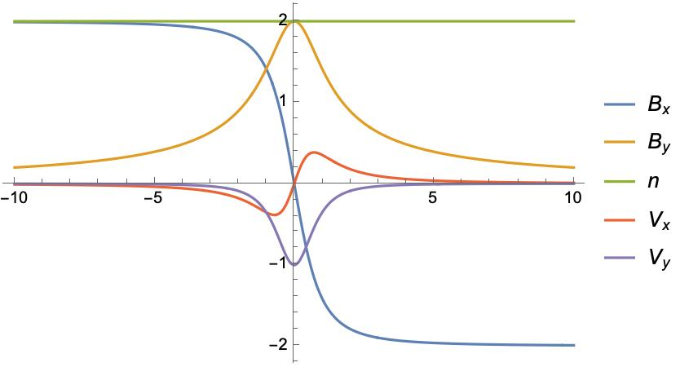
For the simplest case $λ_{n}=1,λ_{z}=−1$, from Equation 5, we have $Γ_{1}=−B_{z}/\sqrt{2}$.
We could also normalize the system length by $δ=1$. So now the system could be fully determined by $c,B_{0}$.
Given $c=1/\sqrt{2}$, we have $B_{y}→0$ as $z→∞$. Profiles are plotted below for $B_{0}=2$.

Slide 22
The multi-fluid effect is clearly demonstrated by $Λ_{y}−1$.
For the same asymptotic magnetic field, it is interesting to see how the plasma profiles change with different system parameters.
$$\text{cond}\left(n\left(z\right),λ_{n,∞},λ_{z,∞}\right)=0$$
Here we set $B_{y}\left(z=∞\right)=1/2B_{y}\left(z=0\right)$ and $B_{0}=2B_{z}$, and fix $λ_{z,∞}=−1$. By varying $λ_{n,∞}$, we find that the magnetic field profiles are exactly the same, while plasma velocity profiles vary. We normalize the plasma velocity by asympotic Alfvén velocity $v_{A,∞}=B_{0}/\sqrt{n}$, and the profiles are plotted below Figure 3. It could be seen that for $λ_{n,∞}=1$, we have zero bulk velocity change across the current sheet in the asymptotic limit.

Slide 23
Symetric case
Figure 1

Slide 24
Figure 2

Slide 25
(a). Magnetic field, ion density, and ion bulk velocity for $n_{1}=n_{2},u_{1}=−u_{2}$ and $δ_{1}=1,c_{1}=1,B_{0}=2$. (b). Current density profiles for the same case.

Slide 26
Asymetric case

Slide 28
Same as ?@fig-profiles, but for two ion species with same bulk velocity but different densities $n_{1}\left(∞\right)=0.6$ and $B_{y}\left(z=∞\right)=1/2B_{0}$.

Slide 29
Figure 3: Plasma velocity $U_{x}$ profiles normalized by aysmpotic Alfvén velocity for different $n_{1}\left(∞\right)$.

Slide 30
Figure 4: Plasma velocity $U_{y}$ profiles normalized by aysmpotic Alfvén velocity for different $n_{1}\left(∞\right)$.

Slide 31
Figure 5: Plasma velocity $U_{x}$ profiles normalized by $v_{A,x}$ for different $n_{1}\left(∞\right)$.

Slide 32
Figure 6: Plasma velocity $U_{y}$ profiles normalized by $v_{A,y}$ for different $n_{1}\left(∞\right)$.

Slide 33
Figure 7

Slide 34
Figure 8

Slide 35
Asymptotic velocity for each species, bulk velocity and normalized one by Alfvén velocity for the case of $u_{1,z}=−u_{2,z}$ (a) and $u_{1,z}=−2u_{2,z}$ (b).
Marsh, G E. 1996. Force-Free Magnetic Fields: Solutions, Topology and Applications. WORLD SCIENTIFIC. https://doi.org/10.1142/2965.
Neugebauer, M., D. R. Clay, B. E. Goldstein, B. T. Tsurutani, and R. D. Zwickl. 1984. “A Reexamination of Rotational and Tangential Discontinuities in the Solar Wind.” Journal of Geophysical Research: Space Physics 89 (A7): 5395–5408. https://doi.org/10.1029/JA089iA07p05395.
Steinhauer, L. C., M. P. McCarthy, and E. C. Whipple. 2008. “Multifluid Model of a One-Dimensional Steady State Magnetotail Current Sheet.” Journal of Geophysical Research: Space Physics 113 (A4). https://doi.org/10.1029/2007JA012578.

