Slide 1
Multifluid model of a one-dimensional steady state force-free current sheet

Slide 2
Introduction

Slide 3
Motivation
In MHD theory, for rotational rotational discontinuity, we have this following relationship
$$\left[\left[\vec{U}\right]\right]={\left(\frac{ξρ}{μ_{0}}\right)}^{1/2}\left[\left[\frac{\vec{B}}{ρ}\right]\right]$$
where $ξ≡1−\frac{p_{∥}−p_{⊥}}{B^{2}/μ_{0}}$.

Slide 4
However, observations of solar wind discontinuities reveals discrepancies between
Alfven velocity and plasma velocity change across discontinuities
Anisotropic MHD theory-predicted and directly measured ion anisotropies
Multifluid theory is proposed to address these discrepancies. The basic idea is that we could have zero bulk velocity with non zero pressure.
MHD in a nutshell
$$\begin{matrix} & \frac{∂ρ}{∂t}+\left(\vec{V}⋅∇\right)ρ+ρ∇⋅\vec{V}=0 \\ & ρ\left[\frac{∂\vec{V}}{∂t}+\left(\vec{V}⋅∇\right)\vec{V}\right]+∇p=\vec{J}×\vec{B} \\ & p=αρ^{γ} \\ & ∇×\vec{B}=μ_{0}\vec{J} \\ & \frac{∂\vec{B}}{∂t}=∇×\left(\vec{V}×\vec{B}\right)\end{matrix}$$

Slide 5
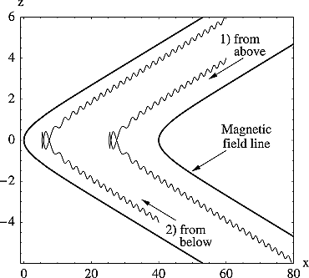
Previous Work
On the extreme of multiple fluid theory, we have the kinetic Harris model for the current sheet.
no normal field, $B_{z}=0$
uniform cross-tail drift velocity, $u_{y}$
vanishing particle density far from the sheet
Steinhauer, McCarthy, and Whipple (2008) built a multifluid model to study the steady state magnetotail current sheet.
Ion trajectories in model magnetic field.

Slide 6
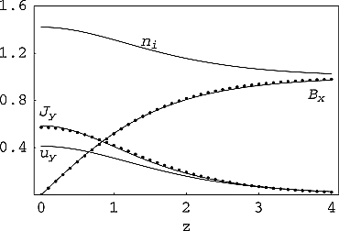
Here, we are interested in the case of a force-free current sheet and start from the simplest case of two ion species.
For the symmetric three-fluid system with $B_{y}=0$,
Magnetic field, current density, ion density and out-of-plane flow for Bz = 0.1, βe = 0.5, βi = 1. Solid lines are fluid model results and dot symbols are from the Harris sheet solution.

Slide 7
Plasma-Field Equations for a One-Dimensional Multifluid

Slide 8
Consider a collisionless, steady state plasma composed of multiple fluid groups, and follow the notation in Steinhauer, McCarthy, and Whipple (2008), we have $3N$ equations for $N$ ion species:
$$\begin{matrix}Γ_{α}\frac{du_{αx}}{dz} & =n_{α}u_{αy}B_{z}−Γ_{α}B_{y} \\ Γ_{α}\frac{du_{αy}}{dz} & =Γ_{α}B_{x}−n_{α}u_{αx}B_{z} \\ Γ_{α}\frac{du_{αz}}{dz} & =−\frac{1}{2}\frac{dp_{α}}{dz}−n_{α}\frac{dϕ}{dz}+n_{α}u_{αx}B_{y}−n_{α}u_{αy}B_{x}\end{matrix} \left(1\right)$$
Ampere’s law connects the fields and the flow components and note that electron motion is along the field lines $u_{e}=Γ_{e}B/\left(n_{e}B_{z}\right)$ :
dBy/dz=−Jx=−α​nαuαx+neuex=−nux+ΓeBx/Bz 2
dBx/dz=Jy=α​nαuαy−neuey=nuy−ΓeBy/Bz 3

Slide 9
This is a system of $3N+2$ equations for $4N+2$ unknown dependent variables: $B_{x}$, $B_{y}$, and $N$ each of $n$, $p$ $u_{x}$, and $u_{y}$.
$B_{z},Γ_{α}$ are constant.
Combine momentum equation (x) (Equation 1) and Ampere’s law (y) (Equation 3) with condition that the constant of integration vanishes at the current sheet center yield
$$B_{x}B_{z}=∑n_{α}u_{α,x}u_{α,z}=∑Γ_{α}u_{α,x}$$
With asymptotic condition that the derivative goes zero, from momentum equation we have
$${B_{z}}^{2}=∑Γ_{α}^{2}/n_{α}\left(∞\right) \left(4\right)$$
In the following, we will consider a system with two ion species.

Slide 10
Force-free current sheet

Slide 11
We are interested in solutions with $B_{x}^{2}+B_{y}^{2}=B_{0}^{2}=const$ (force-free current sheet). This provides another equation for the system, now we have 3*2+2+1=9 equations for 10 unknowns (the system is close to be fully determined). From Ampere’s law (Equation 2) and (Equation 3), we have:
$$n\left(u_{x}B_{y}−u_{y}B_{x}\right)=0$$
And $n_{1}u_{1x}B_{y}=n_{1}u_{1y}B_{x}+C_{1}$ and $n_{2}u_{2x}B_{y}=n_{2}u_{2y}B_{x}−C_{1}$. Assuming $C_{1}=0$, from first two equations in (Equation 1), we have:
$$u_{αx}^{2}+u_{αy}^{2}=const$$

Slide 12
Definition 1 Express the quantities of the second ion species relative to the first species
$$u_{αx}:=λ_{αx}u_{1x}, u_{αy}:=λ_{αy}u_{1y}, u_{αz}:=λ_{αz}u_{1z}, n_{α}:=λ_{αn}n_{1}$$
$$Λ_{x}:=1+∑λ_{αx}λ_{αn}, Λ_{y}:=1+∑λ_{αy}λ_{αn}, Λ_{z}:=∑1+λ_{αz}λ_{αn}$$
Notes
$Γ_{e}=\left(1+λ_{z}λ_{n}\right)Λ_{1}=Λ_{z}Γ_{1}$.
$Λ_{z}$ is constant while $Λ_{x},Λ_{y}$ are not.
Definition 2 Force-free condition let us express the magnetic field and velocity in terms of the angle $θ$:
$$B_{x}=B_{0}cosθ, B_{y}=B_{0}sinθ$$
$$u_{1x}=u_{1}cosθ_{1}, u_{1y}=u_{1}sinθ_{1}$$

Slide 13
$C_{1}=0$ immediately implies $θ=θ_{1}+kπ$ and $Λ_{x}=Λ_{y}$. #TODO: Prove $C_{1}=0$ is like a boundary condition not a equation.
The first momentum equation (Equation 1) after substituting the above expression becomes:
$$−u_{α}sinθ_{α}θ_{α}′=n_{α}u_{α}sinθ_{α}B_{z}/Γ_{α}−B_{0}sinθ$$
$$⇒θ_{α}′=−\frac{n_{α}B_{z}}{Γ_{α}}±\frac{B_{0}}{u_{α}} \left(5\right)$$
Note that $θ_{α},n_{α}$ are dependent variables, and $u_{α},B_{0},B_{z},Γ_{α}$ are constants determined by the system.
So given the profile of $n_{α}$, we could solve the above equation to get the profile of $θ_{α}$, thus the profile of $u_{α}$.
The derivative of $θ$ goes to zero at infinity, gives us a relation between $u_{1}$ and $B_{0}$:
$$u_{1}=±\frac{B_{0}Γ_{1}}{B_{z}n_{1}\left(∞\right)} \left(6\right)$$
The Ampere’s law (Equation 3) become:
$$−B_{0}sinθθ′=Λ_{y}n_{1}u_{1}sinθ_{1}−Λ_{z}Γ_{1}B_{0}sinθ/B_{z}$$
$$⇒θ′=∓\frac{Λ_{y}n_{1}u_{1}}{B_{0}}+\frac{Λ_{z}Γ_{1}}{B_{z}} \left(7\right)$$
By equating the above two equations, we could get a relation between $n_{1}$ and $Λ_{y}$:
$$Λ_{y}=Λ_{y}\left(n_{1}\right)=−\frac{B_{0}\left(−n_{1}u_{1}B_{z}^{2}+B_{0}Γ_{1}B_{z}−Γ_{1}^{2}u_{1}Λ_{z}\right)}{Γ_{1}n_{1}u_{1}^{2}B_{z}}$$

Slide 14
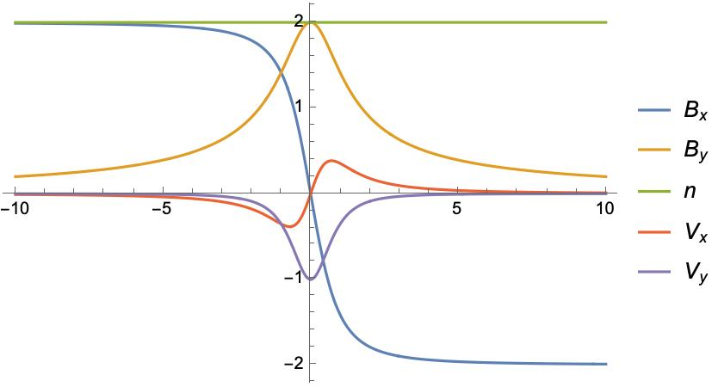
Solutions
Normalize the density by $n_{1}\left(z=∞\right)=1$ and the magnetic field by $B_{z}=1$.
The system $S$ could be fully determined by $λ_{n},λ_{z},B_{0}$ parameters, provided $n\left(z\right)$ profiles.
$$S=S\left(z;n\left(z\right);λ_{n},λ_{z},B_{0}\right)$$
Assuming density profile $n_{1}\left(z\right)→\frac{c}{{\left(\frac{z}{δ}\right)}^{2}+1}+1$
We have
$$\begin{matrix}φ\left(z\right) & →\frac{πΓ_{1}−2cδ\tan^{−1}\left(\frac{z}{δ}\right)}{2Γ_{1}} \\ B_{x} & →B_{0}cos\left(\frac{πΓ_{1}−2cδ\tan^{−1}\left(\frac{z}{δ}\right)}{2Γ_{1}}\right)\end{matrix}$$
For the simplest case $λ_{n}=1,λ_{z}=−1$, from Equation 4, we have $Γ_{1}=−B_{z}/\sqrt{2}$.
We could also normalize the system length by $δ=1$. So now the system could be fully determined by $c,B_{0}$.
Given $c=1/\sqrt{2}$, we have $B_{y}→0$ as $z→∞$. Profiles are plotted below for $B_{0}=2$.

Slide 15
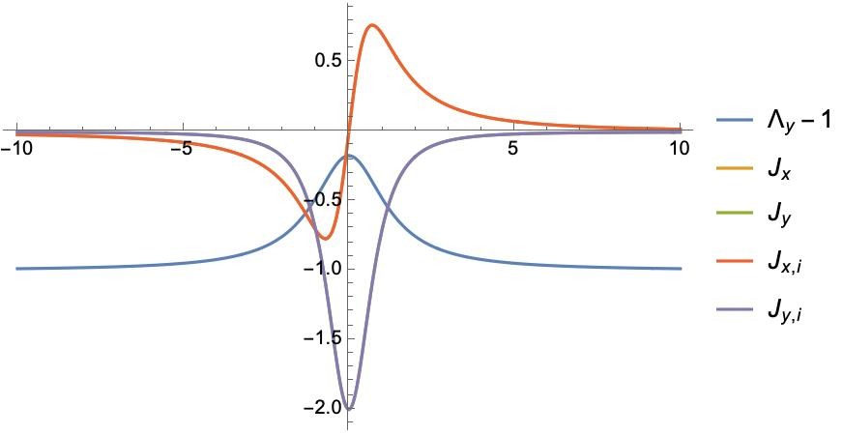

Slide 16
The multi-fluid effect is clearly demonstrated by $Λ_{y}−1$.
Manipulate[ Block[{B0 = B0i, c = ci}, p1 = Plot[ Evaluate[{n[z], Bx[z], By[z], u1x[z], u1y[z]} /. sols //. rulesn], {z, -zmax, zmax}, PlotLegends -> {n, Subscript[B, x], Subscript[B, y], Subscript[u, x], Subscript[u, y]} ]; Export["figures/profiles.jpg", p1]; p1 ], {{ci, 1/Sqrt[2]}, 0, 2}, {{B0i, 2}, 0.5, 2}, {{zmax, 10}, 5, 30} ] Manipulate[ Block[{B0 = B0i, c = ci, Λz = Λz0}, p = Plot[ Evaluate[{Λy - 1, Jxi, Jx, Jyi, Jy} /. sols //. rulesn], {z, -zmax, zmax}, PlotLegends -> {Subscript[Λ, y] - 1, Subscript[J, x, i], Subscript[J, x], Subscript[J, y, i], Subscript[J, y]}, PlotRange -> All]; Export["figures/J_profiles.jpg", p]; p ], {{ci, 1/Sqrt[2]}, 0, 2}, {{B0i, 2}, 0.5, 2}, {Λz0, 0, 1}, {{zmax, 10}, 5, 30} ]
For the same asymptotic magnetic field, it is interesting to see how the plasma profiles change with different system parameters.
$$\text{cond}\left(n\left(z\right),λ_{n,∞},λ_{z,∞}\right)=0$$
Here we set $B_{y}\left(z=∞\right)=1/2B_{y}\left(z=0\right)$ and $B_{0}=2B_{z}$, and fix $λ_{z,∞}=−1$. By varying $λ_{n,∞}$, we find that the magnetic field profiles are exactly the same, while plasma velocity profiles vary. We normalize the plasma velocity by asympotic Alfvén velocity $v_{A,∞}=B_{0}/\sqrt{n}$, and the profiles are plotted below Figure 1 (b). It could be seen that for $λ_{n,∞}=1$, we have zero bulk velocity change across the current sheet in the asymptotic limit.

Slide 17
Different normalization

Slide 18
Normalized the quantities of the ion species
$$ n_α := λ_{αn} n_e \\ u_{αx} := λ_{αu} B_z / \sqrt{n_{e,\infty}} \\ u_{αy} := λ_{αu} B_z / \sqrt{n_{e,\infty}} \\ u_{αz} := λ_{αu} B_z / \sqrt{n_{e,\infty}} $$
$$θ′=∓\frac{Λ_{u}}{B_{0}}+Γ_{e}$$
conf = {ratio -> 1/2} TextString[conf] <!-- Convert a dict-like configuration to a string --> saveName[c_] := StringJoin[ToString /@ c]
Steinhauer, L. C., M. P. McCarthy, and E. C. Whipple. 2008. “Multifluid Model of a One-Dimensional Steady State Magnetotail Current Sheet.” Journal of Geophysical Research: Space Physics 113 (A4). https://doi.org/10.1029/2007JA012578.

