Slide 1
Energetic particle transport by solar wind current sheets
Pitch-angle scattering and spatial transport Zijin Zhang Anton V. Artemyev Vassilis Angelopoulos

Slide 2
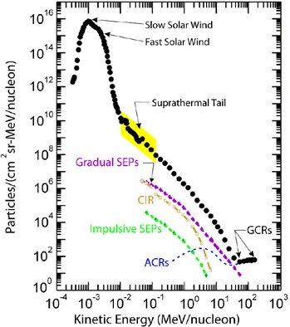
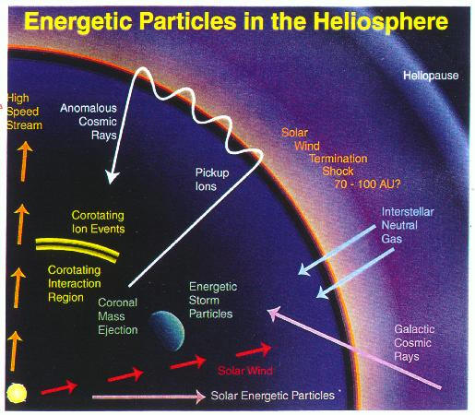
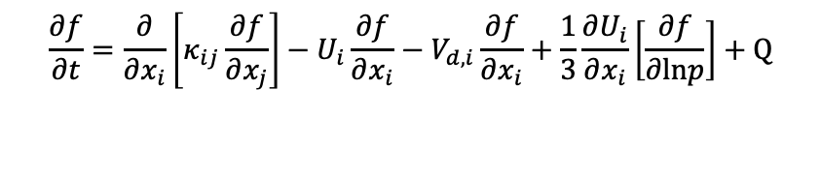
Understanding how energetic particles are transported in the heliosphere (and accelerated) remains one of the central problems in space physics & astrophysics. Despite decades of research, many long-standing questions persist.
(Parker 1965)
$$\frac{∂f}{∂t}=\frac{∂}{∂x_{i}}\left[κ_{ij}\frac{∂f}{∂x_{j}}\right]−U_{i}\frac{∂f}{∂x_{i}}−V_{d,i}\frac{∂f}{∂x_{i}}+\frac{1}{3}\frac{∂U_{i}}{∂x_{i}}\left[\frac{∂f}{∂lnp}\right]+Q$$
Four main transport processes:
spatial diffusion, advection, drifts, energy change
Desai and Giacalone (2016)
It captures four main transport processes:
spatial diffusion (particle scattering)
advection with the solar wind
drifts (such as gradient and curvature drifts)
adiabatic energy change
However, these frameworks struggle to explain all the dynamics observed.

Slide 3
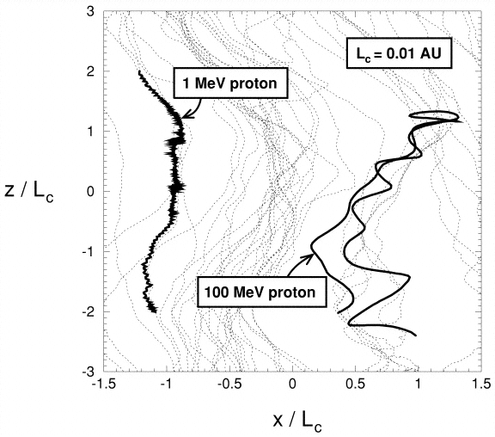
Introduction - Particle Transport in Turbulent Magnetic Field
Parallel diffusion due to pitch-angle diffusion
Drift motion due to magnetic field inhomogeneities
Transverse diffusion due to random walk of magnetic lines
Sample particle trajectories of two protons superimposed on magnetic field lines.
Giacalone and Jokipii (1999)
Notes:
Notes: - Role of turbulent magnetic fields in the heliosphere.
Pitch-angle diffusion, connected with transport in the direction parallel to magnetic field, drift motions due to magnetic field inhomogeneities, as well as transverse diffusion due to random walk of magnetic lines are all aspects of energetic particle transport that are controlled by magnetic turbulence properties, such as fluctuation amplitude, spectral index and anisotropy.

Slide 4
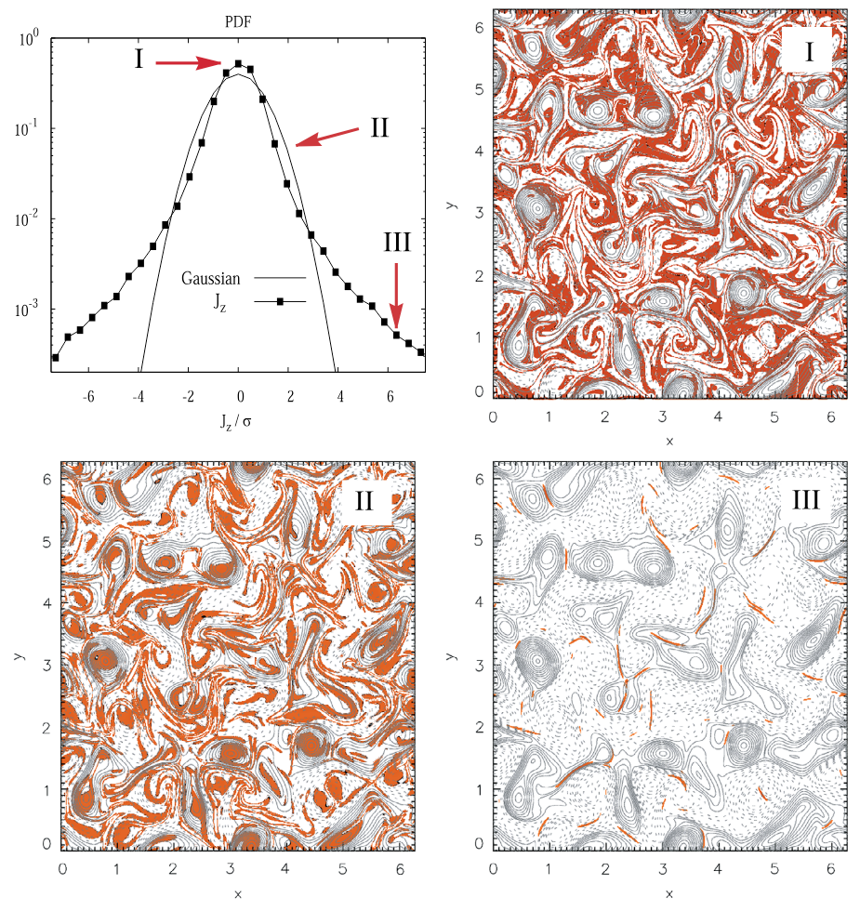
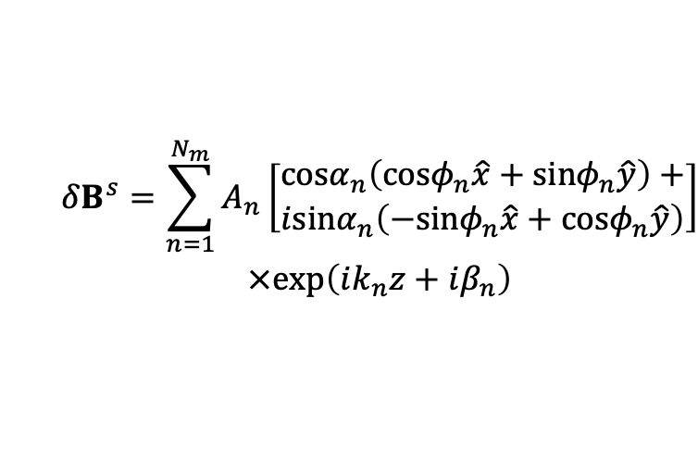
Turbulent Magnetic Fluctuations
(Greco et al. 2017)
$$\begin{matrix} & \begin{aligned}δB^{s}=\sum_{n=1}^{N_{m}}{A_{n}}\left[\begin{aligned}cosα_{n}\left(cosφ_{n}\hat{x}+sinφ_{n}\hat{y}\right)+ \\ isinα_{n}\left(−sinφ_{n}\hat{x}+cosφ_{n}\hat{y}\right)\end{aligned}\right] \\ ×exp\left(ik_{n}z+iβ_{n}\right)\end{aligned} \\ & \end{matrix}$$
Nonlinear energy cascade process results in the formation of coherent structures:
current sheets,
rotational discontinuities,
tangential discontinuities,
magnetic holes,
switchbacks…
PDF of the out-of-plane electric current density $J_{z}$
Notes:
For each region I, II, and III, magnetic field lines (contours of constant magnetic potential $A_{z}$: > 0 solid, < 0 dashed) are shown; the colored (red) regions are places where the selected band (I, II, or III) contributes. (Greco et al. 2017)
A physically appealing interpretation emerges: region I consists of very low values of fluctuations that lie mainly in the lanes between magnetic islands. Region II consists of sub-Gaussian current cores that populate the central regions of the magnetic islands (or flux tubes). Region III is composed of the coherent small-scale current sheet-like structures that form the sharp boundaries between the magnetic flux tubes. This classification provides a real-space picture of the nature of intermittent MHD turbulence.

Slide 5
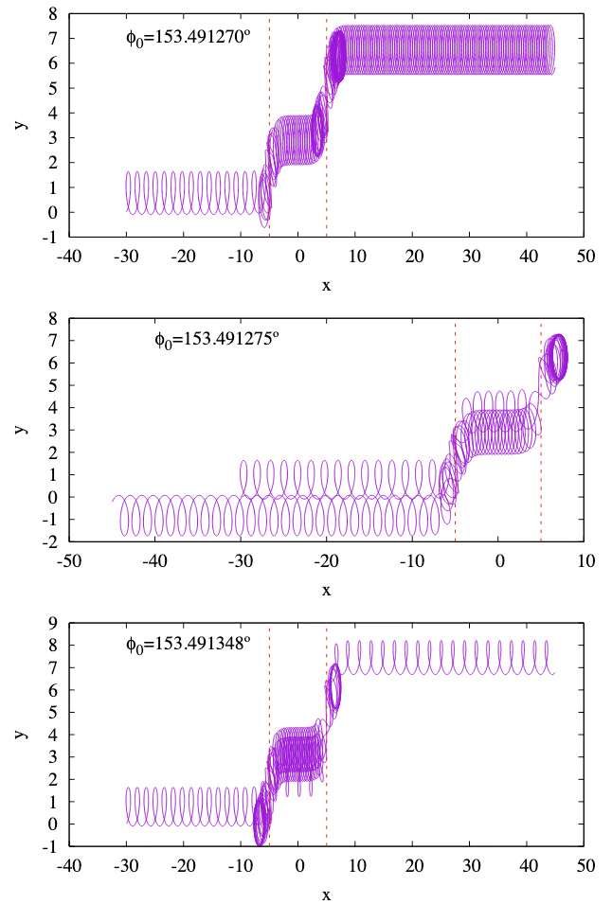
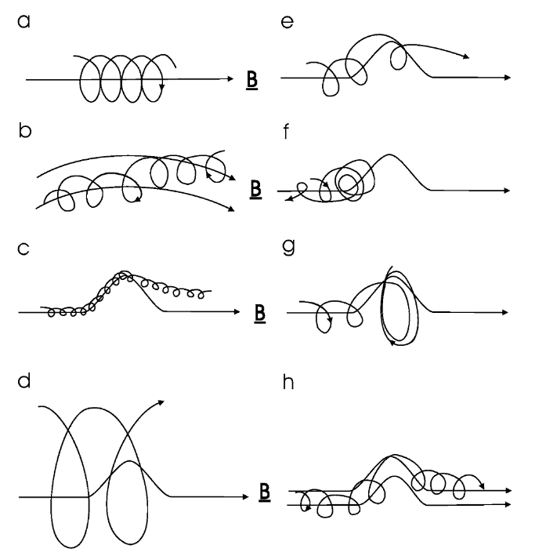
The Role of Coherent Structure in Particle Transport
Moraal (2013)
Malara
(2023)
Trajectories of three particles of 1 MeV SEP interaction with switchback
Notes:
Fig. 1 Charged particle motion in a magnetic field. (a) In a uniform magnetic field the particle has a spiral orbit with a gyroradius rg = P /Bc. (b) When the field is non-uniform the particle drifts away from a field line due to the gradient and curvature of the field. (c) When a particle meets a kink in the field that has a scale length rg , all particles will progress through the kink (but they may drift to adjacent field lines while doing so). (d) Likewise, if rg scale size of the kink, all particles will pass through it without being affected much. (e, f, g) When rg ≈ scale size of the kink, it depends on the gyrophase of the motion when the particles starts to feel the kink whether it will go through the kink (e), be reflected back (f), or effectively get stuck in the kink (g). This process is called pitch-angle scattering along the field. (h) When particles meet such a kink, there is also a scattering in phase angle, which leads to scattering across the field lines, but such that κ⊥ κ‖

Slide 6
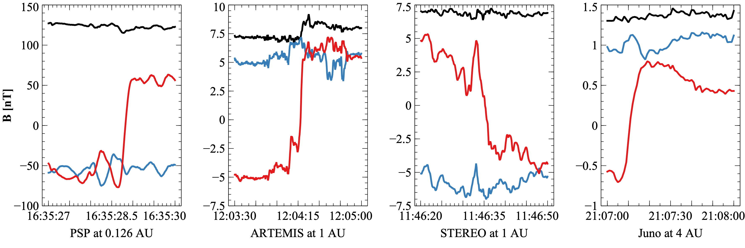
Introduction - Current Sheets in the Solar Wind
Current sheets detected by PSP, Juno, STEREO and near-Earth ARTEMIS satellite: red, blue, and black lines are $B_{l}$, $B_{m}$, and |B|.

Slide 7
The Problem: Scattering by Current Sheets
Malara et al. (2023), Malara, Perri, and Zimbardo (2021)
Artemyev et al. (2020) , Artemyev, Neishtadt, and Zelenyi (2013a, 2013b)
Zelenyi et al. (2013), Neishtadt (2000)
Büchner and Zelenyi (1989), ), Chen (1986), Tennyson et al (1986)
Motivation / Gap : Prior studies lack realistic solar wind statistics &/ large-scale simulation in a realistic magnetic field
How can we quantify the efficiency of particle scattering by solar wind current sheets?
Notes:
Image: Schematic of a particle trajectory interacting with a current sheet. Notes: - Why current sheets matter: Non-diffusive scattering, chaotic dynamics. - Gap: Prior studies lack realistic solar wind statistics.

Slide 8
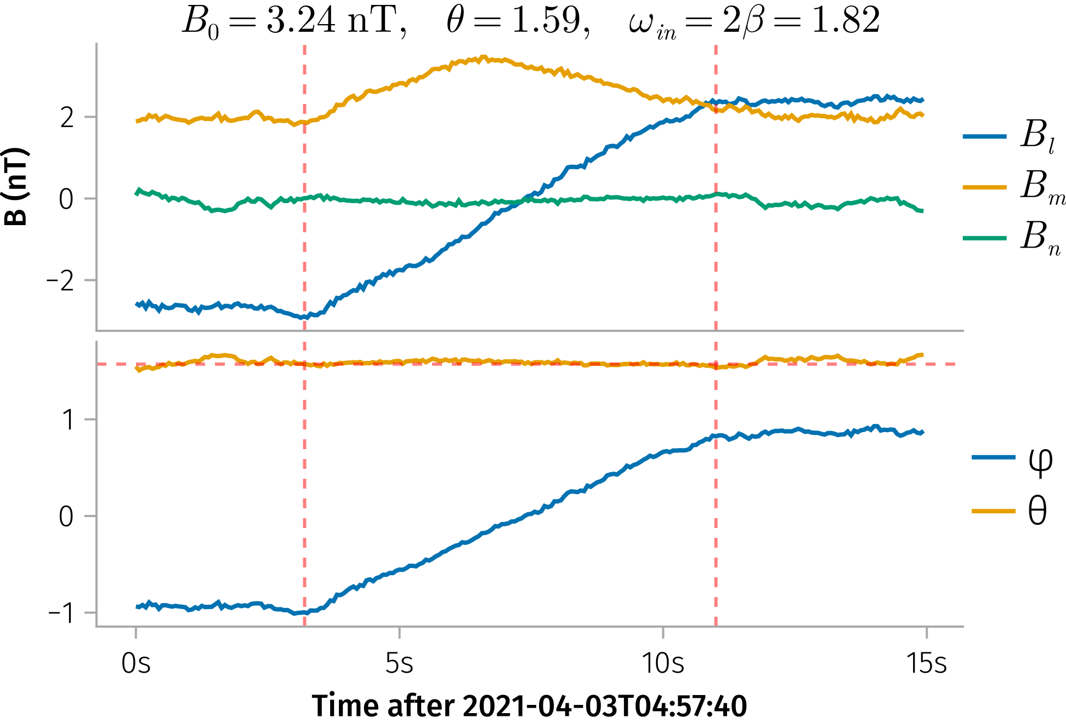
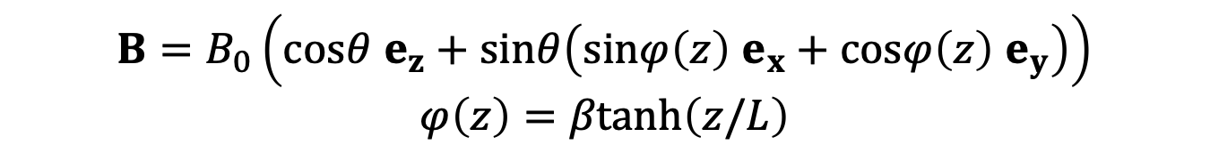
Analytical Model - Magnetic Field Model
Example of a current sheet observed by ARTEMIS.
$$B=B_{0}\left(cosθ e_{z}+sinθ\left(sinφ\left(z\right) e_{x}+cosφ\left(z\right) e_{y}\right)\right)$$
$$φ\left(z\right)=βtanh\left(z/L\right)$$

Slide 9
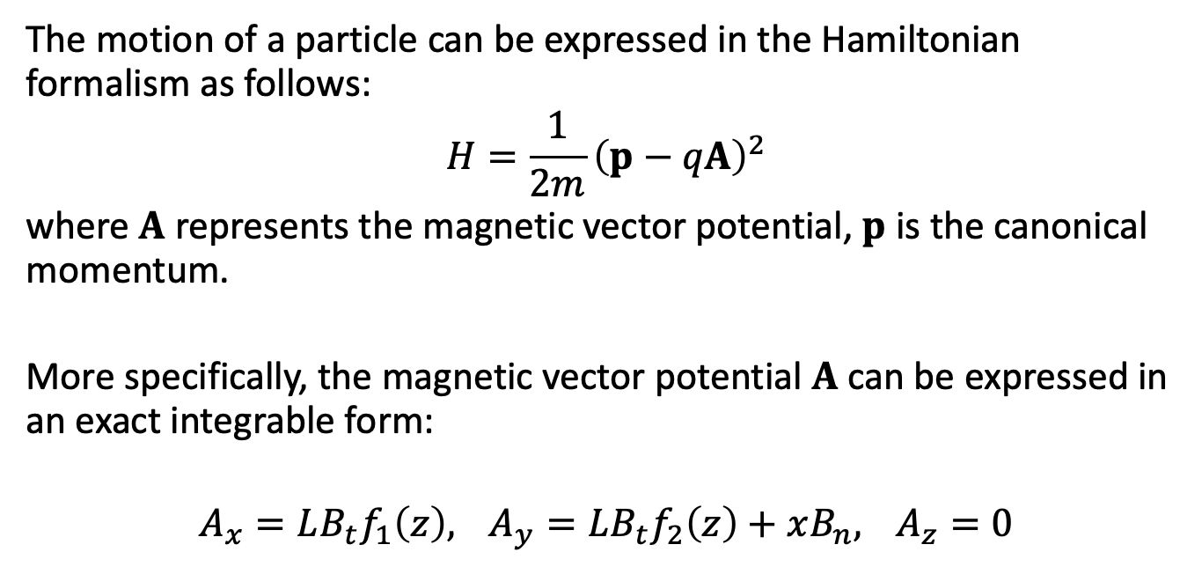
Analytical Model - Hamiltonian Approach
The motion of a particle can be expressed in the Hamiltonian formalism as follows:
$$H=\frac{1}{2m}{\left(p−qA\right)}^{2}$$
where $A$ represents the magnetic vector potential, $p$ is the canonical momentum.
More specifically, the magnetic vector potential $A$ can be expressed in an exact integrable form:
$$A_{x}=LB_{t}f_{1}\left(z\right), A_{y}=LB_{t}f_{2}\left(z\right)+xB_{n}, A_{z}=0$$
Notes:
Key Points:
Introduction to the Hamiltonian formalism in this context.
Expression for the magnetic vector potential.
Transition from canonical to dimensionless variables.
Notes:
Explain why the Hamiltonian approach is useful for modeling particle dynamics.
Highlight the derivation steps and the significance of the normalization.
Image Suggestion:
Flow diagram summarizing the derivation from the physical Hamiltonian to the dimensionless form.

Slide 10


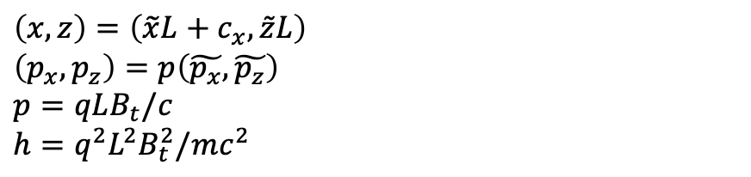

Analytical Model - Dimensionless Hamiltonian and Asymptotic Expansion
$$\left(x,z\right)=\left(\tilde{x}L+c_{x},\tilde{z}L\right)$$
$\left(p_{x},p_{z}\right)=p\left(\tilde{p_{x}},\tilde{p_{z}}\right)$ $$p=qLB_{t}/c$$
$$h=q^{2}L^{2}B_{t}^{2}/mc^{2}$$
$$\tilde{H}=\frac{1}{2}\left({\left(\tilde{p_{x}}−f_{1}\left(\tilde{z}\right)\right)}^{2}+{\left(\tilde{x}cotθ+f_{2}\left(\tilde{z}\right)\right)}^{2}+{\tilde{p_{z}}}^{2}\right)$$
$$\begin{matrix} & f_{1}\left(\tilde{z}\right)=\frac{1}{2}cosβ \left(\text{Ci}\left(βs_{+}\left(\tilde{z}\right)\right)−\text{Ci}\left(βs_{−}\left(\tilde{z}\right)\right)\right) \\ & +\frac{1}{2}sinβ \left(\text{Si}\left(βs_{+}\left(\tilde{z}\right)\right)−\text{Si}\left(βs_{−}\left(z\right)\right)\right), \\ & f_{2}\left(\tilde{z}\right)=\frac{1}{2}sinβ \left(\text{Ci}\left(βs_{+}\left(\tilde{z}\right)\right)+\text{Ci}\left(βs_{−}\left(\tilde{z}\right)\right)\right) \\ & −\frac{1}{2}cosβ \left(\text{Si}\left(βs_{+}\left(\tilde{z}\right)\right)+\text{Si}\left(βs_{−}\left(\tilde{z}\right)\right)\right)\end{matrix}$$
$$κ=cotθ$$
$$f_{1}\left(z\right) \sim z−\frac{1}{6}β^{2}z^{3}+O\left(z^{4}\right)$$
$$f_{2}\left(z\right) \sim \frac{βz^{2}}{2}+O\left(z^{4}\right)$$

Slide 11
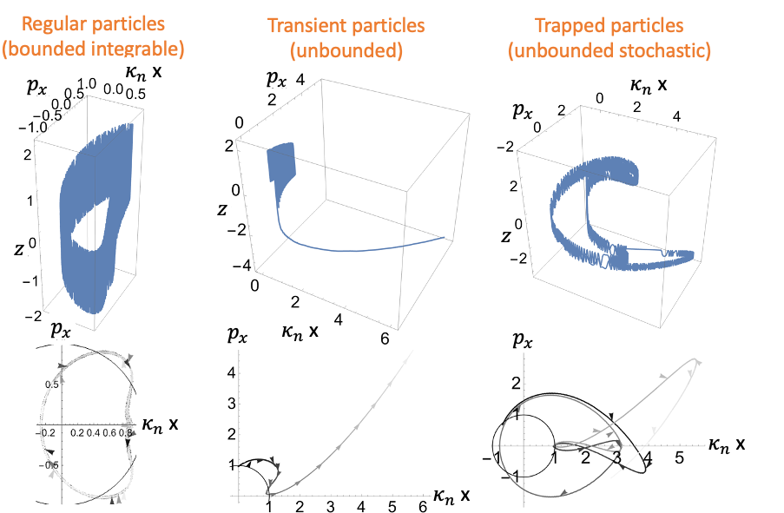
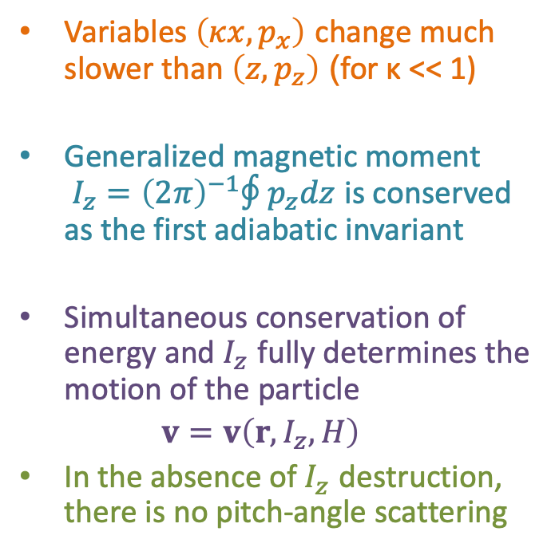
Adiabatic Invariance and Pitch Angle
Variables $\left(κx,p_{x}\right)$ change much slower than $\left(z,p_{z}\right)$ (for κ << 1)
Generalized magnetic moment $I_{z}={\left(2π\right)}^{−1}∮p_{z}dz$ is conserved as the first adiabatic invariant
Simultaneous conservation of energy and $I_{z}$ fully determines the motion of the particle
$v=v\left(r,I_{z},H\right)$
In the absence of $I_{z}$ destruction, there is no pitch-angle scattering
Particle trajectories in phase space
Notes:
Key Points:
Definition of adiabatic invariance and the magnetic moment (I_z).
Conditions under which the adiabatic invariant is conserved.
Notes:
Explain the concept of adiabatic invariance in simple terms.
Discuss why maintaining (I_z) is important for particle trajectory predictions.
Image Suggestion:
Diagram depicting adiabatic invariance with trajectories in phase space.

Slide 12
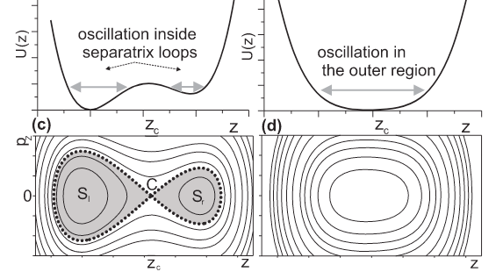
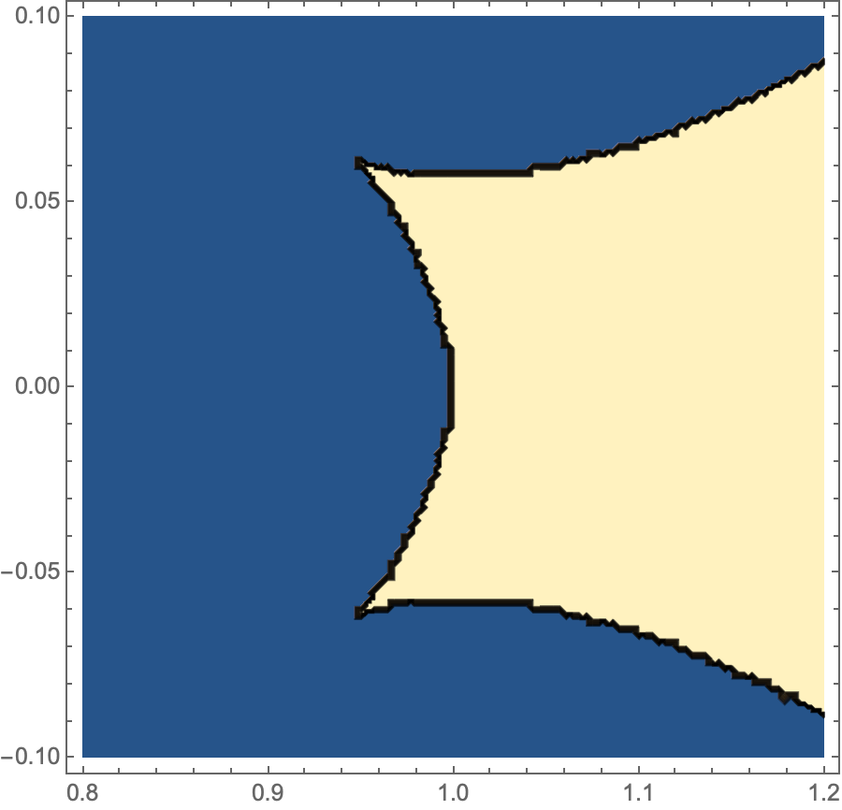

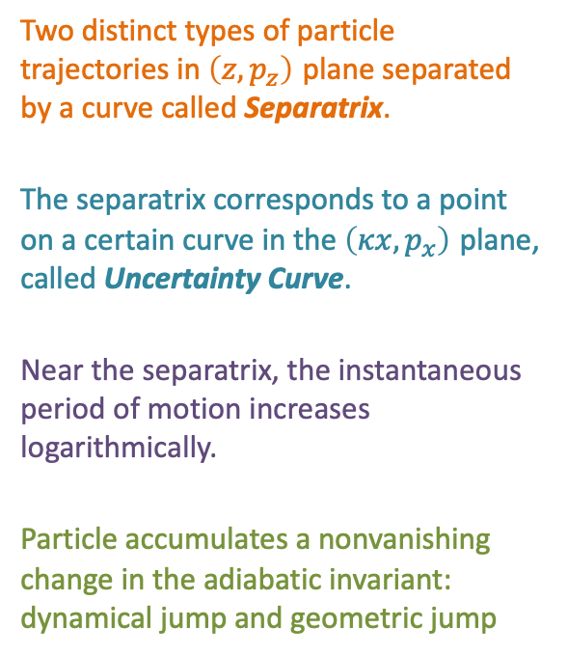


Destruction of Adiabatic Invariance: Separatrix and Uncertainty Curve
Two distinct types of particle trajectories in $\left(z,p_{z}\right)$ plane separated by a curve called Separatrix.
The separatrix corresponds to a point on a certain curve in the $\left(κx,p_{x}\right)$ plane, called Uncertainty Curve.
Near the separatrix, the instantaneous period of motion increases logarithmically.
Particle accumulates a nonvanishing change in the adiabatic invariant: dynamical jump and geometric jump
$$p_{z}$$
One solution
$$p_{x}$$
Uncertainty curve
Two solution
$$κ x$$

Slide 13
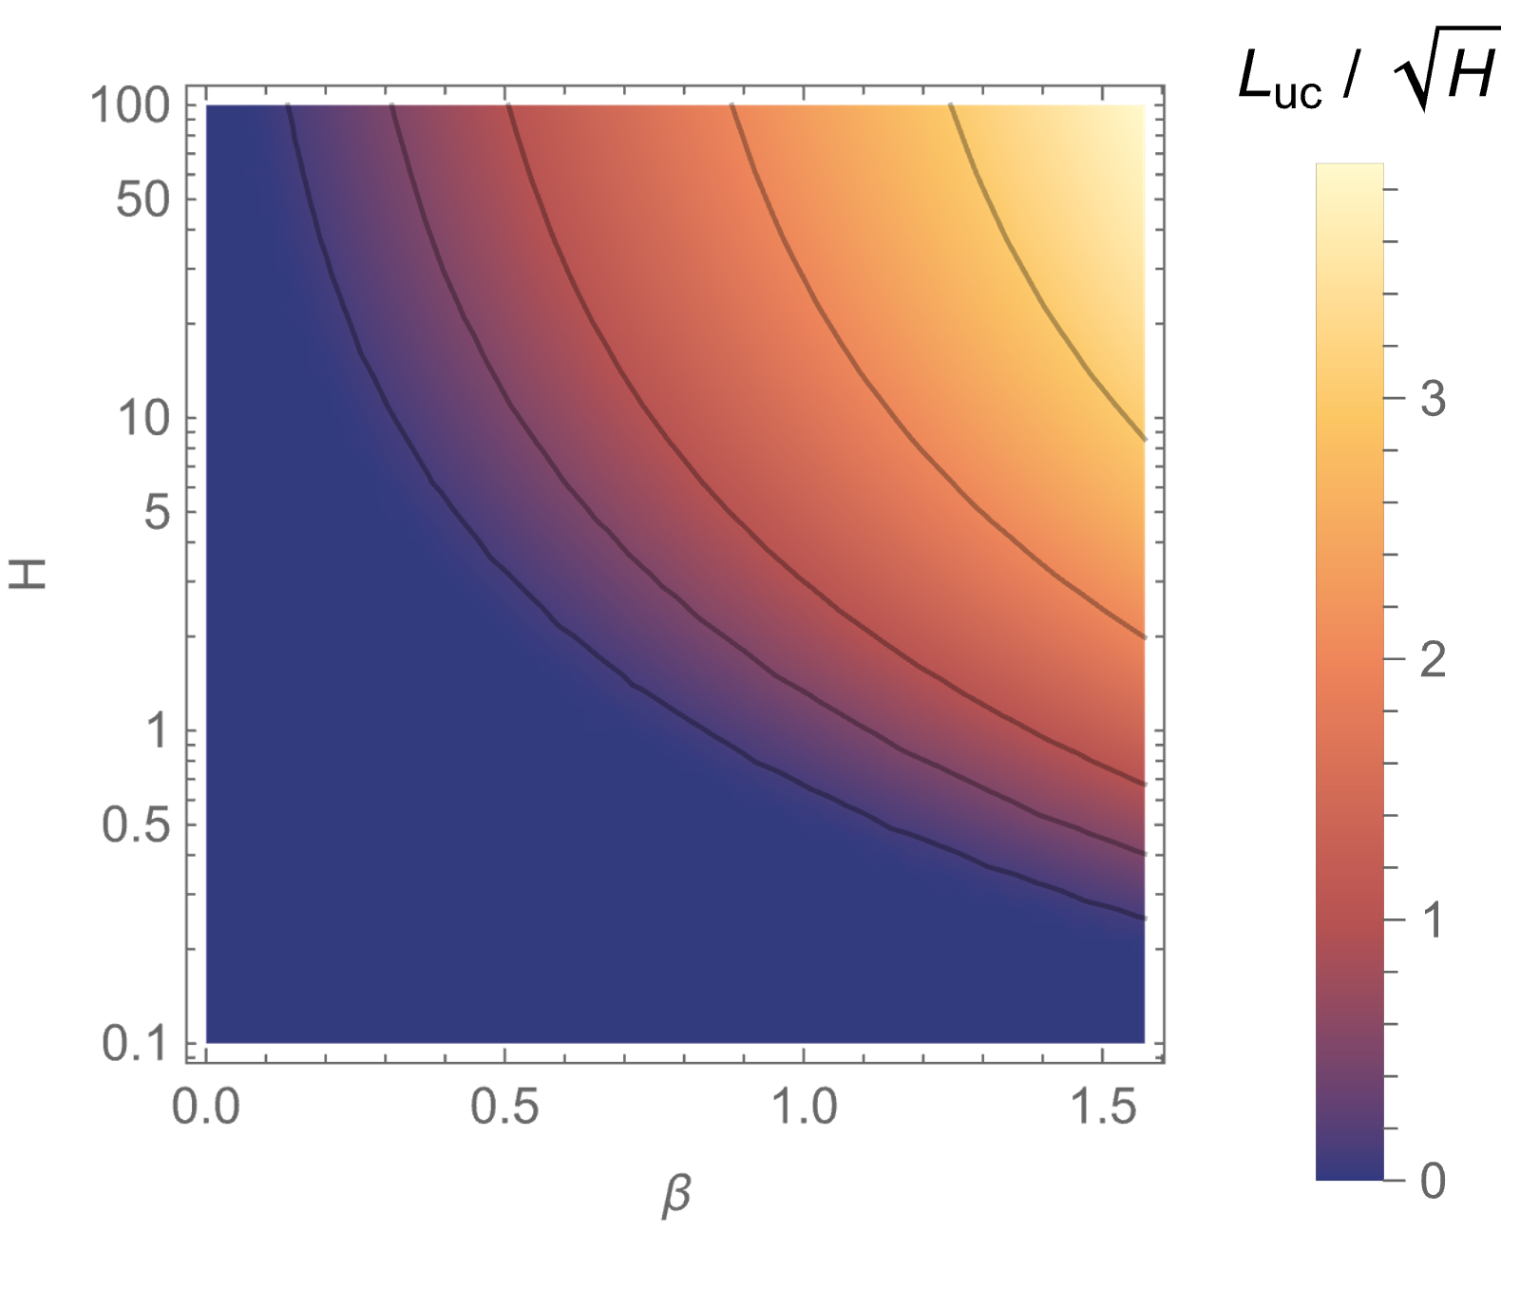
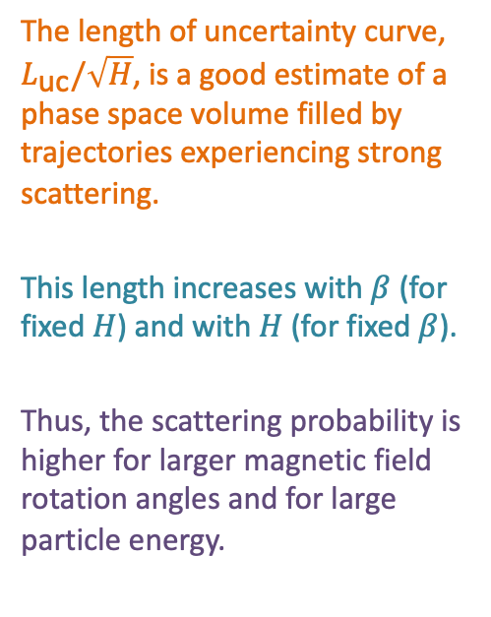
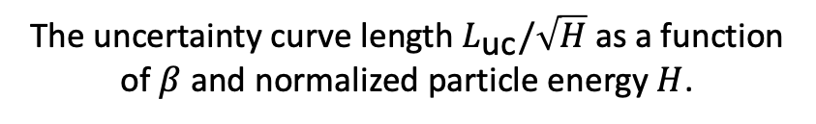
Uncertainty curve
The length of uncertainty curve, $L_{\text{uc}}/\sqrt{H}$, is a good estimate of a phase space volume filled by trajectories experiencing strong scattering.
This length increases with $β$ (for fixed $H$) and with $H$ (for fixed $β$).
Thus, the scattering probability is higher for larger magnetic field rotation angles and for large particle energy.
The uncertainty curve length $L_{\text{uc}}/\sqrt{H}$ as a function of $β$ and normalized particle energy $H$.

Slide 14
Part 2
In the first part, we introduced the basic physics of ion scattering by the solar wind.
Takeaway 1: Larger magnetic field rotation angles and higher particle energies lead to larger chance of pitch-angle scattering.
In the following part, we will focus on the test particle simulations to quantify the ion scattering by the solar wind current sheets.

Slide 15
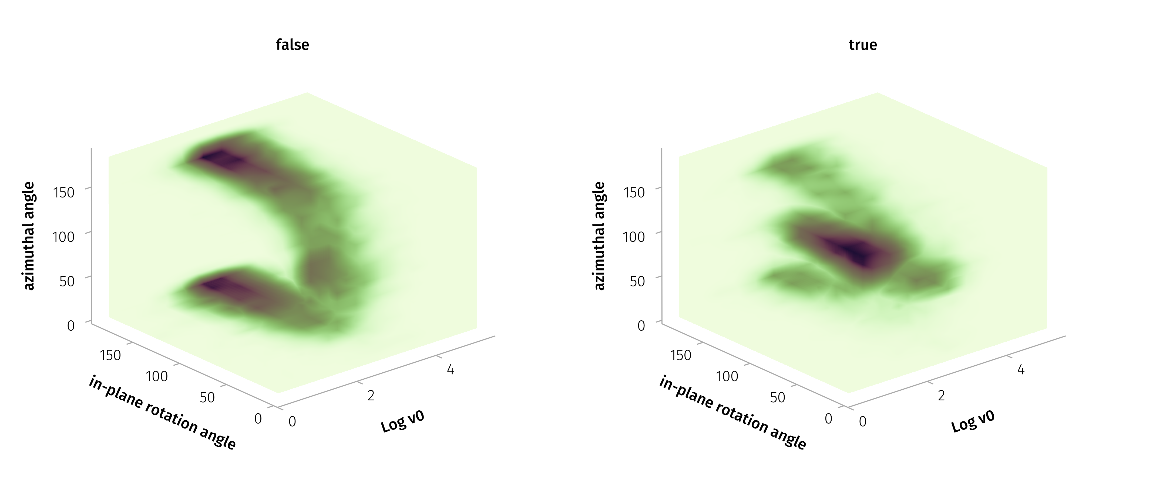
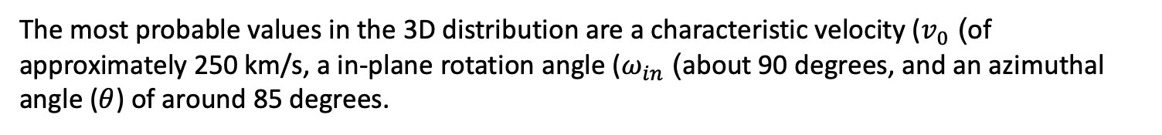
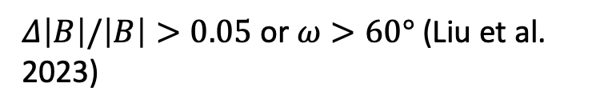
Test Particle Simulations - Solar Wind Dataset
$Δ\left|B\right|/\left|B\right|>0.05$ or $ω>60°$ (Liu et al. 2023)
The most probable values in the 3D distribution are a characteristic velocity ($v_{0}$) of approximately 250 km/s, a in-plane rotation angle ($ω_{in}$) about 90 degrees, and an azimuthal angle ($θ$) of around 85 degrees.

Slide 16
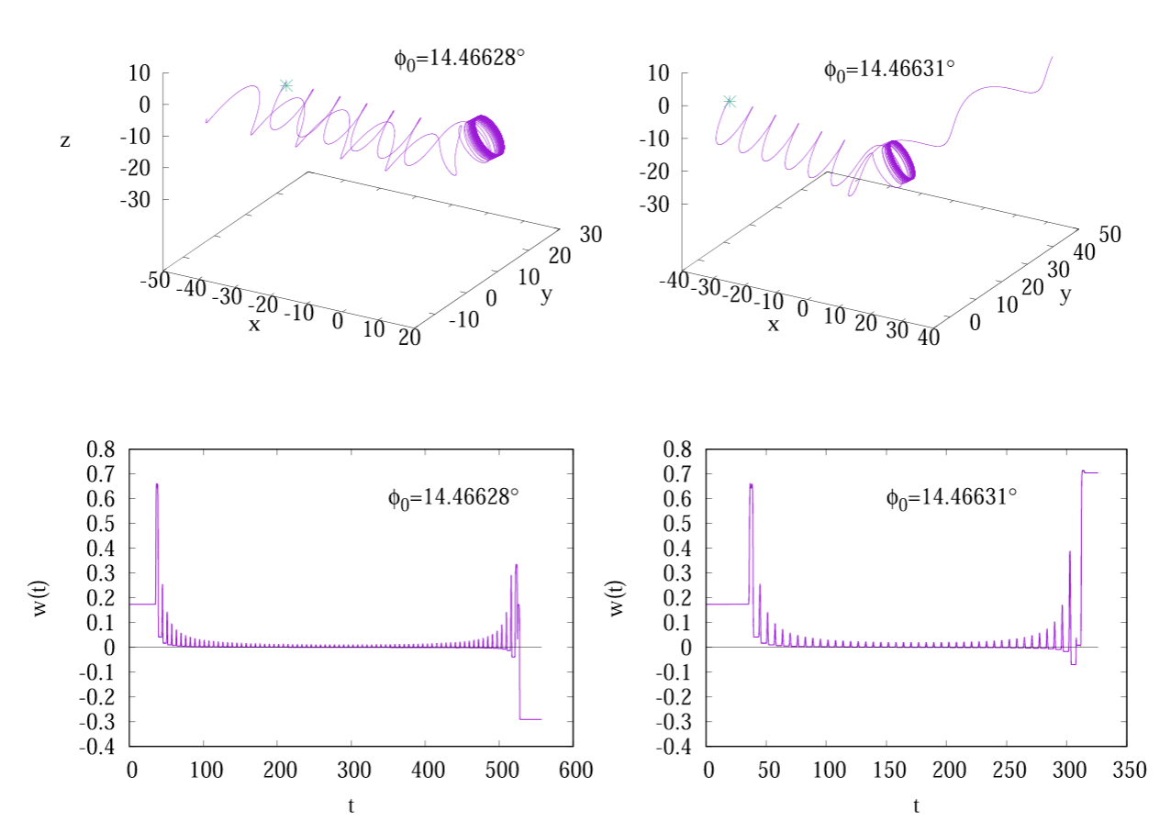
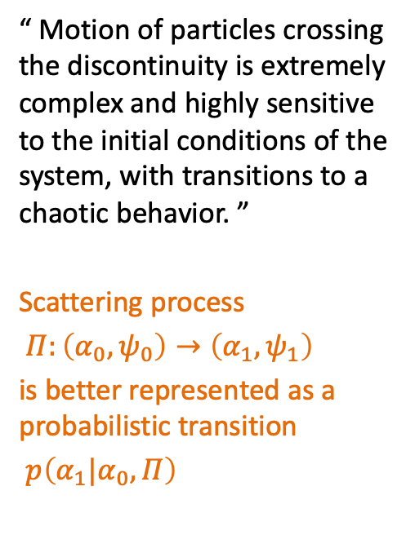

Examples of Pitch Angle Scattering
“ Motion of particles crossing the discontinuity is extremely complex and highly sensitive to the initial conditions of the system, with transitions to a chaotic behavior. ”
Scattering process
$Π:\left(α_{0},ψ_{0}\right)→\left(α_{1},ψ_{1}\right)$
is better represented as a probabilistic transition
$p\left(α_{1}|α_{0},Π\right)$
$$cos α(t)$$
The trajectories of two particles starting with two slightly different gyrophases
Malara, Perri, and Zimbardo (2021)

Slide 17
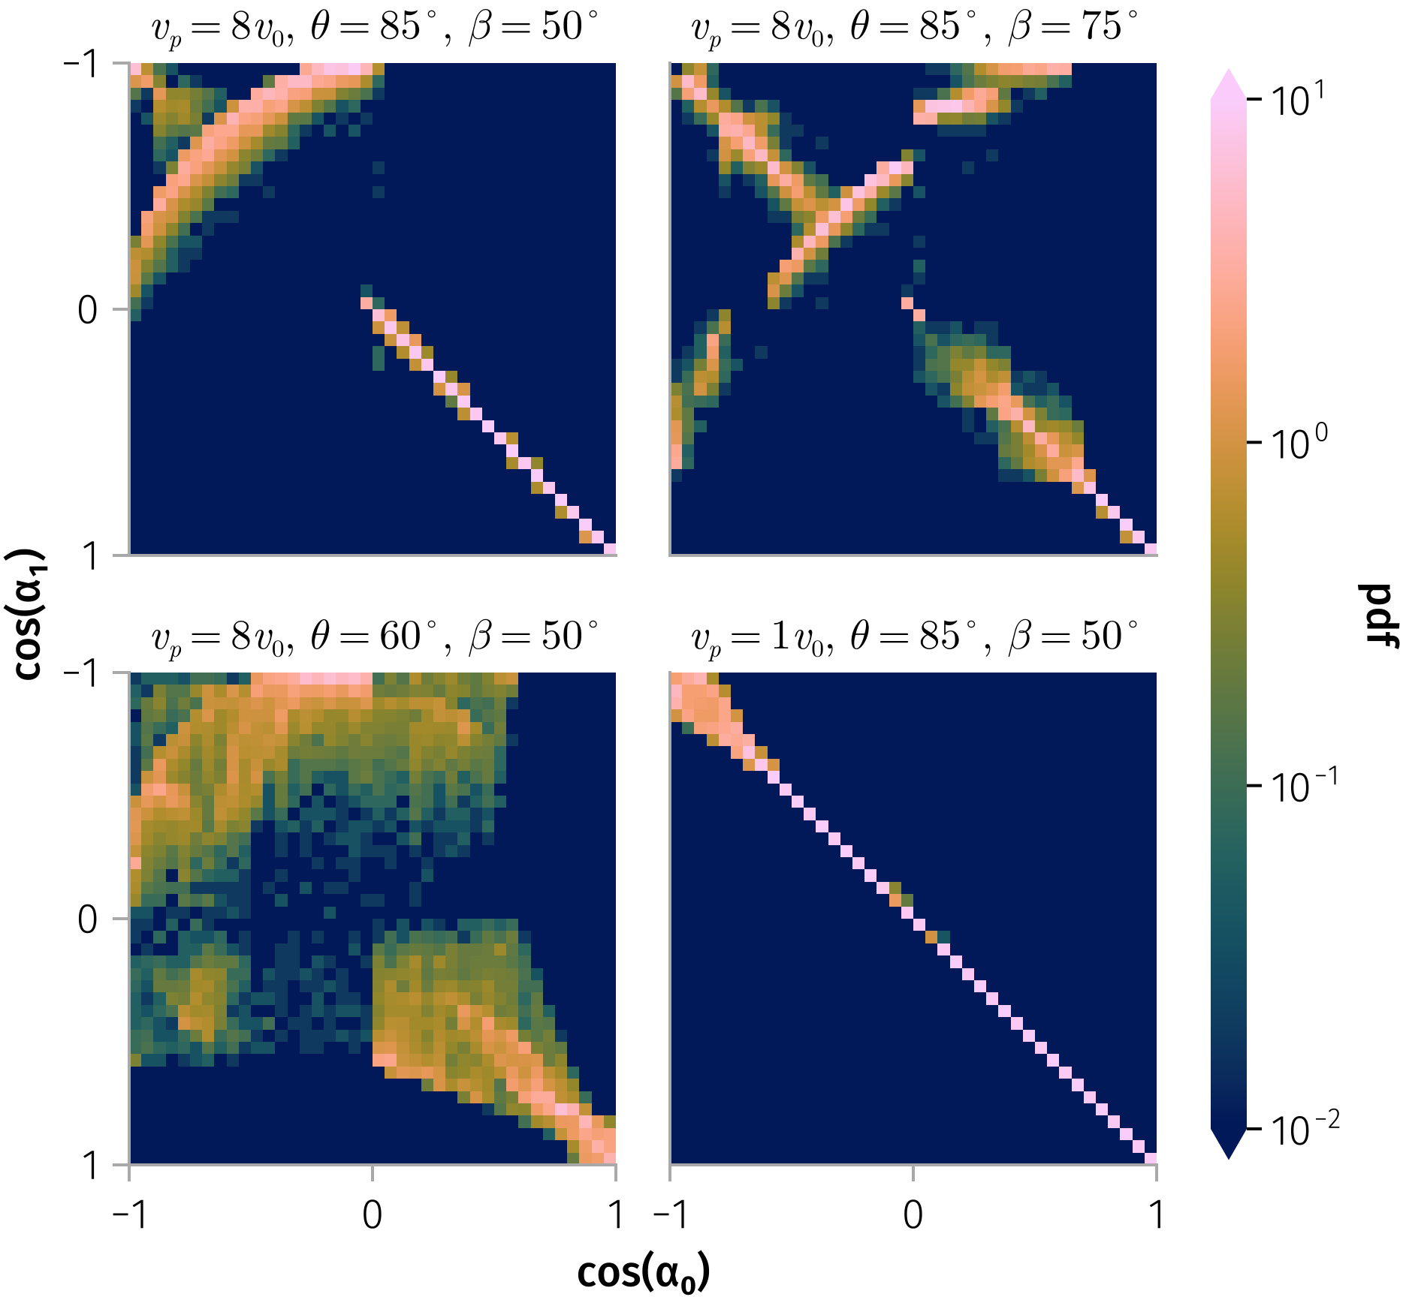
Transition Matrix
Transition matrix for 100 keV protons under four distinct magnetic field configurations
Notes:
Long-term modeling of particle pitch-angle distributions resulting from current-sheet scattering involves simulating the dynamics of a large number of particles through multiple current-sheet interactions over extended periods. To reduce computational time and complexity, we derive a simplified probabilistic description of pitch-angle evolution for modeling energetic particle transport under current-sheet scattering.
The scattering process depends on the particle's initial conditions, $(\mathbf{r}, \mathbf{v})$, as well as the configuration of the current sheet, $\mathbf{B}$.

Slide 18
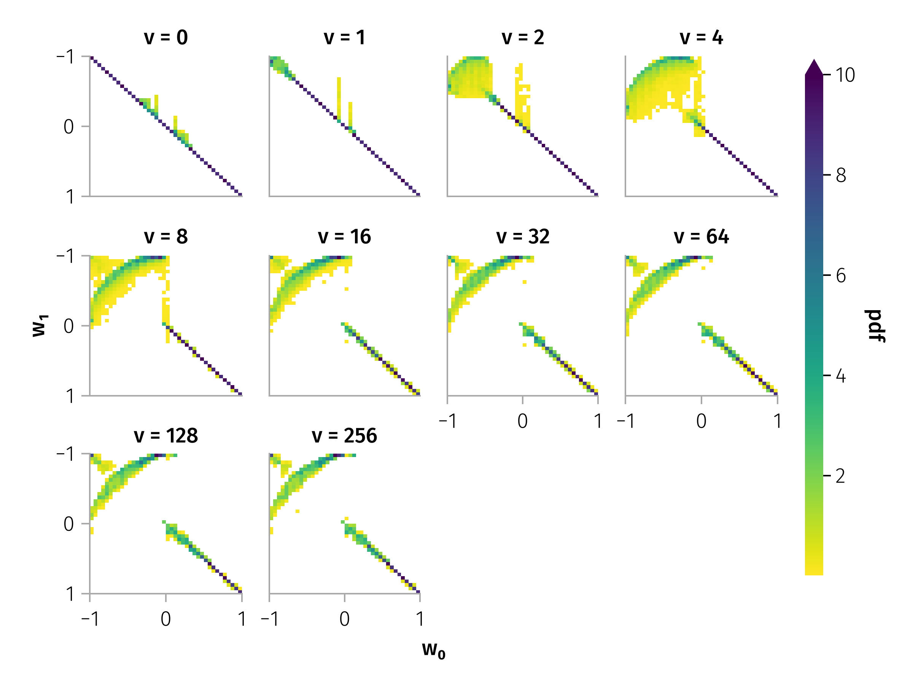
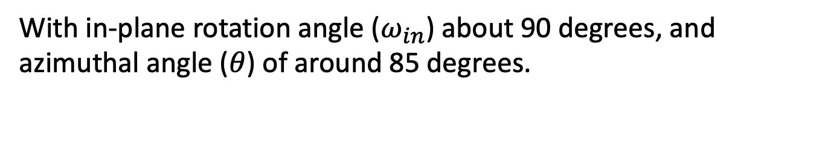
Pitch angle scattering by typical discontinuity
With in-plane rotation angle ($ω_{in}$) about 90 degrees, and azimuthal angle ($θ$) of around 85 degrees.
Luckily, higher or lower energy do not exhibit apparently different scattering probabilities.

Slide 19
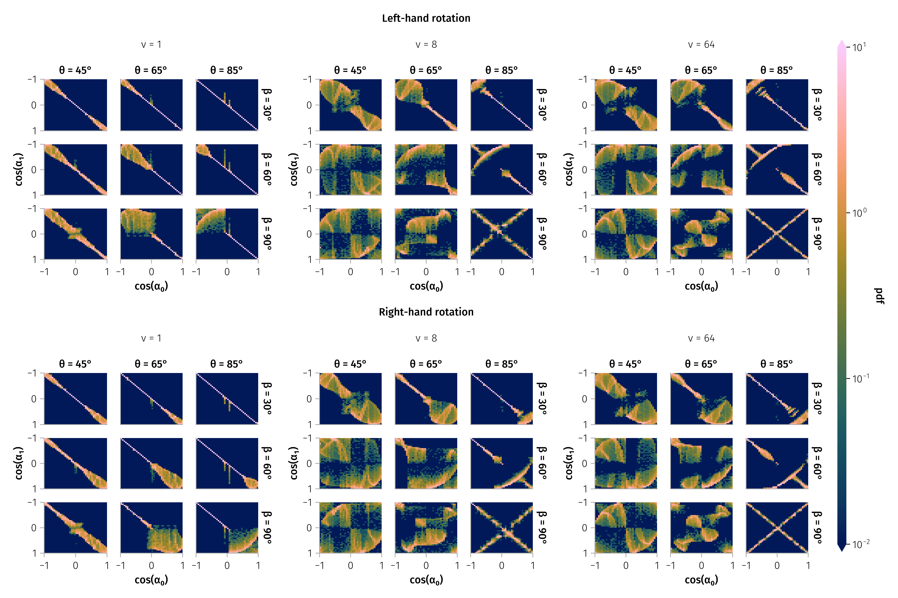
Transition Matrix

Slide 20
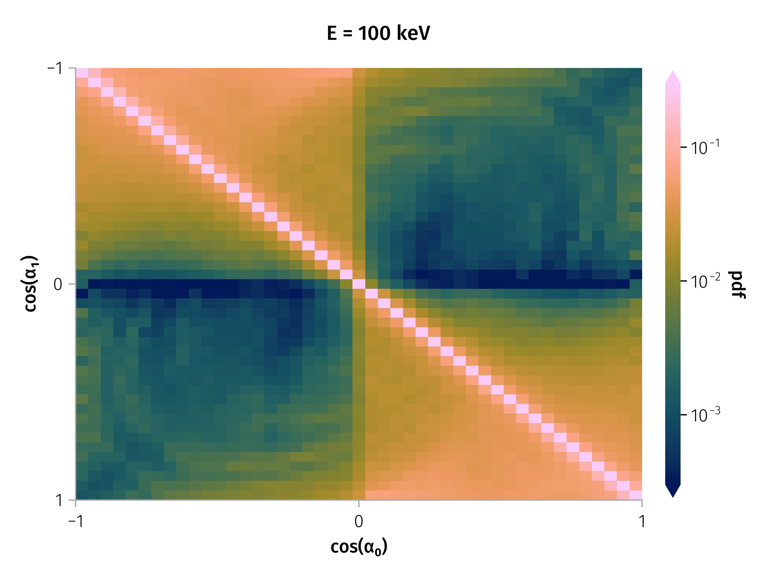
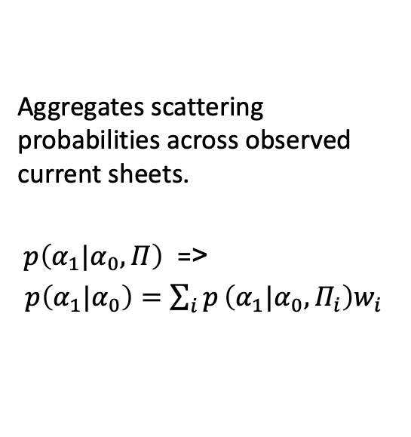
Weighted Transition Matrix
Aggregates scattering probabilities across observed current sheets.
$p\left(α_{1}|α_{0},Π\right)$ =>
$p\left(α_{1}|α_{0}\right)=\sum_{i}^{​}{p}\left(α_{1}|α_{0},Π_{i}\right)w_{i}$
Transition matrix for 100 keV particles.
Notes:
Image: WTM heatmap from fig-tm-stats-100keV. Notes: - Aggregates scattering probabilities across observed current sheets. - Bright diagonal = most particles weakly scattered.

Slide 21
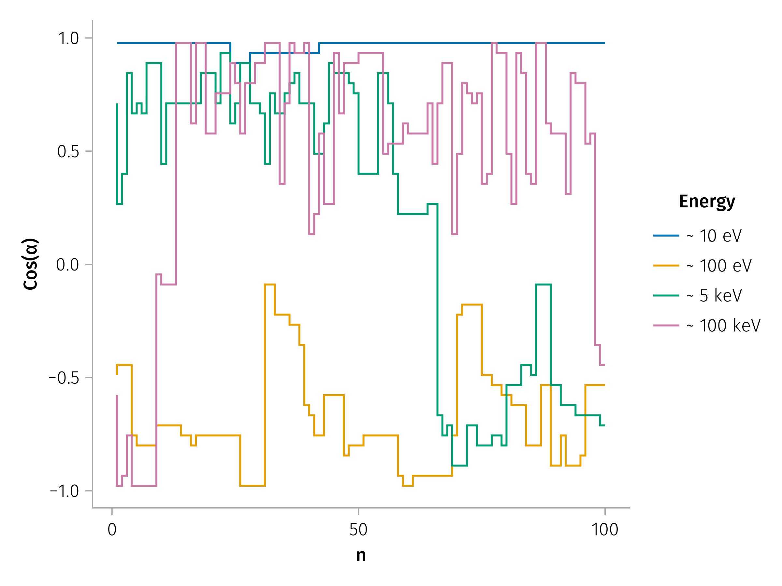

Long-Term Pitch Angle Evolution
Example of Multiple Pitch Angle Scattering for Different Energies
$$α_{n+1,i}=W\left(α_{n,i},ξ_{n,i}\right)$$
Notes:
Notes: - Rare large-angle jumps drive rapid mixing.
A key feature of the pitch-angle dynamics is the occurrence of infrequent but substantial jumps, including rare, large-angle changes that can lead to particle reflection from the current sheet.
However, directly incorporating stochastic difference equations and the WTM into classical numerical schemes for transport-diffusion equations is a complex task. To facilitate comparison with other scattering processes and allow inclusion of SWD-induced scattering effects in such models, we evaluate the effective scattering rate, $D_{nn}$. This rate acts as a global diffusion coefficient, independent of the local pitch angle, since high-energy particles frequently experience large pitch-angle jumps, leading to strong mixing. The scattering rate depends on the particle energy and the WTM (i.e., the distribution of current sheets). Using the mapping described in Equation~\ref{eq-mapping} for an ensemble of particles, we calculate the evolution of the second moment of the pitch-angle distribution for the particle energy range from 100 keV to 1 MeV for current sheets at 1 AU:

Slide 22
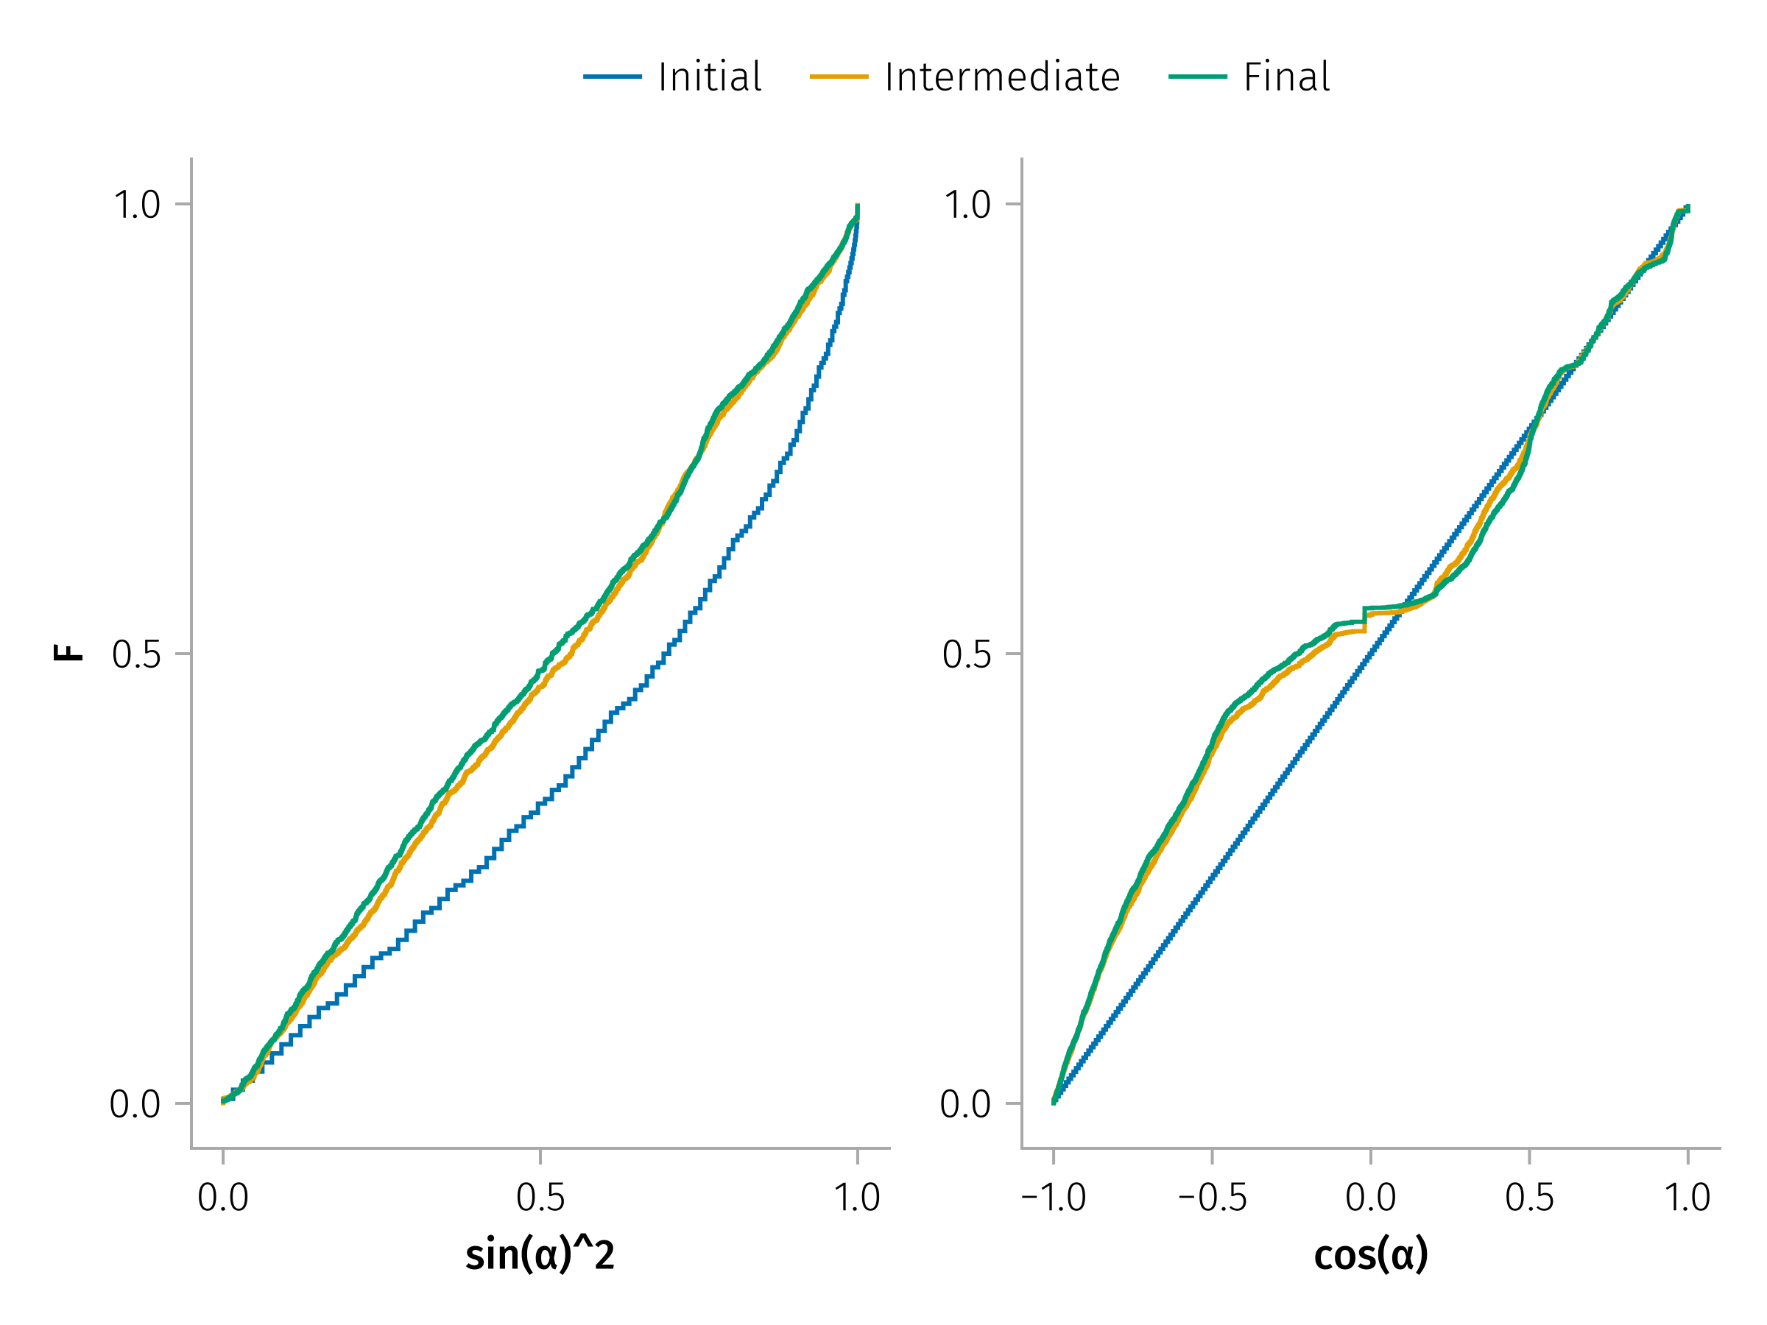
Long-Term Pitch Angle Evolution
Ergodicity?
Notes:
Notes: - Rare large-angle jumps drive rapid mixing.
A key feature of the pitch-angle dynamics is the occurrence of infrequent but substantial jumps, including rare, large-angle changes that can lead to particle reflection from the current sheet.
However, directly incorporating stochastic difference equations and the WTM into classical numerical schemes for transport-diffusion equations is a complex task. To facilitate comparison with other scattering processes and allow inclusion of SWD-induced scattering effects in such models, we evaluate the effective scattering rate, $D_{nn}$. This rate acts as a global diffusion coefficient, independent of the local pitch angle, since high-energy particles frequently experience large pitch-angle jumps, leading to strong mixing. The scattering rate depends on the particle energy and the WTM (i.e., the distribution of current sheets). Using the mapping described in Equation~\ref{eq-mapping} for an ensemble of particles, we calculate the evolution of the second moment of the pitch-angle distribution for the particle energy range from 100 keV to 1 MeV for current sheets at 1 AU:

Slide 23
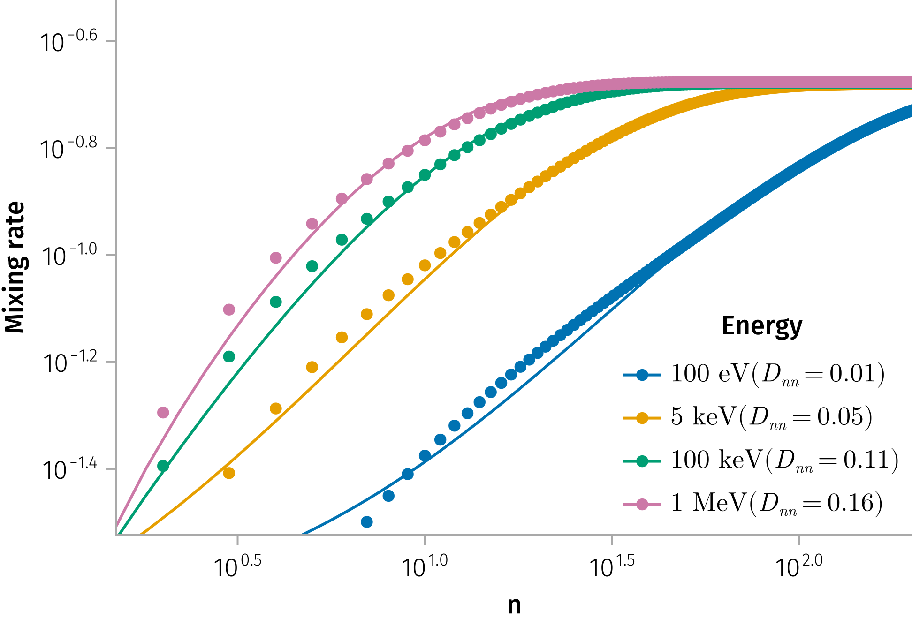
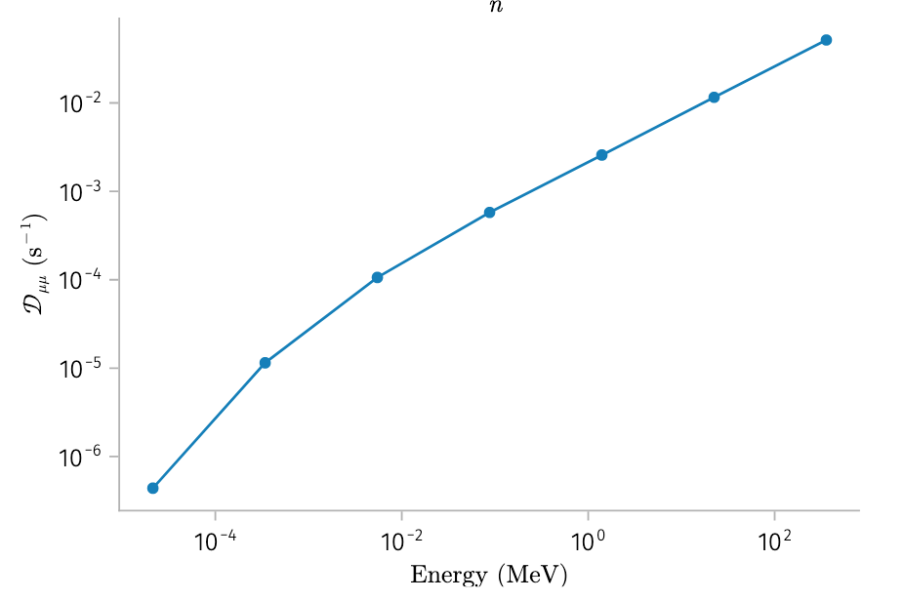
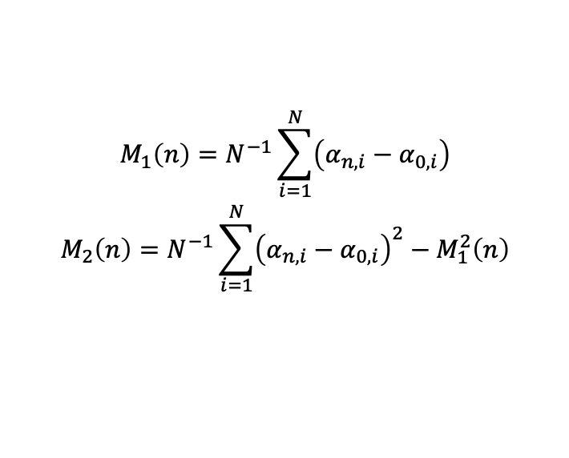
Pitch angle scattering => Parallel Diffusion
$$\begin{matrix}M_{1}\left(n\right)=N^{−1}\sum_{i=1}^{N}{\left(α_{n,i}−α_{0,i}\right)} \\ M_{2}\left(n\right)=N^{−1}\sum_{i=1}^{N}{{\left(α_{n,i}−α_{0,i}\right)}^{2}}−M_{1}^{2}\left(n\right)\end{matrix}$$
Notes:
Notes:
(D_{nn}) quantifies scattering efficiency.

Slide 24
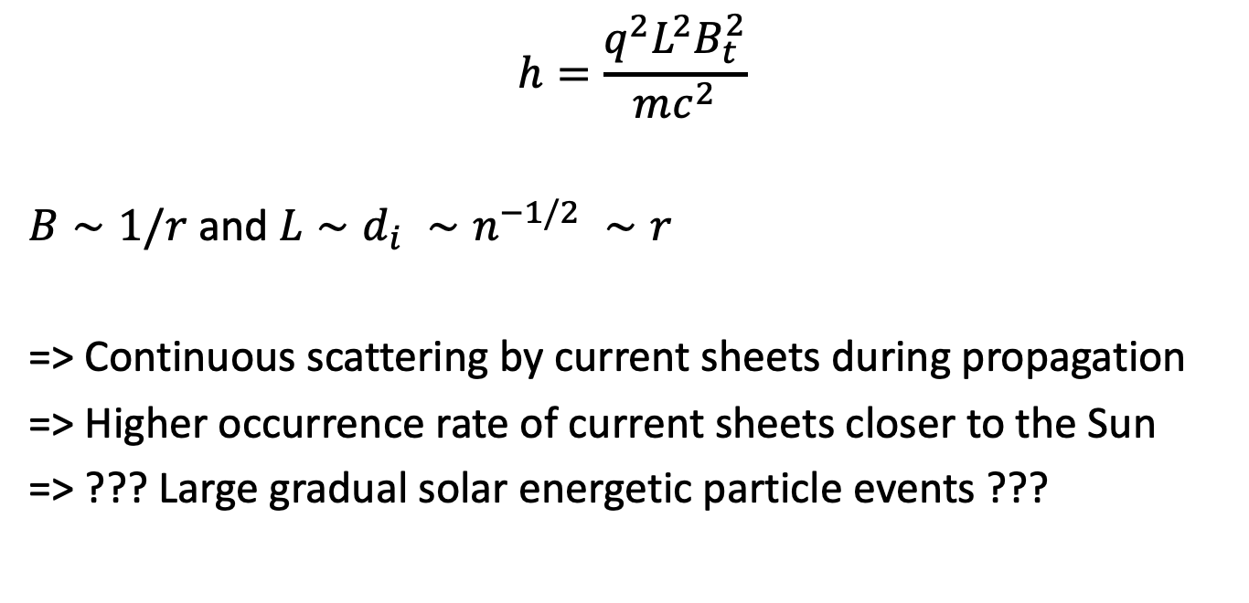
Implications for Particle Transport
$$h=\frac{q^{2}L^{2}B_{t}^{2}}{mc^{2}}$$
$B∼1/r$ and $L∼d_{i} ∼n^{−1/2} ∼r$
=> Continuous scattering by current sheets during propagation
=> Higher occurrence rate of current sheets closer to the Sun
=> ??? Large gradual solar energetic particle events ???
Notes:
Key Points:
Impact on spatial diffusion and acceleration processes.
Connection between enhanced pitch-angle scattering and reduced acceleration timescales in shocks.
Broader relevance for heliospheric and astrophysical plasma transport.
Notes:
Summarize how the research improves our understanding of energetic particle dynamics.
Emphasize the potential integration of these results into global transport models.
Image Suggestion:
Conceptual diagram linking pitch-angle scattering, spatial diffusion, and particle acceleration in shock environments.

Slide 25
Part 3
In the second part, we quantified the pitch-angle scattering by the solar wind current sheets.
Takeaway 2: Infrequent but substantial jumps leads to fast mixing in the pitch-angle distribution.
In the following part, we will investigate the spatial transport of energetic particles due to their interaction with current sheets.

Slide 26
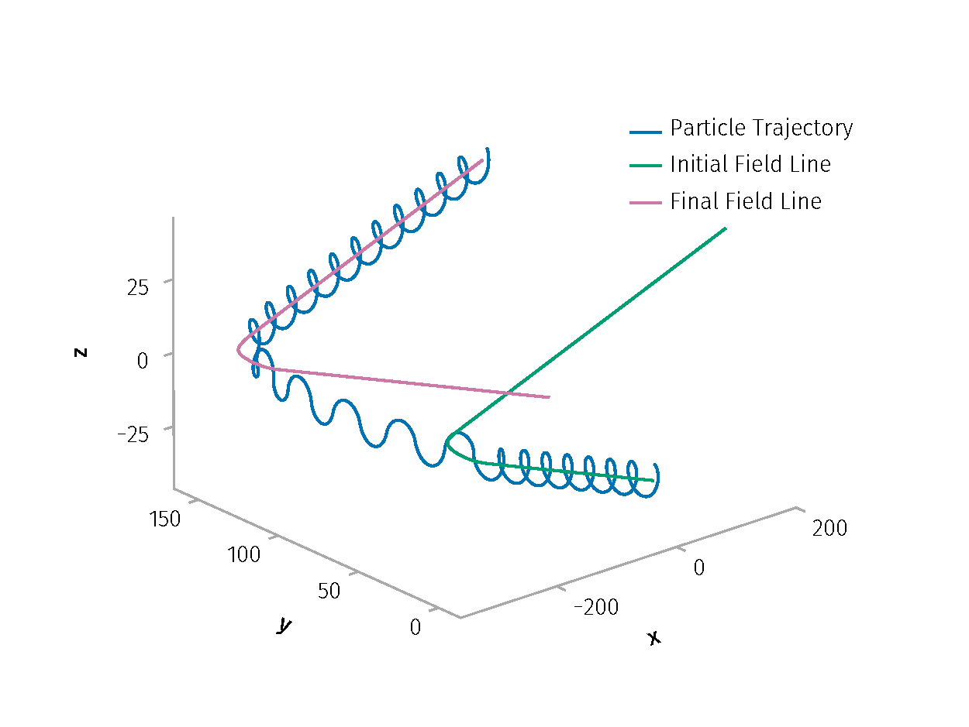
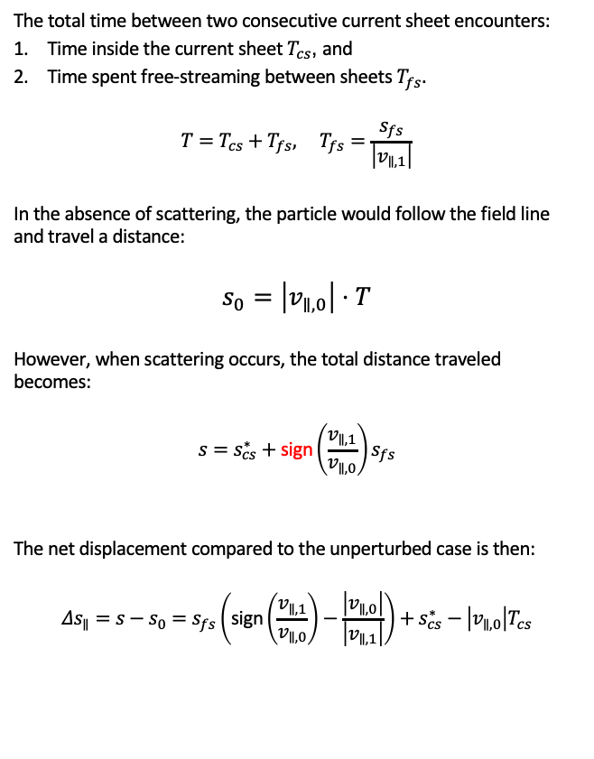


The total time between two consecutive current sheet encounters:
Time inside the current sheet $T_{cs}$, and
Time spent free-streaming between sheets $T_{fs}.$
$$T=T_{cs}+T_{fs}, T_{fs}=\frac{s_{fs}}{\left|v_{∥,1}\right|}$$
In the absence of scattering, the particle would follow the field line and travel a distance:
$$s_{0}=\left|v_{∥,0}\right|⋅T$$
However, when scattering occurs, the total distance traveled becomes:
$$s=s_{cs}^{∗}+\text{sign}\left(\frac{v_{∥,1}}{v_{∥,0}}\right)s_{fs}$$
The net displacement compared to the unperturbed case is then:
$$Δs_{∥}=s−s_{0}=s_{fs}\left(\text{sign}\left(\frac{v_{∥,1}}{v_{∥,0}}\right)−\frac{\left|v_{∥,0}\right|}{\left|v_{∥,1}\right|}\right)+s_{cs}^{∗}−\left|v_{∥,0}\right|T_{cs}$$
$v_{∥,1}$
$v_{∥,0}$
-1 for reflected particle
Example trajectory of a particle interacting with a current sheet

Slide 27
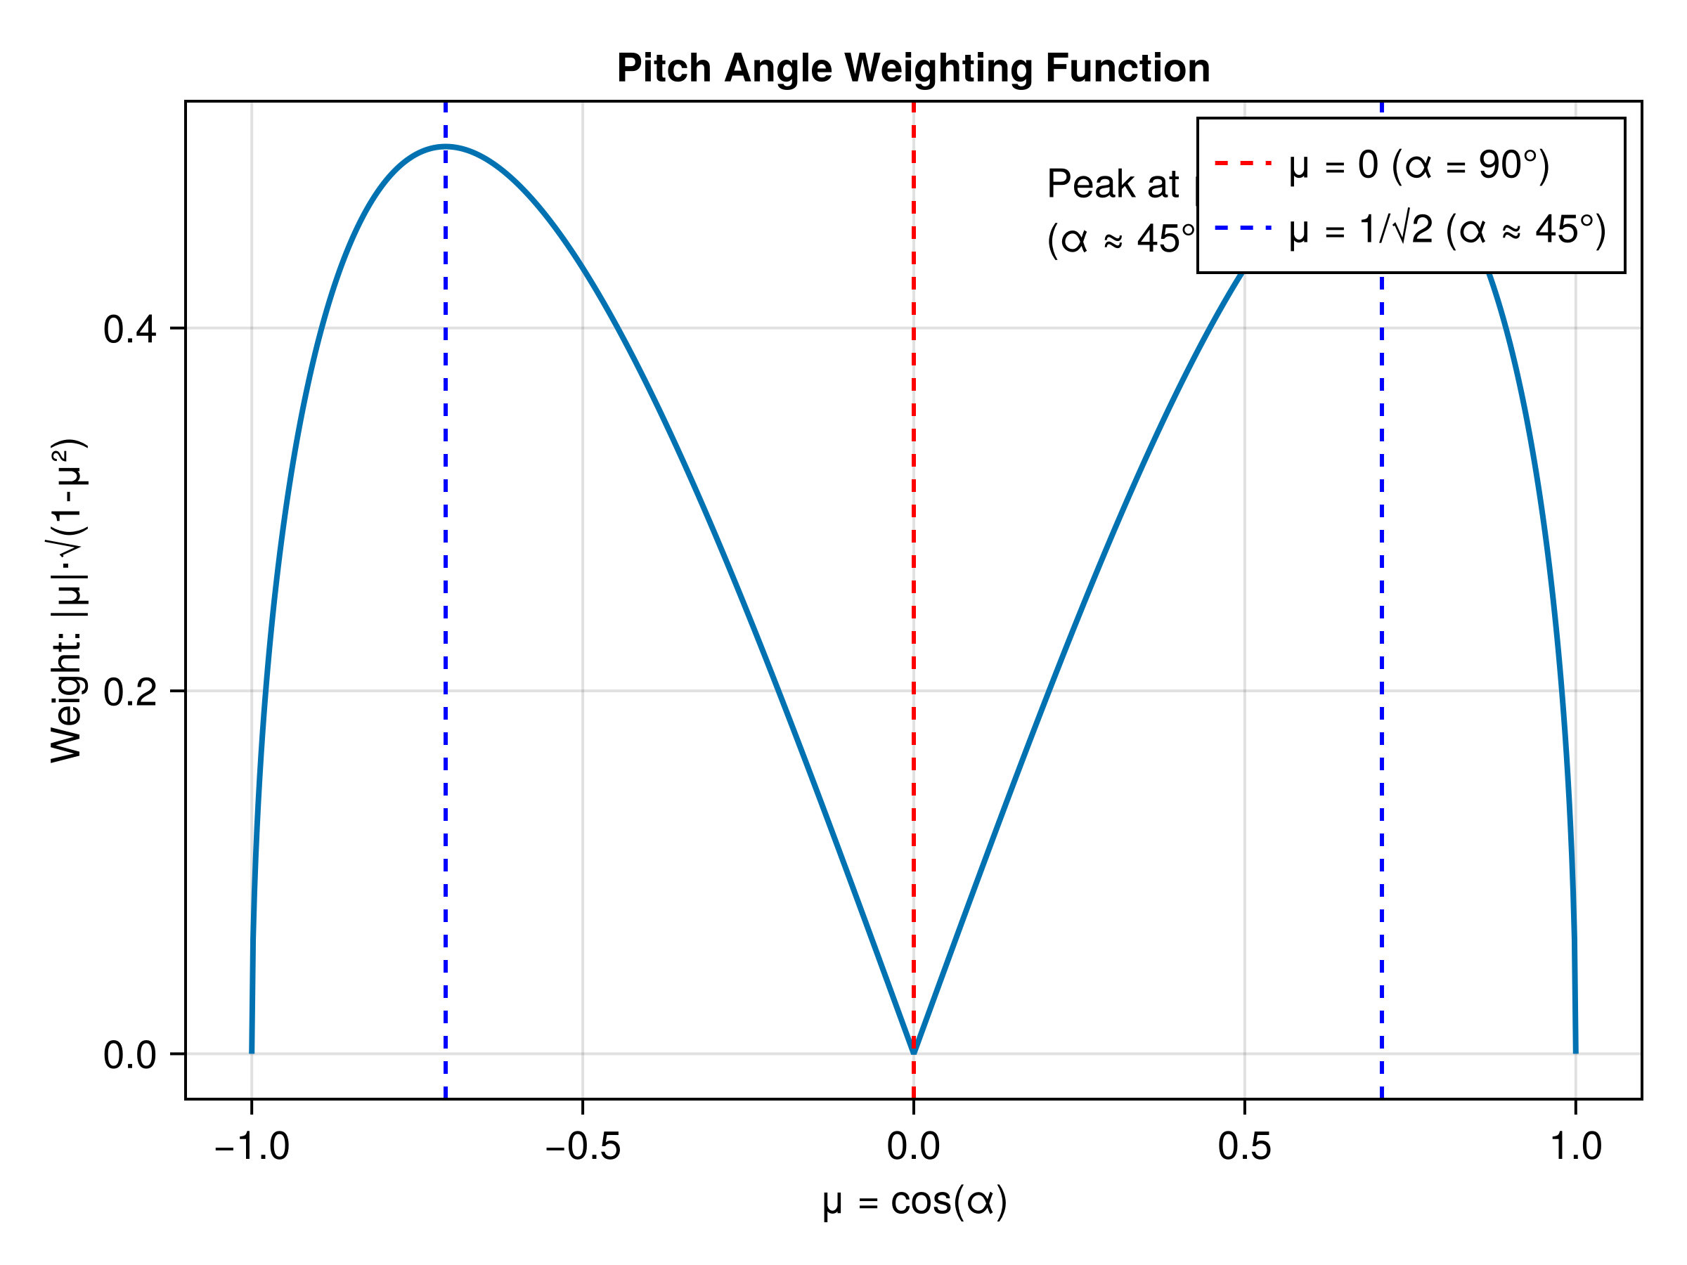

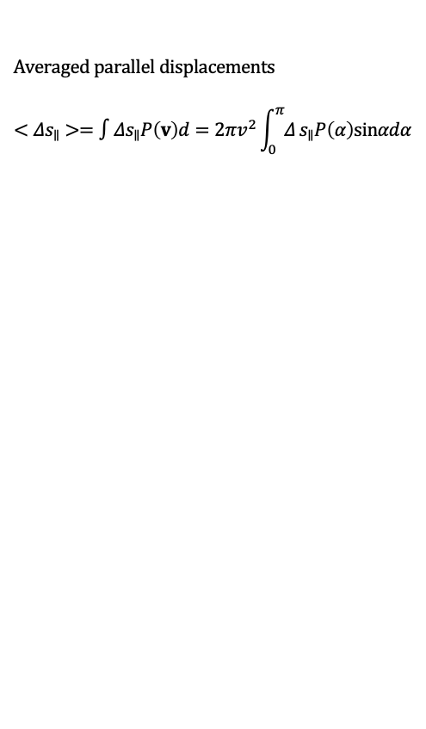
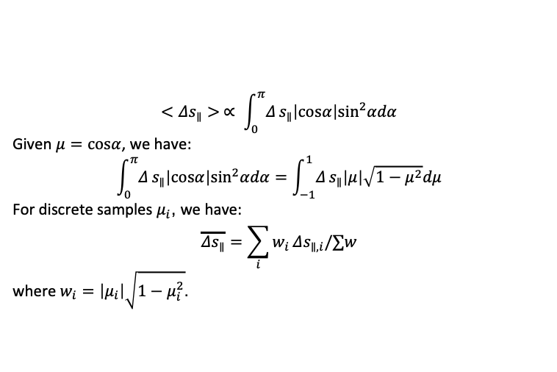

Averaged parallel displacements
$$<Δs_{∥}>=∫Δs_{∥}P\left(v\right)d=2πv^{2}\int_{0}^{π}{Δ}s_{∥}P\left(α\right)sinαdα$$
2 MeV protons
$$P\left(α\right)dα=d\left(\sin^{2}α\right) =>$$
$$P\left(α\right)=sinα\left|cosα\right|$$
$$<Δs_{∥}> ∝ \int_{0}^{π}{Δ}s_{∥}\left|cosα\right|\sin^{2}αdα$$
Given $μ=cosα$, we have:
$$\int_{0}^{π}{Δ}s_{∥}\left|cosα\right|\sin^{2}αdα=\int_{−1}^{1}{Δ}s_{∥}\left|μ\right|\sqrt{1−μ^{2}}dμ$$
For discrete samples $μ_{i}$, we have:
$$\overline{Δs_{∥}}=\sum_{i}^{​}{w_{i}}Δs_{∥,i}/∑w$$
where $w_{i}=\left|μ_{i}\right|\sqrt{1−μ_{i}^{2}}$.
$$l_{0}= 3×{10}^{3} \text{km}$$

Slide 28
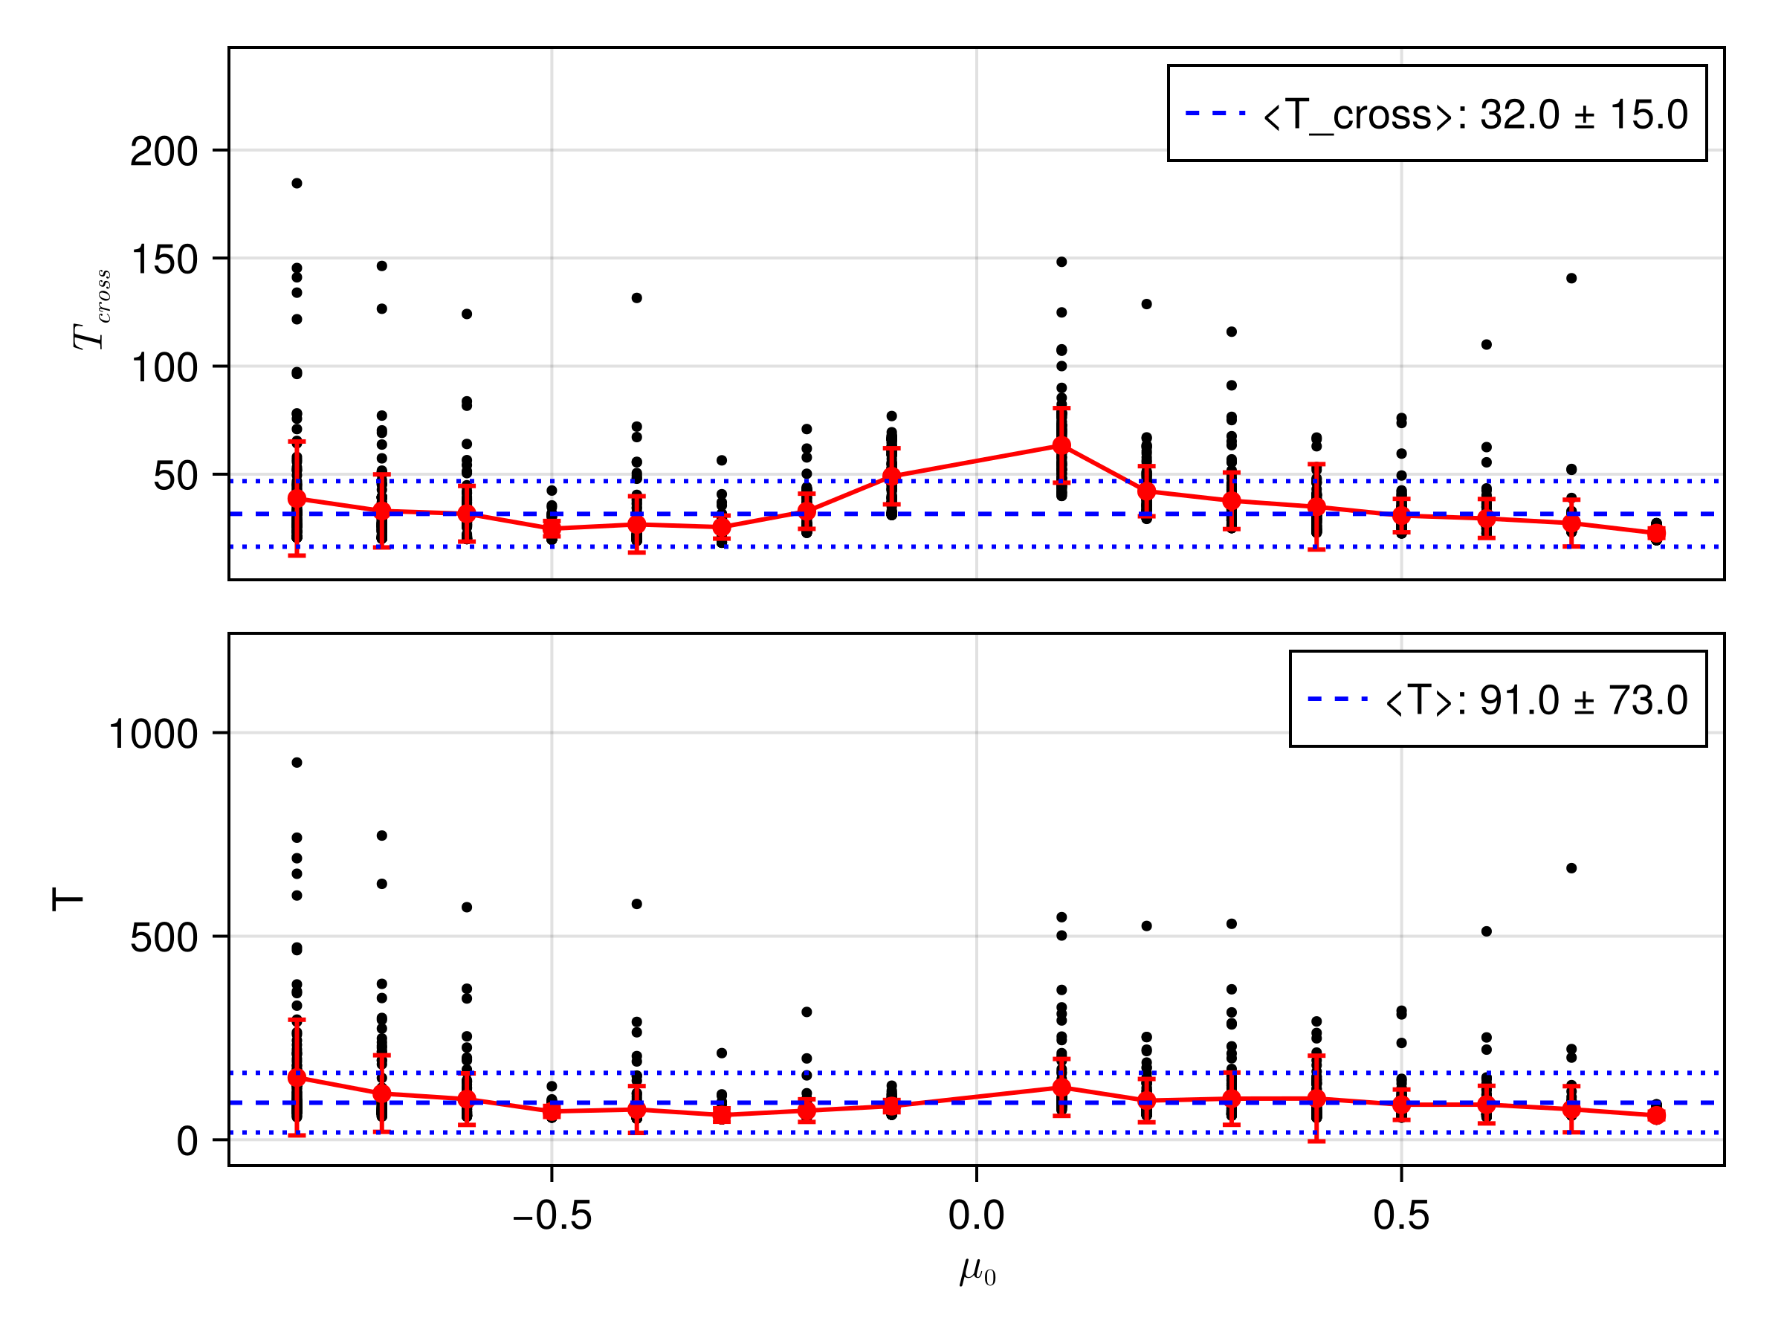
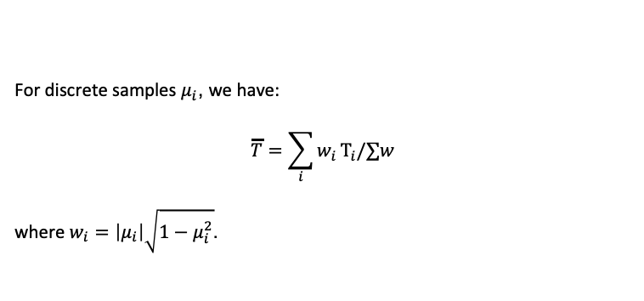
Averaged parallel displacements
$$<Δs_{∥}>=∫Δs_{∥}P\left(v\right)d=2πv^{2}\int_{0}^{π}{Δ}s_{∥}P\left(α\right)sinαdα$$
2 MeV protons
$$P\left(α\right)dα=d\left(\sin^{2}α\right) =>$$
$$P\left(α\right)=sinα\left|cosα\right|$$
For discrete samples $μ_{i}$, we have:
$$\overline{T}=\sum_{i}^{​}{w_{i}}T_{i}/∑w$$
where $w_{i}=\left|μ_{i}\right|\sqrt{1−μ_{i}^{2}}$.

Slide 29
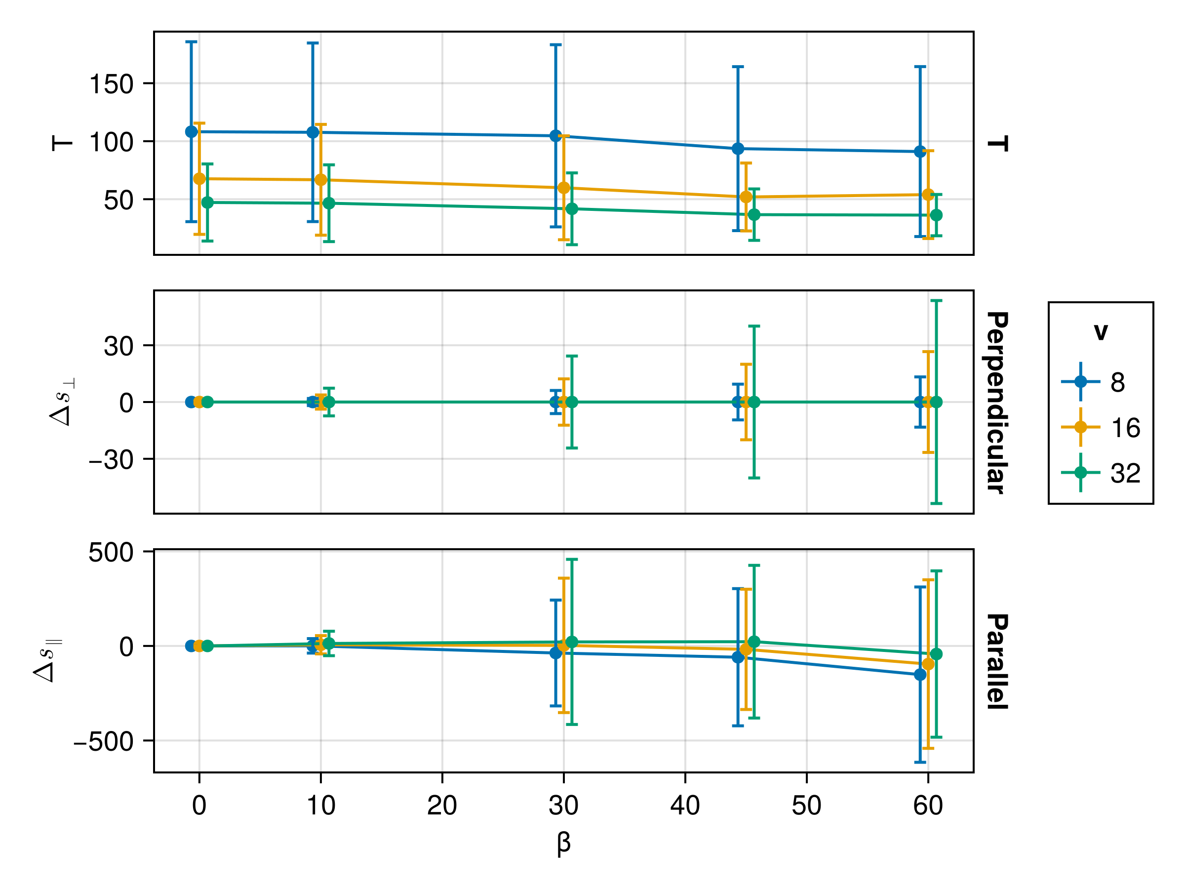


Towards the ensemble of current sheets
1. Polarity
Current sheets of left-hand or right-hand polarity have symmetry in perpendicular displacements. The net average perpendicular transport vanishes
$$\overline{Δs_{⊥}}=0$$
This polarity does not influence the parallel displacement.
2. Larger shear angle => increasing standard deviations of both parallel and perpendicular displacements
3. Higher energy=> larger standard deviation of perpendicular
Gyro-radius /
Thickness
$$l_{0}= 3×{10}^{3} \text{km}$$

Slide 30


The parallel spatial diffusion coefficient is then expressed as:
$$κ_{∥}=\sqrt{\frac{1}{∑w}\sum_{i=1}^{n}{w_{i}\frac{{\left(Δs_{∥,i}−\overline{Δs_{∥}}\right)}^{2}}{T_{i}}}}$$
Similarly, for the perpendicular direction:
$$κ_{⊥}=\sqrt{\frac{1}{∑w}\sum_{i=1}^{n}{w_{i}\frac{{\left(Δs_{⊥,i}−\overline{Δs_{⊥}}\right)}^{2}}{T_{i}}}}$$
where $T_{i}=T_{cs,i}+\left|s_{fs}/v_{∥,1,i}\right|$.
$$κ_{0}=l_{0}^{2}/t_{0}≈{10}^{7}{ \text{km}}^{2}{ \text{s}}^{−1}$$
Gyro-radius /
Thickness
Takeaway 3: Current sheets provide spatial diffusion beyond classical random-phase quasilinear framework

Slide 31



SPEDAS.jl : Julia-based Space Physics Environment Data Analysis Software framework

Slide 32


SPEDAS.jl : Julia-based Space Physics Environment Data Analysis Software framework.
Azimuthal field line visualization

Slide 33
References
Artemyev, A. V., A. I. Neishtadt, A. A. Vasiliev, V. Angelopoulos, A. A. Vinogradov, and L. M. Zelenyi. 2020. “Superfast Ion Scattering by Solar Wind Discontinuities.” Physical Review E 102 (3): 033201. https://doi.org/10.1103/PhysRevE.102.033201.
Desai, Mihir, and Joe Giacalone. 2016. “Large Gradual Solar Energetic Particle Events.” Living Reviews in Solar Physics 13 (1): 3. https://doi.org/10.1007/s41116-016-0002-5.
Giacalone, J., and J. R. Jokipii. 1999. “The Transport of Cosmic Rays Across a Turbulent Magnetic Field.” The Astrophysical Journal 520 (1): 204. https://doi.org/10.1086/307452.
Hussain, A. K. M. F. 1983. “Coherent Structures—Reality and Myth.” Physics of Fluids 26 (10): 2816–50. https://doi.org/10.1063/1.864048.
Liu, Y. Y., J. B. Cao, H. S. Fu, Z. Wang, Z. Z. Guo, and R. J. He. 2023. “Failures of Minimum Variance Analysis in Diagnosing Planar Structures in Space.” The Astrophysical Journal Supplement Series 267 (1): 13. https://doi.org/10.3847/1538-4365/acdd58.
Malara, Francesco, S. Perri, J. Giacalone, and G. Zimbardo. 2023. “Energetic Particle Dynamics in a Simplified Model of a Solar Wind Magnetic Switchback.” Astronomy & Astrophysics 677 (September): A69. https://doi.org/10.1051/0004-6361/202346990.
Malara, Francesco, Silvia Perri, and Gaetano Zimbardo. 2021. “Charged-Particle Chaotic Dynamics in Rotational Discontinuities.” Physical Review E 104 (2): 025208. https://doi.org/10.1103/PhysRevE.104.025208.
Moraal, H. 2013. “Cosmic-Ray Modulation Equations.” Space Science Reviews 176 (1): 299–319. https://doi.org/10.1007/s11214-011-9819-3.
Zelenyi, L. M., A. I. Neishtadt, A. V. Artemyev, D. L. Vainchtein, and H. V. Malova. 2013. “Quasiadiabatic Dynamics of Charged Particles in a Space Plasma.” Physics-Uspekhi 56 (4): 347. https://doi.org/10.3367/UFNe.0183.201304b.0365.

