Slide 1
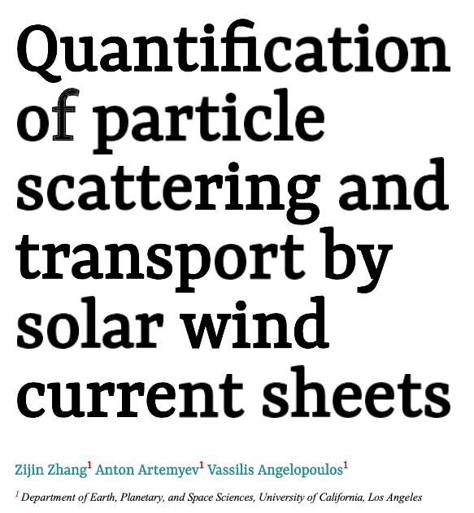
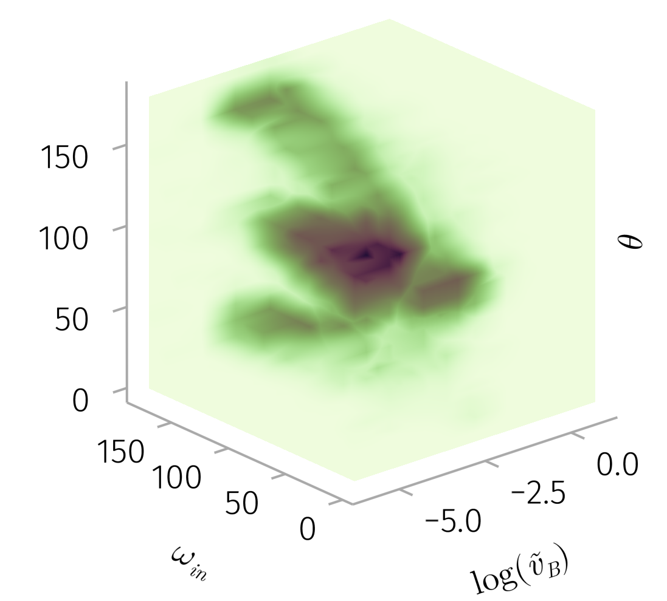
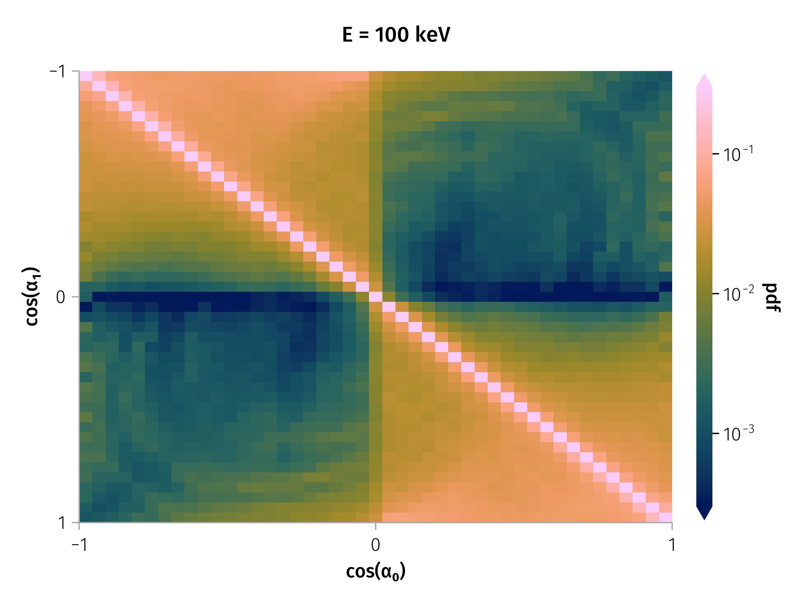
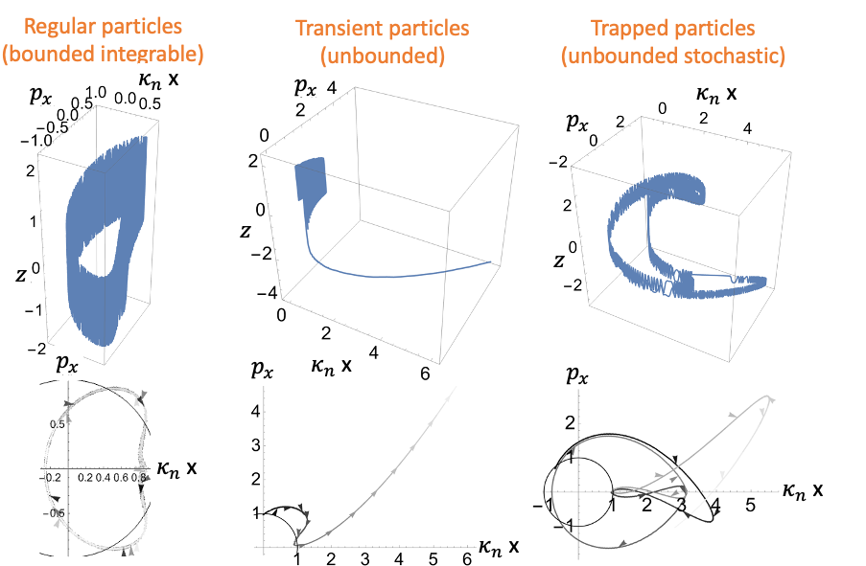
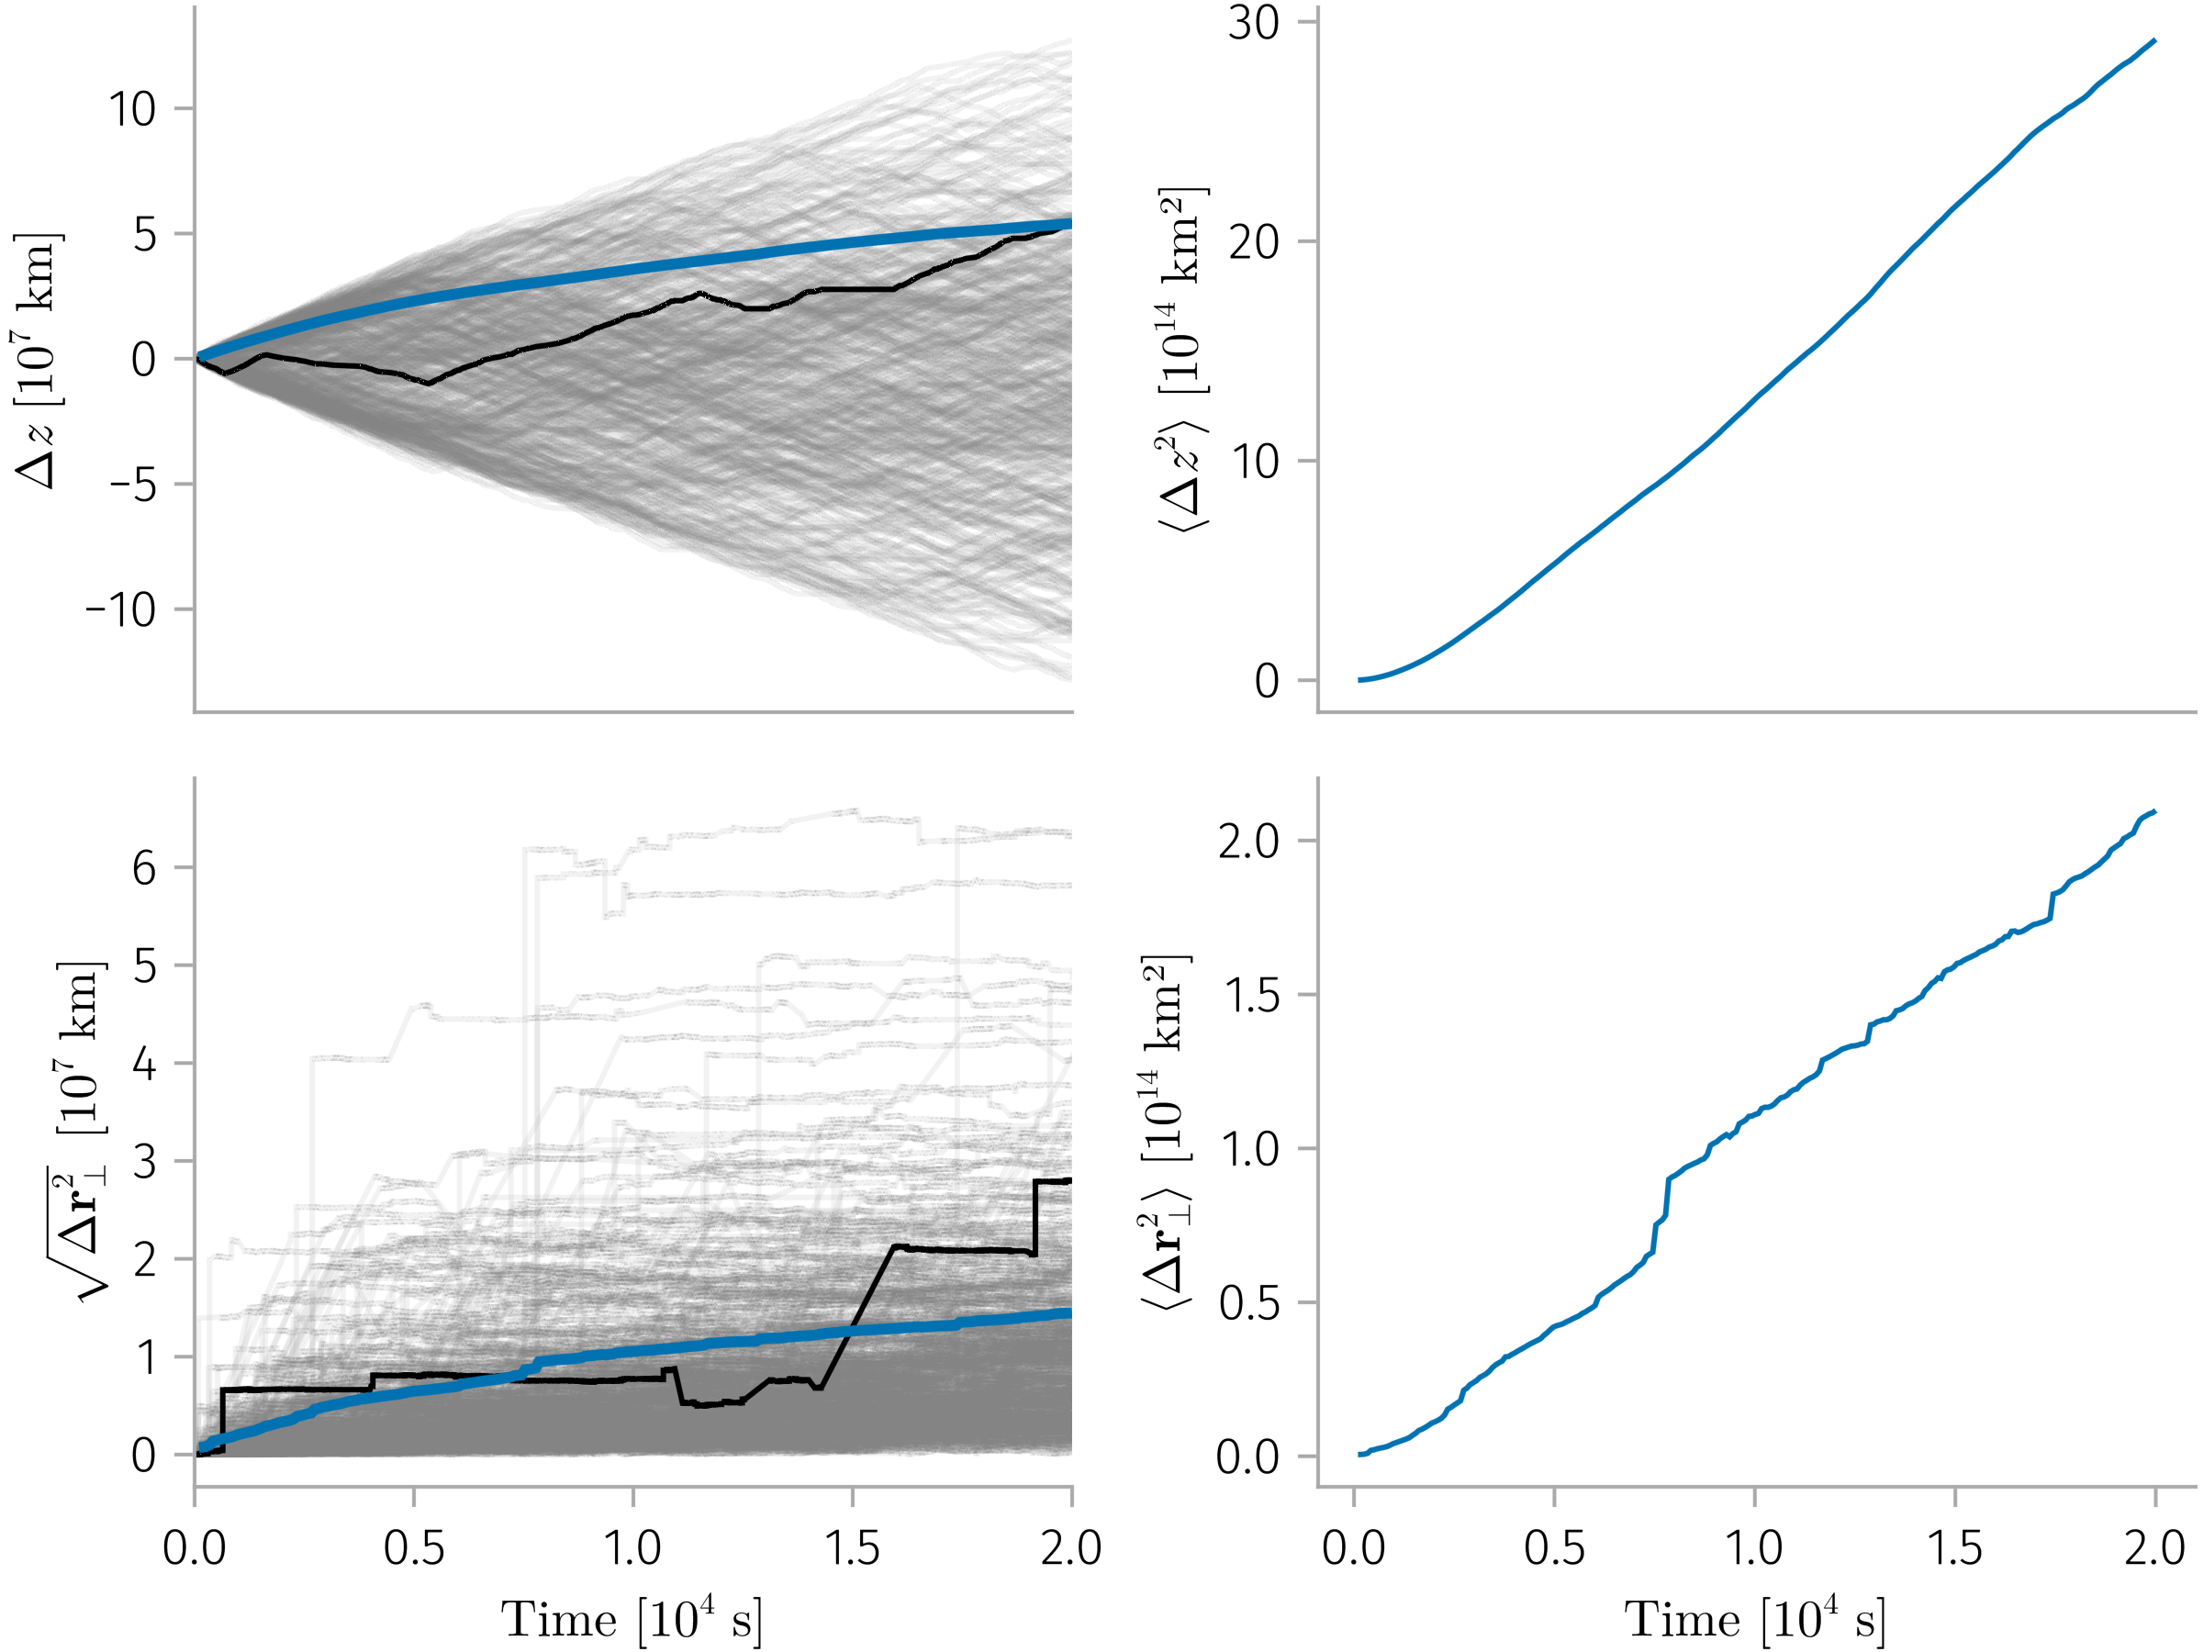


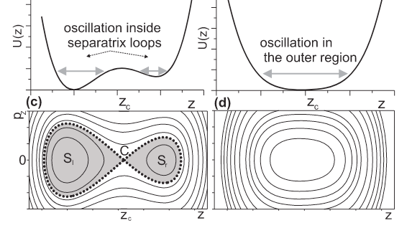
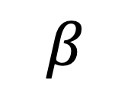
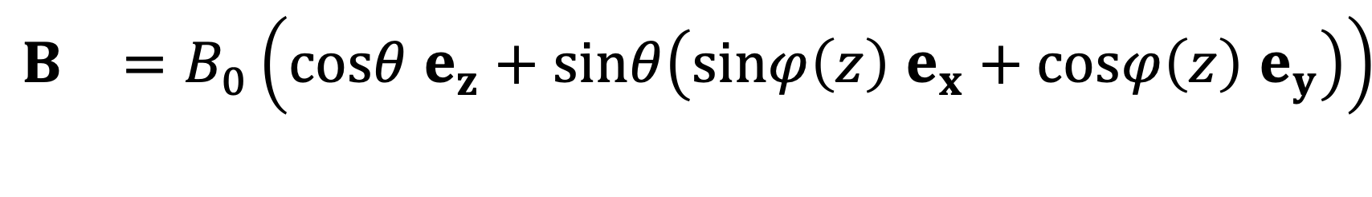
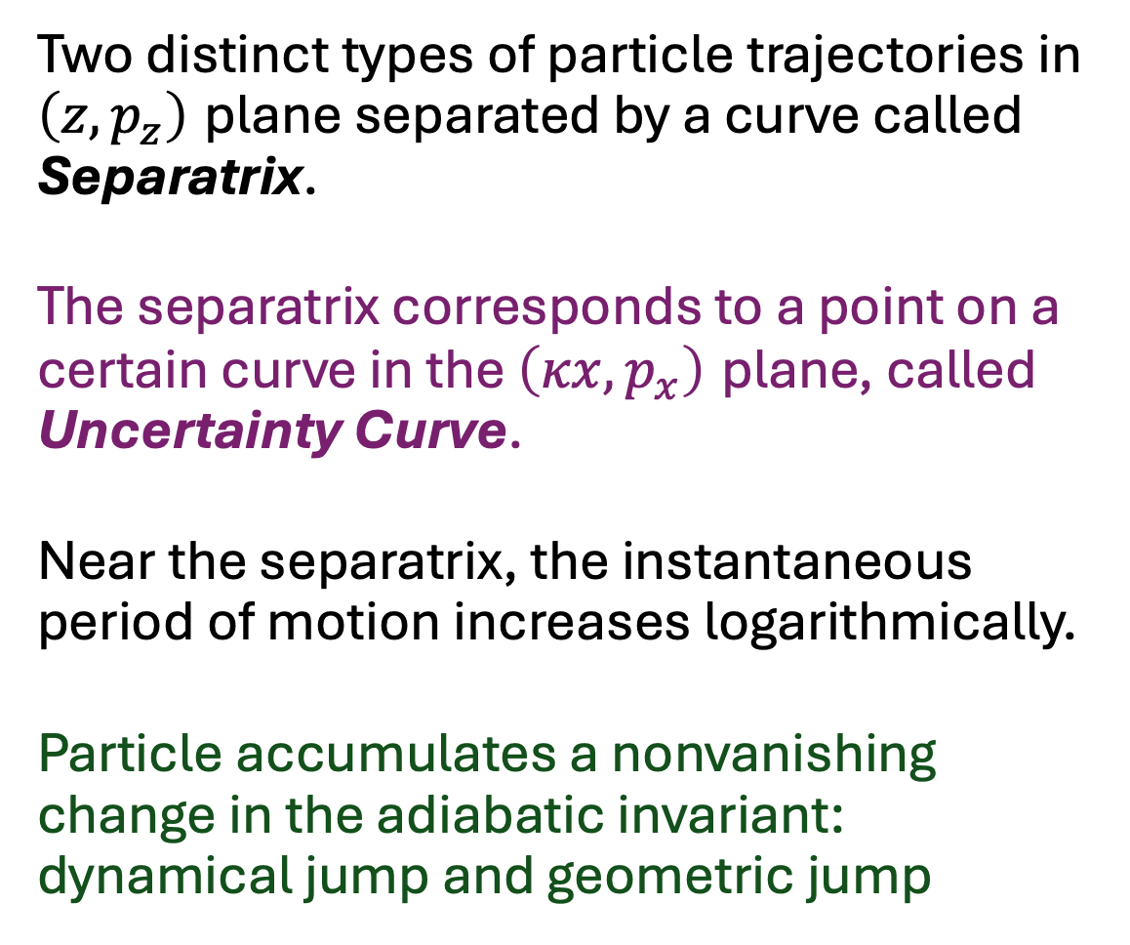


Current sheets characterized by large shear angles or relatively small thickness, can effectively scatter energetic particles and effect transport beyond the conventional diffusion framework.
C. Solar Wind Observation
We compiled a dataset of 100,000 current sheets, characterizing the current sheet parameters from the ARTEMIS and Wind missions.
Introduction & Motivation
$$\begin{matrix}B & =B_{0}\left(cosθ e_{z}+sinθ\left(sinφ\left(z\right) e_{x}+cosφ\left(z\right) e_{y}\right)\right) \\ & \end{matrix}$$
The transport of energetic particles within the heliosphere is significantly influenced by the turbulent magnetic field present in the solar. Rather than being a simple superposition of random fluctuations, these turbulent fields exhibit a structured nature, frequently observed in the solar wind magnetic field in the form of current sheets, discontinuities, Alfvén vortices, magnetic holes, and other coherent structures. These structures arise from nonlinear energy cascade processes and play a critical role in modulating particle transport.
B. Test particle simulation & Mapping
$$β$$
Transition matrix for 100 keV protons under
four magnetic field configurations and weighed transition matrix from observed distribution of current sheet at 1 AU.
A. Theory - Hamiltonian system
$$\tilde{H}=\frac{1}{2}\left({\left(\tilde{p_{x}}−f_{1}\left(z\right)\right)}^{2}+{\left(\tilde{x}cotθ+f_{2}\left(z\right)\right)}^{2}+{\tilde{p_{z}}}^{2}\right)$$
Particle have three types of trajectories in phase space
$$α_{n+1,i}=W\left(α_{n,i},ξ_{n,i}\right)$$
B.2. Long-term pitch angle, parallel and perpendicular evolution
Variables $\left(κx,p_{x}\right)$ change much slower than $\left(z,p_{z}\right)$ (for κ =$cotθ$ << 1)
Generalized magnetic moment $I_{z}={\left(2π\right)}^{−1}∮p_{z}dz$ is conserved as the first adiabatic invariant
Simultaneous conservation of energy and $I_{z}$ fully determines the motion of the particle
In the absence of $I_{z}$ destruction, there is no pitch-angle scattering
Two distinct types of particle trajectories in $\left(z,p_{z}\right)$ plane separated by a curve called Separatrix.
The separatrix corresponds to a point on a certain curve in the $\left(κx,p_{x}\right)$ plane, called Uncertainty Curve.
Near the separatrix, the instantaneous period of motion increases logarithmically.
Particle accumulates a nonvanishing change in the adiabatic invariant: dynamical jump and geometric jump
Perpendicular transport
induced by current sheets increases much more rapidly with particle energy than
parallel transport

