Slide 1

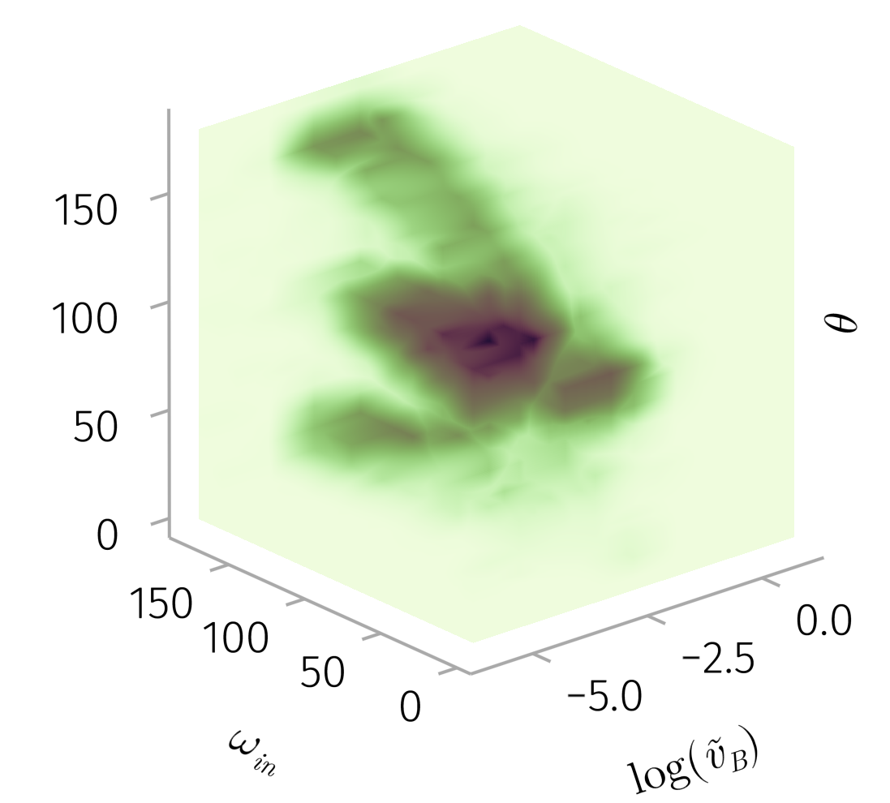

We quantify the role of solar wind current sheets in driving pitch-angle scattering
We conducted extensive test particle simulations to quantitatively model particle scattering and transport due to interactions with current sheets.
Our simulations suggest that the scattering efficiency depends critically on the current sheet’s shear angle, relative magnitude of the magnetic field component directed along the normal to the current sheet surface, and the ratio of the particle gyro-radius to the current sheet thickness
¹ Department of Earth, Planetary, and Space Sciences, University of California, Los Angeles
Introduction & Motivation
The transport of energetic particles within the heliosphere is significantly influenced by the turbulent magnetic field present in the solar. Rather than being a simple superposition of random fluctuations, these turbulent fields exhibit a structured nature, frequently observed in the solar wind magnetic field in the form of current sheets, discontinuities, Alfvén vortices, magnetic holes, and other coherent structures. These structures arise from nonlinear energy cascade processes and play a critical role in modulating particle transport.
We modelled the long-term pitch-angle evolution of particles in the presence of current sheets using mapping techniques.
Results
We compiled a dataset of 100,000 current sheets characterizing the current sheet parameters from the ARTEMIS and Wind missions.

