Slide 1
Ion scattering by solar wind discontinuities
Zijin Zhang Anton V. Artemyev Vassilis Angelopoulos

Slide 2
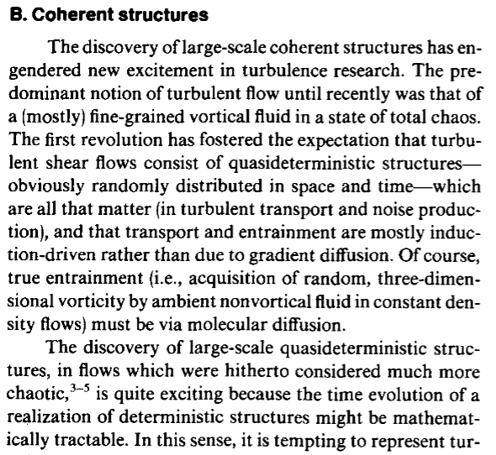

Slide 3
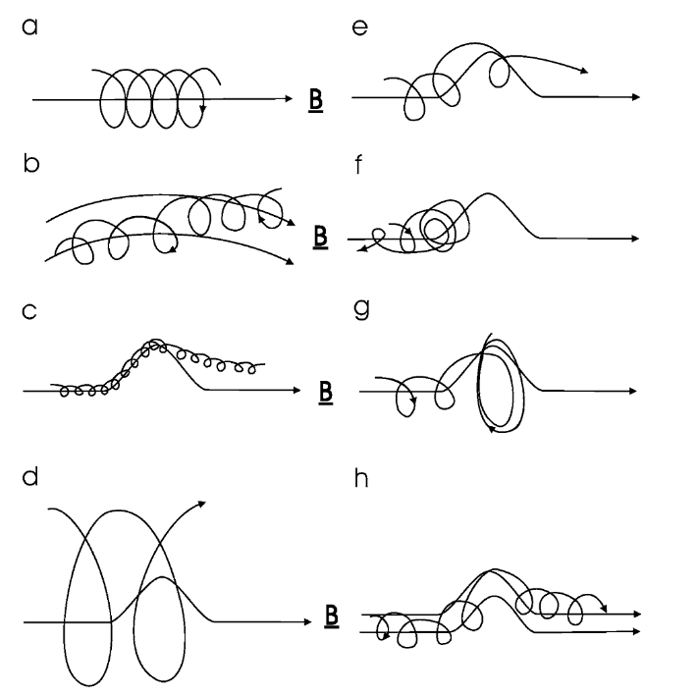
Introduction
The transport of energetic particles within the heliosphere is significantly influenced by the turbulent magnetic field present in the solar wind.
However, this turbulence should not be regarded merely as a collection of random magnetic field fluctuations. Instead, the nonlinear energy cascade process results in the formation of coherent structures.
These coherent structures have been shown to act as efficient particle scatterers in non-collisional plasmas (Artemyev et al. 2020).
Moraal (2013)

Slide 4
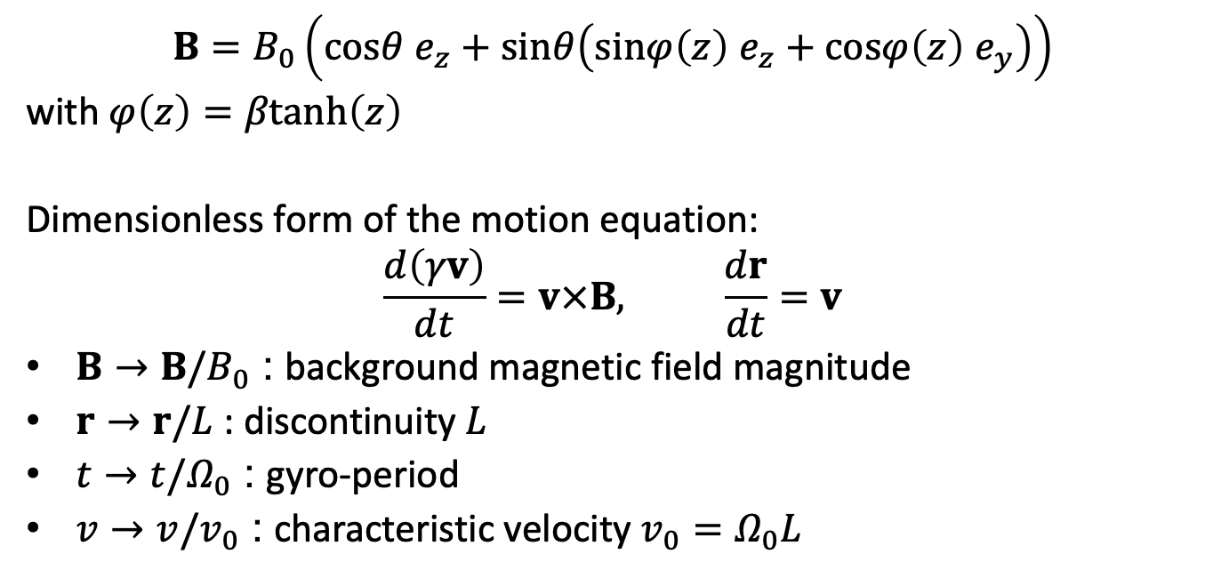
Test particle simulations
$$B=B_{0}\left(cosθ e_{z}+sinθ\left(sinφ\left(z\right) e_{z}+cosφ\left(z\right) e_{y}\right)\right)$$
with $φ\left(z\right)=βtanh\left(z\right)$
Dimensionless form of the motion equation:
$$\frac{d\left(γv\right)}{dt}=v×B, \frac{dr}{dt}=v$$
$B→B/B_{0}$ : background magnetic field magnitude
$r→r/L$ : discontinuity $L$
$t→t/Ω_{0}$ : gyro-period
$v→v/v_{0}$ : characteristic velocity $v_{0}=Ω_{0}L$

Slide 5
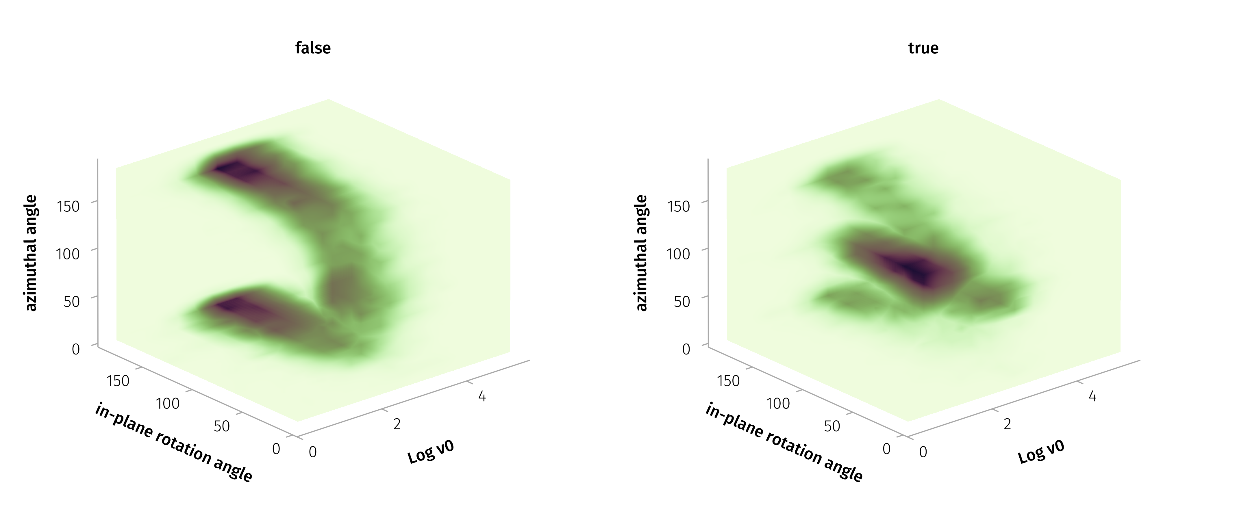

Parameters
$Δ\left|B\right|/\left|B\right|>0.05$ or $ω>60°$
The most probable values in the 3D distribution are a characteristic velocity ($v_{0}$) of approximately 250 km/s, a in-plane rotation angle ($ω_{in}$) about 90 degrees, and an azimuthal angle ($θ$) of around 85 degrees.

Slide 6
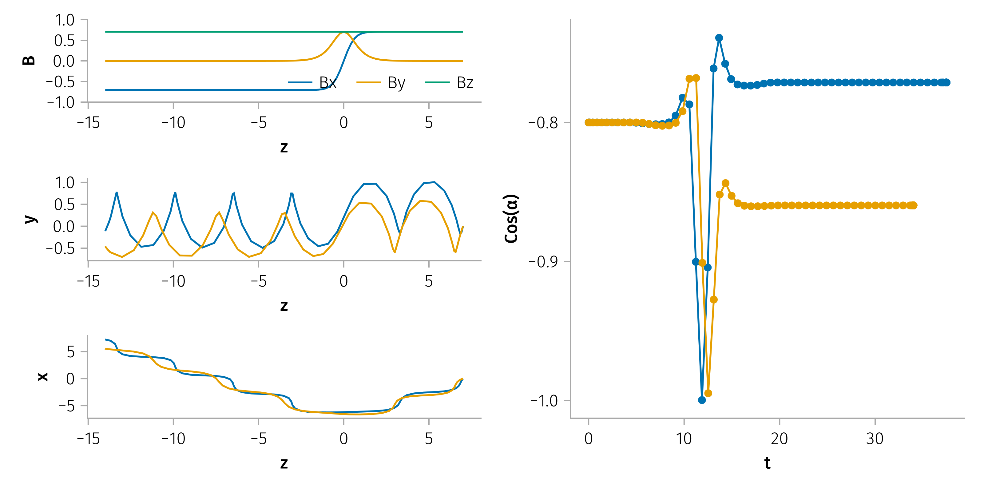
Examples of Pitch angle scattering

Slide 7
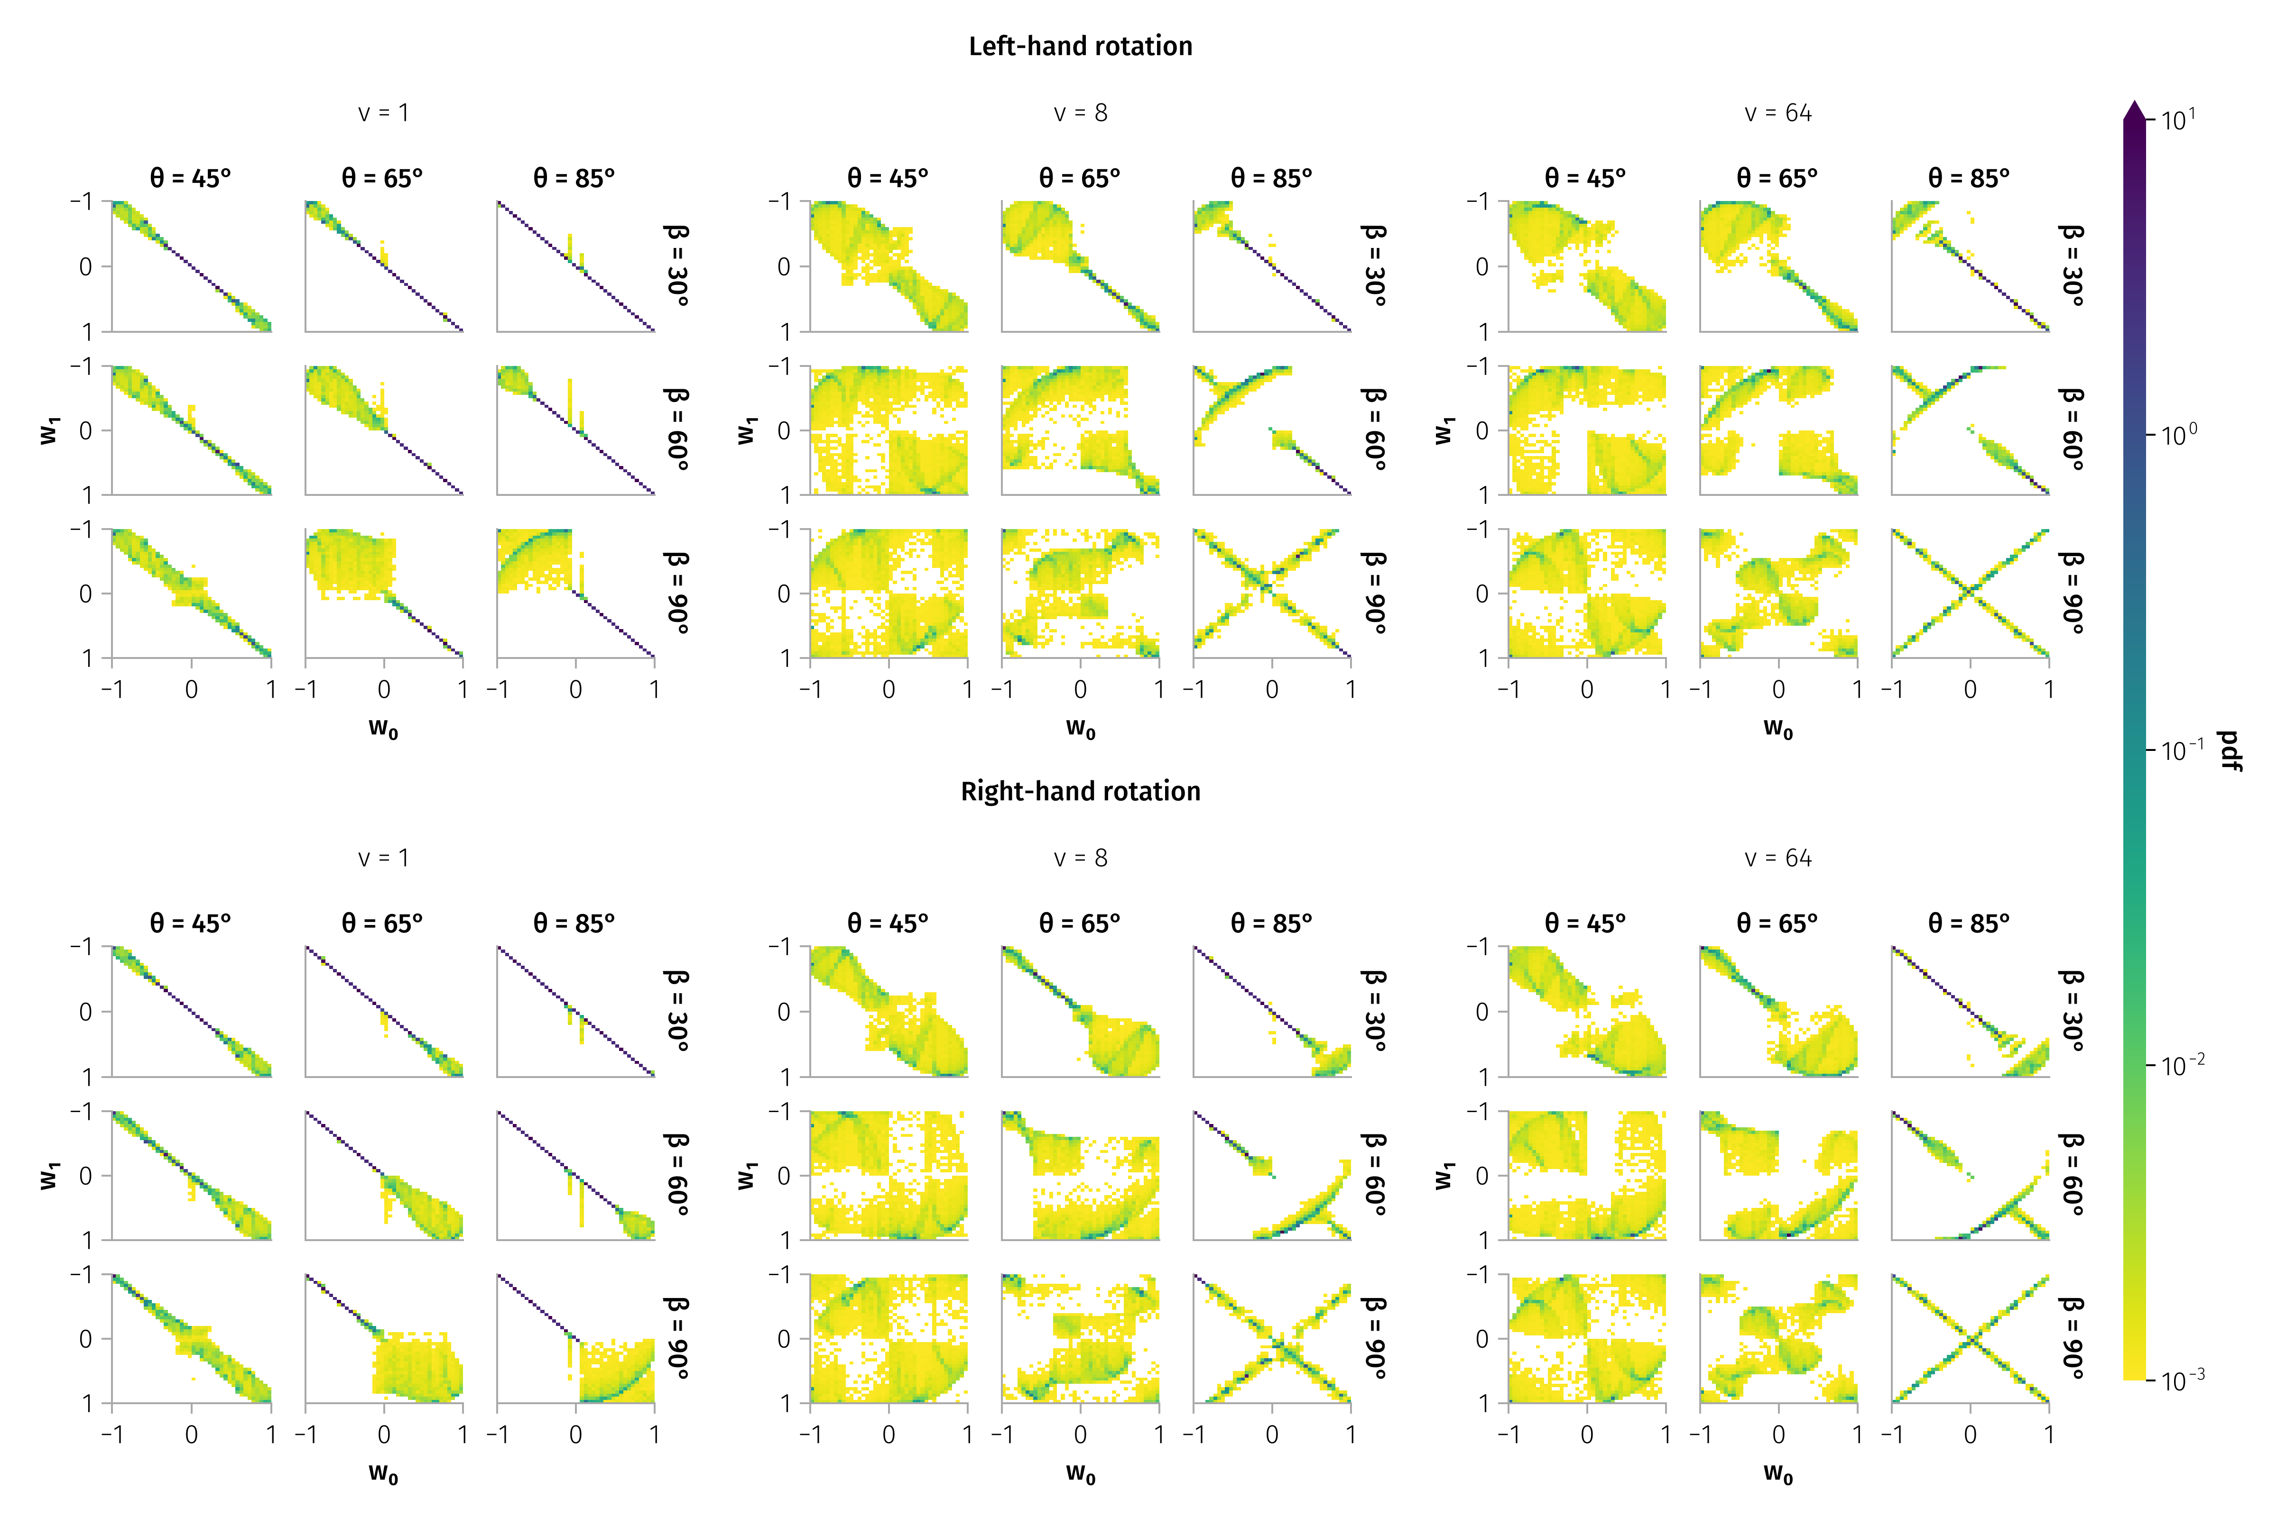
Examples of transition matrix
$$B=B_{0}\left(cosθ e_{z}+sinθ\left(sinφ\left(z\right) e_{z}+cosφ\left(z\right) e_{y}\right)\right)$$

Slide 8
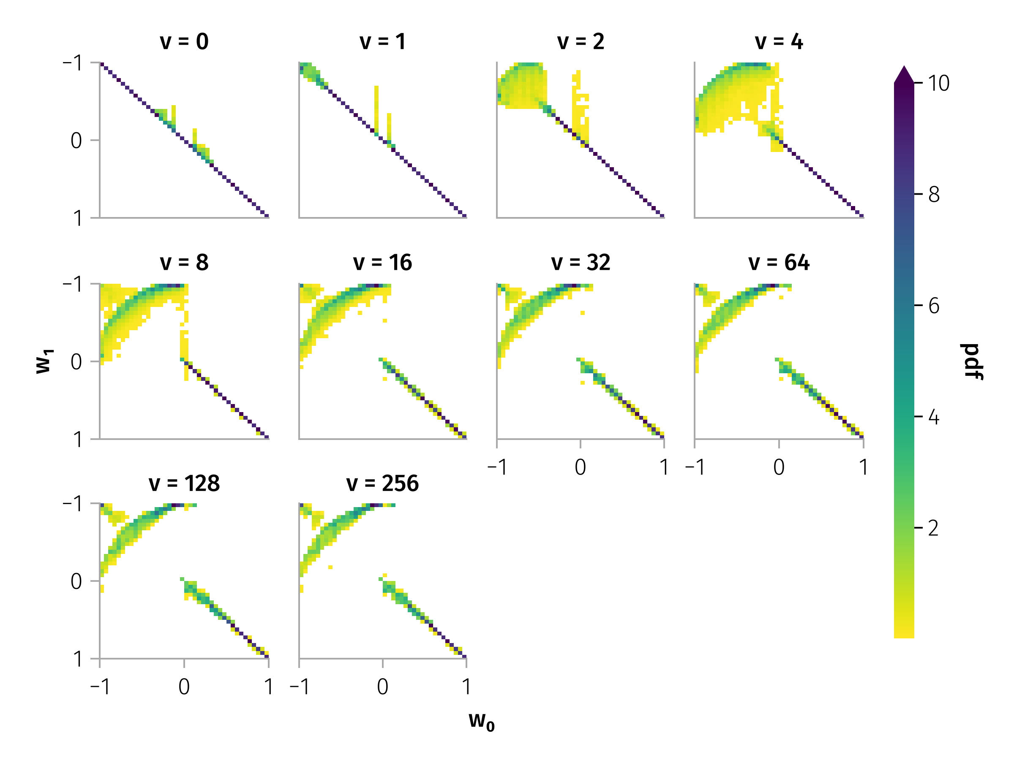

Pitch angle scattering by typical discontinuity
$$ω_{in}\sim 90\text{°}$$
$$θ \sim 85\text{°}$$

Slide 9
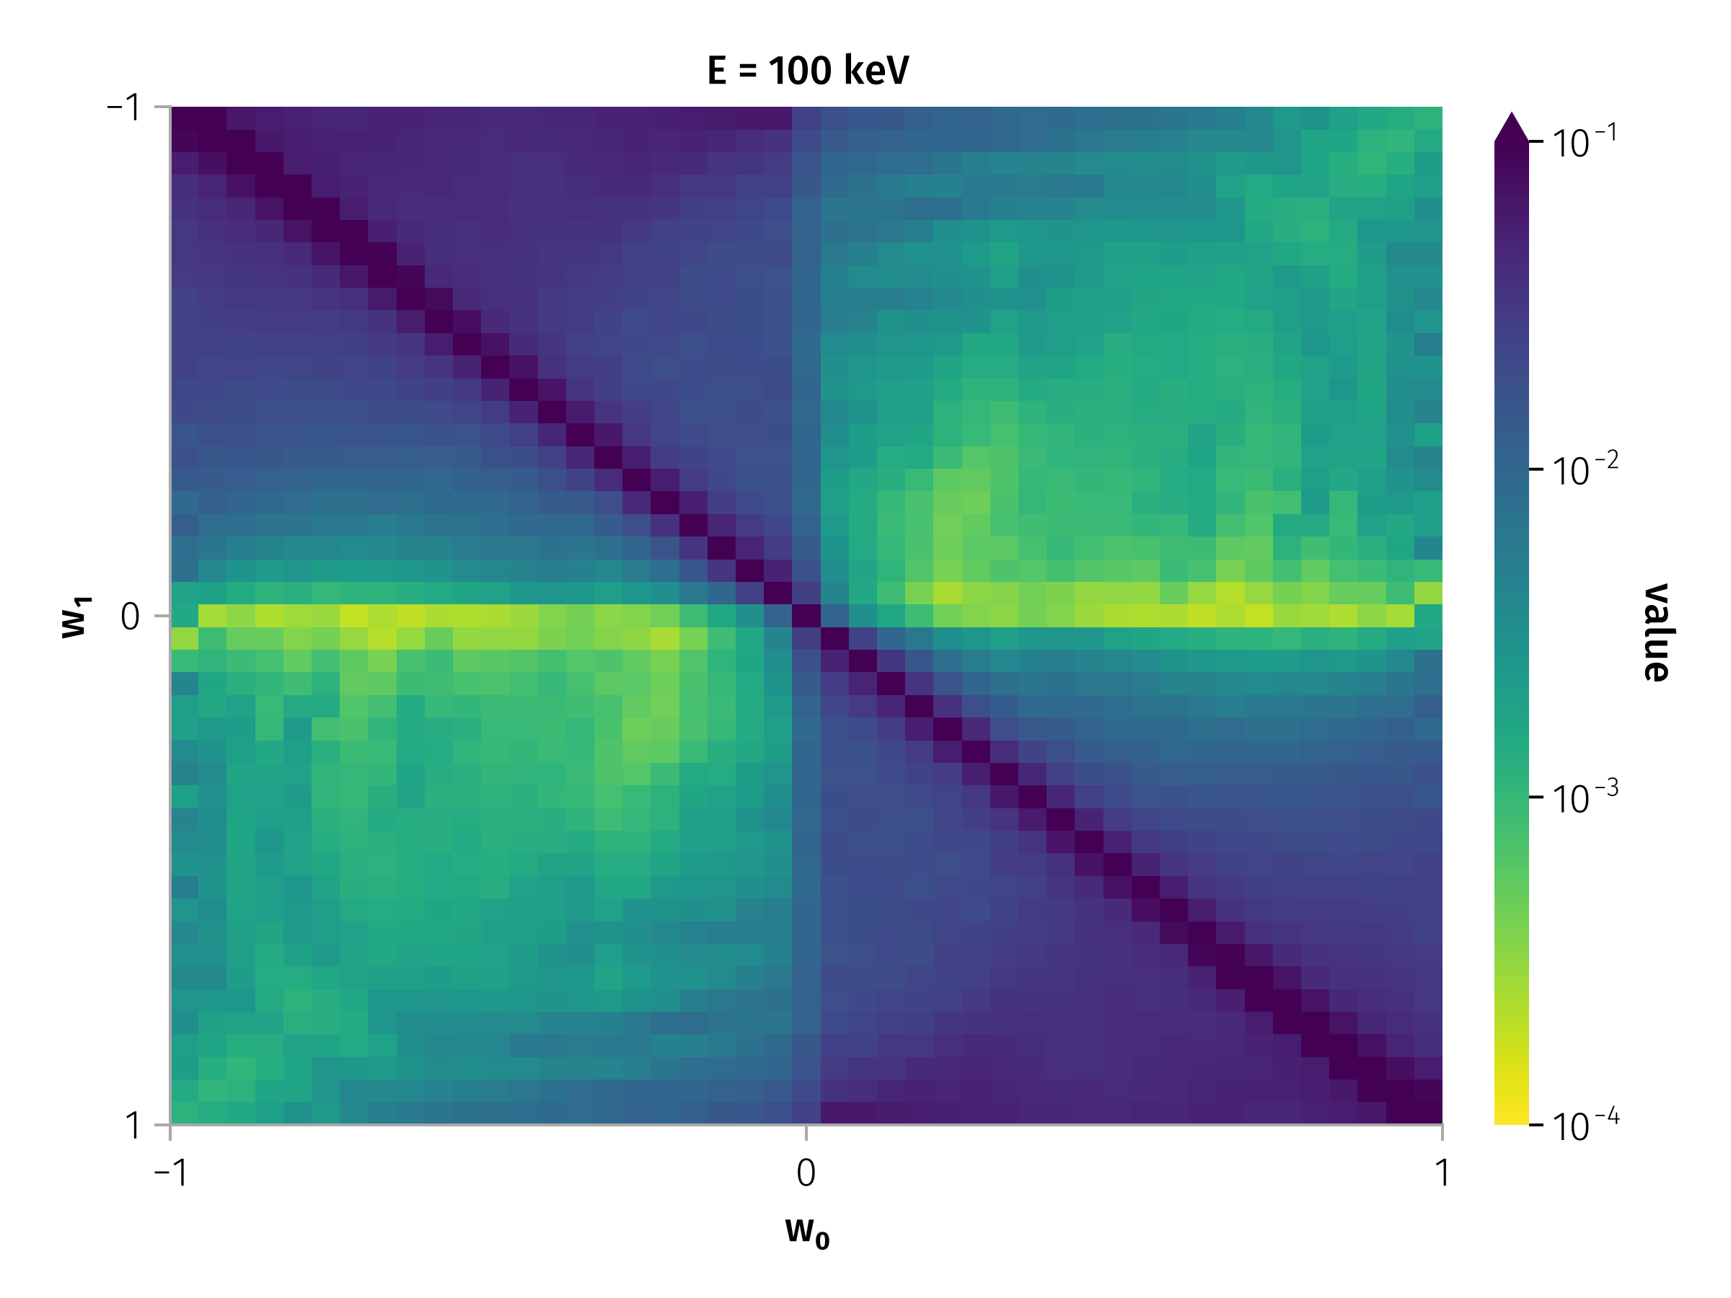
Transition matrix for 100 keV particles

Slide 10
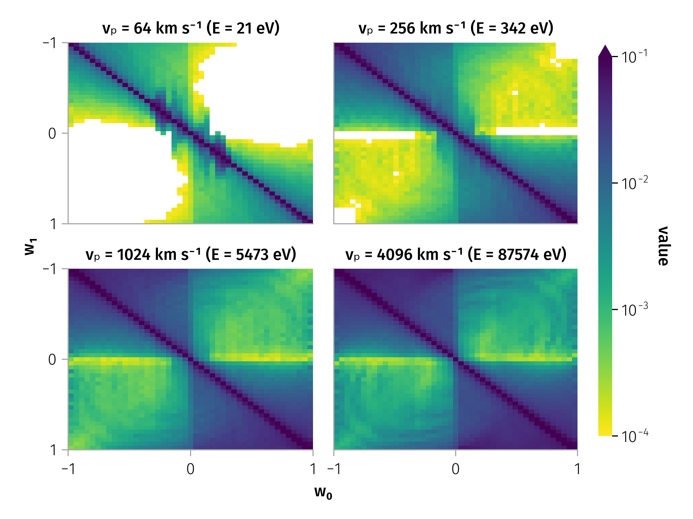
Transition matrix for different particle energies

Slide 11
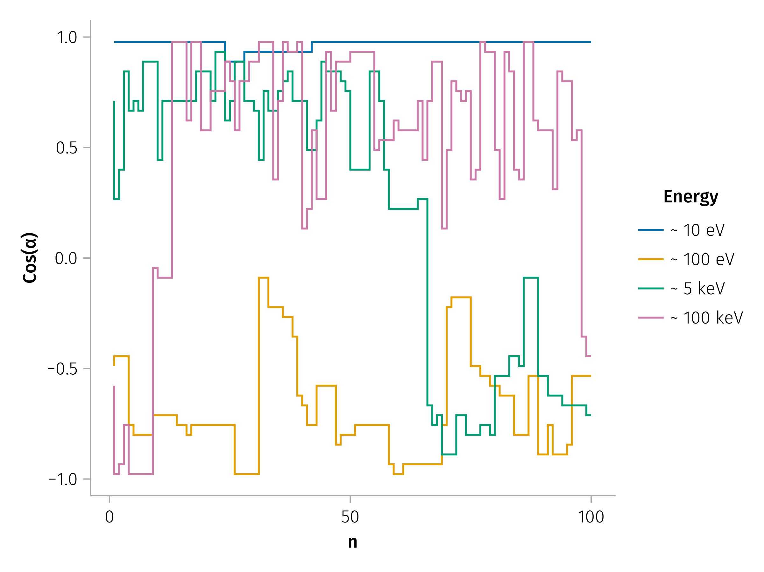
Example of multiple pitch angle scattering for different energies

Slide 12
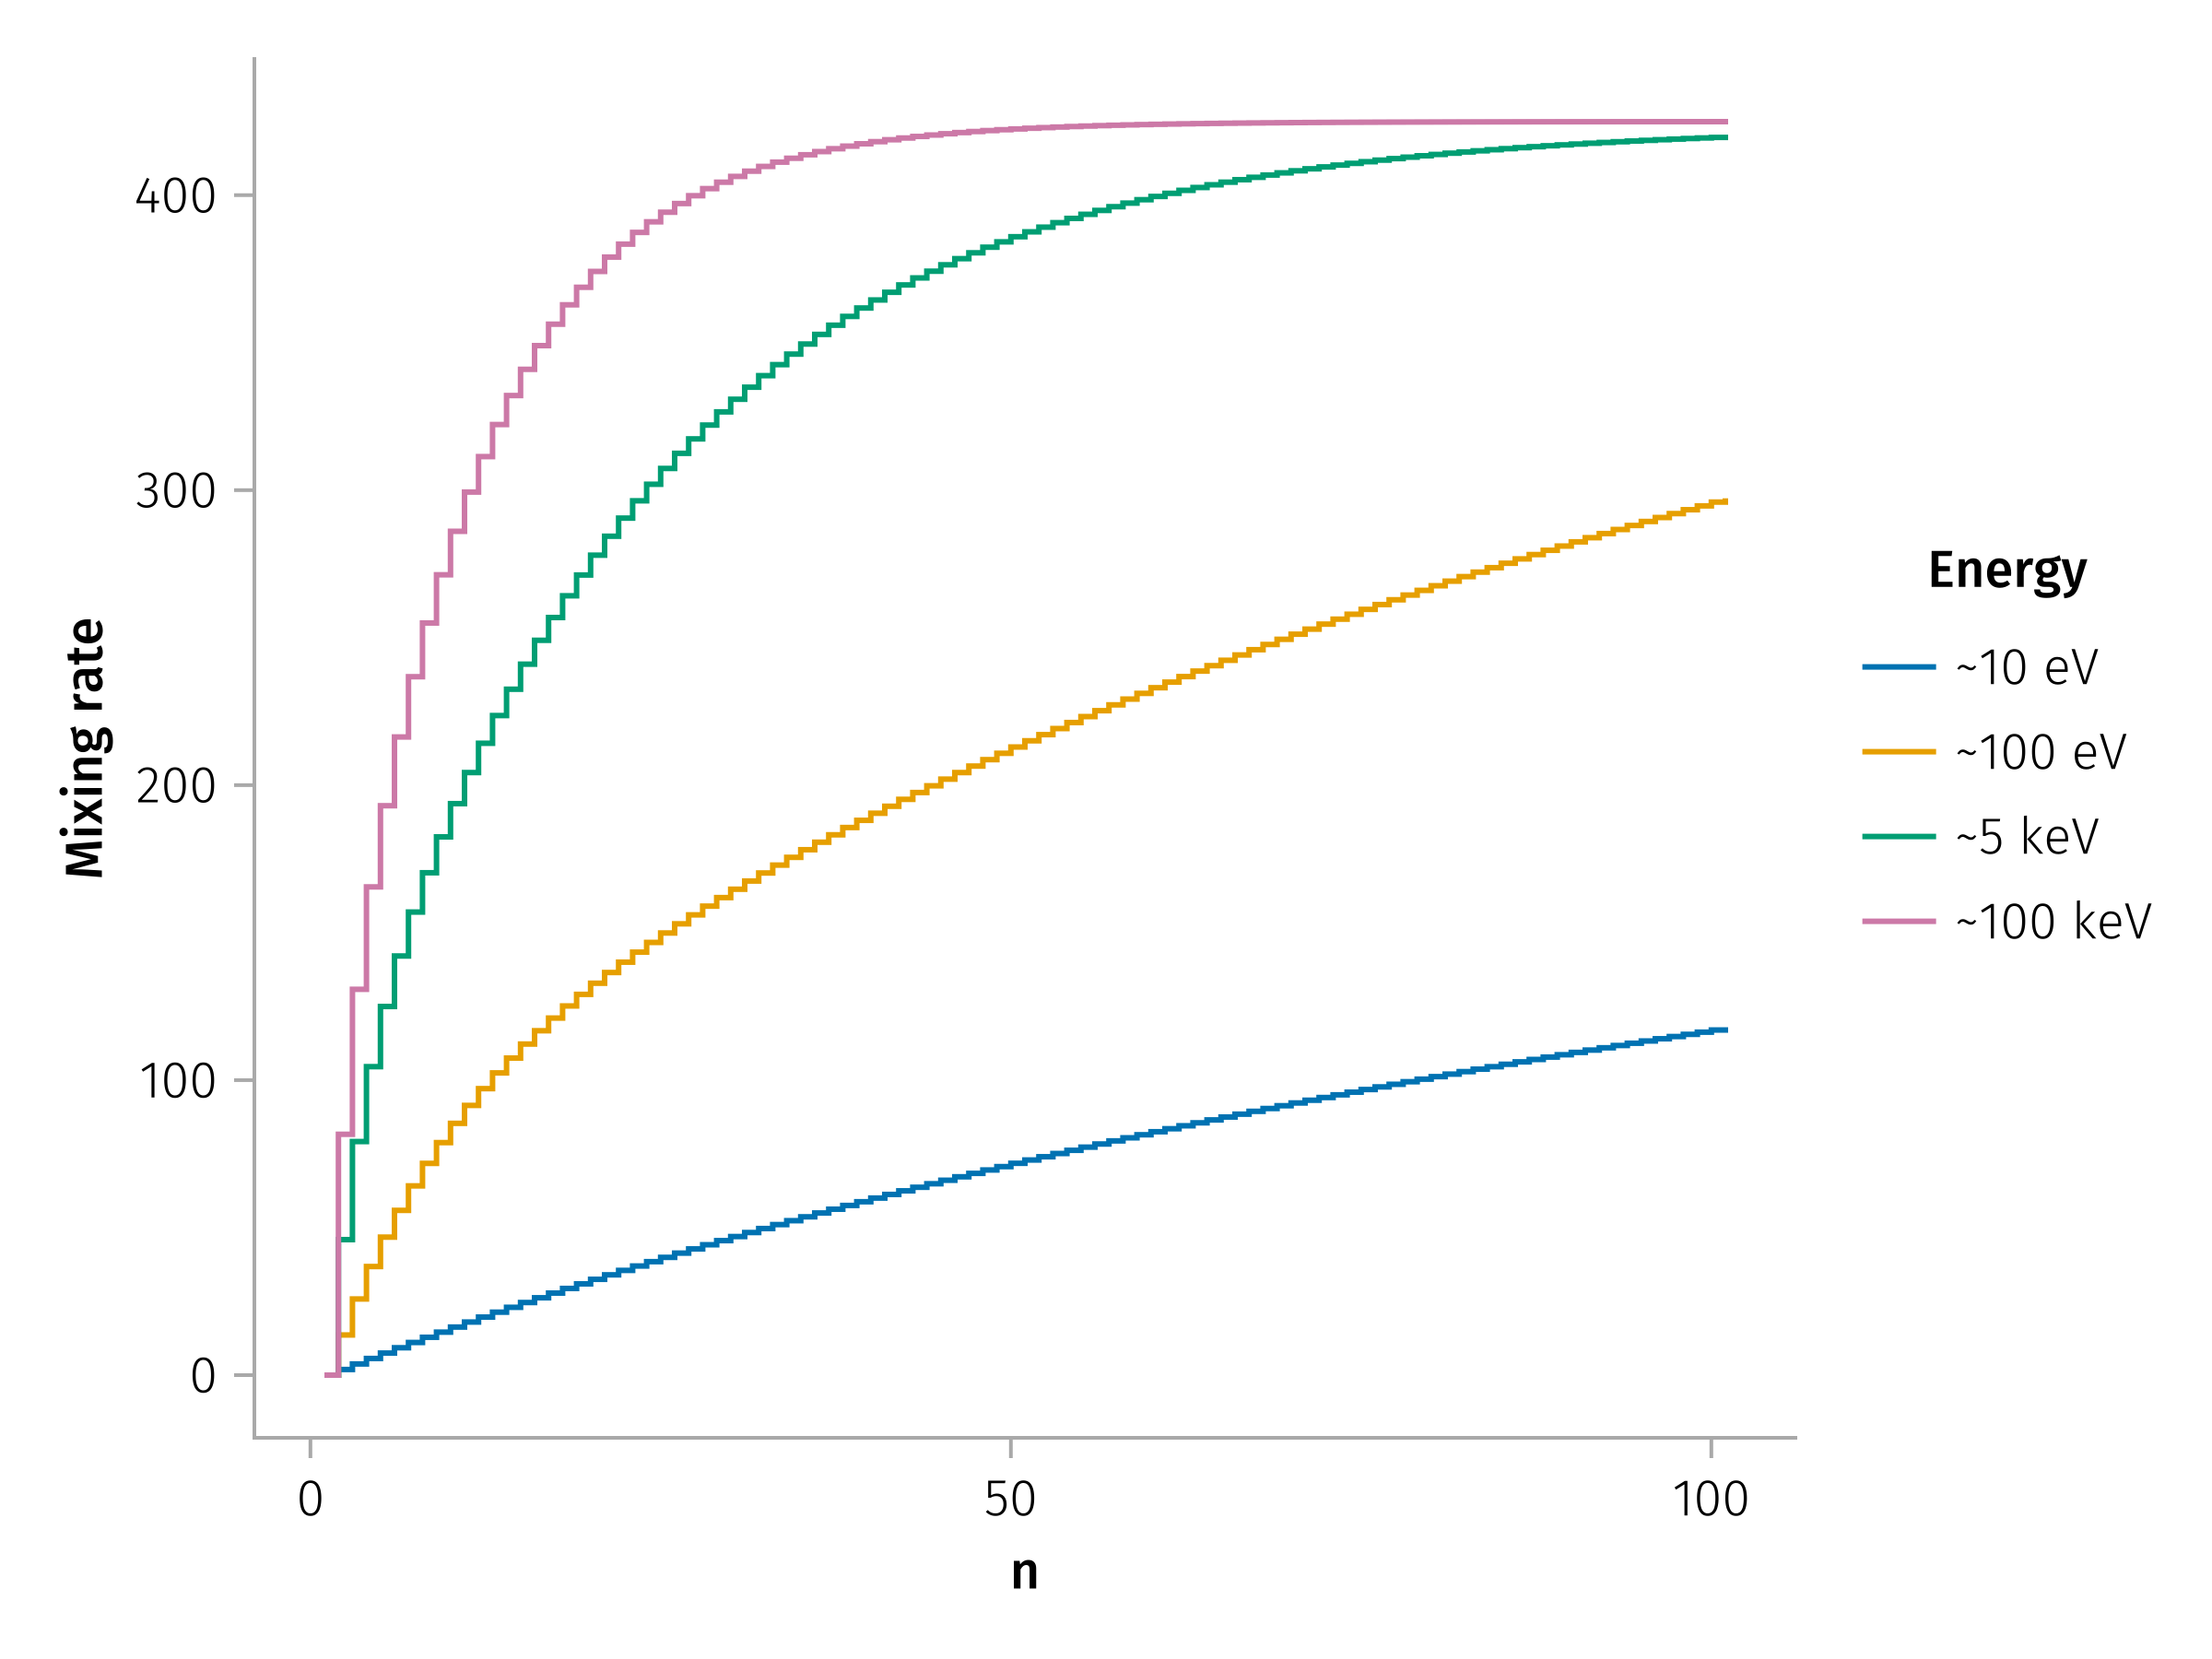
Mixing rates

Slide 13
References
Artemyev, A. V., A. I. Neishtadt, A. A. Vasiliev, V. Angelopoulos, A. A. Vinogradov, and L. M. Zelenyi. 2020. “Superfast Ion Scattering by Solar Wind Discontinuities.” Physical Review E 102 (3): 033201. https://doi.org/10.1103/PhysRevE.102.033201.
Moraal, H. 2013. “Cosmic-Ray Modulation Equations.” Space Science Reviews 176 (1): 299–319. https://doi.org/10.1007/s11214-011-9819-3.

