Slide 1

AI
HopeWorks ✦ AI4India
Proposal by
SAHELI
सहेली
India's First Voice-Native, Stealth Evidence Vault & Rights Companion for Women on Shared Phones
WitchHunt 2026 | HopeWorks × AI4India × Skills Café Track: Health & Well-Being ✦ Cross-track: Smart Cities, Education

Slide 2
AI
HopeWorks ✦ AI4India
CRISIS IN NUMBERS
43%
58%
67%
26%
74%
of Indian women do not own a smartphone
of rural women use shared devices
harassment cases go unreported
DV conviction rate due to evidence gaps
Nirbhaya Fund still sits unspent
Existing apps require a personal device
Shared phones mean constant surveillance
Fear + no private channel = forced silence
Without evidence, cases collapse
Systemic failure at the last mile
Every existing solution assumes private smartphones, stable internet, and high digital literacy. 180M+ Indian women have none of these. Saheli is built for that gap.
Sources: NSSO ✦ IAMAI ✦ GSMA Connected Women 2024 ✦ NCRB ✦ NARI ✦ NALSA

Slide 3
AI
HopeWorks ✦ AI4India
Problem Statement
Shared phones make safety and rights invisible for 180M+ Indian women.
Problem Statement Expansion
Most women's safety tools assume individual smartphone ownership, stable internet, and English literacy. 43% of Indian women don't own a phone. 58% in rural areas share devices with those they need protection from. Any visible app is a danger.
How it manifests for the user
Safety apps are visible on shared devices — a DV survivor cannot install them. Complex UI excludes WhatsApp-first users. SOS-only tools miss legal aid, evidence documentation, and scheme access.
How it impacts the user or client
PROBLEM STATEMENT
Abuse stays undocumented and cases collapse. Women miss legal aid, government schemes, and care. Institutions exist — OSCs, NALSA, ASHA — but the last-mile connection fails the women who need it most.
The Invisible Evidence Gap

Slide 4

AI
HopeWorks ✦ AI4India
Project Details
SAHELI (सहेली)
A voice-native, stealth-first evidence vault and rights companion disguised as a devotional app. One sentence in Hindi triggers evidence capture, legal guidance, SOS alerts, scheme eligibility, and health screening — all offline-capable on a ₹1,000 phone.
DEMOGRAPHIC IT IMPACTS
Women aged 18–45 in tier-2/3 India: shared-phone households, rural users with feature phones, low-literacy survivors navigating abuse, harassment, and health gaps.
COMPETITION TRACK
Health & Well-Being ✦ Smart Cities ✦ Education

Slide 5
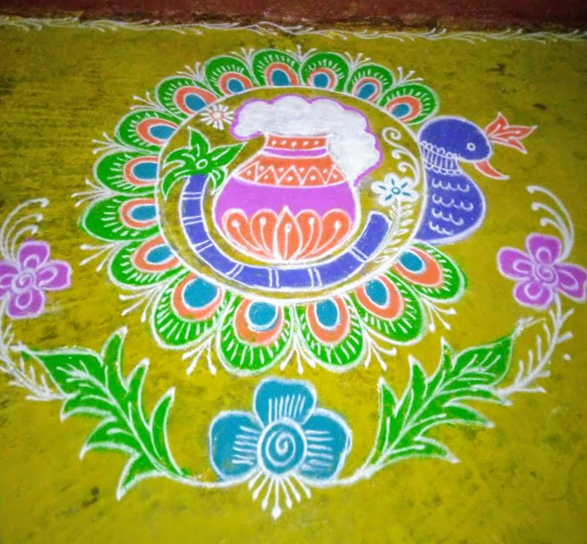
AI
Saheli Design Principles
HopeWorks ✦ AI4India
Built for real humans, not hypothetical users.
✦
Voice-first: one conversation replaces every form and every menu
✦
Stealth-first: invisible on shared phones, hidden inside a devotional app
✦
Offline-first: works on ₹1,000 phones with zero data plan
✦
Build for need and necessity — not comfort and convenience
✦
Assume constraints, not perfect conditions
✦
Design for simplicity, empathy, and dignity
✦
Aim for solutions that actually change someone's day-to-day reality
✦
Reach the woman with the shared phone first — she is the real user

Slide 6
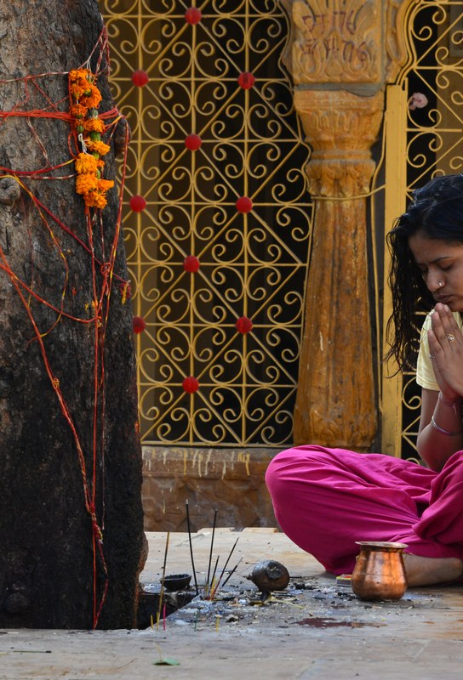
USER PERSONA 1
HopeWorks ✦ AI4India
ABOUT THE USER
TRAITS
Priya lives with an abusive husband who controls the phone, the money, and what apps stay installed. She needs to document abuse, understand her rights, and find help — without ever appearing to do so.
✦ Cautious ✦ Resourceful ✦ Protective ✦ Hindi-first ✦ Privacy-sensitive
TRIGGER MOMENTS
PROBLEMS
GOALS AND NEEDS
✦ Phone use is monitored ✦ Needs proof without a visible app ✦ Wants rights explained safely
✦ No secure evidence storage ✦ Limited DV Act knowledge ✦ Cannot openly ask for help
✦ Capture proof invisibly ✦ Understand maintenance, custody & property ✦ Reach OSC or trusted contacts
PRIYA
• 35 years old • Lucknow • Shared-phone mother • 2 children
✦ JOURNEY SNAPSHOT
Week 1: friend installs 'Daily Mantras', husband approves → Week 4: 7 evidence items SHA-256 hashed → Week 6: stealth SOS configured → Week 8: OSC contacted with full case file

Slide 7
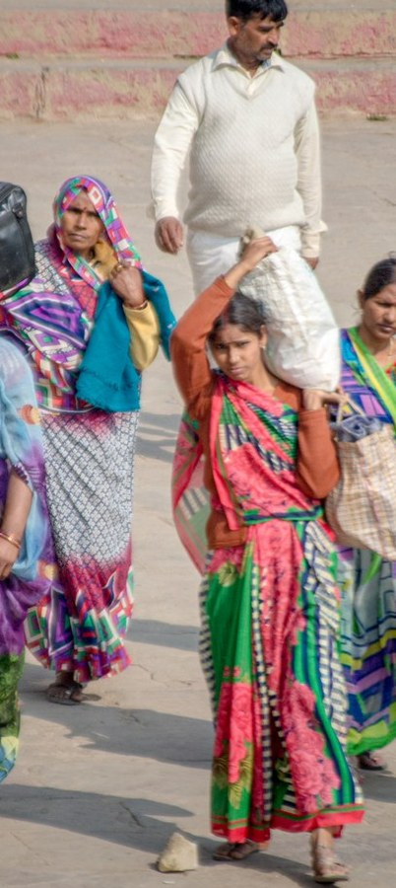
USER PERSONA 2
HopeWorks ✦ AI4India
ABOUT THE USER
TRAITS
Sunita has lived with severe period pain for 13 years and calls it normal because care is expensive and no one explained otherwise. She needs structured screening, affordable medicine, and a Hindi doctor-ready summary.
✦ Resilient ✦ Underdiagnosed ✦ Budget-conscious ✦ Working daily ✦ Seeks relief
TRIGGER MOMENTS
PROBLEMS
GOALS AND NEEDS
✦ Pain is normalized at home ✦ Doctor visits feel expensive ✦ Needs simple Hindi guidance
✦ No symptom history to share ✦ No structured screening flow ✦ Affordable care hard to find
✦ Track symptoms over time ✦ Access Jan Aushadhi (₹3/day vs ₹30) ✦ Carry a structured Doctor Card
SUNITA
• 29 years old • Nashik • Teacher • Basic smartphone
✦ JOURNEY SNAPSHOT
ASHA shares link → 'Pet mein dard' → PCOS screening positive → exercise protocol → Doctor Card generated → Jan Aushadhi ₹3/day vs ₹30 → first doctor visit in 13 years

Slide 8
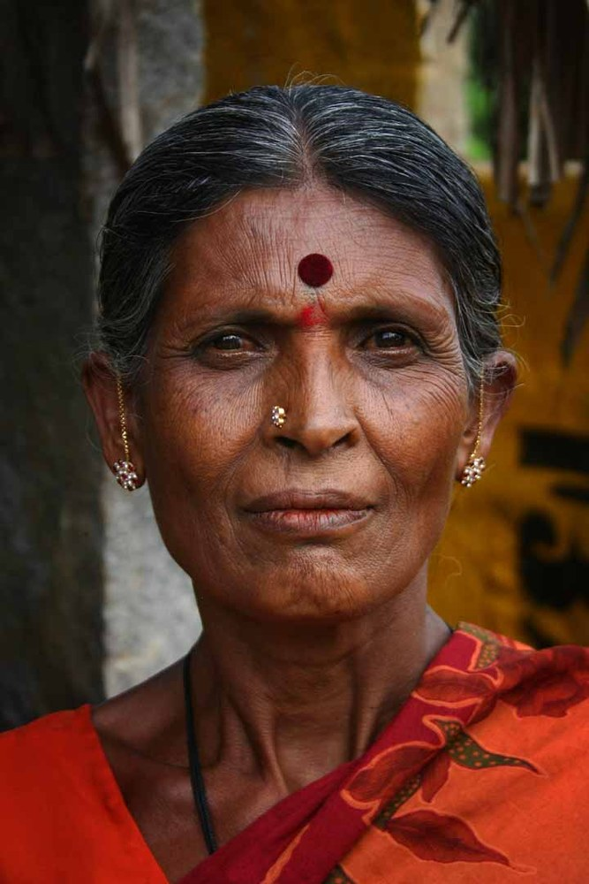
USER PERSONA 3
HopeWorks ✦ AI4India
ABOUT THE USER
TRAITS
Meena has no app-install capacity, no data plan, and no habit of digital healthcare. If support cannot reach her through SMS it does not reach her at all. She has never been screened for any health condition in her life.
✦ Low-literacy ✦ Rural ✦ Persistent ✦ Never screened ✦ Trusts ASHA workers
TRIGGER MOMENTS
PROBLEMS
GOALS AND NEEDS
✦ No data plan or app store ✦ Needs SMS-first guidance ✦ Lives far from formal care
✦ No installable app path ✦ Screening info never reaches her ✦ High-risk signs go unchecked
✦ Screen through SMS/USSD ✦ Get nearest PHC guidance offline ✦ Receive follow-up via ASHA
MEENA
• 42 years old • Varanasi • Lava feature phone • No internet
✦ JOURNEY SNAPSHOT
SMS 'SAHELI' to shortcode → 5-SMS cervical risk screen → high risk flagged → 'Free test, PHC 2 km' → ASHA follow-up scheduled → first health screening in 42 years

Slide 9
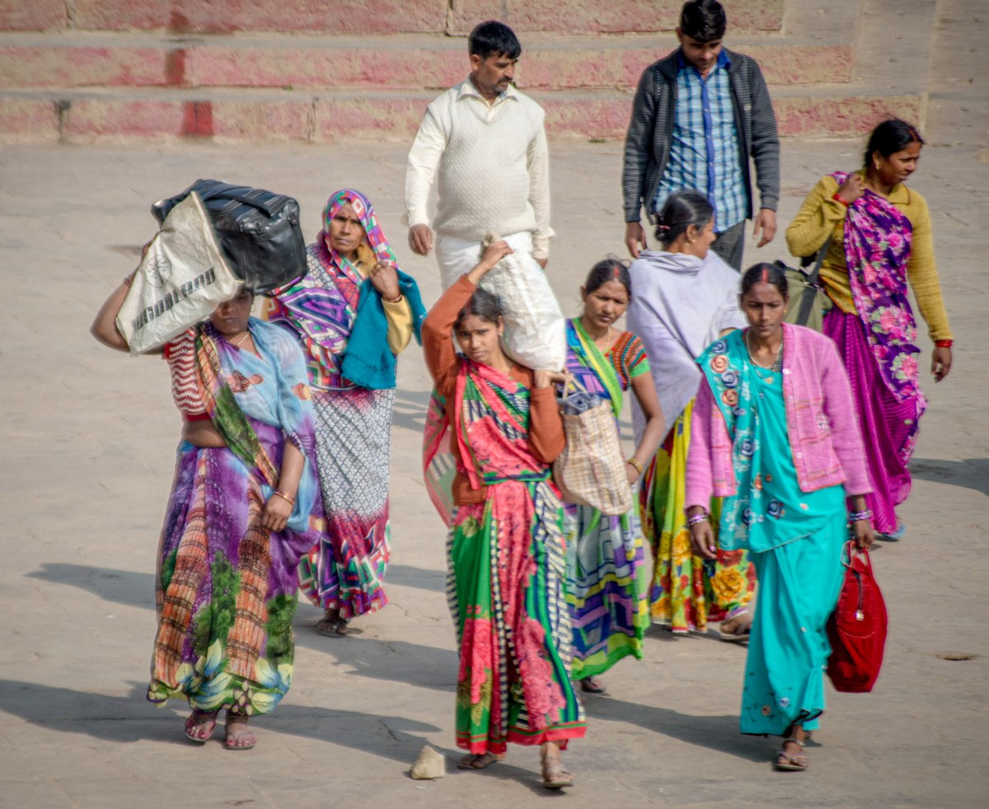
AI
Our Solution
HopeWorks ✦ AI4India
A stealth, voice-native rights and evidence companion for women on shared phones.
What do you plan to build?
Voice-first stealth app: evidence vault + rights guide + SOS + scheme finder + health journal.
Who is it for?
180M+ women aged 18–45 in tier-2/3 India — shared phones, feature phones, offline users.
What problem does it address?
The invisible evidence gap: women can't document abuse or access rights on a monitored device.
How would it work in the real world?
One sentence in Hindi → Saheli captures evidence, explains rights, or triggers SOS offline.
What impact would it create?
Documented cases, legal empowerment, reduced burnout — at scale via ASHA and SHG networks.
Why is it worth building?
300M+ women are excluded by every existing platform. Saheli closes that gap.

Slide 10
AI
Our Solution Continue
HopeWorks ✦ AI4India
Five capabilities. One conversation.
Evidence Vault (सबूत तिजोरी)
01
SHA-256 hashed photos, recordings, documents, GPS timestamps. Aligned to DV Act 2005, IPC 498A, POSH Act. Cover app shows nothing.
Know Your Rights (अधिकार)
02
RAG on PWDVA, POSH, Hindu Succession, maintenance, property. Voice delivery in Hindi/regional via Bulbul V3 TTS. Divorce calculator.
Safety Net (सुरक्षा)
03
Stealth SOS from mala counter. GPS to 3 contacts, offline SMS fallback. 733+ One Stop Centre locator. Cached helplines: 181, 112, 1091.
Entitlements (योजना)
04
20+ schemes: PMMVY, Ayushman Bharat, Mudra, Sukanya Samriddhi. OCR scan of Aadhaar/Ration Card → auto eligibility via Sarvam Vision.
Health Journal (सेहत)
05
Voice EPDS, PCOS, cervical risk screening. Evidence-based stretching (Frontiers Med 2025). Doctor Card generator. ABHA integration.

Slide 11

AI
HopeWorks ✦ AI4India
USE OF
Artificial Intelligence
AI is the interface layer, not the product. It converts complex legal, health, and scheme workflows into one sentence in Hindi. The outcomes — evidence, rights, safety — are real whether or not AI drafted the response.
✦ Saaras V3 STT
— Hindi-first voice capture across 22+ Indian languages
✦ Bulbul V3 TTS
— Empathetic spoken guidance — not robotic readout
✦ Sarvam LLM
— Domain-specific RAG on Bare Acts, WHO protocols, NALSA
✦ Sarvam Vision
— OCR on Aadhaar/Ration Card for scheme eligibility
✦ Edge AI
— Full offline inference on low-RAM Android devices

Slide 12
HopeWorks ✦ AI4India
Challenges ✦ Risks ✦ Mitigations
Challenges and Risks
✦ Trust & Safety:
AI must never sound like legal or medical advice. Guardrails and escalation paths required at every response.
✦ Stealth Failure:
Any visible trace on a shared phone can endanger the user. Quick exit, hidden notifications, and cover-app integrity are non-negotiable.
Key Design Principle
"Build as if every feature could get someone hurt."
✦ Localization Drift:
Dialect accuracy and cached legal/health knowledge can become stale. Curated update cycles are built into the roadmap.
Safety is not a feature — it is the constraint that shapes every decision.
✦ Last-Mile Reach:
SMS/USSD path must be maintained so feature-phone users are never cut off from safety-critical features.
✦ सुरक्षा ✦
The product only works if privacy, accuracy, and last-mile delivery outperform every existing safety app — simultaneously.

Slide 13
AI
HopeWorks ✦ AI4India
Technical Request for Facilitated Datasets
Categorized parameters for AI4India facilitated data access:
Specification of Required Data
Technical Justification
Data Type:
Indic speech from women in low-resource dialects; verified OSC/PHC/ASHA directories; anonymized women's health records.
Accuracy:
Improves STT for rural voices and code-mixed Hindi queries.
Volume & Depth:
10,000+ annotated audio clips; 5-year scheme data; district-level service coverage.
Validation:
Grounds EPDS, PCOS, and cervical screening in verified clinical data.
Granularity:
Village-level service locations; daily scheme update feeds.
Edge-Case Handling:
Dialect data ensures Meena-tier users are never excluded.
The "Ask" vs. "Leveraged" Mapping
Environment & Security Requirements
What we have:
Bare Acts, NALSA, WHO/UNICEF protocols, open IndiaAI datasets, Bhashini corpora.
Access Method:
Secure API, sandbox, or encrypted batch download.
What we need:
Facilitated dialect voice data and verified service directories — the missing piece for rural accuracy.
Security:
Minimum-retention storage; DPDP-compliant pipeline; no PII retained in prompts.
Request focus: voice accuracy ✦ service routing ✦ health validation

Slide 14

AI
Anticipated Results
HopeWorks ✦ AI4India
Year 1 targets anchored to documented action, not vanity metrics.
Saheli Impact Model
Primary beneficiary (Priya — DV Survivor)
Estimated 40% increase in evidence-backed DV filings. OSC case completion rate improved through guided documentation.
Secondary beneficiary (Sunita — Health Gap)
First structured screening for 50,000+ women in Year 1. Jan Aushadhi saves ~₹27/day per user.
Feature-phone reach (Meena — Rural / Offline)
SMS/USSD path onboards users with zero internet. ASHA network drives last-mile coverage at no additional infrastructure cost.
Solution scalability — operational and technical
ASHA/SHG distribution requires zero new infrastructure. Edge inference scales to ₹1,000 devices. B2G + B2B revenue sustains the free core.
Distribution & Sustainability
ASHA network (1M+) — primary distribution at zero infrastructure cost ✦ SHG network (9M) — group sessions, leader runs Saheli for 10–15 women ✦ Revenue: B2G (ASHA/OSC tools) ✦ B2B (POSH compliance) ✦ Grants — core always free

Slide 15
AI
HopeWorks ✦ AI4India
THANK YOU
for your time and attention
Saheli ✦ सहेली
one conversation for every right, every scheme, and every tool
WitchHunt 2026 | HopeWorks Foundation × AI4India × Skills Café Track: Health & Well-Being

