Slide 1


CAPSTONE PROJECT
Empowering India: A Data-Driven Analysis of Socio-Economic & Health Progress (NFHS-4 vs. NFHS-5)
Presented By
Student Name: B Madhavi
College Name: Pondicherry University
Department: Computer Science
Email ID: madhavi.cdk1234@gmail.com

Slide 2
OUTLINE:
Problem Statement
Proposed System/Solution
System Development Approach
Algorithm & Deployment
Result (Output Image)
Conclusion
Future Scope
References

Slide 3
Problem Statement:
Despite national growth, there remains a significant disparity in healthcare access, digital literacy, and basic living standards between rural and urban India. Policy makers lack a consolidated, interactive way to track how specific indicators (like the 9.4% Literacy Gap) vary across states over time. This makes it difficult to identify high-risk zones that require immediate infrastructure investment.

Slide 4
Proposed Solution:
To bridge the information gap in India’s public health and socio-economic sectors by developing a high-fidelity, interactive "Decision-Support System" using the NFHS-5 dataset.
1. Multidimensional Trend Analysis: A unified interface that transitions seamlessly between three critical development sectors: Digital Empowerment, Maternal Health, and Infrastructure Standards. This allows stakeholders to see how progress in one area (Literacy) affects another (Banking/Mobile access).
2. Granular Comparative Intelligence: Implementation of dynamic slicers and "Rural vs. Urban" toggles. This provides the ability to perform Comparative Analysis at a click, revealing hidden disparities that are often lost in national-level averages.
3. Visual Risk Categorization: Instead of raw numbers, the solution uses Conditional Formatting and Geospatial Logic to immediately flag "High-Priority" zones. This enables "Management by Exception," where leaders can focus only on the red-flagged regions.
4. Enhanced Navigation UI/UX: An "App-like" navigation framework that ensures non-technical users can explore complex health data without specialized training, making data-driven governance accessible

Slide 5
System development Approach:
1.Data Acquisition (Source):
Extracted secondary data from the National Data and Analytics Platform (NDAP).
Dataset includes comprehensive indicators from NFHS-4 (2015-16) and NFHS-5 (2019-21) for comparative trend analysis
2. Data Preprocessing :
Tool : Power BI Power Query Editor.
Cleaning: Removed null values, handled outliers in mortality data, and standardized state names to ensure geographic accuracy.
Transformation: Performed "Data Pivoting" and changed data types (Text to Decimal) to enable mathematical aggregations.
3. Data Modeling :
Created a Star Schema inspired model by organizing data into logical themes.
Established relationships between different survey years to allow the "NFHS Version" slicer to function across all visuals.
4. Visualization Design:
Applied UI/UX principles (Consistent color palettes from Coolors, high-contrast text, and intuitive navigation buttons) to ensure the dashboard is accessible by people.

Slide 6
Algorithm & Deployment:
1.Data Transformation Logic (ETL):
Cleaning: Utilized Power Query to handle missing values and standardize state-level naming conventions across NFHS-4 and NFHS-5.
Normalization: Converted percentage-based strings into decimal/numeric formats to enable mathematical calculations.
2. Analytical Calculations (DAX Algorithms):
Gap Analysis: Developed a custom measure to calculate the Gender Literacy Gap using the formula: Average(Men_Literacy) - Average(Women_Literacy).
Risk Categorization: Implemented a logical "Binning" algorithm. If Infant_Mortality_Rate > National Median, the state is flagged as "High Risk", otherwise, it is labeled "Low/Stable Risk."
3.Deployment & Interaction:
Dynamic Filtering: Deployed "Slicers" that act as the user interface, allowing real-time filtering by Residence Type (Urban/Rural) and Survey Version.
Cross-Highlighting: Enabled interaction between visuals, where selecting a specific state on one chart automatically filters the health and economic data on the others.

Slide 7
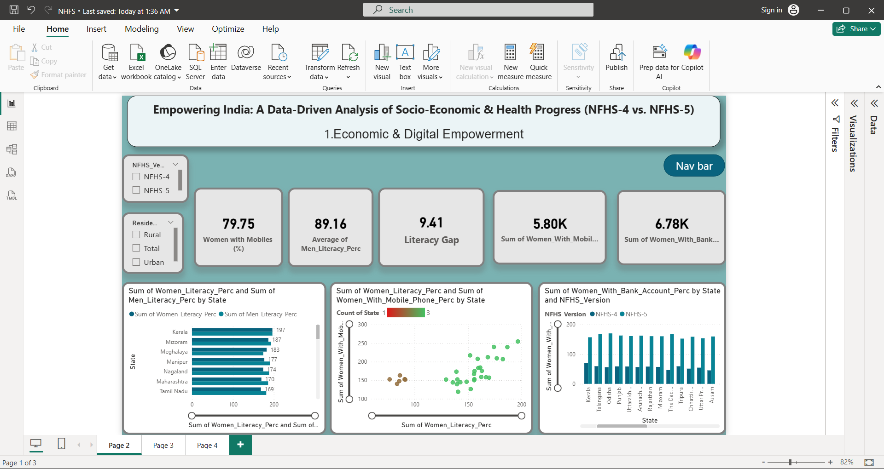
Result:
Economic and Digital Empowerment

Slide 8
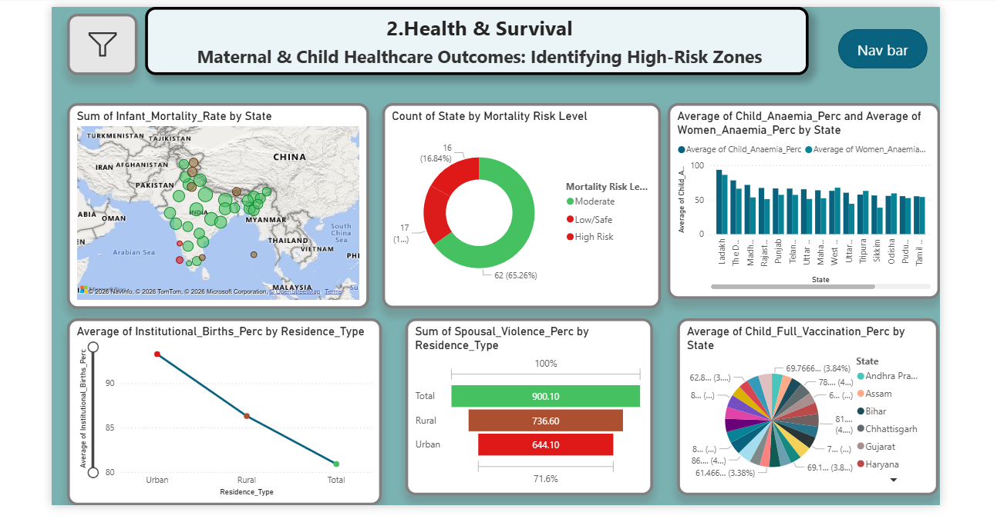
Health and Survival

Slide 9
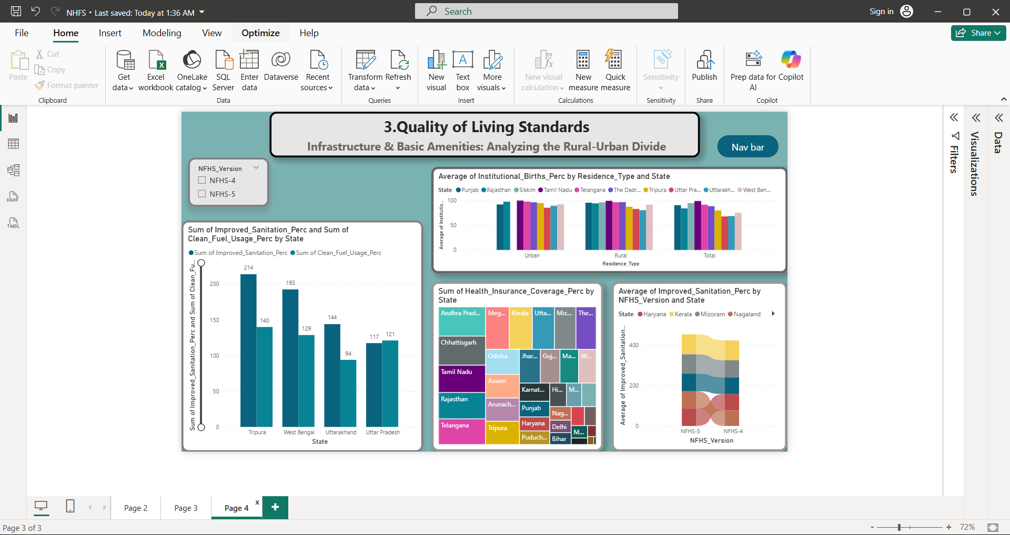
Quality of Living Standards Report

Slide 10
Conclusion:
1.The analysis confirms that while India has made strides in financial inclusion, the "Rural-Urban Divide" in infrastructure remains a hurdle.
2.The dashboard successfully provides a data-driven roadmap for targeted development, proving that digital literacy is a major catalyst for overall socio-economic improvement.

Slide 11
Future scope:
1.Real-time Integration: Connecting the dashboard to live government APIs for instant data updates.
2.Predictive Analytics: Using Machine Learning to forecast future health trends based on current improvement rates.
3.Granular Mapping: Expanding the data from State-level to District-level analysis for more local policy impact

Slide 12
References:
Website Link : https://ndap.niti.gov.in/
Data Source Link: National Data and Analytics Platform (NDAP) - NFHS Dataset
URL: https://ndap.niti.gov.in/dataset/national-family-health-survey
GitHub Link: https://github.com/Begginer2/NFHS-Socio-Economic-Dashboard

Slide 13
Thank You

