Slide 1
Could we prevent avoidable death by reducing health risk factors?
Renjie Meng (Rudy)

Slide 2
Structure
Motivation and outcome
Datasets
Data Wrangling Methodologies
Findings 1-3
Challenges
Summary
Question

Slide 3
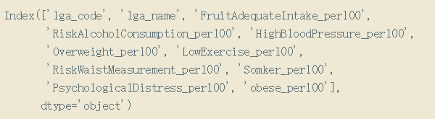
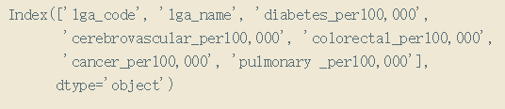
Motivation and outcome
There are around 4,800 people died from avoidable death in Victoria in 2015.
We can prevent avoidable death by encouraging people eating enough fruit and reducing obese, low-exercise, risk waist measurement, psychological distress and smoking population.
Datasets
LGA _15_Health_Risk_Factor.csv Dataset
LGA_15_Avoidable_Death_by_Causes.csv Dataset

Slide 4
Data Wrangling Methodologies
Data Preprocessing
Format Transforming
Missing Value
Outlier
Boxplot
Add values
Total population has health risk factor per 100 population
Total avoidable death per 100,000 population
Data Visualization
Scatter plot
Heatmap
Pie Chart
Clustering Map
Data Analyzing
Pearson Correlation

Slide 5
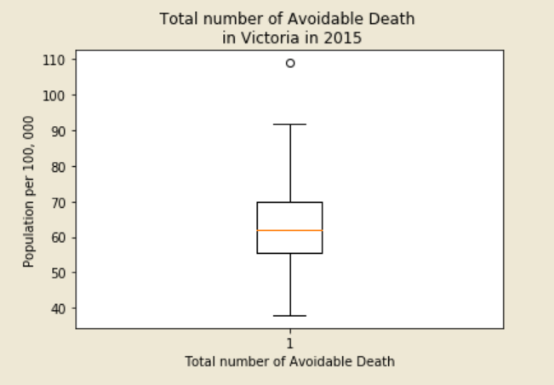
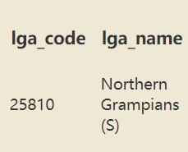
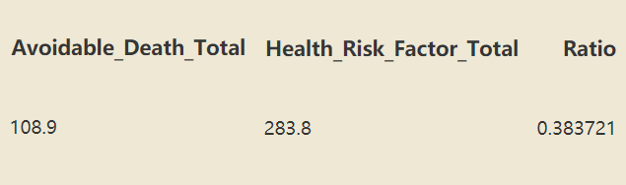
Finding1 - Outlier

Slide 6
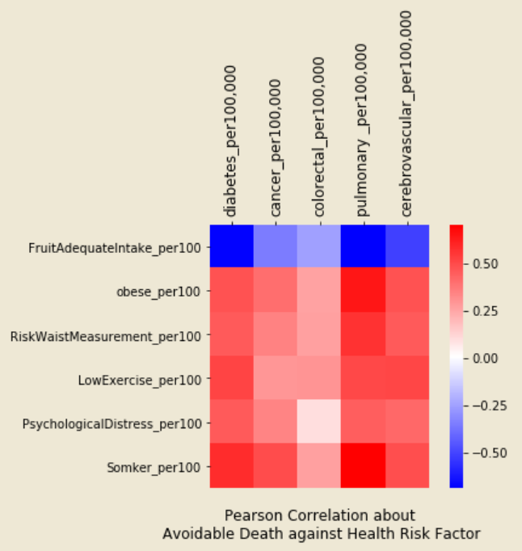
Finding 2 – Heatmap of Pearson Correlation

Slide 7
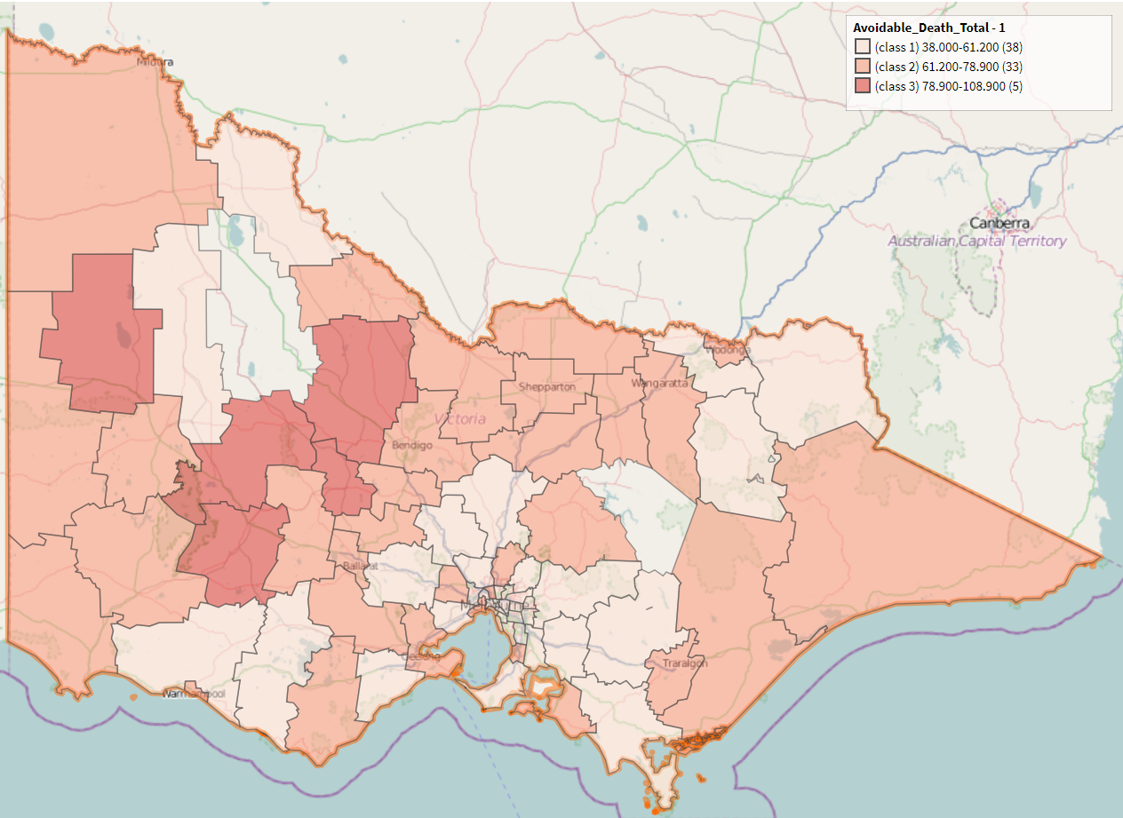
Finding 3 – Clustering Map

Slide 8
Challenge
Finding datasets
Dead findings
Coding

Slide 9
Summary
We could prevent and reducing avoidable death by reducing health risk factor.
Government should take different action with respect to which class the area is in.

Slide 10
Thank You!!!

