Slide 1
International Capstone Project
Age-Related Macular Degeneration
Model Building
Model Prediction
Model Training

Slide 2
Model Building
Input
Scale Adaptive Model
Pretrained Model
ResNet50
Classification
+
+
+

Slide 3
Model Building
Functions and their reflection
load_encoder_model()
build_feature_extractor_model()
attach_classifier()
Final Model
Classification Model
Input Layer
Pretrained Model ResNet50
SA Layers
Scale Adaptive Model
Input
448*448*3
ResNet50 Layers
Classification Layers

Slide 4
Model Prediction
Input
Output
Image
Preprocessing Image
Final Model
Classification
+
+
+

Slide 5
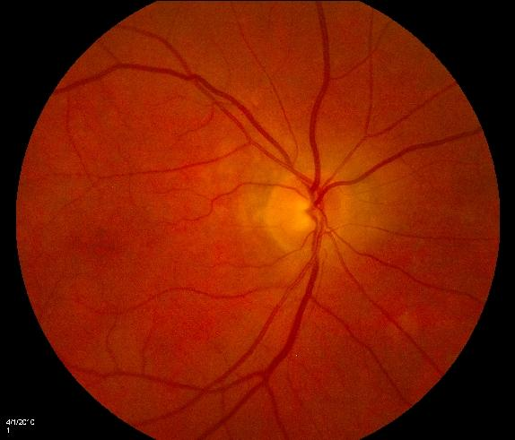

Model Prediction
Functions and their reflection
load_image()
preprocess_image()
load_model()
apply_prediction()
Preprocessing Image
Image
Resizing
Model
GA
Target Size
448*448*3
Intermediate
Normal
Expanding Dimension
Wet
Any Size
Conversion from 3D to 4D array
Normalization
Normalizing values to [0.0, 1.0]

Slide 6
Model Training
Dataset
Build Model
Train Model
Evaluate Model
+
+
+
Augmenting Data

Slide 7
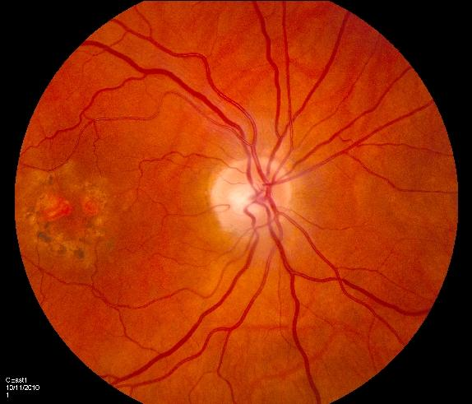
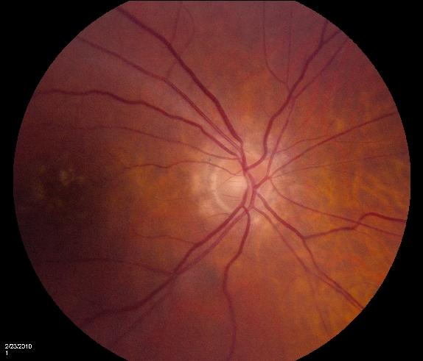
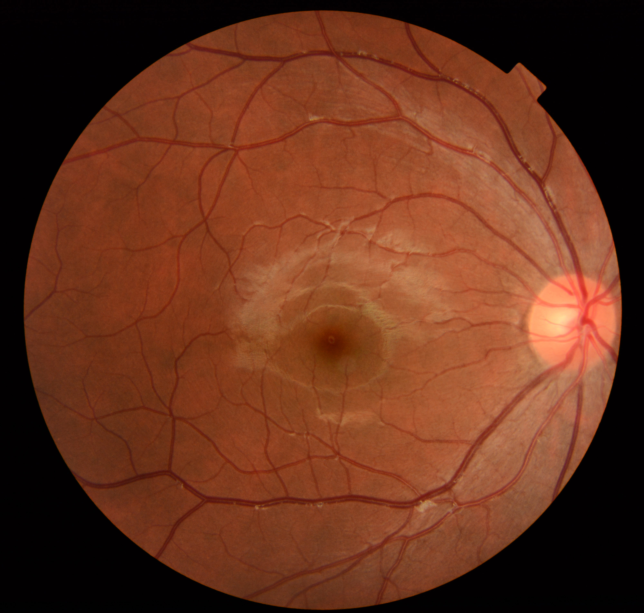
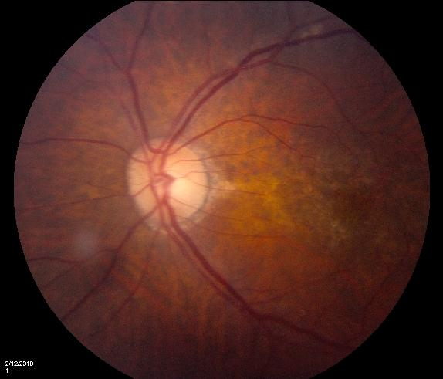
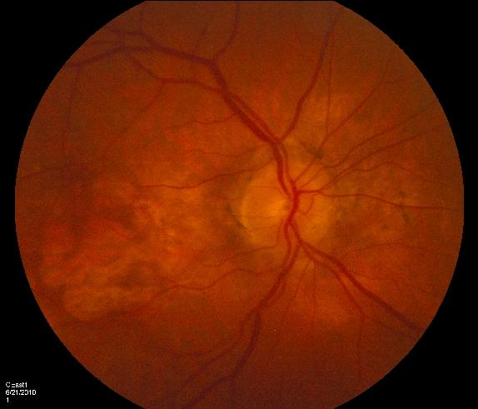
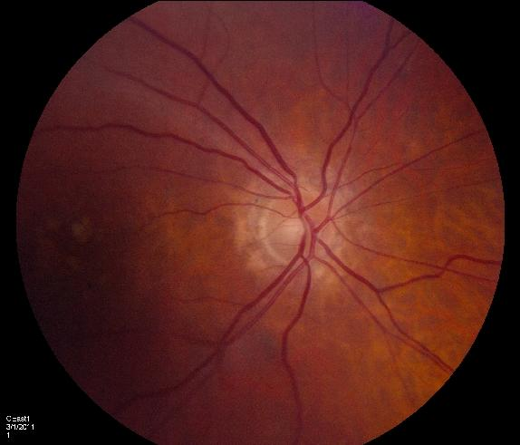
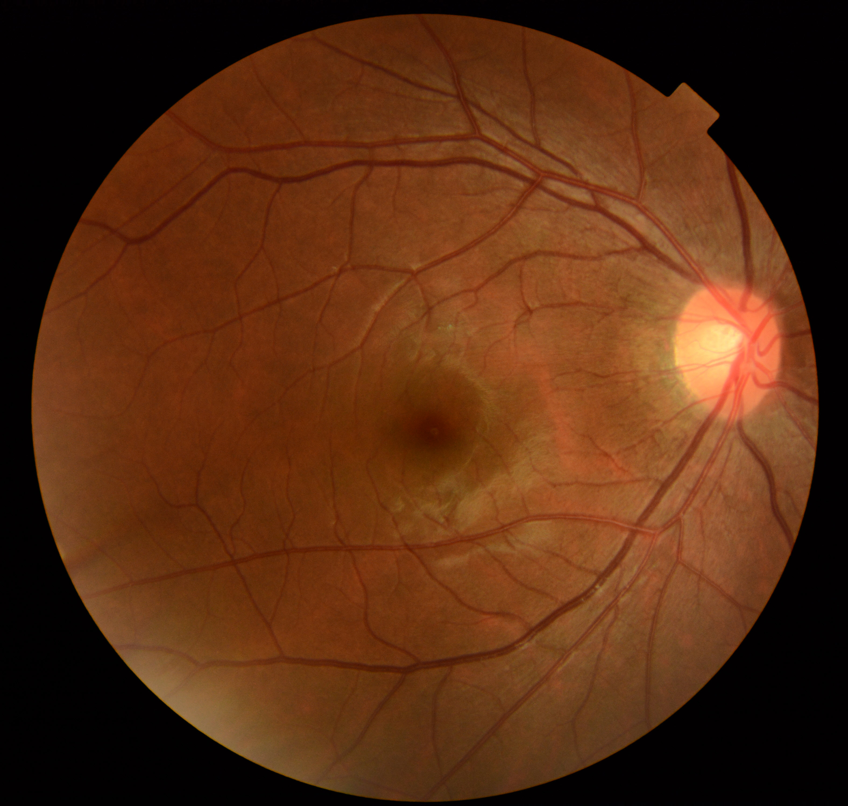
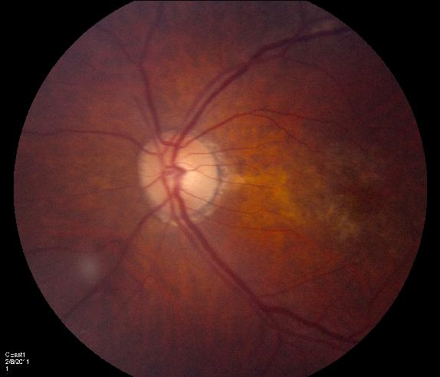

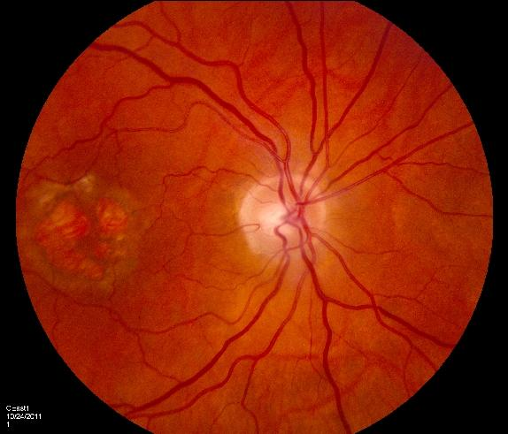
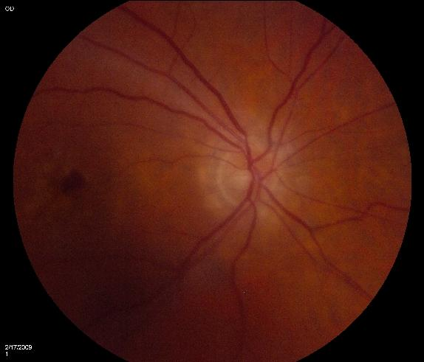
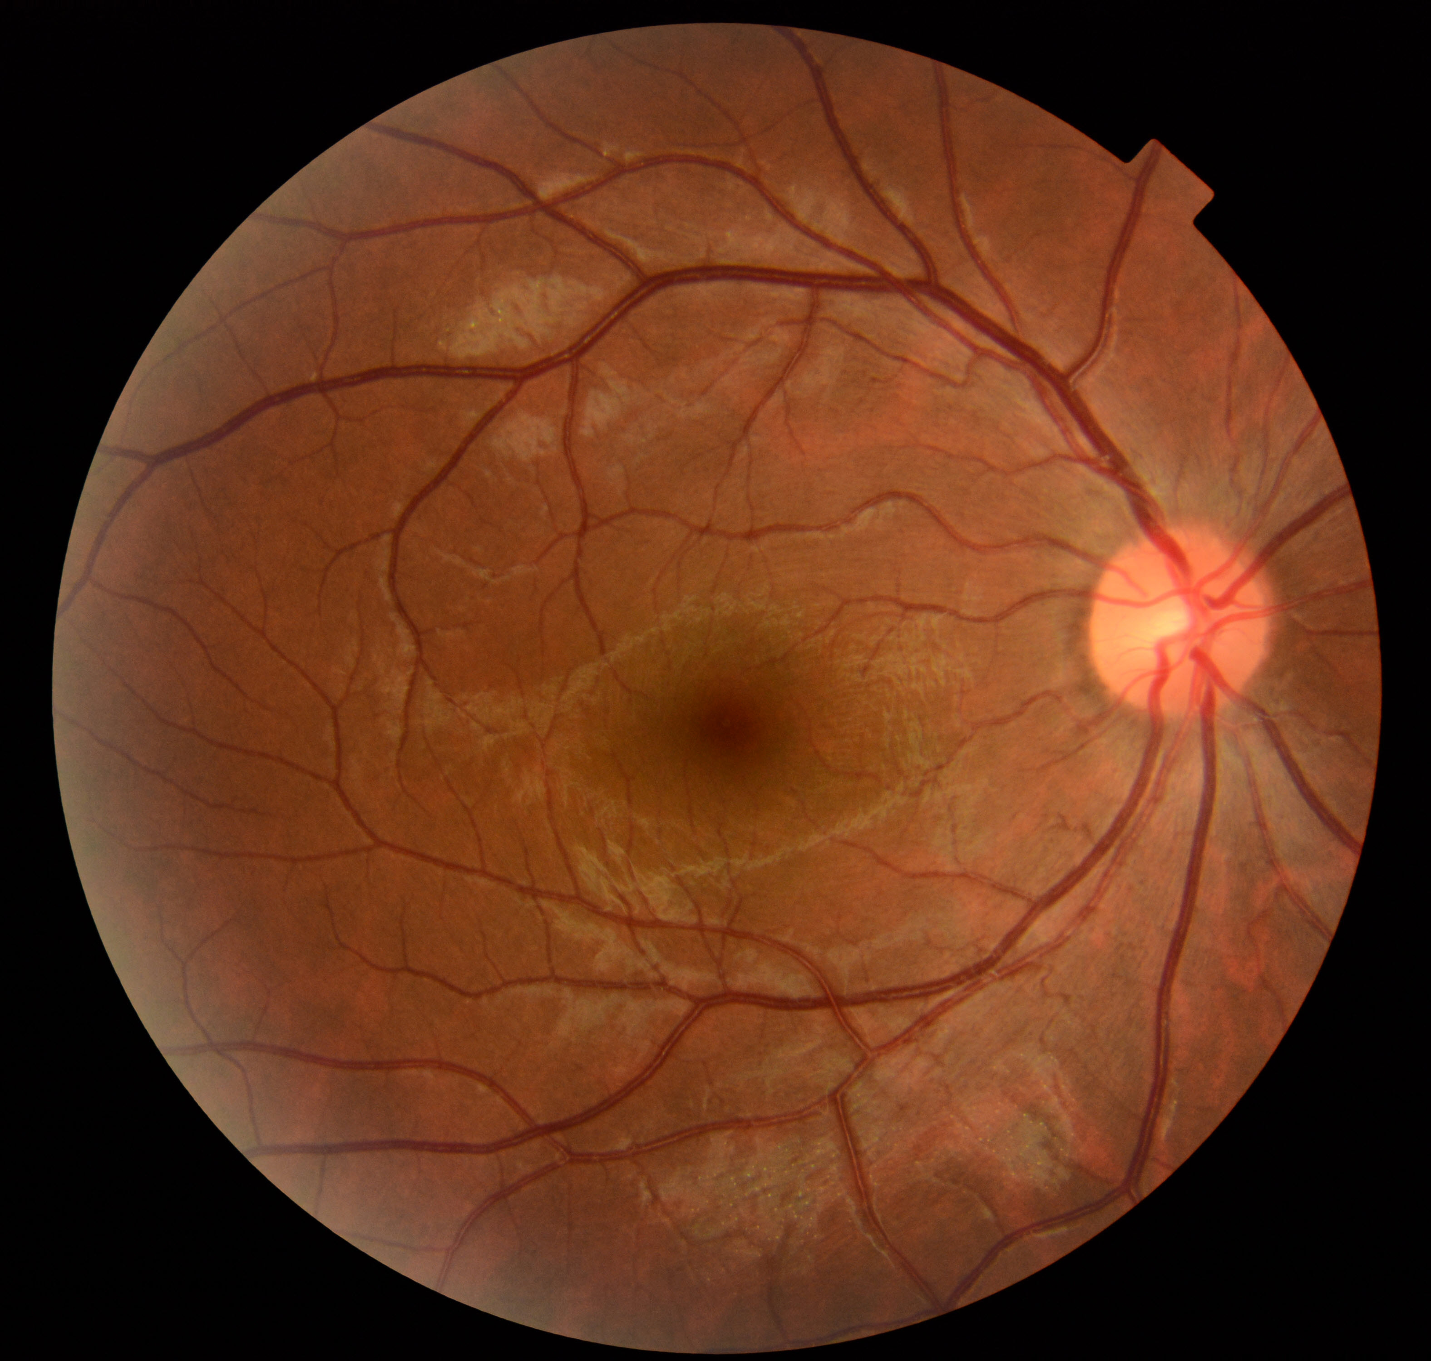
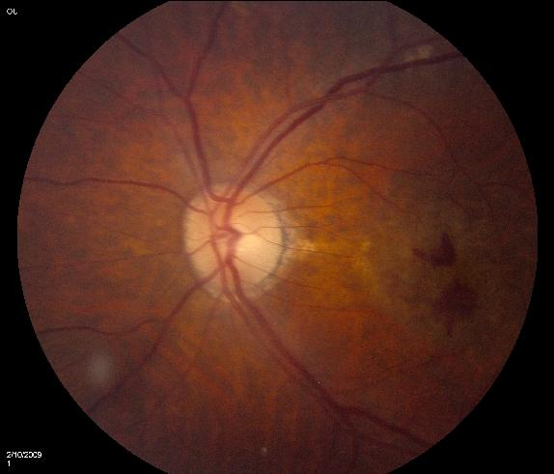

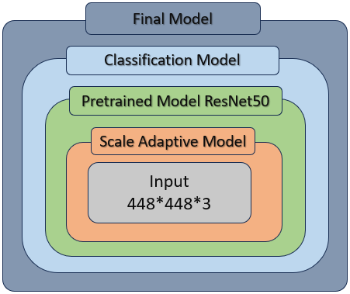

Model Training
Functions and their reflection
compiling_model()
splitting_data_to_train_test_val()
augmenting_data()
building_model()
evaluating_model()
fitting_model()
Dataset
Training Model
Load Dataset
Data Augmentation
Evaluating Model
Model Building
Compiling
Augmentation techniques
GA
Inter
Normal
Wet
Shift
Shear
Fitting ….
Splitting Data
Zoom
Rotate
Train
Validation
Test

