Slide 1
Functions in R & Python
A practical introduction
Lima, Perú
08 October 2022

Slide 2
Content
Introduction to function
Coding vs programming
Benefits of programming
Introduction to Python
Function structure (Python vs R)
Create a source (function dictionary)

Slide 3
Coding vs programming
Instead these words are often used interchangeably, they actually signify two very different things.
Coding | Programming
Translate the requirement logics into a machine-understandable code without worrying about the details | Analyze and conceptualize different aspects of any program and also solutions to any problems that may or may not occur due to the process
Basic knowledge of programming skills without any software tools | Good knowledge of programming skills and good software development tools
Helps to work with simple projects | helps to work with big projects and manage them

Slide 4
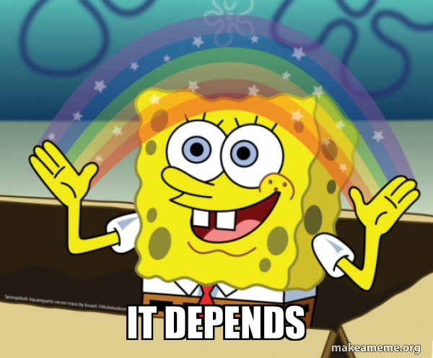
Coding vs programming
So, is it better to learn coding or programming?
Coding: occasional use, general solutions, but also high demand
Programming: frequent use, specific solutions, high demand

Slide 5
Benefits of programming (functions)
Why functions are useful?
Reusability
Modularity
Testing
It can be called multiple times from different spaces. This avoids duplicated code
Divide a complex problem into multiple functions. Better tracking
Less code to test, easier to find bugs. Test a function just once time
Extensibility
Abstraction
Functions reduce the amount of code that has to be written
You don’t need to know how it works, or what other code it’s dependent upon to use it

Slide 6
Imagine the first 10 employees of Google, it’s pretty clear they didn’t have a PHD in computer science, they had programming experience
- Dr. Chuck Severance

Slide 7
Python
What is it?
It’s a high level, dynamic “multiparadigm” (maybe more OOP than others) language. Its core philosophy is readability.
Typing in Python is based on “classes”, which allow programmers to create their own types.
Why it matters?
Because of its readability and broad range of libraries it is one of the more accessible and popular languages for Data Science today, it has also been implemented as an scripting language in multiple softwares which allows interdisciplinary approaches

Slide 8

Function structure
Basic Logic
A function is a block of code which performs a task.
It has a name; which we use to call the function
It has a void; which means it has “no value”
It has an argument; which is the mini-program inside
Photo by Dave Hoefler on Unsplash

Slide 9
C++ and Python
Objective: Return a signal for the execution of a function
// Create a function
void myFunction() {
cout << "I just got executed!";
}
int main() {
myFunction(); // call the function
return 0;
}
// Outputs
"I just got executed!"
#Create a function
def my_function():
print("I just got executed!")
#Call the function
my_function()
#Outputs
"I just got executed!"
C++
Python

Slide 10
R and Python
Objective: Create a function which tells if a number is odd or even
# Create a function
evenodd = function(x)
{
if (x %% 2 == 0)
return(“even!”)
else
return(“odd¡”);
}
# Call the function
print(evenodd)(4)) ;
# Outputs
"even!"
#Create a function
def evenodd(x):
if x%2 == 0:
print("even!")
else:
print("odd¡")
#Call the function
evenodd(4)
#Outputs
“even!”
R
Python

Slide 11
R and Python
Objective: Create a function which tells if a number is odd or even
# Create a function
evenodd = function(x)
{
if (x %% 2 == 0)
return(“even!”)
else
return(“odd¡”);
}
# Call the function
print(evenodd)(4)) ;
# Outputs
"even!"
#Create a function
def evenodd(x):
if x%2 == 0:
print("even!")
else:
print("odd¡")
#Call the function
evenodd(4)
#Outputs
“even!”
R
Python

Slide 12
Python Dive
Objective: Return a signal for the execution of a function
#Create a function
def my_function(fname):
print("Hello from a function called: ", fname)
#Call the function
my_function(“my first function”)
#Outputs
“Hello from a function called: my first function”
#Create a function
def my_function(fname, flastname):
print("Hello from a function called ", fname, flastname)
#Call the function
my_function(“my first function”, “is quite simple”)
#Outputs
“Hello from a function called: my first function is quite simple”
Arguments get a value when called
...And you can have multiple values

Slide 13
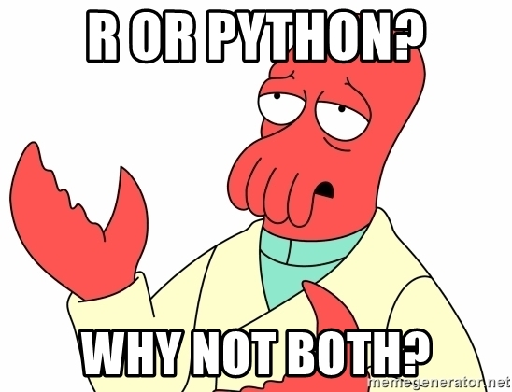
Create a source (function dictionary)
Problem: How automate sum of squares?

Slide 14

The thing with creating Python Source…
And why some people say its and Object Oriented Language

Slide 15

Its impossible to call a function directly from somewhere outside the main file/code
Or at least, it ain’t the easy way…

Slide 16
Python Dive
Objective: Create a function which returns the square of a number
class square:
#x square
def _init_(self, x, y):
self.x = x
self.y= y
def sq(x):
return x*x
#Call function
print(square.sq(4))
#Outputs
16

