Slide 1
Pokedex
Vasyl Bodnar & Willie Lui

Slide 2
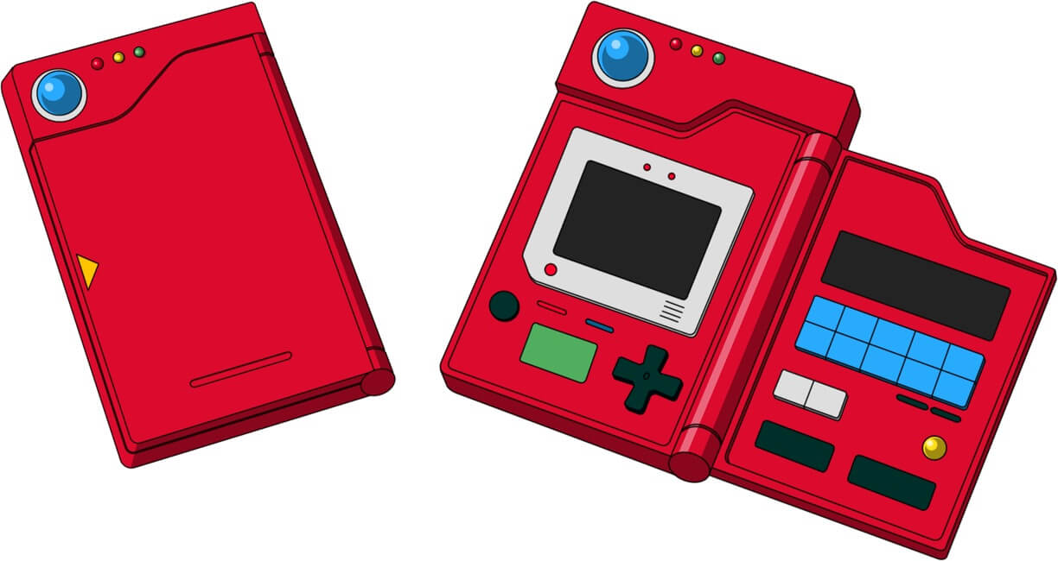
Goal
Pokedex for General Pokémon Information utilizing Swing GUI with a Simple Design

Slide 3
Functionalities
Displays Basic Information, such as Name, ID, Description, etc.
Ability to View all Pokémon in a List Form
To Directly Lookup Pokémon through a Search Bar
To Utilize Custom Data and Images
To Display Miscellaneous Information such as Towns, Weakness Table, etc.

Slide 4
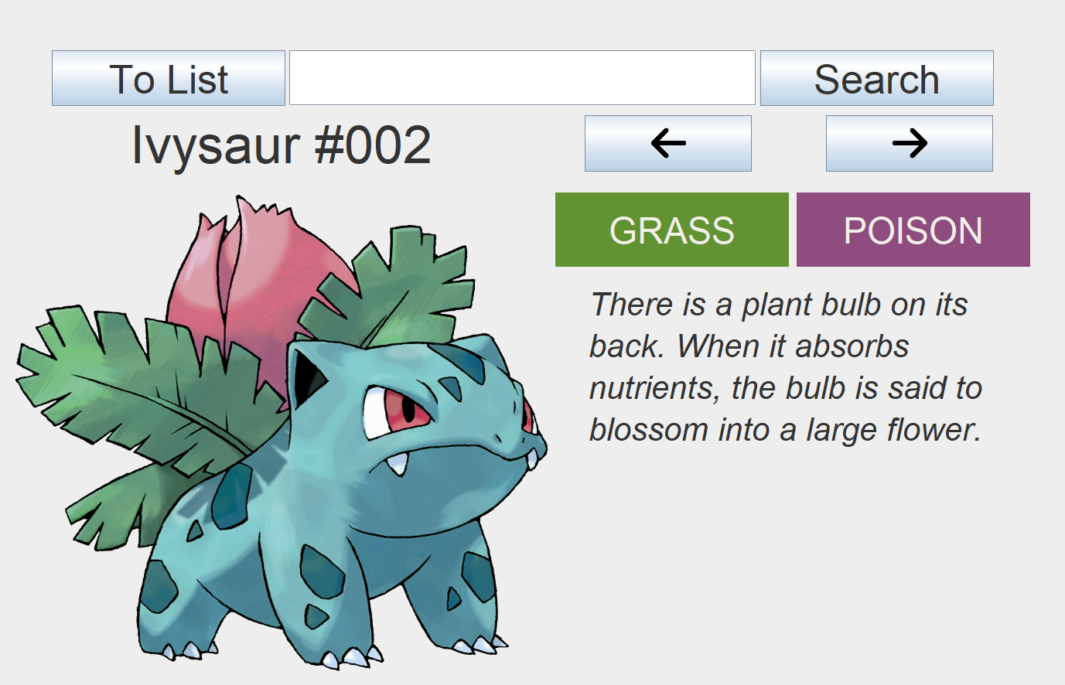
Main Display
The main way to view Pokémon in all their glory
Currently shows Name, ID, Picture, Types, and simple Description
Allows to navigate Pokémon in a simple left-right button configuration
Includes the Search feature for finding ‘em all by ID or Name

Slide 5
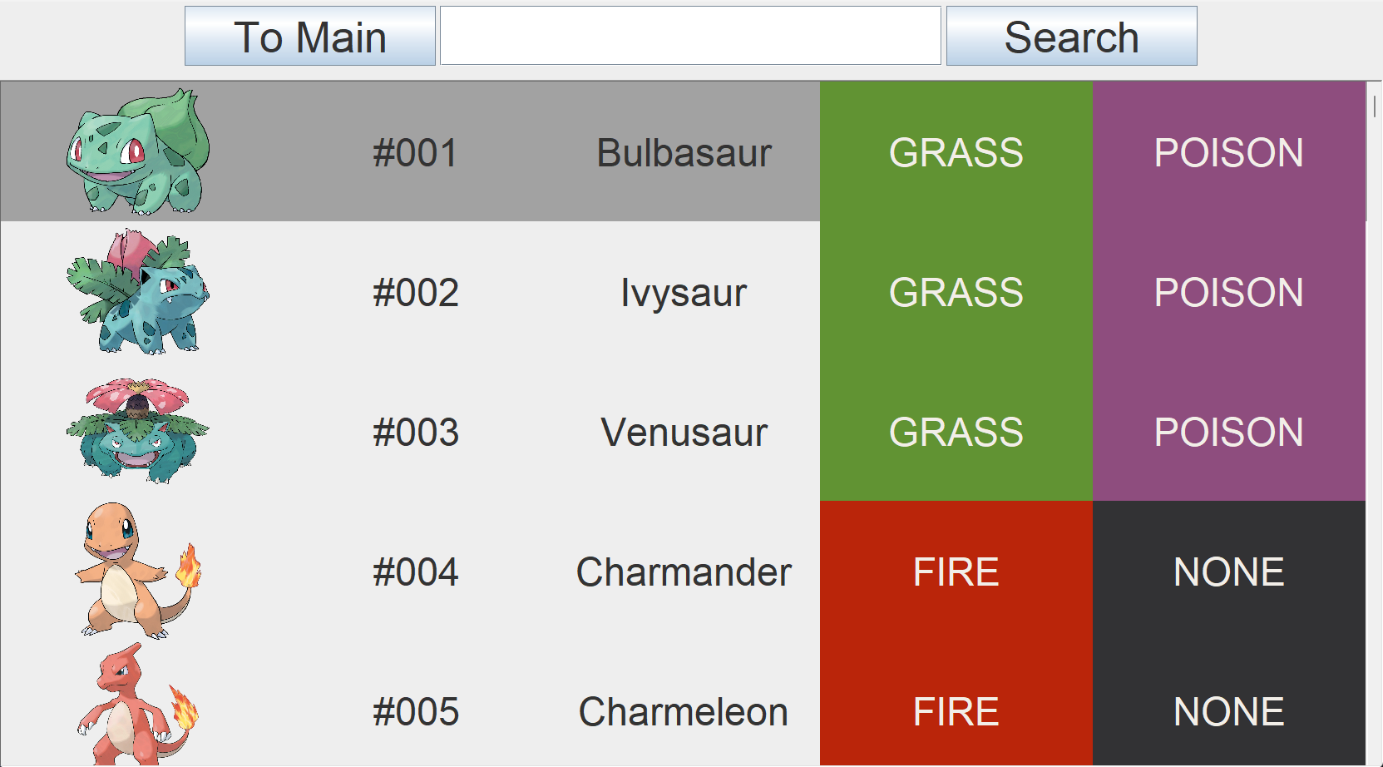
List View
A Scroll List to navigate all the loaded Pokémon with some basic information
Clicking on an item takes you straight to Main View of that Pokémon
Also includes the Search feature on top for direct access

Slide 6

Custom Data
All information displayed is loaded from CSV files and images provided
Which also means that you can provide your own custom data
Currently this is only done from terminal input, planned as a GUI feature
1 | Bulbasaur | Grass | Poison | "There is a plant seed on its back right from the day this Pokémon is born. The seed slowly grows larger."
6 | Charizard | Fire | Flying | "Its wings can carry this Pokémon close to an altitude of 4,600 feet. It blows out fire at very high temperatures."
25 | Pikachu | Electric | None | "It has small electric sacs on both its cheeks. If threatened, it looses electric charges from the sacs."

Slide 7
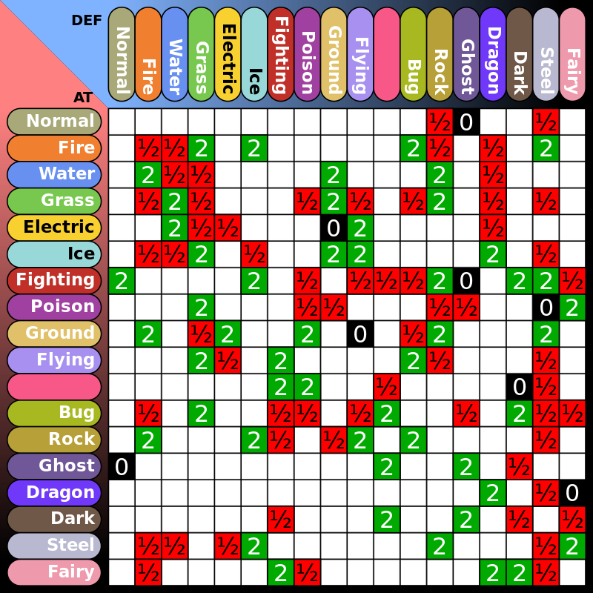
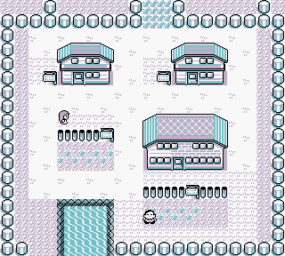
Miscellaneous Information
Planned feature, currently not implemented
Will display various information related to Pokémon and their World
Will include Weakness Table, Town Information, etc.

Slide 8
The End

