Slide 1
Hackathon Project
Kebba Conta

Slide 2

Screenshot Sorter

Slide 3
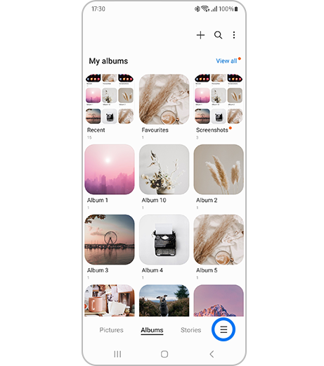
What it is about?
Have you ever taken a screenshot of something important like a diagram for school or even a meme to use for your friends but cannot find it because its stuck deep in your photo gallery
Well similarly to how apple and samsung allocate your folders into different sub categories we thought to do the same for our project with screenshots

Slide 4
Why would it be useful?
Well its main use is to save time for the user.
Instead of looking at screenshots upon screenshots to find one item sorting it out automatically makes it
In one study, people searched their own photo collections of about 4,000 items and were 45% faster with a time-grouped layout than with flat or timeline layouts.
And we hope to improve this number with screenshots also having categories

Slide 5
How the invisible ai works?

