Slide 1

Eniac Magist
Magist Does Not Meet Partnership Criteria With Eniac
- By Ajmal Behmanish & Anish Shenji

Slide 2
This Analysis is Grounded On Three Critical Aspects
Magist’s performance of tech products
Trends in customer purchasing behavior
Efficiency of delivery processes

Slide 3
Tech Products: A Low Priority For Magist Customers

Slide 4
Magist Is Unpopular In Terms Of Premium/Innovation Tech Products
94 %
Low-Cost Tech-Products

Slide 5
There Is A Significant Gap Between Eniac’s & Magist’s Avg Sales Price
Magist has 6 times less avg. sales than Eniac

Slide 6

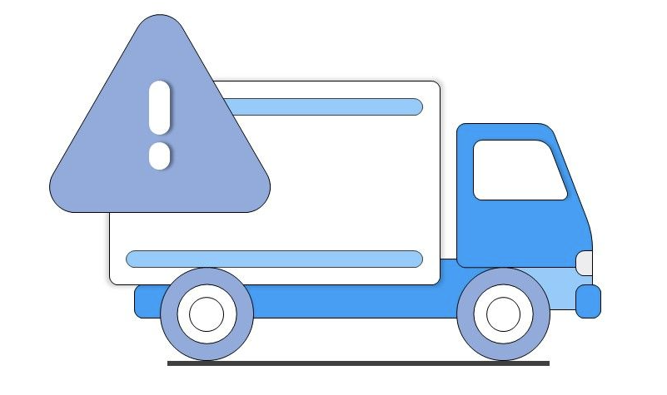
Prolonged Delivery Durations, With An Estimated Chance For Delays In Arrival
Avg. Days
12.5
Delivery Delay
~10%

Slide 7
Final Findings And Path Forward
Analysis:
Magist shows weaker performance in selling premium technology products.
There are extended delivery times, with a 10% chance of delays.
Recommendation:
Magist does not meet our brand standards effectively.
Consider other partnership options or strategies for successfully entering the tech market.

Slide 8
Thank you
?

