Slide 3
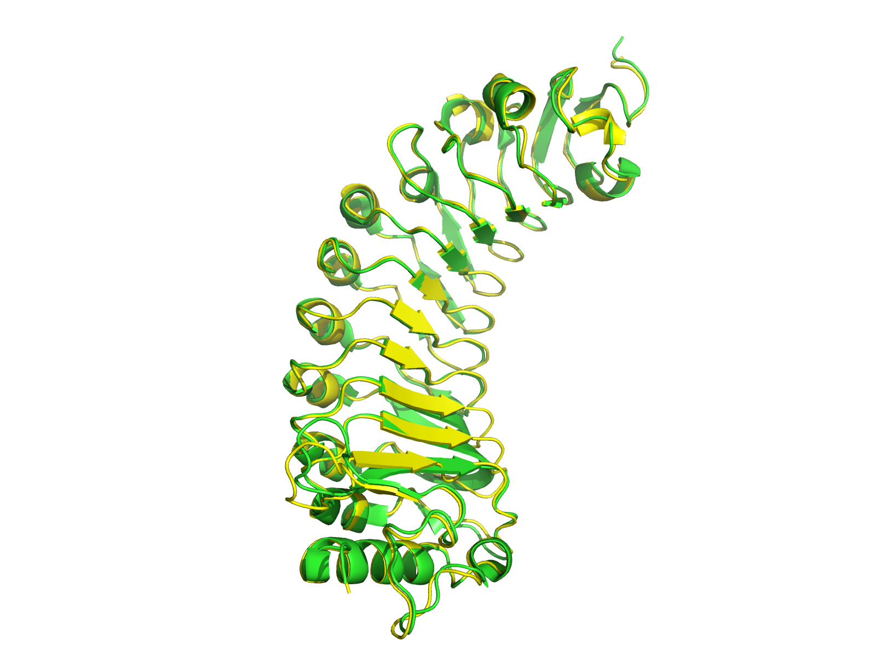
8IKW - AlphaFold
Nearly perfect match

Slide 4
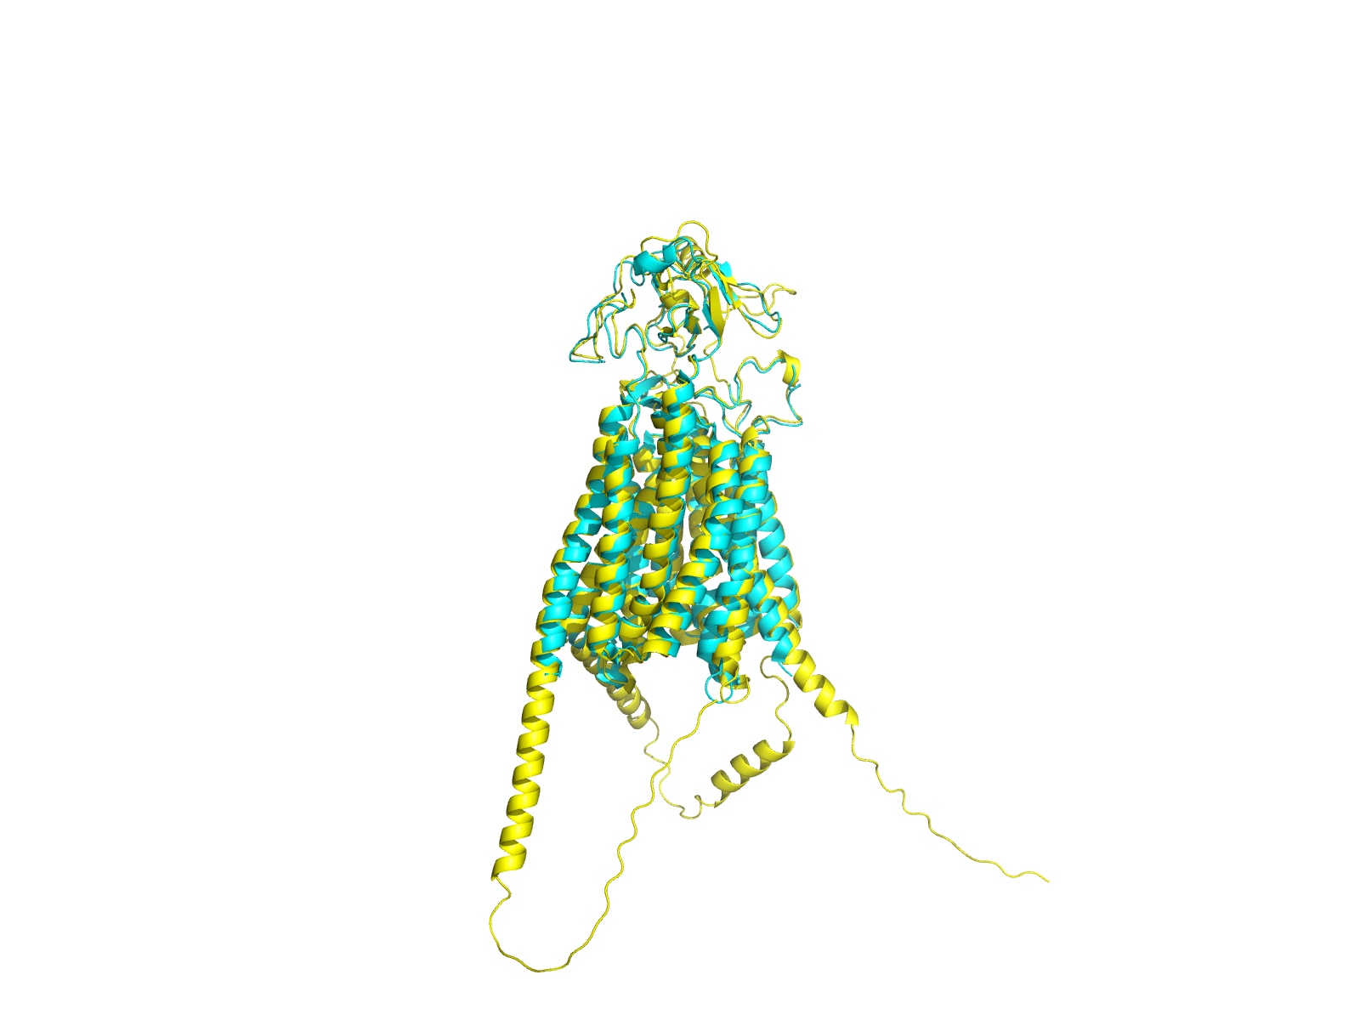
8HND - AlphaFold
Good match for some of the structure
Some of the external chains are far more spread out than in the predicted protein

Slide 5
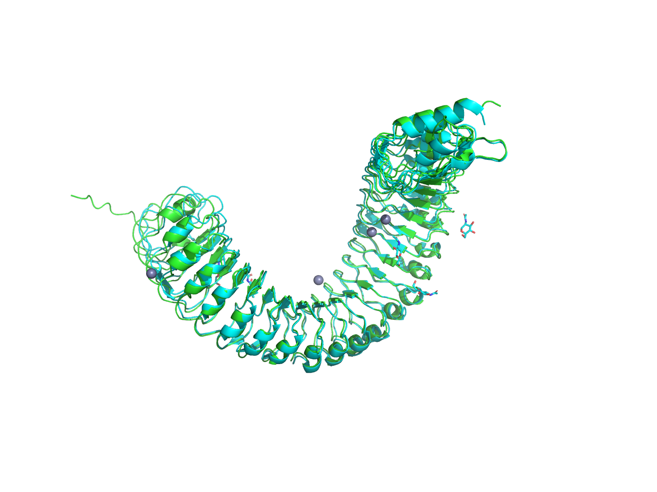
4MN8
Good similarity between pridicted and actual structure throughout the entire protein

Slide 6
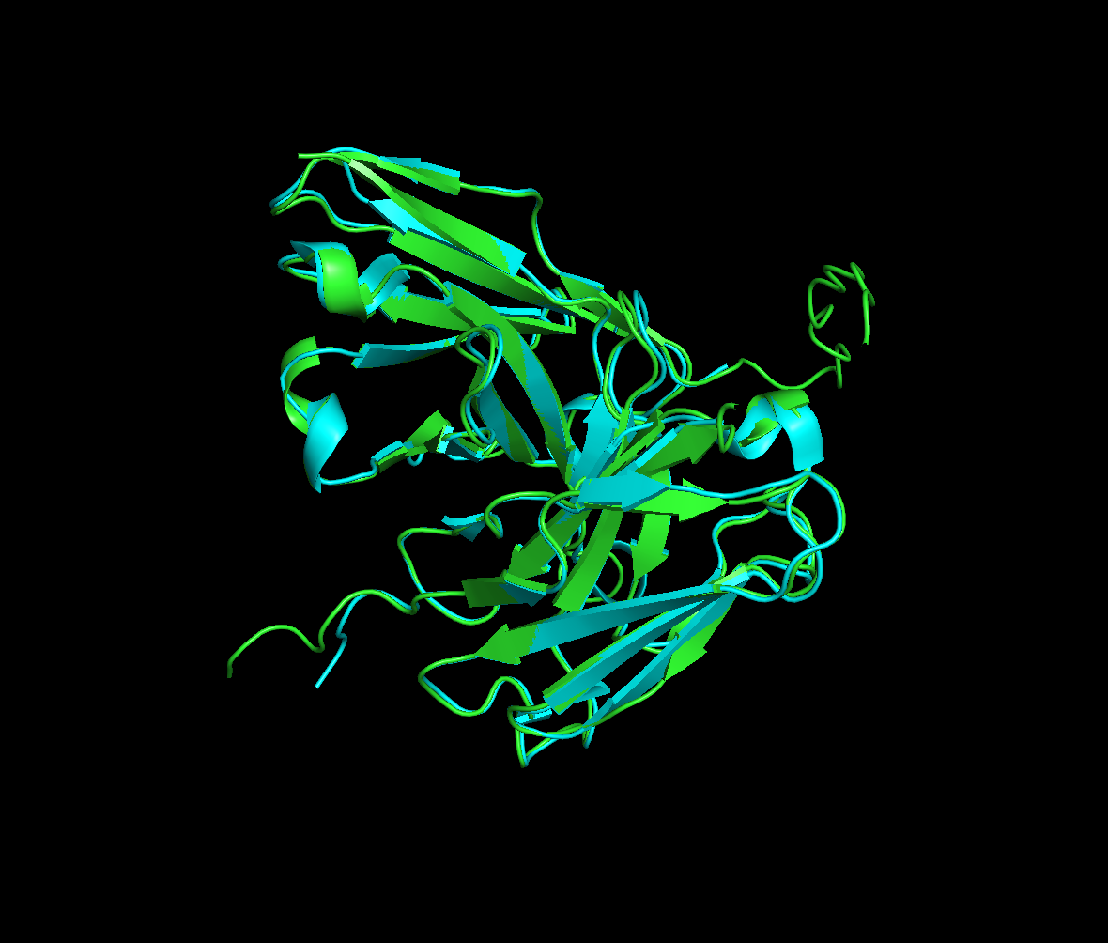
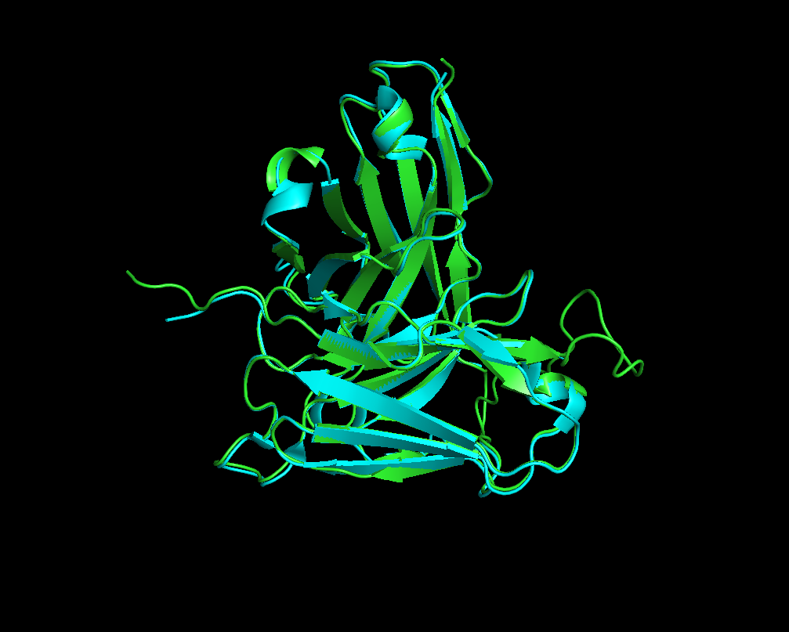
3H3B
Overall good overlap from both models on predicted structure
AlphaFold
Boltz-2

Slide 7
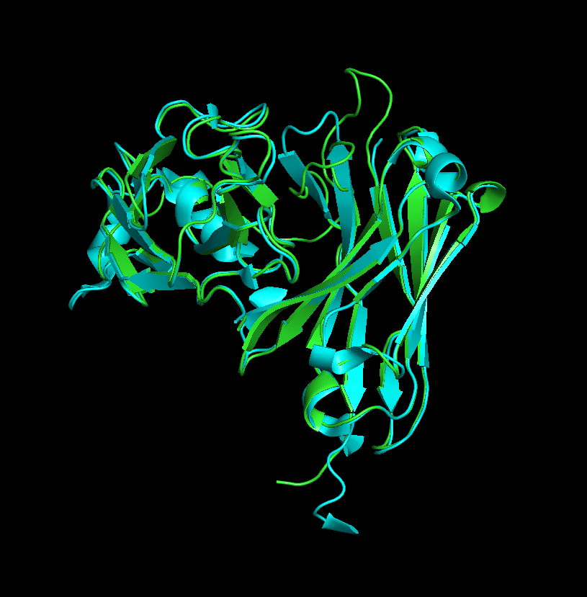
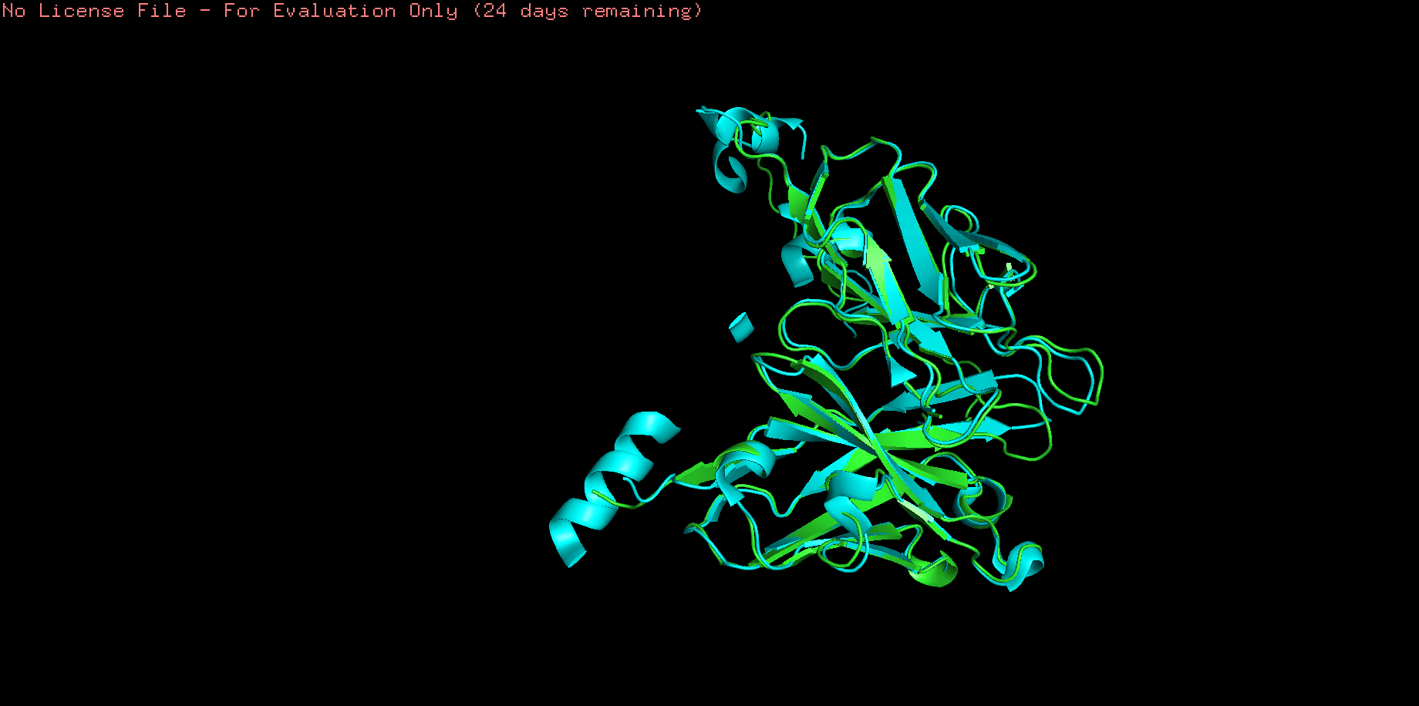
8IQS
Decent overlap between the beta sheets
Alpha helices don't all align
Some stray loops
AlphaFold
Boltz-2

Slide 8
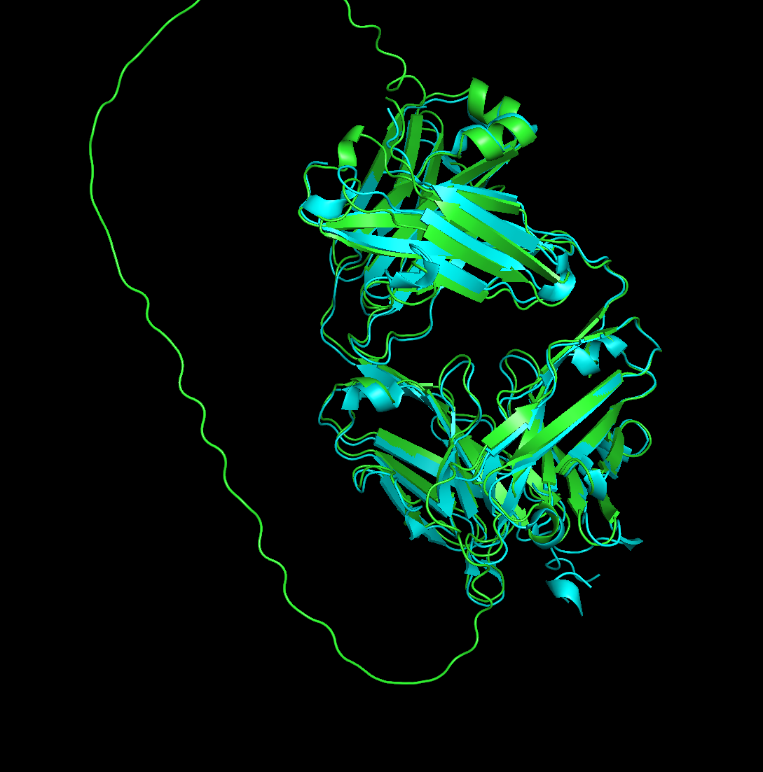
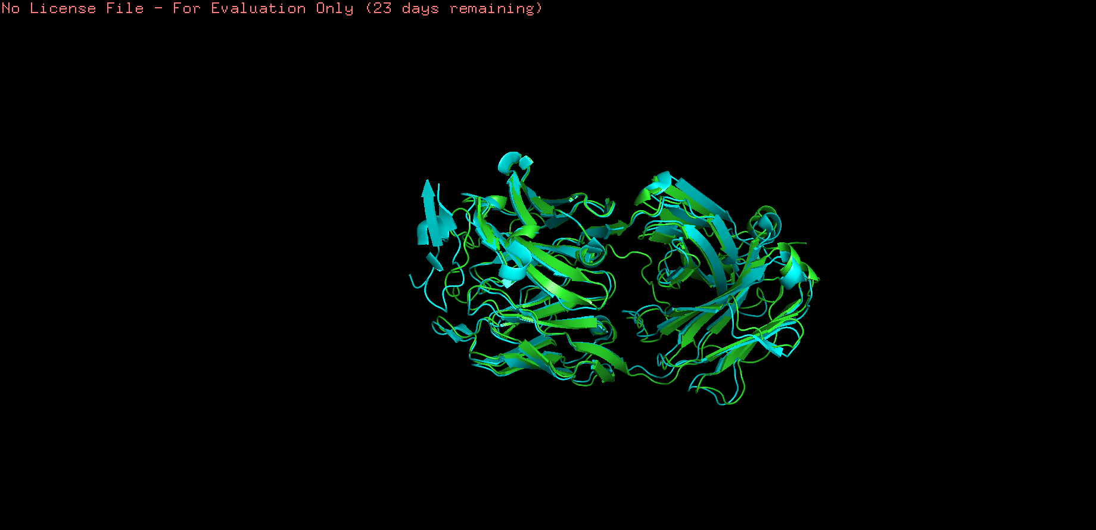
8JYR
Boltz-2 model structure is missing a big loop
All the other beta sheet and alpha helices overlap well
AlphaFold
Boltz-2

Slide 9
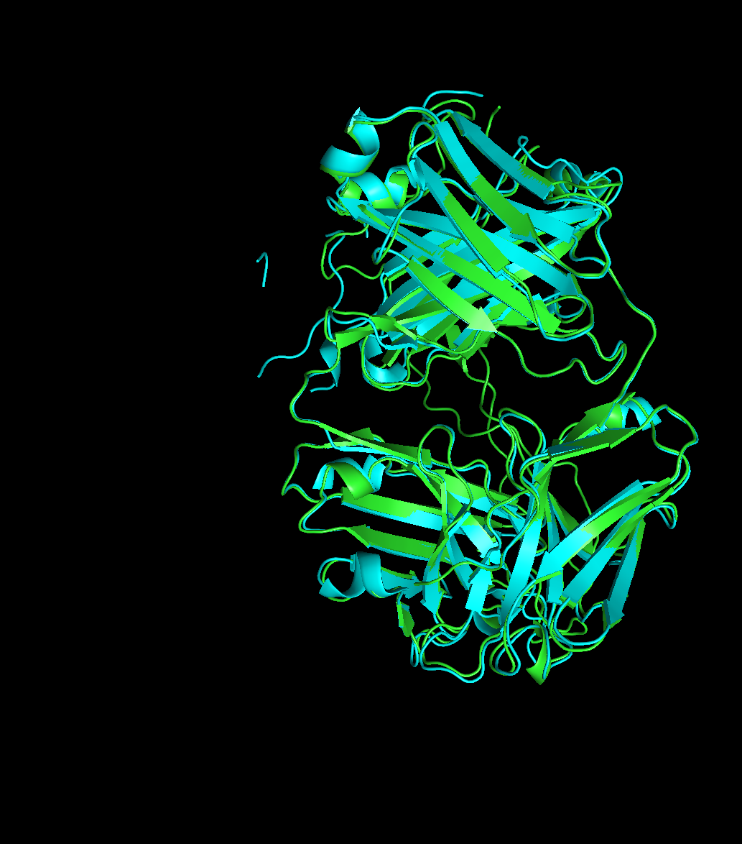
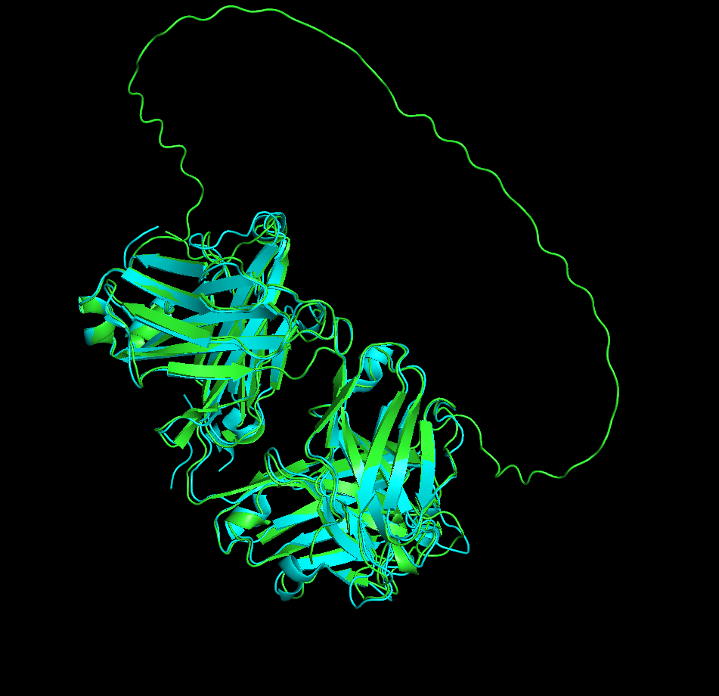
3KDM
Boltz-2 model structure is missing a big loop
All the other beta sheet and alpha helices overlap well
AlphaFold
Boltz-2

