Slide 1
CMSE 882 Week 4
Boltz and Onionnet binding affinities

Slide 2
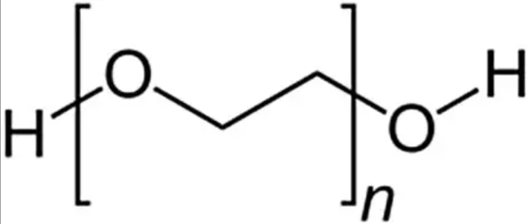
Positive controls were selected as moderately sized amphiphilic ligands capable of interacting within antibody surface grooves
•PE8 (Positive Control)
•Moderate size
•PEG6_diol
•Octylphenyl_PEG8
•TEGDN

Slide 3
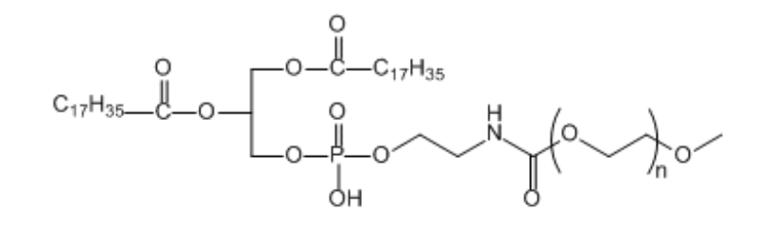
Negative controls were selected as large, highly flexible PEG or lipid-conjugated molecules expected have lower affinities due to steric hindrance
•Large, highly flexible polymers
•PEG13/14_diol
•mPEG12 variants
•Bulky lipids/molecules
•DSPE_PEG12
•Cholesterol_PEG

Slide 4
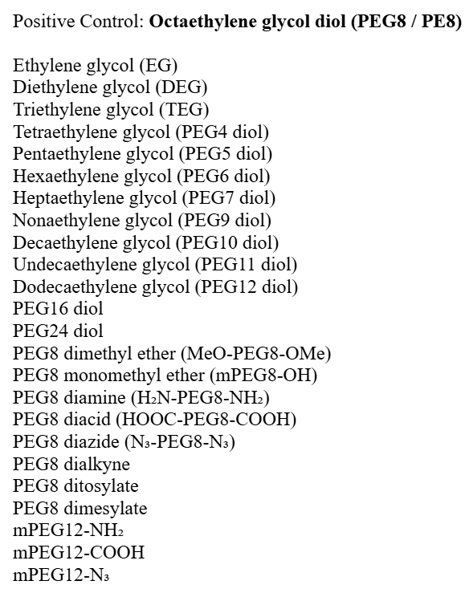
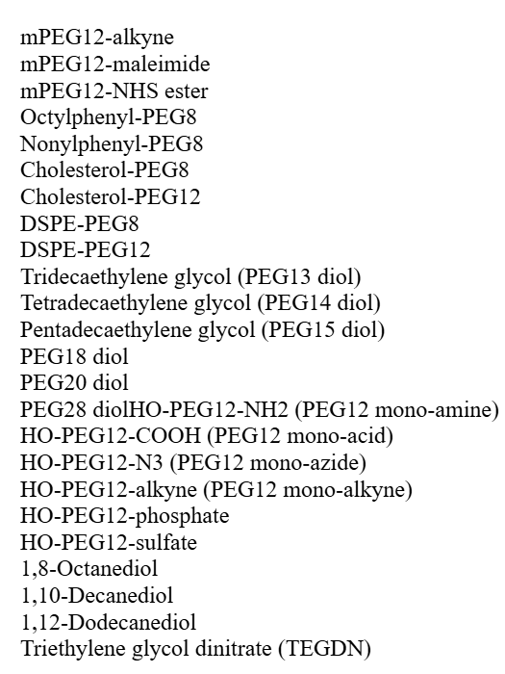

Slide 6
Top 10 ligands (ranked by OnionNet)
Rank | Ligand | OnionNet_pKa | Boltz_pKd | Boltz_Binding_Prob | Boltz_Confidence
1 | Cholesterol_PEG8 | 6.639 | 0.655 | 0.177 | 0.894
2 | mPEG12_maleimide | 6.04 | 0.879 | 0.352 | 0.822
3 | DSPE_PEG8_maleimide | 6.007 | -0.068 | 0.657 | 0.790
4 | PEG16_diol | 5.723 | 0.364 | 0.428 | 0.761
5 | mPEG12_NHS_ester | 5.635 | -0.030 | 0.471 | 0.799
6 | PEG28_diol | 5.51 | -0.018 | 0.556 | 0.722
7 | HO_PEG12_phosphate | 5.445 | 0.045 | 0.464 | 0.789
8 | Cholesterol_PEG12 | 5.444 | 0.008 | 0.266 | 0.781
9 | PEG8_dimesylate | 5.375 | 0.634 | 0.441 | 0.770
10 | HO_PEG12_NH2 | 5.34 | 0.424 | 0.429 | 0.810

Slide 7
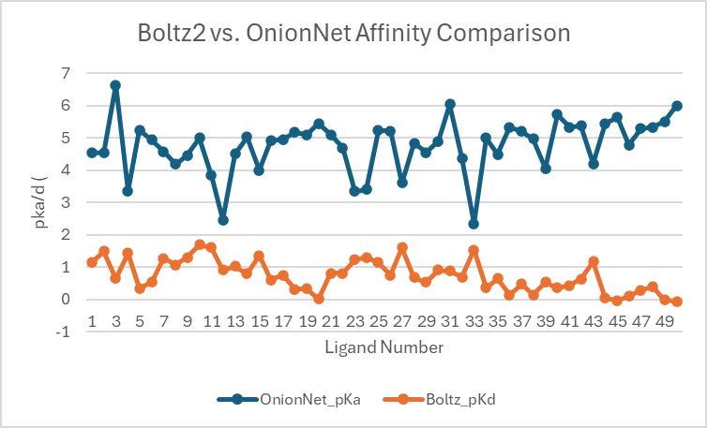
Data shows little correlation between OnionNet and Boltz2 prediction values

