Slide 1
Final Project: Health Insurance Sales Prediction
Ayodeji & Behrooz
20.02.2021
Ironhack Berlin

Slide 2
The Story
This is about an Insurance company that has provided Health Insurance to its customers, now the company needs help in building a model to predict whether the policyholders (customers) from past year will also be interested in Vehicle Insurance provided by the company again.
Building a model to predict whether a customer would be interested in Vehicle Insurance is extremely helpful for the company because it can then accordingly plan its communication strategy to reach out to those customers and optimise its business model and revenue.
Now, in order to predict, whether the customer would be interested in Vehicle insurance, I will use the below information: demographics (gender, age, region code type), Vehicles (Vehicle Age, Damage), and Policy (Premium, sourcing channel).
Therefore we are interested to predict the response of the customer to take up the insurance (Probability of response 'yes' or '1'). The evaluation metric for this project is ROC_AUC score.

Slide 3
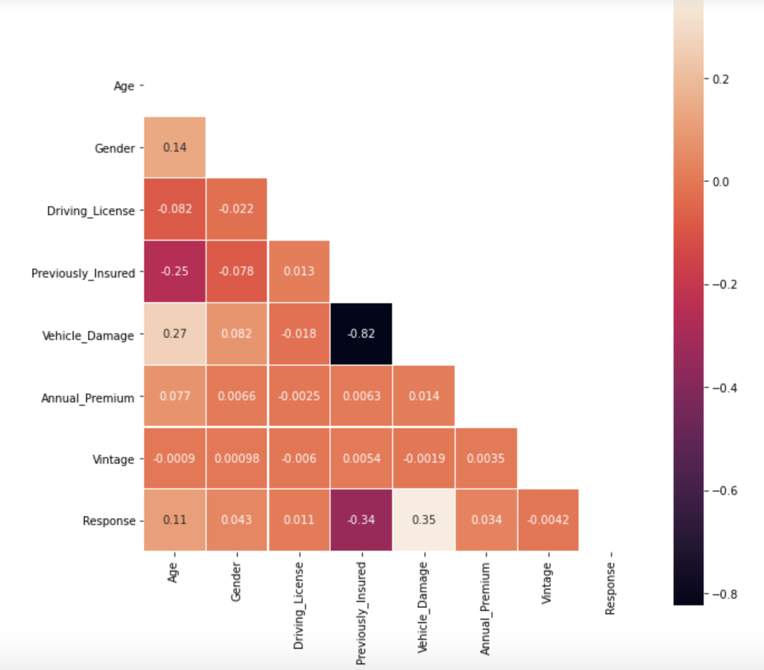
Correlation

Slide 4
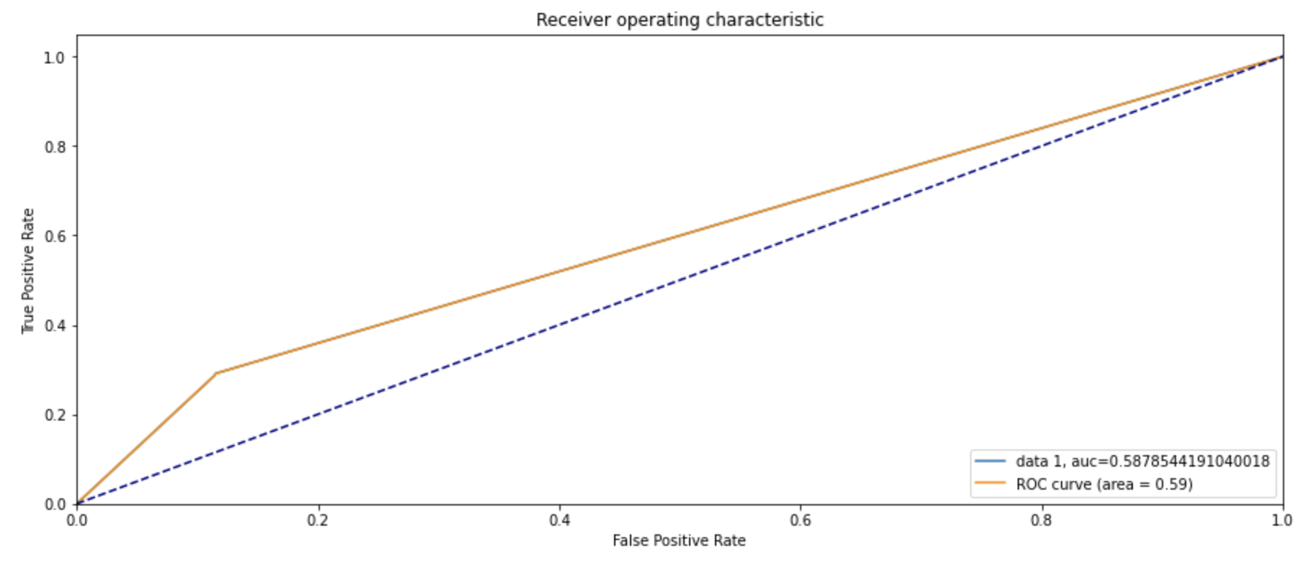
ROC_AUC Curve: original data

Slide 5
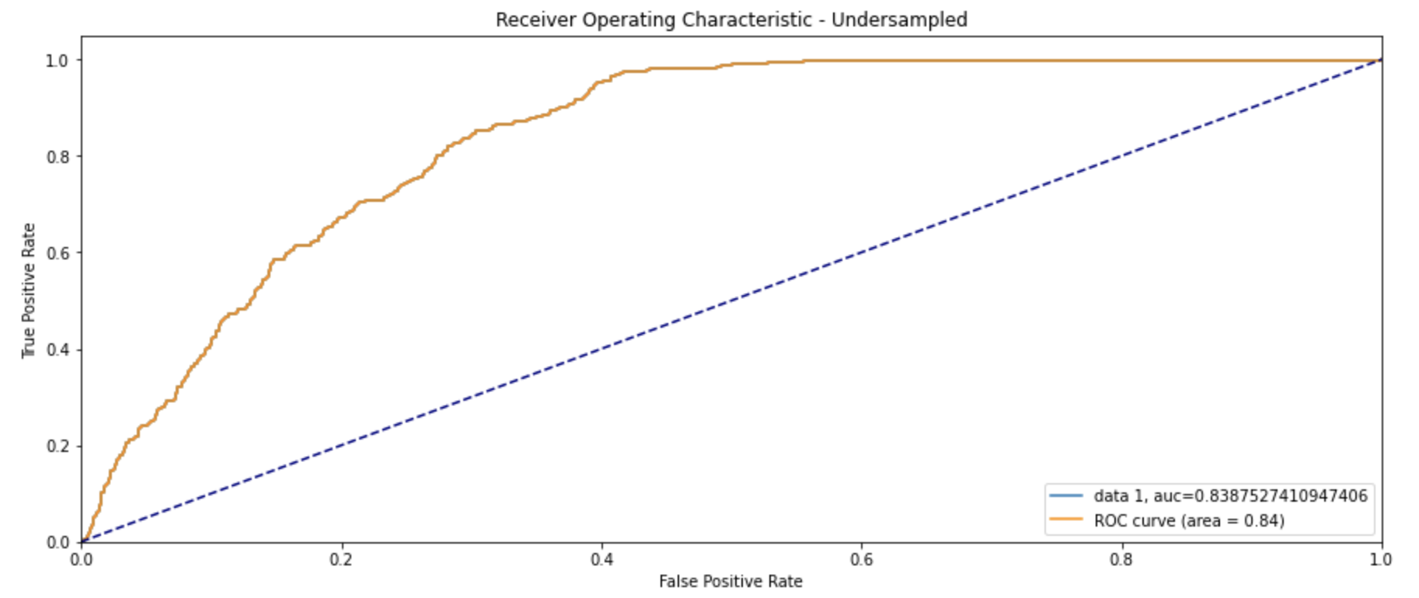
Dealing with imbalanced data - Under Sampling ROC_AUC Curve: UnderSampled

Slide 6
Odds Ratio
In order to get a numerical gauge of the impact of each feature in the LogisticRegression model, the Odds Ratio is used.
For continuous variables
For categorical predictors

Slide 7
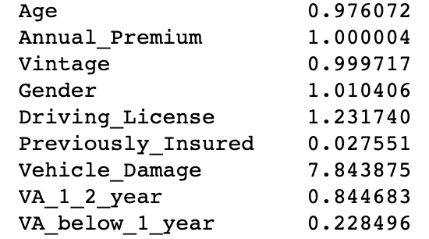
Odds Ratio
Age, Annual premium, and vintage will increase the possiblity of signing up with the insurance is 0.97, 1, and 0.99 respectively if they increase by 1 unit.
Our results show that being Male, anda having driver license, and also previously damaged vehicle you are more likely to take up insurance.
Being previously insured and the vehicle age does not necessarily contribute to the enrollment.

Slide 8
Real world test: We used Pickle to predict

