Slide 1
Making your research reproducible

Slide 2
Reproducible vs Replicable
Notes:
Girls can’t do maths
Give them a test of spatial rotation – boys do better.

Slide 3
 |  | Data
 |  | Same | Different
Code | Same
 | Different
Notes:
Girls can’t do maths
Give them a test of spatial rotation – boys do better.

Slide 4
 |  | Data
 |  | Same | Different
Code | Same | Reproducible
 | Different
Notes:
Girls can’t do maths
Give them a test of spatial rotation – boys do better.

Slide 5
 |  | Data
 |  | Same | Different
Code | Same | Reproducible | Replicable
 | Different
Notes:
Girls can’t do maths
Give them a test of spatial rotation – boys do better.

Slide 6
 |  | Data
 |  | Same | Different
Code | Same | Reproducible | Replicable
 | Different | Robust
Notes:
Girls can’t do maths
Give them a test of spatial rotation – boys do better.

Slide 7
 |  | Data
 |  | Same | Different
Code | Same | Reproducible | Replicable
 | Different | Robust | Generalisable
Notes:
Girls can’t do maths
Give them a test of spatial rotation – boys do better.

Slide 8
Barriers to reproducible research

Slide 9
Barriers to reproducible research
Is not considered for promotion
Requires additional skills
Plead the 5th
Support additional users
Takes time
Held to higher standards than others
Publication bias towards novel findings

Slide 10
Barriers to reproducible research
Is not considered for promotion
Requires additional skills
Plead the 5th
Support additional users
Takes time
Held to higher standards than others
Publication bias towards novel findings

Slide 11
Barriers to reproducible research
Is not considered for promotion
Requires additional skills
Plead the 5th
Support additional users
Takes time
Held to higher standards than others
Publication bias towards novel findings

Slide 12
Barriers to reproducible research
Is not considered for promotion
Requires additional skills
Plead the 5th
Support additional users
Takes time
Held to higher standards than others
Publication bias towards novel findings

Slide 13
Barriers to reproducible research
Is not considered for promotion
Requires additional skills
Plead the 5th
Support additional users
Takes time
Held to higher standards than others
Publication bias towards novel findings

Slide 14
Barriers to reproducible research
Is not considered for promotion
Requires additional skills
Plead the 5th
Support additional users
Takes time
Held to higher standards than others
Publication bias towards novel findings

Slide 15
Start small
Notes:
Girls can’t do maths
Give them a test of spatial rotation – boys do better.

Slide 16
Protocols.io
Notes:
Girls can’t do maths
Give them a test of spatial rotation – boys do better.

Slide 17
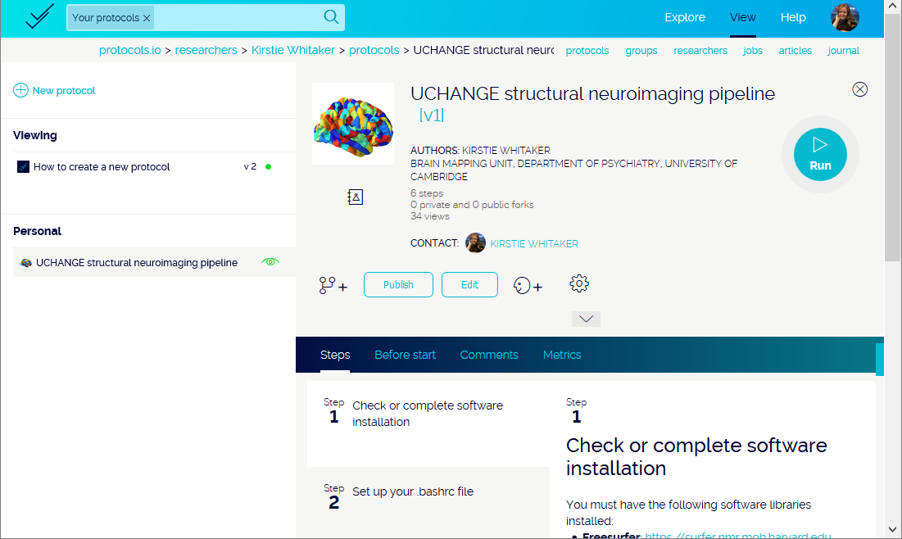
Notes:
Girls can’t do maths
Give them a test of spatial rotation – boys do better.

Slide 18
Coding your analyses
Notes:
Girls can’t do maths
Give them a test of spatial rotation – boys do better.

Slide 19
Comments are your friend!
Notes:
Girls can’t do maths
Give them a test of spatial rotation – boys do better.

Slide 20
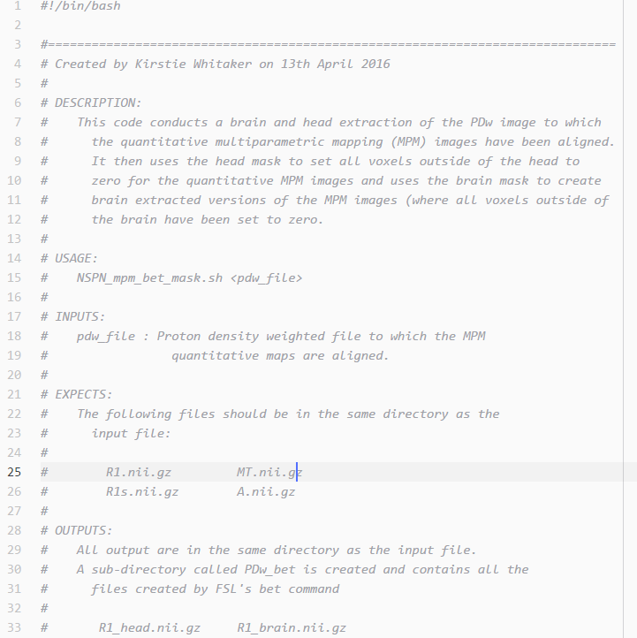
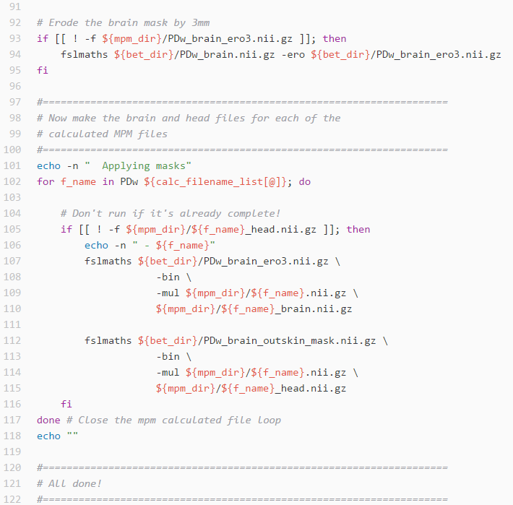
Notes:
Girls can’t do maths
Give them a test of spatial rotation – boys do better.

Slide 21
Aim for 40% comments in your code
Notes:
Girls can’t do maths
Give them a test of spatial rotation – boys do better.

Slide 22
Share your comments with the original author
Notes:
Girls can’t do maths
Give them a test of spatial rotation – boys do better.

Slide 23
StackOverflow & MWEs
http://stackoverflow.com
Notes:
Girls can’t do maths
Give them a test of spatial rotation – boys do better.

Slide 24
Python vs R (vs Matlab vs STATA etc…)

Slide 25
Python vs R (vs Matlab vs STATA etc…)

Slide 26
R Studio
https://www.rstudio.com

Slide 27
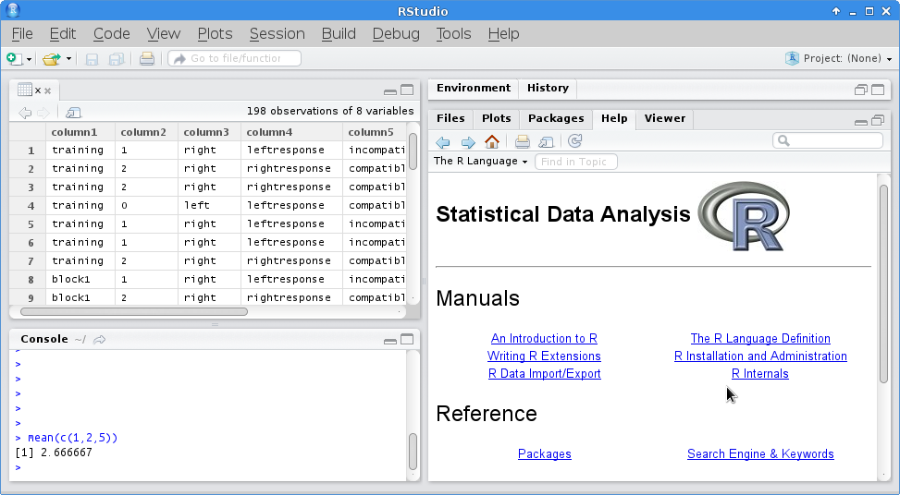
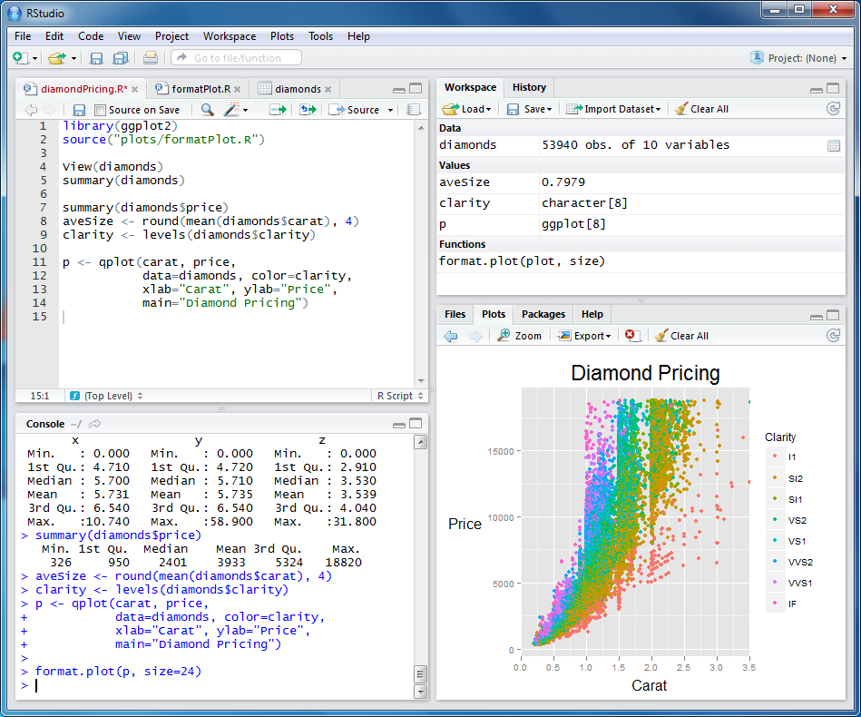

Slide 28
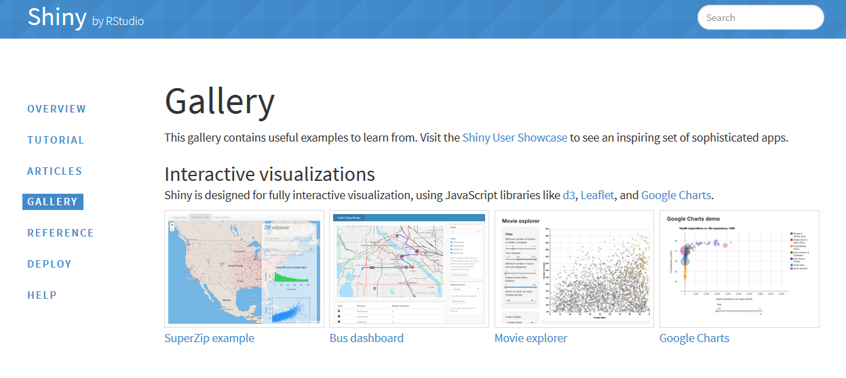
Shiny gallery

Slide 29

Anaconda
Notes:
Girls can’t do maths
Give them a test of spatial rotation – boys do better.

Slide 30
Matplotlib & Seaborn
http://matplotlib.org
http://stanford.edu/~mwaskom/software/seaborn

Slide 31
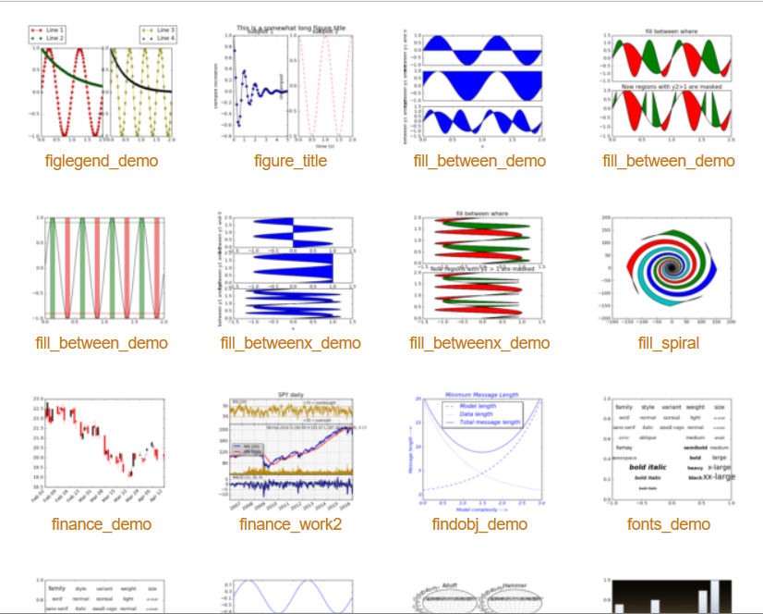
Matplotlib & Seaborn
Matplotlib gallery
Click each example to see source code

Slide 32
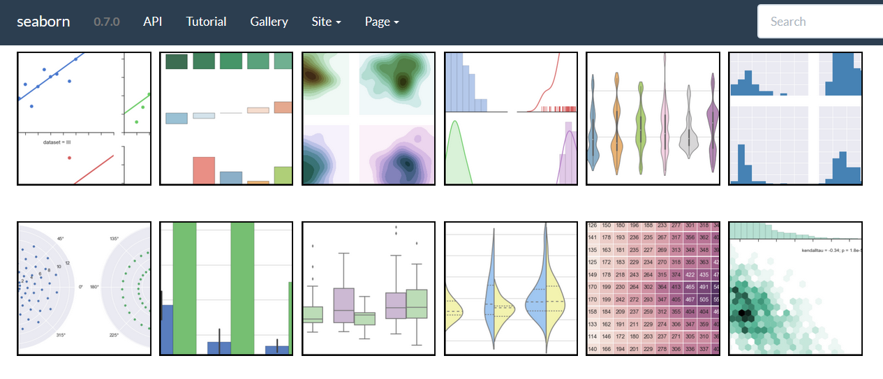
Matplotlib & Seaborn
Seaborn gallery

Slide 33

Jupyter Notebook
http://jupyter.org

Slide 34
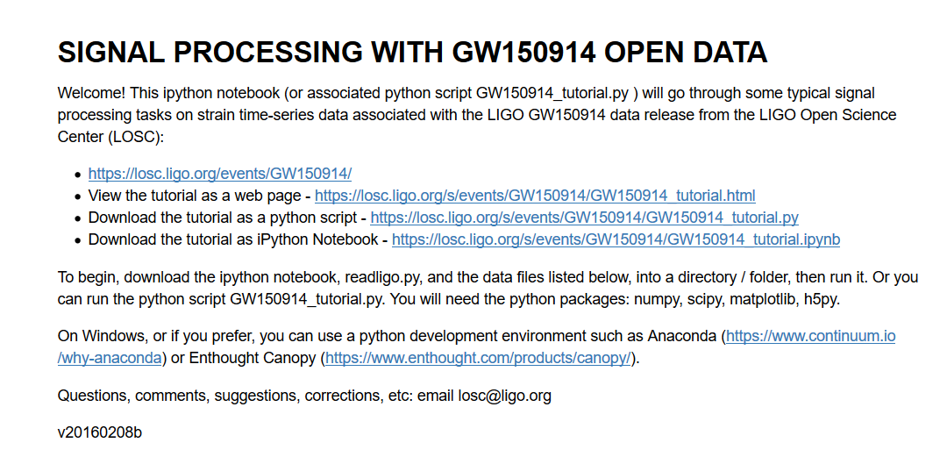
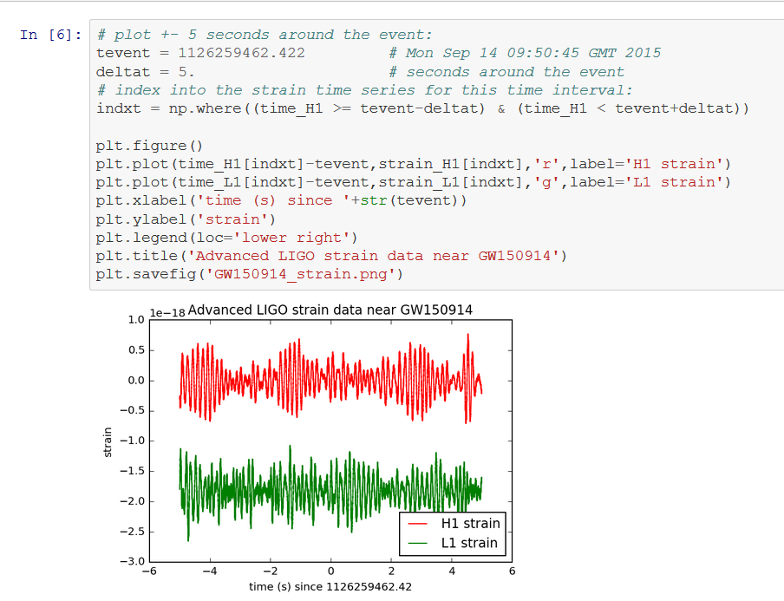
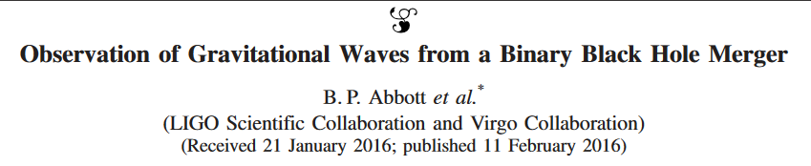
https://losc.ligo.org/s/events/GW150914/GW150914_tutorial.html
Notes:
https://losc.ligo.org/s/events/GW150914/GW150914_tutorial.html

Slide 35



Community
https://www.mozillascience.org
http://software-carpentry.org
http://data-carpentry.org
https://www.coursera.org/specializations/jhu-data-science
https://www.coursera.org/learn/python/home/info

Slide 36
Git vs GitHub

Slide 37
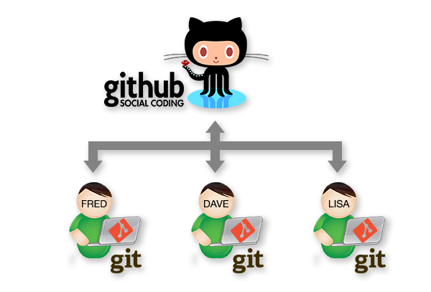
www.stemmrolemodels.com
www.github.com/KirstieJane/STEMMRoleModels

Slide 38
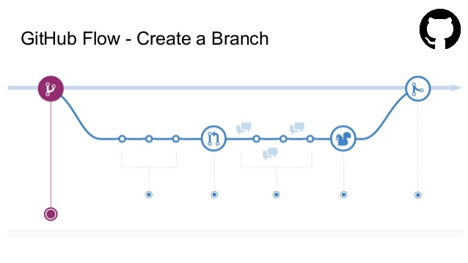
http://www.slideshare.net/nishanbose/introduction-to-github-55872492/7

Slide 39
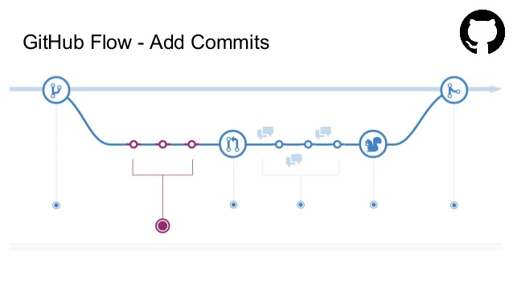
http://www.slideshare.net/nishanbose/introduction-to-github-55872492/7

Slide 40
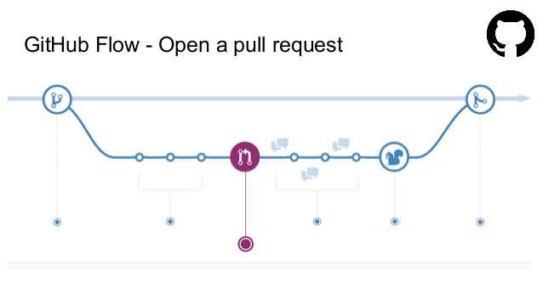
http://www.slideshare.net/nishanbose/introduction-to-github-55872492/7

Slide 41
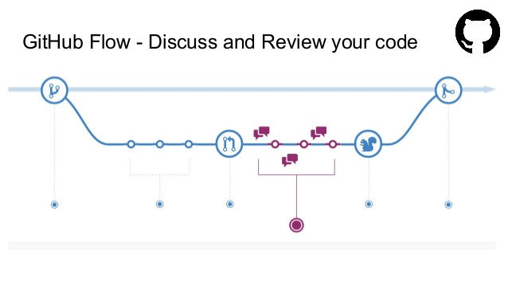
http://www.slideshare.net/nishanbose/introduction-to-github-55872492/7

Slide 42
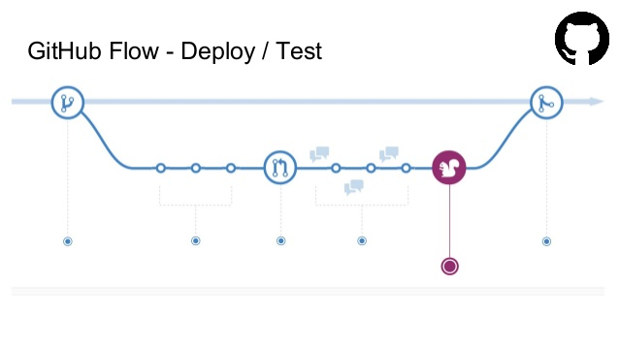
http://www.slideshare.net/nishanbose/introduction-to-github-55872492/7

Slide 43
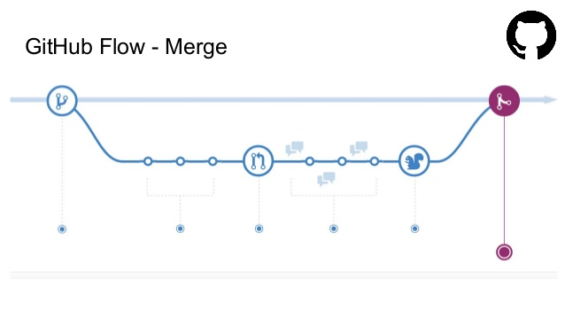
http://www.slideshare.net/nishanbose/introduction-to-github-55872492/7
Notes:
http://www.slideshare.net/nishanbose/introduction-to-github-55872492/7

Slide 44
www.GitHub.com/ KirstieJane/ ReproducibleResearch

Slide 45
Some jargon busting
Clone
Repository
Pull request
Branch
Version control
Merge
Issues
Release
Commit
Fork
Markdown
www.stemmrolemodels.com
www.github.com/KirstieJane/STEMMRoleModels

Slide 46
Submit your first pull request!
Inspired by: https://yourfirstpr.github.io

Slide 47
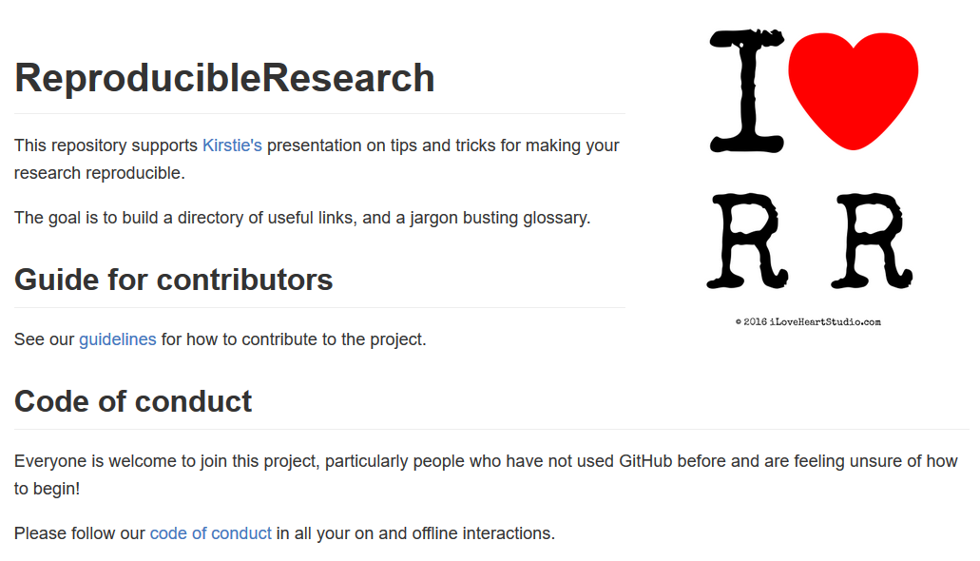
Submit your first pull request!
Inspired by: https://yourfirstpr.github.io

Slide 48
Create a glossary

Slide 49
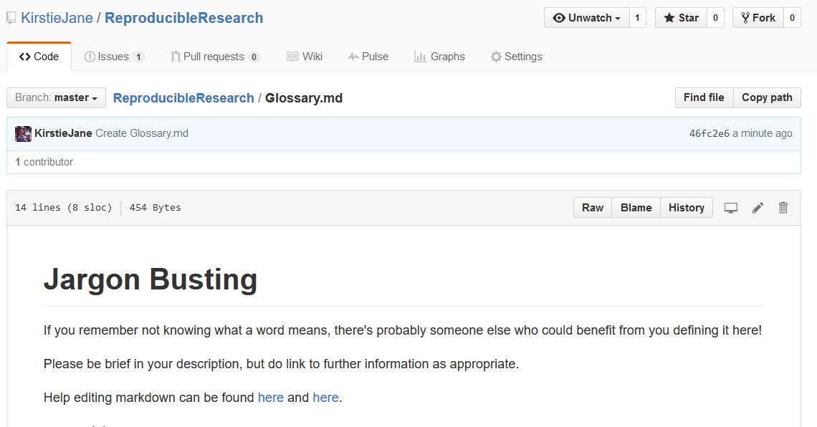
Create a glossary

Slide 50




Thank you!
KirstieJane/ReproducibleResearch
@kirstie_j
doi: 10.6084/m9.figshare.3203929

