Slide 1
Making your research reproducible

Slide 2
Reproducible vs Replicable

Slide 3
 |  | Data
 |  | Same | Different
Code | Same
 | Different

Slide 4
 |  | Data
 |  | Same | Different
Code | Same | Reproducible
 | Different

Slide 5
 |  | Data
 |  | Same | Different
Code | Same | Reproducible | Replicable
 | Different

Slide 6
 |  | Data
 |  | Same | Different
Code | Same | Reproducible | Replicable
 | Different | Robust

Slide 7
 |  | Data
 |  | Same | Different
Code | Same | Reproducible | Replicable
 | Different | Robust | Generalisable

Slide 8
Barriers to reproducible research

Slide 9
Barriers to reproducible research
Is not considered for promotion
Requires additional skills
Plead the 5th
Support additional users
Takes time
Held to higher standards than others
Publication bias towards novel findings

Slide 10
Barriers to reproducible research
Is not considered for promotion
Requires additional skills
Plead the 5th
Support additional users
Takes time
Held to higher standards than others
Publication bias towards novel findings

Slide 11
Barriers to reproducible research
Is not considered for promotion
Requires additional skills
Plead the 5th
Support additional users
Takes time
Held to higher standards than others
Publication bias towards novel findings

Slide 12
Barriers to reproducible research
Is not considered for promotion
Requires additional skills
Plead the 5th
Support additional users
Takes time
Held to higher standards than others
Publication bias towards novel findings

Slide 13
Barriers to reproducible research
Is not considered for promotion
Requires additional skills
Plead the 5th
Support additional users
Takes time
Held to higher standards than others
Publication bias towards novel findings

Slide 14
Barriers to reproducible research
Is not considered for promotion
Requires additional skills
Plead the 5th
Support additional users
Takes time
Held to higher standards than others
Publication bias towards novel findings

Slide 15
Start small

Slide 16
Protocols.io

Slide 17
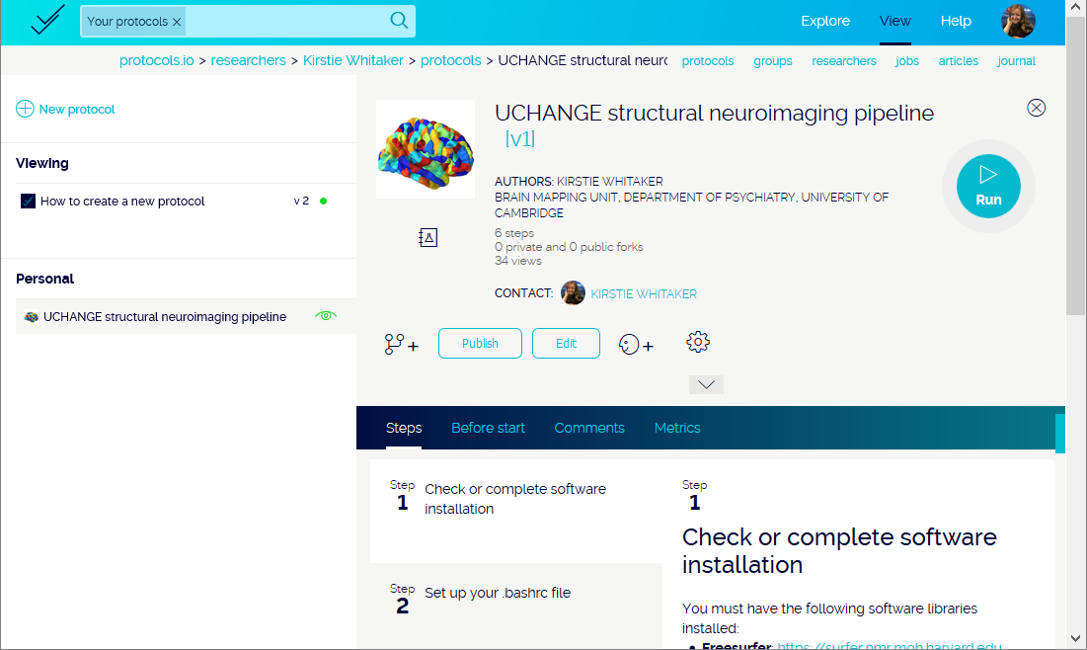

Slide 18
Coding your analyses

Slide 19
Comments are your friend!

Slide 20
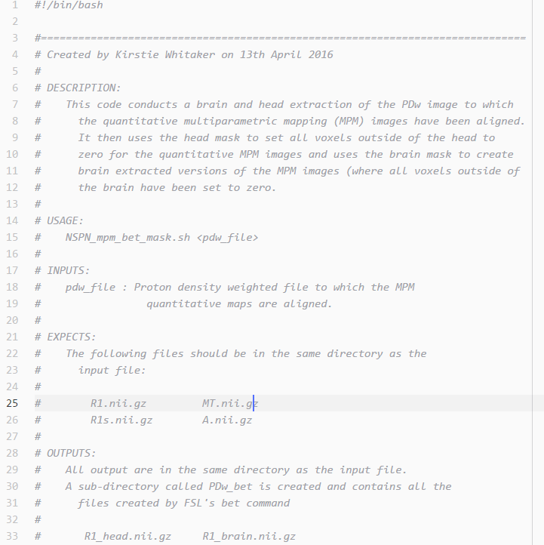
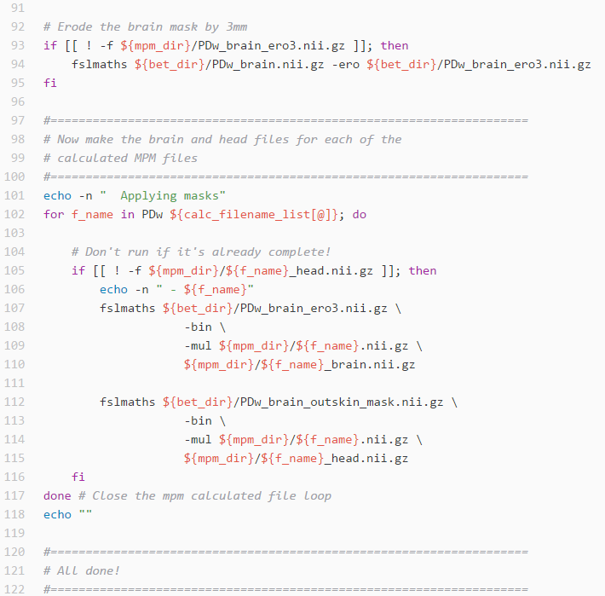

Slide 21
Aim for 40% comments in your code

Slide 22
Share your comments with the original author

Slide 23
StackOverflow & MWEs
http://stackoverflow.com

Slide 24
Python vs R (vs Matlab vs STATA etc…)

Slide 25
Python vs R (vs Matlab vs STATA etc…)

Slide 26
R Studio
https://www.rstudio.com

Slide 27
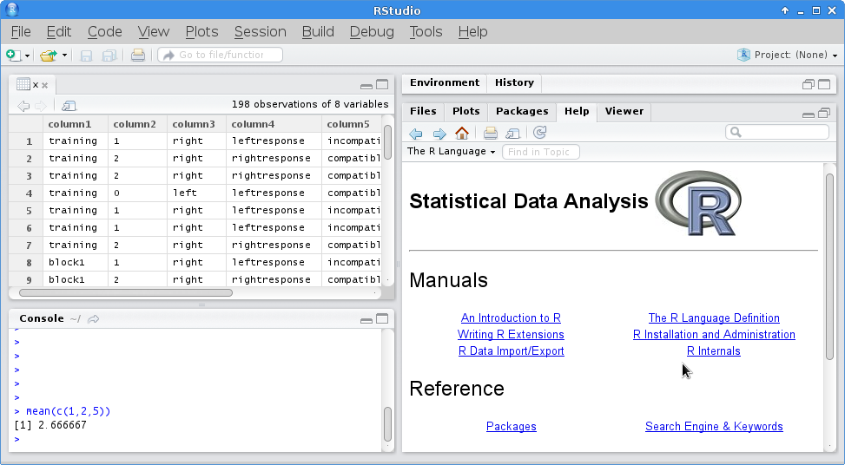
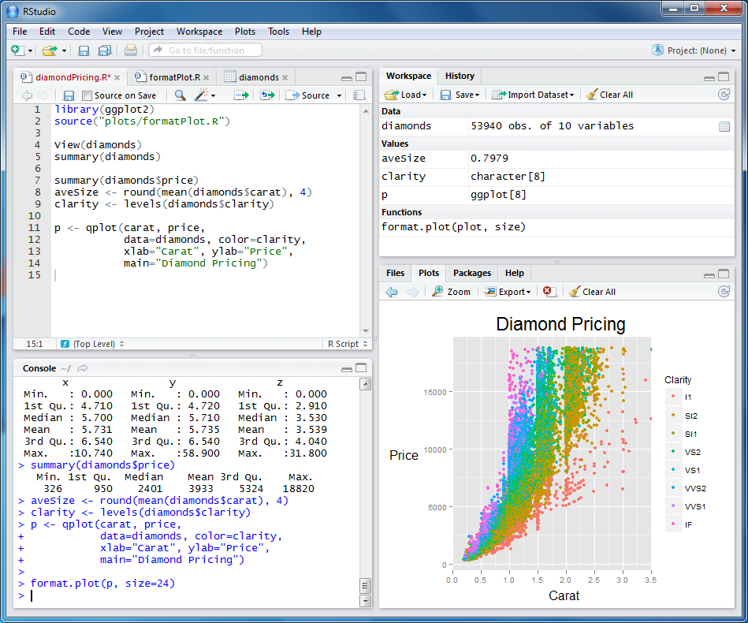

Slide 28
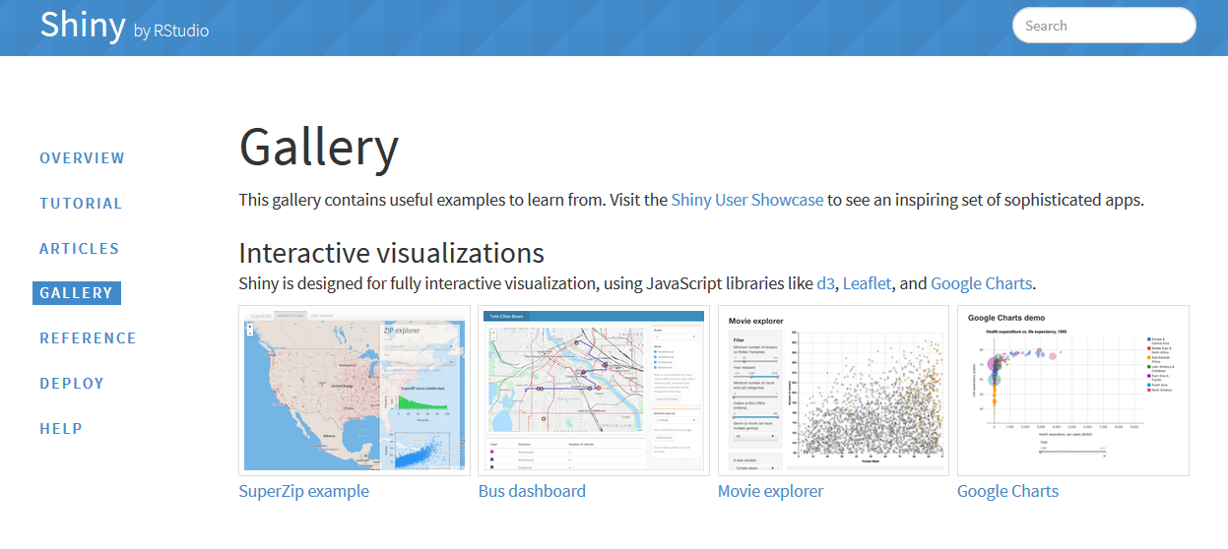
Shiny gallery

Slide 29

Anaconda

Slide 30
Matplotlib & Seaborn
http://matplotlib.org
http://stanford.edu/~mwaskom/software/seaborn

Slide 31
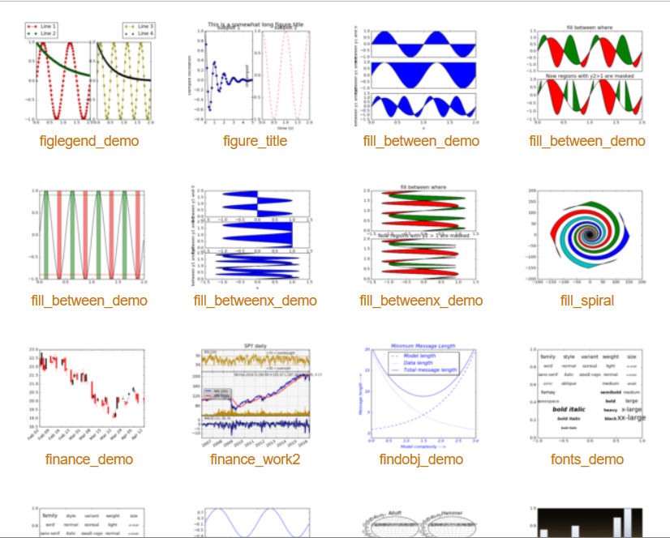
Matplotlib & Seaborn
Matplotlib gallery
Click each example to see source code

Slide 32
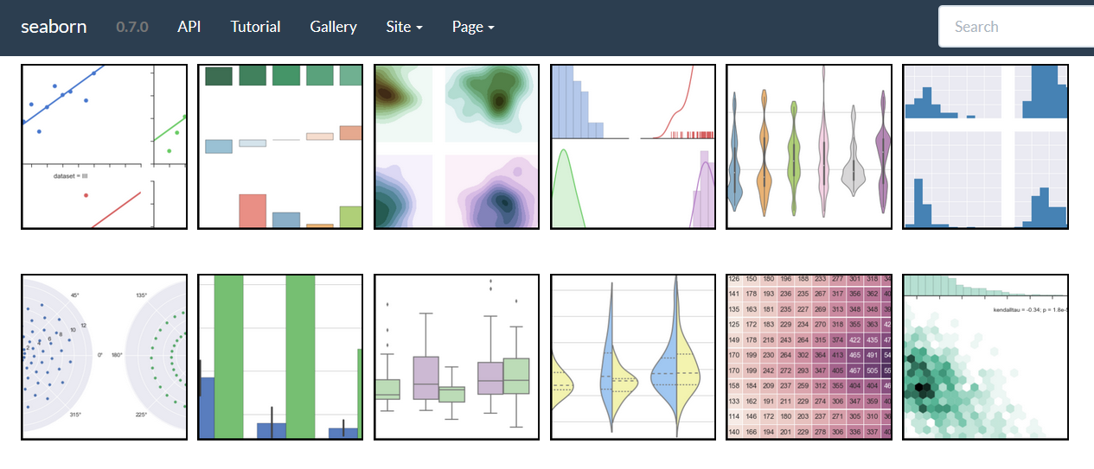
Matplotlib & Seaborn
Seaborn gallery

Slide 33

Jupyter Notebook
http://jupyter.org

Slide 34
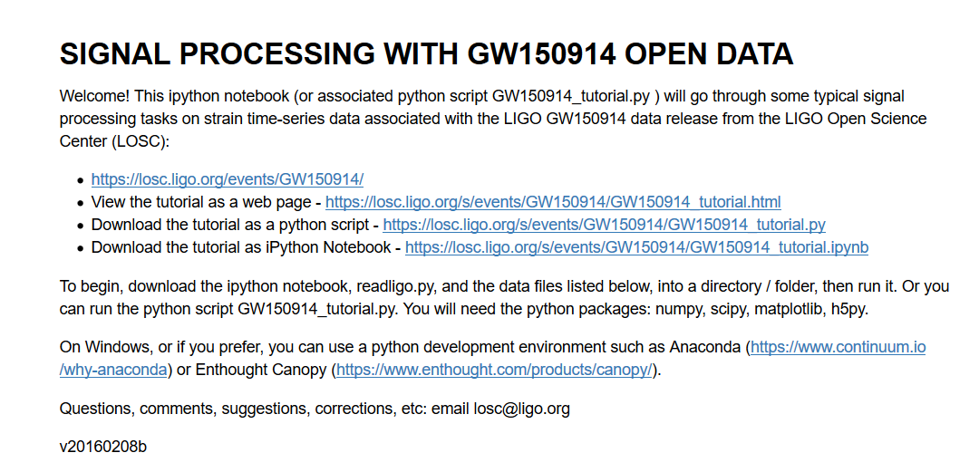
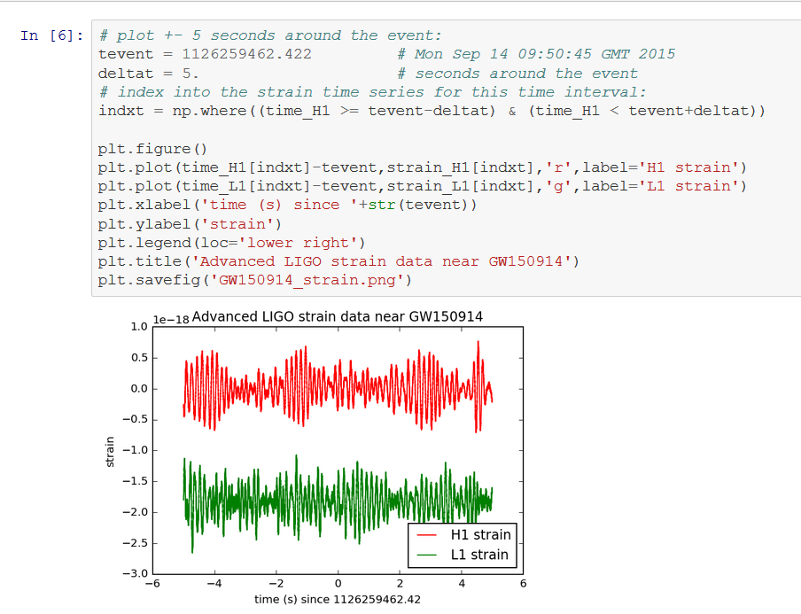
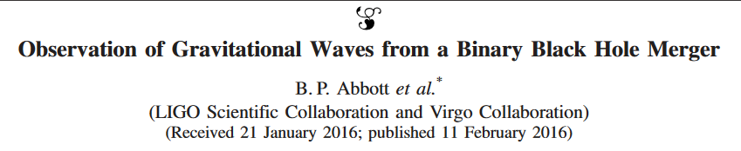
https://losc.ligo.org/s/events/GW150914/GW150914_tutorial.html
Notes:
https://losc.ligo.org/s/events/GW150914/GW150914_tutorial.html

Slide 35



Community
https://www.mozillascience.org
http://software-carpentry.org
http://data-carpentry.org
https://www.coursera.org/specializations/jhu-data-science
https://www.coursera.org/learn/python/home/info

Slide 36
Git vs GitHub

Slide 37
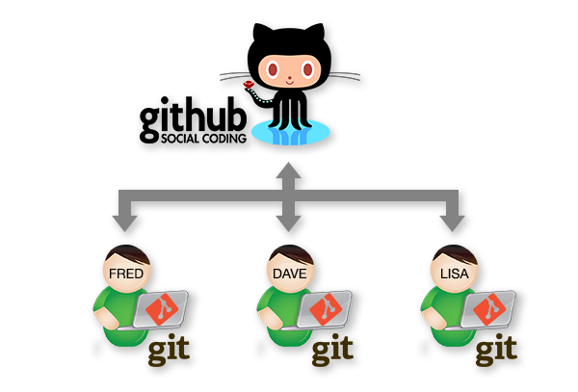
www.stemmrolemodels.com
www.github.com/KirstieJane/STEMMRoleModels

Slide 38
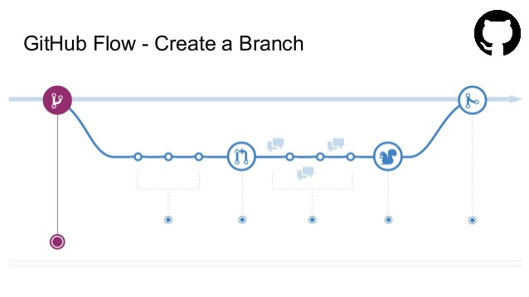
http://www.slideshare.net/nishanbose/introduction-to-github-55872492/7

Slide 39
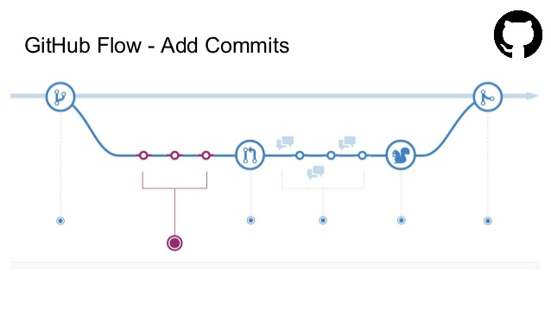
http://www.slideshare.net/nishanbose/introduction-to-github-55872492/7

Slide 40
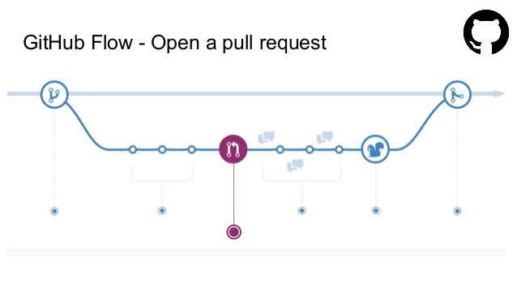
http://www.slideshare.net/nishanbose/introduction-to-github-55872492/7

Slide 41
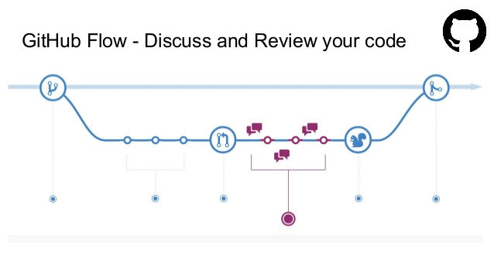
http://www.slideshare.net/nishanbose/introduction-to-github-55872492/7

Slide 42
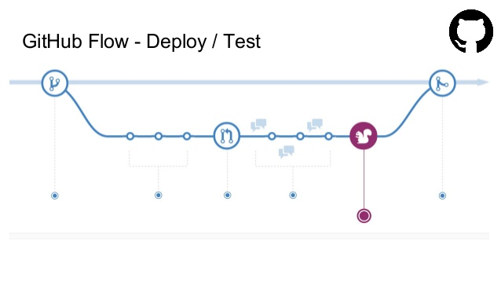
http://www.slideshare.net/nishanbose/introduction-to-github-55872492/7

Slide 43
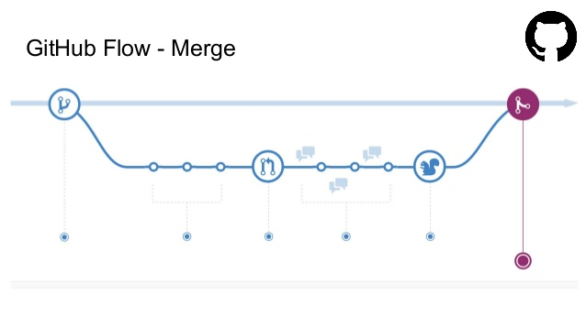
http://www.slideshare.net/nishanbose/introduction-to-github-55872492/7
Notes:
http://www.slideshare.net/nishanbose/introduction-to-github-55872492/7

Slide 44
www.GitHub.com/ KirstieJane/ ReproducibleResearch

Slide 45
Some jargon busting
Clone
Repository
Pull request
Branch
Version control
Merge
Issues
Release
Commit
Fork
Markdown
www.stemmrolemodels.com
www.github.com/KirstieJane/STEMMRoleModels

Slide 46
Submit your first pull request!
Inspired by: https://yourfirstpr.github.io

Slide 47
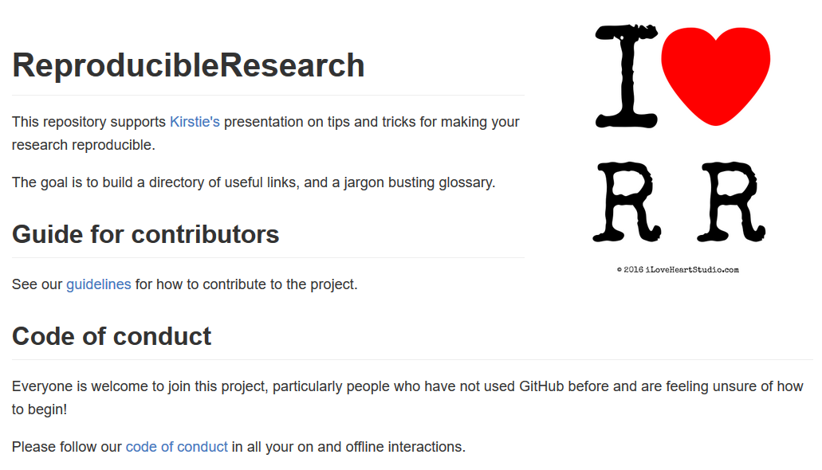
Submit your first pull request!
Inspired by: https://yourfirstpr.github.io

Slide 48
Create a glossary

Slide 49
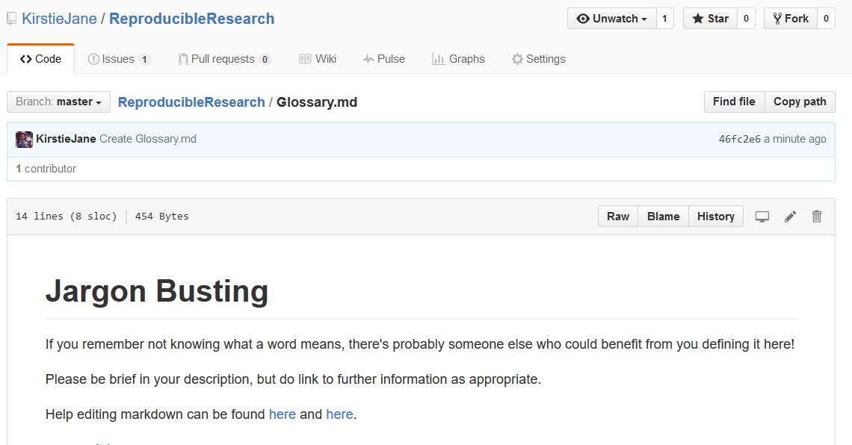
Create a glossary

Slide 50




Thank you!
KirstieJane/ReproducibleResearch
@kirstie_j
doi: 10.6084/m9.figshare.3203929

