Slide 1
Making your research reproducible

Slide 2
Reproducible vs Replicable
Notes:
Girls can’t do maths
Give them a test of spatial rotation – boys do better.

Slide 3
 |  | Data
 |  | Same | Different
Code | Same
 | Different
Notes:
Girls can’t do maths
Give them a test of spatial rotation – boys do better.

Slide 4
 |  | Data
 |  | Same | Different
Code | Same | Reproducible
 | Different
Notes:
Girls can’t do maths
Give them a test of spatial rotation – boys do better.

Slide 5
 |  | Data
 |  | Same | Different
Code | Same | Reproducible | Replicable
 | Different
Notes:
Girls can’t do maths
Give them a test of spatial rotation – boys do better.

Slide 6
 |  | Data
 |  | Same | Different
Code | Same | Reproducible | Replicable
 | Different | Robust
Notes:
Girls can’t do maths
Give them a test of spatial rotation – boys do better.

Slide 7
 |  | Data
 |  | Same | Different
Code | Same | Reproducible | Replicable
 | Different | Robust | Generalisable
Notes:
Girls can’t do maths
Give them a test of spatial rotation – boys do better.

Slide 8
Barriers to reproducible research

Slide 9
Barriers to reproducible research
Is not considered for promotion
Requires additional skills
Plead the 5th
Support additional users
Takes time
Held to higher standards than others
Publication bias towards novel findings

Slide 10
Barriers to reproducible research
Is not considered for promotion
Requires additional skills
Plead the 5th
Support additional users
Takes time
Held to higher standards than others
Publication bias towards novel findings

Slide 11
Barriers to reproducible research
Is not considered for promotion
Requires additional skills
Plead the 5th
Support additional users
Takes time
Held to higher standards than others
Publication bias towards novel findings

Slide 12
Barriers to reproducible research
Is not considered for promotion
Requires additional skills
Plead the 5th
Support additional users
Takes time
Held to higher standards than others
Publication bias towards novel findings

Slide 13
Barriers to reproducible research
Is not considered for promotion
Requires additional skills
Plead the 5th
Support additional users
Takes time
Held to higher standards than others
Publication bias towards novel findings

Slide 14
Barriers to reproducible research
Is not considered for promotion
Requires additional skills
Plead the 5th
Support additional users
Takes time
Held to higher standards than others
Publication bias towards novel findings

Slide 15
Start small
Notes:
Girls can’t do maths
Give them a test of spatial rotation – boys do better.

Slide 16
Protocols.io
Notes:
Girls can’t do maths
Give them a test of spatial rotation – boys do better.

Slide 17
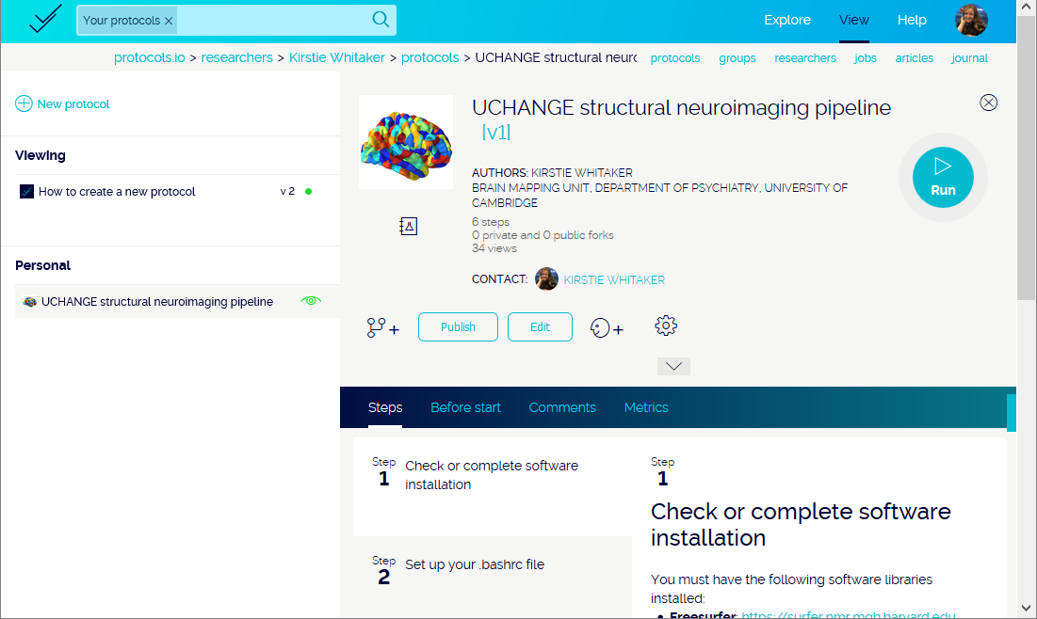
Notes:
Girls can’t do maths
Give them a test of spatial rotation – boys do better.

Slide 18
Coding your analyses
Notes:
Girls can’t do maths
Give them a test of spatial rotation – boys do better.

Slide 19
Comments are your friend!
Notes:
Girls can’t do maths
Give them a test of spatial rotation – boys do better.

Slide 20
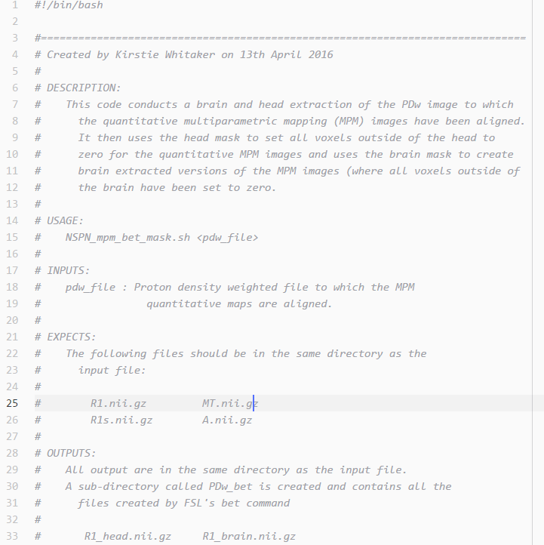
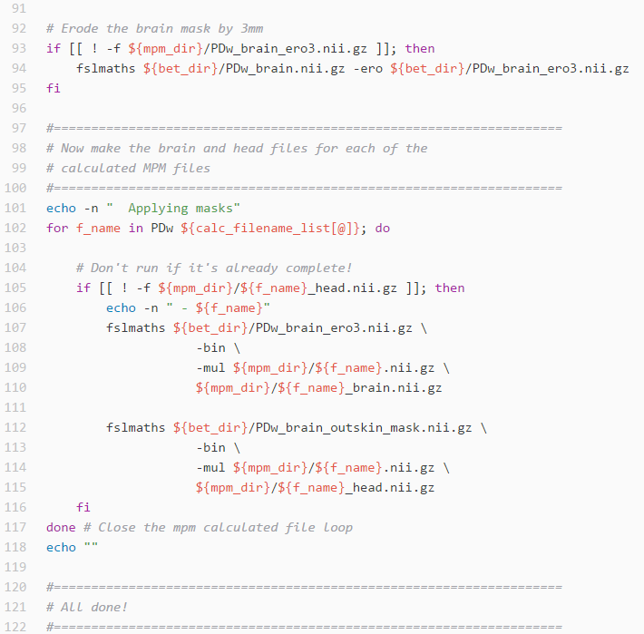
Notes:
Girls can’t do maths
Give them a test of spatial rotation – boys do better.

Slide 21
Aim for 40% comments in your code
Notes:
Girls can’t do maths
Give them a test of spatial rotation – boys do better.

Slide 22
Share your comments with the original author
Notes:
Girls can’t do maths
Give them a test of spatial rotation – boys do better.

Slide 23
Python vs R (vs Matlab vs STATA etc…)

Slide 24
Python vs R (vs Matlab vs STATA etc…)

Slide 25
R Studio

Slide 26
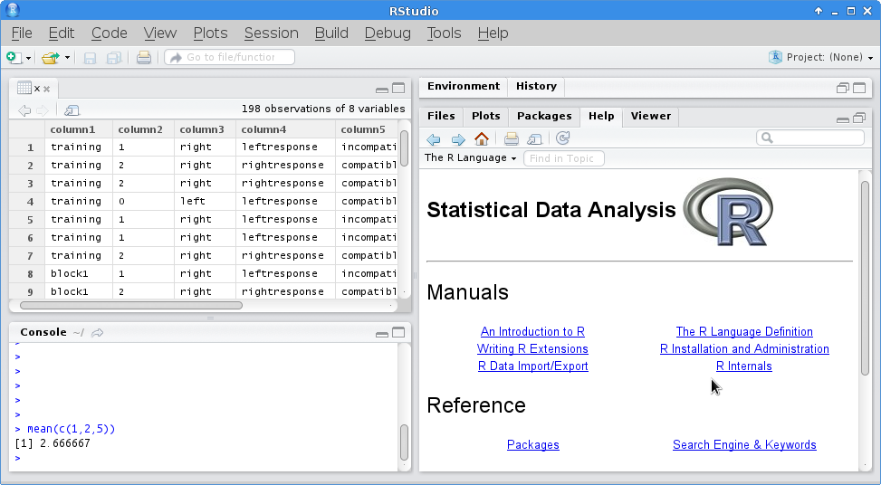
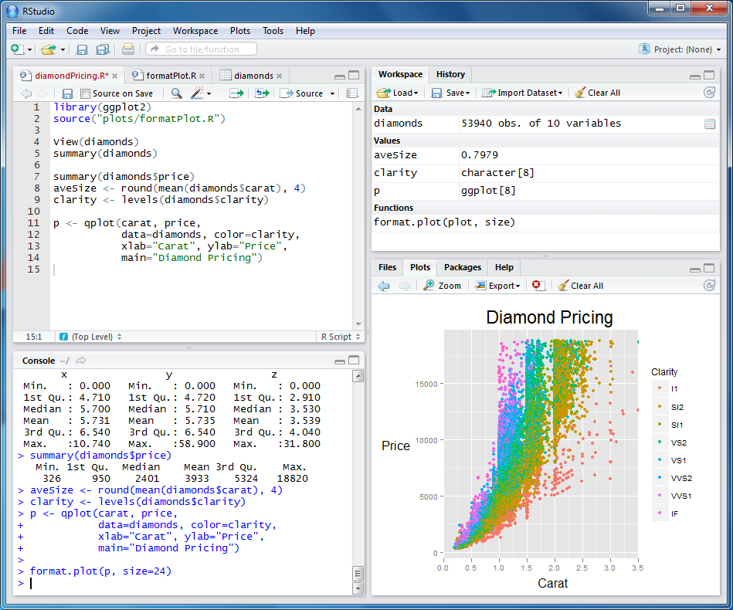

Slide 27
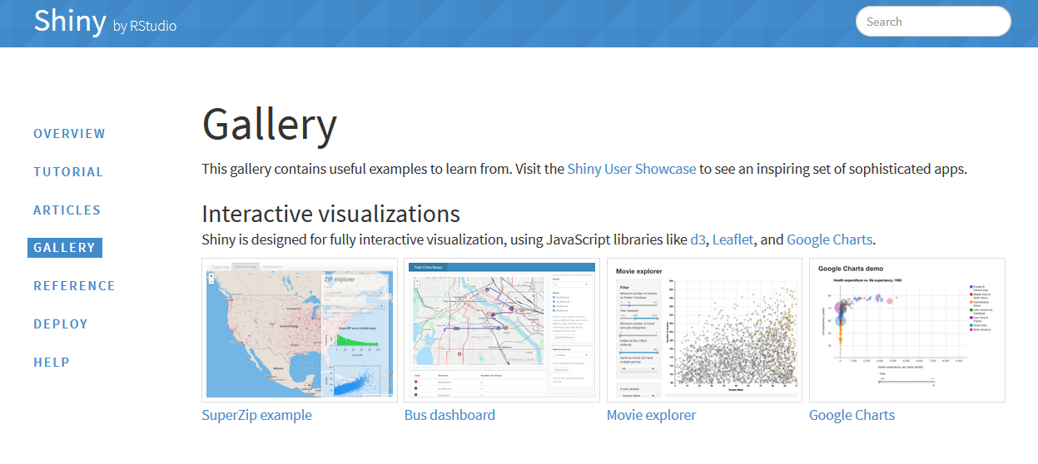
Shiny gallery

Slide 28

Anaconda
Notes:
Girls can’t do maths
Give them a test of spatial rotation – boys do better.

Slide 29
Matplotlib & Seaborn

Slide 30
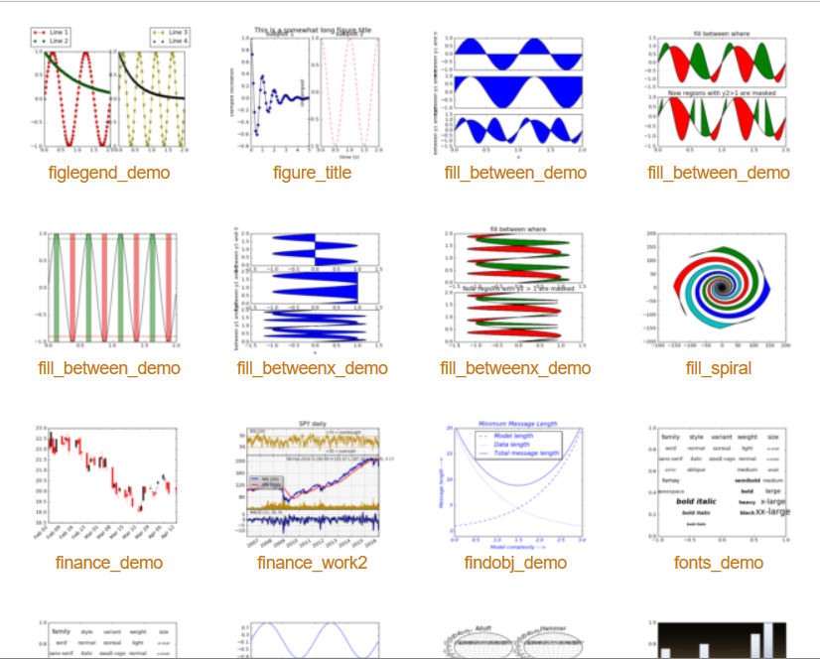
Matplotlib & Seaborn
Matplotlib gallery
Click each example to see source code

Slide 31
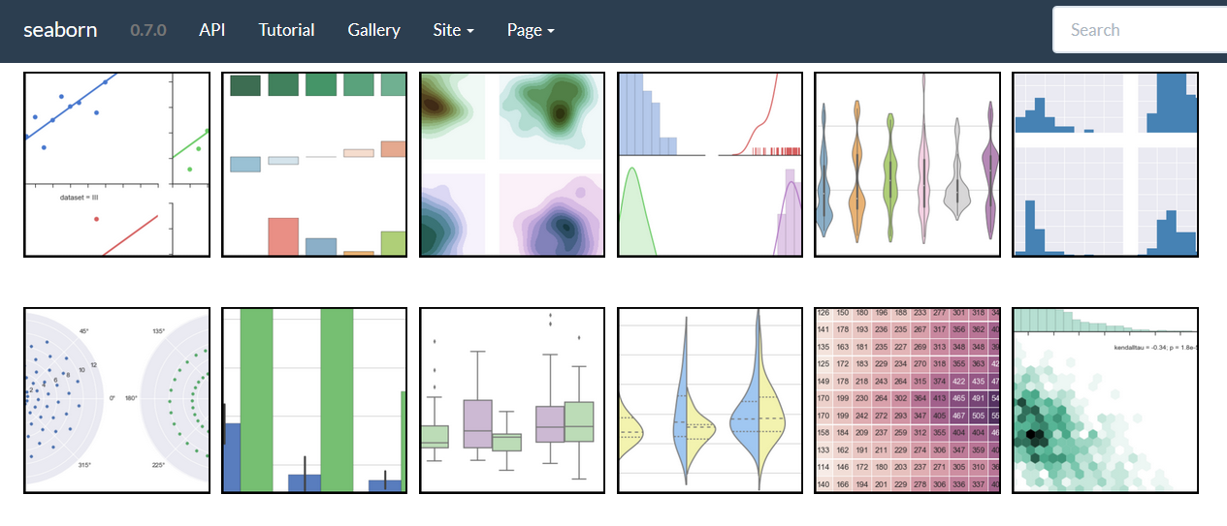
Matplotlib & Seaborn
Seaborn gallery

Slide 32

Jupyter Notebook

Slide 33
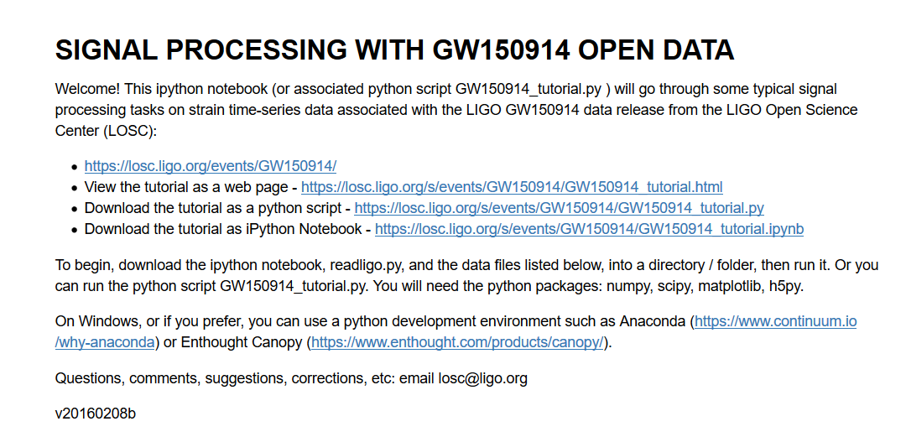
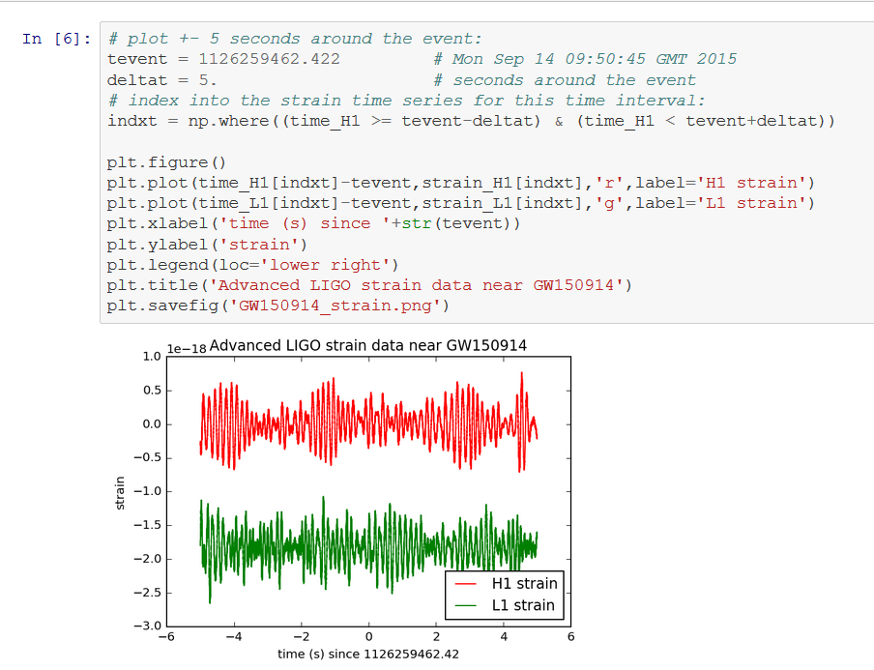
Notes:
https://losc.ligo.org/s/events/GW150914/GW150914_tutorial.html

Slide 34

Community

Slide 35
Git vs GitHub

Slide 36
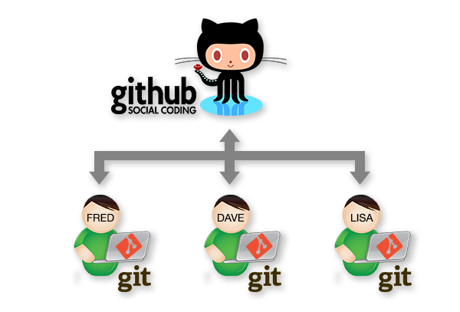
www.stemmrolemodels.com
www.github.com/KirstieJane/STEMMRoleModels

Slide 37
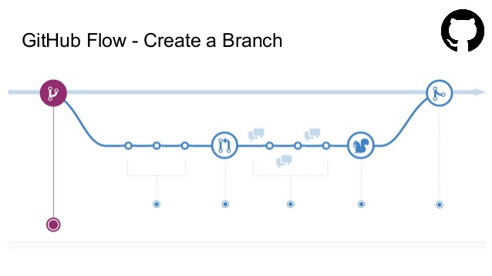

Slide 38
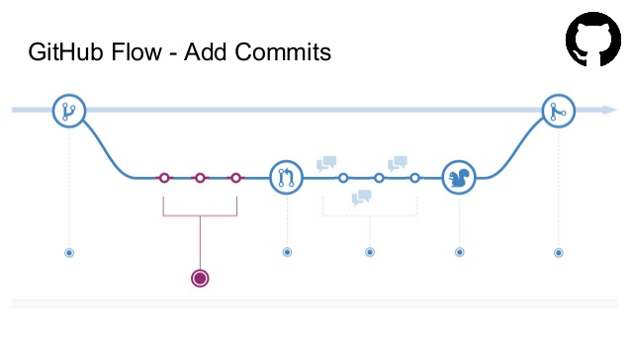

Slide 39
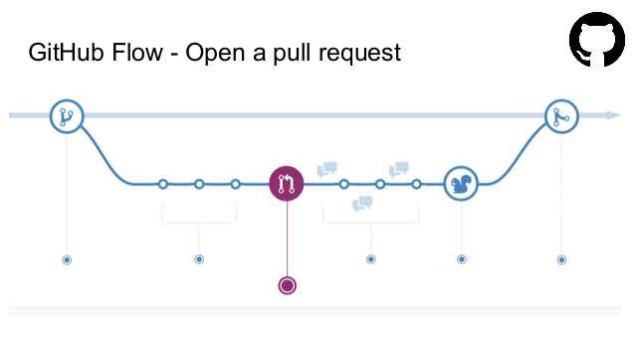

Slide 40
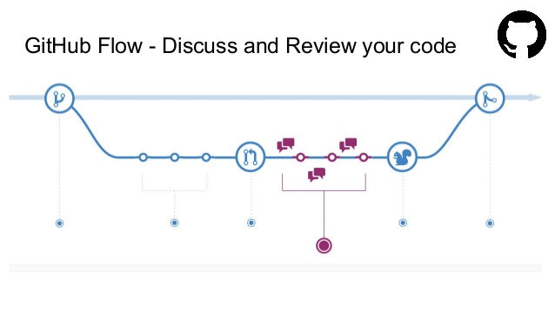

Slide 41
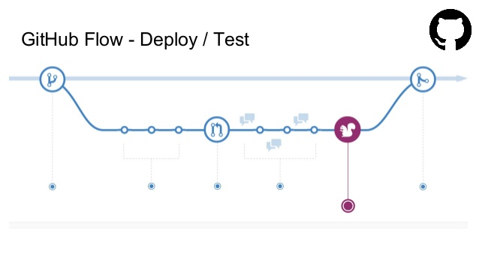

Slide 42
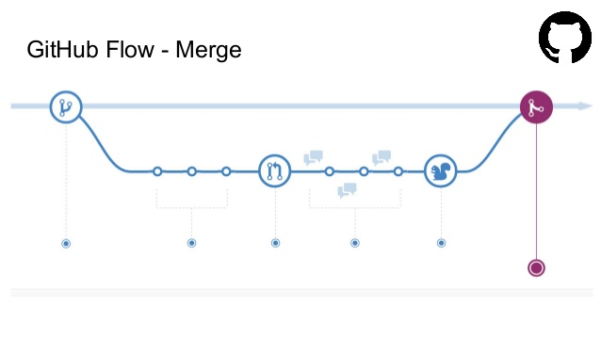
Notes:
http://www.slideshare.net/nishanbose/introduction-to-github-55872492/7

Slide 43
www.GitHub.com/ KirstieJane/ ReproducibleResearch

Slide 44
Create a glossary

Slide 45
Some jargon busting
Clone
Repository
Pull request
Branch
Version control
Merge
Issues
Release
Commit
Fork
Markdown
www.stemmrolemodels.com
www.github.com/KirstieJane/STEMMRoleModels

Slide 46
Submit your first pull request!
Inspired by: https://yourfirstpr.github.io/

Slide 47



Thank you!
KirstieJane/ReproducibleResearch
@kirstie_j
doi: 10.6084/m9.figshare.3188422

