Slide 1
Vehicle Crash
Bei He

Slide 2
Dataset
Vic Roads
Accident
Atmospheric condition
Surface condition
Person
Vehicle
Accident Location

Slide 3
Target
Probability of Severe Injury
no_persons | no_persons_inj_2 | no_persons_inj_3 | no_persons_killed | no_persons_not_inj
number of person involved | number of person severe injured | number of person light injured | number of person killed | number of person not injured
434,522 (100%) | 73,132 (16.83%) | 155,026 (35.68%) | 3,727 (0.86%) | 202,665 (46.64%)

Slide 4
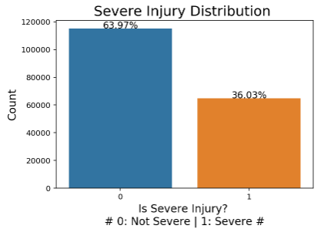
Severe Injury Accident Distribution
Total accidents :
180,084
Severe injury accident:
64,892 (36.03%)

Slide 5
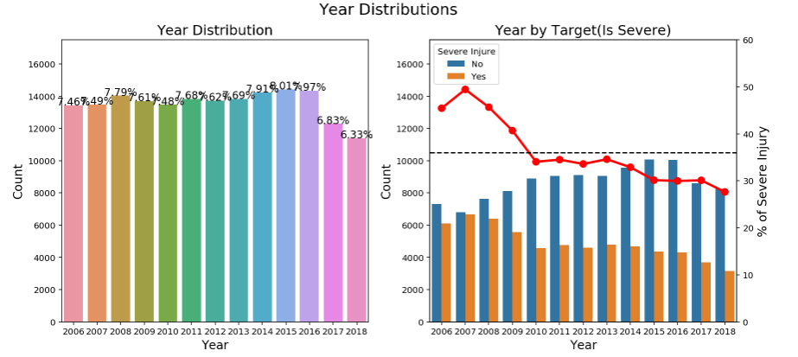
Year
The accident number are dropping since 2016
Before 2010, the chance of severe injury is high,
* 2019 data not included

Slide 6
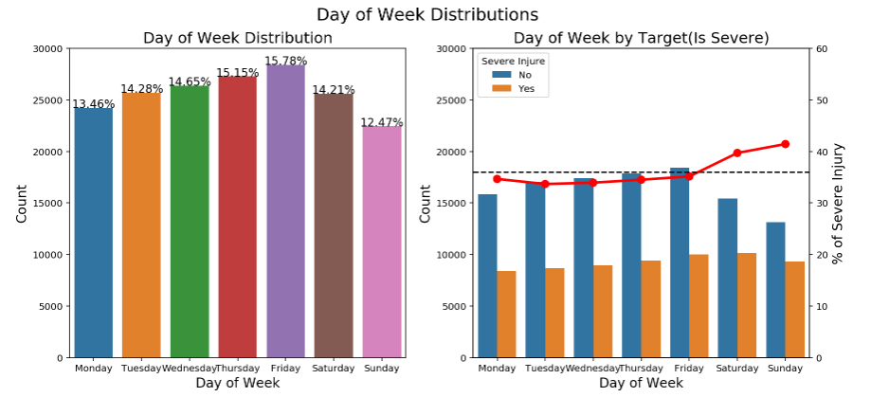
Day of Week
Although Weekends have less accidents,
the severe injury accidents take a relatively bigger portion

Slide 7
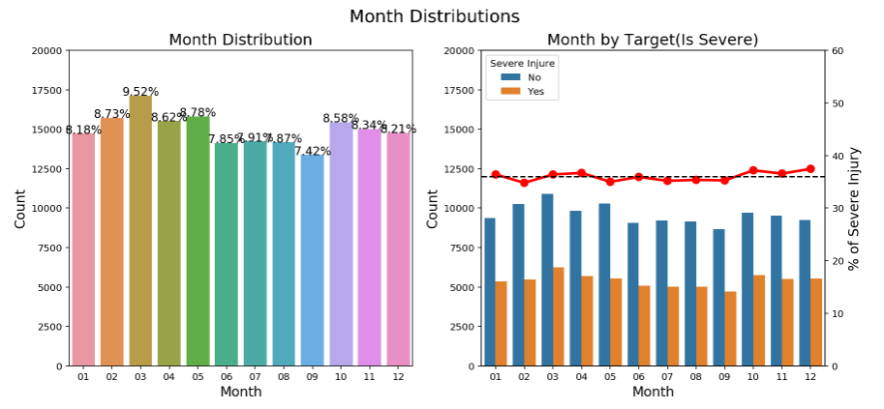
Month
There is not too much difference.
It may not be a strong indicator.

Slide 8
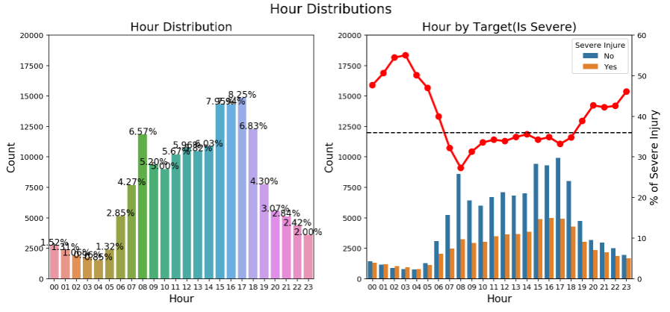
Hour
Although Midnight have less accidents,
the severe injury accidents take a extremely higer portion
The light condition maybe important.

Slide 9
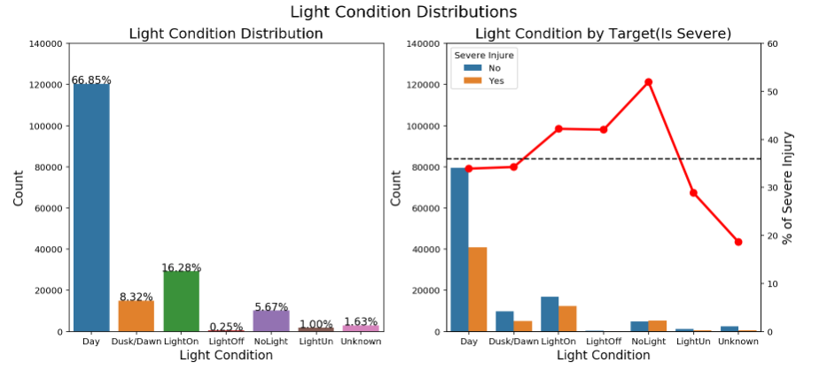
Light Condition
Middle level: Dusk/Dawn, Dark with light on (higher)
Darker level: Dark with light off/ no light (much higher)

Slide 10
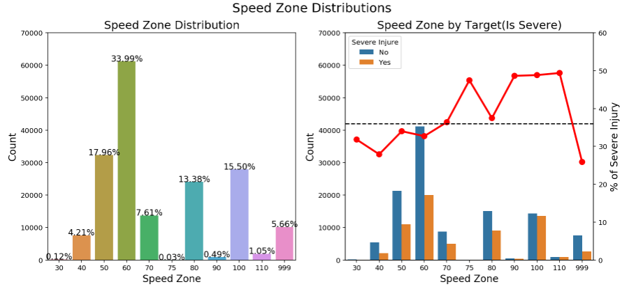
Speed Zone
75 is not a common number for speed zone, only 59 accidents
90, 100, 110 may lead to a more severe injury accident

Slide 11
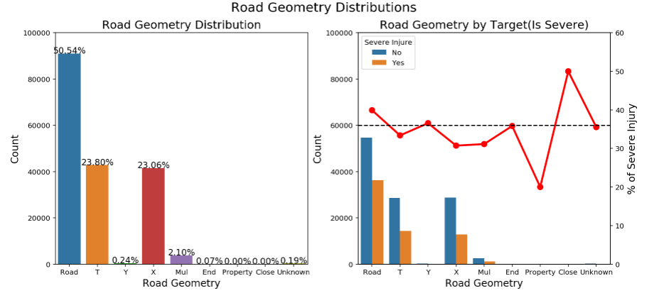
Road Geometry
Data for Property and Closed road is rare
Intersection has a relatively lower chance, Road does higher.

Slide 12
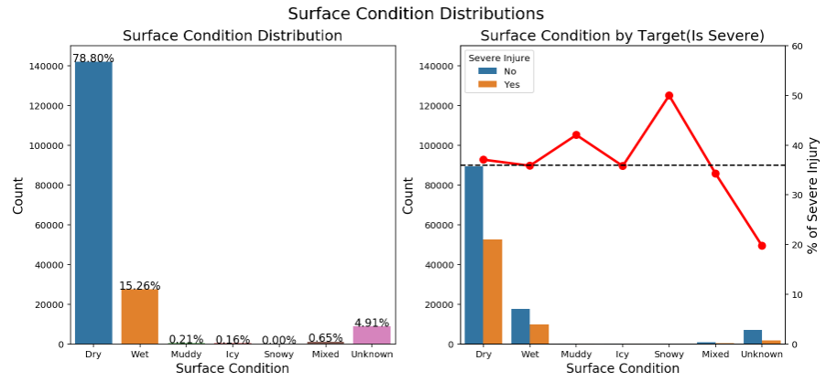
Surface Condition
Data for Snowy, Icy and Muddy is rare
The difference between Dry and Wet is not too much.

Slide 13
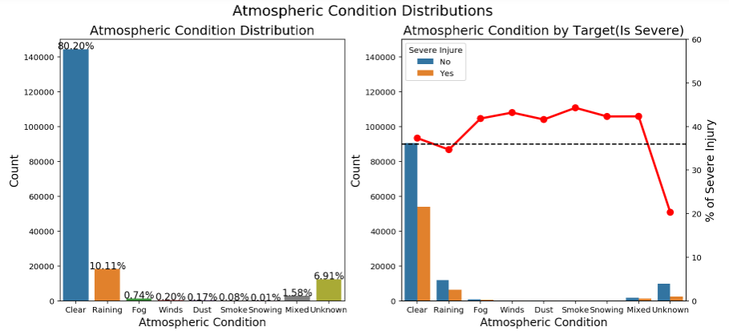
Atmospheric Condition
Fog, Dust and Smoke means bad vision, not too much data
Winds and Snowing mean weaker control, not too much data

Slide 14
Features Covered & Not Covered
Road Factor
Vehicle Factor
Human Factor
Time
Geographic
Atmospheric
Speed Zone
Vision-related
Control-related
Vehicle Type
Body Type
Make
Model
Year of manufacture
Can be used to predict:
Seat Belt / Helmet
Seating position
Age Group
Cannot be used to predict:
Transient reaction
Concentration
real-time speed

Slide 15
Thank You !

