Slide 1
Vehicle Crash
Modelling
Bei He

Slide 2
Target
Whether a person in an accident
will get serious injury or not.

Slide 3
BaseLine
15.56%
of the persons get serious injury

Slide 4
Features
Road User Type | Location | Day of Week | Hour | Speed Zone | Light Cond | Road Geometry | Surface Cond | Atmospheric Cond
Drivers, Motorcyclist, Bicyclist, Pedstrains, etc | Melbourne, Casey, Dandenong, Geelong, Brimbank, etc. | Mon - Sun | 00 - 23 | 30 - 110 | Day Dusk Dawn Dark light on light off no light | Intersection Street Road End | Dry Wet Muddy Icy Snowy | Clear Raining Fog Winds Dust Smoke Snowing

Slide 5
Pre-Processing
Encoding: sklearn.preprocessing.LabelEncoder
All features are categorical, no need to Standardize!

Slide 6
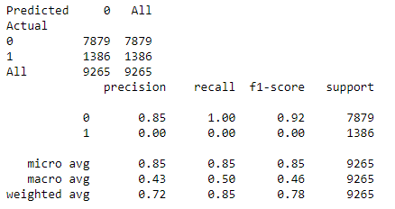
Logistic Regression
Simply Guessing
0: not serious injury

Slide 7
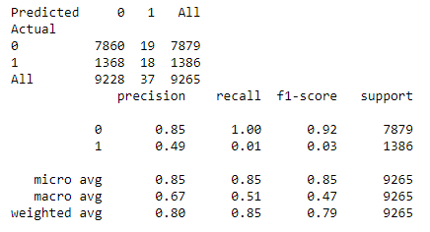
Random Forest
Better than Logistic Regression!!!

Slide 8
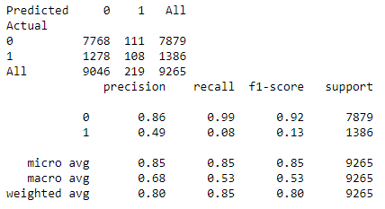
Ada Boost
Improve again!!!

Slide 9
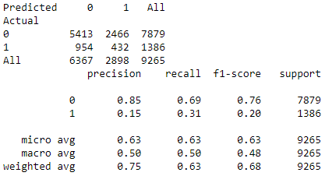
MultinomialNB
Seems the best I can do.
Better than baseline.

Slide 10
What Can I Do Now?
Over Sampling

Slide 11
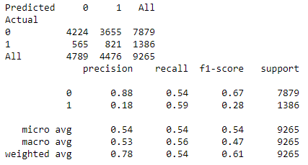
Logistic Reg (OverSampling Train Data)
Better Result on target.

Slide 12
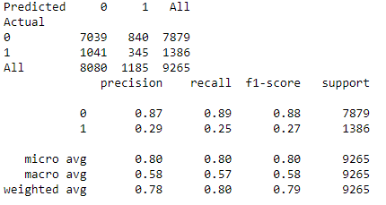
RandomForest(OverSampling Train Data)
Better Precision but less recall.

Slide 13
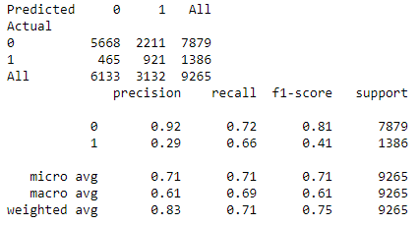
RandomForest(OverSampling Train Data)
max_depth=10
n_estimators = 100

Slide 14
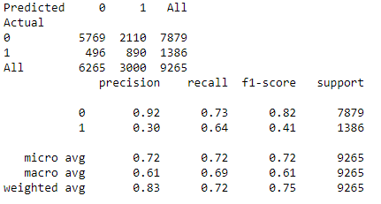
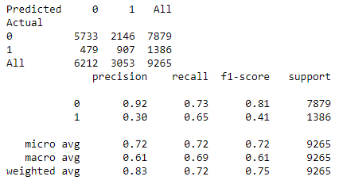
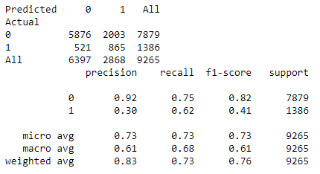
Other (OverSampling Train Data)
Ada boost
Gradient boost
MLP
All these gave similar results.

Slide 15
Why not MultinomialNB
Based on Probability
Oversampling changes that

Slide 16
How to interpret the result?
The Recall score: 0.65
The Precision score: 0.30
The F1 score: 0.41
What if the test data is balanced?

Slide 17
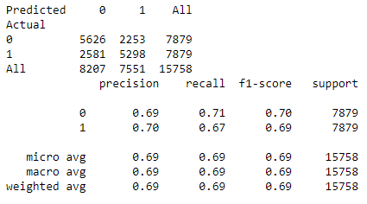
Logistic Reg (OverSampling All)
Low F1 on one category does not mean it is bad!

Slide 18
Is that model useful?
Cover 2/3 of the high risks.
Alert 1/3 of the time compare with 15% of real.
Make an app which makes alert when the risk is high.

Slide 19
What to do next?
Flask
AWS
Real-time Atmospheric info
GPS / Google Map
API
APP

Slide 20
Model Improvement?
LGA Name for Location
Administrative Division by Gov
Clustering for the Geo Info

Slide 21
Thank You!

