Slide 1
Neural Network with Feedback Control through Gain Modulation
Jerry Jin

Slide 2
1. Introduction

Slide 3
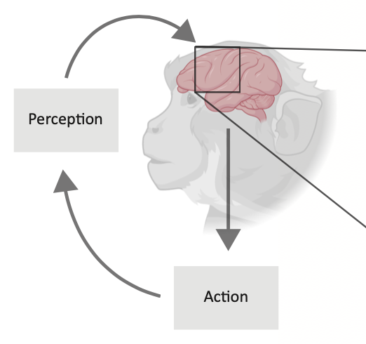
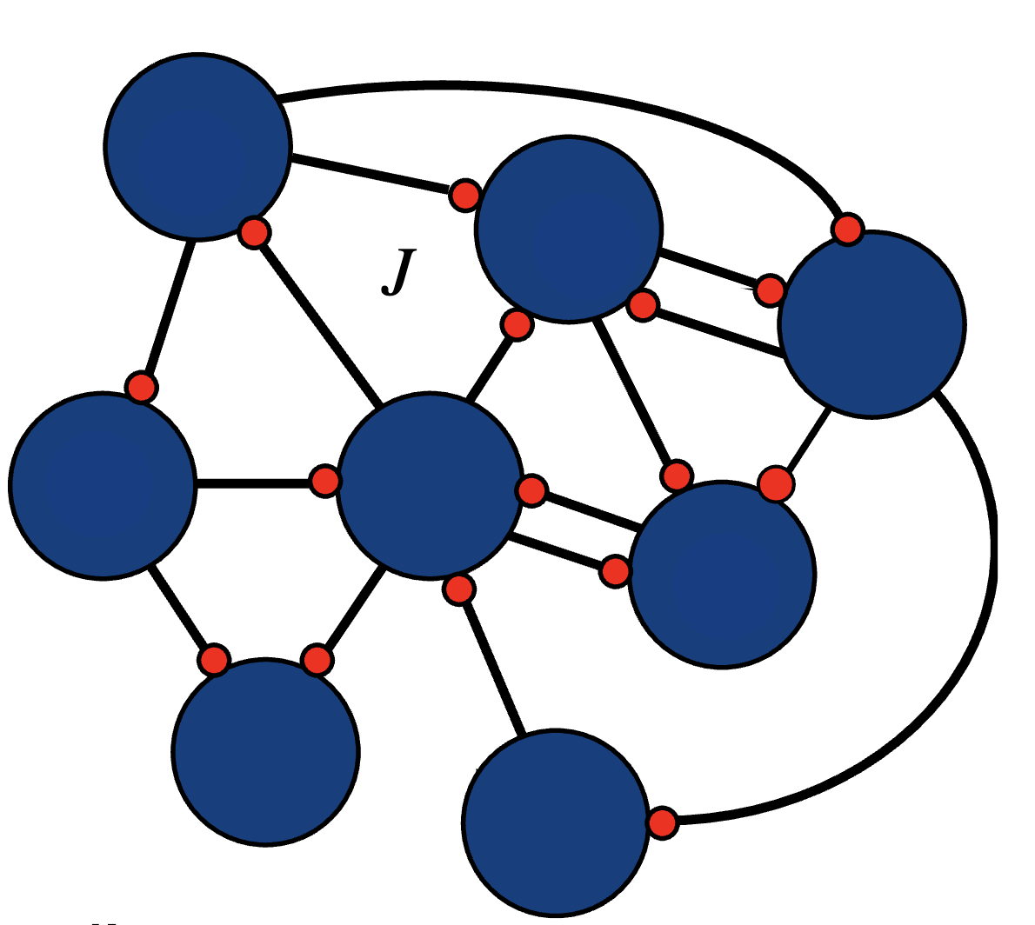
1. Introduction: Feedback Control
Feedback control is central to intelligent behavior
W
Feed-forward Control System
Feedback Control System
System
Inputs
Dynamical
System
System
Outputs
System
Inputs
+
Dynamical
System
System
Outputs
Feedback
Controller
Notes:
As we all know, …
Neuroscientists have found many feedback control systems in the brain.
For example, sensory consequences of arm reaches provide feedback signals to control the arm, and feedback control could also provide a normative explanation of many aspects of reaching.
In control theory, we distinguish between feedforward control system and feedback control system.
Think of the dynamical system as the neural network in the motor cortex. In the feedforward case, it is like to produce a pre-determined action, not considering the errors or perturbations; in the feedback case, it is like to adjust your action through visual feedback to prevent perturbations and finally reach your target. The feedback control input essentially changes the dynamic of the system.
---
For the feedforward system, the output is totally determined by its input. An example of the feedforward system is the eye blink reflex. Feedforward control is good for such direct functionalities. But it could not prevent perturbations. If there are unexpected perturbations in the system, the output would deviate from the target.
To correct such errors, we need feedback control. For example, when reaching to a target, we would have to use the feedback sensory information to adjust our arm movement if the target moves a little bit.

Slide 4
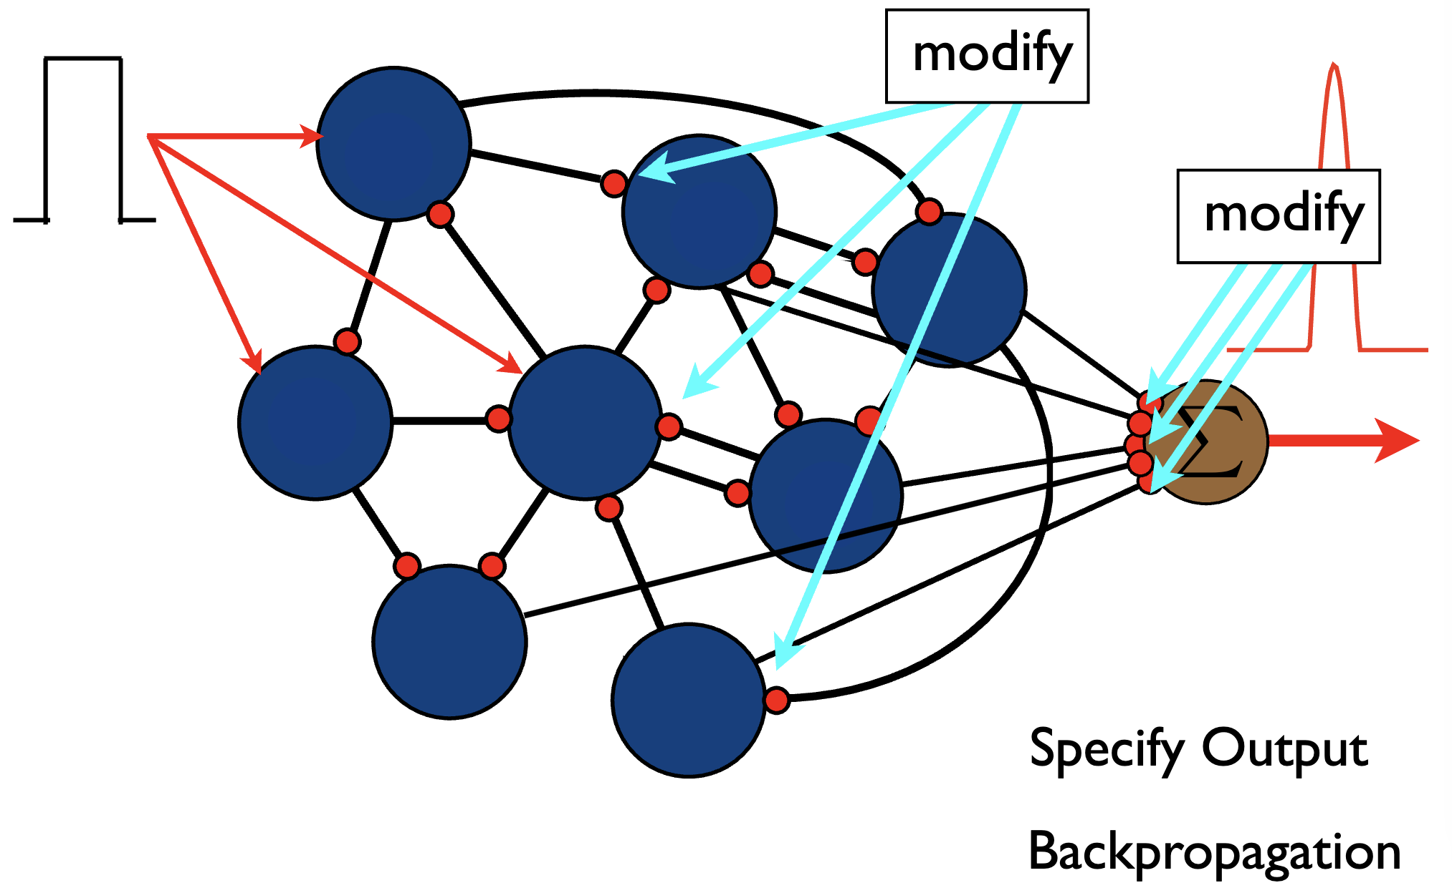
Introduction: Problematic Backpropagation
Conventionally, we backpropagate errors to synaptic weights to train the neural network, but it is not biologically realistic
The brain uses Hebbian learning to update synaptic weights, but it is slow and unsupervised
Notes:
However, to train a neural network to output an ideal target,
But directly changing synapses is not
Hebbian learning is the usual way to adjust weights, but it is slow and unsupervised, you can’t expect it to learn an arbitrary target without giving any guidance
So, the brain must have some ways to exert feedback control rapidly, to change the dynamics and to guide Hebbian learning

Slide 5
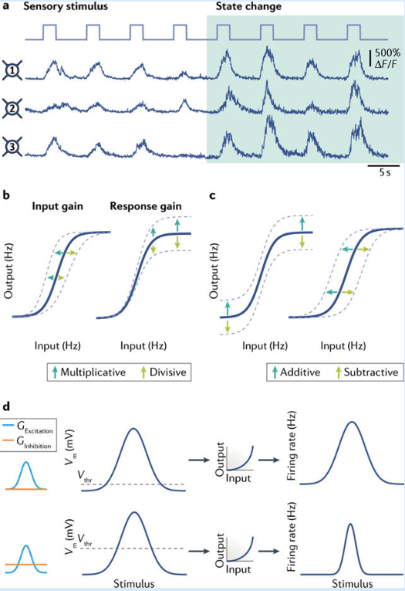
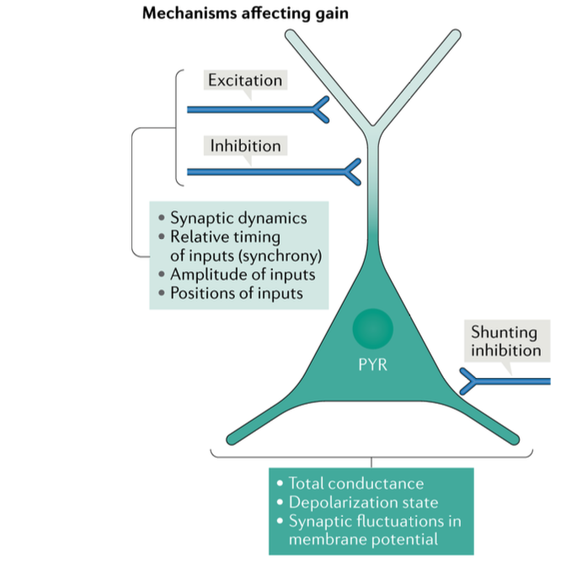
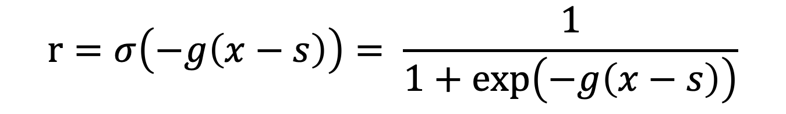
1. Introduction: Gain Modulation
How is rapid feedback control exerted?
Response modulation is a robust experimental phenomena
Gain Modulation
Shift Modulation
$$r=σ\left(−g\left(x−s\right)\right)= \frac{1}{1+\exp\left(−g\left(x−s\right)\right)}$$
Ferguson & Cardin (2020)
Notes:
One way that neuroscientists found is through response modulation
The two kinds of …
In gain modulation, the gain or sensitivity of a neuron to inputs is altered, while the selectivity is preserved. It is a kind of multiplicative modulation, in the sense that a change in slope without a change in the action potential threshold.
Shift modulation maintains the shape of the curve and shift the input/output relationships uniformly for all input values. This maintains the sensitivity of a neuron but alter the input required to reach the threshold for a response, thereby changing stimulus selectivity. It is a kind of additive modulation.
If you model the neural response as a sigmoid function, we could write both gain and shift in one formula…

Slide 6
1. Introduction: Our Vision
A biologically realistic neural network for learning, using feedback control through gain modulation and Hebbian learning on synaptic weights.
Transfer of learning from gains to weights
Feedback control quickly makes the network to output the target
Hebbian learning gradually adjusts the synaptic weights
The network eventually outputs the target without the need of control
Notes:
So, our idea is that
More specifically, we want to use … and then, … resulting in a kind of long-term learning

Slide 7
2. Feedback Control and Gain Modulation in Feedforward Network

Slide 8
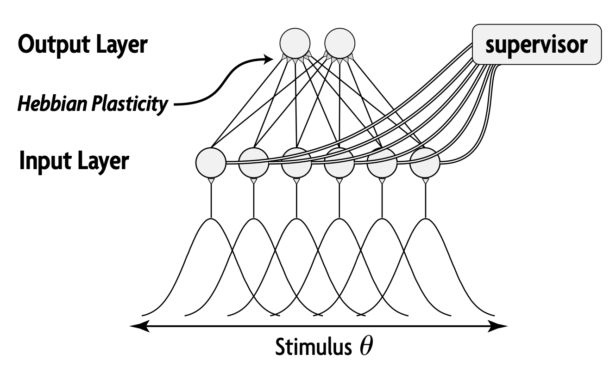
2. Feedforward Network
Structure:
Feedforward network
Sigmoid activation function (with adjustable gains and shifts)
Feedback control on gains (and shifts)
Hebbian learning on synaptic weights
Properties:
Transfer of learning from gains to weights
Adaptation under perturbation
Swinehart and Abbott (2005)
Notes:
First, we realized our goals on the feedforward network
Note that this feedforward is in the machine learning sense. It is not the same meaning as feedforward control system. In fact, here we do have feedback control on gains and shifts using SGD.
Mostly a replication, verify the adaptation property

Slide 9

2. Feedforward Network
Modeling details:
230 input nodes
Gaussian receptive field
Sigmoid activation function $ri=σ\left(−g_{i}\left(I_{i}−s_{i}\right)\right), g_{i}=3, s_{i}=1$
1 output node
Sigmoid activation function $r_{o}=σ(−g_{o}\left({∑w_{i}r}_{i}−s_{o}\right)), g_{o}=6.67, s_{o}=1.035$
Training:
Approximate cosine function
Squared error loss, SGD on gains
Hebbian learning
$w_{i}=w_{i}+ ηr_{i}r_{o}$
${∑w}_{i}=a=5.5$
Notes:
Swinehart and Abbott (2005) trained a neural network based on gain modulation. It has one input layer and one output layer.
They use SGD to modulate shifts and gains, rather than directly on synaptic weights. They then use normalized Hebbian learning to change the synaptic weights.
---
The gain and shift in output is actually not the same as the paper

Slide 10
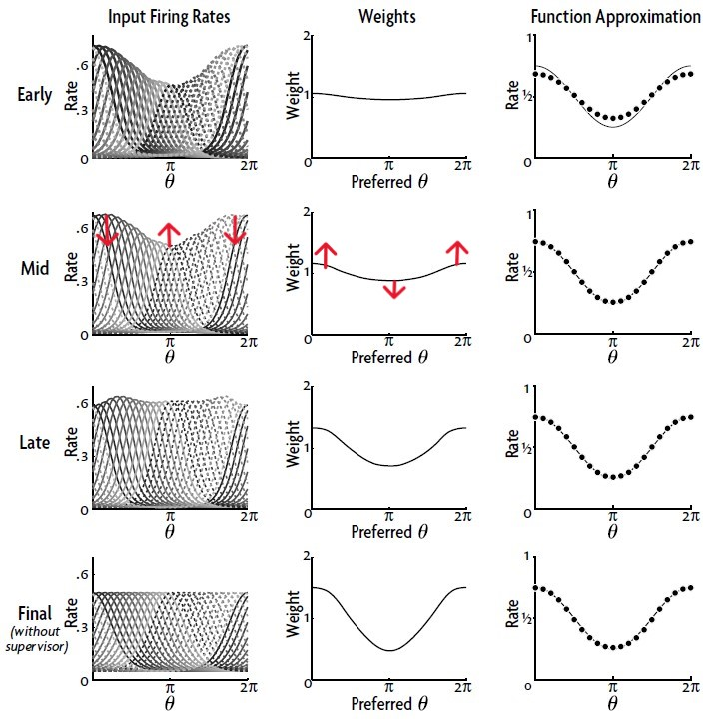
2. Feedforward Network
Transfer of learning from gains to weights
Swinehart and Abbott (2005)
Notes:
For example. The target is a cosine function.
Ideally, after doing backprop on gains and shifts, the response tuning curves of side neurons would go up and those of middle neurons would go down. Then, when hebbian learning is turning on, the weights of side neurons would get larger update than those of middle nuerons. Plus, the normalization process would keep the sum of the weights as constant, resulting in a cosine-like weights. The changed in weights would in turn flatten the response tuning curves.
In theory, this process transfers the learning in gains and shifts to synaptic weights and finally making the supervisor unnecessary.

Slide 11
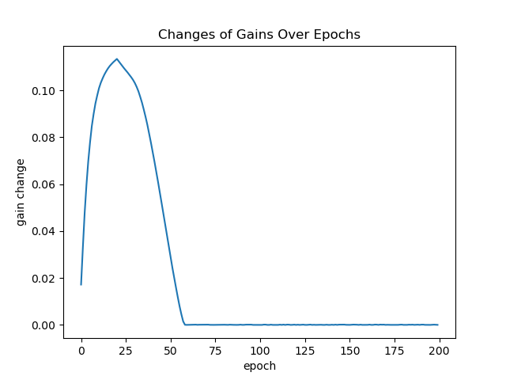
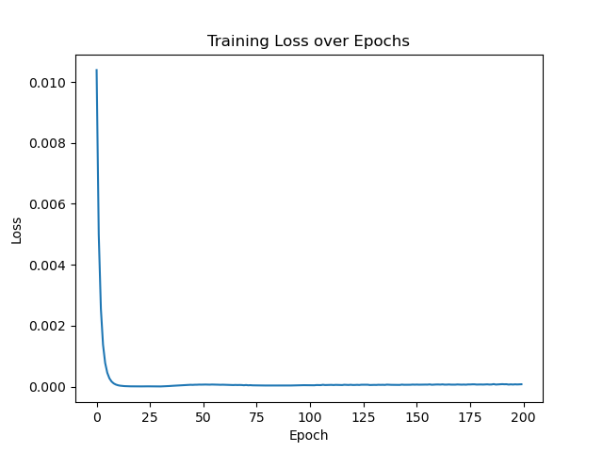
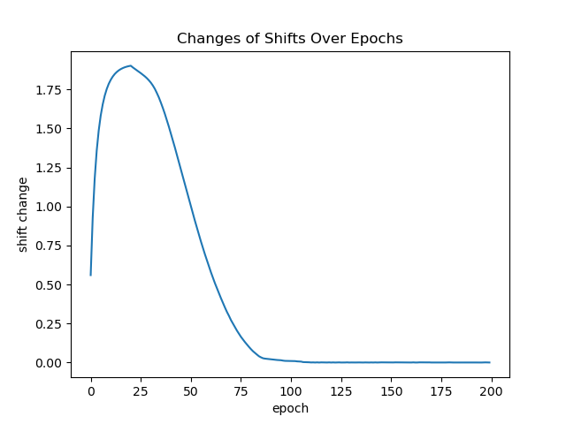
2. Feedforward Network
Transfer of learning from gains to weights
Notes:
We replicate their model.

Slide 12
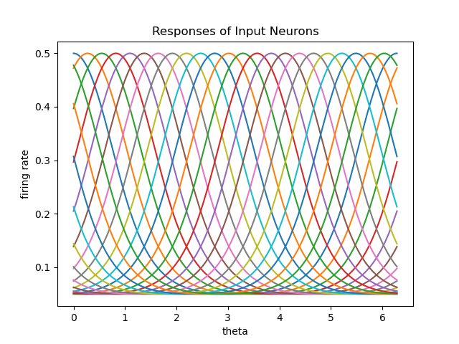
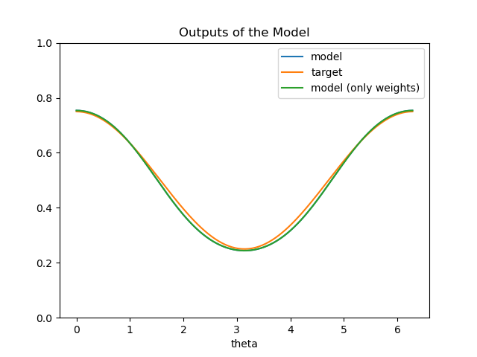
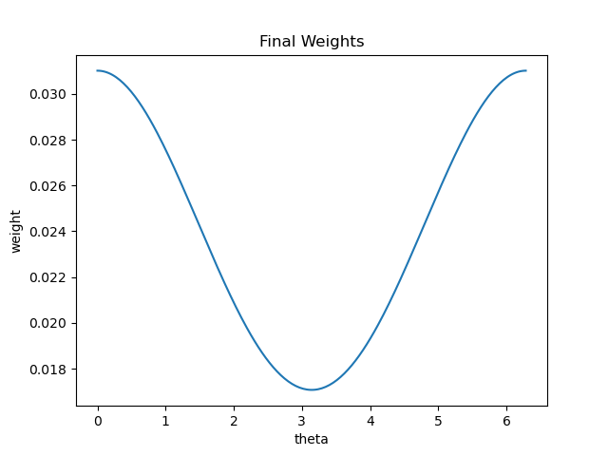
2. Feedforward Network
Transfer of learning from gains to weights
Notes:
Final stage, response curve for input neurons back to initial
Using initial gains and shifts, fit well

Slide 13
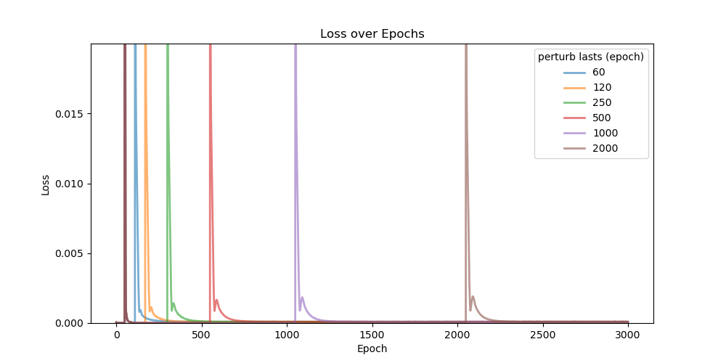
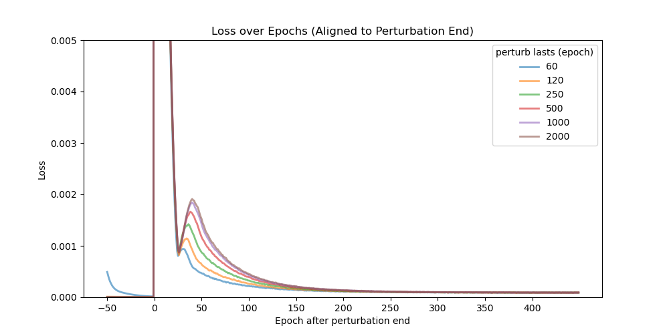
2. Feedback Control and Gain Modulation in Feedforward Network
Adaptation under perturbation
In the trained feedforward network, add a persistent noise on all nodes at 50th epoch, last for different epochs, and then turn off (SGD and Hebbian learning always on)
Notes:
Perturbation experiment
The motivation is that,
Mimic the adaptation phenomena in psychology. For example, there is the classic prism experiment that people wear glasses which distort their vision, and they could gradually learn how to correctly reach the target, but immediately after you take the prism off, people would overcompensate in their action and need some time to recover to normal again.
To quantify, I define two metrics, AUC and how long it takes to return to a low loss

Slide 14
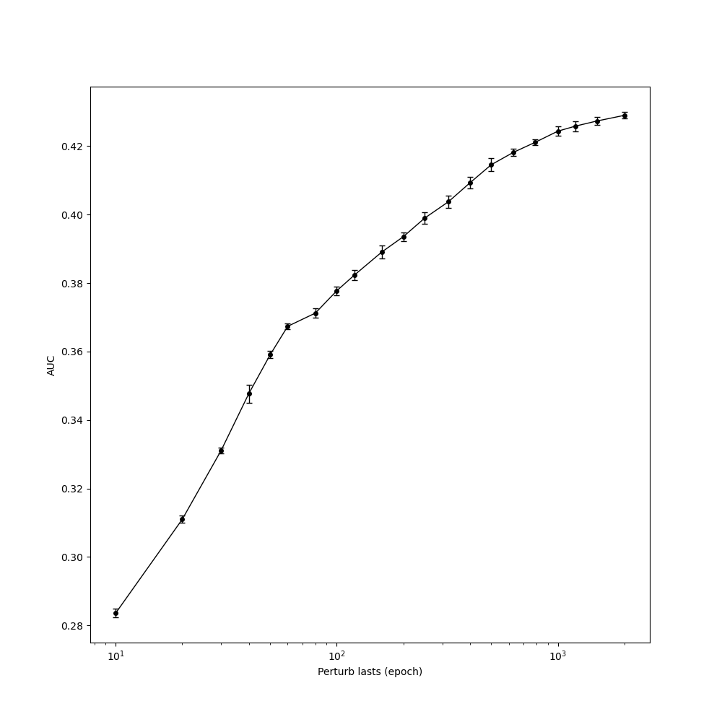
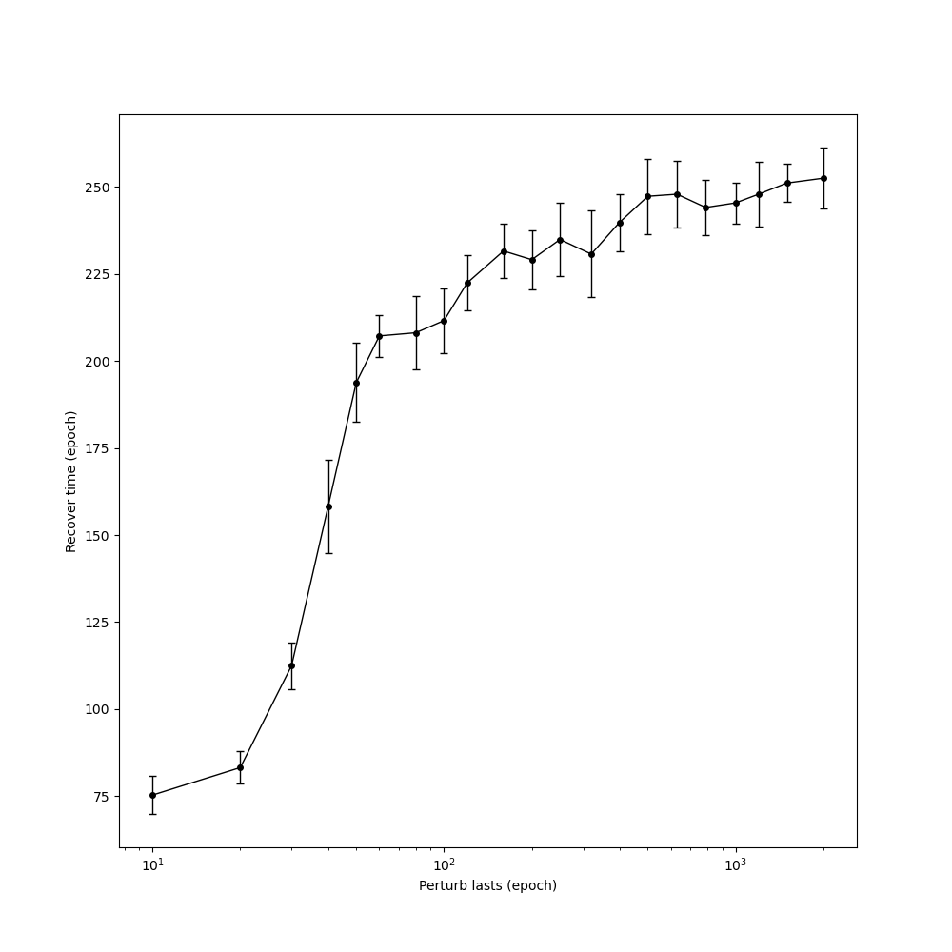
2. Feedback Control and Gain Modulation in Feedforward Network
Adaptation under perturbation
In the trained feedforward network, add a persistent noise on all nodes at 50th epoch, last for different epochs, and then turn off (SGD and Hebbian learning always on)
Notes:
Each perturbation lasts for 10 simulations

Slide 15
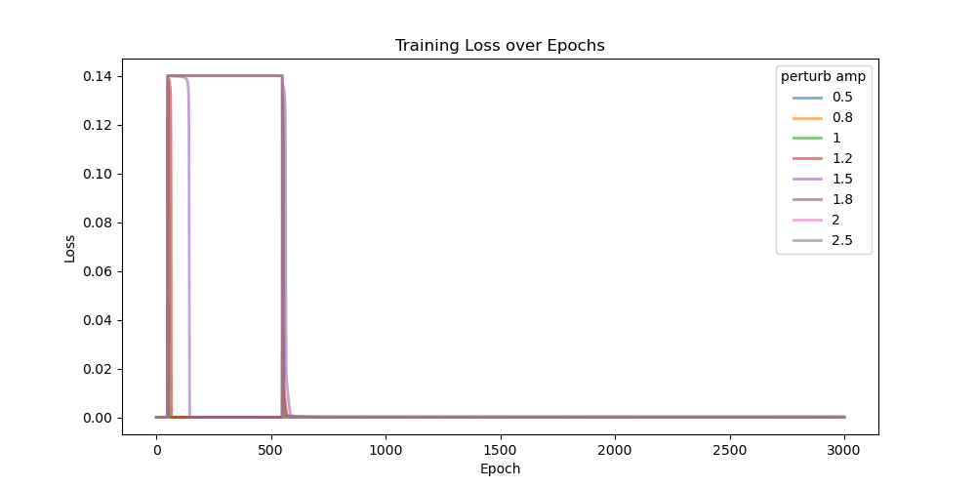
2. Feedforward Network
Adaptation under perturbation
In the trained feedforward network, add a persistent noise on all nodes at 50th epoch with different amplitude, last for 500 epochs, and then turn off (SGD and Hebbian learning always on)
Notes:
We also did another perturbation experiment where we systematically change the amplitude of the perturbation.

Slide 16
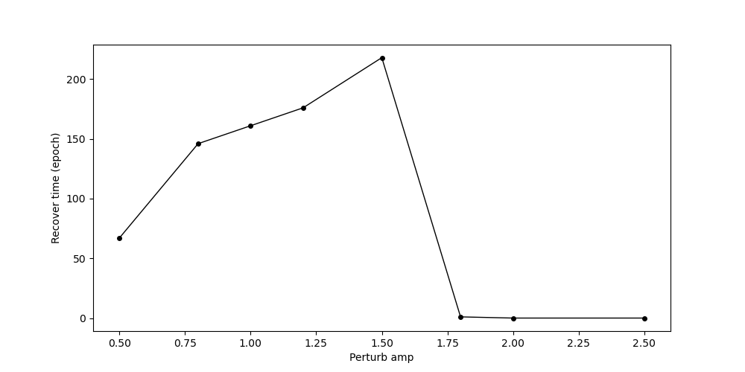
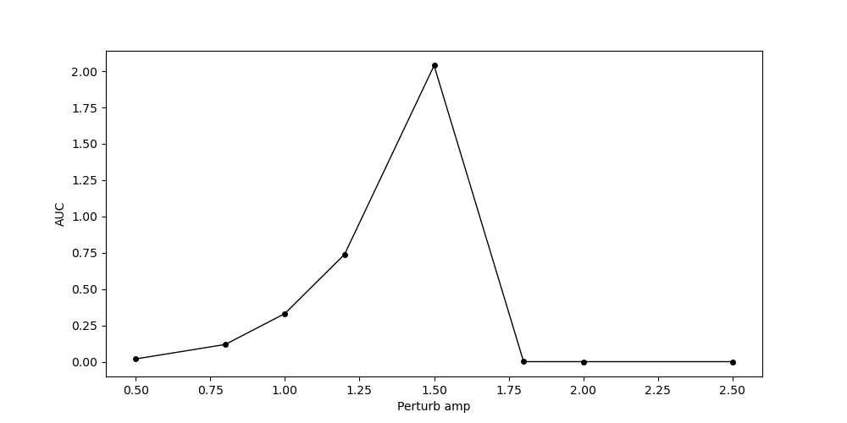
2. Feedforward Network
Adaptation under perturbation
In the trained feedforward network, add a persistent noise on all nodes at 50th epoch with different amplitude, last for 500 epochs, and then turn off (SGD and Hebbian learning always on)
A possible reason: sigmoid saturation
Notes:
This result aligns with the observation that, in psychological experiment, if the distortion is too big, people tend to not to believe and refuse to learn in perturbation.

Slide 17
3. Feedback Control and Gain Modulation in RNN
Notes:
Next, we explore our idea in RNN

Slide 18
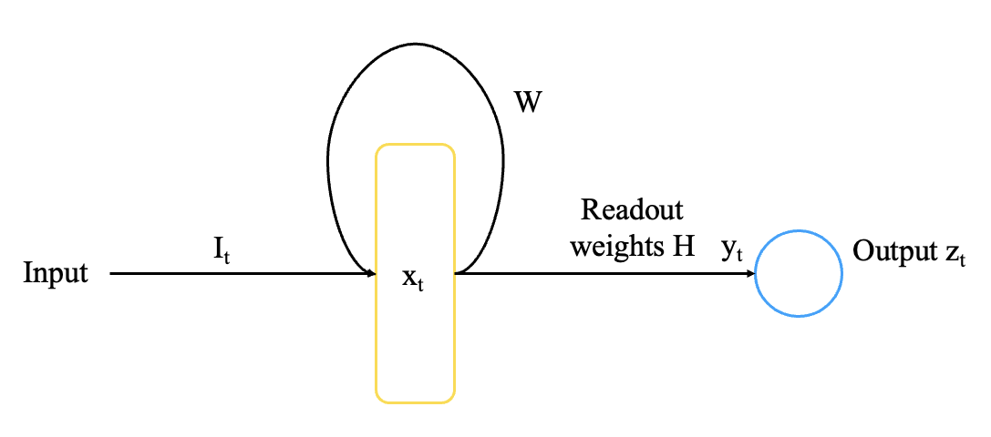
3. RNN
Structure:
Recurrent neural network (RNN)
Sigmoid activation function (with adjustable gains and shifts)
Dale’s Law
Feedback control on gains
Hebbian learning on synaptic weights (readout weights)
Properties:
Transfer of learning from gains to weights
Notes:
Our goal is to let the RNN to produce the signal that we want, for example, a sine wave
We tried to apply feedback control on gains and hebbian learning on recurrent matrix W, but it turned out to be complex and I did not succeed in making it converge
So for now, we tried a simpler procedure, that is, using feedback control on gains and Hebbian learning only on readout weights H, leaving W intact

Slide 19
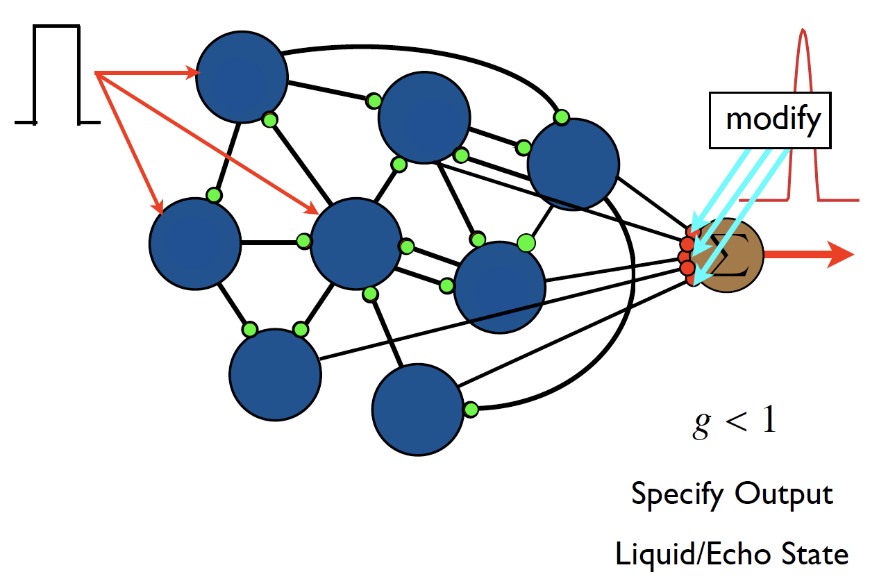
3. RNN
Notes:
This is actually the liquid state machine idea, leaving the dynamics intact but doing different readout to reach out target

Slide 20
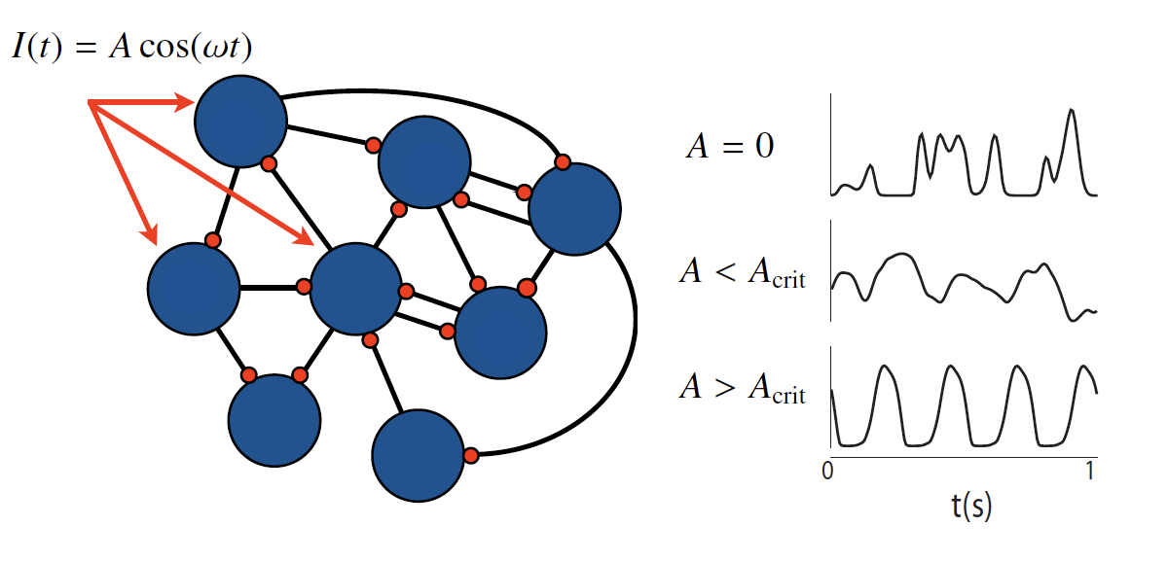
3. RNN
Notes:
Since we leave the dynamic intact, we don’t want it to be chaotic.
So adding a input as teaching signal is crucial here, which could make the activation of every node periodic.

Slide 21
3. RNN
W
Readout weights H
I_{t}
y_{t}
Output z_{t}
Input
x_{t}
Sine wave with random phases
Notes:
Here, we input a sine wave with a random phase to every node.

Slide 22
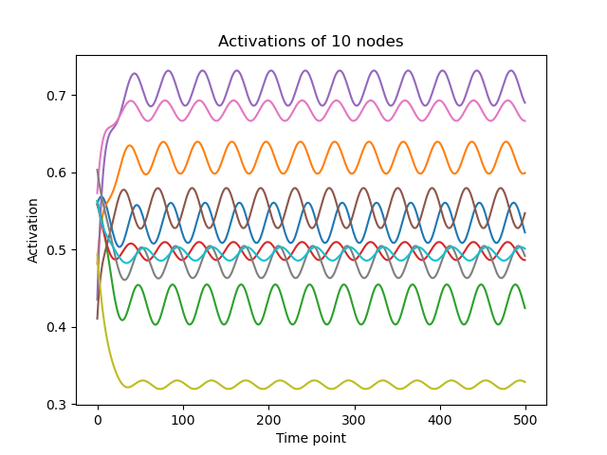
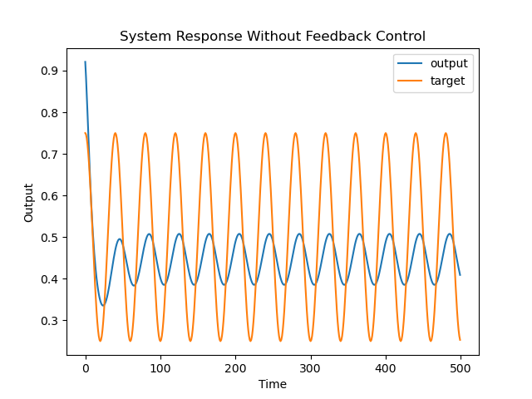
3. RNN
Notes:
Indeed, without any control and learning, the network shows sine like activities in every node, although with different scales and phases
Importantly, The output is already a sine wave, although it is not the correct

Slide 23


3. RNN
Step 1: Make the initial network to output the target using feedback control
W
$$x_{t+1}=σ\left(−(g+u_{t})\left(Wx_{t}+I_{t}−s\right)\right)$$
Readout weights H
I_{t}
y_{t}
Output z_{t}
Input
x_{t}
$${\tilde{y}}_{t}$$
$${\tilde{z}}_{t}$$
Sine wave with random phases
u_{t}
LQR
Linear Approx
200 nodes, 50% excitatory neurons, 50% inhibitory neurons
Notes:
Now we add feedback control, so that the network could output the target
To do this, we first linearly approximate our nonlinear system and then use the LQR

Slide 24
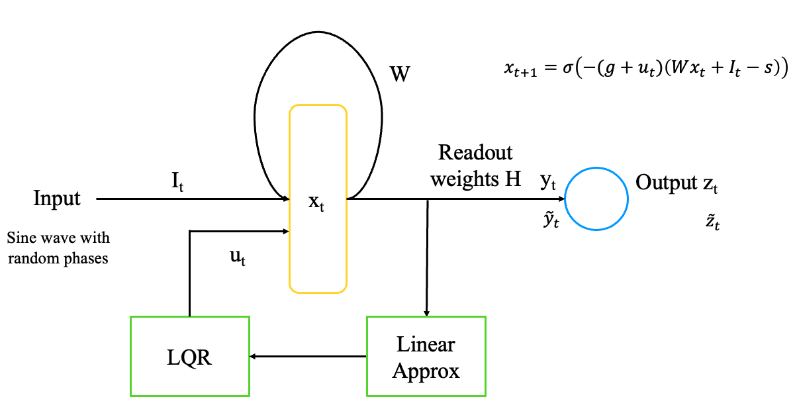
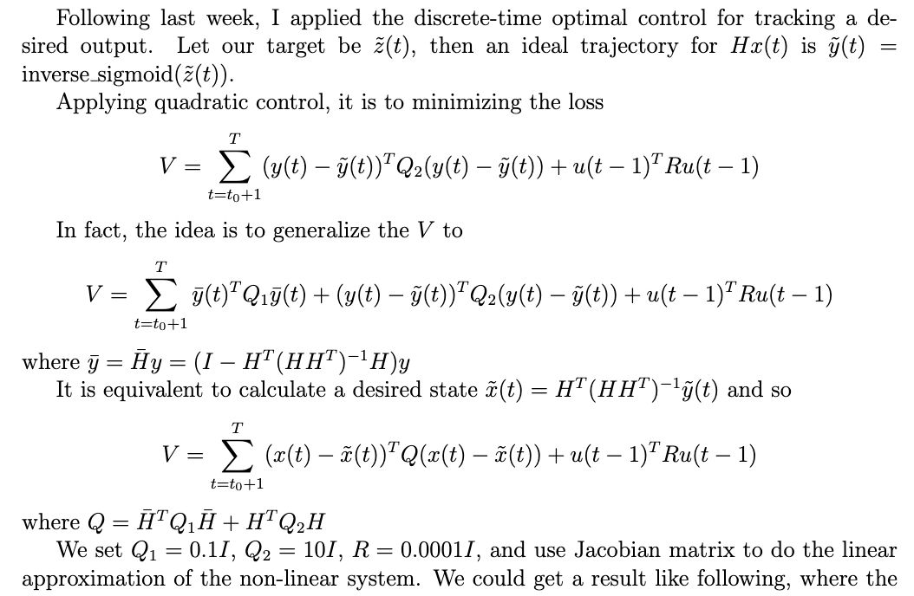
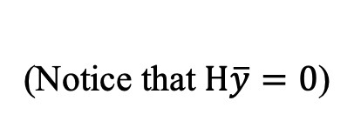
3. RNN
Discreate-time Tracking Problem
(Notice that $H\overline{y}=0$)
Notes:
It is called … in control theory.
---
y=Hx is essentially doing dot product between H^T and x
y_bar is the part of x that is orthogonal to H^T, which does not influence the dot product, thus Q1 punish this
x_tilde is the perfect x that is parallel to H^T that produce y_tilde

Slide 25
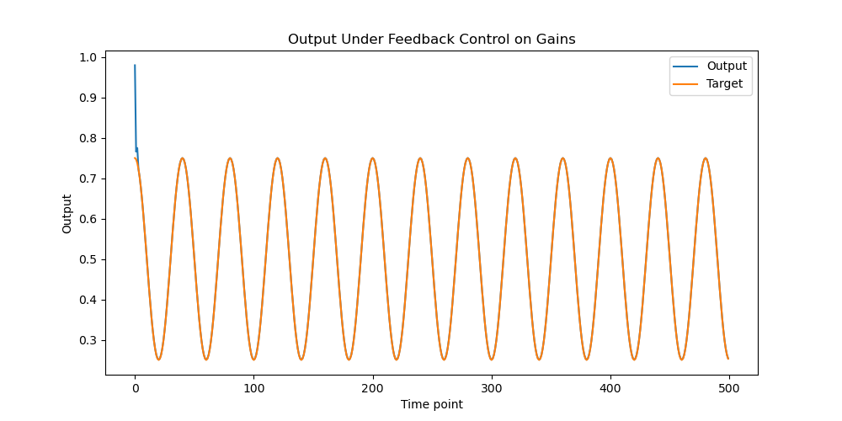
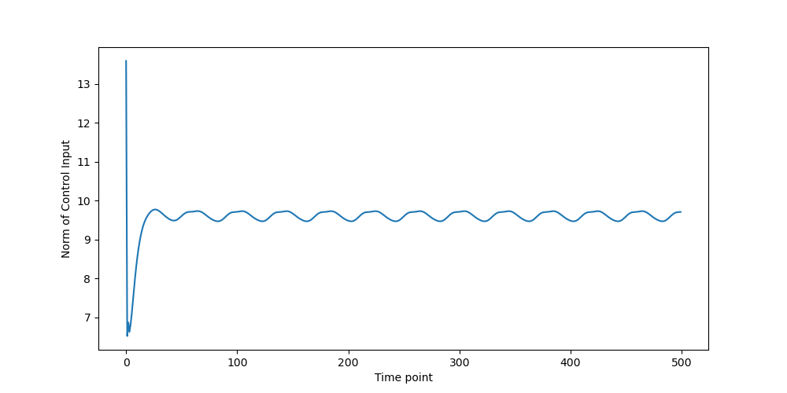
3. RNN
Notes:
And we succeed.

Slide 26
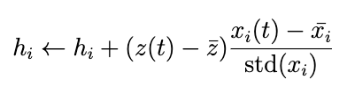


3. RNN
Step 1: Make the initial network to output the target using feedback control
Step 2: Hebbian learning on readout weights
W
$$x_{t+1}=σ\left(−(g+u_{t})\left(Wx_{t}+I_{t}−s\right)\right)$$
Readout weights H
I_{t}
y_{t}
Output z_{t}
Input
x_{t}
$${\tilde{y}}_{t}$$
$${\tilde{z}}_{t}$$
Sine wave with random phases
u_{t}
Hebbian Covariance Rule:
LQR
Linear Approx
Clipping so that ext. weights >= 0, inh. weights >= 0
Normalization so that ext. and inh. weights sum constant
Notes:
Then we use Hebbian learning …
We are applying a noramlized Hebbian Covariance rule here
---
Hebbian correlation rule does not work
the readout weights would converge to a point where each weight is proportional to the mean activation of the corresponding node

Slide 27
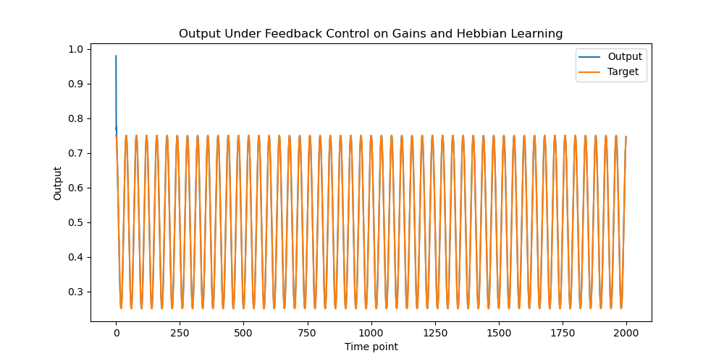
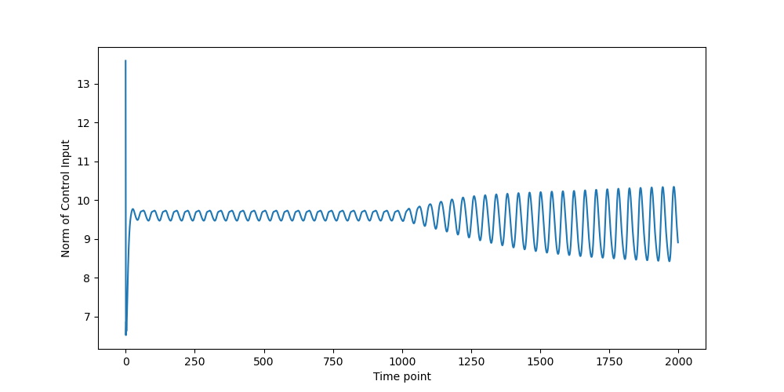
3. RNN
Notes:
This is the output and the norm of the control signal in time, we turn on Hebbian learning at t = 1000

Slide 28
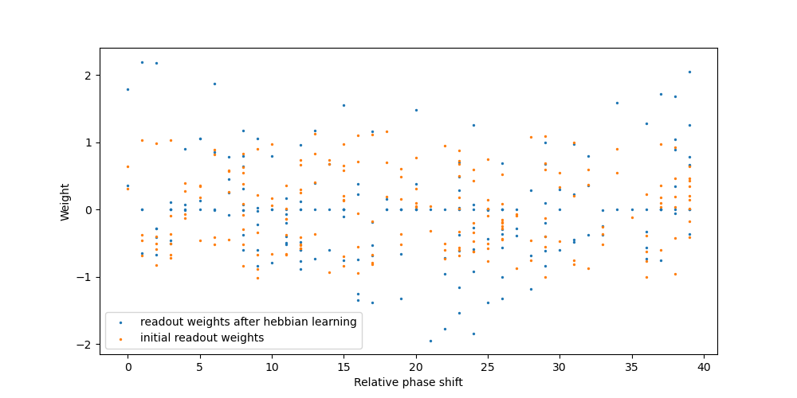
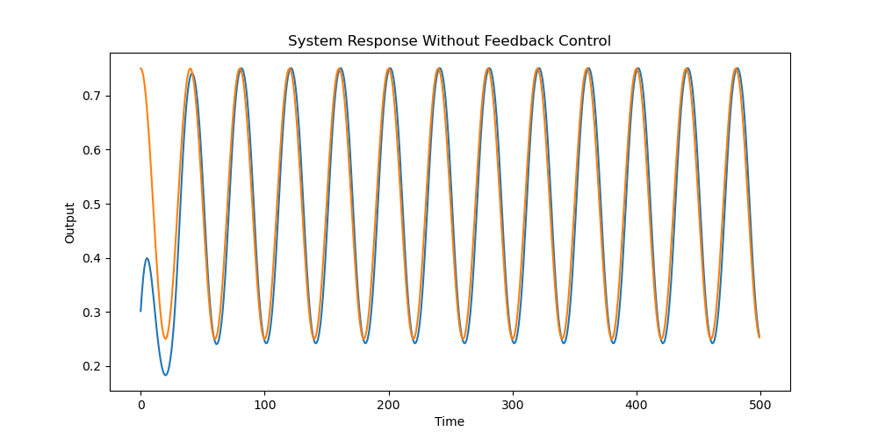
3. RNN
Notes:
Our results show that this process could finally let the network to learn the correct phase of the sine wave. This is the figure where we turn off feedback control, only simulating with the learned readout weights.
Note that Hebbian learning can not correct the amplitude of the output. In fact, here I hand-tuned the output node, so that the output is aligned with the target is scale. Otherwise, you’ll probably get an output with correct phase but different scale. (This is also why the control signal does not go down to 0 during the training.)
From the final distribution of the readout weights, we can see that, if the node’s activation has a correct phase, then its weight gets higher; if the node’s activation has just the opposite phase, then its weight would be low.

Slide 29
4. Future Steps
FFN
Multilayer
RNN
Adaptation properties
Different inputs and targets
Learning in recurrent weights
Biologically realistic controller?

Slide 30
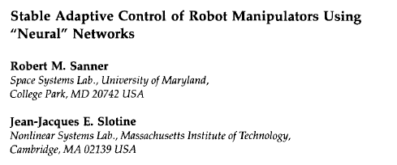
4. Biologically Realistic Controller?
Use a single hidden layer neural network to design a nonlinear controller

Slide 31
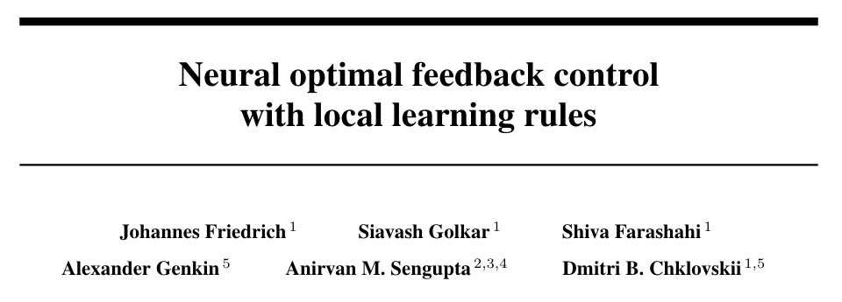
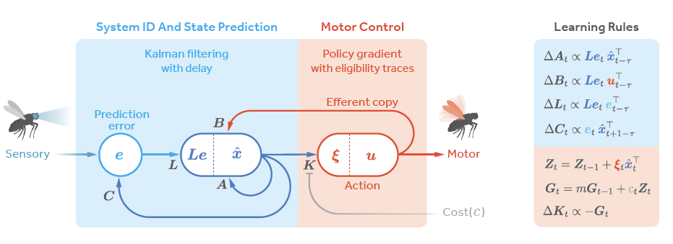


4. Biologically Realistic Controller?
Hebbian learning for C
Local (but non-Hebbian) learning for A, B, L
Policy gradient method for K

Slide 32
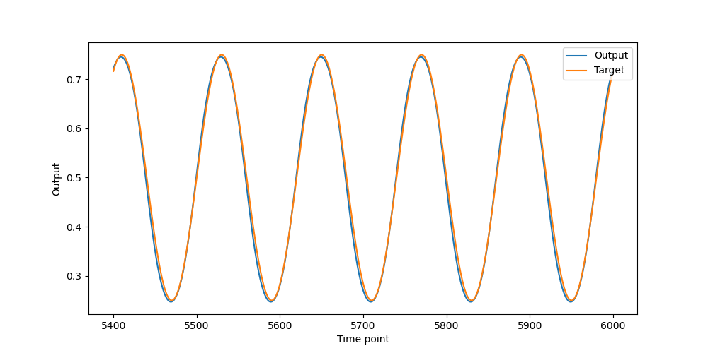
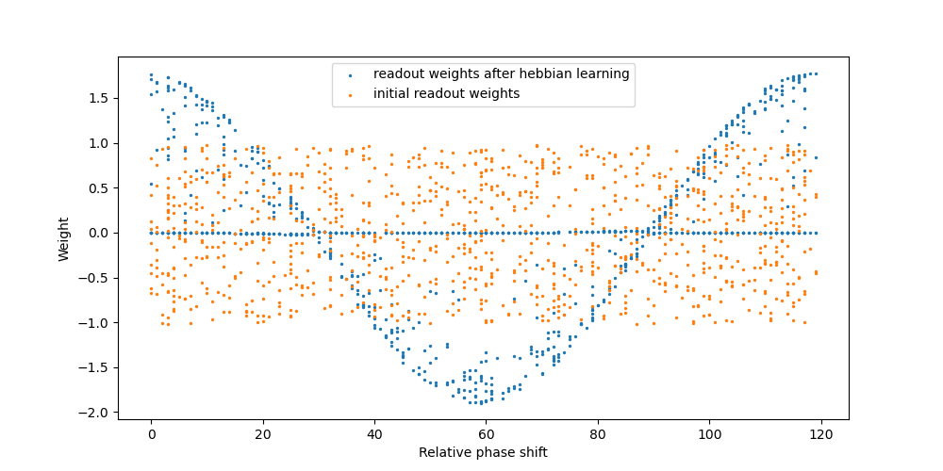
Supplementary figure: Hebbian learning on target

