Slide 1



When Sport Impacts on Global Situation. General Ideas and Cases
Saparbai Beibarys Orazalyuly
b_saparbai@kbtu.kz
KBTU, FIT, IS, 2year

Slide 2



Plan:
Advantages part 1, 2
Disadvantages
Conclusion
Sources

Slide 3
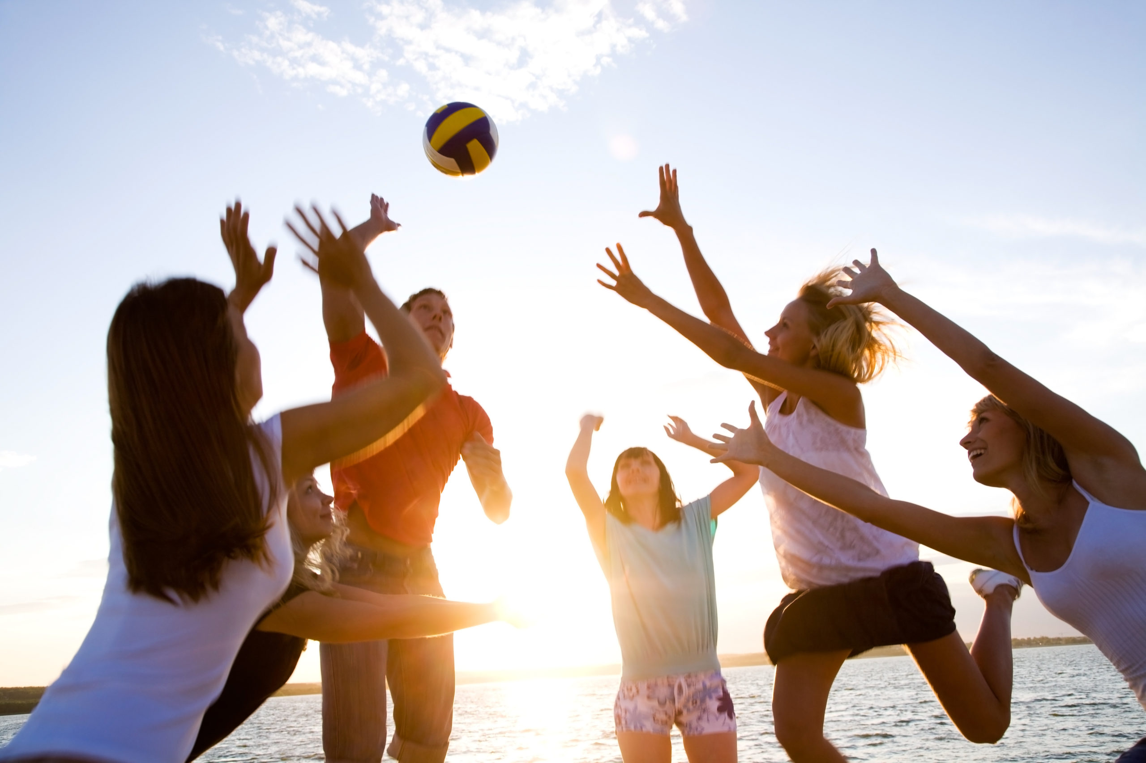
Advantages Part 1
Improving Social skills
Better Health
Friendship
Anti – Depression
Anxiety
Cognition

Slide 4
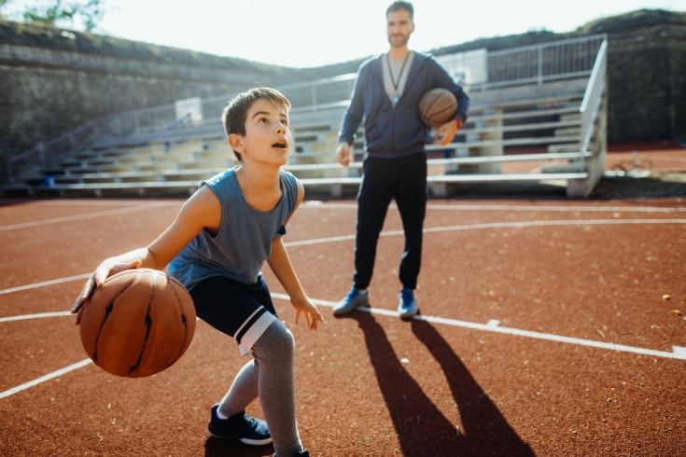
Advantages Part 2
By doing sport and being a positive improves your IQ;
More positive view about you;
New Challenges;
Develop environmental mastery;

Slide 5
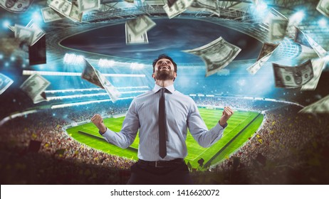
Disadvantages
Excitement (Gambling and Bets) –
It developed by sports.
Loss of money, which can then affect your mental health in the form of anxiety or stress.

Slide 6

Ending
Summarize the main ideas Sport improves your body and mental health, and you will be more productive.
Do sports, without gamblings;

Slide 7
List of sources
https://www.sportanddev.org/sites/default/files/downloads/81__sport_and_globalisation.pdf
https://howtheyplay.com/misc/Disadvantages-of-Playing-Sportshttps://howtheyplay.com/misc/Disadvantages-of-Playing-Sports
https://www.sportsrec.com/8071877/the-effect-of-sports-on-teenagers

