Slide 1
Progressive Graph Matching: Making a Move of Graphs via Probabilistic Voting
Minsu Cho Kyoung Mu Lee
Proc. Computer Vision and Pattern Recognition (CVPR), 2012

Slide 2
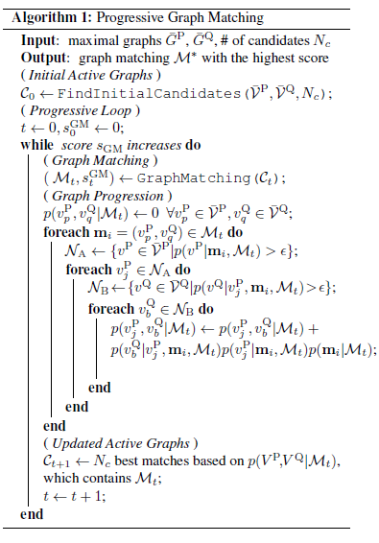
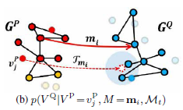
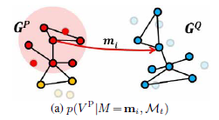
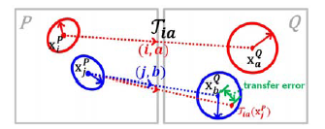
Graph Matching

