Slide 1
Personalized living place
Beichen Su

Slide 2

Motivation of this model
Having trouble finding a place to live.
Perspectives to consider before making decision
Introduce an optimization model of find a location which
$$Minimize w_{1}∗\frac{\left|{Price}_{Desired}−{Price}_{Real}\right|}{{Price}_{Desired}}+w_{2}∗\frac{{|Crime rate}_{Desired}−{Crime rate}_{Real}|}{{Crime rate}_{Desired}}+…$$
where $\sum_{1}^{n}{w_{i}}$ = 1 and the optimization subjects to longitude and latitude.

Slide 3
Assumptions
Rentals can be find anywhere on the map(Yes you can live under water, no problem in desert as well!) .
The planet we are living on is not a sphere, it’s flat! For this reason, I grid longitude and latitude value by 0.001(Approximately the square area of a block).
The houses with better location/ furniture/ condition would have more rent/month.
Guess: the house with same amount of rent/month would fall in same neighborhood

Slide 4
Data to investigate
Take only one characteristic parameter for example
Zillow provides some research data on their website
ZRI(Zillow rental index) is monthly median rent in particular geographical regions.
Trade off: rent/ft^2, better response to consider but less data to obtain
Other data, median rental for different house type
Zip-code and coordinate

Slide 5
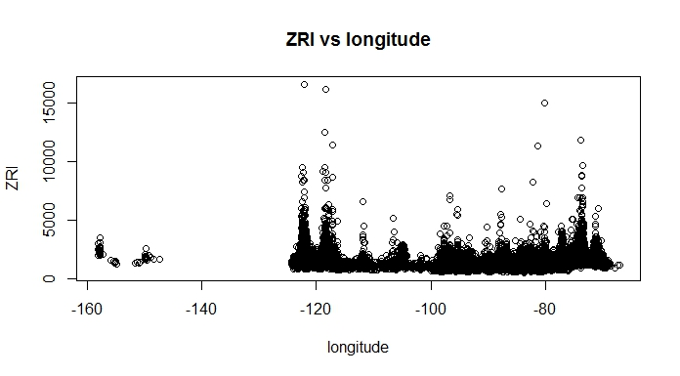
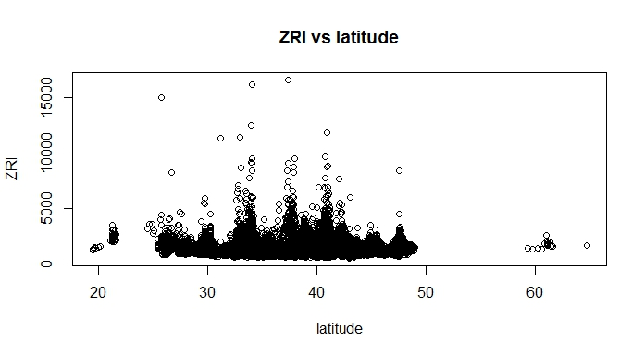
Original Data points, Z~X, Z~Y
Gaps on the plots
Reduce data size by taking out data from Hawaii and Alaska(Sharks in pacific ocean!)

Slide 6
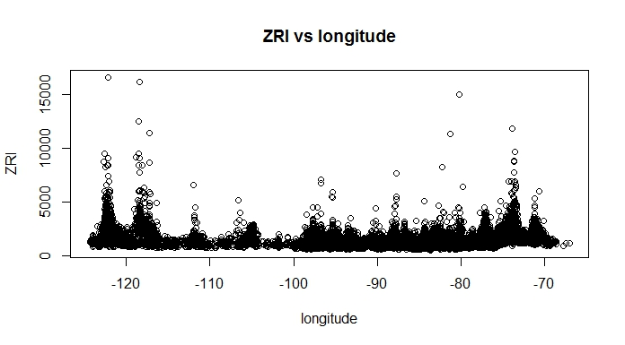
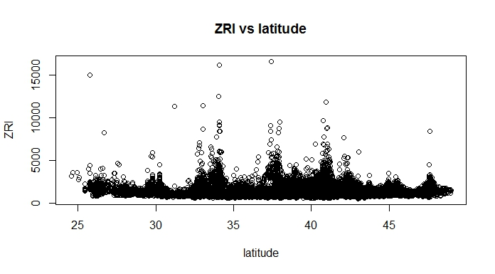
Reduced Data
Now they looks better! No sharks no extreme cold!

Slide 7
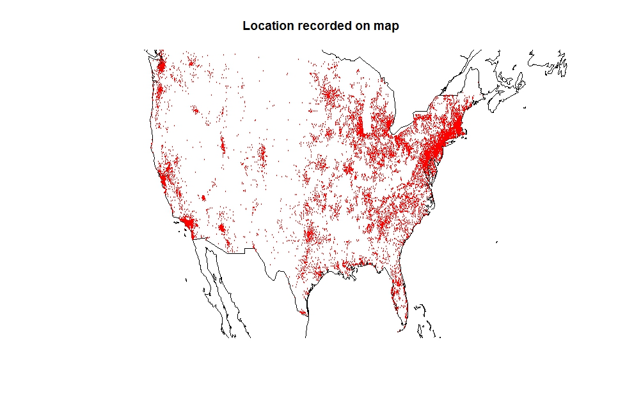
All Zillow rental index on map

Slide 8
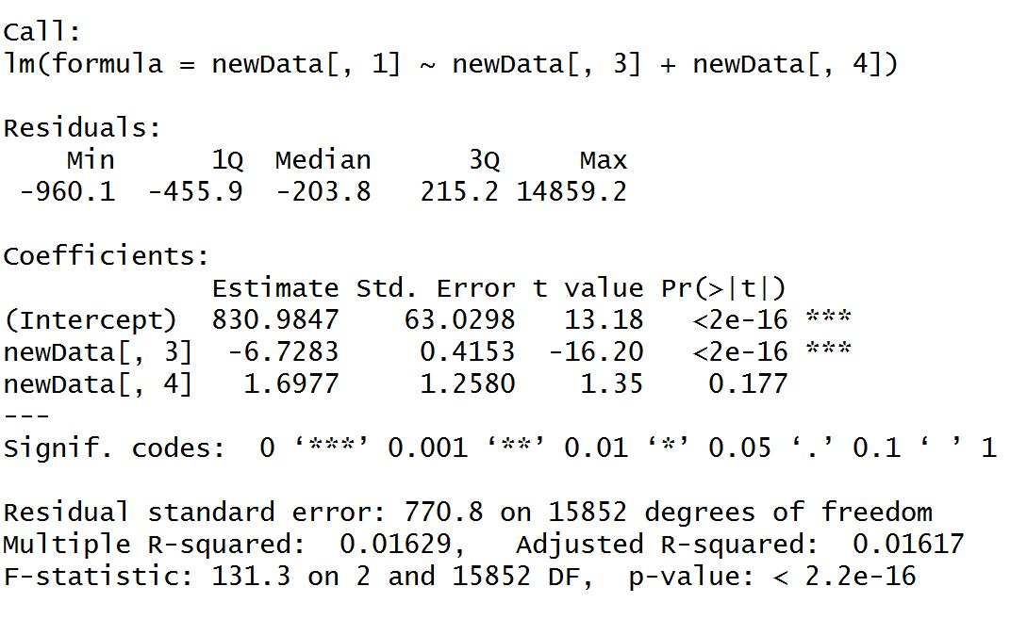
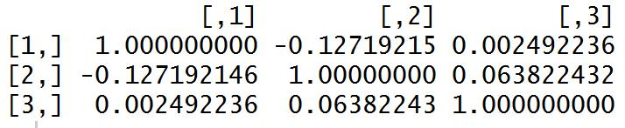

Parametric approach
From above plot, there is not strong linear pattern between z and x,y(With all data)
Fit simple linear regression model to see
$\hat{ZRI}=β_{0}+β_{1}∗longitude+β_{2} ∗latitude$

Slide 9

Non-parametric approach(3D kernel)
In every sub-model, x(longitude) and y(latitude) stand for predictor variables, z stand for characteristic parameter, in this case, ZRI
Kernel density estimation in 3D
Having p grid points horizontal, and q grid points to estimate
N pairs of (x,y,z) original data, define
$V_{i,j}=\left(\begin{matrix}m_{x_{i}} \\ m_{y_{j}}\end{matrix}\right), and O=\left(\begin{matrix}x_{k} \\ y_{k}\end{matrix}\right), then we have \hat{f}\left(V_{i,j}\right)= \frac{\sum_{k}^{n}{K\left(\frac{{\left\|V − O_{k}\right\|}_{2}}{b}\right)∗Z_{k}}}{\sum_{k}^{n}{K\left(\frac{{\left\|V − O_{k}\right\|}_{2}}{b}\right)}}= \frac{\sum_{k}^{n}{K\left(\frac{\sqrt{{\left(X_{k} −m_{xi}\right)}^{2}+{\left(Y_{k}−m_{yj}\right)}^{2}}}{b}\right)∗Z_{k}}}{\sum_{k}^{n}{K\left(\frac{\sqrt{{\left(X_{k} −m_{xi}\right)}^{2}+{\left(Y_{k} −m_{yj}\right)}^{2}}}{b}\right)}}$
Function K represent the Gaussian kernel and b the bandwidth.

Slide 10
Continued.
However to build kernel we have about 15000 data points
Further reduce the data in part of California, longitude from -121 to -116 degree and latitude from 32 to 35 degree

Slide 11
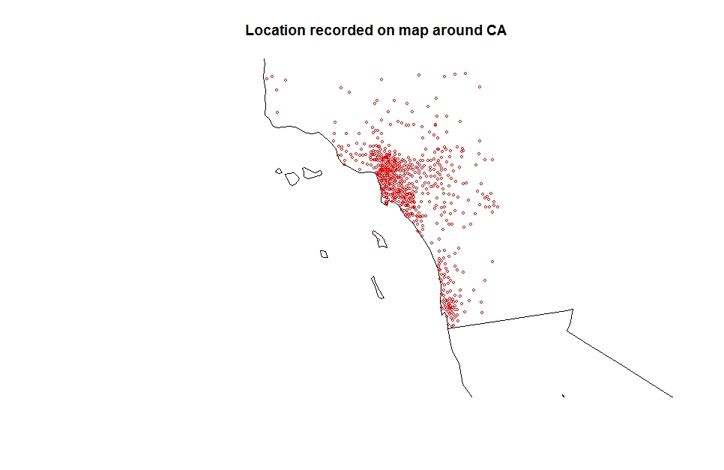
Selected Location on map

Slide 12
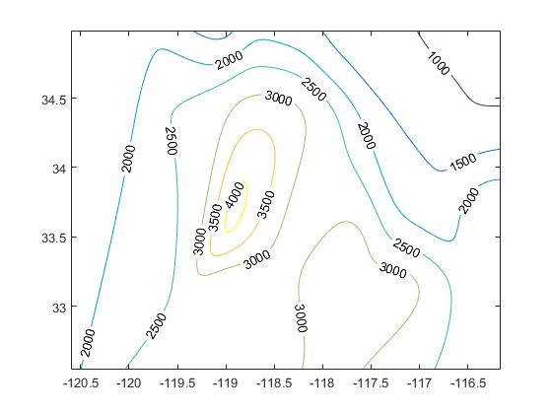
Kernel Density estimation
For Example, UCLA(34.07,-118.44)
gives KDE of ZRI = 2161.162

Slide 13

Discussion
Source of data on different characteristic parameters
Data and grid chosen
parametric vs non-parametric
Asymptotic analysis($O(N^3)$)

Slide 14
Questions?

