Slide 1
Visual study of extreme weather effects and causes
Group 9
2023.10.24

Slide 2
Project Descriptions
Datasets
EM-DAT[1]:
the most widely used global disaster database in the world
two categories of global natural and technological disasters since 1900
geographic information on the country (region) where the disaster occurred, the start and end time of the disaster, the cause of the disaster, related disasters, as well as the population loss and the assessed economic loss of the disaster.
Background The world suffers from many climatic disasters every year, which cause many casualties and economic and property losses
Objectives explore the reasons for the frequent occurrence of extreme weather and the impact of human behavior on climate change
What we will focus on next
On the basis of EM-DAT, Hong Kong's meteorological data will be used to analyze and concretize the problem
Look for possible relationships between variables
Use other visualization tools or other datasets mentioned in the proposal
[1]EM-DAT - The international disaster database, https://emdat.be/. Accessed 9 October 2023.

Slide 3
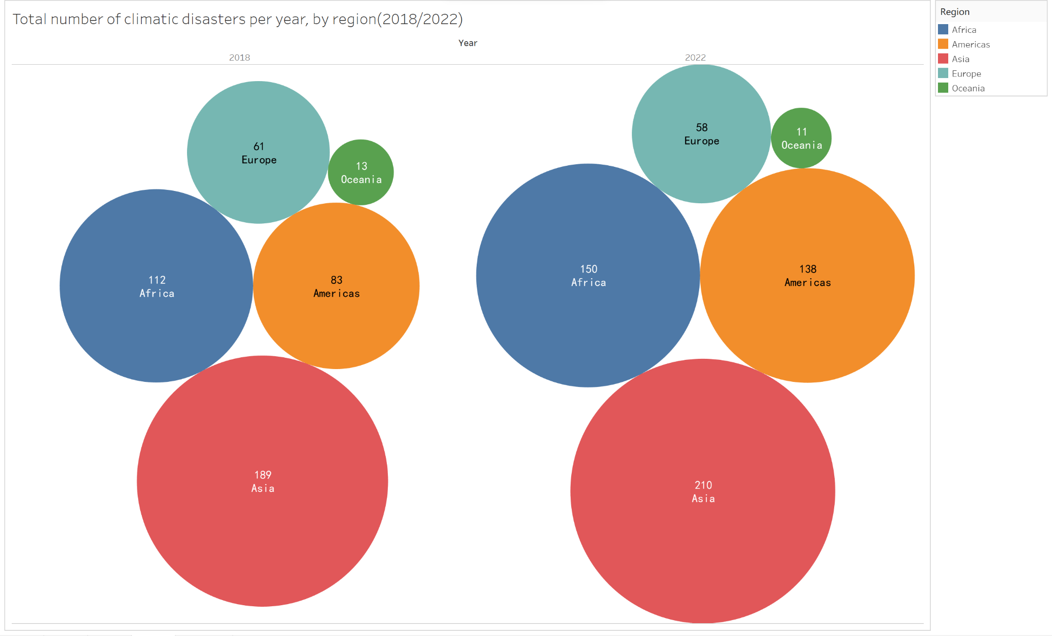
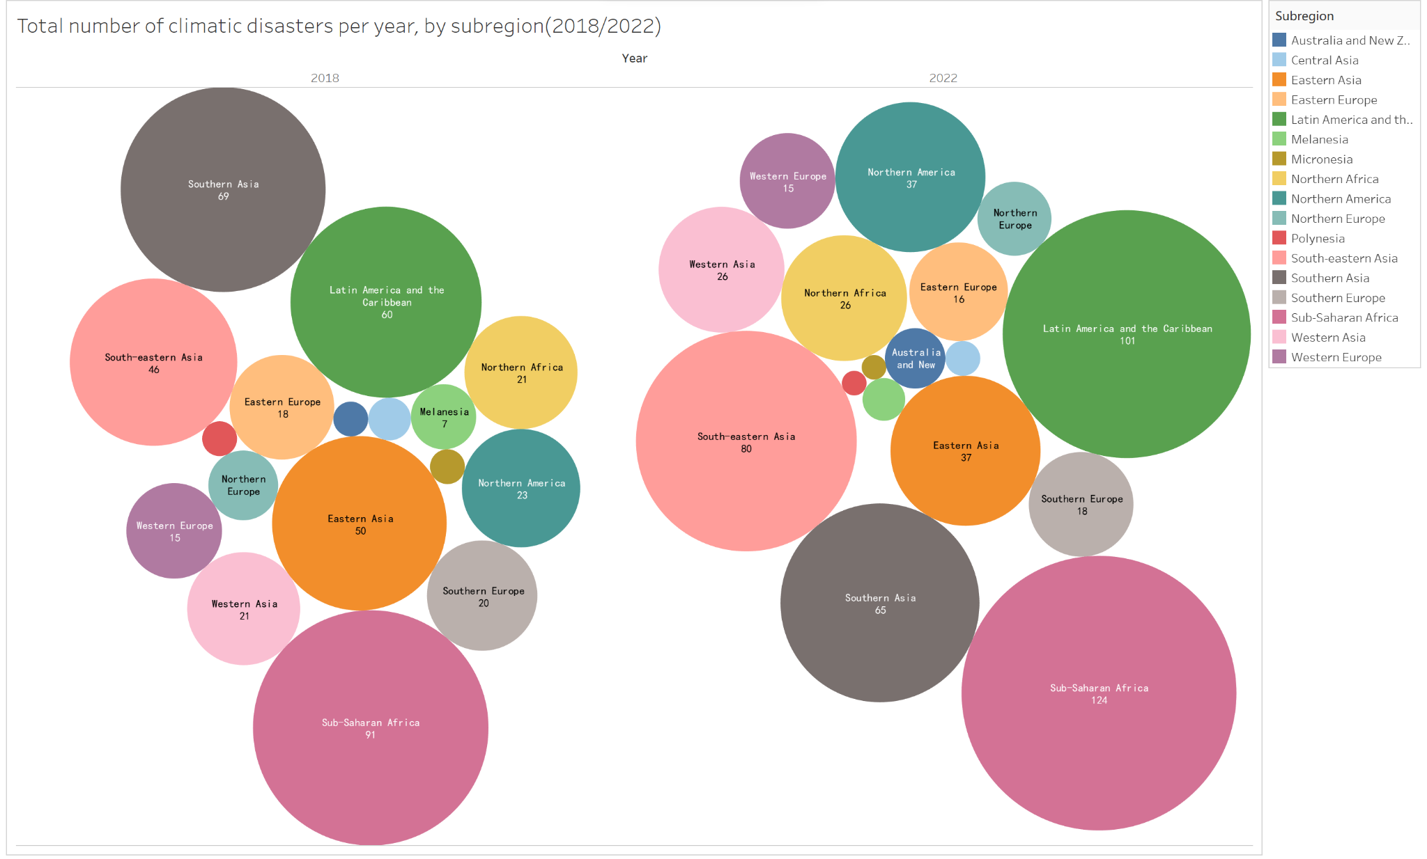
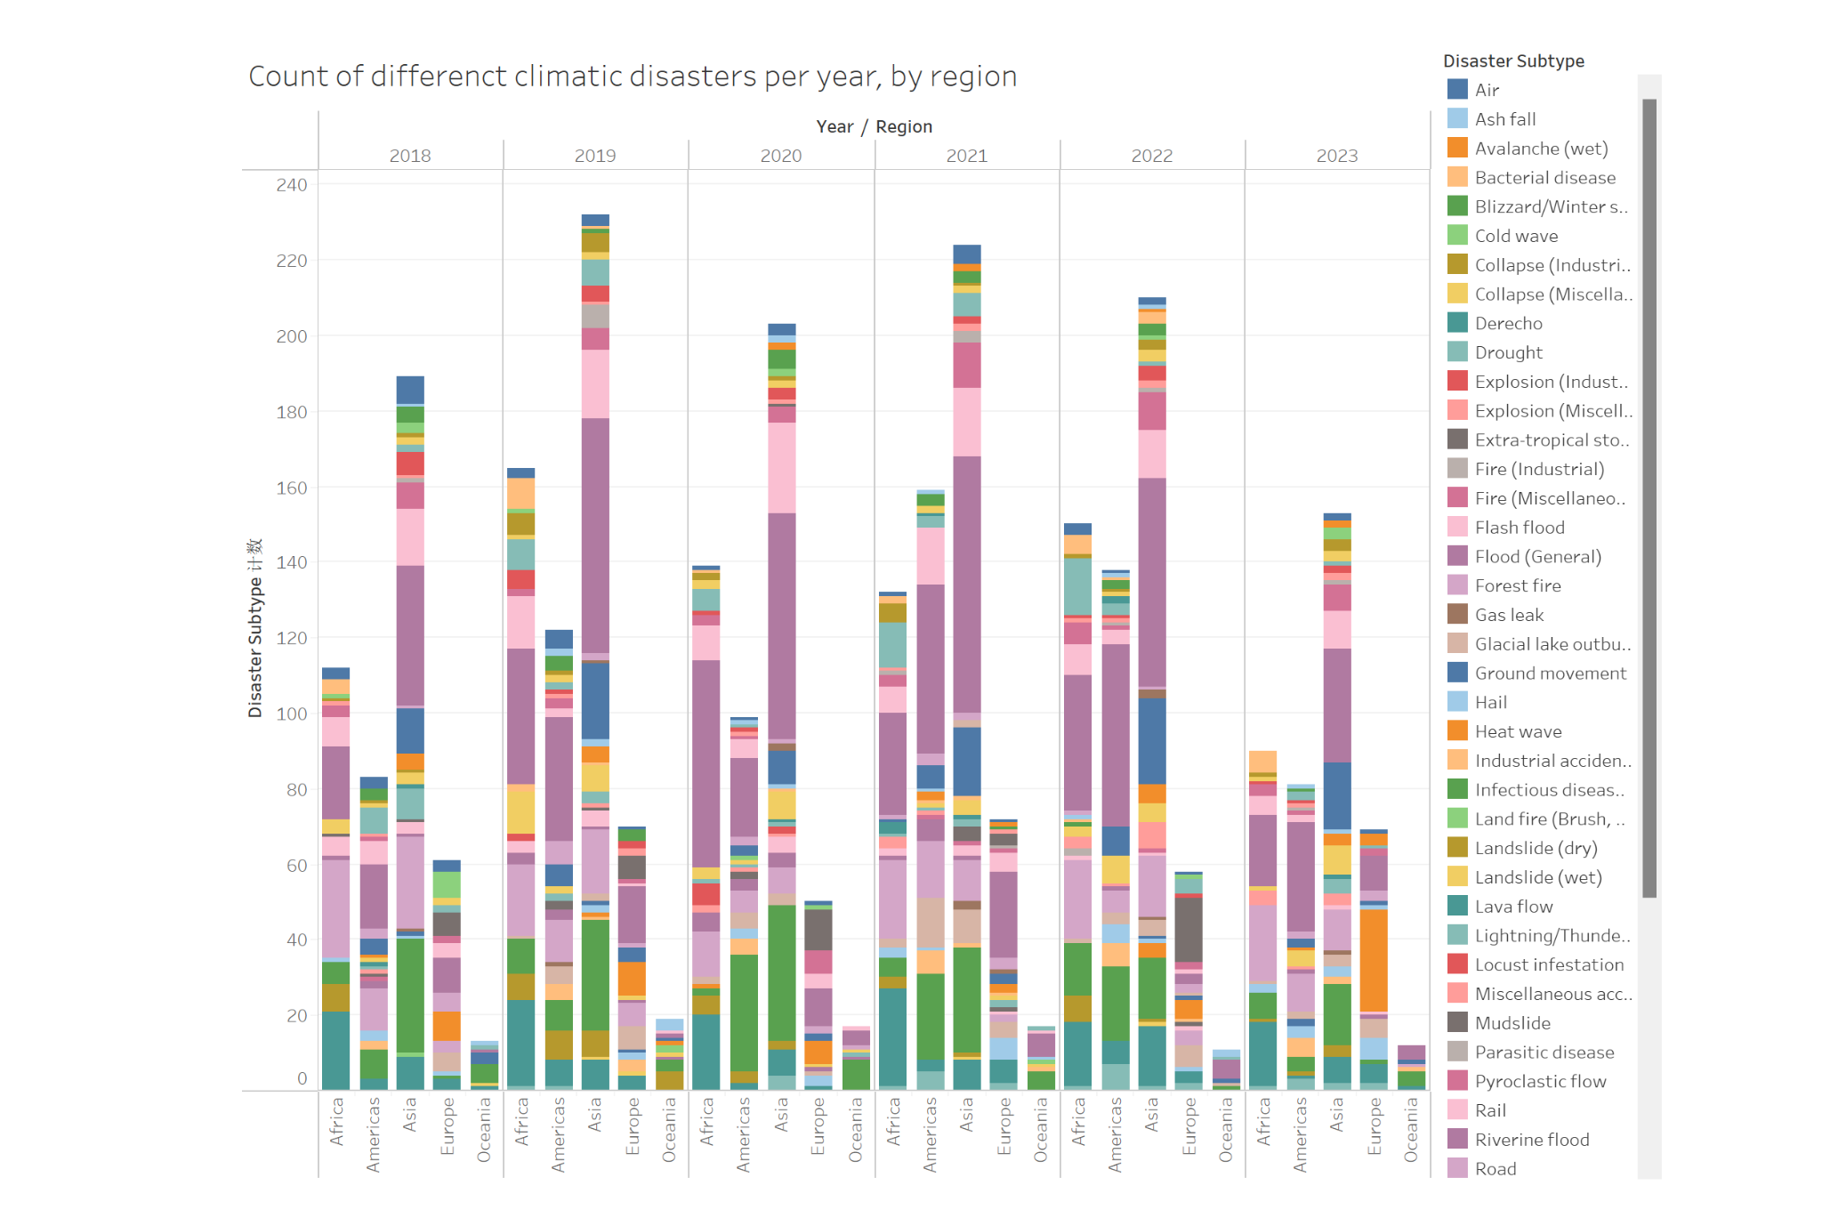
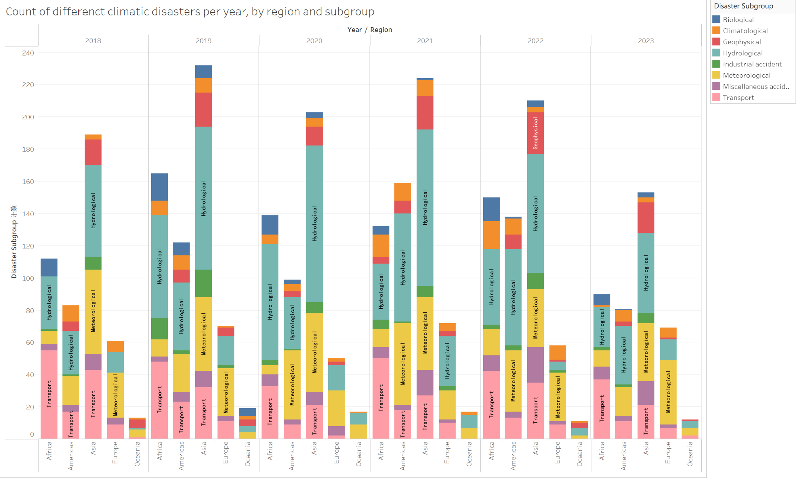
Climatic Disasters by region
Climatic Disasters by subregion
Count of Climatic Disasters by region
Count of Climatic Disasters by region

