Slide 1



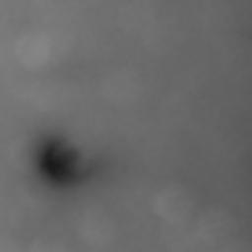
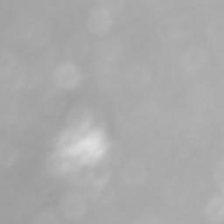
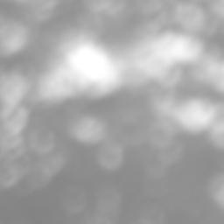
AlexNet
VGG
Source of weight
ResNet
Classification
Identification
Iterative fine-tuning
of model weights

Slide 2
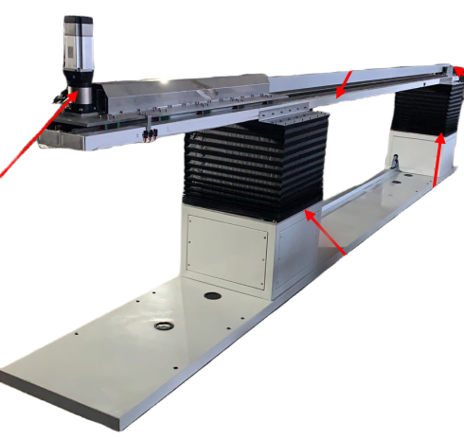
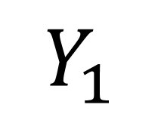
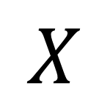
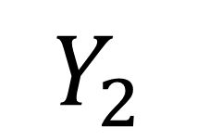
$$X$$
Platform for square tube support
Servo for
horizontal feed
Detection device
$$Y_{2}$$
$$Y_{1}$$
Lifting and tilting
adjustment device

Slide 3
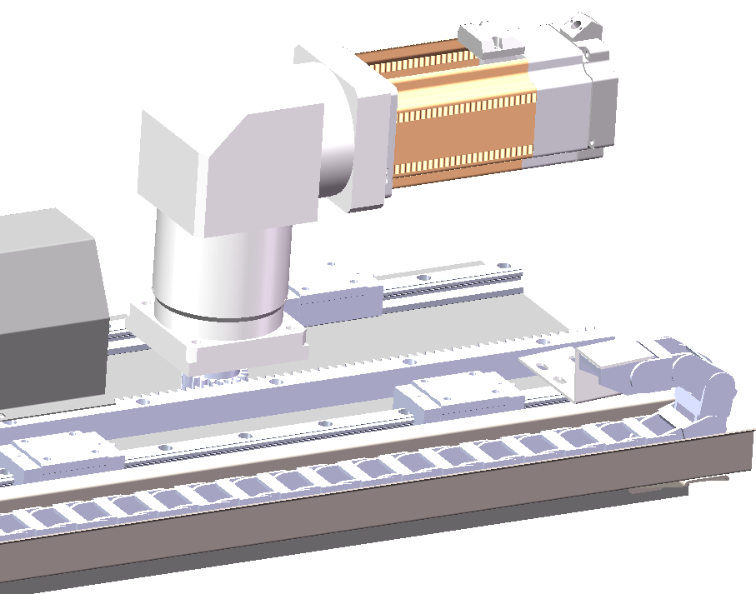
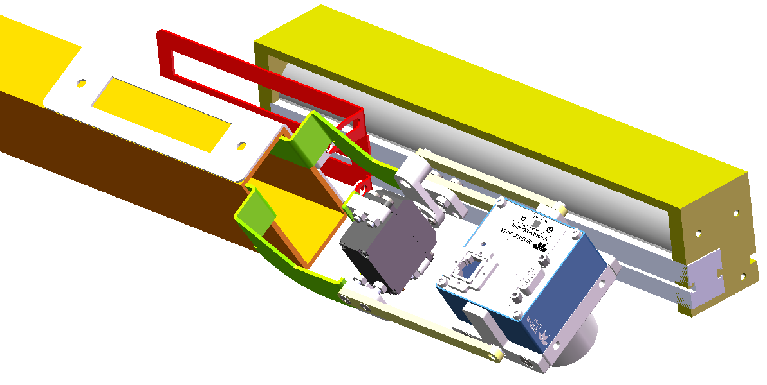
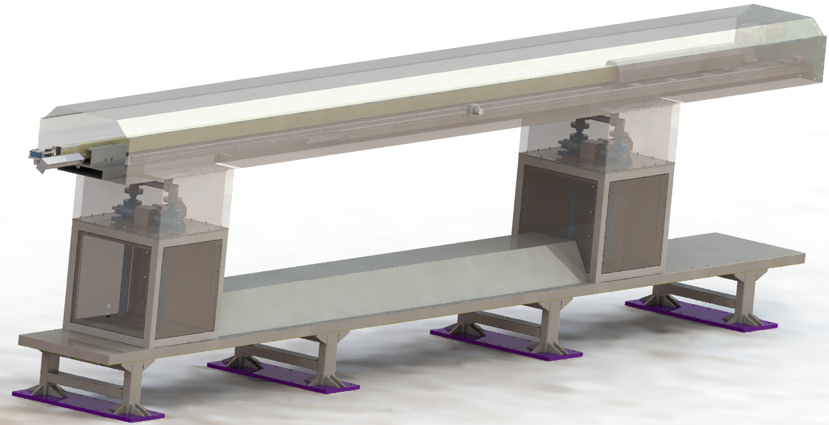
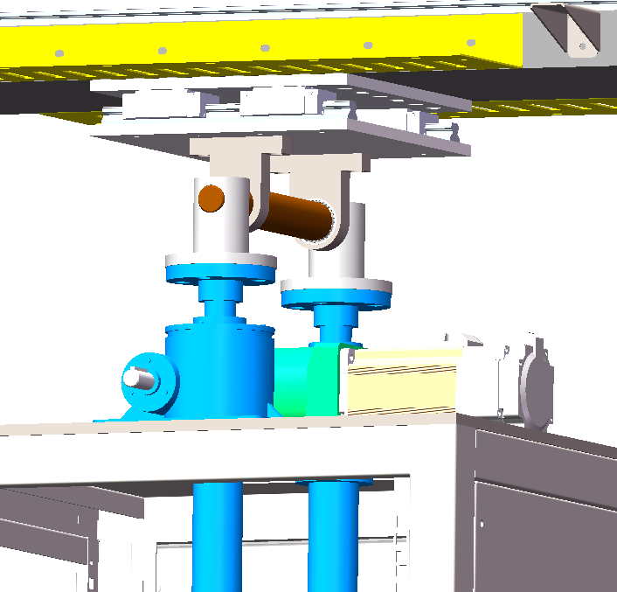
Lightening device
Servo for horizontal
feed
Camera
Thin-walled
tubes
Servo
Horizontal drive motor
Detection device
Lifting platform
Vertical guide rollers
Servo for driving
the lift
Lifting and pitch angle adjustment device

Slide 4
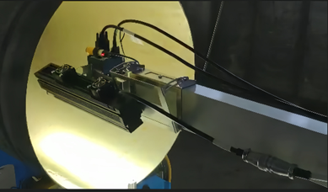
Image acquisition
camera
Illuminating source
Rotary-acting servo
Adhesive coating surface
Thin-walled tube
Adhesive coating
Deflection 30°
(facing left)
Deflection 30°
(facing right)
Shell
rotation
Detection
device
Shooting field
of view
Small sealed port
Straight portion
Big sealed port

Slide 5
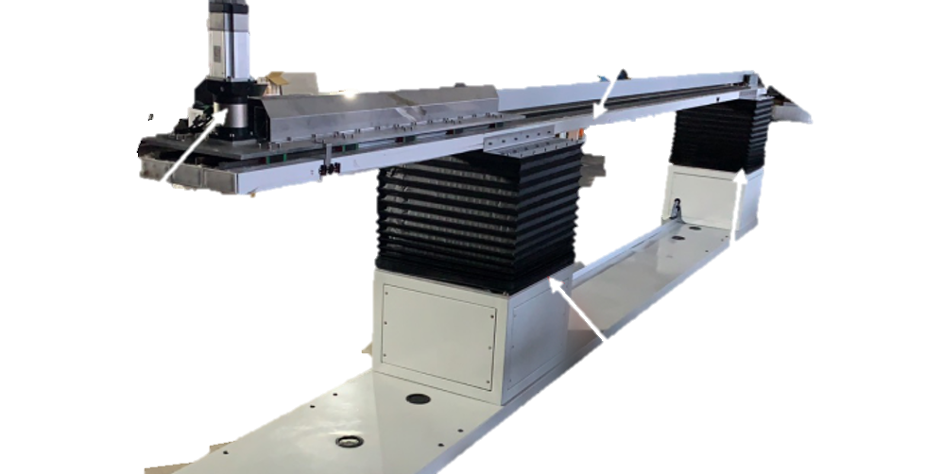

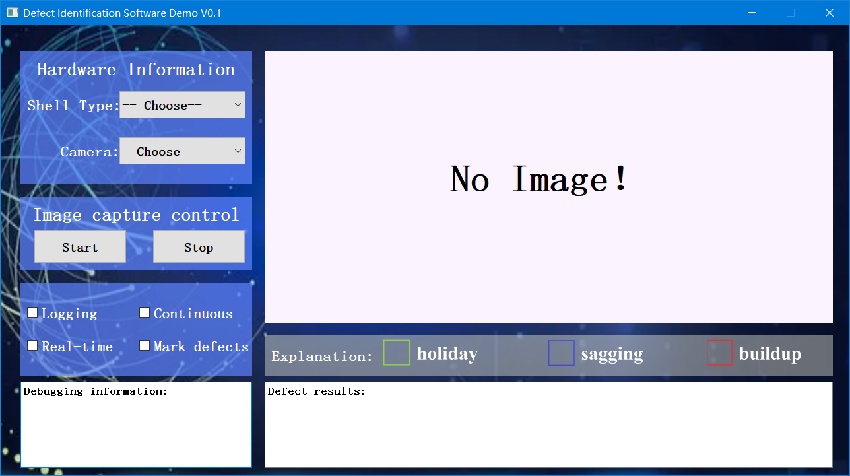
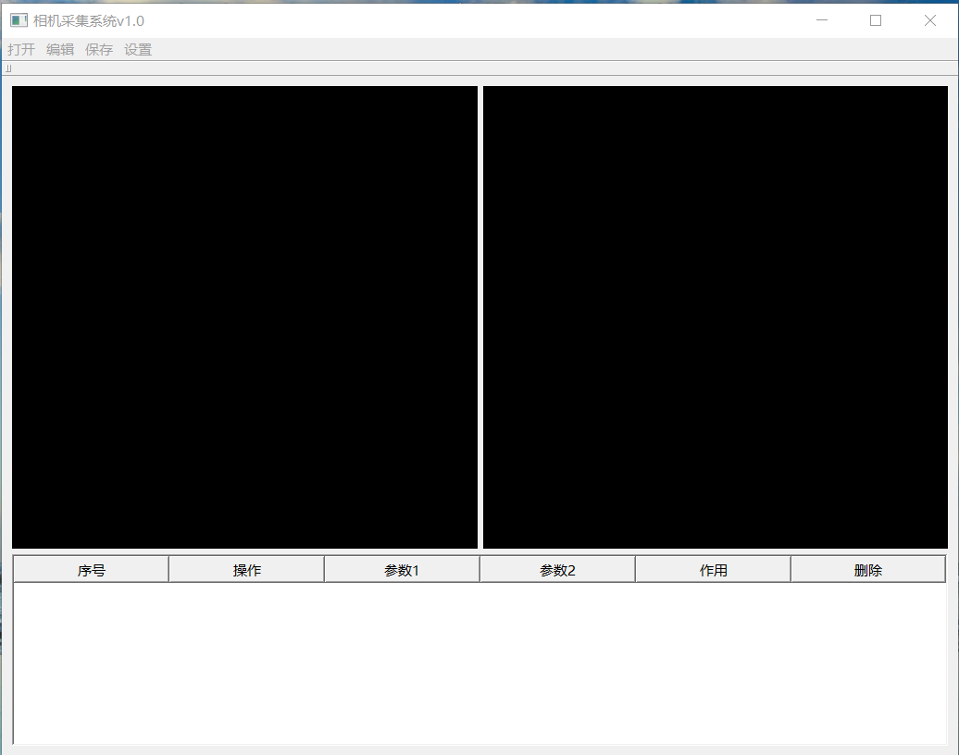
Real-time response
Drive
Motion control
Entire workflow
Defect detection
Image acquisition
Image capture
Data sources
Image storage

Slide 6
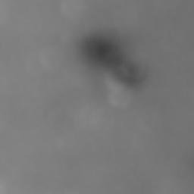

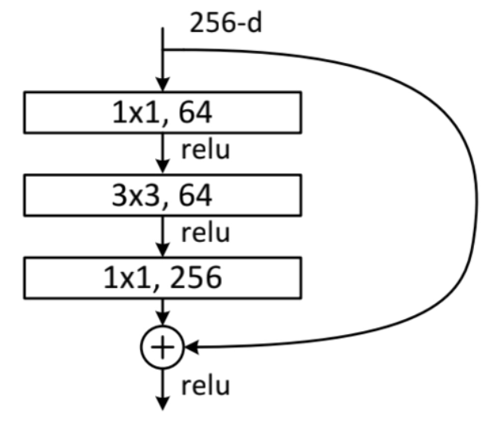
(256,256,1)
(256,256,3)
ResNetV101V2
(None, 2048)
(None, 512)
(None, 64)
(None, 4)
Dropout
Dropout
Dropout
INPUT
Grayscale_to_RGB
Transfer Learning
Global Average
Pooling2D
Full
Connection
Full
Connection
Full
Connection
Classifier
Layer

Slide 7
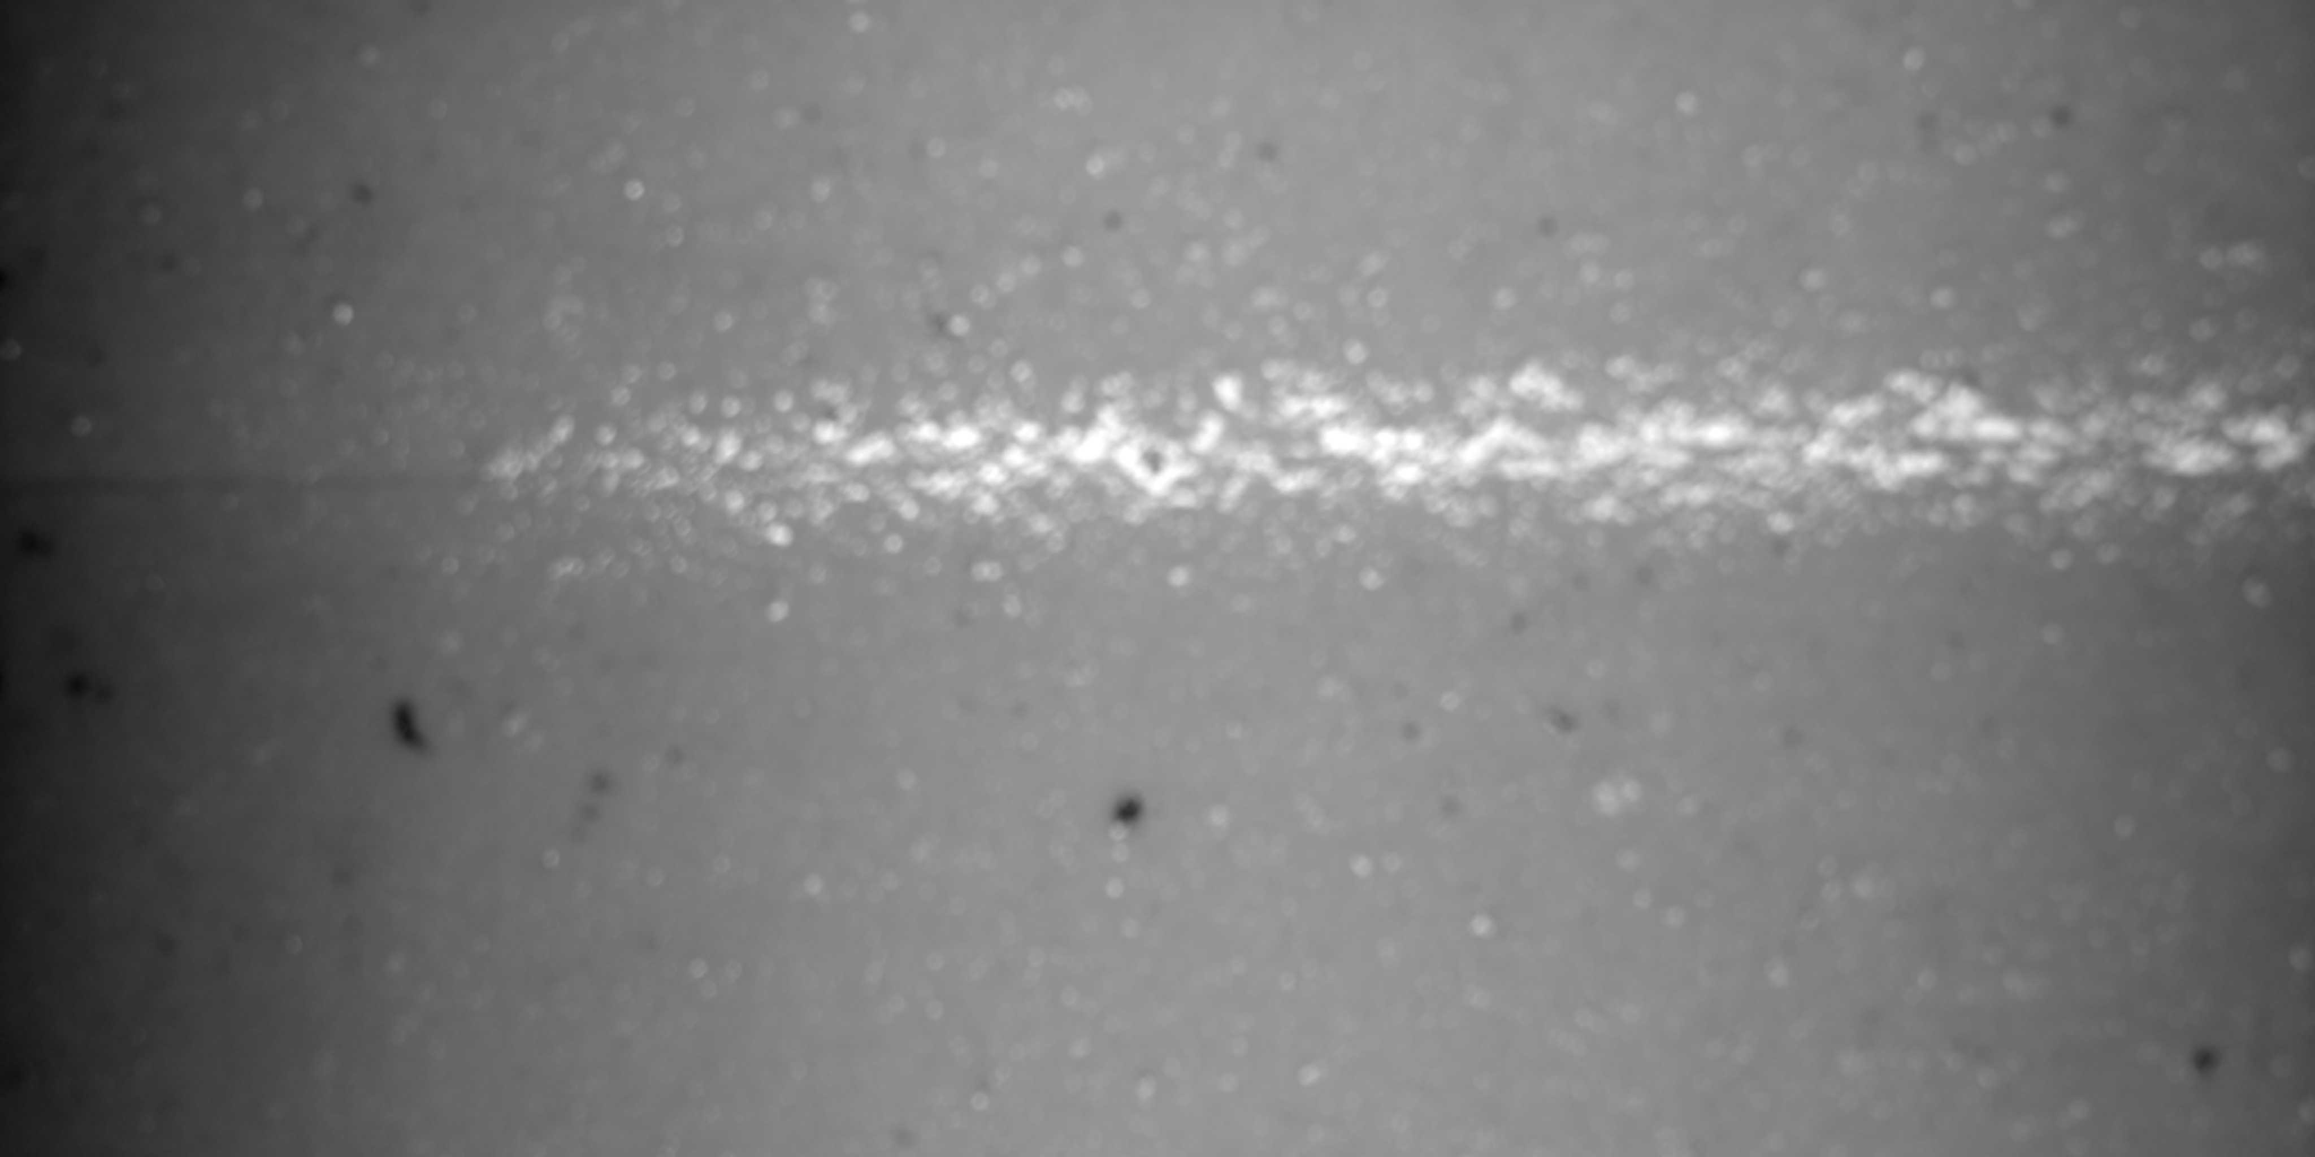
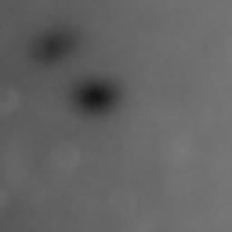
Iterative fine-tuning
of model weights
Source of weight
Input image
Dropout
Prediction
ResNet101V2
Splitting into subgraphs

Slide 8
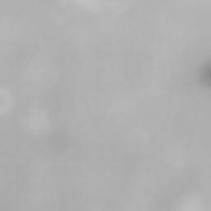

4096
Horizontal traversal
Vertical traversal
2058
256
（a）
（b）
（c）
256
256
256
span
span

Slide 9
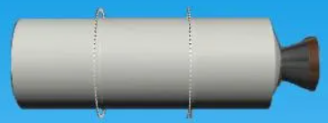
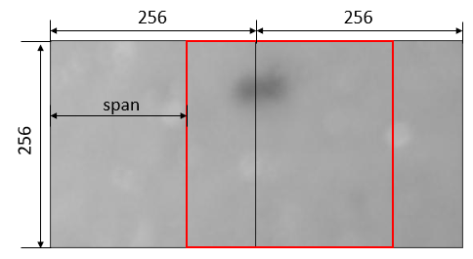
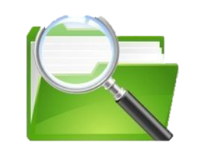

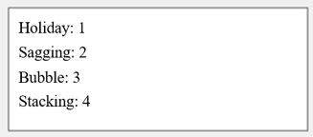
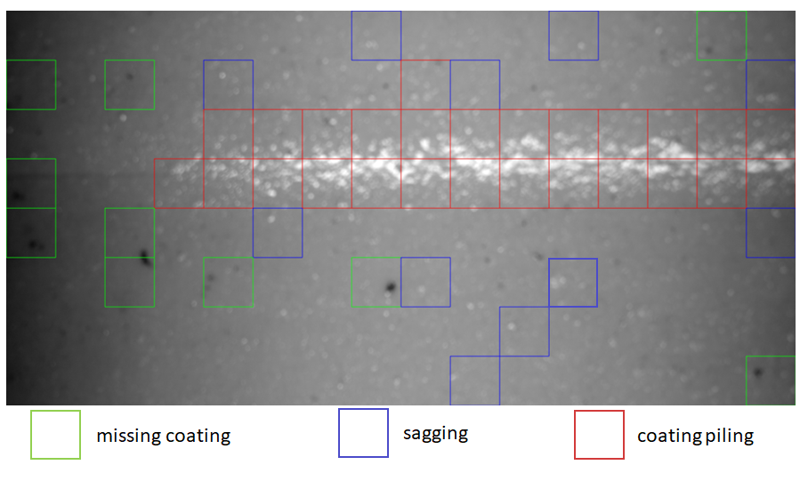
Open software
Select working directory
Check files date
Select engine
diameter model
Expired files
Select Block Span
0.99
0.95
Deep Learning model
0.90
0.85
default
Credibility filtering
Defect identification
Not mark defects
Mark defects
Identification result
Identification result
Image with defect markings

Slide 10
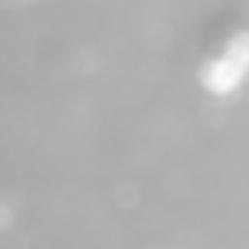

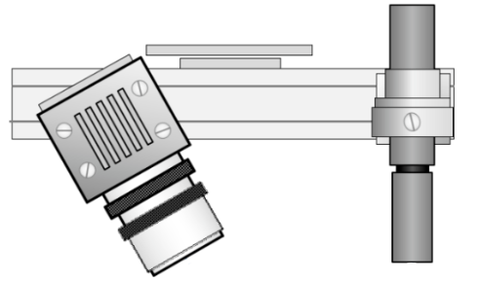
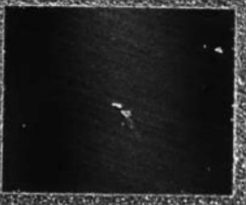
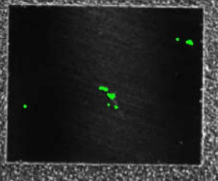

Laser Scanning
Feature-level Fusion
Industrial Cameras
Image features
Features obtained from laser scanning
Data-level fusion
Feature-level fusion
Fine tuned transfer learning/user-defined deep learning model
camera
Laser
Label 1
Label 2
Label 3
Result voting
Result weighting
Final prediction results
Decision-level fusion

