Slide 1
Hiring a Data Science Team: Salary Insights & Recommendations
Prepared for the CEO
Beija Richardson| April 2025

Slide 2
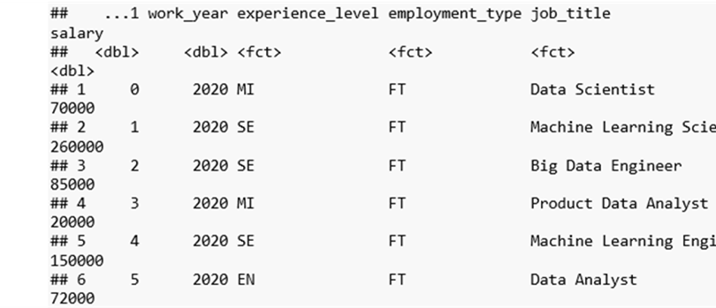
What Should We Pay to Attract Top Data Science Talent?
- How much do data scientists earn globally and in the U.S.?
- What experience levels affect salary?
- Where should we hire—locally or offshore?
- How can we stay competitive and attract leadership talent?

Slide 3
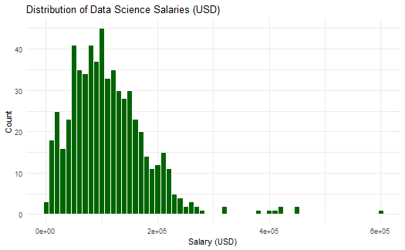
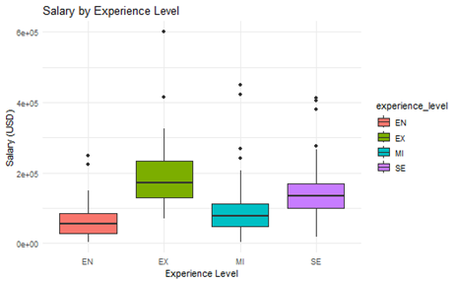
How Much Do Data Scientists Earn?
Does Experience Play a Factor?
- Most data scientists earn between $60K–$150K USD
- A few high outliers (>$300K) suggest executive-level compensation
- Executives earn over $200K USD on average
- Clear salary growth from Entry to Executive level

Slide 4
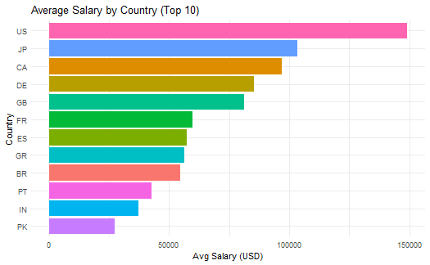
Location Impact Salary
Recommendations
Offer
- Offer $140K–$180K USD for U.S.-based leadership roles
Build
- Build a hybrid team: U.S. lead + offshore support (e.g., Europe, India)
Stay
- Stay flexible on location to access global talent and manage costs
- U.S. salaries are highest (~$140K+)
- Countries like Canada, Japan, Germany offer competitive alternatives

