Slide 1
Final Presentation
CSED 332
Team Orange
최규민, 김지훈, 빙준호

Slide 2
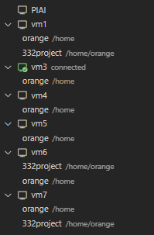
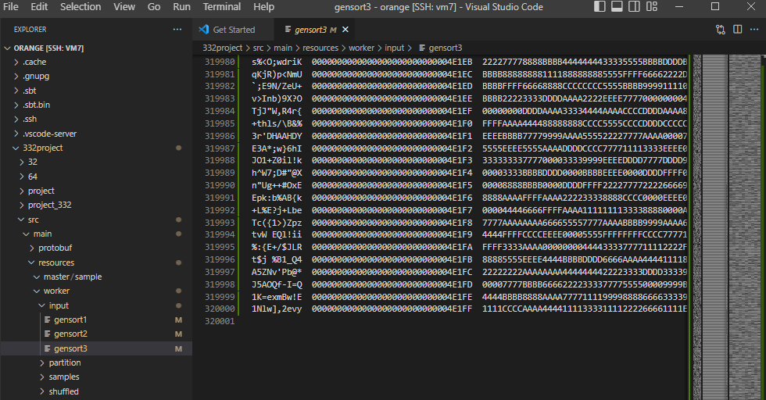
Experiment on 5 workers, 32 MB 3 input blocks per worker
Setup

Slide 3

Experiment on 5 workers, 32 MB 3 input blocks per worker
Correctness 1: Does the master start?

Slide 4
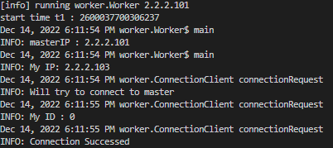
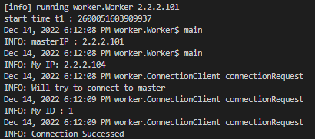
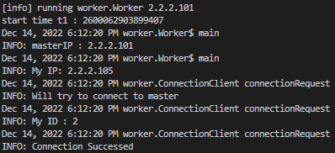
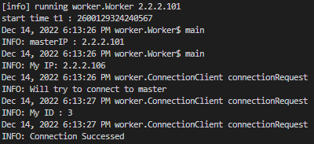
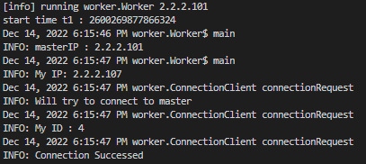
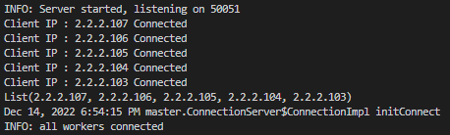
Experiment on 5 workers, 32 MB 3 input blocks per worker
Correctness 2: Does each worker connect to the master?

Slide 5

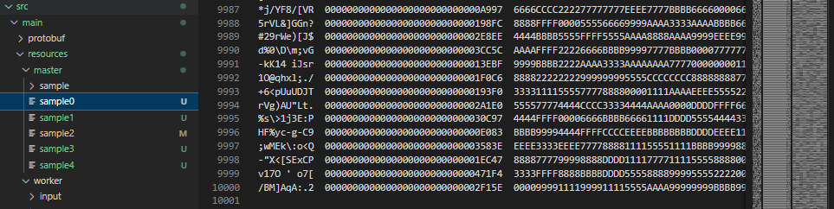
Experiment on 5 workers, 32 MB 3 input blocks per worker
Correctness 3: Does the master collect sample data?

Slide 6
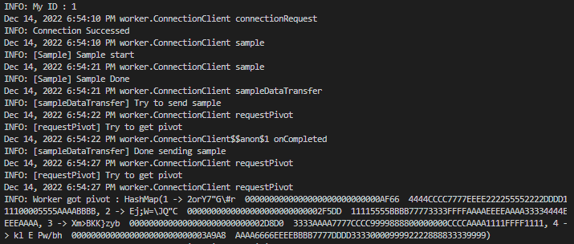
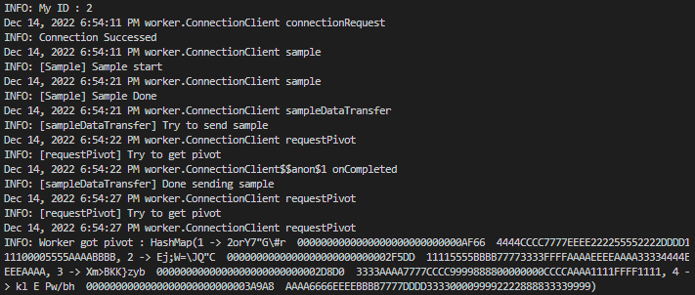
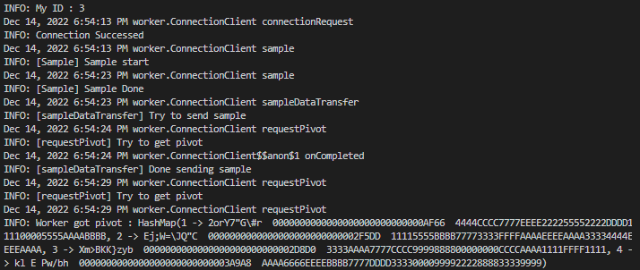

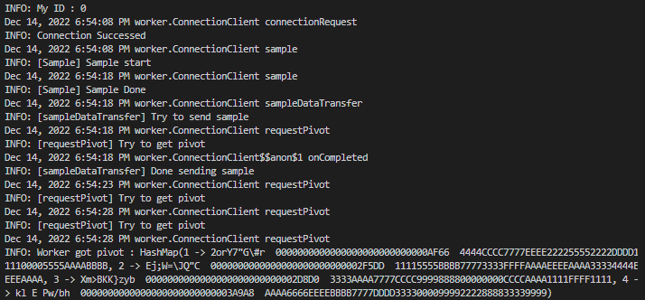
Experiment on 5 workers, 32 MB 3 input blocks per worker
Correctness 4: Does the master return distribution keys back to workers?

Slide 7
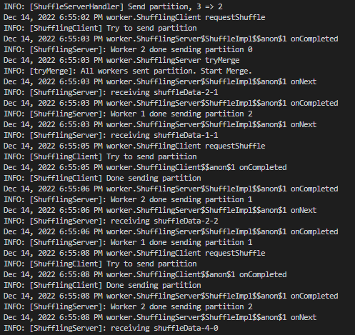
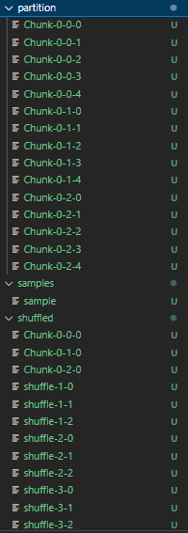
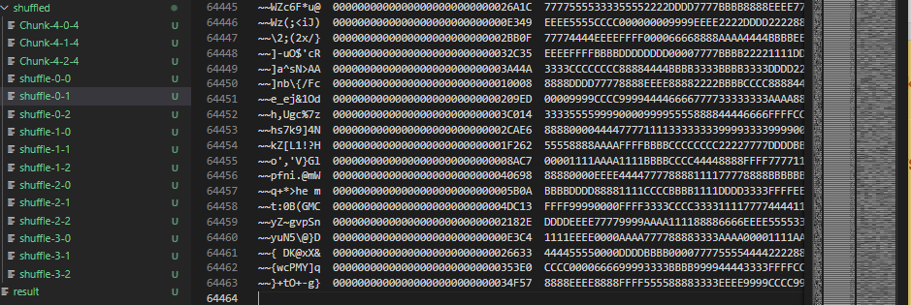
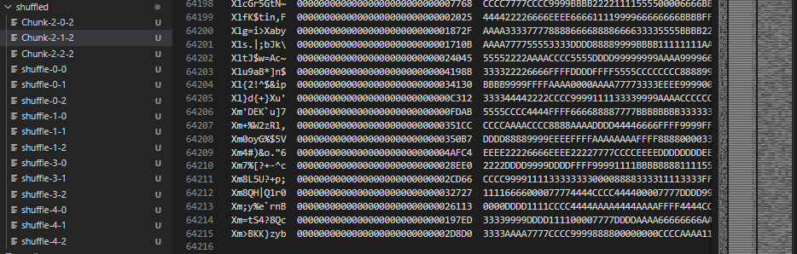
Experiment on 5 workers, 32 MB 3 input blocks per worker
Correctness 5: Do workers pass intermediate data between each other?

Slide 8
Experiment on 5 workers, 32 MB 3 input blocks per worker
Correctness 6: Does the master print a sequence of workers?

Slide 9
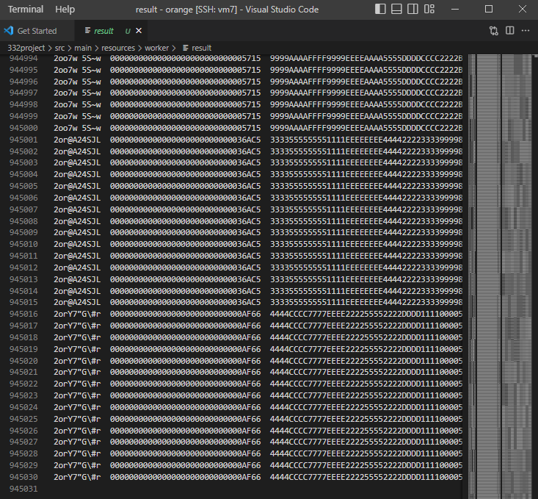
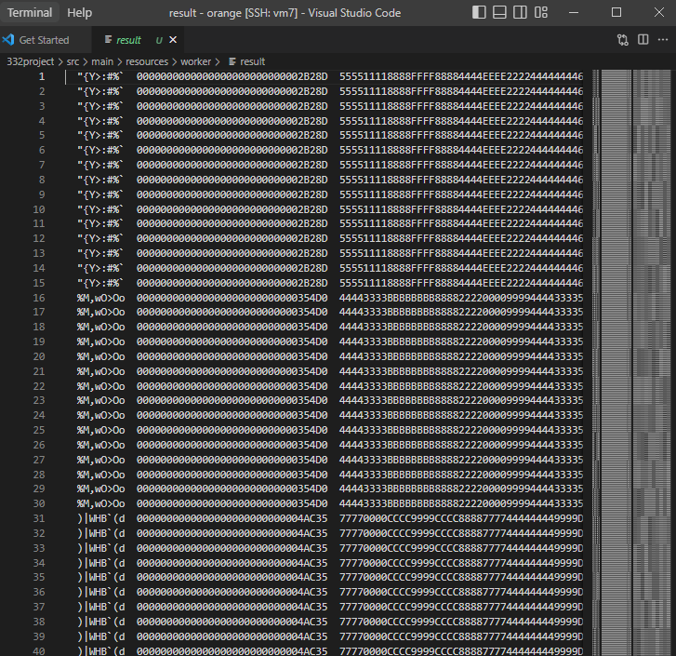
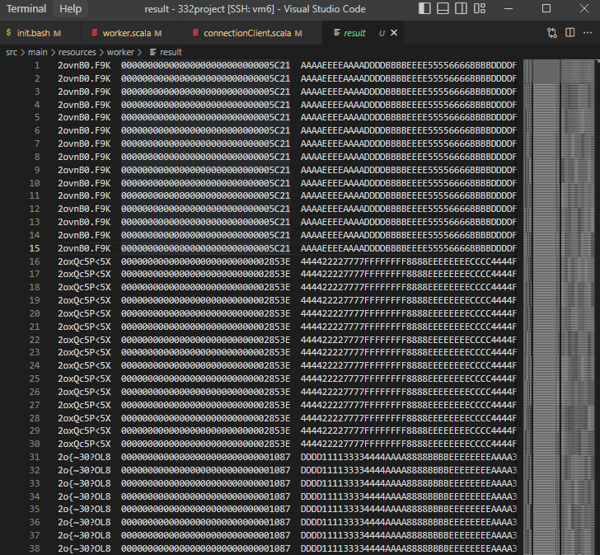
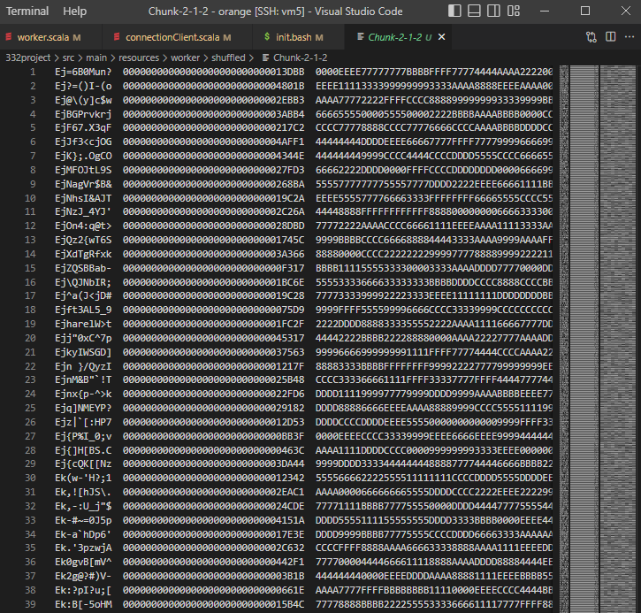
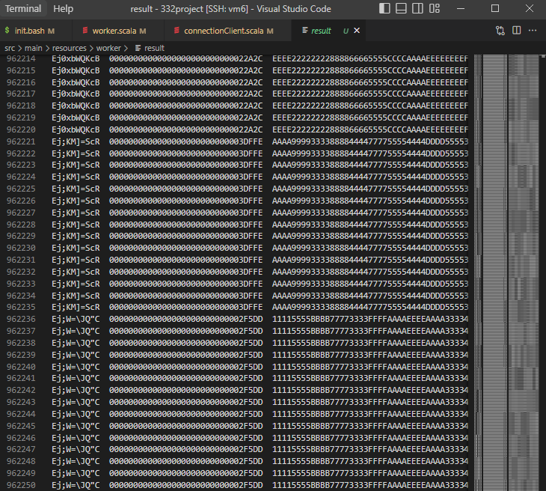
Experiment on 5 workers, 32 MB 3 input blocks per worker
Correctness 7: Is the output sorted in each worker? Key 비교

Slide 10
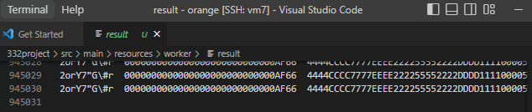
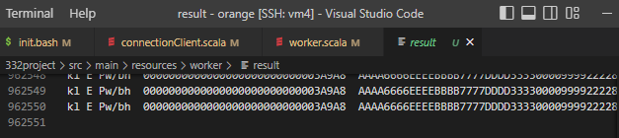
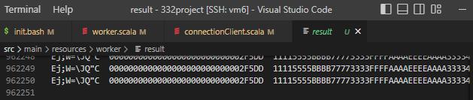
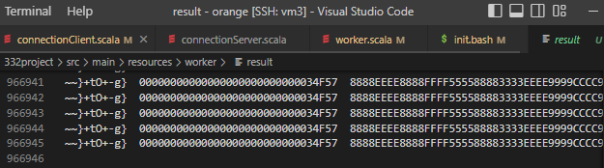
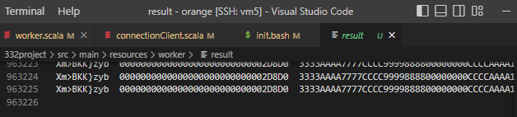
Experiment on 5 workers, 32 MB 3 input blocks per worker
Correctness 8: # of input == # of output?
Input : 320,000 lines * 3 files * 5 workers = 4,800,000 lines
Sum of 5 output files’ lines = 4,800,000

Slide 11
Experiment on 5 workers, 32 MB 3 input blocks per worker
Result: 8/8 correctness
Execution time:

Slide 12
Progress - Milestones
Milestone 1 – Init > Completed on Week 4
Milestone 2 – Sample > Completed on Week 8
Milestone 3 – Sort > Completed on Week 7
Milestone 4 – Partition > Completed on Week 8
Milestone 5 – Shuffle > Completed on Week 8
Milestone 6 – Merge > Completed on Week 7
Milestone 7 – Test on Virtual Machine > Completed on Week 8

Slide 13
Contribution
최규민: gRPC communication, Baseline, Init, Shuffle
김지훈: Sample, Sort, Partition, Merge
빙준호: gRPC communication, Shuffle, Test, Presentation

Slide 14
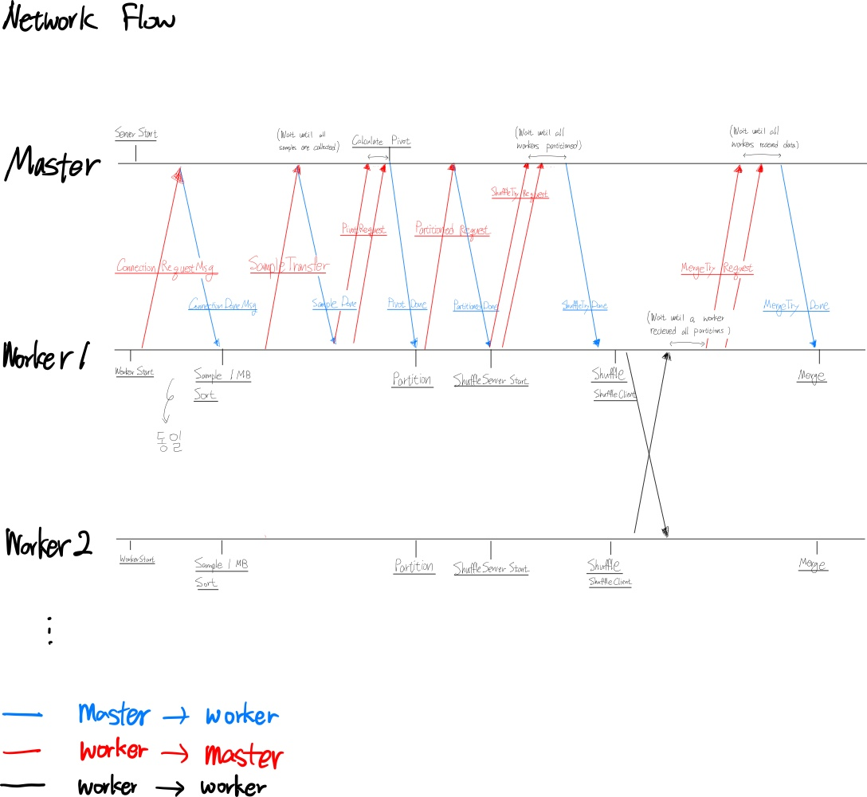
Design

Slide 15
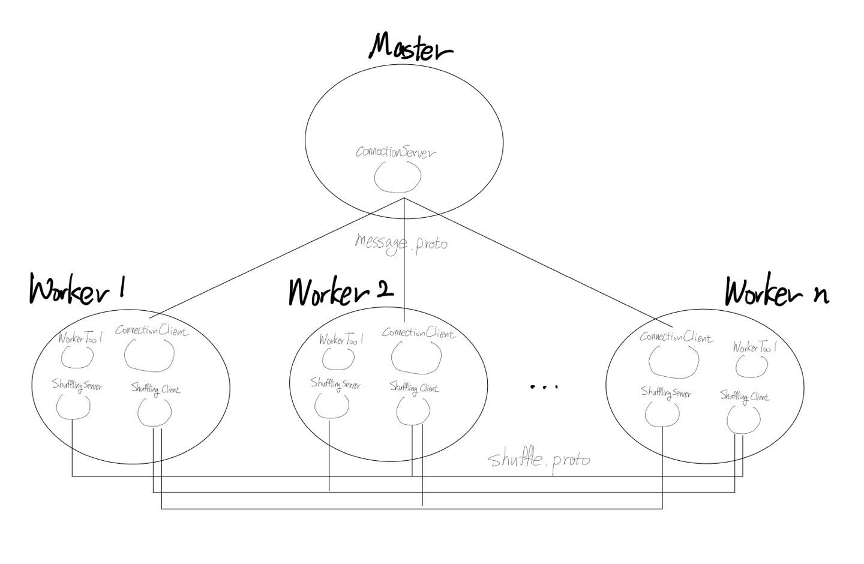
Master – Worker Modules
Notes:
Server 클래스는 gRPC의 ServerBuilder API를 통해 생성된 master-worker간 connection하는 Server이다.
Client 클래스는 gRPC의 Service를 이용해 master-worker간 connection하는 client이다.
Server와 Client간의 RPC는 message.proto 에 정의되어 있다.
WorkerTool은 Worker가 사용하는 각종 기능을 제공하는 object이고, shuffleServer와 shuffleClient는 Worker간의 data 교환, 즉 shuffling 시에 각 worker가 server이자 동시에 client의 역할을 하여 데이터를 주고받을 수 있도록 shuffle.proto에 정의하여 구현하였다.

Slide 16
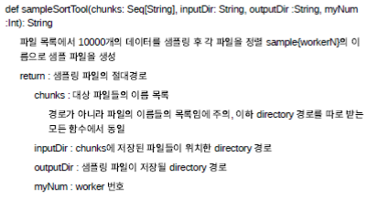
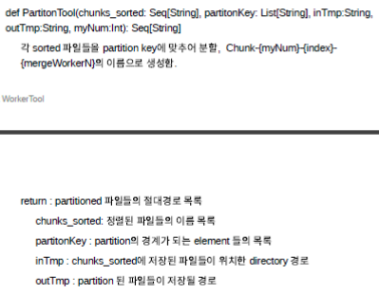
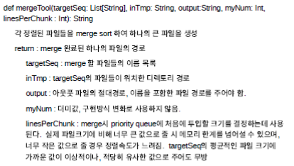
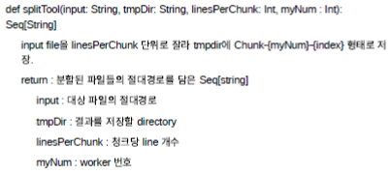
Object WorkerTool

Slide 17
What we learned
마일스톤을 정하고 계획에 맞게 달성하는 것의 중요성
세심한 디자인의 중요성
빠른 착수의 중요성
효율적 미팅의 중요성

