Slide 1
Progress Presentation
Team Orange
최규민, 김지훈, 빙준호

Slide 2
Review of the weekly progress
Week 1: ★★★★★ (중간고사, create git repo)
Week 2: ★★★☆☆ (gRPC, sorting 등 공부, 구조 설계)
Week 3: ★★★★★ (구조 설계, milestone 설정, master/worker
connection)
Week 4: ★★★★☆ (Init, Sort done)

Slide 3
Logistics
Communication: Kakao talk, weekly offline meeting
Documentation: Flow diagram, Message format
Divide and Conquer : 각자 milestone 별로 업무분담
Decision making: 팀원의 조언을 참고하며 맡은 사람이 결정

Slide 4
Details
Programming Environment
OS : Ubuntu 20.04 LTS
JDK : OpenJDK 8 (1.8.0_342)
sbt 1.7.2
Scala : 2.13.6
Input generation: Done
Libraries: gRPC, scalaPB(protocol buffer compiler for scala)
Logging: java.util.logging.Logger

Slide 5
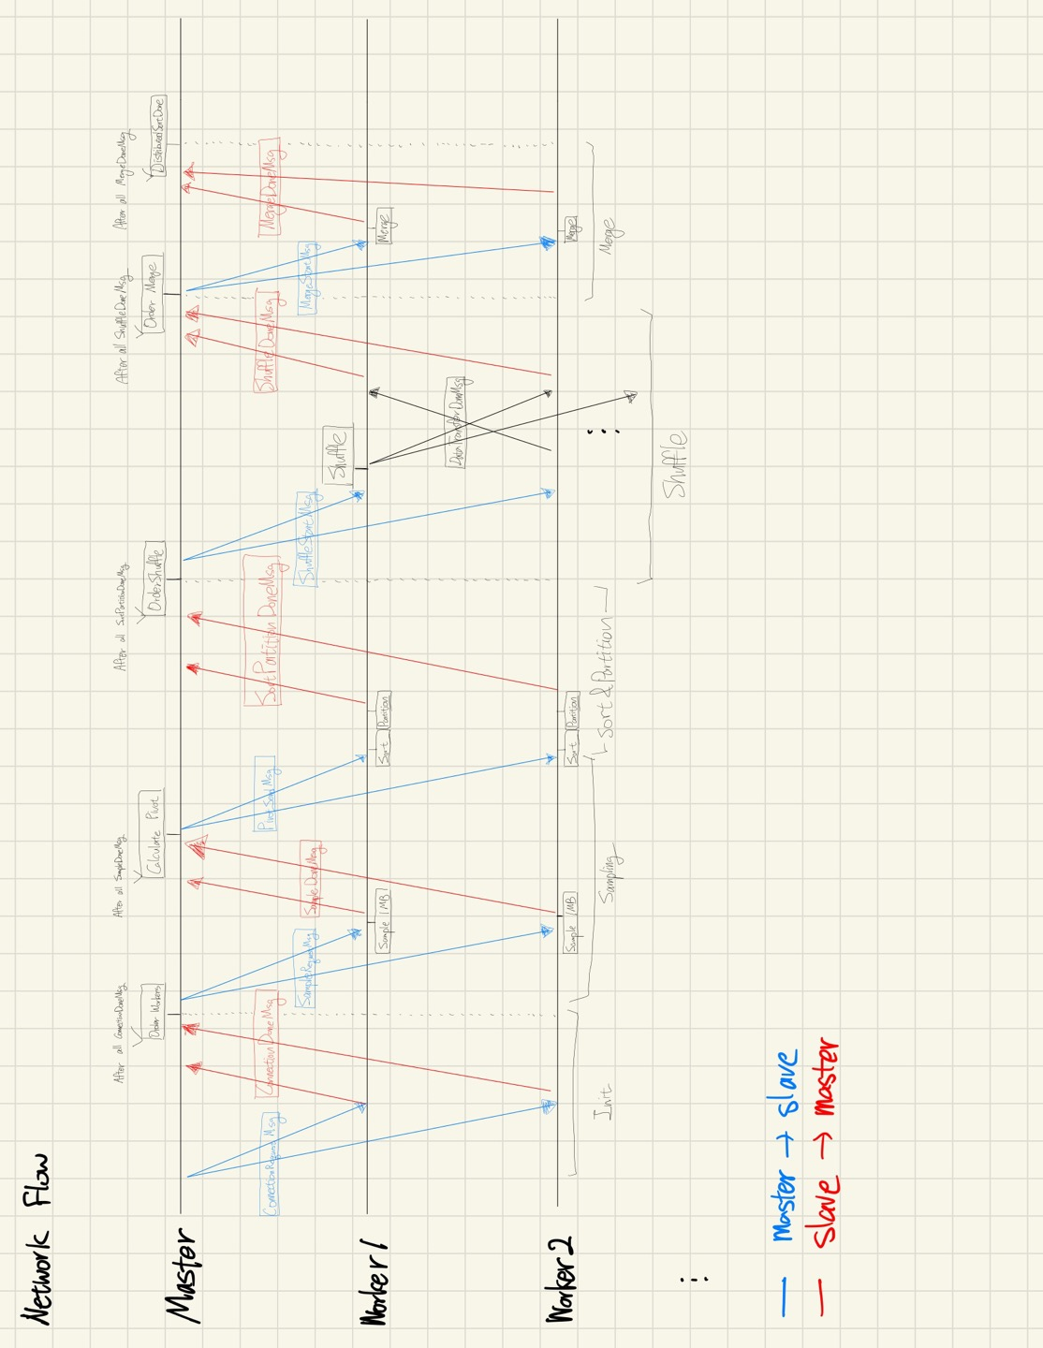
Design

Slide 6
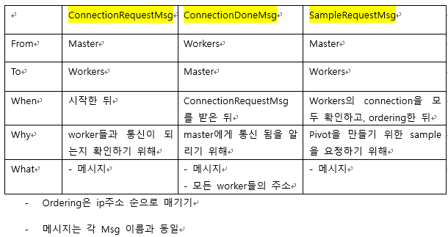
Message Format

Slide 7
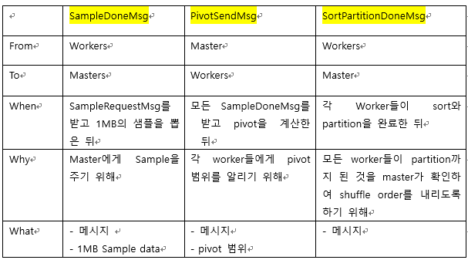
Message Format

Slide 8
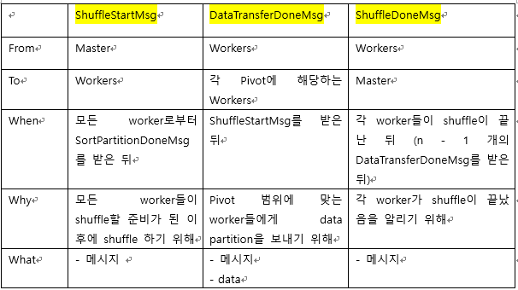
Message Format

Slide 9
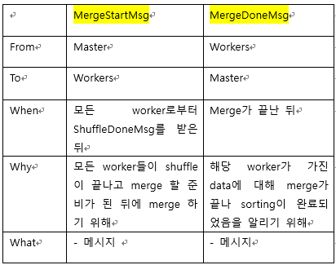
Message Format

Slide 10
Progress - Milestones
Milestone 1 - Init (완료)
Milestone 2 - Sample (진행중)
Milestone 3 - Sort (완료)
Milestone 4 - Partition (진행중)
Milestone 5 - Shuffle
Milestone 6 - Merge (진행중)
Milestone 7 - Test on Virtual Machine

Slide 11
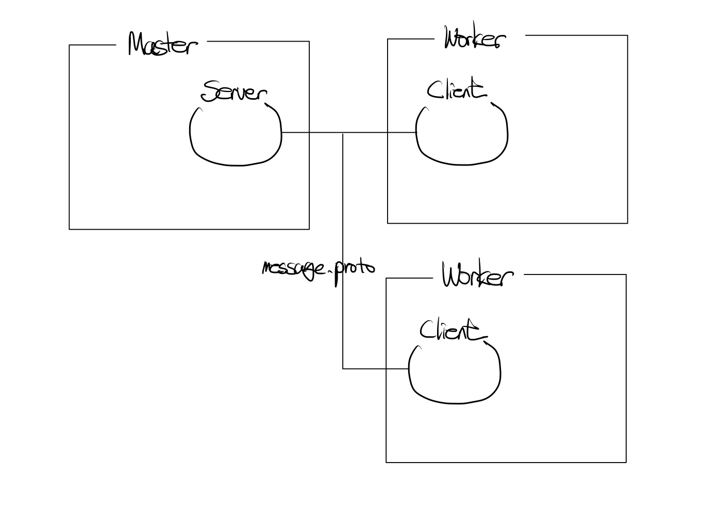
Progress – Modules/components

