Slide 1

Exposure
Motilal Nehru National Institute of Technology Allahabad, Prayagraj
Presented By : Triloki Nath, Abhishek Keer, Deendayal gour
Under the guidance of
Dr. Dinesh Singh
Jul 06, 2020
Exposure

Slide 2
Acknowledgement
We would like to thanks everyone who contributed to helping us in some way to achieve our goals with regards to our project. We are especially grateful to our mentor Dr. Dinesh Singh for assisting us in our project. Without their expertise and suggestions we would never have been able to complete our work.
Exposure

Slide 3
Presentation Outline
Introduction Requirements Application Snapshots Use case
Control Flow Future Scope Conclusion
Exposure

Slide 4
Introduction
About Exposure
The era of mobile technology android there are various social media applica- tion already exist, We also thought about some related application regarding social media, and We develop an android application “Exposure”.
This is a confession app. That allows you to whisper and confess directly to someone by showing or hiding yourself. Also you can read gossips and give advice such as comment, tips to confessors.
Exposure

Slide 5
Requirements
Android Studio
Android Studio is the official IDE for Android app development, based on IntelliJ IDEA. On top of IntelliJ’s powerful code editor and developer tools.
A flexible Gradle-based build system. A fast and feature-rich emulator.
Apply Changes to push code and resource changes to your running app without reinstalling your app.
Firebase
Google Firebase is a mobile platform that helps you quickly develop high quality app.
The Firebase Realtime Database uses data synchronization every time data changes, any connected device receives that update within milliseconds.
It provides free of cost access up to some data and connections limits.
Exposure

Slide 6
Requirements
Java
Java is an object oriented programming language.
It is mostly used for standalone and backend development.
The Core libraries of Android is also written in Java, therefore, it is the first choice of the developers for creating android applications.
Exposure

Slide 7
Requirements
User Requirements
A user shall be required to have access to Internet
A new user shall be required to register using mail account and password.
An existing user able to login using email and password.
A user must have Android 7 or onward version to run this application
Exposure

Slide 8
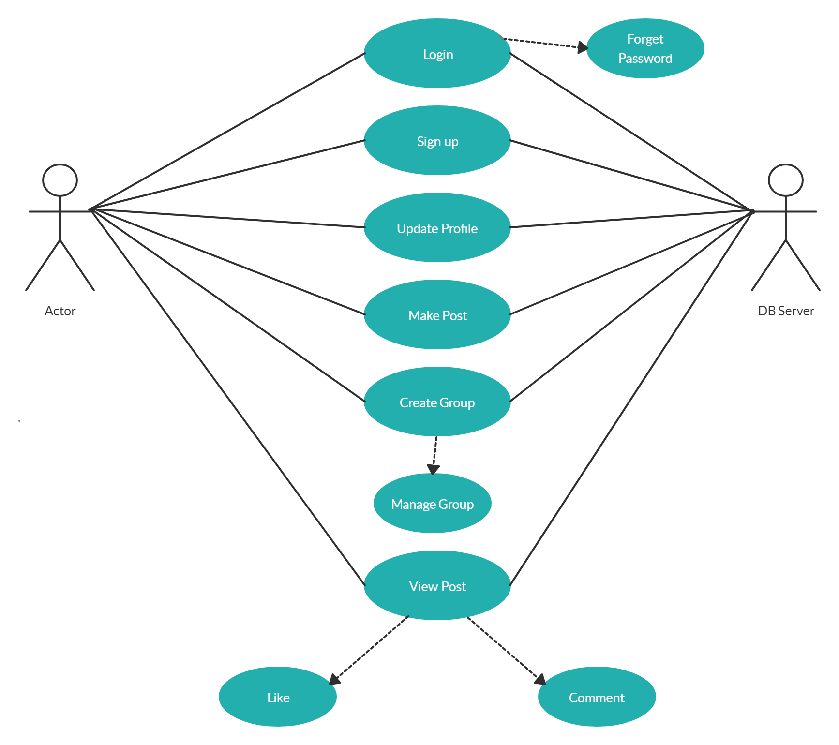
Use case
Exposure

Slide 9
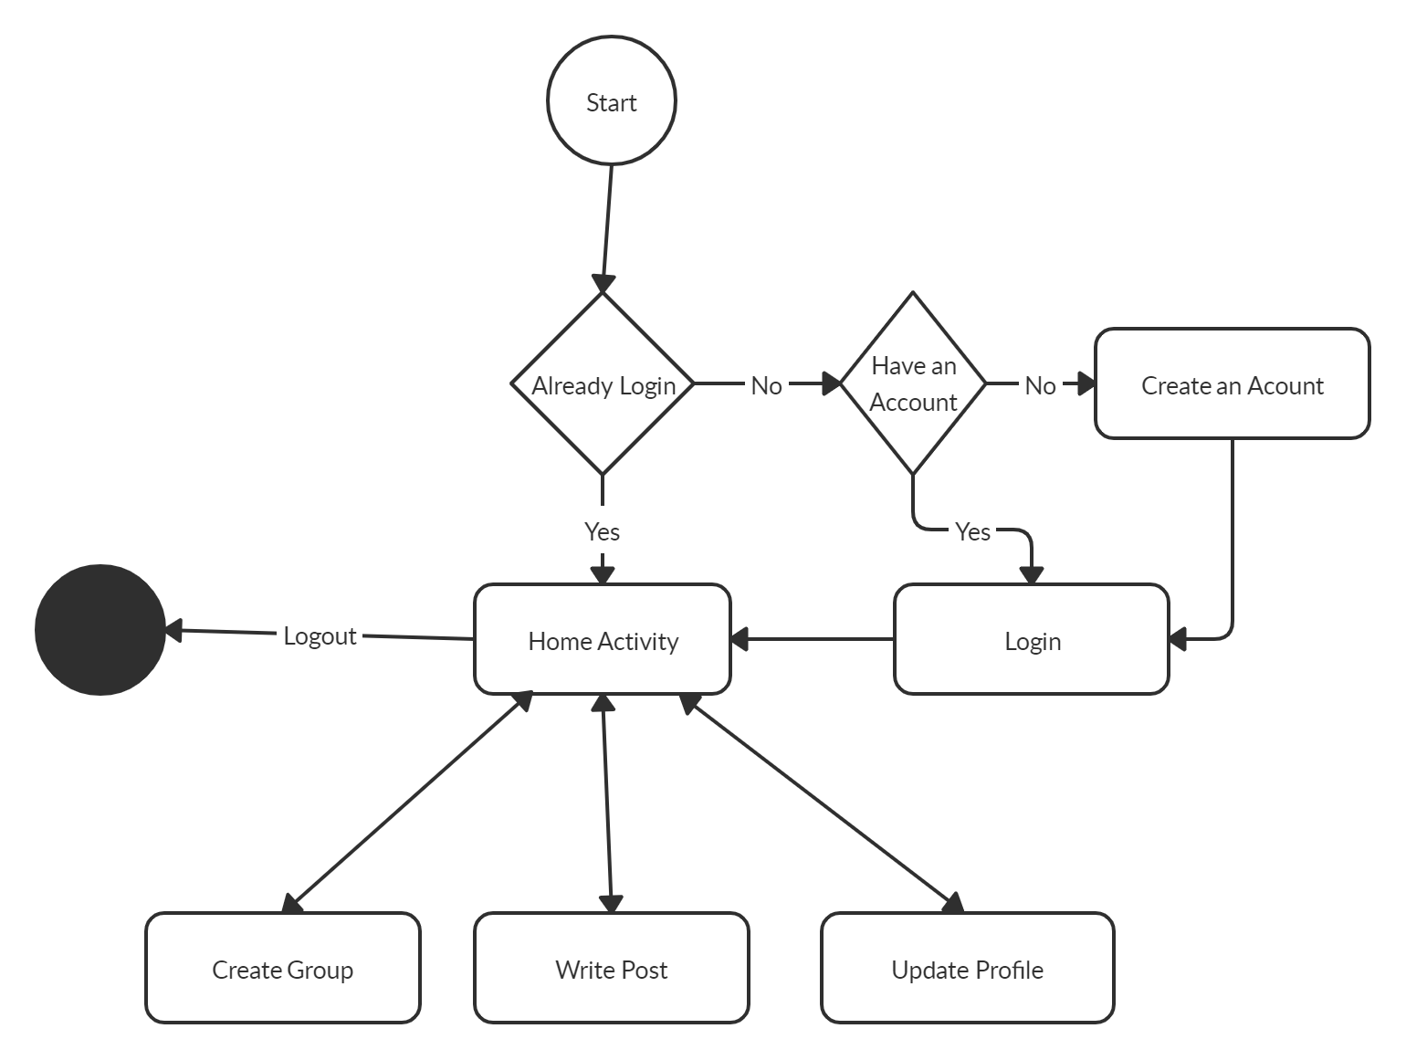
Control Flow
Exposure

Slide 10
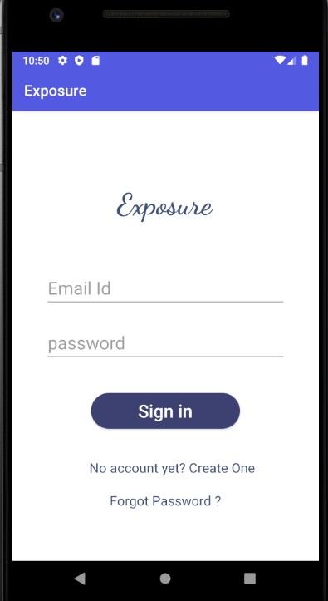
Login Activity
Exposure

Slide 11
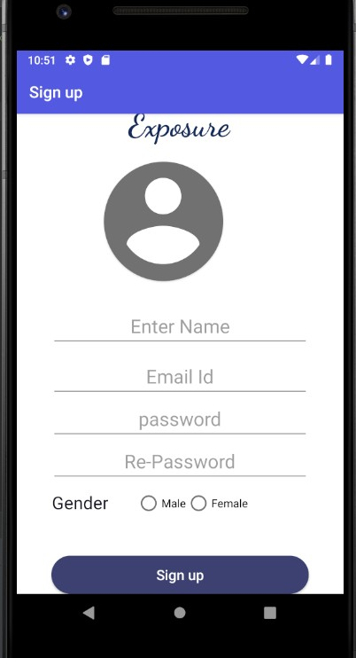
Signup Activity
Exposure

Slide 12
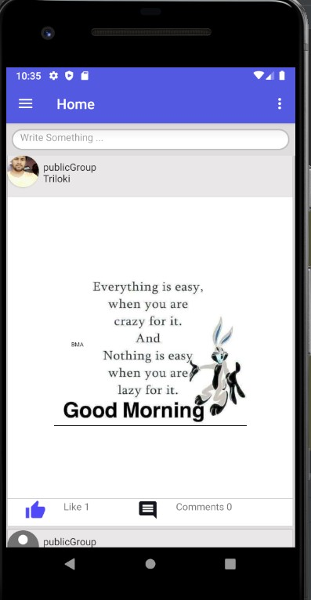
Home Fragment
Exposure

Slide 13
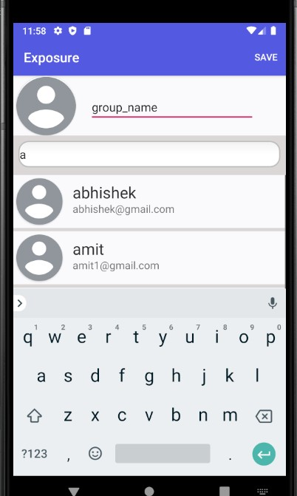
Create Group Activity
Exposure

Slide 14
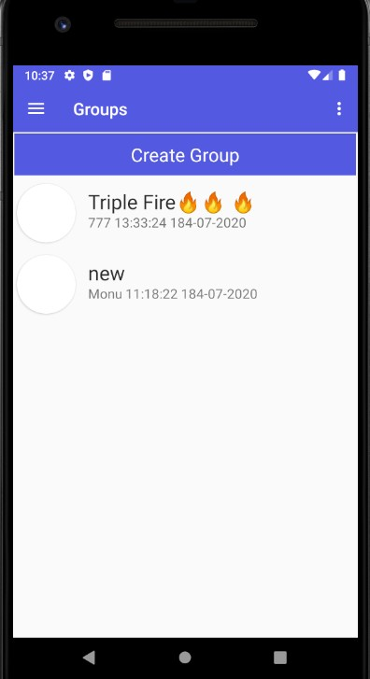
Group Fragment
Exposure

Slide 15
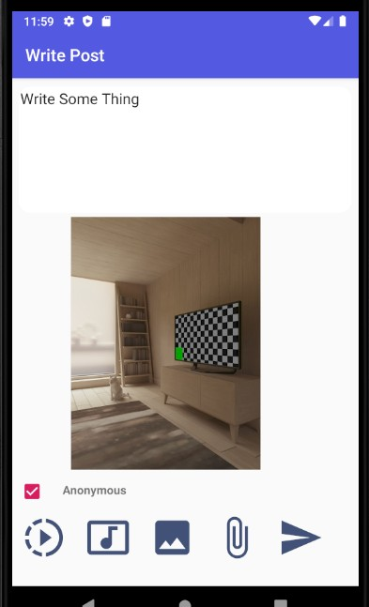
Write Post Activity
Exposure

Slide 16
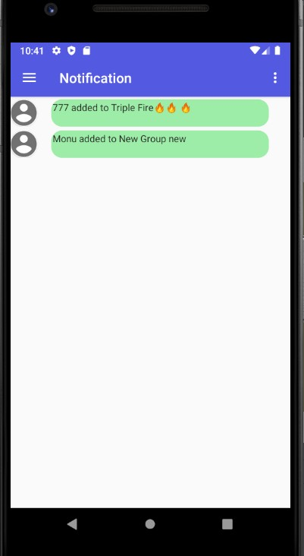
Notification Fragment
Exposure

Slide 17
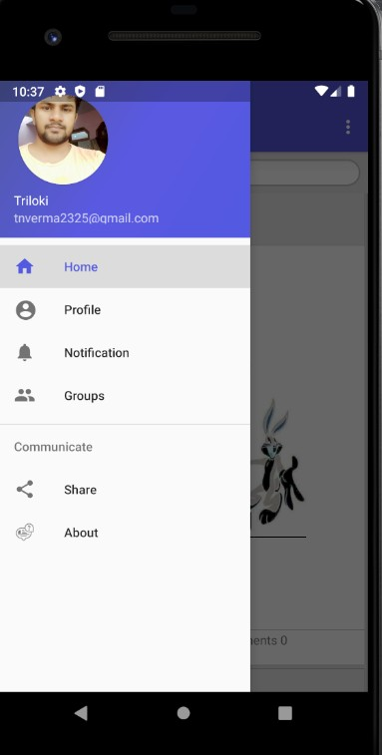
Navigation Bar
Exposure

Slide 18
Future Scope
Future Scope
The improvements can be done to this project which we could not do because of the time limit of the course. We can do the following improvements.
Sensitivity Analysis of the text post.
We can add peer to peer user communication (Audio and Video).
Also add functionality to manage image gallery based on some event via image processing.
Exposure

Slide 19
Conclusion
Conclusion
The project exposed us to the different technology in the field of android application development.
We face many challenge and problems during development time.and we learn a lot from these challenges and problems.
We got a experience in the field of android app development.
We acknowledged with great thanks to our project Supervisor “Dr. Dinesh Singh”for his most valuable suggestion and co-operations.
Exposure

Slide 20
Thank You
End
Exposure

