Slide 1

.

Slide 2
WHAT IS JQUERY
jQuery is a fast, small, and feature-rich JavaScript library.
It makes things like HTML document traversal and manipulation, event handling, animation, and Ajax much simpler with an easy-to-use API that works across a multitude of browsers.

Slide 3
WHY JQUERY
Lightweight : Less than 82KB in size (Minified and Gzipped)
CSS-like syntax – easy for developers/non-developers to understand
Cross Browser
(IE 6.0+, FF 2+, Safari 3.0+, Opera 9.0+, Chrome)

Slide 4
JQUERY IS CROSS-BROWSER
A huge issue facing JavaScript is that no two browsers handle JavaScript in the same way.
jQuery puts an end to that worry by giving you a common set of functions across all browsers.

Slide 5
















WHO’s USING JQUERY

Slide 6
MOST POPULAR LIBRARIES
YUI
Prototype
Dojo
Jquery
Mootools
ExtJS
Underscore

Slide 7
INITIAL REQUIREMENTS
JAVASCRIPT
A scripting language(client side mostly)
DOM
The way browser manipulates a web page in memory
HTML
A markup language for web page

Slide 8
ADVANTAGES
DOM MANIPULATION
DOM element selections functions
DOM traversal and modification
CROSS BROWSER
EVENT MANAGEMENT
SIMPLIFIED AJAX
EFFECTS AND ANIMATIONS
JAVASCRIPT PLUGINS

Slide 9
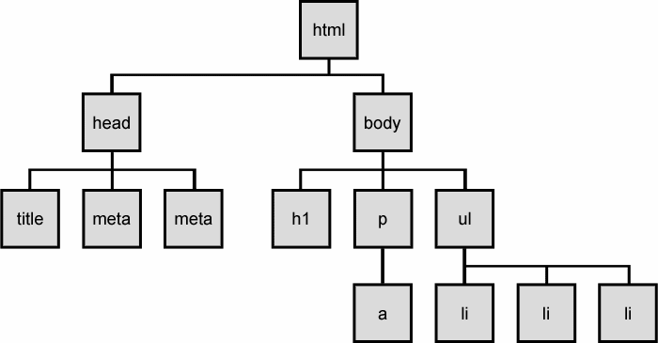
DOM TREE

Slide 10
JQUERY IN YOUR PAGE
<html>
<head>
<script src="path/to/jquery-x.x.js"></script>
<script>
$(document).ready(function(){
// Start here
});
</script>
</head>
<body> … </body>
</html>

Slide 11
JQUERY PHILOSOPHY
}
FIND SOME ELEMENTS
}
$(“div”).addClass(“xyz”);
Do something with them
jQuery Object

Slide 12
JQUERY HELLO WORLD EXAMPLE
<html>
<head>
<title>jQuery Hello World</title>
<script type="text/javascript" src="jquery-1.11.3.js"></script>
</head>
<script type="text/javascript">
$(document).ready(function(){
$(“p").html("Hello World !! (display due to jQuery)");
});
</script>
<body>
<p></p>
</body>
</html>

Slide 13
EASIER TO WRITE JQUERY THAN
PURE JAVASCRIPT

Slide 14
JQUERY SELECTORS
The jQuery selectors are one of the main feature in jQuery library.
These selectors uses CSS syntax to allow developer to easily identify the elements of page.
Note: For using JQuery library most effectively, you must be familiar with jQuery selectors.
Syntax pattern of jQuery selector :
$(selector).methodName();
The selector is a string expression that identify the element on which the method has to be implemented.
Examples
$("p").click();
$("p").hide();

Slide 15
JQUERY AND SELECTORS
Selector | Name | Description
#id | ID Selector | Selects a single element with the specified ID.
element | Type Selector | Selects all elements with the specified name.
.class | Class Selector | Selects all elements with the specified class.
* | All Selector | Selects all elements.
selector1, selector2, selectorN | Multiple /Compound selector | Selects the combined results of all the selectors.
ancestor descendant | descendant selector | Selects all elements that are descendants of a given ancestor. A descendant of an element could be a child, grandchild, great-grandchild, and so on, of that element.
parent > child | Child Selector | Selects all direct child elements specified by child of elements specified by parent.
previous + next | next adjacent selector | Selects all next elements matching "next" that are immediately preceded by a sibling "prev".
previous ~ siblings | next siblings selector | Selects all sibling elements that follow after the "prev" element, have the same parent, and match the filtering "siblings" selector.

Slide 16
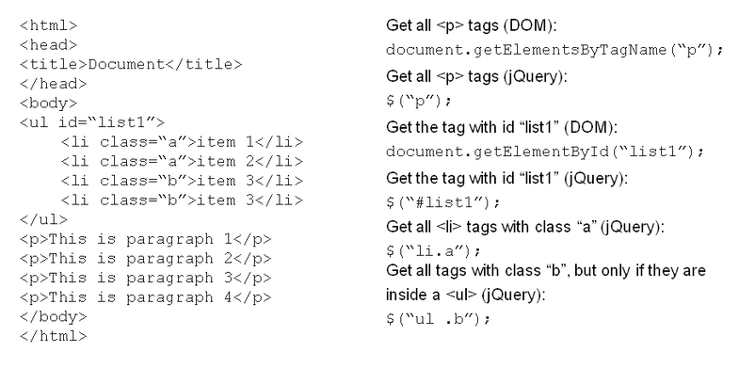
JQUERY / DOM COMPARISON

Slide 17
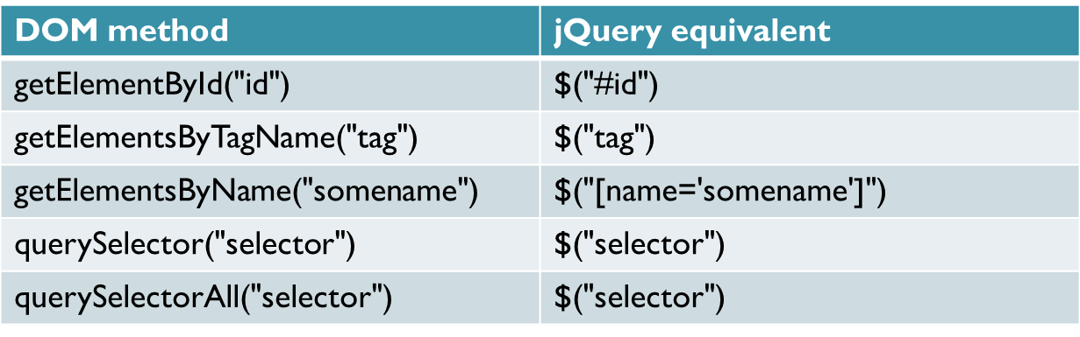
JQUERY / DOM COMPARISON

Slide 18
JQUERY / DOM COMPARISON
HIDE DIVS WITH PURE JAVASCRIPT
var divs = document.getElementByTagName('div');
for(i=0 ; i<=divs.length; i++){
Divs[ i ].style.display = 'none';
}
HIDE DIV WITH JQUERY
$(‘div’).hide();

Slide 19
JQUERY / DOM COMPARISON
SHOW/HIDE THE OLD WAY
<a href="#" onclick="toggle_visibility('foo');">Click here to toggle visibility of #foo</a>
function toggle_visibility(id) {
var e = document.getElementById(id);
if(e.style.display == 'block')
e.style.display = 'none';
else
e.style.display = 'block';
}

Slide 20
JQUERY / DOM COMPARISON
$(document).ready(function(){
$("a").click(function(){
$("#more").toggle("slow");
return false;
});
});

Slide 21
JQUERY AND SELECTORS

Slide 22
JQUERY AND SELECTORS
SELECT BY ID
// Select By ID
<div id=”foo”></div>
<div></div>
$(‘#foo’);
<div id=”foo”></div>
<div></div>

Slide 23
JQUERY AND SELECTORS
SELECT BY CLASS
// Select by class
<div class=”myClass foo bar”></div>
<div class=”baz myClass”></div>
<div class=”bar”></div>
$(‘.myClass’)
<div class=”myClass foo bar”></div>
<div class=”baz myClass”></div>
<div class=”bar”></div>

Slide 24
JQUERY AND SELECTORS
SELECT BY TAG
// Select by tag
<ul>
<li>Apple</li>
<li>Pear</li>
</ul>
$(“li”);
<ul>
<li>Apple</li>
<li>Pear</li>
</ul>

Slide 25
JQUERY AND SELECTORS
COMPOUND SELECTORS
<p class=”important”></p>
<p></p>
<p class=”warning”></p>
<p class=”important warning”></p>
$(‘p.important,p.warning’);
<p class=”important”></p>
<p></p>
<p class=”warning”></p>
<p class=”important warning”></p>

Slide 26
JQUERY AND SELECTORS
DESCENDANT SELECTOR (“ancestor descendant”)
<form>
<label>Child:</label>
<input name="name" />
<fieldset>
<label>Grandchild:</label>
<input name="newsletter" />
</fieldset>
</form>
Sibling to form: <input name="none" />
<script>$("form input").css("border", "2px dotted blue");</script>

Slide 27
JQUERY AND SELECTORS
CHILD SELECTOR
<ul class="topnav">
<li>Item 1</li>
<li>Item 2
<ul>
<li>Nested item 1</li>
<li>Nested item 2</li>
<li>Nested item 3</li>
</ul>
</li>
<li>Item 3</li>
</ul>
<script>$("ul.topnav > li").css("border", "3px double red");</script>

Slide 28
JQUERY AND SELECTORS
NEXT ADJACENT SELECTOR
<form> <label>Name:</label> <input name="name" />
<fieldset> <label>Newsletter:</label> <input name="newsletter" /> </fieldset>
</form> <input name="none" />
<script>$("label + input").css("color", "blue").val("Labeled!")</script>

Slide 29
JQUERY AND SELECTORS
NEXT SIBLINGS SELECTOR
<div>div (doesn't match since before #prev)</div> <span id="prev">span#prev</span> <div>div sibling</div> <div>div sibling <div id="small">div niece</div></div> <span>span sibling (not div)</span> <div>div sibling</div>
<script>
$("#prev ~ div").css("border", "3px groove blue");
</script>

Slide 30
JQUERY AND ATTRIBUTE SELECTORS
Selector | Description
E[a] | Selects all the elements E that have an attribute 'a' of any value.
E[a=v] | Selects all the elements E that have an attribute 'a' whose value is exactly 'v'.
E[a^=v] | Selects all the elements E that have an attribute 'a' whose value starts with 'v'.
E[a$=v] | Selects all the elements E that have an attribute 'a' whose value ends with 'v'.
E[a*=v] | Selects all the elements E that have an attribute 'a' whose value contains 'v'.

Slide 31
JQUERY FILTERS

Slide 32
JQUERY FILTERS
Selector | Description
:first | Selects the first selected element in the page.
:last | Selects the last selected element in the page.
:not(selector) | Removes all elements matching the specified selector.
:even | Selects even elements.
:odd | Selects odd elements.
:eq(index) | Selects a single element by its index number.
:gt(index) | Selects all elements with an index number greater than the specified one.
:lt(index) | Selects all elements with an index number less than the specified one.
:header | Selects all elements that are headers, such as h1, h2, and h3.
:hidden | Selects all elements that are hidden.
:visible | Selects all elements that are visible.
:first-child | Selects all elements that are the first child of their parents.
:last-child | Selects all elements that are the last child of their parents.

Slide 33
JQUERY FILTERS
Selector | Description
:input | Selects all input elements.
:text | Selects all input elements of type text.
:radio | Selects all input elements of type radio.
:checkbox | Selects all input elements of type checkbox.
:enabled | Selects all elements that are enabled.
:disabled | Selects all elements that are disabled.
:checked | Selects all elements that are checked.
:selected | Selects all elements that are selected.

