Slide 1
Farmer‐Connection
Software Requirements Specification (SRS)

Slide 2
Farmer‐Connection
Introduction:
The purpose of this website is to help farmers in gaining knowledge, connecting with experts to improve their crops, sharing their success stories, buying agricultural items, and to sell their produce. This must be a responsive website optimized for viewing on desktops, mobiles and tablets.

Slide 3
Requirements - User Profile
It must provide users to register an account by creating a profile. The profile must include name, email, mobile number, location (city, state, country), profession (farmer, academics, consultant, other), level of expertise (expert, intermediate, beginner), picture, etc. When displaying the profile, it must show the join date, number of posts, number of likes, links to latest posts made by user, etc. The user must be able to change or reset his password.

Slide 4
Requirements - Discussion Forum
The admin must be able to create categories and sub-categories for discussion.
The user must be able to start a new discussion thread.
The user must be able to post on the selected categories or reply to any discussion thread.
The admin must be able to delete any inappropriate discussion thread or move it to another appropriate category.
The users must be able to search in the discussion forums.
Latest posts must be visible on sidebar section.

Slide 5
Requirements - Knowledge Base
The admin must be able to create categories and sub-categories.
The user must be able to post a blog on a specific topic under the selected category.
The user must be able to include videos, audio, pictures, PowerPoint presentations, Word documents, etc. in the blog to illustrate the topic matter.
The user must be able to tag the blog as Farmer Experience, Success Stories, etc.
There must be an option for users to comment on the blog.
The admin must be able to delete any inappropriate posts or comments.
The users must be able to search in the knowledge base.
Latest posts must be visible on the sidebar section.

Slide 6
Requirements - Consultancy Services
The admin must be able to create categories and sub-categories.
The user must be able to register as a consultant for providing expertise to other users on a voluntary basis.
The admin will review and approve the profile to appear on the website in the appropriate categories.

Slide 7
Requirements - E-Commerce
The admin must be able to create categories and sub-categories.
The admin must be able to post items for sale under appropriate categories. The posts can include list of photos, product specifications, price, contact email for seller, etc.
The admin must be able to remove / inactivate posted items.
The users must be able to search in the online store.
The farmer must be able to post his produce for sale. He must be able to remove his post at any time.
The admin must be able to remove any inappropriate post.
The system must automatically remove any post older than a predefined number of days.

Slide 8
Requirements - E-Commerce
When it comes to e-commerce websites, it's all about functionality, features, and design.
This E-Commerce software application is used for online shopping, this software consist of web platform. Store owner/administrator should be able to add and remove products and view reporting about sell and order etc. Customer can view products and purchase from web.
Ability to select options such as featured, free shipping, reviews/comments allowed.
Add and manage main product image and additional product images.
All Products will be displayed on front end of site category wise, and when customer click on any product it displays detailed page of the product.

Slide 9
Requirements - E-Commerce
Featured products on the shop page.
Set products as “active” or “inactive”.
Add products to a single category or multiple categories.
Add and manage related products.
Manage (approve and delete) product reviews/comments.
View customer details and orders.
View individual customers product reviews/comments.
“Active” or “Inactive” customer accounts.

Slide 10
Requirements - E-Commerce
Search and sort to easily find orders by specific variables/attributes.
Manage and updated order status.
View order information and purchase details (products, shipping, addresses, etc.).
Administrator can view/search/generate reports of orders and their sales.
Date range reports include: top selling product by date range, low inventory by quantity and new customer by date range.
There should be a search area on shop page, for search a product by name or category.
The system shall allow user to cancel the order.

Slide 11
Requirements - E-Commerce
The system shall allow user to change shipping, payment method.
The system shall display both the active and completed order history in the customer profile.
The system shall display the detailed information about the selected order.
The system shall display available payment methods for payment.
The system shall allow user to select the payment method for order.
The system shall provide shopping cart during online purchase.
User can view products and have option to add to cart products.
Users can add/edit/remove products from cart.

Slide 12
Requirements - E-Commerce
When user process their orders for checkout and payment, there should be login and create my account option.
User should insert their personal information to create an account.
The system shall allow user to update the profile information.
Register customer can login with their email and password to compete their order process.
System should maintain the purchasing/ordering history for registered users.

Slide 13
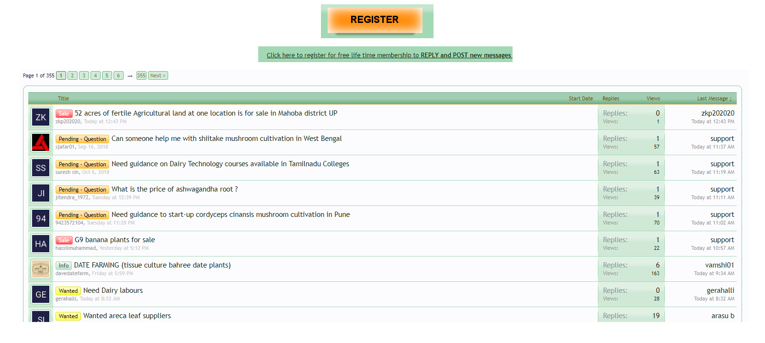
discussion forum

Slide 14
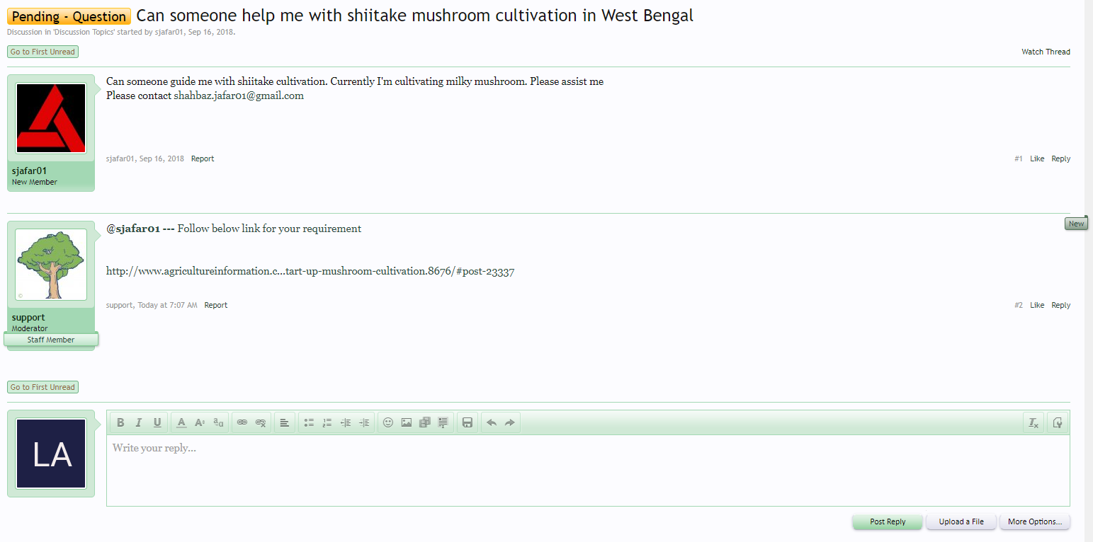
discussion forum
The discussion forum registration must include Image, First & Last Name, E-Mail Address, Telephone, Username, Password, Occupation, Address etc.

Slide 15
Requirements - PhoneGap mobile app
Use Framework7 to Build Hybrid Mobile APP (Farmer‐Connection) for Android.
Add custom splash screen and icon to PhoneGap (Farmer‐Connection) APP.
Farmer‐Connection APP should be based on all the plugins listed below.
Battery Status
Camera
Whitelist
Dialogs
Device
Geolocation
Contacts

Slide 16
Requirements - PhoneGap mobile app
PHP REST API for user Registration, Login, Logout & User Profile.
PHP REST API for Discussion Forum, Knowledge Base, Consultancy Services & E-Commerce can do the same functionality likewise mentioned for the web-based environment.
User must be able to buy items from the APP Store and can book the order and can review the order details and history.
User can save Farmers & Consultants profile data like a phone book contact in their phone via APP.
The user specifically if the seller wants to sell a new product, then the seller must be able to add a new product item directly from the APP via a REST API and can take a picture of the product via phone camera/gallery and can trace the location name and other details via GPS coordinates, latitude and longitude.

Slide 17
Farmer‐Connection Deadlines and Milestones :
S.NO | Project Section | Last Date
1 | Brainstorming + ERD | January 01, 2020
2 | Frontend Design | January 02, 2020
3 | Project Checking Phase: Presentation/Progress | January 15, 2020
4 | Whole Project Checking + Presentation | 27 to 30 January, 2020
5 | Farewell | January 31, 2020

