Slide 1

DEPARTMENT OF CSE
Project Synopsis Presentation
AegisAI
A Trust-Aware Security Gateway for RAG-Powered Agentic AI
“Trust the knowledge. Control the action.”
Submitted by: Kartik Ghansela And Mudita Jain
Roll No: 26082 & 26111
Branch: Computer Science
Semester: VII
Batch: 2023-2027
Submitted to: Dr. Ashima Mehta (HOD)
Mentor: Vimmi Malhotra
Dronacharya College of Engineering, Gurugram

Slide 2


The Problem & Motivation
LLM agents now read untrusted text — and hold real power.
threat
UNTRUSTED TEXT
users · docs · web
Prompt
injection
They ingest user messages, documents and web pages — any of which can carry hidden instructions.
They also hold real capabilities: databases, email, the web, code execution.
Prompt injection turns that untrusted text into unauthorized actions.
The model cannot be the security boundary — it can be fooled perfectly.
LLM AGENT
plans & acts
REAL CAPABILITIES
DB · email · web · code
Design principle The brain proposes; the gateway disposes.
Fig 1.1 — Injected text becomes action.

Slide 3
End-to-End Architecture
USER
“Summarize invoices & flag issues”
TASK & POLICY ENGINE
POLICY STORE
intent · permissions · destinations
agent/tool/data policies
KNOWLEDGE LAYER
RAG TRUST GATEWAY
TRUSTED
docs · web · PDF
email · DB
Provenance · Instruction · Semantic
→ Trust Engine
SUSPICIOUS
BLOCK
AI AGENT
LLM + RAG · reasoning · planning → tool proposal
AGENT SECURITY FIREWALL
ALLOW
Tool Auth · Parameter · Data-Flow
→ Risk Engine
CONFIRM
BLOCK
TOOLS / APIs
SECURITY AUDIT
SOC DASHBOARD
Fig 1.2 — End-to-end architecture: trust the knowledge, then control the action.

Slide 4
Request Lifecycle — Defense in Depth
USER / API
GUARD INPUT
GUARDED RETRIEVAL
PLAN
JWT · roles
firewall · suspension
RAG · trust-scored
Ollama brain · proposes
RESPONSE
OUTPUT DLP
HUMAN APPROVAL
TOOL GATEWAY
audited · trust updated
redact · leak check
high-impact actions
6 checks · deny-by-default
Trust score every layer is audited and moves one running trust score · deny-by-default · the model is not a security boundary.
Fig 1.3 — Request pipeline: screen every channel the model reads; decide every tool call at a deny-by-default gateway.

Slide 5
Component Model
«interface»
SecurityEngine
«service»
TrustGateway
«service»
AgentFirewall
+ trust_threshold: float
+ policies: PolicyStore
+ checks: Check[3]
+ rules: Policy[]
+ screen(source)
+ classify() : Verdict
+ authorize(tool)
+ decide() : Action
+ evaluate_input(text)
+ decide_tool_call(req)
+ score_trust() : float
«abstract»
AuditLog
«store»
SessionStore
«realizes»
PostgresAuditLog
+ max_events: int
+ sessions: Map
+ engine: Engine
+ record_event(e)
+ list_events(f)
+ summary()
+ create(p, a)
+ append_turn(t)
+ list() : Session[]
+ _store_event(e)
+ flush()
«realizes»
Fig 1.4 — Core security components. The single SecurityEngine holds all decision logic; adapters only translate to its event model.

Slide 6
Technology Used
Presentation
React
19.3.0
TypeScript
7.0.2
Tailwind CSS
4.3.3
Recharts
3.10.1
Security Middleware
FastAPI
0.142.2
JWT Auth · PyJWT
2.15.1
Interception
Custom middleware
Firewall Engine
Custom
Agent & AI
LangGraph
1.2.12
LangChain Core
1.6.6
Ollama
0.35.1
Knowledge / RAG
Custom RAG pipeline
in-repo
pypdf ingestion
Sentence-Transformers
optional ML
Data
PostgreSQL
16
pgvector
0.5.0
SQLAlchemy
2.0.54
Alembic
1.20.0
Platform
Docker
Docker Compose
Git / GitHub
GitHub Actions CI
Fig 2.1 — Layered technology stack (core: Python · FastAPI · PostgreSQL / pgvector · React).

Slide 7
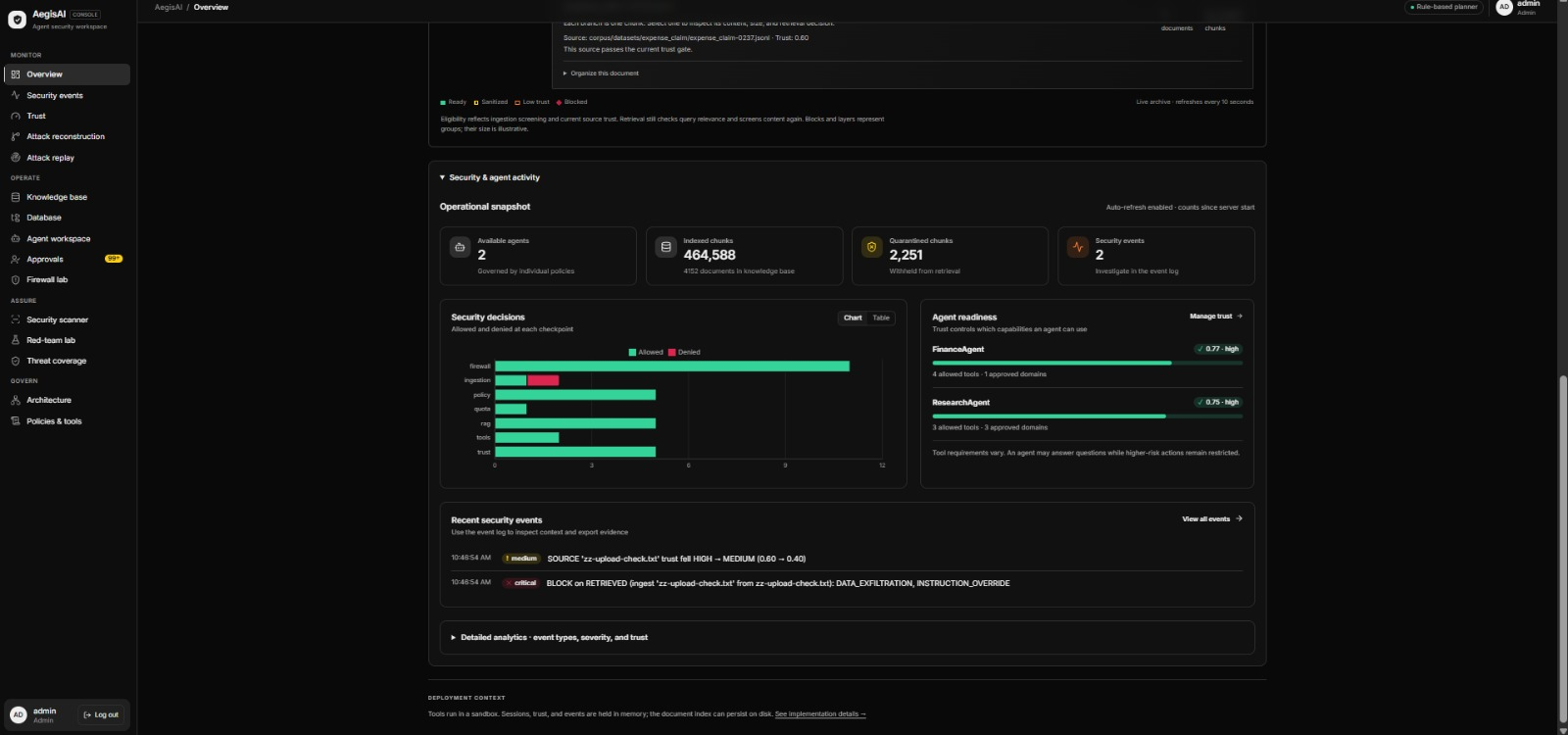
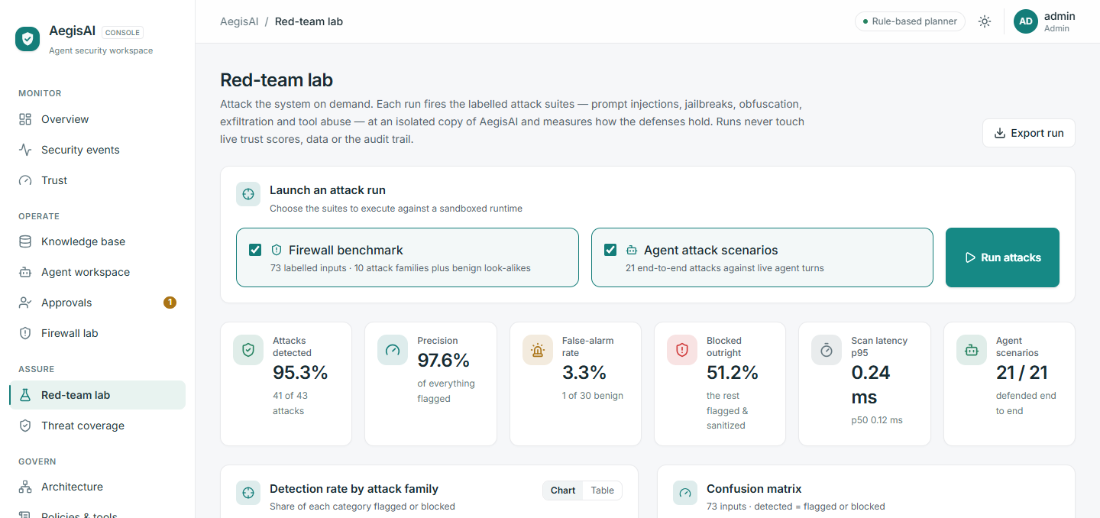
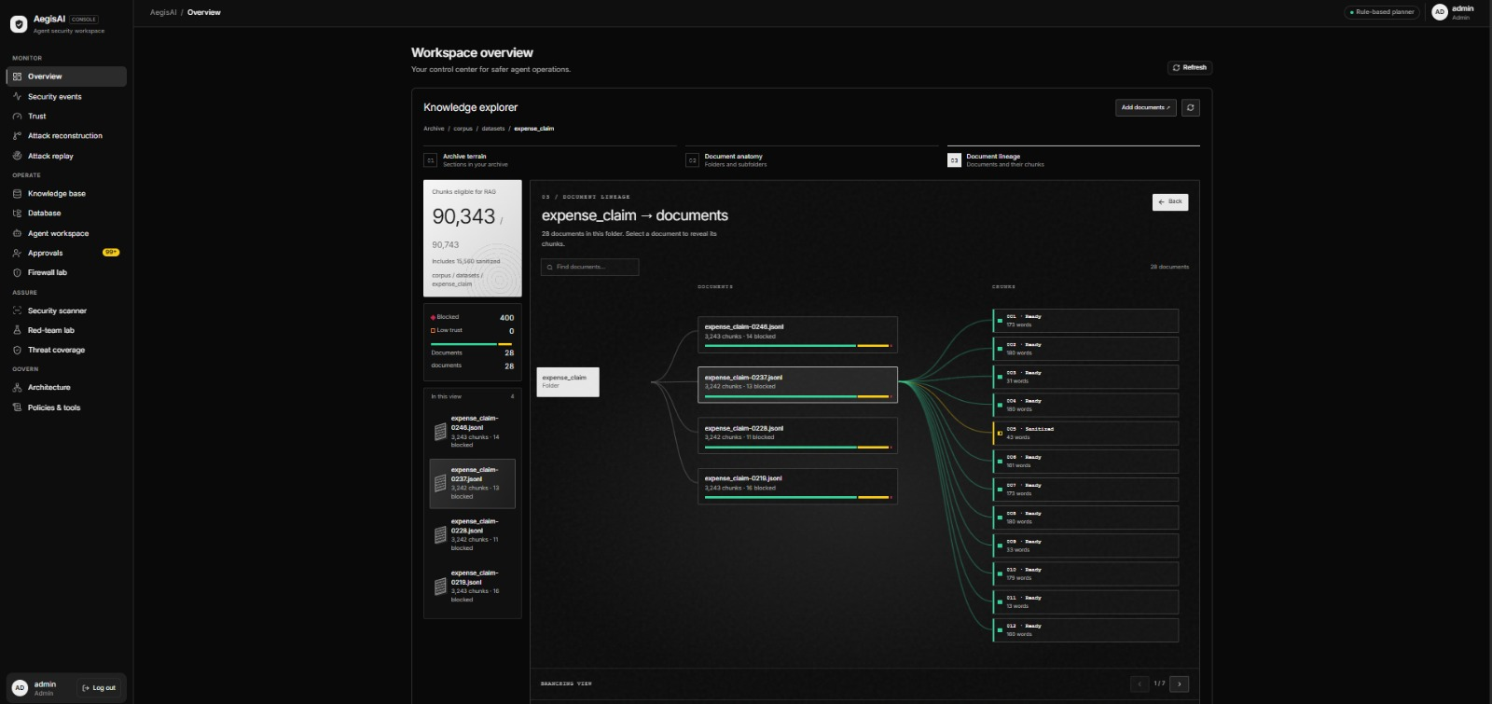
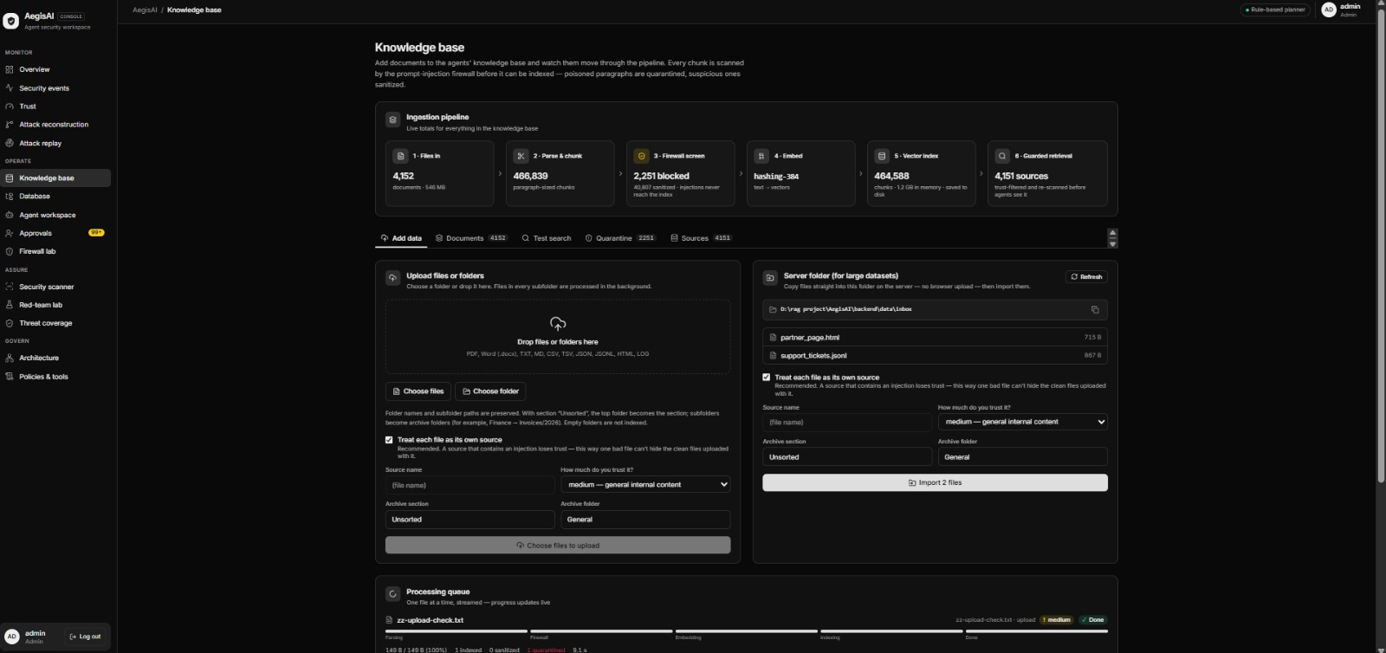
Operator Console — Frontend
A single light, airy operator dashboard across 11 pages — live trace, trust, red-team and threat coverage.
Overview tab
Overview
Knowledge base

Slide 8
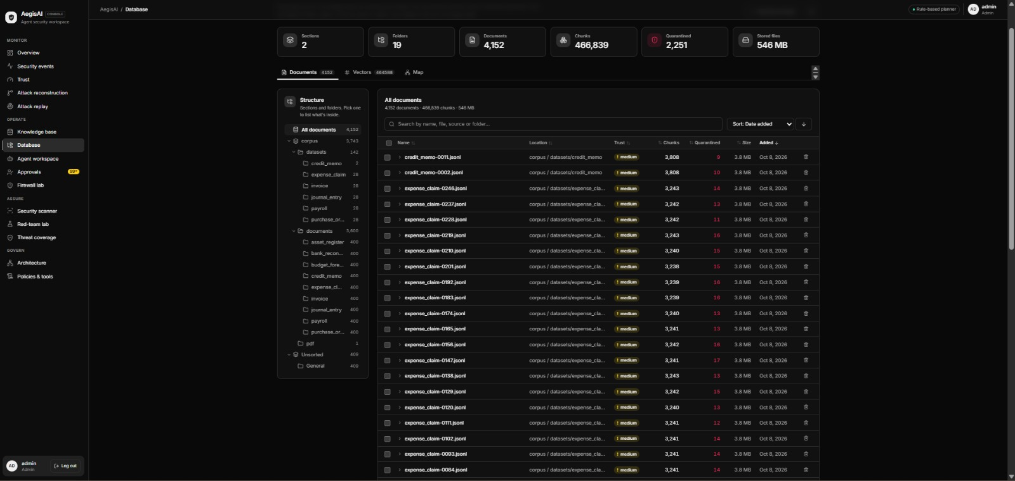
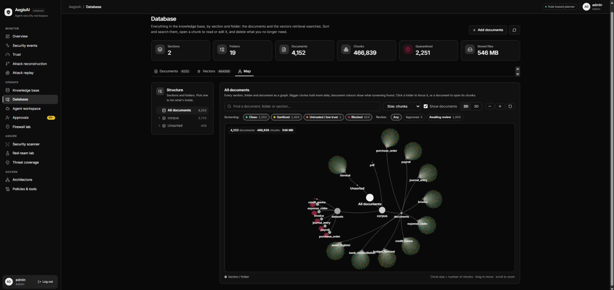
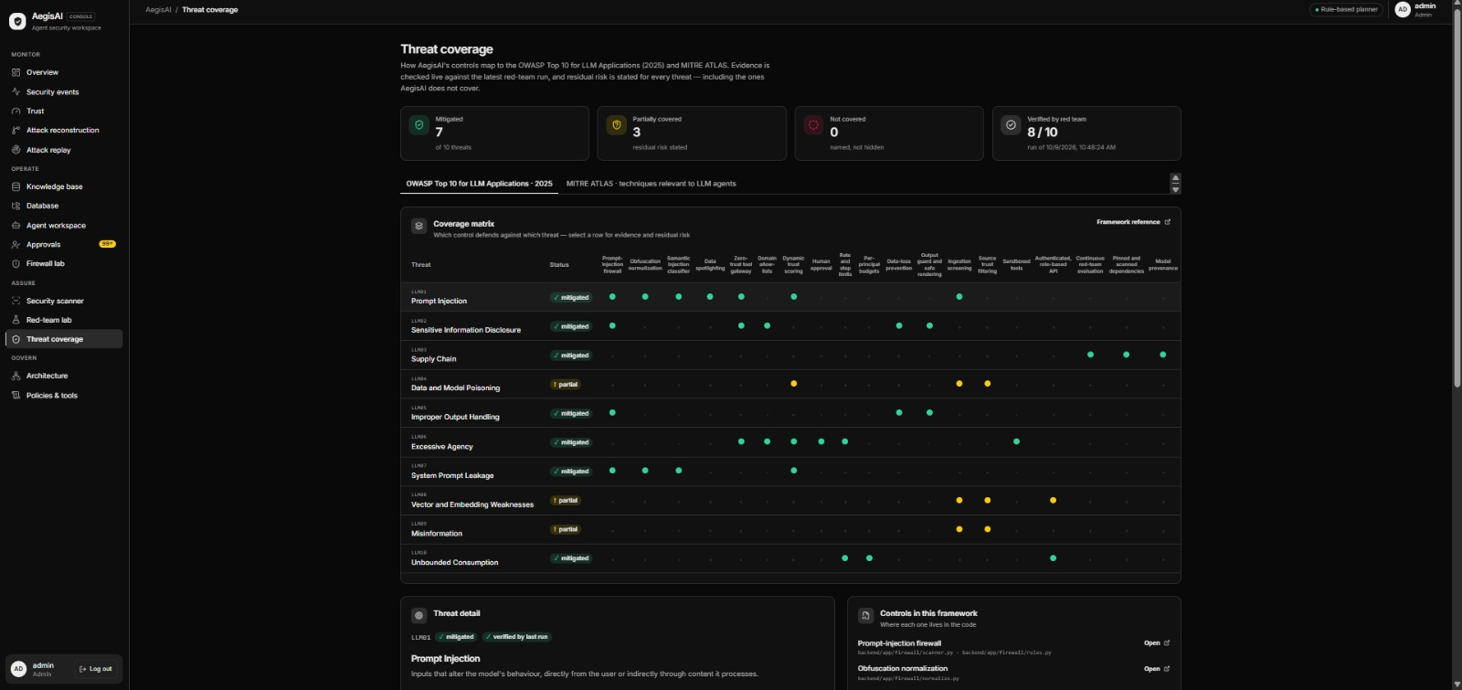
Operator Console — Frontend
A single light, airy operator dashboard across 11 pages — live trace, trust, red-team and threat coverage.
Database tab
Database – 2D visualization
Threat coverage

Slide 9






Future Work
Where AegisAI goes next — closing the gap between measured today and production-grade tomorrow.
Close the generalization gap
Full standards coverage
Improve the semantic firewall and add adversarial training to lift held-out recall (45% → 80%+).
Complete OWASP LLM Top 10 (2025) and broaden MITRE ATLAS, with automated residual-risk reports.
Multi-agent & richer tools
Production hardening
Policy-aware gateway for multi-agent workflows and an expanded tool / plugin registry.
Managed deployment, SIEM / observability export, and verified performance under load.
Autonomous red-teaming
Model-agnostic brains
Risk-guided fuzzing that feeds newly found attack signatures back into the firewall.
Pluggable local + hosted LLM backends with per-model trust calibration.

