Slide 1
Classification

Slide 2
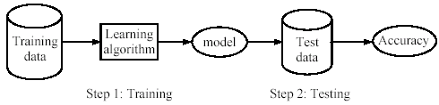
Supervised learning process: two steps
Learning (training): learn a model via the training data
Testing: test the model via test data and evaluate the model accuracy

Slide 3
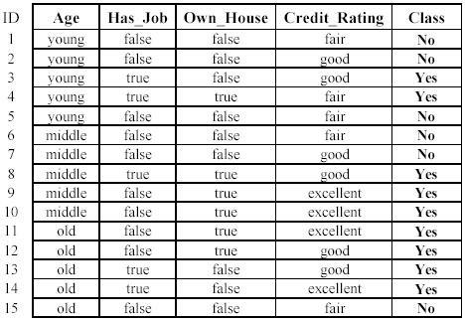
A decision tree from the loan data

Slide 4
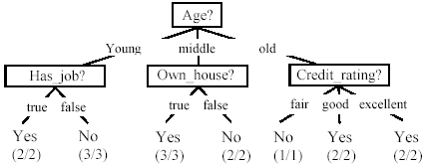
A decision tree from the loan data
Decision nodes and leaf nodes (classes)

Slide 5



Use the decision tree

Slide 6
Another example
Test Data
Home Owner
Yes
No
NO
MarSt
Single, Divorced
Married
Income
NO
< 80K
> 80K
NO
YES

Slide 7
Decision Tree Induction
Many Algorithms:
Hunt’s Algorithm (one of the earliest)
CART
ID3, C4.5
SLIQ,SPRINT

Slide 8
General Structure of Hunt’s Algorithm
Let D_{t} be the set of training records that reach a node t
General Procedure:
If D_{t} contains records that belong the same class y_{t}, then t is a leaf node labeled as y_{t}
If D_{t} contains records that belong to more than one class, use an attribute test to split the data into smaller subsets. Recursively apply the procedure to each subset.
D_{t}
?

Slide 9
Design Issues of Decision Tree Induction
How should training records be split?
Method for expressing test condition
depending on attribute types
Measure for evaluating the goodness of a test condition
How should the splitting procedure stop?
Stop splitting if all the records belong to the same class or have identical attribute values
Early termination

Slide 10
Methods for Expressing Test Conditions
Depends on attribute types
Binary
Nominal
Ordinal
Continuous

Slide 11
Test Condition for Nominal Attributes
Multi-way split:
Use as many partitions as distinct values.
Binary split:
Divides values into two subsets

Slide 12
Test Condition for Ordinal Attributes
Multi-way split:
Use as many partitions as distinct values
Binary split:
Divides values into two subsets
Preserve order property among attribute values
This grouping violates order property

Slide 13
Test Condition for Continuous Attributes

Slide 14



Splitting Based on Continuous Attributes
Different ways of handling
Discretization to form an ordinal categorical attribute
Ranges can be found by equal interval bucketing, equal frequency bucketing (percentiles), or clustering.
Static – discretize once at the beginning
Dynamic – repeat at each node
Binary Decision: (A < v) or (A ≥ v)
consider all possible splits and finds the best cut
can be more compute intensive

Slide 15
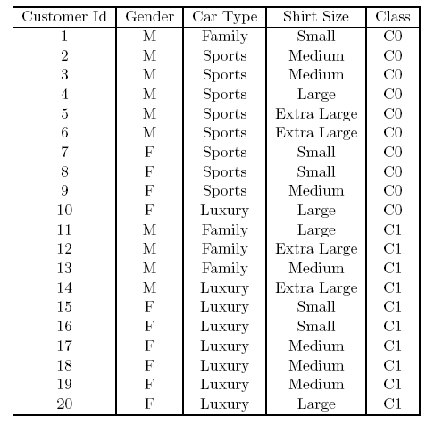

How to determine the Best Split
Before Splitting: 10 records of class 0 (c0), 10 records of class 1 (c1)
What are the values of the label for this data? How many cases / records for each label.
Learn the type of each attribute / feature, their values.
Which test condition is the best?

Slide 16
How to determine the Best Split
Greedy approach:
Nodes with purer class distribution are preferred
Need a measure of node impurity:
How to define what is purer or not
High degree of impurity
Low degree of impurity

Slide 17
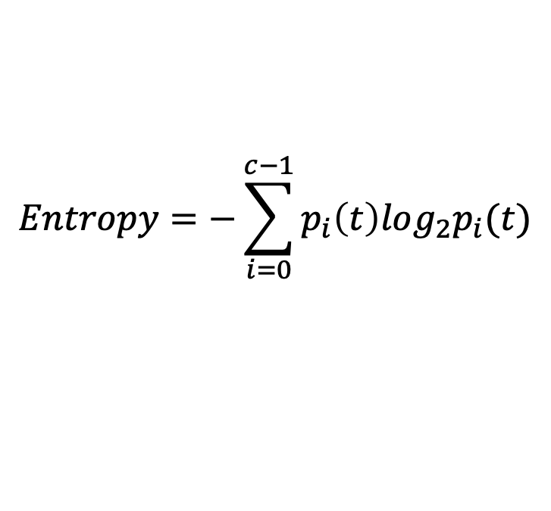
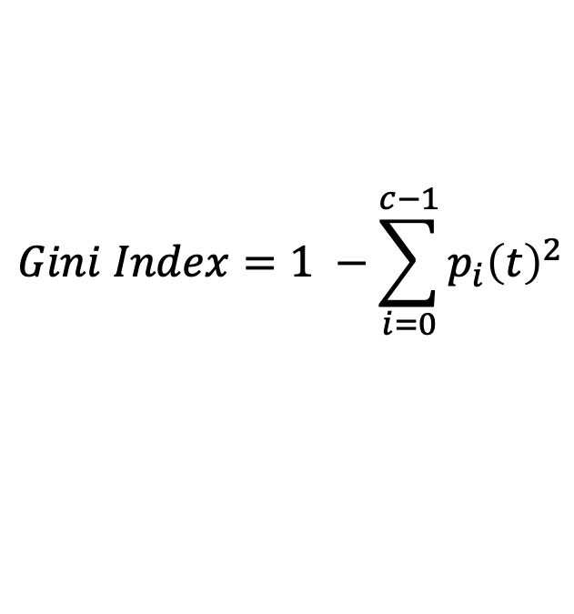
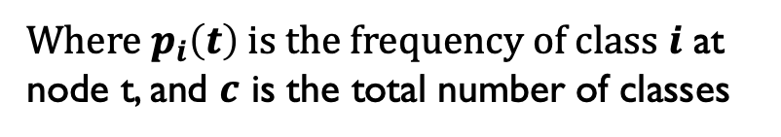
Measures of Node Impurity
Gini Index
Entropy
Misclassification error (confusing matrix for decision tree)
$$Gini Index=1 −\sum_{i=0}^{c−1}{p_{i}{\left(t\right)}^{2}}$$
Where $p_{i}\left(t\right)$ is the frequency of class $i$ at node t, and $c$ is the total number of classes
$$Entropy=−\sum_{i=0}^{c−1}{p_{i}\left(t\right)log_{2}p_{i}(t)}$$
$$Classification error={1 −max⁡[p}_{i}(t)]$$

Slide 18
Finding the Best Split
Compute impurity measure (P) before splitting
Compute impurity measure (M) after splitting
Compute impurity measure of each child node
M is the weighted impurity of child nodes
Choose the attribute test condition that produces the highest gain
Gain = P - M or equivalently, lowest impurity measure after splitting (M)

Slide 19
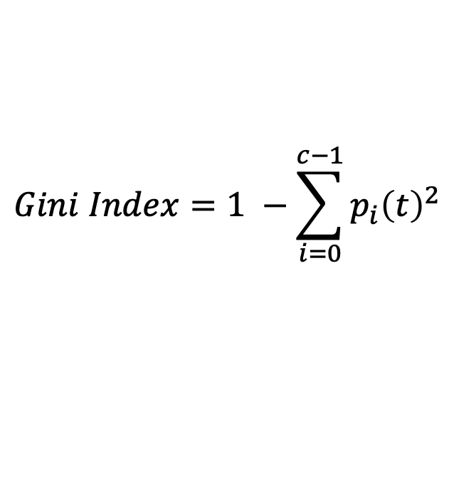


Gini Index
What is Gini Index?
Gini index or Gini impurity measures the degree or probability of a particular variable being wrongly classified when it is randomly chosen.
But what is actually meant by ‘impurity’?
If all the elements belong to a single class, then it can be called pure.
The degree of Gini index varies between 0 and 1, 0: all elements belong to a certain class or if there exists only one class, and 1: the elements are randomly distributed across various classes.
A Gini Index of 0.5 denotes equally distributed elements into some classes.
$$Gini Index=1 −\sum_{i=0}^{c−1}{p_{i}{\left(t\right)}^{2}}$$

Slide 20
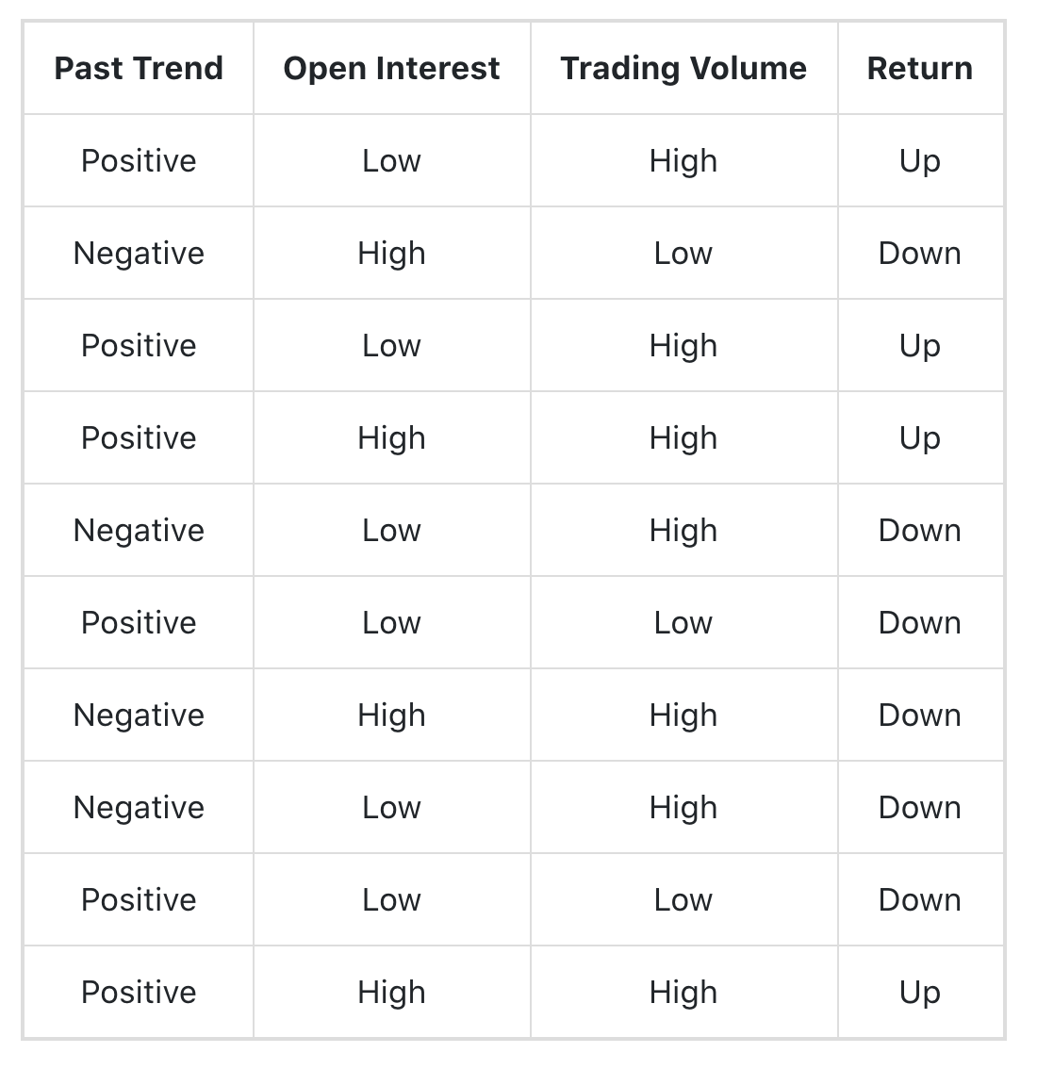

Example of Gini Index
P(Past Trend=Positive): 6/10
P(Past Trend=Negative): 4/10
If (Past Trend = Positive & Return = Up), probability = 4/6
If (Past Trend = Positive & Return = Down), probability = 2/6
Gini index = 1 - ((4/6)^2 + (2/6)^2) = 0.45
If (Past Trend = Negative & Return = Up), probability = 0
If (Past Trend = Negative & Return = Down), probability = 4/4
Gini index = 1 - ((0)^2 + (4/4)^2) = 0
Weighted sum of the Gini Indices can be calculated as follows:
Gini Index for Past Trend = (6/10)0.45 + (4/10)0 = 0.27
G(PT) = P(PT=P)*G(PT=P) + P(PT=N)*G(PT=N)

Slide 21
Finding the Best Split
Before Splitting:
P
A?
B?
Yes
No
Yes
No
Node N1
Node N2
Node N3
Node N4
M11
M12
M21
M22
M1
Gain = P – M1 vs P – M2
M2

Slide 22
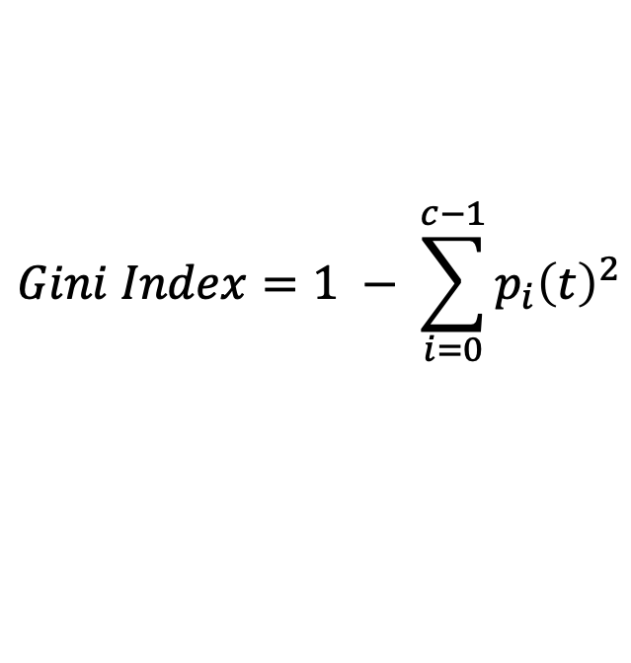
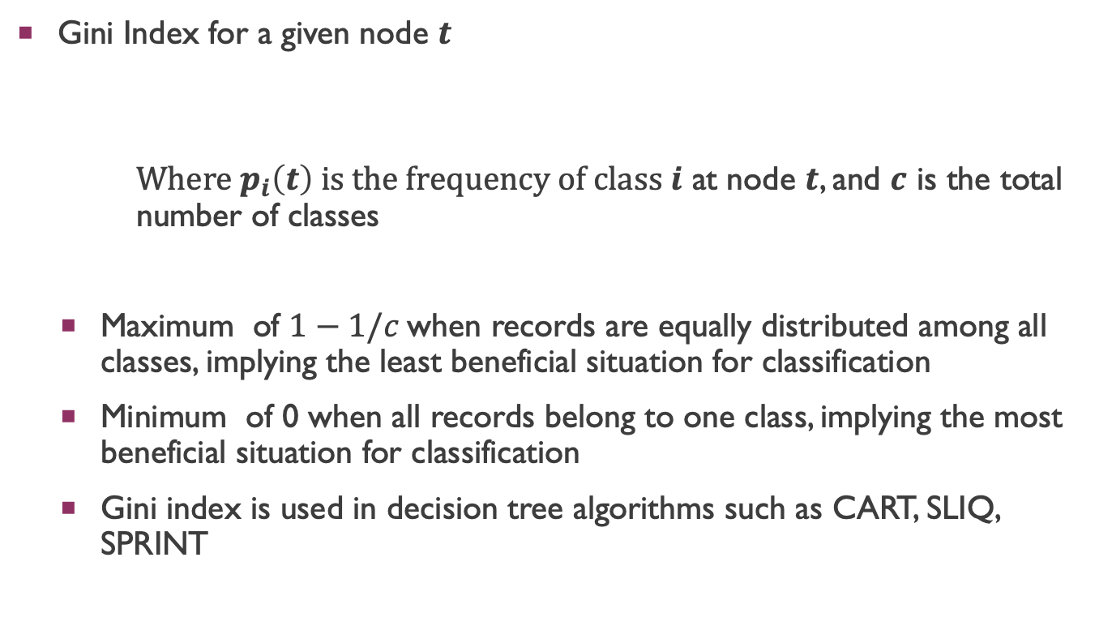
Measure of Impurity: GINI
$$Gini Index=1 − \sum_{i=0}^{c−1}{p_{i}{\left(t\right)}^{2}}$$
Gini Index for a given node $t$
Where $p_{i}\left(t\right)$ is the frequency of class $i$ at node $t$, and $c$ is the total number of classes
Maximum of $1−1/c$when records are equally distributed among all classes, implying the least beneficial situation for classification
Minimum of 0 when all records belong to one class, implying the most beneficial situation for classification
Gini index is used in decision tree algorithms such as CART, SLIQ, SPRINT

Slide 23
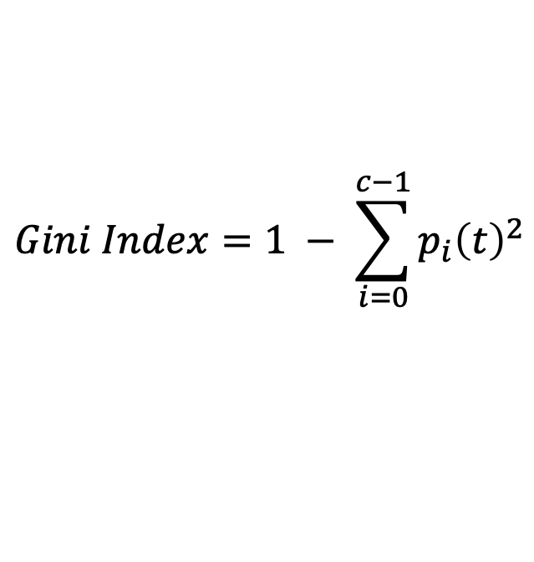
Measure of Impurity: GINI
Gini Index for a given node t :
For 2-class problem (p, 1 – p):
GINI = 1 – p² – (1 – p)² = 2p (1-p)
$$Gini Index=1 − \sum_{i=0}^{c−1}{p_{i}{\left(t\right)}^{2}}$$

