Slide 1
clustering

Slide 2
What is Cluster Analysis?
Given a set of objects, place them in groups such that:
the objects in a group are similar (or related)
different from (or unrelated to) the objects in other groups
Inter-cluster distances are maximized
Intra-cluster distances are minimized

Slide 3
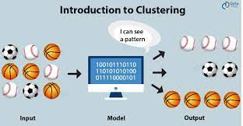
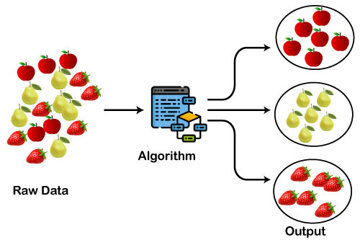
Applications of Cluster Analysis
Understanding
Group related documents for browsing, group genes and proteins that have similar functionality, or group stocks with similar price fluctuations
Summarization
Reduce the size of large data sets

Slide 4
Notion of a Cluster can be Ambiguous
How many clusters?
Six Clusters
Two Clusters
Four Clusters

Slide 5
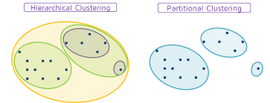
Types of Clusterings
A clustering is a set of clusters
Important distinction between hierarchical and partitional sets of clusters
Partitional Clustering
A division of data objects into non-overlapping subsets (clusters)
Hierarchical clustering
A set of nested clusters organized as a hierarchical tree

Slide 6
Partitional Clustering
Original Points
A Partitional Clustering

Slide 7
Hierarchical Clustering
Traditional Hierarchical Clustering
Traditional Dendrogram
Non-traditional Hierarchical Clustering
Non-traditional Dendrogram

Slide 8
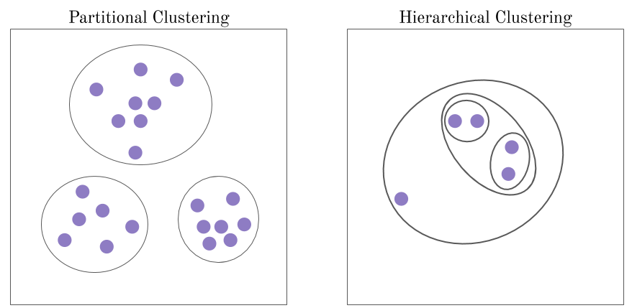
Types of Clustering

Slide 9
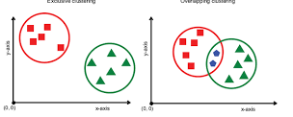
Other Distinctions Between Sets of Clusters
Exclusive versus non-exclusive
non-exclusive clustering:
points may belong to multiple clusters.
an belong to multiple classes or could be ‘border’ points
fuzzy clustering : a point belongs to every cluster with some weight between 0 and 1
weights sum to 1
probabilistic clustering has similar characteristics
Partial versus complete
Partial: only cluster some of the data

Slide 10
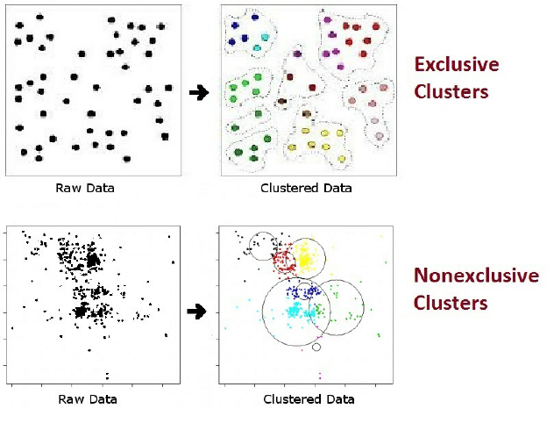
Other Distinctions Between Sets of Clusters

Slide 11
Types of Clusters
Well-separated clusters
Prototype-based clusters
Contiguity-based clusters
Density-based clusters
Described by an Objective Function

Slide 12
Types of Clusters: Well-Separated
Well-Separated Clusters:
A cluster is a set of points such that any point in a cluster is closer to every other point in the cluster than to any point not in the cluster.
3 well-separated clusters

Slide 13
Types of Clusters: Prototype-Based
Prototype-based
A cluster is a set of objects such that an object in a cluster is closer (more similar) to the prototype or “center” of a cluster, than to the center of any other cluster
centroid, the average of all the points in the cluster,
medoid, the most “representative” point of a cluster
4 center-based clusters

Slide 14
Types of Clusters: Contiguity-Based
Contiguous Cluster (Nearest neighbor or Transitive)
A cluster is a set of points such that a point in a cluster is closer to one or more other points in the cluster than to any point not in the cluster.
8 contiguous clusters

Slide 15
Types of Clusters: Density-Based
Density-based
A cluster is a dense region of points, which is separated by low-density regions, from other regions of high density.
Used when the clusters are irregular or intertwined, and when noise and outliers are present.
6 density-based clusters

Slide 16
Types of Clusters: Objective Function
Clusters Defined by an Objective Function
Finds clusters that minimize or maximize an objective function.
Enumerate all possible ways of dividing the points into clusters
Evaluate the goodness of each potential set of clusters.
Objectives can be global or local
Hierarchical clustering algorithms typically have local objectives
Partitional algorithms typically have global objectives

Slide 17
Characteristics of the Input Data Are Important
Type of proximity or density measure
Central to clustering
Depends on data and application
Data characteristics that affect proximity and/or density are
Dimensionality
Sparseness
Attribute type
Special relationships in the data
For example, autocorrelation
Distribution of the data
Noise and Outliers
Often interfere with the operation of the clustering algorithm
Clusters of differing sizes, densities, and shapes

Slide 18
Clustering Algorithms
K-means and its variants
Hierarchical clustering
Density-based clustering

Slide 19
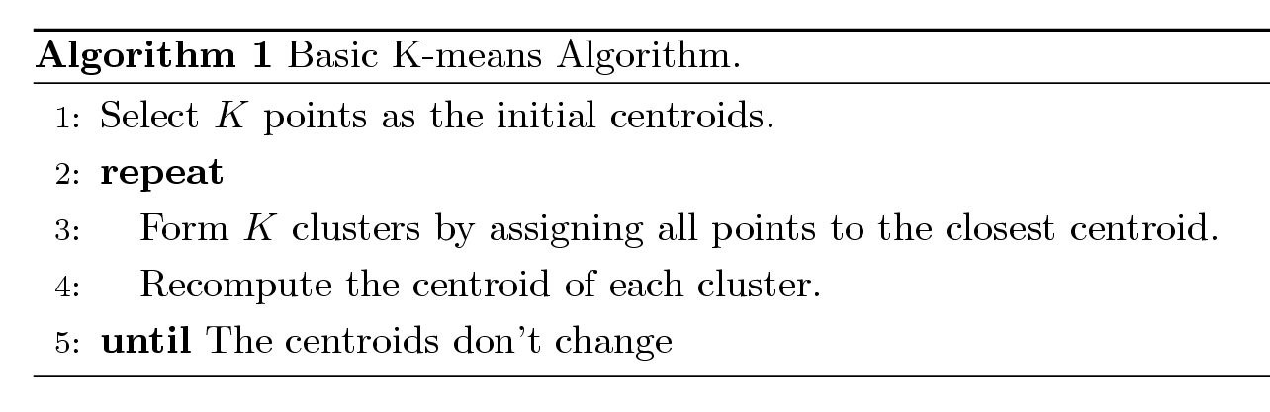
K-means Clustering
Partitional clustering approach
Number of clusters, K, must be specified
Each cluster is associated with a centroid
Each point is assigned to the cluster with the closest centroid
The basic algorithm is very simple

Slide 20
Example of K-means Clustering

Slide 21
Example of K-means Clustering

Slide 22
K-means Clustering – Details
Simple iterative algorithm.
Choose initial centroids;
repeat {assign each point to a nearest centroid; re-compute cluster centroids}
until centroids stop changing.
Initial centroids are often chosen randomly.
Clusters produced can vary from one run to another
The centroid is (typically) the mean of the points in the cluster, but other definitions are possible
K-means will converge for common proximity measures with appropriately defined centroid
Most of the convergence happens in the first few iterations.
Often the stopping condition is changed to ‘Until relatively few points change clusters’
Complexity is O( n * K * I * d )
n = number of points, K = number of clusters, I = number of iterations, d = number of attributes

Slide 23
K-means Objective Function
A common objective function (used with Euclidean distance measure) is Sum of Squared Error (SSE)
For each point, the error is the distance to the nearest cluster center
To get SSE, we square these errors and sum them.
x is a data point in cluster C_{i} and m_{i} is the centroid (mean) for cluster C_{i}
SSE improves in each iteration of K-means until it reaches a local or global minima.

Slide 24
Two different K-means Clustering
Original Points
Optimal Clustering
Sub-optimal Clustering

Slide 25
Importance of Choosing Initial Centroids …

Slide 26
Importance of Choosing Initial Centroids …

Slide 27
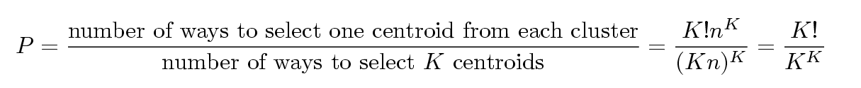
Problems with Selecting Initial Points
If there are K ‘real’ clusters, then the chance of selecting one centroid from each cluster is small.
Chance is relatively small when K is large
If clusters are the same size, n, then
For example, if K = 10, then probability = 10!/10¹⁰ = 0.00036

Slide 28
10 Clusters Example
Starting with two initial centroids in one cluster of each pair of clusters

Slide 29
10 Clusters Example
Starting with two initial centroids in one cluster of each pair of clusters

Slide 30
10 Clusters Example
Starting with some pairs of clusters having three initial centroids, while other have only one.

Slide 31
10 Clusters Example
Starting with some pairs of clusters having three initial centroids, while other have only one.

Slide 32
Solutions to Initial Centroids Problem
Multiple runs
Use some strategy to select the k initial centroids and then select among these initial centroids
Select most widely separated
K-means++ is a robust way of doing this selection
Use hierarchical clustering to determine initial centroids
Bisecting K-means
Not as susceptible to initialization issues

Slide 33
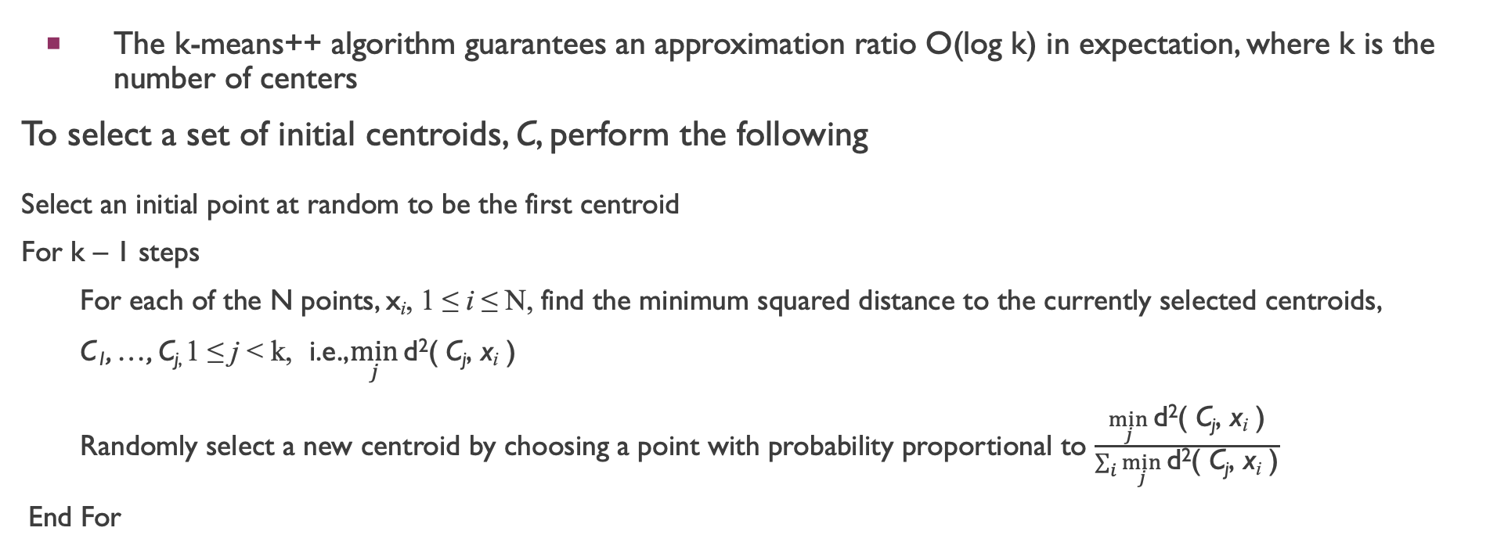
K-means++
The k-means++ algorithm guarantees an approximation ratio O(log k) in expectation, where k is the number of centers
To select a set of initial centroids, C, perform the following
Select an initial point at random to be the first centroid
For k – 1 steps
For each of the N points, x_{i}, 1 ≤ i ≤ N, find the minimum squared distance to the currently selected centroids,
C₁, …, C_{j,} 1 ≤ j < k, i.e.,$\min_{j}{\text{d}\text{2}\text{( }\text{C}\text{j}\text{, }\text{x}\text{i}\text{ )}}$
Randomly select a new centroid by choosing a point with probability proportional to $\frac{\min_{j}{\text{d}\text{2}\text{( }\text{C}\text{j}\text{, }\text{x}\text{i}\text{ )}}}{\sum_{i}{\min_{j}{\text{d}\text{2}\text{( }\text{C}\text{j}\text{, }\text{x}\text{i}\text{ )}}}}$
End For

Slide 34
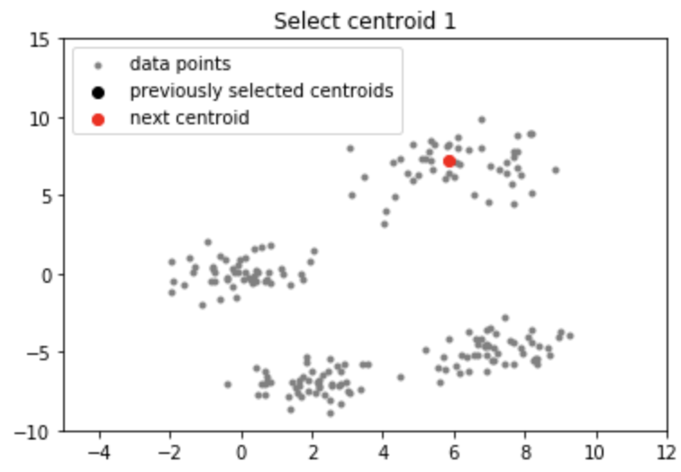
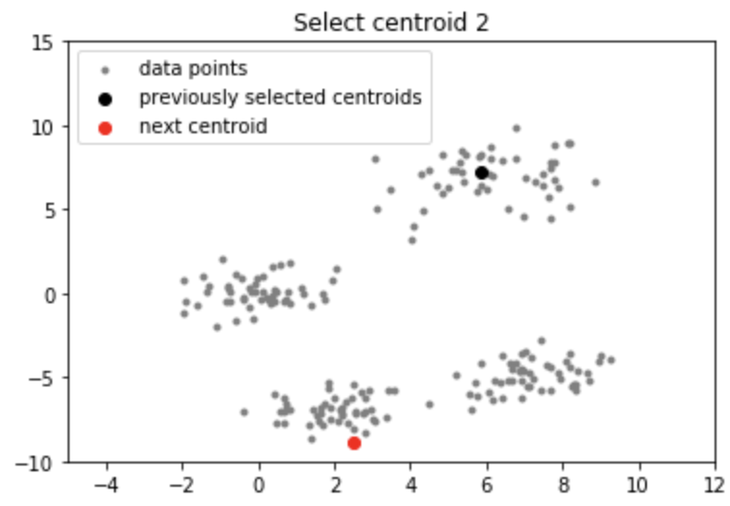
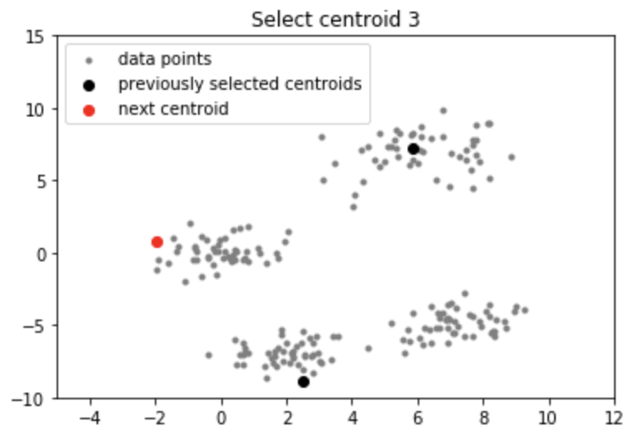
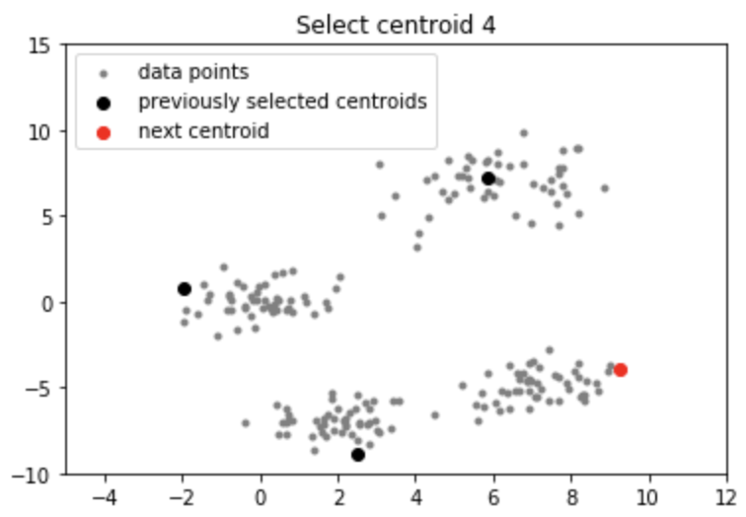
K-mean++

Slide 35
Bisecting K-means
Bisecting K-means algorithm
Variant of K-means that can produce a partitional or a hierarchical clustering

Slide 36
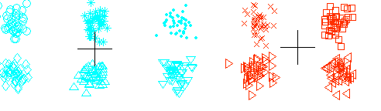
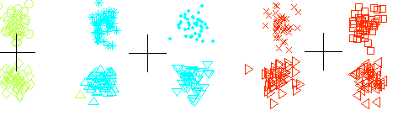
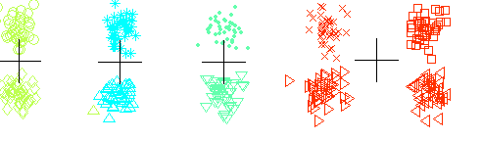
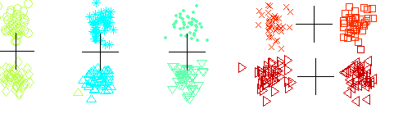
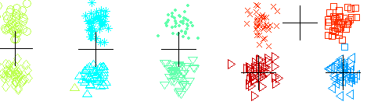
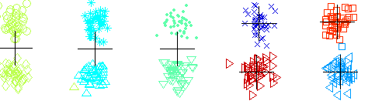
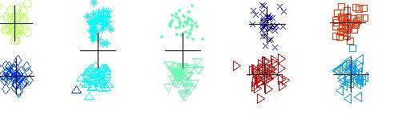
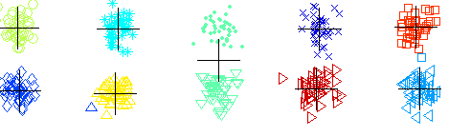
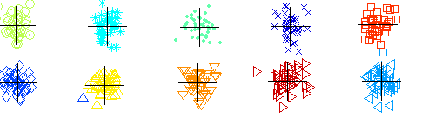
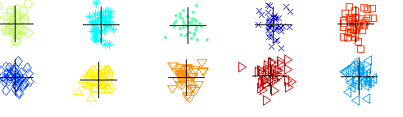
Bisecting K-means Example

Slide 37
Limitations of K-means
K-means has problems when clusters are of differing
Sizes
Densities
Non-globular shapes
K-means has problems when the data contains outliers.
One possible solution is to remove outliers before clustering

Slide 38
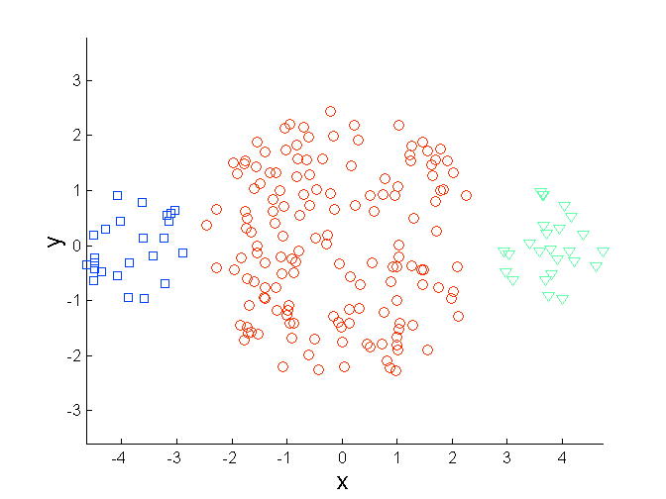
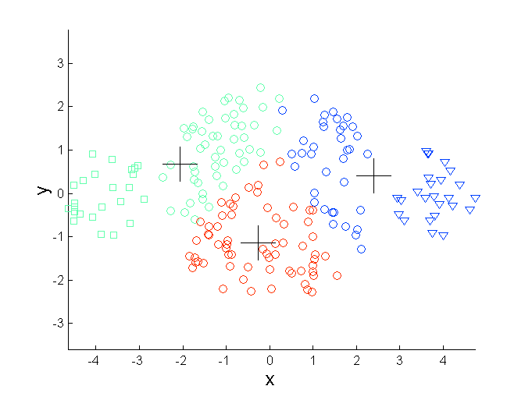
Limitations of K-means: Differing Sizes
Original Points
K-means (3 Clusters)

Slide 39
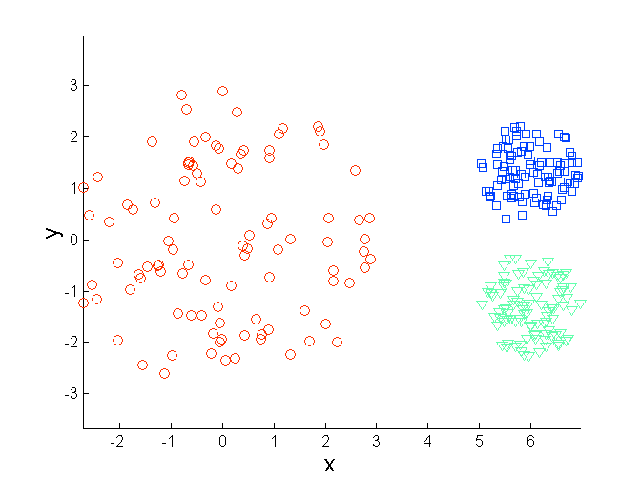
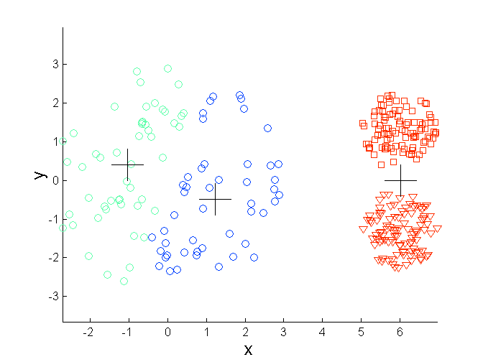
Limitations of K-means: Differing Density
Original Points
K-means (3 Clusters)

Slide 40
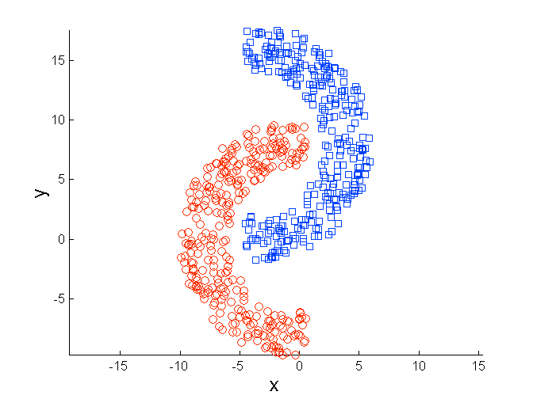
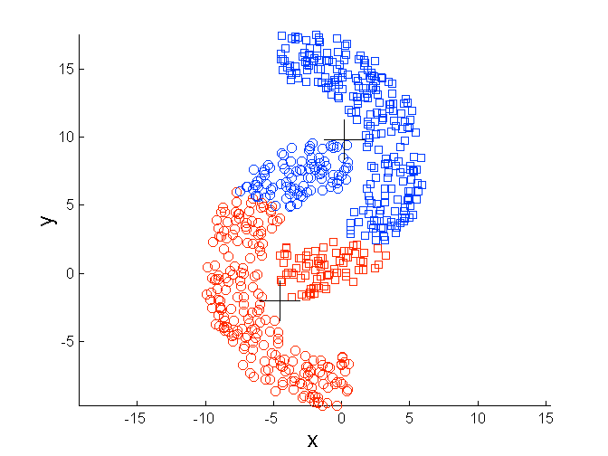
Limitations of K-means: Non-globular Shapes
Original Points
K-means (2 Clusters)

Slide 41
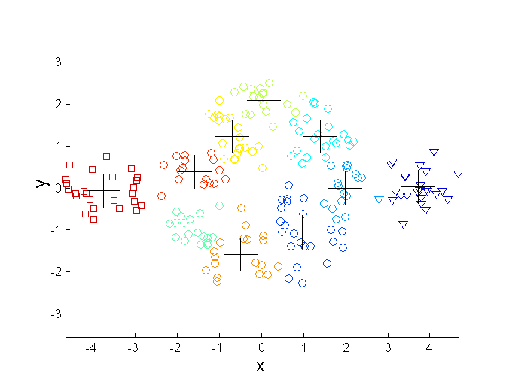
Overcoming K-means Limitations
Original Points K-means Clusters
One solution is to find a large number of clusters such that each of them represents a part of a natural cluster. But these small clusters need to be put together in a post-processing step.

Slide 42
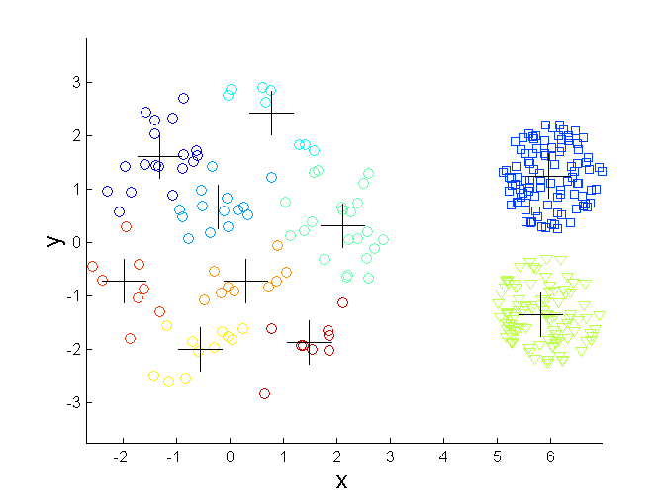
Overcoming K-means Limitations
Original Points K-means Clusters
One solution is to find a large number of clusters such that each of them represents a part of a natural cluster. But these small clusters need to be put together in a post-processing step.

Slide 43
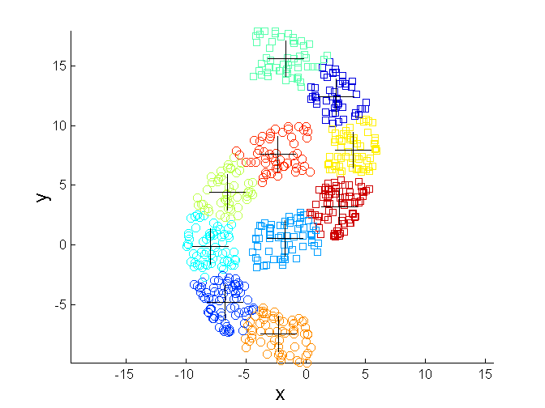
Overcoming K-means Limitations
Original Points K-means Clusters
One solution is to find a large number of clusters such that each of them represents a part of a natural cluster. But these small clusters need to be put together in a post-processing step.

