Slide 1
Classification

Slide 2
Road Map
Basic concepts and Decision Trees
Inferring rudimentary rules
Covering rules
Experiments with Weka

Slide 3
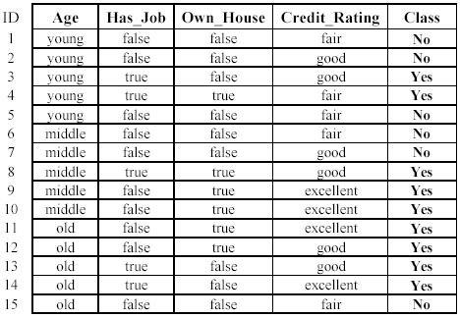
example
A credit card company receives thousands of applications for new cards. Each application contains information about an applicant,
age
has_job
own_house
credit rating
etc.
Problem: to decide whether an application should be approved, or to classify applications into two categories, approved and not approved.

Slide 4
An example application
An emergency room in a hospital measures 15 variables (e.g., blood pressure, age, heart rate, etc) of newly admitted patients.
A decision is needed: whether to send a new patient to an intensive-care unit based on the mortality risk.
Problem: to predict high-risk patients and distinguish them from low-risk patients.

Slide 5


CLASSIFICATION
Definition:
Given a collection of records (training set )
Each record is by characterized by a tuple (x,y), where x is the attribute set and y is the class label
x: attribute, predictor, independent variable, input
y: class, response, dependent variable, output
Our focus:
learn a target function
Use the learned function to predict the values of a discrete class attribute
e.g., approve or not-approved, and high-risk or low risk.
Features / variables / attributes
Label
= class
= category
Each row = a datapoint

Slide 6


predict
model /
function
In real life, it may not follow i.i.d assumption of the supervised learning (classification problem).
Accuracy of correctly classify a datapoint = 8/10 = 80%

Slide 7
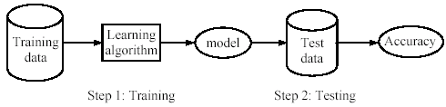

Supervised learning process: two steps
Learning (training): learn a model via the training data
Testing: test the model via test data and evaluate the model accuracy

Slide 8

An example
Data: loan application data
Task: predict whether a loan should be approved or not.
Performance measure: accuracy
No learning: put all test data to the majority class (i.e., Yes):
Accuracy = 8/15 = 53%
With the learned model, we can do better than 53%.

Slide 9

Fundamental assumption of learning
Assumption: the distribution of training data is identical to the distribution of test data.
To achieve good accuracy on the test data, training data must be sufficiently large.
Classification ( supervised learning)

Slide 10
Road Map
Basic concepts and Decision Trees
Inferring rudimentary rules
Covering rules
Experiments with Weka

Slide 11




Example of a Decision Tree
categorical
categorical
continuous
Splitting Attributes
class
Income
Home Owner
Yes
No
Home owner
NO
MarSt
Single, Divorced
Married
Marital status
Income
NO
< 80K
> 80K
YES
Income
NO
Model: Decision Tree
Training Data

Slide 12




Apply Model to Test Data
Test Data
Start from the root of tree.
Home Owner
Yes
No
NO
MarSt
Single, Divorced
Married
Income
NO
< 80K
> 80K
NO
YES

Slide 13
Apply Model to Test Data
Test Data
Home Owner
Yes
No
NO
MarSt
Single, Divorced
Married
Income
NO
< 80K
> 80K
NO
YES

Slide 14
Apply Model to Test Data
Test Data
Home Owner
Yes
No
NO
MarSt
Single, Divorced
Married
Assign Defaulted to “No”
Income
NO
< 80K
> 80K
NO
YES

Slide 15

Another Example of Decision Tree
categorical
categorical
continuous
class
Single, Divorced
MarSt
Married
NO
Home Owner
Yes
No
NO
Income
< 80K
> 80K
NO
YES
There could be more than one tree that fits the same data!

Slide 16
Decision Tree Classification Task
Decision Tree

Slide 17

Decision Tree Induction
Many Algorithms:
Hunt’s Algorithm (one of the earliest)
CART
ID3, C4.5
SLIQ,SPRINT

Slide 19
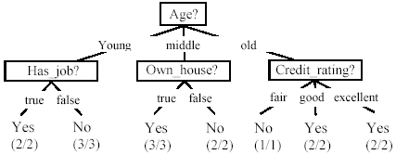
A decision tree from the loan data
Decision nodes and leaf nodes (classes)

Slide 20



Use the decision tree

Slide 21
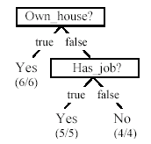


Is the decision tree unique?
No. There could be many trees.
We want smaller (easy to understand) and accurate tree (good performance).

Slide 22




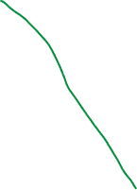


From a decision tree to a set of rules
A decision tree can be converted to a set of rules
Each path from the root to a leaf is a rule.
(if condition)

Slide 23

Algorithm for decision tree learning
Basic algorithm (greedy divide-and-conquer)
given categorical attributes/features
tree is constructed in a top-down recursive manner
at start, all the training examples are at the root
examples are partitioned recursively based on selected attributes
attributes are selected based on information gain

Slide 24


Algorithm for decision tree learning
When to stop partitioning
All examples for a given node belong to the same class
There are no remaining attributes for further partitioning
There are no examples left

