Slide 1
Machine Learning in HEALTHCARE, AGING.

Slide 2
Objectives
In ‘Machine Learning’, machine is made to learn the various parameters including,
symptoms,
behavior,
biochemical variables
Pathologic parameters
ML helps with diagnostic sensitivity, specificity and treatment
e.g., AI in Medicine

Slide 3
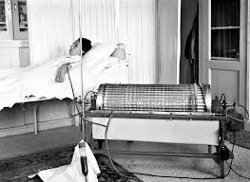
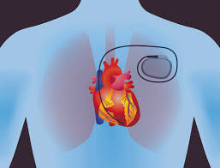
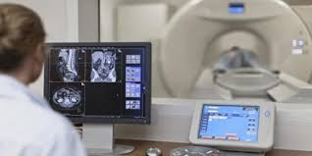
Innovations in Medical and Biological Engineering
1950s and earlier
Artificial Kidney
X ray
Cardiac Pacemaker
Antibiotic Production technology
1970s
Computer assisted tomography
Artificial hip and knee replacements
Balloon catheter

Slide 4
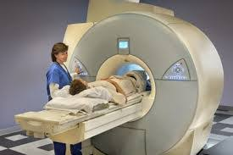
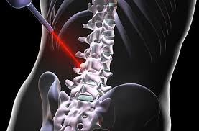
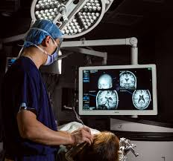
Innovations in Medical and Biological Engineering
1960s
Heart valve replacement
Intraocular lens
Ultrasound
Vascular grafts
Blood analysis and processing
1980s
Magnetic resonance imaging
Laser surgery
Vascular grafts
Recombinant therapeutics
Present day
Genomic sequencing and microarrays
Positron Emission tomography
Image guided surgery

Slide 5
New generations of medical technology

Slide 6
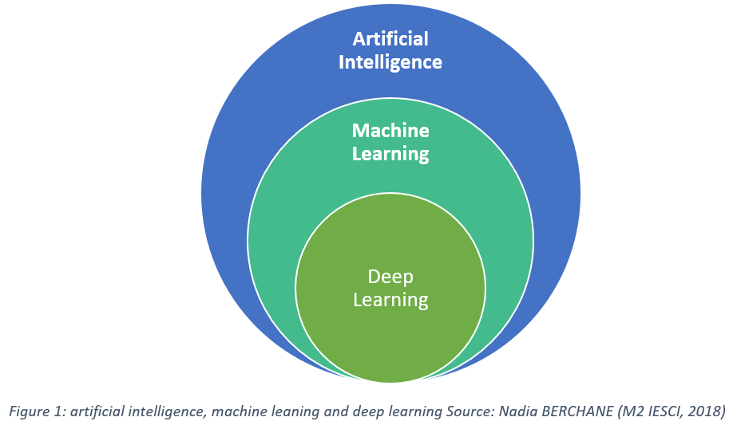
What is Artificial Intelligence
Machines & computer programs are capable of problem solving and learning, like a human brain.
Machine Learning (“ML”),

Slide 7
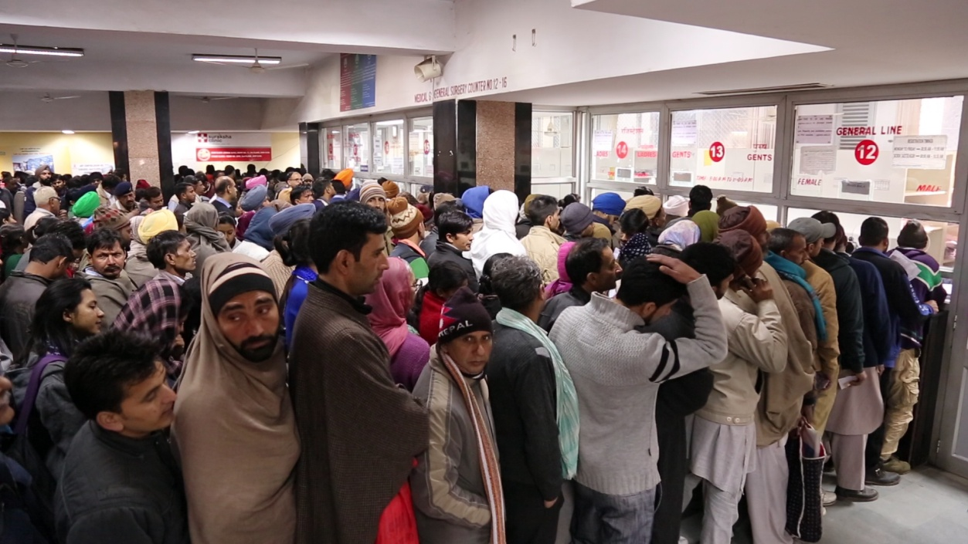
The application of AI in medicine has two main branches:
A) Virtual branch
B) Physical branch.
Highly repetitive work
Empower doctors
help them deliver faster and more accurate
Augment the professionals, offering them expertise and assistance.
Replace personnel and staffing in medical facilities, particularly in administrative functions,
Managing wait times & automating scheduling
“Deep-learning devices will not replace clinicians

Slide 8

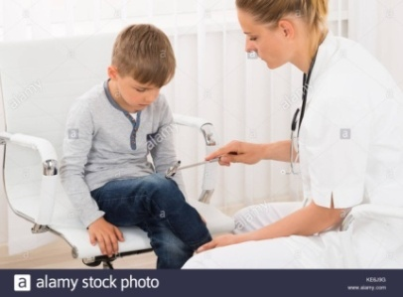
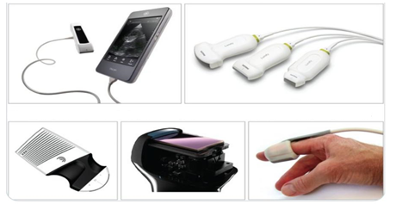
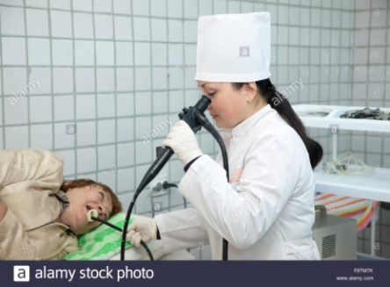
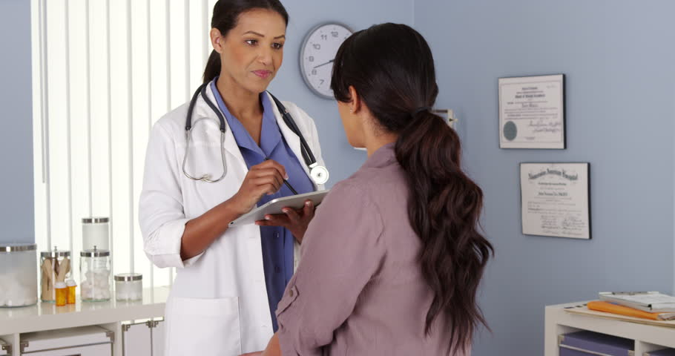
Artificial intelligence in medicine : The virtual branch
The virtual component is represented by Machine Learning, (also called Deep Learning)-mathematical algorithms that improve learning through experience.
Three types of machine learning algorithms:
Unsupervised (ability to find patterns)
Supervised (classification and prediction algorithms based on previous examples)
Reinforcement learning (use of sequences of rewards and punishments to form a strategy for operation in a specific problem space)

Slide 9
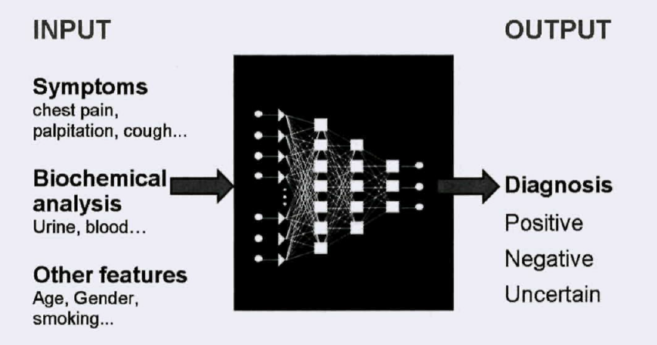
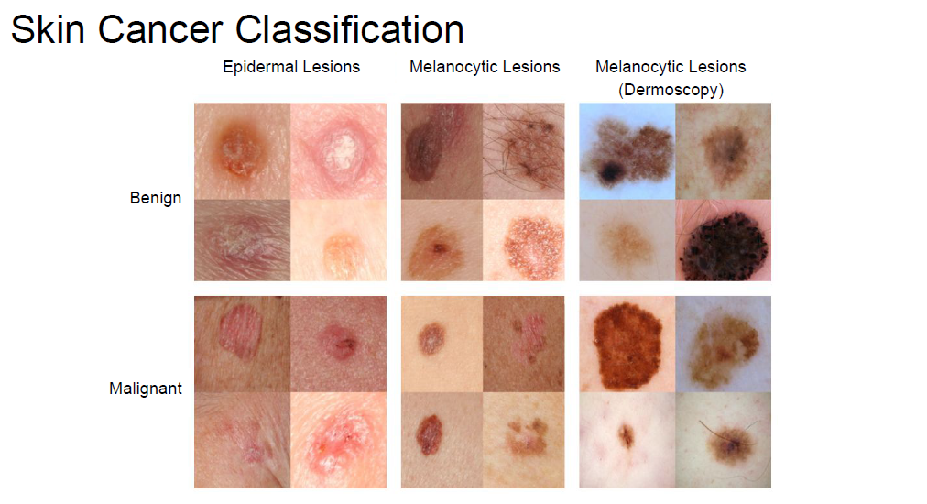
Benefits of Artificial intelligence
AI can definitely assist physicians
Clinical decision making - better clinical decisions
Replace human judgement in certain functional areas of healthcare (eg, radiology).
up-to-date medical information from journals, textbooks and clinical practices
Experienced vs (fresh Clinician + AI algorithms)
Early diagnosis
Prediction of outcome of the disease as well as treatment
Feedback on treatment
Reinforce non pharmacological management
Reduce diagnostic and therapeutic errors
Increased patient safety and Huge cost savings associated with use of AI
AI system extracts useful information from a large patient population
Assist making real-time inferences for health risk alert and health outcome prediction

Slide 10
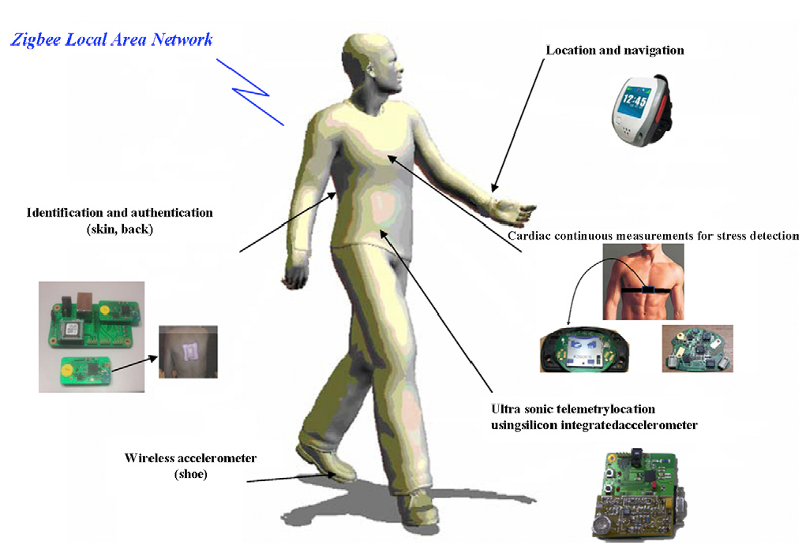
Artificial intelligence in medicine: The physical branch
It includes:
Physical objects,
Medical devices
Sophisticated robots for delivery of care (carebots)/ robots for surgery.

Slide 11
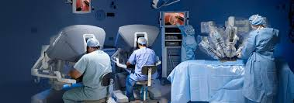
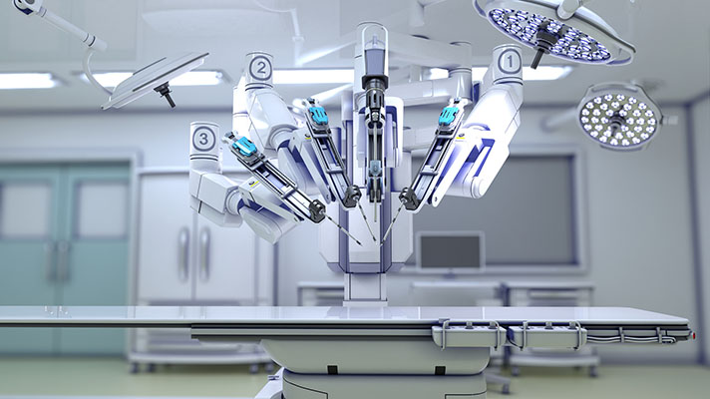
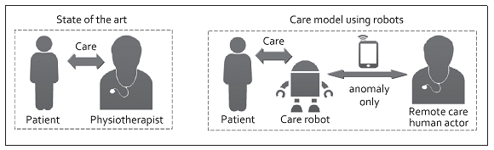
Use of robots to deliver treatment..robotic surgery
Use of robots to deliver treatment - Robotic surgery
Use of robots to monitor effectiveness of treatment

Slide 12
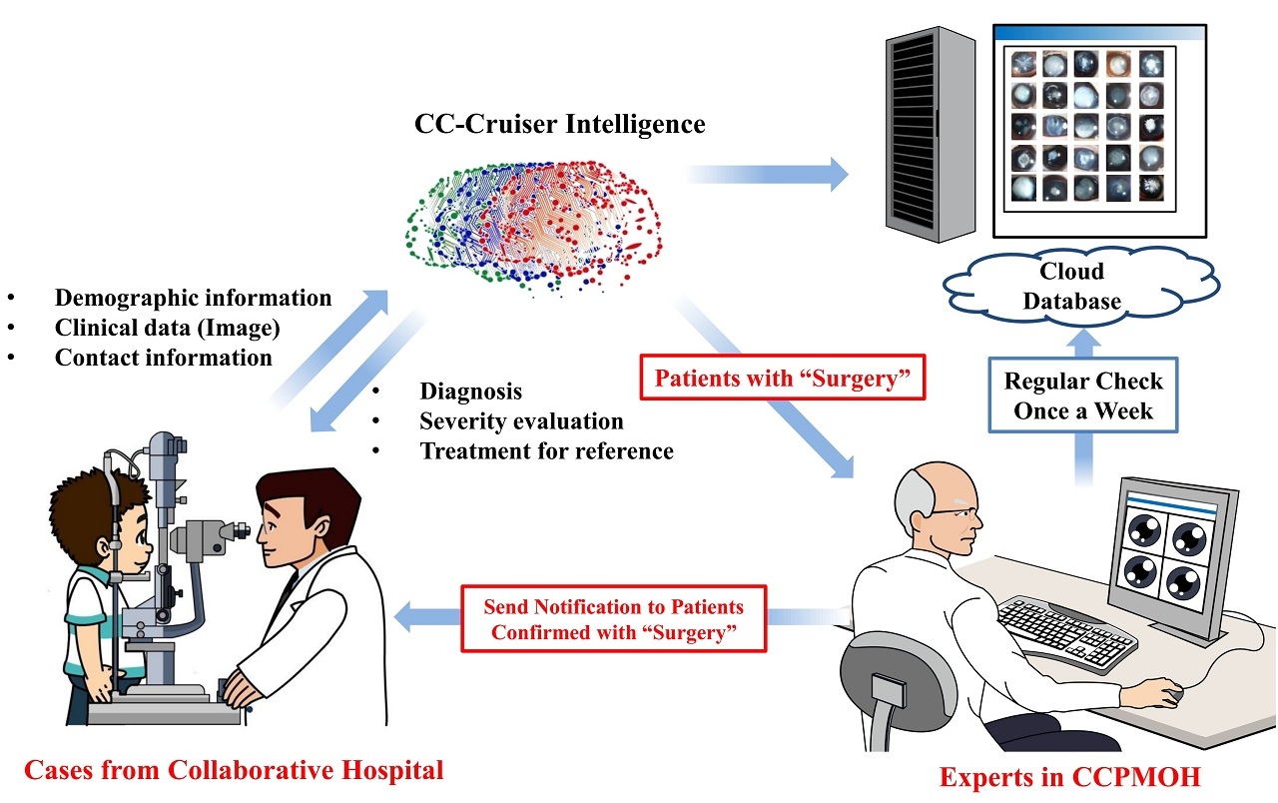
Growth drivers of AI in healthcare
Increasing individual healthcare expenses
Larger Geriatric population
Imbalance between health workforce and patients
Increasing Global Health care expenditure
Continuous shortage of nursing and technician staff. The number of vacancies for nurses will be 1.2 million by 2020
AI is and will help medical practitioners efficiently achieve their tasks with minimal human intervention, a critical factor in meeting increasing patient demand.

Slide 13
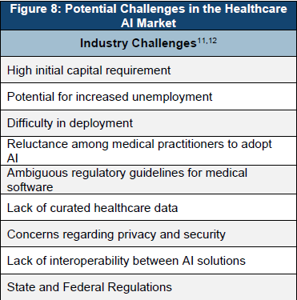
Potential challenges
Development costs
Integration issues
Ethical issues / Fear of replacing humans
Reluctance among medical practitioners to adopt AI
Explainable AI
Data Privacy and security – adversarial attacks
Mobile health applications and devices that use AI
Lack of interoperability between AI solutions
Data exchange
Need for continuous training by data from clinical studies
Incentives for sharing data on the system for further development and improvement of the system. Nevertheless,
All the parties in the healthcare system, the physicians, the pharmaceutical companies and the patients, have greater incentives to compile and exchange information

Slide 14
Future Indian Scenario
Collaboration between medical and technical institutions
Government funding – more intelligent and result oriented rather than you pat – i pat
Scientific mafia or scientist Mafia
Current status of medical records
incommunicable silos of wasted information for the health system and for knowledge acquisition. Laboratories and clinics need to collaborate to accelerate the implementation of electronic health records
Data need to be captured in real-time, and institutions should promote their transformation into intelligible processes
Integration and interoperability including ethical, legal and logistical concerns are enormous
Simplification, readability and clinical utility of data sets
Each result must be questioned for its clinical applicability.
Aim of increasing their clinical value and decreasing health costs
Electronic medical or health records
are essential tools for personalized medicine
Early detection and targeted prevention, again

