Slide 1
DATA MINING LECTURE 2
Data Preprocessing
Exploratory Analysis
Post-processing

Slide 2
What is Data Mining?
Data mining is the use of efficient techniques for the analysis of very large collections of data and the extraction of useful and possibly unexpected patterns in data.
“Data mining is the analysis of (often large) observational data sets to find unsuspected relationships and to summarize the data in novel ways that are both understandable and useful to the data analyst” (Hand, Mannila, Smyth)
“Data mining is the discovery of models for data” (Rajaraman, Ullman)
We can have the following types of models
Models that explain the data (e.g., a single function)
Models that predict the future data instances.
Models that summarize the data
Models the extract the most prominent features of the data.

Slide 3
Why do we need data mining?
Really huge amounts of complex data generated from multiple sources and interconnected in different ways
Scientific data from different disciplines
Weather, astronomy, physics, biological microarrays, genomics
Huge text collections
The Web, scientific articles, news, tweets, facebook postings.
Transaction data
Retail store records, credit card records
Behavioral data
Mobile phone data, query logs, browsing behavior, ad clicks
Networked data
The Web, Social Networks, IM networks, email network, biological networks.
All these types of data can be combined in many ways
Facebook has a network, text, images, user behavior, ad transactions.
We need to analyze this data to extract knowledge
Knowledge can be used for commercial or scientific purposes.
Our solutions should scale to the size of the data

Slide 4
The data analysis pipeline
Mining is not the only step in the analysis process
Preprocessing: real data is noisy, incomplete and inconsistent. Data cleaning is required to make sense of the data
Techniques: Sampling, Dimensionality Reduction, Feature selection.
A dirty work, but it is often the most important step for the analysis.
Post-Processing: Make the data actionable and useful to the user
Statistical analysis of importance
Visualization.
Pre- and Post-processing are often data mining tasks as well
Data Preprocessing
Data Mining
Result
Post-processing

Slide 5
Data Quality
Examples of data quality problems:
Noise and outliers
Missing values
Duplicate data
A mistake or a millionaire?
Missing values
Inconsistent duplicate entries

Slide 6
Sampling
Sampling is the main technique employed for data selection.
It is often used for both the preliminary investigation of the data and the final data analysis.
Statisticians sample because obtaining the entire set of data of interest is too expensive or time consuming.
Example: What is the average height of a person in Ioannina?
We cannot measure the height of everybody
Sampling is used in data mining because processing the entire set of data of interest is too expensive or time consuming.
Example: We have 1M documents. What fraction has at least 100 words in common?
Computing number of common words for all pairs requires 10¹² comparisons
Example: What fraction of tweets in a year contain the word “Greece”?
300M tweets per day, if 100 characters on average, 86.5TB to store all tweets

Slide 7
Sampling …
The key principle for effective sampling is the following:
using a sample will work almost as well as using the entire data sets, if the sample is representative
A sample is representative if it has approximately the same property (of interest) as the original set of data
Otherwise we say that the sample introduces some bias
What happens if we take a sample from the university campus to compute the average height of a person at Ioannina?

Slide 8
Types of Sampling
Simple Random Sampling
There is an equal probability of selecting any particular item
Sampling without replacement
As each item is selected, it is removed from the population
Sampling with replacement
Objects are not removed from the population as they are selected for the sample.
In sampling with replacement, the same object can be picked up more than once. This makes analytical computation of probabilities easier
E.g., we have 100 people, 51 are women P(W) = 0.51, 49 men P(M) = 0.49. If I pick two persons what is the probability P(W,W) that both are women?
Sampling with replacement: P(W,W) = 0.51²
Sampling without replacement: P(W,W) = 51/100 * 50/99

Slide 9
Types of Sampling
Stratified sampling
Split the data into several groups; then draw random samples from each group.
Ensures that both groups are represented.
Example 1. I want to understand the differences between legitimate and fraudulent credit card transactions. 0.1% of transactions are fraudulent. What happens if I select 1000 transactions at random?
I get 1 fraudulent transaction (in expectation). Not enough to draw any conclusions. Solution: sample 1000 legitimate and 1000 fraudulent transactions
Example 2. I want to answer the question: Do web pages that are linked have on average more words in common than those that are not? I have 1M pages, and 1M links, what happens if I select 10K pairs of pages at random?
Most likely I will not get any links. Solution: sample 10K random pairs, and 10K links
Probability Reminder: If an event has probability p of happening and I do N trials, the expected number of times the event occurs is pN

Slide 10

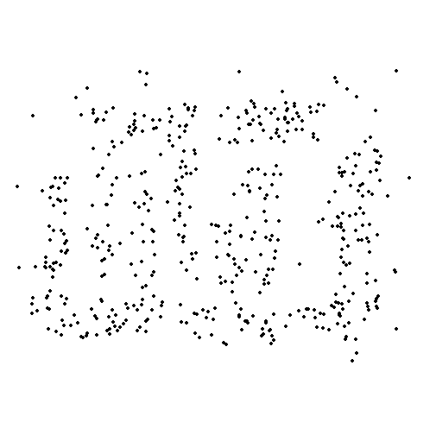
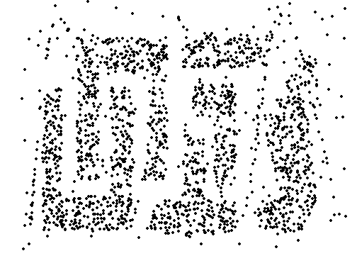
Sample Size
8000 points 2000 Points 500 Points

Slide 11

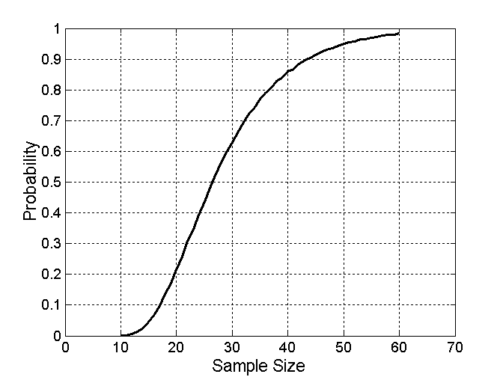
Sample Size
What sample size is necessary to get at least one object from each of 10 groups.

Slide 12
A data mining challenge
You have N integers and you want to sample one integer uniformly at random. How do you do that?
The integers are coming in a stream: you do not know the size of the stream in advance, and there is not enough memory to store the stream in memory. You can only keep a constant amount of integers in memory
How do you sample?
Hint: if the stream ends after reading n integers the last integer in the stream should have probability 1/n to be selected.
Reservoir Sampling:
Standard interview question for many companies

Slide 13
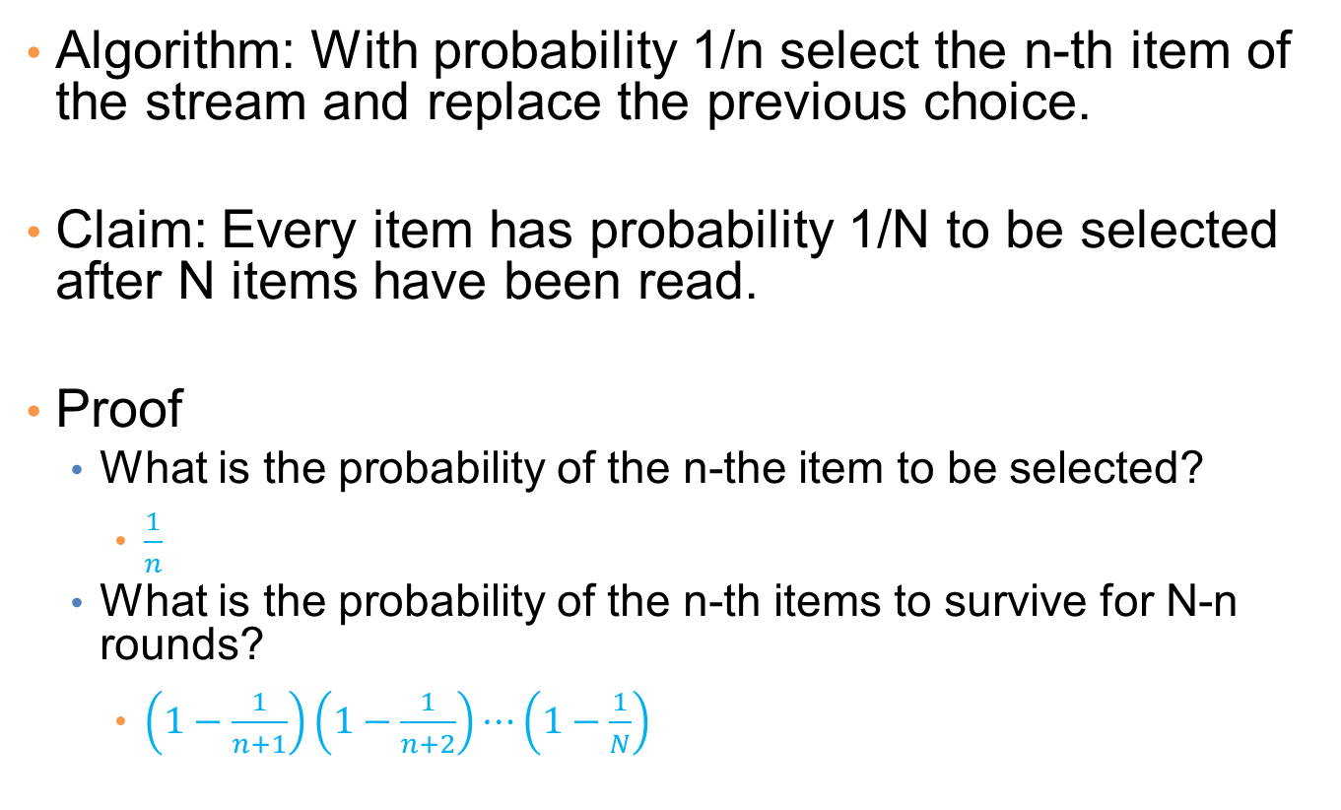
Reservoir sampling
Algorithm: With probability 1/n select the n-th item of the stream and replace the previous choice.
Claim: Every item has probability 1/N to be selected after N items have been read.
Proof
What is the probability of the n-the item to be selected?
$\frac{1}{n}$
What is the probability of the n-th items to survive for N-n rounds?
$\left(1−\frac{1}{n+1}\right)\left(1−\frac{1}{n+2}\right)⋯\left(1−\frac{1}{N}\right)$

Slide 14


A (detailed) data preprocessing example
Suppose we want to mine the comments/reviews of people on Yelp and Foursquare.

Slide 15
Data Collection
Today there is an abundance of data online
Facebook, Twitter, Wikipedia, Web, etc…
We can extract interesting information from this data, but first we need to collect it
Customized crawlers, use of public APIs
Additional cleaning/processing to parse out the useful parts
Respect of crawling etiquette
Data Collection
Data Preprocessing
Data Mining
Result
Post-processing

Slide 16
Mining Task
Collect all reviews for the top-10 most reviewed restaurants in NY in Yelp
(thanks to Hady Law)
Find few terms that best describe the restaurants.
Algorithm?

Slide 17
Example data
I heard so many good things about this place so I was pretty juiced to try it. I'm from Cali and I heard Shake Shack is comparable to IN-N-OUT and I gotta say, Shake Shake wins hands down. Surprisingly, the line was short and we waited about 10 MIN. to order. I ordered a regular cheeseburger, fries and a black/white shake. So yummerz. I love the location too! It's in the middle of the city and the view is breathtaking. Definitely one of my favorite places to eat in NYC.
I'm from California and I must say, Shake Shack is better than IN-N-OUT, all day, err'day.
Would I pay $15+ for a burger here? No. But for the price point they are asking for, this is a definite bang for your buck (though for some, the opportunity cost of waiting in line might outweigh the cost savings) Thankfully, I came in before the lunch swarm descended and I ordered a shake shack (the special burger with the patty + fried cheese &amp; portabella topping) and a coffee milk shake. The beef patty was very juicy and snugly packed within a soft potato roll. On the downside, I could do without the fried portabella-thingy, as the crispy taste conflicted with the juicy, tender burger. How does shake shack compare with in-and-out or 5-guys? I say a very close tie, and I think it comes down to personal affliations. On the shake side, true to its name, the shake was well churned and very thick and luscious. The coffee flavor added a tangy taste and complemented the vanilla shake well. Situated in an open space in NYC, the open air sitting allows you to munch on your burger while watching people zoom by around the city. It's an oddly calming experience, or perhaps it was the food coma I was slowly falling into. Great place with food at a great price.

Slide 18
First cut
Do simple processing to “normalize” the data (remove punctuation, make into lower case, clear white spaces, other?)
Break into words, keep the most popular words
the 27514
and 14508
i 13088
a 12152
to 10672
of 8702
ramen 8518
was 8274
is 6835
it 6802
in 6402
for 6145
but 5254
that 4540
you 4366
with 4181
pork 4115
my 3841
this 3487
wait 3184
not 3016
we 2984
at 2980
on 2922
the 16710
and 9139
a 8583
i 8415
to 7003
in 5363
it 4606
of 4365
is 4340
burger 432
was 4070
for 3441
but 3284
shack 3278
shake 3172
that 3005
you 2985
my 2514
line 2389
this 2242
fries 2240
on 2204
are 2142
with 2095
the 16010
and 9504
i 7966
to 6524
a 6370
it 5169
of 5159
is 4519
sauce 4020
in 3951
this 3519
was 3453
for 3327
you 3220
that 2769
but 2590
food 2497
on 2350
my 2311
cart 2236
chicken 2220
with 2195
rice 2049
so 1825
the 14241
and 8237
a 8182
i 7001
to 6727
of 4874
you 4515
it 4308
is 4016
was 3791
pastrami 3748
in 3508
for 3424
sandwich 2928
that 2728
but 2715
on 2247
this 2099
my 2064
with 2040
not 1655
your 1622
so 1610
have 1585

Slide 19
First cut
Do simple processing to “normalize” the data (remove punctuation, make into lower case, clear white spaces, other?)
Break into words, keep the most popular words
the 27514
and 14508
i 13088
a 12152
to 10672
of 8702
ramen 8518
was 8274
is 6835
it 6802
in 6402
for 6145
but 5254
that 4540
you 4366
with 4181
pork 4115
my 3841
this 3487
wait 3184
not 3016
we 2984
at 2980
on 2922
the 16710
and 9139
a 8583
i 8415
to 7003
in 5363
it 4606
of 4365
is 4340
burger 432
was 4070
for 3441
but 3284
shack 3278
shake 3172
that 3005
you 2985
my 2514
line 2389
this 2242
fries 2240
on 2204
are 2142
with 2095
the 16010
and 9504
i 7966
to 6524
a 6370
it 5169
of 5159
is 4519
sauce 4020
in 3951
this 3519
was 3453
for 3327
you 3220
that 2769
but 2590
food 2497
on 2350
my 2311
cart 2236
chicken 2220
with 2195
rice 2049
so 1825
the 14241
and 8237
a 8182
i 7001
to 6727
of 4874
you 4515
it 4308
is 4016
was 3791
pastrami 3748
in 3508
for 3424
sandwich 2928
that 2728
but 2715
on 2247
this 2099
my 2064
with 2040
not 1655
your 1622
so 1610
have 1585
Most frequent words are stop words

Slide 20
Second cut
Remove stop words
Stop-word lists can be found online.
a,about,above,after,again,against,all,am,an,and,any,are,aren't,as,at,be,because,been,before,being,below,between,both,but,by,can't,cannot,could,couldn't,did,didn't,do,does,doesn't,doing,don't,down,during,each,few,for,from,further,had,hadn't,has,hasn't,have,haven't,having,he,he'd,he'll,he's,her,here,here's,hers,herself,him,himself,his,how,how's,i,i'd,i'll,i'm,i've,if,in,into,is,isn't,it,it's,its,itself,let's,me,more,most,mustn't,my,myself,no,nor,not,of,off,on,once,only,or,other,ought,our,ours,ourselves,out,over,own,same,shan't,she,she'd,she'll,she's,should,shouldn't,so,some,such,than,that,that's,the,their,theirs,them,themselves,then,there,there's,these,they,they'd,they'll,they're,they've,this,those,through,to,too,under,until,up,very,was,wasn't,we,we'd,we'll,we're,we've,were,weren't,what,what's,when,when's,where,where's,which,while,who,who's,whom,why,why's,with,won't,would,wouldn't,you,you'd,you'll,you're,you've,your,yours,yourself,yourselves,

Slide 21
Second cut
Remove stop words
Stop-word lists can be found online.
ramen 8572
pork 4152
wait 3195
good 2867
place 2361
noodles 2279
ippudo 2261
buns 2251
broth 2041
like 1902
just 1896
get 1641
time 1613
one 1460
really 1437
go 1366
food 1296
bowl 1272
can 1256
great 1172
best 1167
burger 4340
shack 3291
shake 3221
line 2397
fries 2260
good 1920
burgers 1643
wait 1508
just 1412
cheese 1307
like 1204
food 1175
get 1162
place 1159
one 1118
long 1013
go 995
time 951
park 887
can 860
best 849
sauce 4023
food 2507
cart 2239
chicken 2238
rice 2052
hot 1835
white 1782
line 1755
good 1629
lamb 1422
halal 1343
just 1338
get 1332
one 1222
like 1096
place 1052
go 965
can 878
night 832
time 794
long 792
people 790
pastrami 3782
sandwich 2934
place 1480
good 1341
get 1251
katz's 1223
just 1214
like 1207
meat 1168
one 1071
deli 984
best 965
go 961
ticket 955
food 896
sandwiches 813
can 812
beef 768
order 720
pickles 699
time 662

Slide 22
Second cut
Remove stop words
Stop-word lists can be found online.
ramen 8572
pork 4152
wait 3195
good 2867
place 2361
noodles 2279
ippudo 2261
buns 2251
broth 2041
like 1902
just 1896
get 1641
time 1613
one 1460
really 1437
go 1366
food 1296
bowl 1272
can 1256
great 1172
best 1167
burger 4340
shack 3291
shake 3221
line 2397
fries 2260
good 1920
burgers 1643
wait 1508
just 1412
cheese 1307
like 1204
food 1175
get 1162
place 1159
one 1118
long 1013
go 995
time 951
park 887
can 860
best 849
sauce 4023
food 2507
cart 2239
chicken 2238
rice 2052
hot 1835
white 1782
line 1755
good 1629
lamb 1422
halal 1343
just 1338
get 1332
one 1222
like 1096
place 1052
go 965
can 878
night 832
time 794
long 792
people 790
pastrami 3782
sandwich 2934
place 1480
good 1341
get 1251
katz's 1223
just 1214
like 1207
meat 1168
one 1071
deli 984
best 965
go 961
ticket 955
food 896
sandwiches 813
can 812
beef 768
order 720
pickles 699
time 662
Commonly used words in reviews, not so interesting

Slide 23
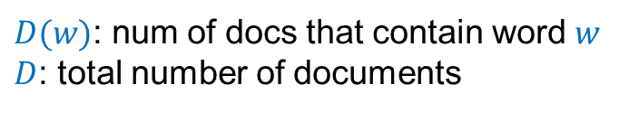
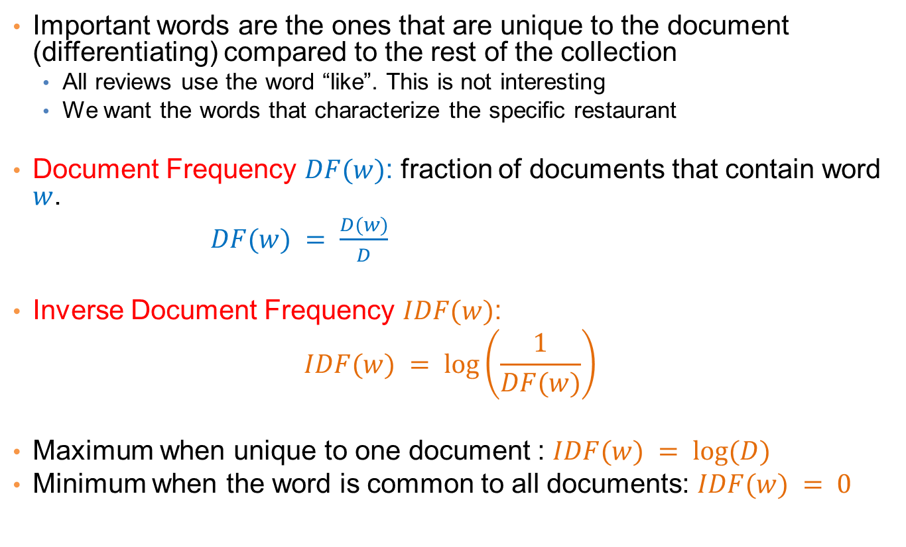
IDF
Important words are the ones that are unique to the document (differentiating) compared to the rest of the collection
All reviews use the word “like”. This is not interesting
We want the words that characterize the specific restaurant
Document Frequency $DF(w)$: fraction of documents that contain word $w$.
$DF(w) = \frac{D(w)}{D}$
Inverse Document Frequency $IDF(w)$:
$$IDF(w) = log⁡\left(\frac{1}{DF(w)}\right)$$
Maximum when unique to one document : $IDF(w) = log⁡(D)$
Minimum when the word is common to all documents: $IDF(w) = 0$
$D(w)$: num of docs that contain word $w$
$D$: total number of documents

Slide 24
TF-IDF
The words that are best for describing a document are the ones that are important for the document, but also unique to the document.
TF(w,d): term frequency of word w in document d
Number of times that the word appears in the document
Natural measure of importance of the word for the document
IDF(w): inverse document frequency
Natural measure of the uniqueness of the word w
TF-IDF(w,d) = TF(w,d) × IDF(w)

Slide 25
Third cut
Ordered by TF-IDF
ramen 3057.41761944282 7
akamaru 2353.24196503991 1
noodles 1579.68242449612 5
broth 1414.71339552285 5
miso 1252.60629058876 1
hirata 709.196208642166 1
hakata 591.76436889947 1
shiromaru 587.1591987134 1
noodle 581.844614740089 4
tonkotsu 529.594571388631 1
ippudo 504.527569521429 8
buns 502.296134008287 8
ippudo's 453.609263319827 1
modern 394.839162940177 7
egg 367.368005696771 5
shoyu 352.295519228089 1
chashu 347.690349042101 1
karaka 336.177423577131 1
kakuni 276.310211159286 1
ramens 262.494700601321 1
bun 236.512263803654 6
wasabi 232.366751234906 3
dama 221.048168927428 1
brulee 201.179739054263 2
fries 806.085373301536 7
custard 729.607519421517 3
shakes 628.473803858139 3
shroom 515.779060830666 1
burger 457.264637954966 9
crinkle 398.34722108797 1
burgers 366.624854809247 8
madison 350.939350307801 4
shackburger 292.428306810 1
'shroom 287.823136624256 1
portobello 239.8062489526 2
custards 211.837828555452 1
concrete 195.169925889195 4
bun 186.962178298353 6
milkshakes 174.9964670675 1
concretes 165.786126695571 1
portabello 163.4835416025 1
shack's 159.334353330976 2
patty 152.226035882265 6
ss 149.668031044613 1
patties 148.068287943937 2
cam 105.949606780682 3
milkshake 103.9720770839 5
lamps 99.011158998744 1
lamb 985.655290756243 5
halal 686.038812717726 6
53rd 375.685771863491 5
gyro 305.809092298788 3
pita 304.984759446376 5
cart 235.902194557873 9
platter 139.459903080044 7
chicken/lamb 135.8525204 1
carts 120.274374158359 8
hilton 84.2987473324223 4
lamb/chicken 82.8930633 1
yogurt 70.0078652365545 5
52nd 67.5963923222322 2
6th 60.7930175345658 9
4am 55.4517744447956 5
yellow 54.4470265206673 8
tzatziki 52.9594571388631 1
lettuce 51.3230168022683 8
sammy's 50.656872045869 1
sw 50.5668577816893 3
platters 49.9065970003161 5
falafel 49.4796995212044 4
sober 49.2211422635451 7
moma 48.1589121730374 3
pastrami 1931.94250908298 6
katz's 1120.62356508209 4
rye 1004.28925735888 2
corned 906.113544700399 2
pickles 640.487221580035 4
reuben 515.779060830666 1
matzo 430.583412389887 1
sally 428.110484707471 2
harry 226.323810772916 4
mustard 216.079238853014 6
cutter 209.535243462458 1
carnegie 198.655512713779 3
katz 194.387844446609 7
knish 184.206807439524 1
sandwiches 181.415707218 8
brisket 131.945865389878 4
fries 131.613054313392 7
salami 127.621117258549 3
knishes 124.339595021678 1
delicatessen 117.488967607 2
deli's 117.431839742696 1
carver 115.129254649702 1
brown's 109.441778045519 2
matzoh 108.22149937072 1

Slide 26
Third cut
TF-IDF takes care of stop words as well
We do not need to remove the stopwords since they will get IDF(w) = 0

Slide 27
Decisions, decisions…
When mining real data you often need to make some
What data should we collect? How much? For how long?
Should we throw out some data that does not seem to be useful?
Too frequent data (stop words), too infrequent (errors?), erroneous data, missing data, outliers
How should we weight the different pieces of data?
Most decisions are application dependent. Some information may be lost but we can usually live with it (most of the times)
We should make our decisions clear since they affect our findings.
Dealing with real data is hard…
An actual review
AAAAAAAAAAAAA
AAAAAAAAAAAAAAAAAAAAAAAAA AAAAAAAAAAAAAAAAAAAAAAAAA AAA

Slide 28
Exploratory analysis of data
Summary statistics: numbers that summarize properties of the data
Summarized properties include frequency, location and spread
Examples: location - mean spread - standard deviation
Most summary statistics can be calculated in a single pass through the data

Slide 29
Frequency and Mode
The frequency of an attribute value is the percentage of time the value occurs in the data set
For example, given the attribute ‘gender’ and a representative population of people, the gender ‘female’ occurs about 50% of the time.
The mode of a an attribute is the most frequent attribute value
The notions of frequency and mode are typically used with categorical data

Slide 30
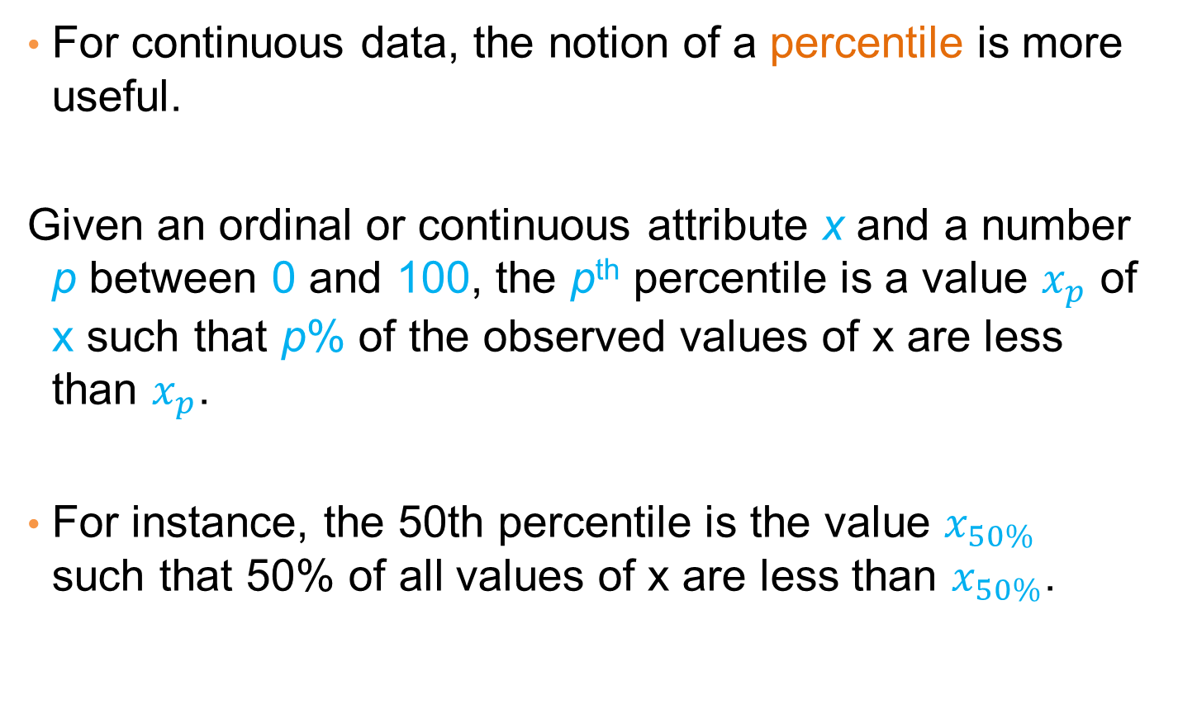
Percentiles
For continuous data, the notion of a percentile is more useful.
Given an ordinal or continuous attribute x and a number p between 0 and 100, the p^{th} percentile is a value $x_{p}$ of x such that p% of the observed values of x are less than $x_{p}$.
For instance, the 50th percentile is the value $x_{50\%}$ such that 50% of all values of x are less than $x_{50\%}$.

Slide 31
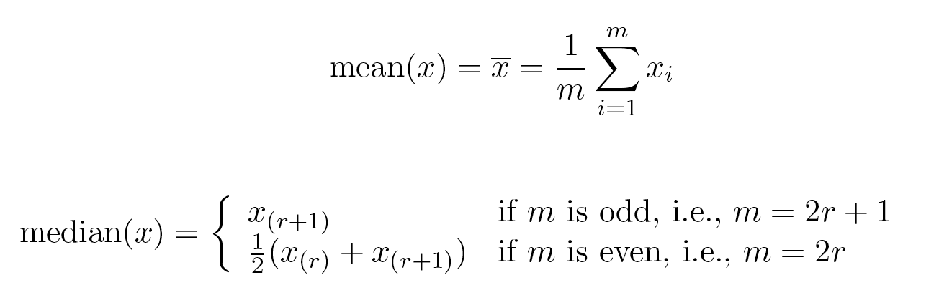
Measures of Location: Mean and Median
The mean is the most common measure of the location of a set of points.
However, the mean is very sensitive to outliers.
Thus, the median or a trimmed mean is also commonly used.

Slide 32
Example
Mean: 1090K
Trimmed mean (remove min, max): 105K
Median: (90+100)/2 = 95K

Slide 33
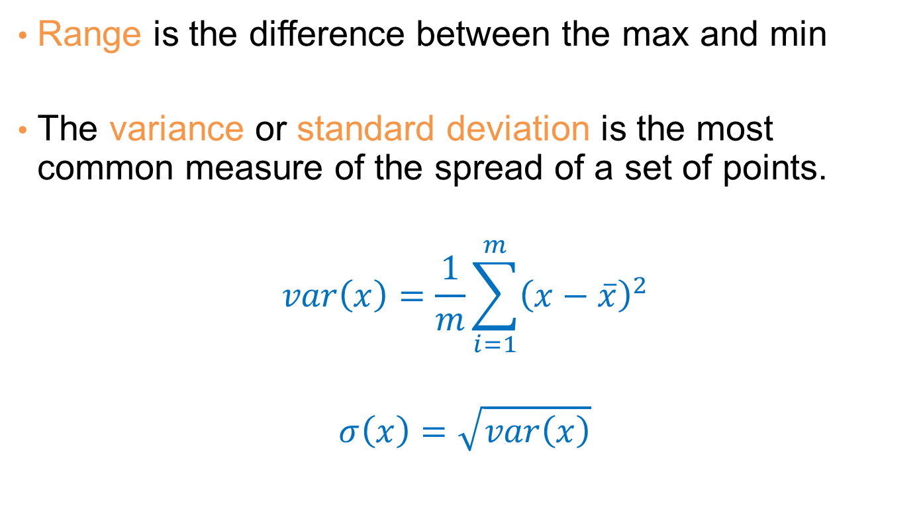
Measures of Spread: Range and Variance
Range is the difference between the max and min
The variance or standard deviation is the most common measure of the spread of a set of points.
$$var\left(x\right)=\frac{1}{m}\sum_{i=1}^{m}{{\left(x−\overline{x}\right)}^{2}}$$
$$σ\left(x\right)=\sqrt{var\left(x\right)}$$

Slide 34
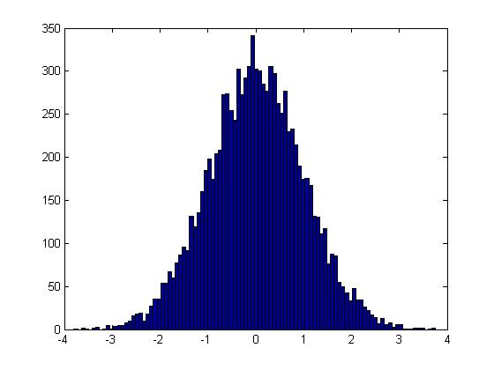
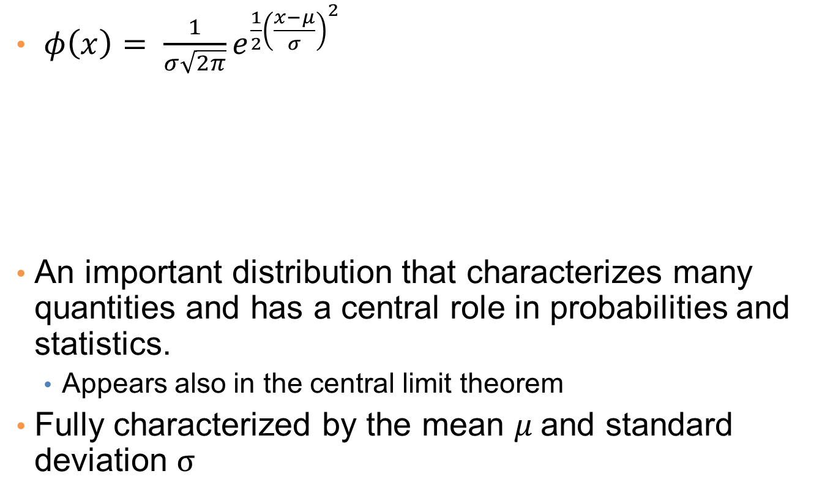
Normal Distribution
$φ\left(x\right)= \frac{1}{σ\sqrt{2π}}e^{\frac{1}{2}{\left(\frac{x−μ}{σ}\right)}^{2}}$
An important distribution that characterizes many quantities and has a central role in probabilities and statistics.
Appears also in the central limit theorem
Fully characterized by the mean $μ$and standard deviation $σ$
This is a value histogram

Slide 35
Not everything is normally distributed
Plot of number of words with x number of occurrences
If this was a normal distribution we would not have a frequency as large as 28K

Slide 36

Power-law distribution
We can understand the distribution of words if we take the log-log plot
Linear relationship in the log-log space
$$p\left(x=k\right)=k^{−a}$$

Slide 37

Zipf’s law
Power laws can be detected by a linear relationship in the log-log space for the rank-frequency plot
$f\left(r\right):$Frequency of the r-th most frequent word
$f\left(r\right)=r^{−β}$

Slide 38
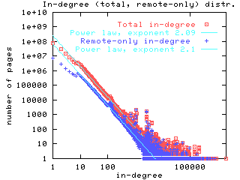
Power-laws are everywhere
Incoming and outgoing links of web pages, number of friends in social networks, number of occurrences of words, file sizes, city sizes, income distribution, popularity of products and movies
Signature of human activity?
A mechanism that explains everything?
Rich get richer process

Slide 39
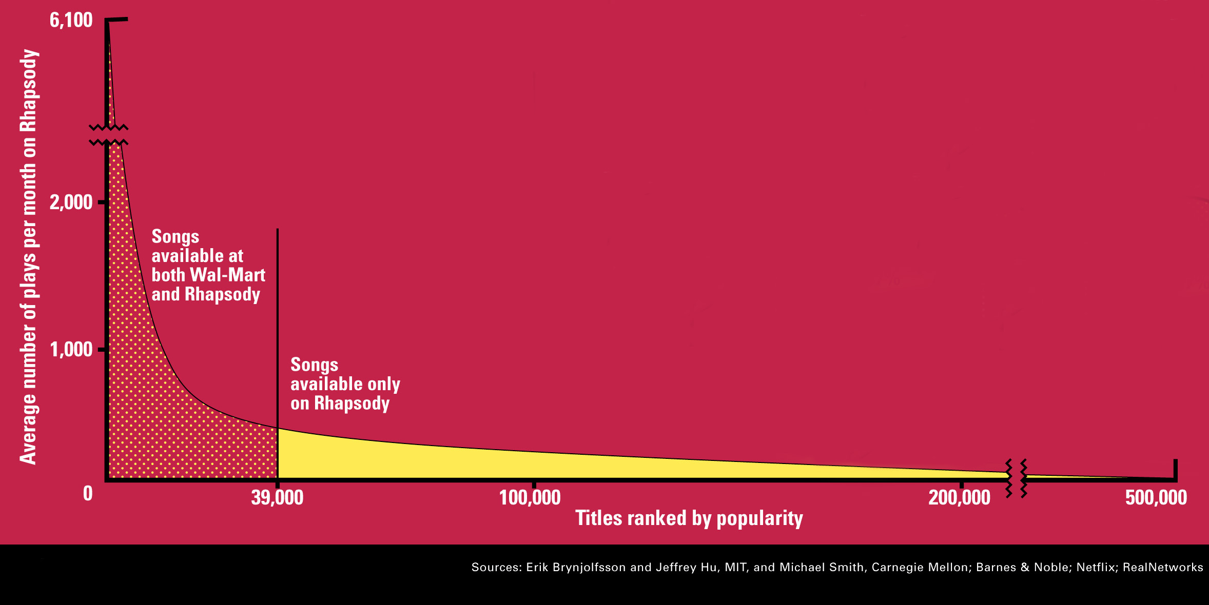
The Long Tail
Source: Chris Anderson (2004)

Slide 40
Post-processing
Visualization
The human eye is a powerful analytical tool
If we visualize the data properly, we can discover patterns
Visualization is the way to present the data so that patterns can be seen
E.g., histograms and plots are a form of visualization
There are multiple techniques (a field on its own)

Slide 41
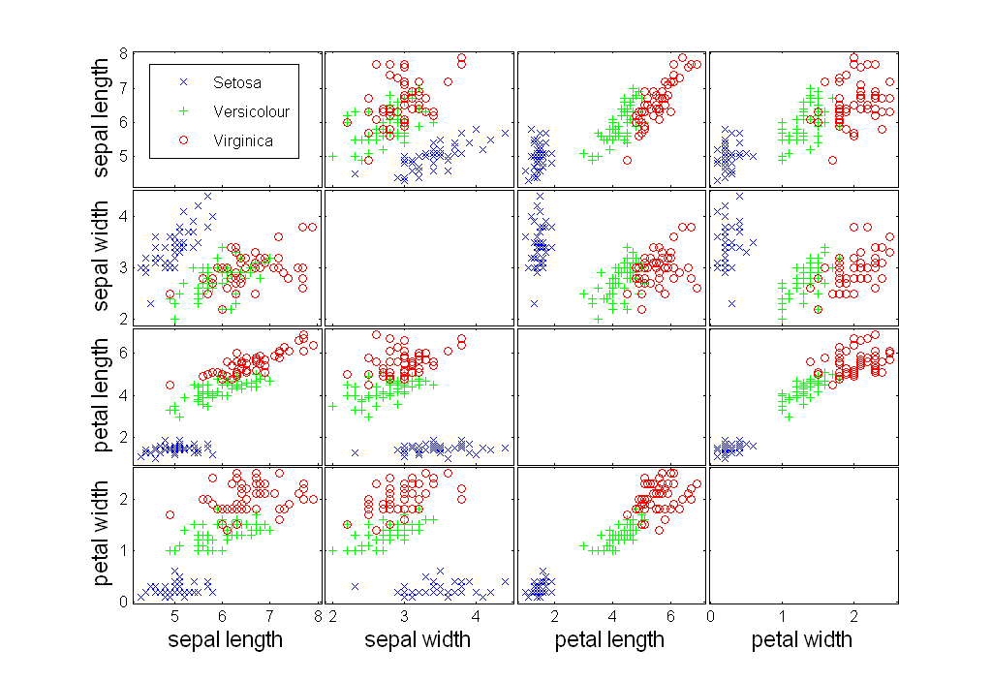
Scatter Plot Array of Iris Attributes

Slide 42
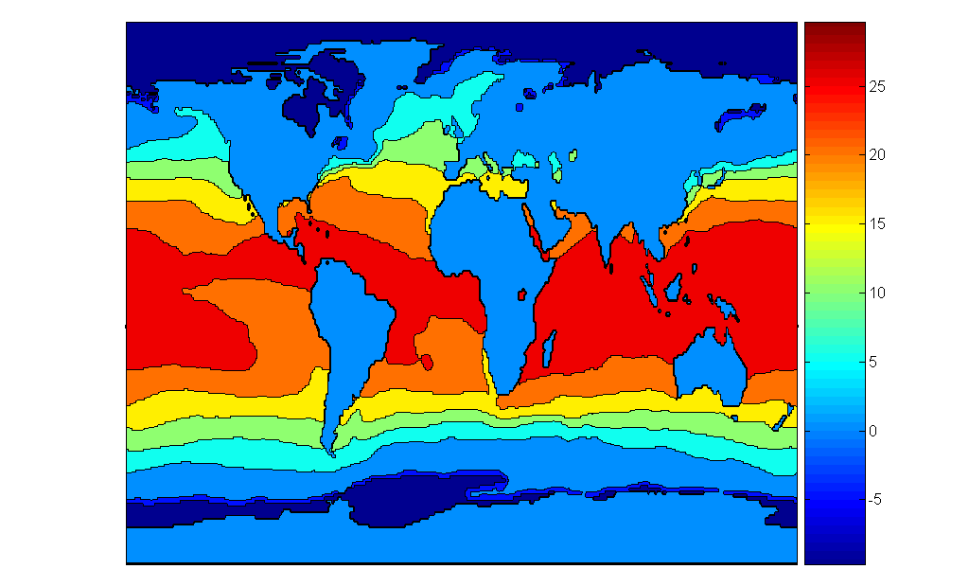
Contour Plot Example: SST Dec, 1998
Celsius

Slide 43
Meaningfulness of Answers
A big data-mining risk is that you will “discover” patterns that are meaningless.
Statisticians call it Bonferroni’s principle: (roughly) if you look in more places for interesting patterns than your amount of data will support, you are bound to find crap.
The Rhine Paradox: a great example of how not to conduct scientific research.
CS345A Data Mining on the Web: Anand Rajaraman, Jeff Ullman

Slide 44
Rhine Paradox – (1)
Joseph Rhine was a parapsychologist in the 1950’s who hypothesized that some people had Extra-Sensory Perception.
He devised (something like) an experiment where subjects were asked to guess 10 hidden cards – red or blue.
He discovered that almost 1 in 1000 had ESP – they were able to get all 10 right!
CS345A Data Mining on the Web: Anand Rajaraman, Jeff Ullman

Slide 45
Rhine Paradox – (2)
He told these people they had ESP and called them in for another test of the same type.
Alas, he discovered that almost all of them had lost their ESP.
What did he conclude?
Answer on next slide.
CS345A Data Mining on the Web: Anand Rajaraman, Jeff Ullman

Slide 46
Rhine Paradox – (3)
He concluded that you shouldn’t tell people they have ESP; it causes them to lose it.
CS345A Data Mining on the Web: Anand Rajaraman, Jeff Ullman

