Slide 1

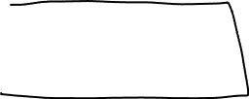
Last week
Euclidean distance
Minkowski distance
Simple Matching and Jaccard Coefficient
Cosine similarity
Correlation measures

Slide 2
Association Rule Mining
Beiyu Lin

Slide 3
Association Rule Mining
Given a set of transactions, find rules that will predict the occurrence of an item based on the occurrences of other items
Market transactions
Example of Association Rules
{Beer} → {Eggs}, {Milk, Bread} → {Diaper, Beer},

Slide 4




Review: Set and subset
{a, b, c, d} ⬄ a set (there are one or more than one items)
Subset ⬄ possible combinations of the items in a set
Possible sets:
{a}, {b}, {c}, {d}, {a, b}, {a, c}, {a, d}, {b, c}, {b, d}, {c, d},{a, b, c}, {a, b, d}, {a, c, d}, {b, c, d},{a, b, c, d}, {}
What is the total number of the subset:

Slide 5

Association Rule Mining
Itemset (set / subset)
A collection of one or more items
Example: {Milk, Bread, Diaper}
k-itemset
An itemset that contains k items
Support count (σ)
Frequency of occurrence of an itemset
E.g. σ({Milk, Bread,Diaper}) = 2
Support
Fraction of transactions that contain an itemset
E.g. s({Milk, Bread, Diaper}) = 2/5
Frequent Itemset
An itemset whose support is greater than or equal to a minsup threshold

Slide 6
Definition: Association Rule
Association Rule
An implication expression of the form X → Y, where X and Y are itemsets
Example: {Milk, Diaper} → {Beer}
Rule Evaluation Metrics
Support (s)
Fraction of transactions that contain both X and Y
Confidence (c)
Measures how often items in Y appear in transactions that contain X
Example:
=# of itemset / total # transactions
= # of itemset of Xand Y/ # of itemset of X

Slide 7

Association Rule Mining Task
Given a set of transactions T, the goal of association rule mining is to find all rules having
support ≥ minsup threshold
confidence ≥ minconf threshold
Brute-force approach:
List all possible association rules
Compute the support and confidence for each rule
Prune rules that fail the minsup and minconf thresholds
⇒ Computationally expensive / prohibitive!
{a,b,c,d} ➔ # of subset:

Slide 8
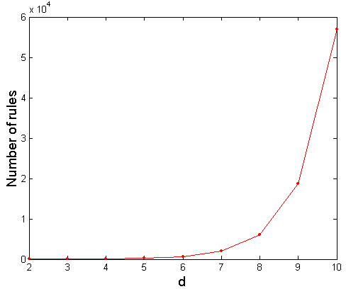
Computational Complexity
Given d unique items:
Total number of itemsets = 2^{d}
Total number of possible association rules:
If d=6, R = 602 rules

Slide 9
Mining Association Rules
Example of Rules:
{Milk,Diaper} → {Beer} (s=0.4, c=0.67) {Milk,Beer} → {Diaper} (s=0.4, c=1.0)
{Diaper,Beer} → {Milk} (s=0.4, c=0.67)
{Beer} → {Milk,Diaper} (s=0.4, c=0.67) {Diaper} → {Milk,Beer} (s=0.4, c=0.5)
{Milk} → {Diaper,Beer} (s=0.4, c=0.5)
{a, b, c}
={b, c, a}
={c, a, b}
={c,b,a}
Observations:
All the above rules are binary partitions of the same itemset: {Milk, Diaper, Beer}
Rules originating from the same itemset have identical support but can have different confidence
Thus, we may decouple the support and confidence requirements

Slide 10

Mining Association Rules
Two-step approach:
Frequent Itemset Generation
Generate all itemsets whose support ≥ minsup
Rule Generation
Generate high confidence rules from each frequent itemset, where each rule is a binary partitioning of a frequent itemset
Frequent itemset generation is still computationally expensive

Slide 11
Frequent Itemset Generation
Given d items, there are 2^{d} possible candidate itemsets

Slide 12
Frequent Itemset Generation
Brute-force approach:
Each itemset in the lattice is a candidate frequent itemset
Count the support of each candidate by scanning the database
Match each transaction against every candidate
Complexity ~ O(NMw) => Expensive since M = 2^{d} !!!

Slide 13
Frequent Itemset Generation Strategies
Reduce the number of candidates (M)
Complete search: M=2^{d}
Use pruning techniques to reduce M
Reduce the number of transactions (N)
Reduce size of N as the size of itemset increases
Used by DHP and vertical-based mining algorithms
Reduce the number of comparisons (NM)
Use efficient data structures to store the candidates or transactions
No need to match every candidate against every transaction

